Slide 1
LING/C SC/PSYC 438/538
Lecture 10
Prof. Sandiway Fong

Slide 2
Today's Topics
Lingua::EN:CMUDict
Homework 7: a fun one
Perl regex
  we're finally here!

Slide 3
From last time
Did anyone try the cmudict ungraded homework?
  $ cpanm Lingua::EN::CMUDict
  --> Working on Lingua::EN::CMUDict
  Fetching http://www.cpan.org/authors/id/L/LM/LMETCALF/Lingua-EN-CMUDict-0.07.tar.gz ... OK
  Configuring Lingua-EN-CMUDict-0.07 ... OK
  Building and testing Lingua-EN-CMUDict-0.07 ... OK
  Successfully installed Lingua-EN-CMUDict-0.07
  1 distribution installed
  $ cat cmudict.perl
  use Lingua::EN::CMUDict;
  $o = new Lingua::EN::CMUDict;
  print $ARGV[0], ": ", $o->number_of_syllables($ARGV[0]), "\n"

Slide 4
Perl warnings
Seem to be enforced more strictly in recent versions:
  $ perl cmudict.perl
  Use of uninitialized value $word in pattern match (m//) at /Users/sandiway/perl5/lib/perl5/Lingua/EN/CMUDict.pm line 75.
  Use of uninitialized value $word in uc at /Users/sandiway/perl5/lib/perl5/Lingua/EN/CMUDict.pm line 81.

Slide 5
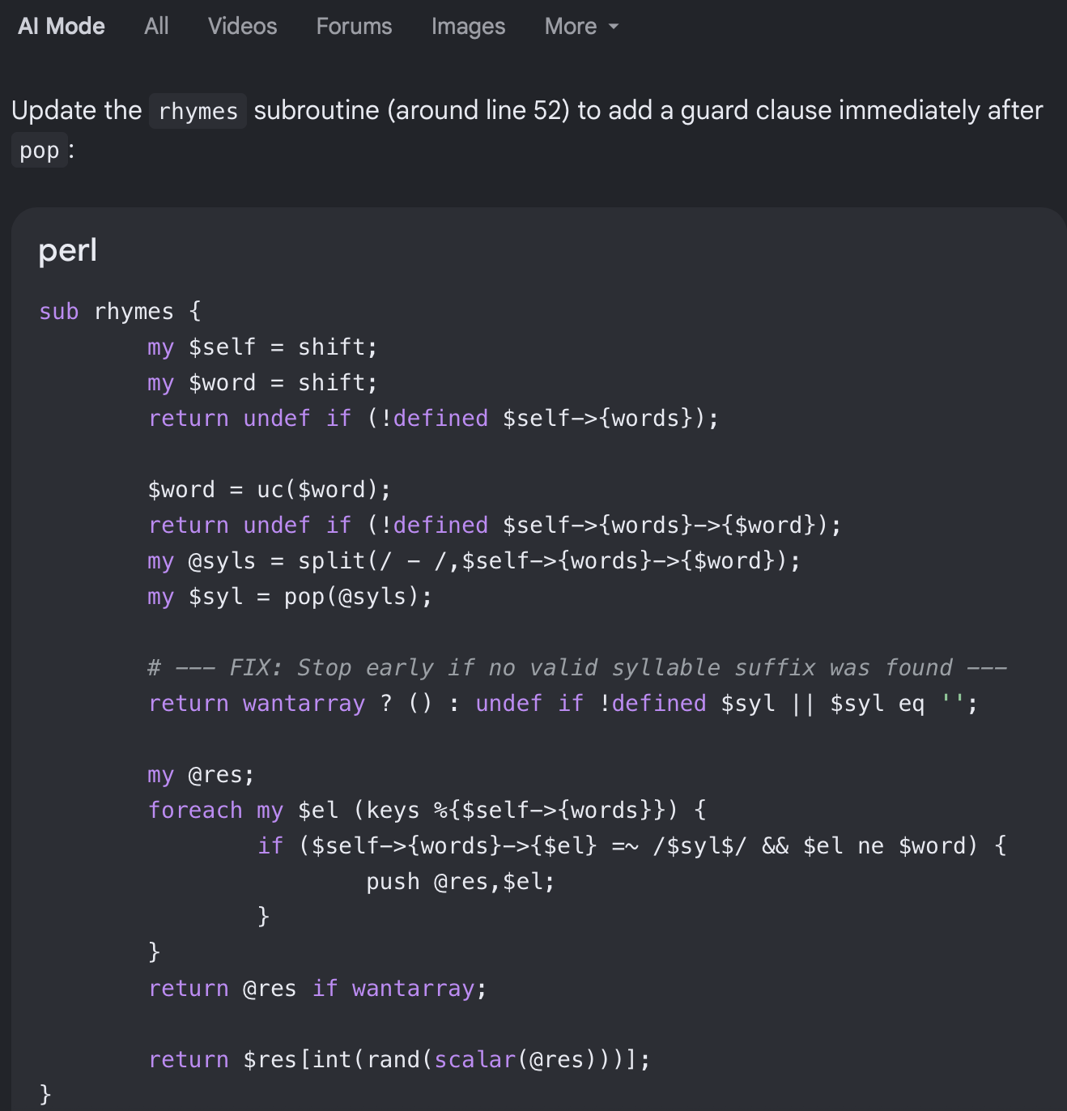
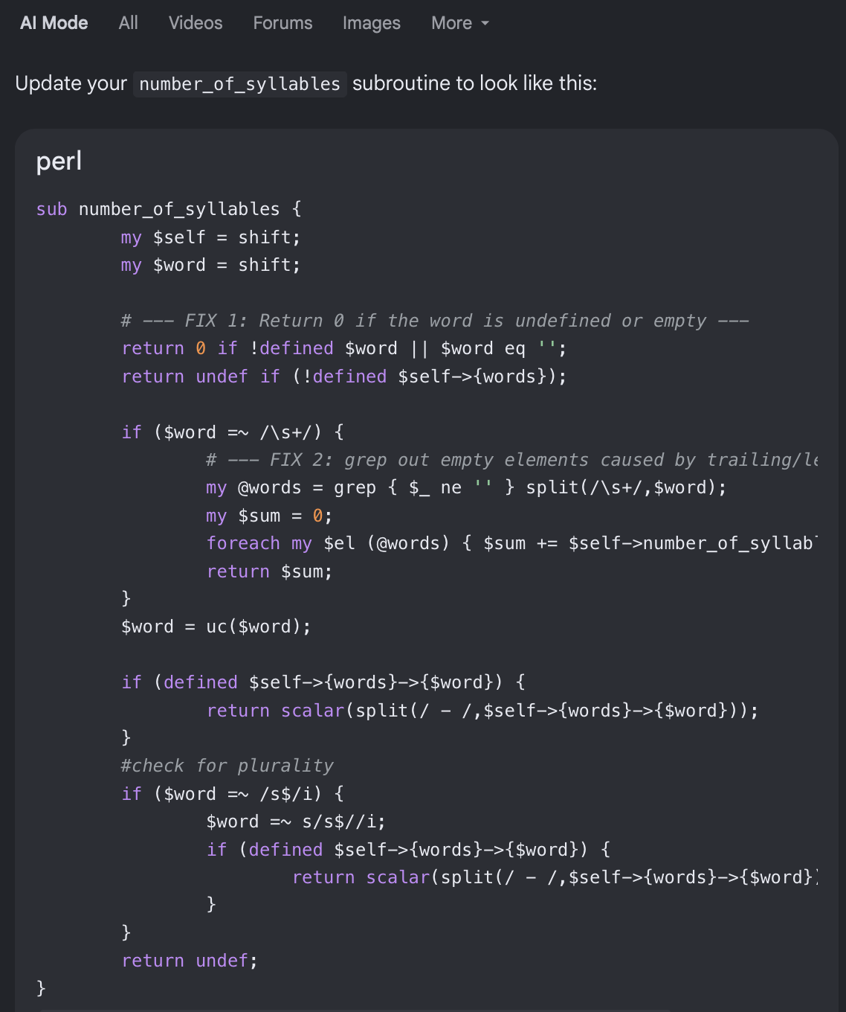
Google AI suggested fixes

Slide 6
Working .pm!
  $ perl cmudict.perl trump
  trump: 1
  $ perl cmudict.perl hello
  hello: 2
  $ perl cmudict.perl intersection
  intersection: 4
  $ perl cmudict.perl asoifhaigfsfgdknj
  asoifhaigfsfgdknj:
T R AH M P
HH AH L OW
IH N T ER S EH K SH AH N

Slide 7
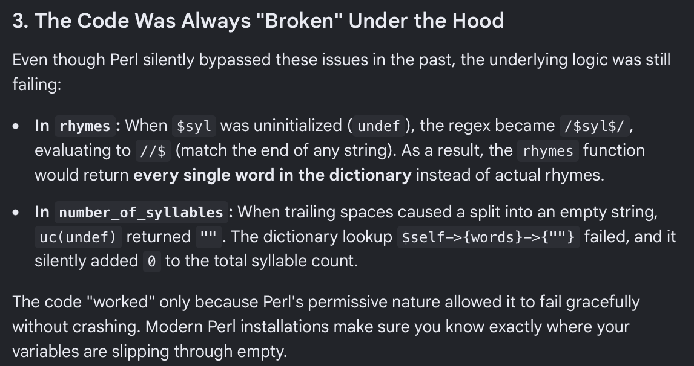
Google AI

Slide 8
Regular Expressions to the rescue
https://xkcd.com/208/

Slide 9
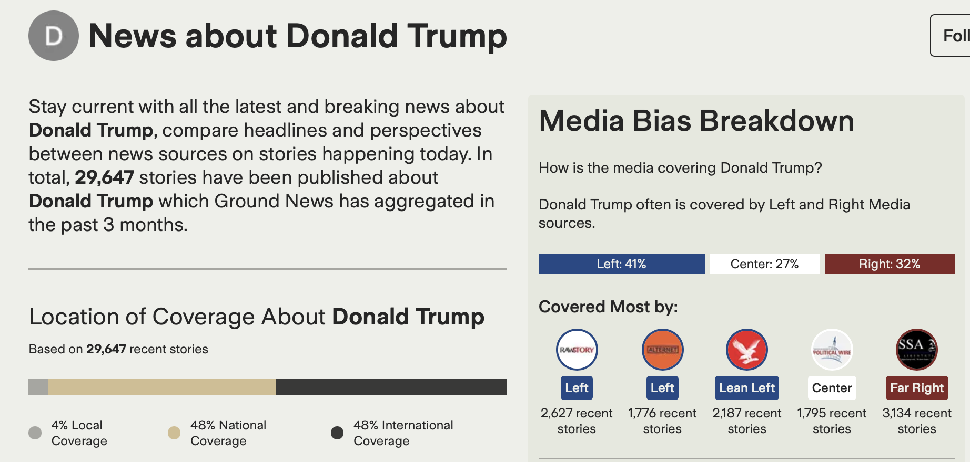
GroundNews

Slide 10
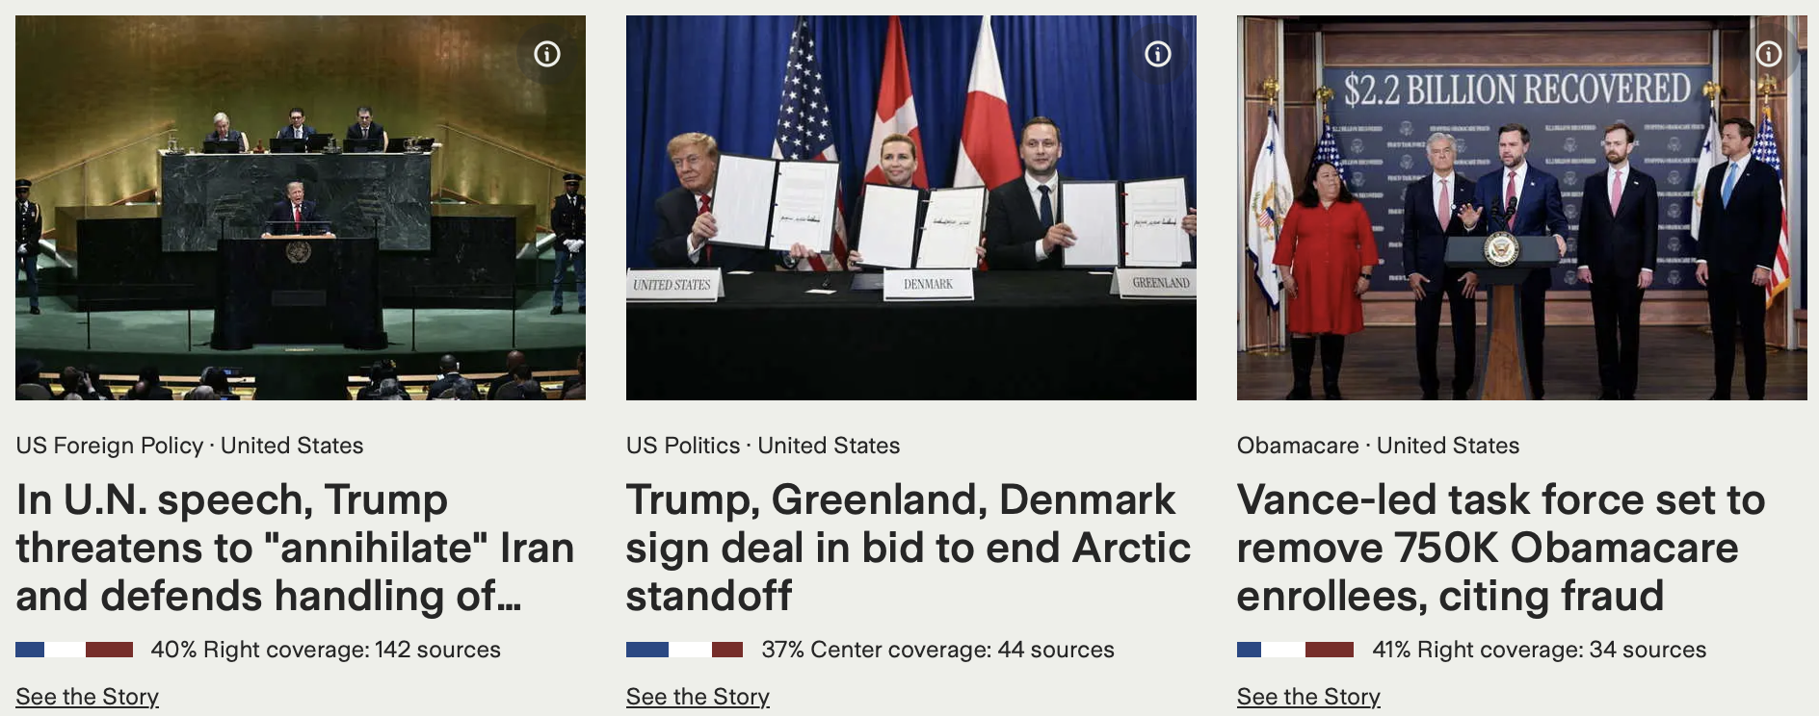
Do we expect even coverage?

Slide 11
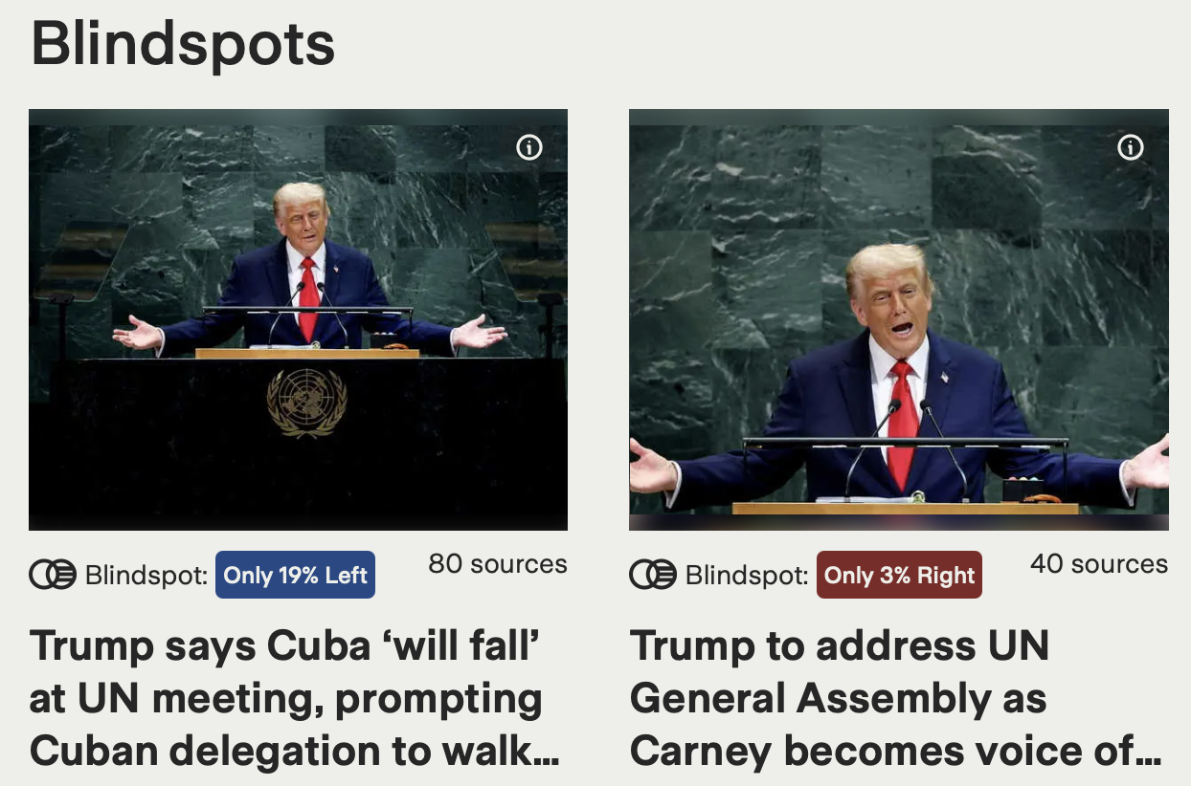
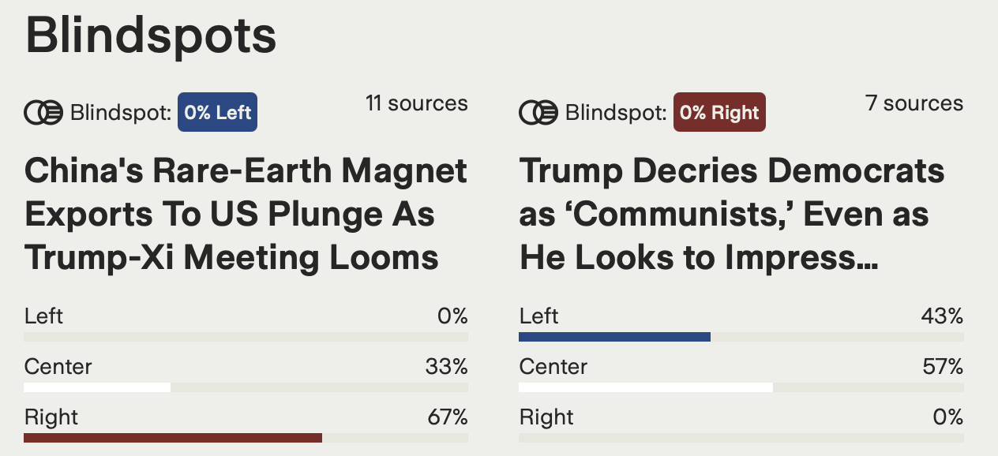
GroundNews Blindspot

Slide 12
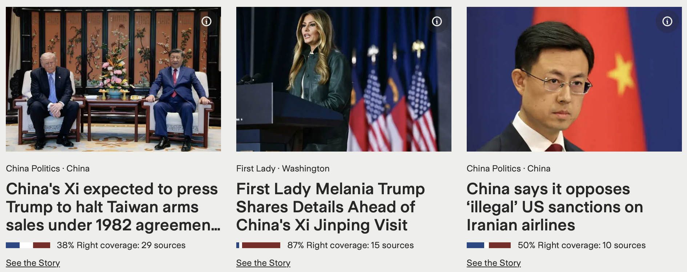
September 23 to September 25, 2026
going on right now!

Slide 13

Homework 7
Here are some headlines about
  Milo Yiannopoulos says he was ‘terrified’ by the ‘brutality’ of his ICE deportation
  Shed no tears for Milo Yiannopoulos, the deported right-wing provocateur
  I am a persecuted human rights icon
  Milo Yiannopoulos, cheerleader of mass deportations, detained by ICE
  Deported Milo Yiannopoulos says he is ‘ashamed’ of support for Trump
  Milo Yiannopoulos deported to the U.K. one day after ICE arrest
  Milo Yiannopoulos’ Black husband accuses him of shocking racism, “enslavement” & abuse
  Milo Yiannopoulos ‘very ashamed’ of support for Trump after deportation
  Milo Yiannopoulos, Right-Wing Agitator, Deported Home to U.K.
  Far-right commentator Milo Yiannopoulos deported to UK
  British far-right provocateur Milo Yiannopoulos deported after ICE arrest
  Far-right British provocateur Milo Yiannopoulos arrested by US immigration enforcement

Slide 14
Homework 7
Question 1
without looking ahead, first use your own judgment and rate each headline (#1-12 shown previously) as being from media:
  Left (L),
  Center (C), or
  Right (R)

Slide 15


Homework 7

Slide 16


Homework 7

Slide 17
Homework 7
Question 2
GroundNews uses several sources for rating media sources
Look up each of the news sources in AllSides (see next slide)
Rate each headline source (#1-12 shown previously)
  Left (L),
  Center (C), or
  Right (R)

Slide 18
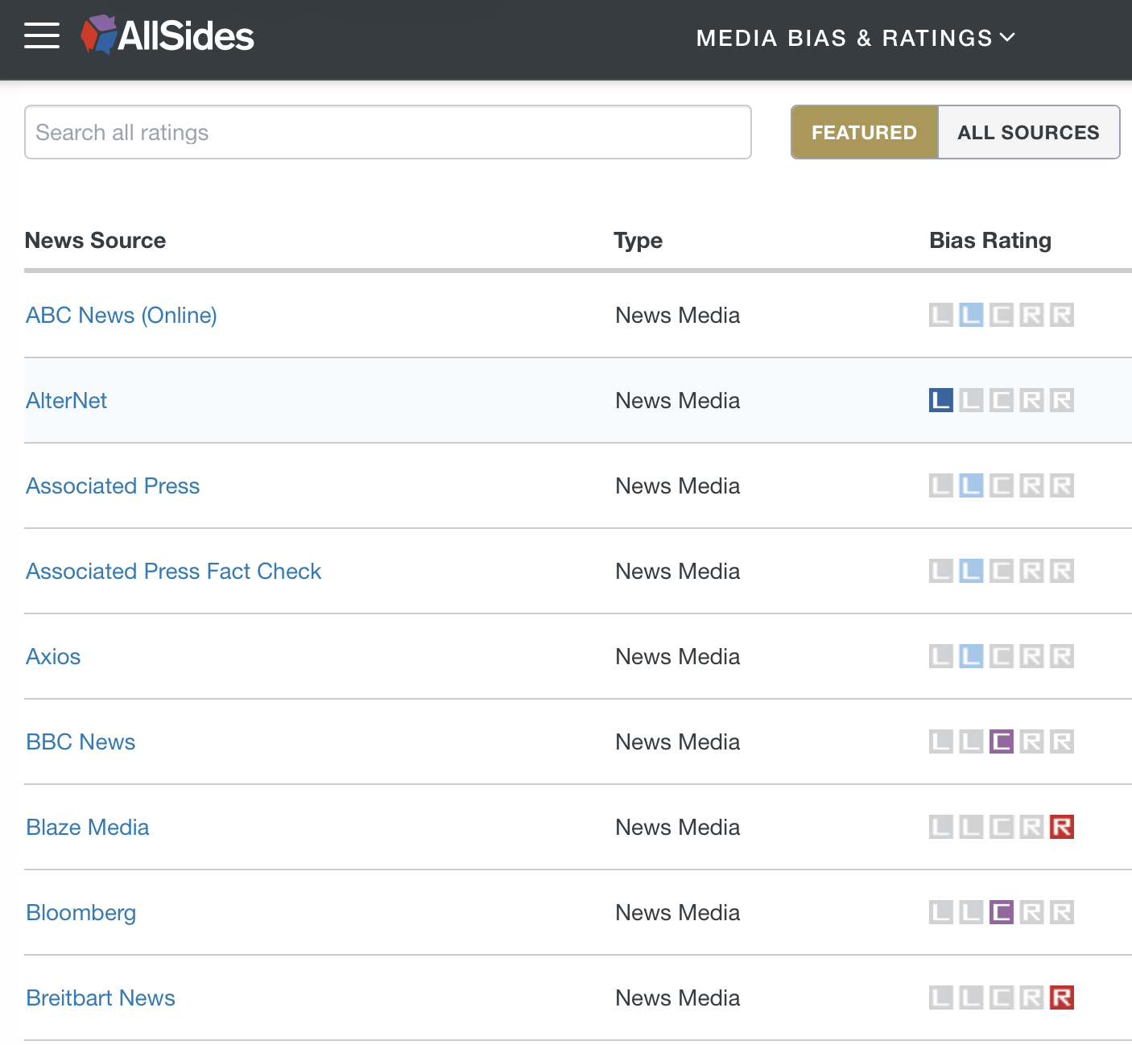
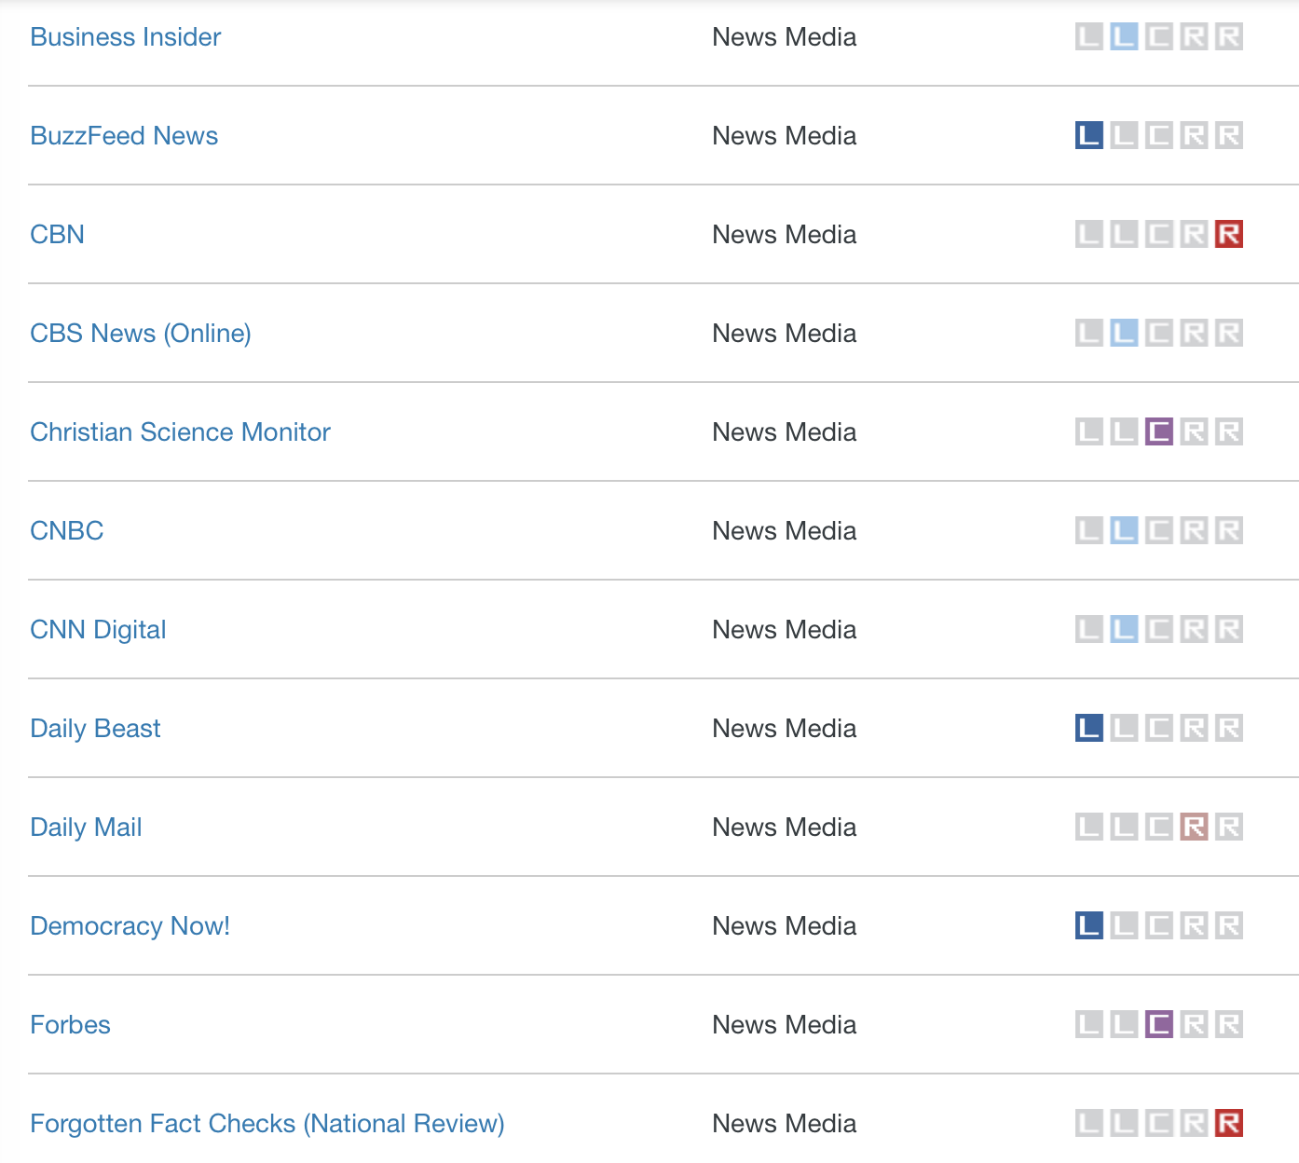
AllSides
www.allsides.com/media-bias/ratings

Slide 19
Homework 7
Question 3
Compare your rating and the source? Accurate? Correlated?
Which keywords and phrases do you think can be used to identify story as being Left (L), Center (C) or Right (R)? Or perhaps none?

Slide 20
Homework 7
Email to me: sandiway@arizona.edu
Subject: 438/538 Homework 7: YOUR NAME
Submit everything in one PDF file
Submit a real file, not a link
Screenshots: make sure text is not too tiny!
Due Sunday midnight:
  to be reviewed in class next Tuesday

Slide 21
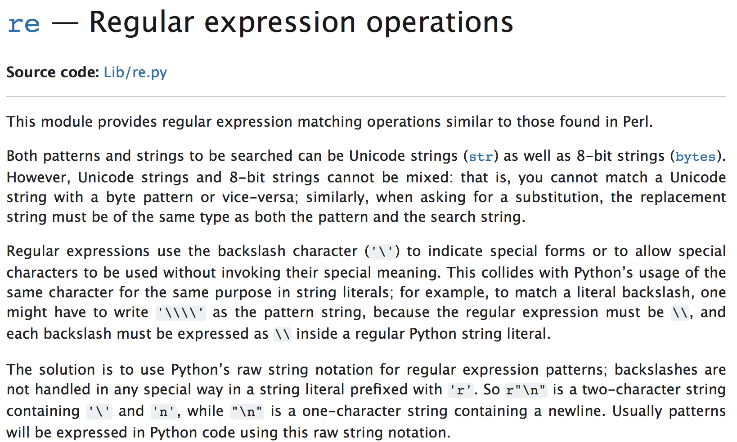
Perl regex
Python re
  import re
  slightly complicated string handling: use raw r'…' format
  https://docs.python.org/3/library/re.html
  (there's also a 3rd party regex module)

Slide 22
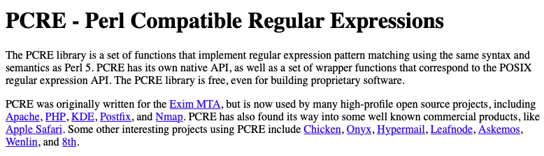
Perl regex
https://www.pcre.org

Slide 23
A regex from Hell
Email validation: RFC 5322 (Internet Message Format):
(?:[a-z0-9!#$%&'*+/=?^_`{|}~-]+(?:\.[a-z0-9!#$%&'*+/=?^_`{|}~-]+)*|"(?:[\x01-\x08\x0b\x0c\x0e-\x1f\x21\x23-\x5b\x5d-\x7f]|\\[\x01-\x09\x0b\x0c\x0e-\x7f])*")@(?:(?:[a-z0-9](?:[a-z0-9-]*[a-z0-9])?\.)+[a-z0-9](?:[a-z0-9-]*[a-z0-9])?|\[(?:(?:(2(5[0-5]|[0-4][0-9])|1[0-9][0-9]|[1-9]?[0-9]))\.){3}(?:(2(5[0-5]|[0-4][0-9])|1[0-9][0-9]|[1-9]?[0-9])|[a-z0-9-]*[a-z0-9]:(?:[\x01-\x08\x0b\x0c\x0e-\x1f\x21-\x5a\x53-\x7f]|\\[\x01-\x09\x0b\x0c\x0e-\x7f])+)\])
https://www.rfc-editor.org/rfc/rfc5322

Slide 24
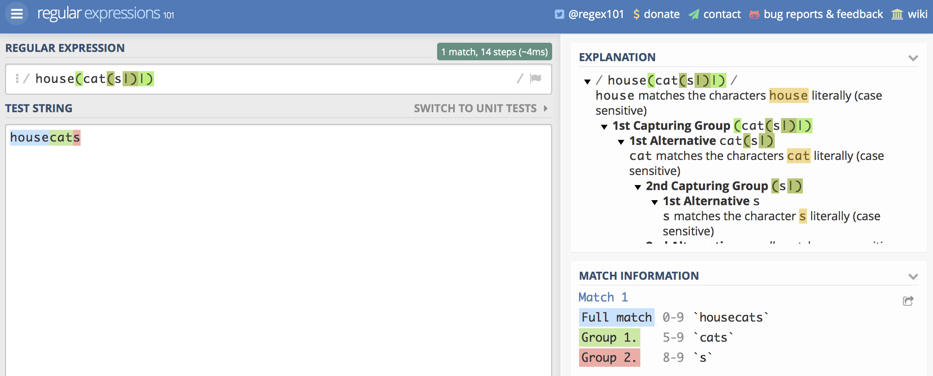
Online regex tester
https://regex101.com

Slide 25
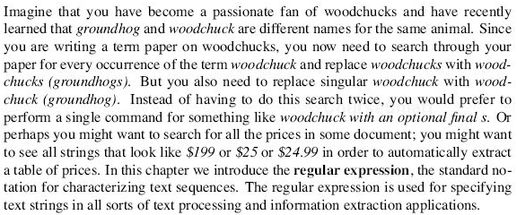
regex
Read JM textbook chapter 2: section 1 on regex (if you have it)

Slide 26
Perl regex
Read up on the syntax of Perl regular expressions
Online tutorials
  http://perldoc.perl.org/perlrequick.html
  http://perldoc.perl.org/perlretut.html

Slide 27
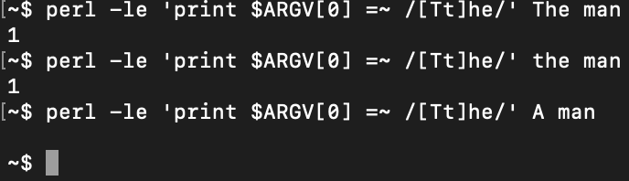
Perl regex
Perl regex matching:
  $s =~ /foo/ (/…/ contains a regex)
  can use in a conditional:
    e.g. if ($s =~ /foo/) …
    evaluates to true/false depending on what’s in $s
  can also use as a statement:
    e.g. $s =~ /foo/;
    global variable $& contains the match
Examples:

Slide 28

Perl regex
Match is not exact:

Slide 29
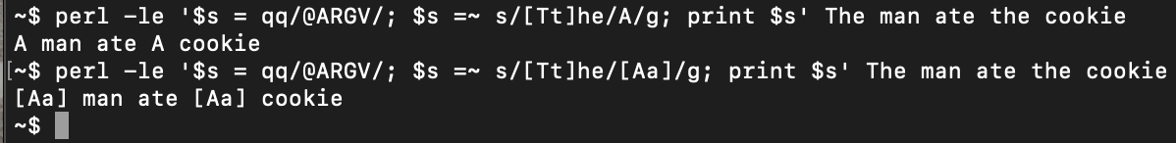
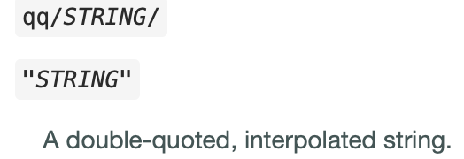
Perl regex
Perl regex match and substitute:
  $s =~ s/foo/bar/
  s/…match… /…substitute… / contains two expressions
  will modify $s by looking for a single occurrence of match and replacing that with substitute
  s/…match… /…substitute… /g global substitution
Examples:
https://perldoc.perl.org/perlop#Quote-Like-Operators

Slide 30
Perl regex
Most useful with template.perl for reading in a file line-by-line:
  open($fh, $ARGV[0]) or die "$ARGV[0] not found!\n";
  while ($line = <$fh>) {
  $line =~ /…/
  }
  close($fh)
Or on the command line in abbreviated form as:
  perl -le 'open $f, filename; while (<$f>) {while (/regex/g) {print $&}}'
Let’s practice this after we've introduced the notation …

Slide 31
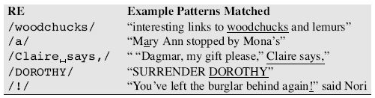
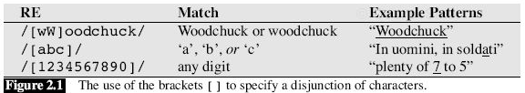
Chapter 2: JM
spaces matter!
character class: Perl lingo

Slide 32
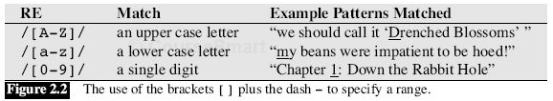
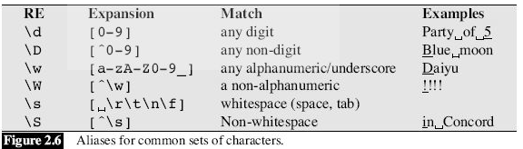
Chapter 2: JM
range: in ASCII table
backslash lowercase letter for class
Uppercase variant for all but class

Slide 33
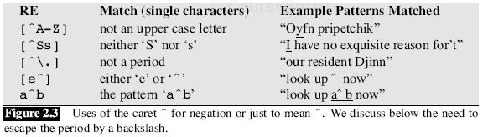

Chapter 2: JM

Slide 34

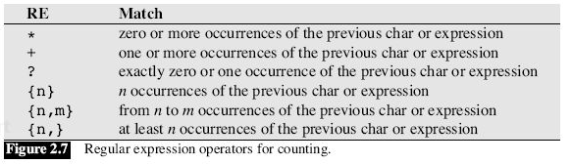
Chapter 2: JM
Can use parentheses(…) to group around a sub-expression if > 1 char
e.g. (ab)* vs. ab*

Slide 35
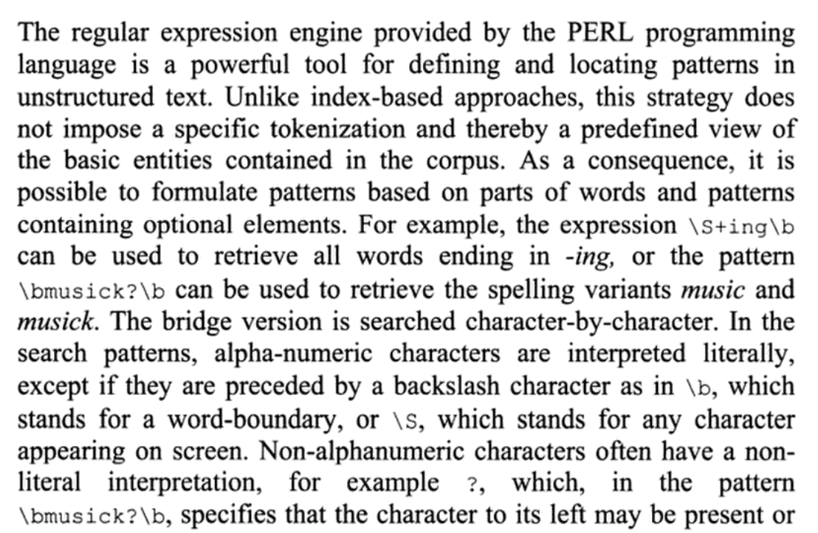
Perl regex
Example: \S+ing\b
\s is a whitespace, so \S is a non-whitespace
+ is repetition (1 or more)
\b is a word boundary, (words are made up of \w characters)

