Slide 1
LING/C SC/PSYC 438/538
Lecture 1
Prof. Sandiway Fong

Slide 2
Contents
The Big Picture
Syllabus
Questions about the Syllabus
Homeworks 1 and 2 (possibly the null homework)
A note on Programming Languages
Some real intro next time!

Slide 3
Computation and Language
We assume human language can be modeled as a formal system
  Research Question:
  What is the nature of this formal system for human language?
  How is it different from other (mathematical) formal systems?
What we study here has much to do with formal systems
  Examples:
  programming (languages)
  regular expressions (regex), finite state automata (FSA)
  context-free (CFG) and context-sensitive grammars
  parse trees, word dependencies, sets

Slide 4
Computation and Language
Why only us?
  50 billion species since life emerged on earth almost 4 billion years ago (Mayr, 1995)
  Modern humans a recent arrival (300TYA) through a remarkable series of accidents
Language and thought is a species-specific property (Chomsky)
  closest relatives to modern humans have about the same auditory system
  only a human infant reflexively develops complex systems for constructing and expressing thought
Language shows peculiar properties
  not arbitrary (there are rules: man-made or otherwise?)
  Research question: why is it the way it is, and not some other way?

Slide 5
Syllabus
Description of Course
An introductory level course at the advanced level for computational linguistics. Required core course for the Master’s Human Language Technology (HLT) program.
Course Pre-requisites
438: LING 388 or familiarity with one or more of the following: formal languages, syntax, data structures, or compilers.
538: no formal pre-requisites.

Slide 6
Syllabus
Instructor and Contact Information
Instructor: Sandiway Fong (sandiway@arizona.edu, submit homeworks here)
Homepage: sandiway.arizona.edu
Dept. of Linguistics Office: Douglass 308
Hours:
make appointments by email or drop by my office
Meet:
Rm 411, Social Sciences: 3:30PM-4:45PM Tuesdays/Thursdays
another good time to ask questions is right after class!

Slide 7
Syllabus
Course Format and Teaching Methods
Lecture with slides. Panopto videos (when available) for lecture review.
All homeworks will be introduced and reviewed in class.
Course Objectives
Topics covered include:
Introductory programming relevant to computational linguistics in two or more programming languages. We will use programming languages Perl, Python and Prolog this semester.
Introduction to a range of topics in computational linguistics, see detailed list of topics later below.

Slide 8
Syllabus
Course Learning Outcomes
After completing this course, students will:
Have acquired the ability to read and write programs in two or more programming languages.
Relates to Linguistics Department HLT program outcome #1.
Be familiar with basic concepts, techniques and applications in computational linguistics.
Relates to Linguistics Department HLT program outcome #2 and Linguistics Department Undergraduate program outcome #1.
538-only: be able to present and explain advanced concepts in computational linguistics. (See chapter presentation requirement.)
Be equipped to take more advanced classes in computational linguistics, e.g. 581 (Spring) or 439/539 (Statistical NLP).

Slide 9
Syllabus
Boilerplate
https://catalog.arizona.edu/syllabus-policies
By placing this URL on your syllabus you no longer need to list the individual university policies.
Specific to this class
  Absence and Class Participation Policy
  I expect you to attend lectures (though attendance will not be taken).
  Tell me ahead of time so we can make alternative arrangements in the case of missed homeworks. No homework will be accepted late. Explained below.

Slide 10
Syllabus
Required Text
438: None.
538 Presentations: Speech and Language Processing, Jurafsky & Martin, draft 3rd edition (PDF available).
Required or Special Materials
All necessary software will be available online at no cost to the student.
However, students are expected to either have a laptop/desktop capable of handling homework and classwork
Mac, PC (Windows 11) or Linux.

Slide 11
Syllabus
Assignments and Examinations: Schedule/Due Dates
All homeworks will be introduced and reviewed in class.
Homework submissions by email to me (sandiway@arizona.edu).
Late homeworks will be not accepted since all homeworks will be solved in class.
Homeworks are typically assigned in class on a Thursday and due Sunday midnight. (I will attempt to grade them Monday.)
We discuss the homework in class the following Tuesday. (Some longer homeworks may have an extended due date.)
Students can expect 10+ homeworks over the course.

Slide 12
Syllabus
Final Examination or Project
No examinations, e.g. mid-term or final, are scheduled for this course.
Grading Scale and Policies
438:
  100% of the grade comes from the homework assignments.
538:
  75% of the grade comes from the homework assignments (possibly a superset of the 438 assignments), 25% of the grade comes from a textbook chapter presentation.

Slide 13

Syllabus
Scheduled Topics/Activities
Topics will be drawn from the following:
– Programming Languages: Perl and Python
– Regular Expressions (Theoretical and practical)
– Automata (Finite State) and Transducers (Finite State)
– Programming Language: Prolog (definite clause grammars)
– NLTK (Natural Language Toolkit)
– Part of Speech (POS) Tagging
– Stemming (Morphology)
– Edit Distance (Spelling)
– Grammars (Regular, Context-free)
– Parsing (Syntax trees, dependency trees, algorithms)
– and more ...

Slide 14
Syllabus
Code of Academic Integrity
You may discuss homework questions with anyone (or anything).
You may look things up on the web and use answers found therein; however, you must write it up yourself (in your own words/own code etc.).
You must cite all (web) references including ChatGPT, and credit your classmates (in the case of shared discussion).
Students are encouraged to share intellectual views and discuss freely the principles and applications of course materials.
However, graded work/exercises must be the product of independent effort unless otherwise instructed.

Slide 15
Syllabus
Subject to Change Statement
Information contained in the course syllabus, other than the grade and absence policy, may be subject to change with advance notice, as deemed appropriate by the instructor.
Schedule changes
I will notify ahead of time if there are any changes
Questions?

Slide 16
UofA website
Download lecture slides, also links to Panopto recordings, from:
  sandiway.arizona.edu > Classes > LING/C SC/PSYC 438/538
  URL: https://sandiway.arizona.edu/ling538-26
  available from just before class time
    (afterwards, please look again for updates and corrections)
  in .pptx (good for animations) and .pdf formats

Slide 17
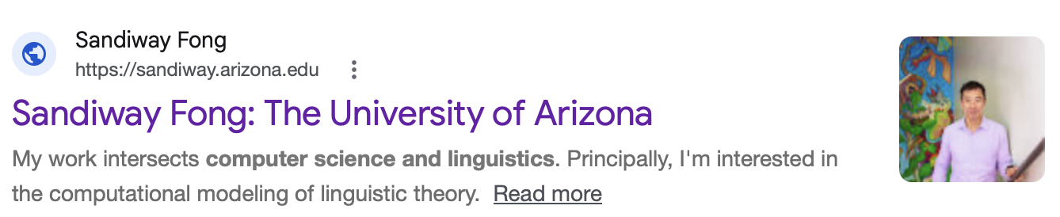
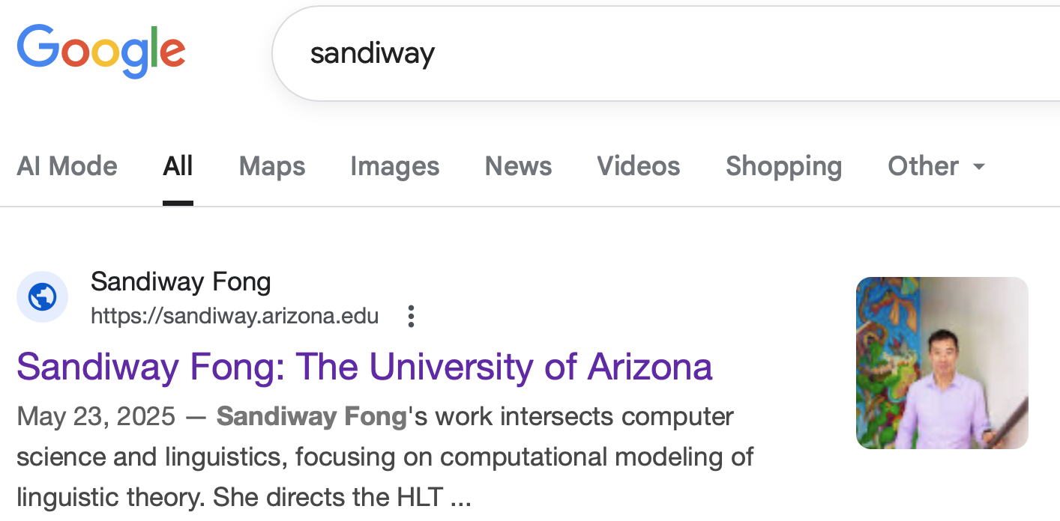
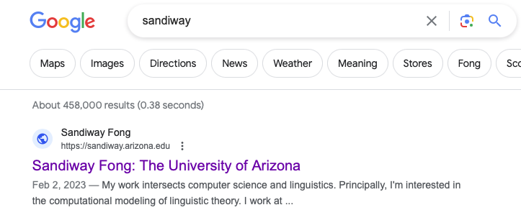
UofA website
Notice a difference between 2023, 2025 & 2026?

Slide 18
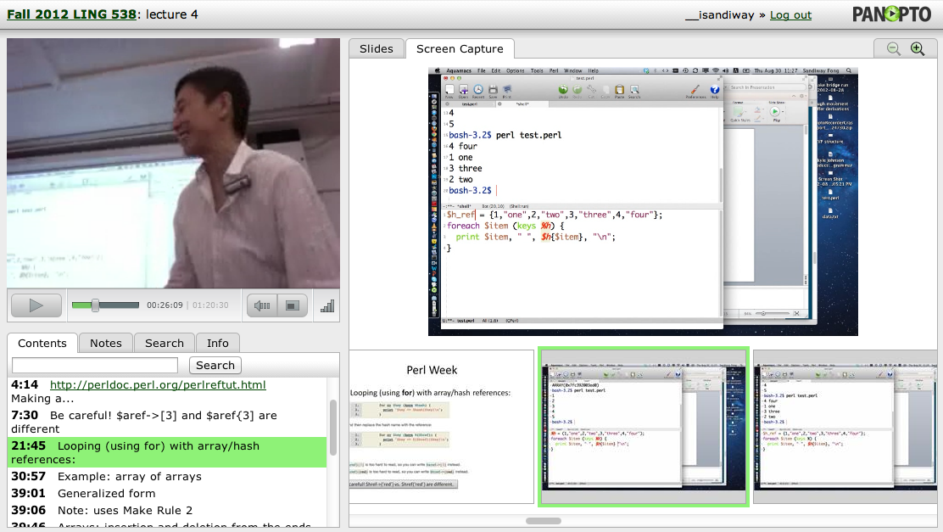
Panopto
Lectures will be recorded using the Panopto system
  accessible via the course webpage and your browser
  sometimes crashes (not guaranteed to be recorded)
  (video, laptop screen, synchronized slides, keyword search)

Slide 19
Syllabus
I’m gonna tentatively assume you don’t know how to program at all (yet)
  we’re going to use Perl and Python
  good to learn both …
  good to be polyvalent, you'll also get some Prolog

Slide 20
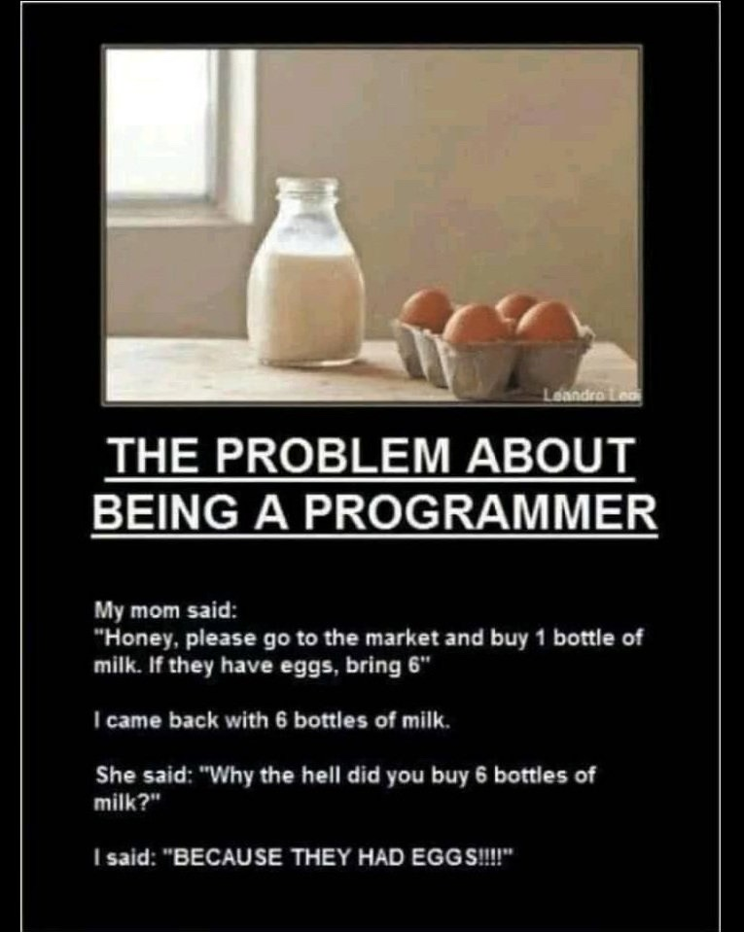
Being Precise
Always check to see if you typed something in exactly right.
saw this on my Facebook feed
Do you understand the joke?
if condition:
do command

Slide 21
Homework: Reading
Homework 1:
Chapter 1 from JM (2nd ed)
  READ IT before next time!
  Try to understand the concepts
  Homework 3 next time
  available on course webpage as:
sandiway.arizona.edu/ling538-26/1.pdf

Slide 22
Homework 2
Could be the null homework for many of you:
Install Perl, and
Install Python (version 3.X) (no longer available - obsolete 2.7)

Slide 23
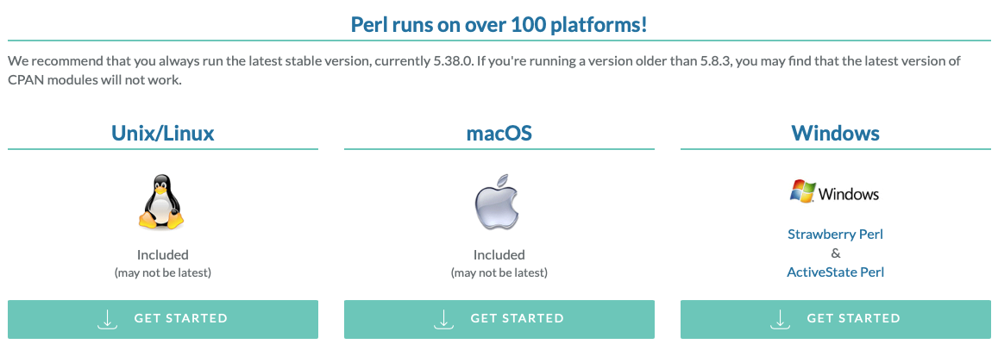
Homework 2: Install Perl
Install Perl on your computer
  pre-installed on macOS and Linux, check your machine from the Terminal/command line
  on Windows PCs, if you don’t already have it, it’s freely available here
  https://www.perl.org/get.html

Slide 24
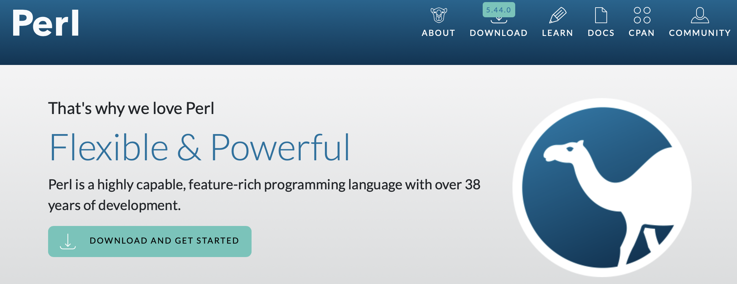
Homework 2: Install Perl
Pre-installed on macOS and Linux (why?), check your machine from the Terminal/command line
  on Windows PCs, if you don’t already have it, it’s freely available from perl.org

Slide 25
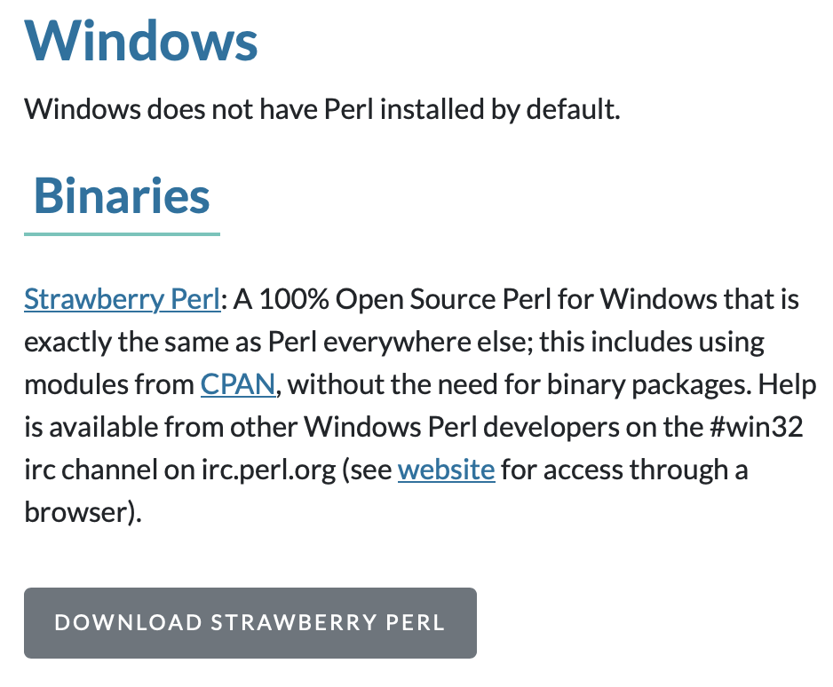
Homework 2: Install Perl
You could install Ubuntu on Windows 11 using Microsoft's WSL (Windows Subsystem for Linux)
  In PowerShell or Terminal
    wsl --install
  then you'd have Perl in addition to many other things …

Slide 26
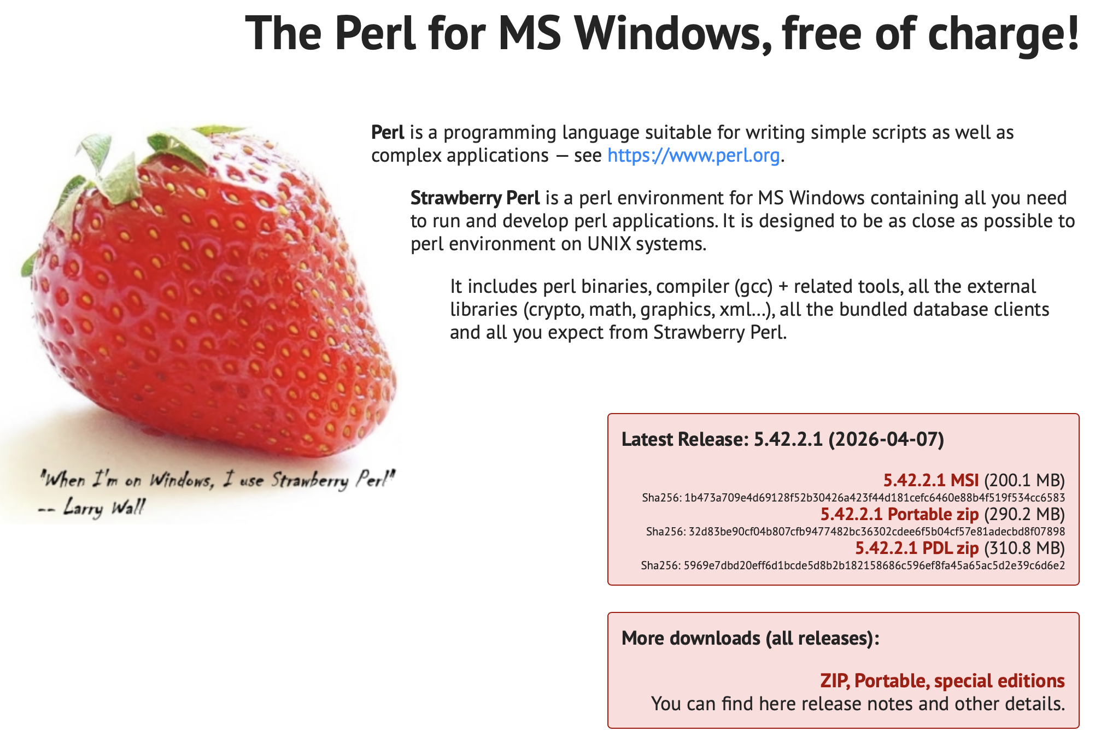
Homework 2: Install Perl
strawberryperl.com

Slide 27
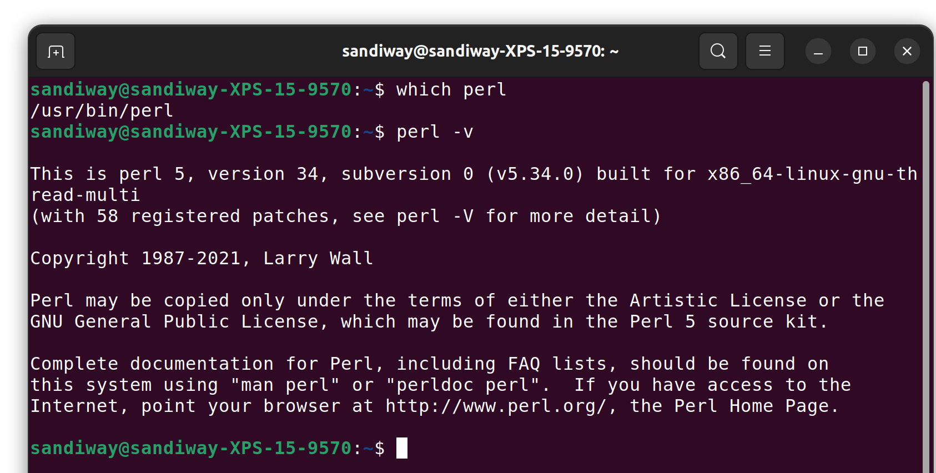
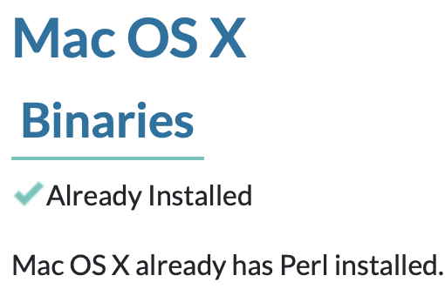
Homework 2: Install Perl
How to check?
  which perl
  perl -v
Ubuntu (Terminal):

Slide 28
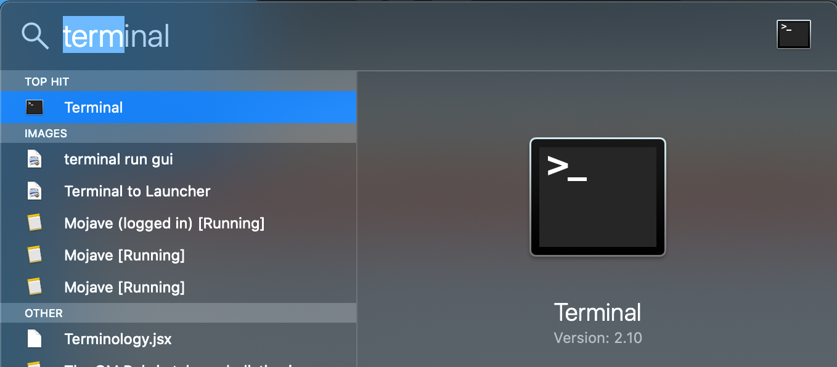
Homework 2: Install Perl
macOS (Terminal): (complete path specified here)
  /usr/bin/perl
  /opt/homebrew/bin/perl (Homebrew package manager brew.sh)
  /opt/local/bin/perl (MacPorts package manager)
PATH
commands:
perl (hangs; type Control-D)
perl –v
perl –V (much more verbose)

Slide 29
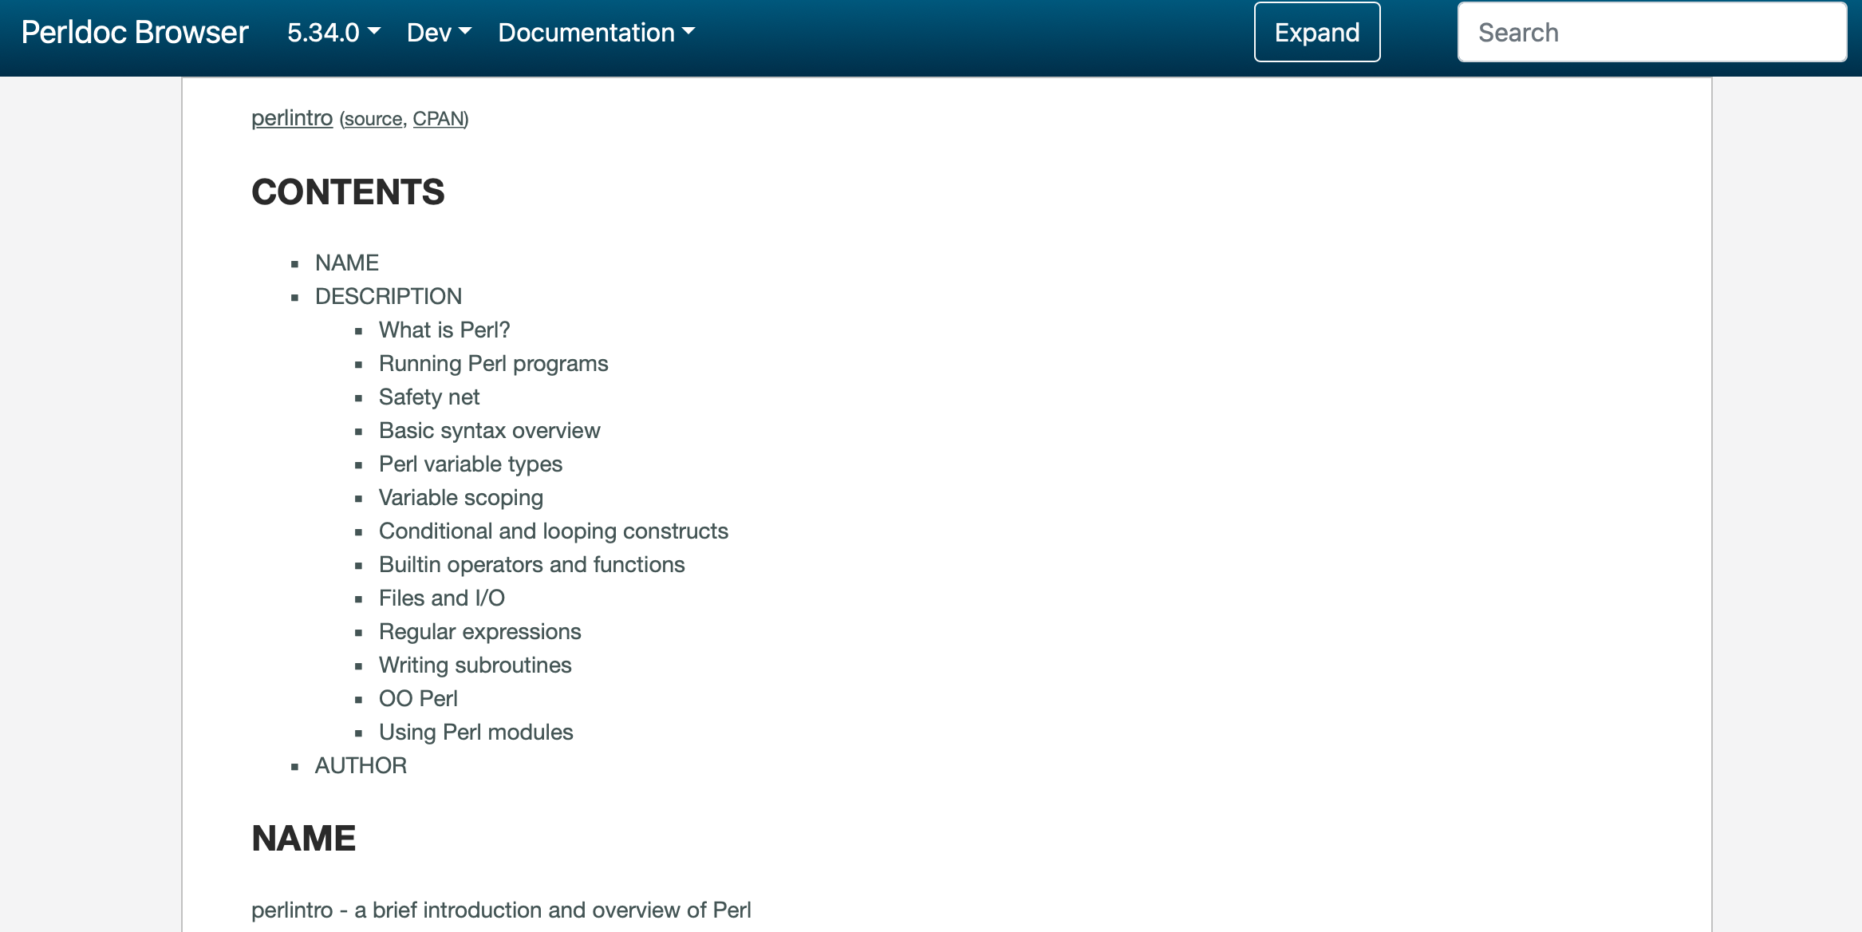
Learning Perl
Learn Perl
  https://perldoc.perl.org/perlintro.html

Slide 30
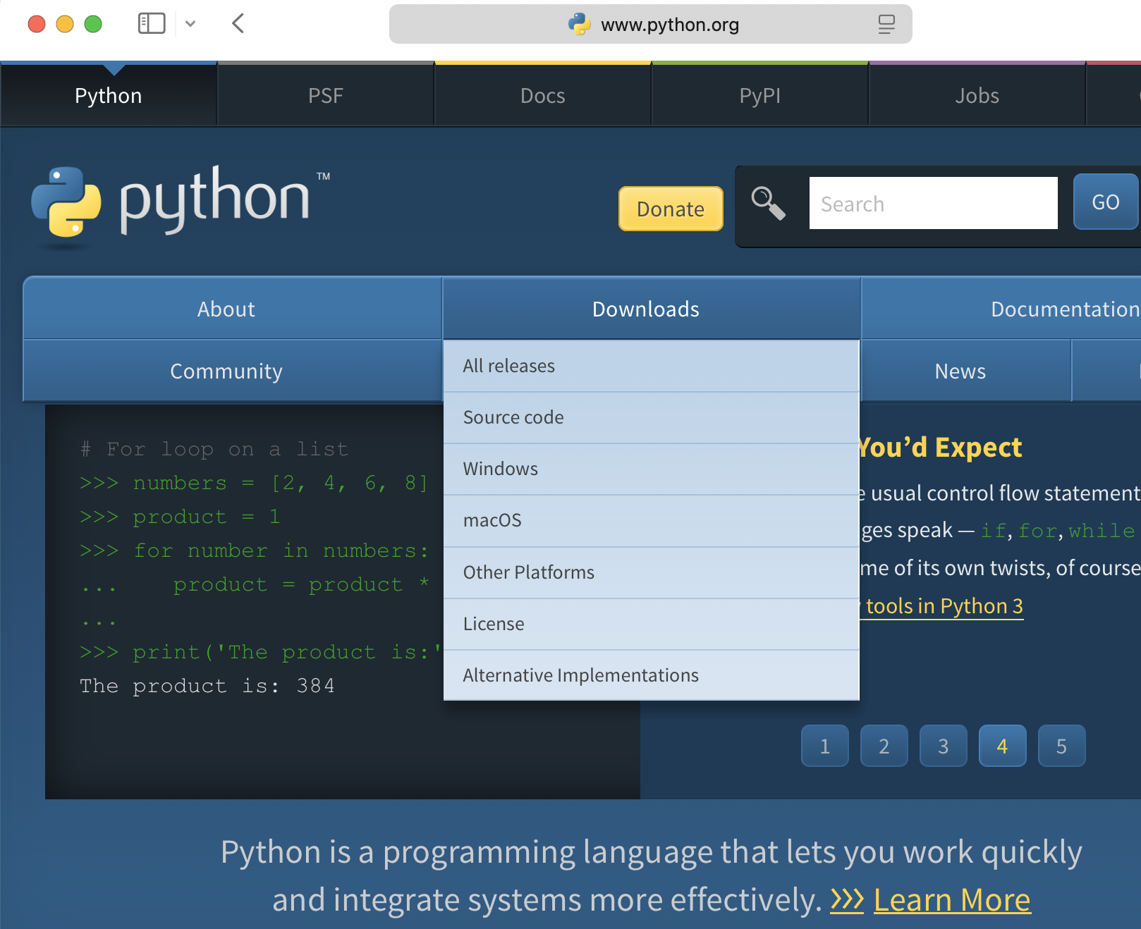
Homework 2: Install Python
www.python.org
Note: 3.x is not backwards compatible with Python 2.7!

Slide 31

Which language is easier?
A subjective question …
All good programmers know more than one programming language, always an advantage to be versatile.
In NLP, Python is overwhelmingly popular, but we will do both Perl and Python. AND for writing grammars, Prolog.

Slide 32
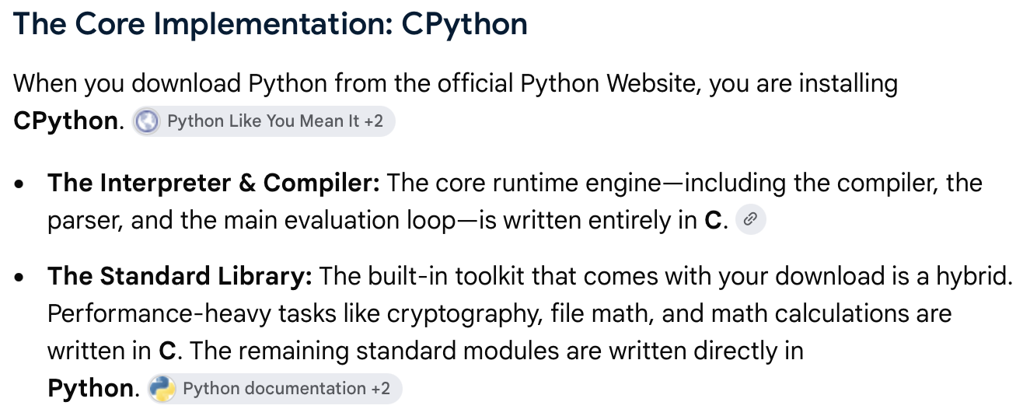
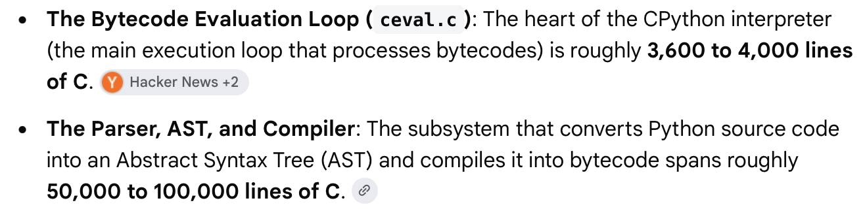
What is Python itself written in?

Slide 33
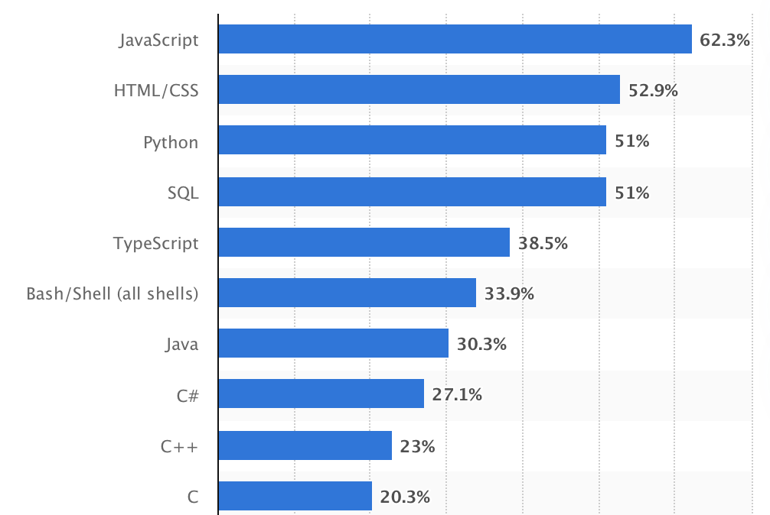
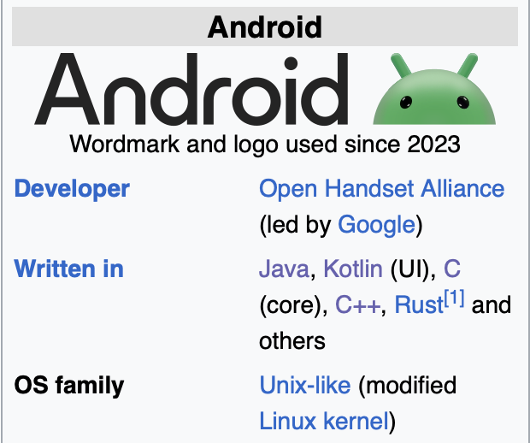
Development work (2024 survey)
1995
1990/1996
1991
1973
2012
1989
1995
2000
1985
1972
www.statista.com/statistics/793628/worldwide-developer-survey-most-used-languages/

Slide 34
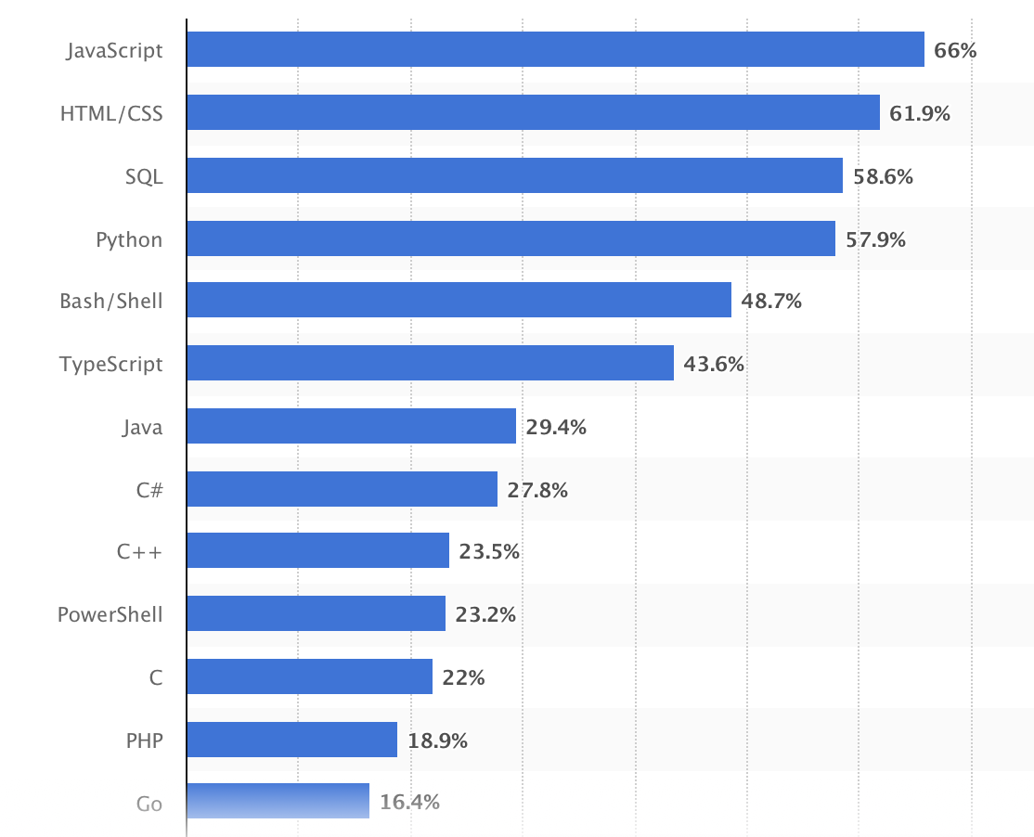
Development work (2025 survey)

Slide 35
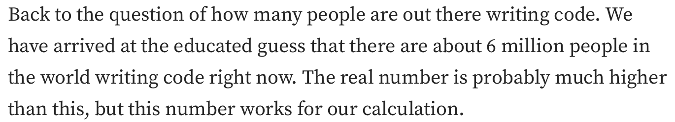
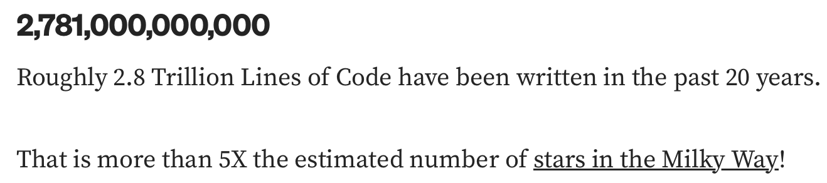
How many programmers, how many lines?
medium.com/modern-stack/how-much-computer-code-has-been-written-c8c03100f459

Slide 36
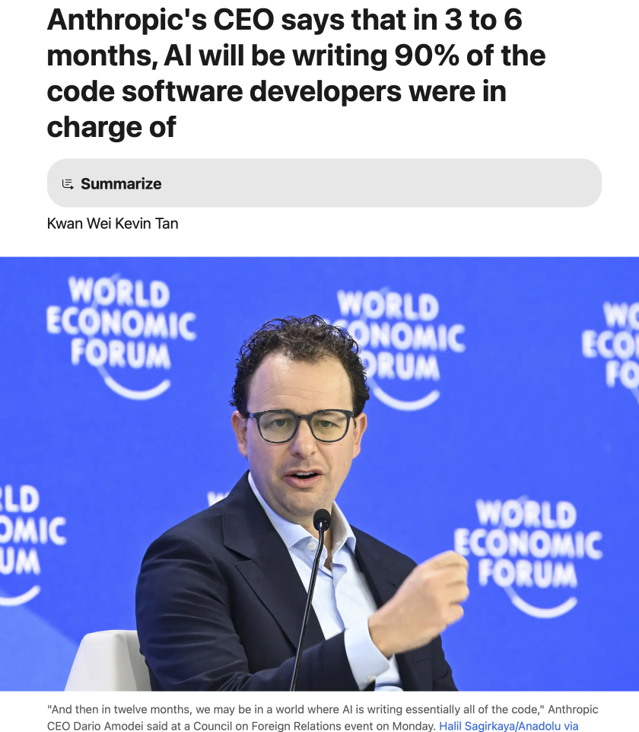
AI and Coding (2025)
www.businessinsider.com/anthropic-ceo-ai-90-percent-code-3-to-6-months-2025-3

Slide 37
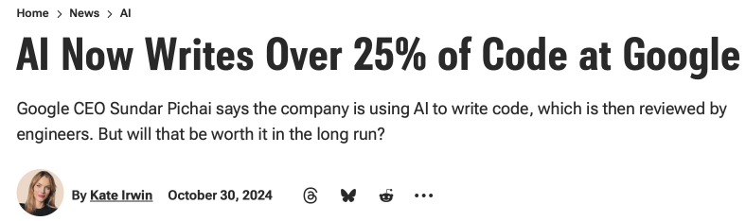
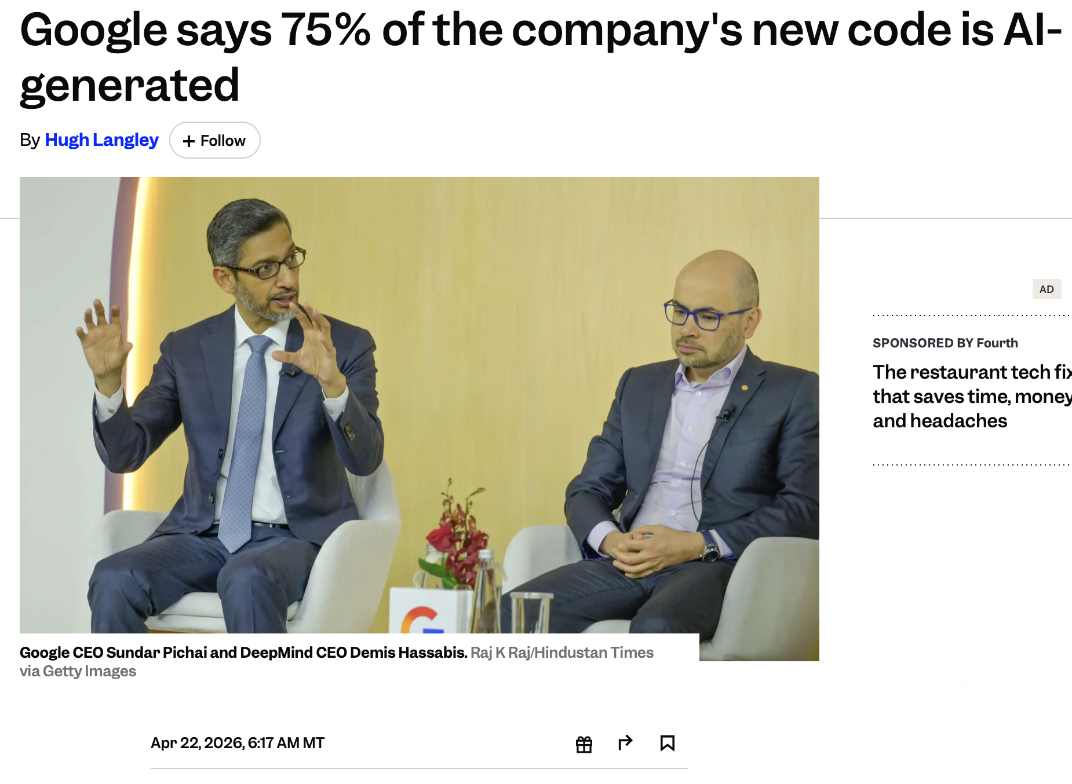
AI and Coding
www.pcmag.com/news/ai-now-writes-over-25-percent-of-code-at-google

Slide 38
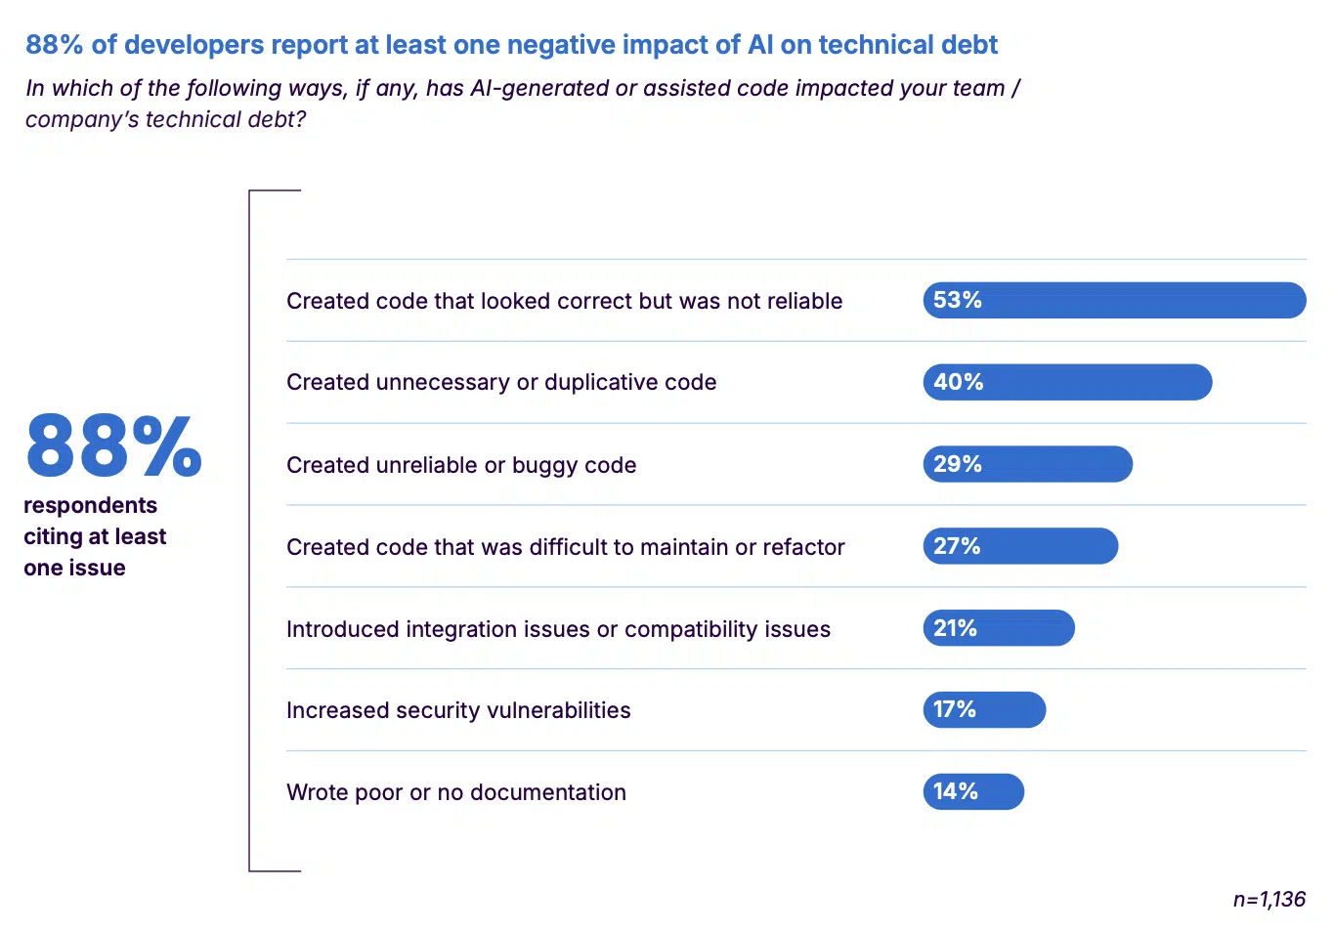
AI and Coding
Less-experienced developers: AI functions as both assistant and tutor.
https://shiftmag.dev/state-of-code-2025-7978/

Slide 39
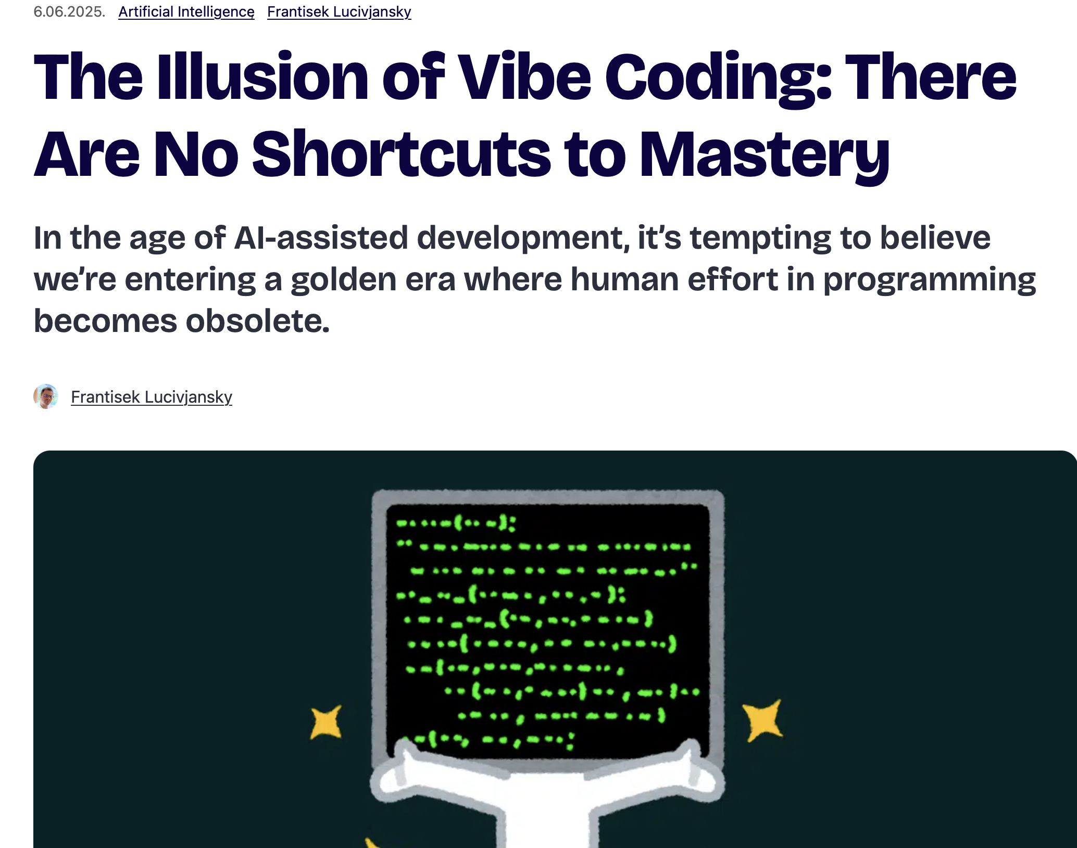
Vibe Coding
https://shiftmag.dev/the-illusion-of-vibe-coding-5297/

