Slide 1
LING/C SC/PSYC 438/538
Lecture 2
Prof. Sandiway Fong

Slide 2
Administrivia
Hope you have Perl and Python3 installed on your computer?
  That was Homework 2
  Please try to have it ready by next class!

Slide 3
Today's Lecture
Chapter 1 of JM Reading:
That was Homework 1. A brief quiz today. See end of lecture.
Introduction
Sentence analysis

Slide 4

Language and Computers
We want computers to be smart about language
    there's plenty of training data around
    make the machines learn by themselves
    pass the Turing Test, but not be too smart?
HAL 9000 in 2001: A Space Odyssey

Slide 5
Language and Computers
Github openai / whisper
Whisper was trained on 680,000 hours of audio and corresponding transcripts gathered from the internet.
(base) ~$ pip install -U openai-whisper
Collecting openai-whisper
Downloading openai_whisper-20250625.tar.gz (803 kB)
Installing build dependencies ... done
Getting requirements to build wheel ... done
Successfully built openai-whisper
Installing collected packages: mpmath, sympy, setuptools, networkx, more-itertools, MarkupSafe, llvmlite, tiktoken, numba, jinja2, torch, openai-whisper
Successfully installed MarkupSafe-3.0.2 jinja2-3.1.6 llvmlite-0.44.0 more-itertools-10.7.0 mpmath-1.3.0 networkx-3.5 numba-0.61.2 openai-whisper-20250625 setuptools-80.9.0 sympy-1.14.0 tiktoken-0.11.0 torch-2.8.0
(base) ~$ which whisper
/Library/Frameworks/Python.framework/Versions/3.13/bin/whisper
(base) Desktop$ whisper hal9000.mp3 --model medium

Slide 6
Language and Computers
Detected language: English
[00:00.000 --> 00:11.680] Rotate the pod please, Hal.
[00:11.680 --> 00:12.680] Rotate the pod please, Hal.
[00:12.680 --> 00:17.680] I don't think he can hear us.
[00:17.680 --> 00:20.680] Rotate the pod please, Hal.
[00:20.680 --> 00:25.680] Yeah, I'm sure we're okay.
[00:25.680 --> 00:28.680] Well, what do you think?
[00:29.360 --> 00:31.360] I've got a bad feeling about him.
[00:31.360 --> 00:32.360] You do?
[00:32.360 --> 00:33.360] Yeah, definitely.

Slide 7
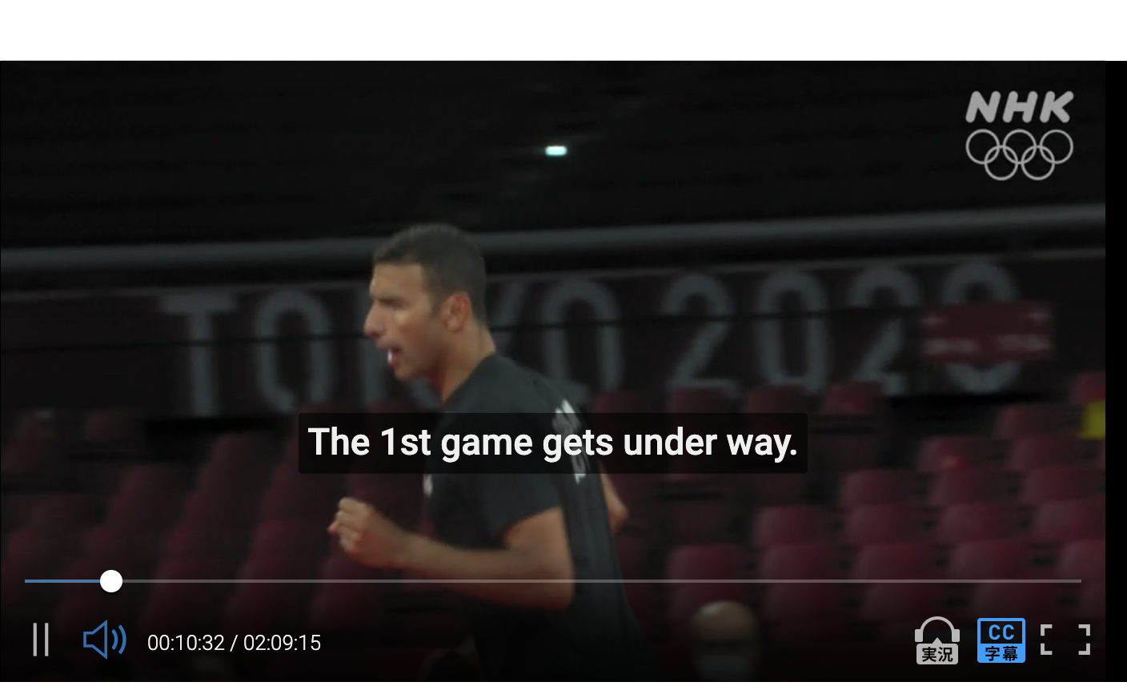
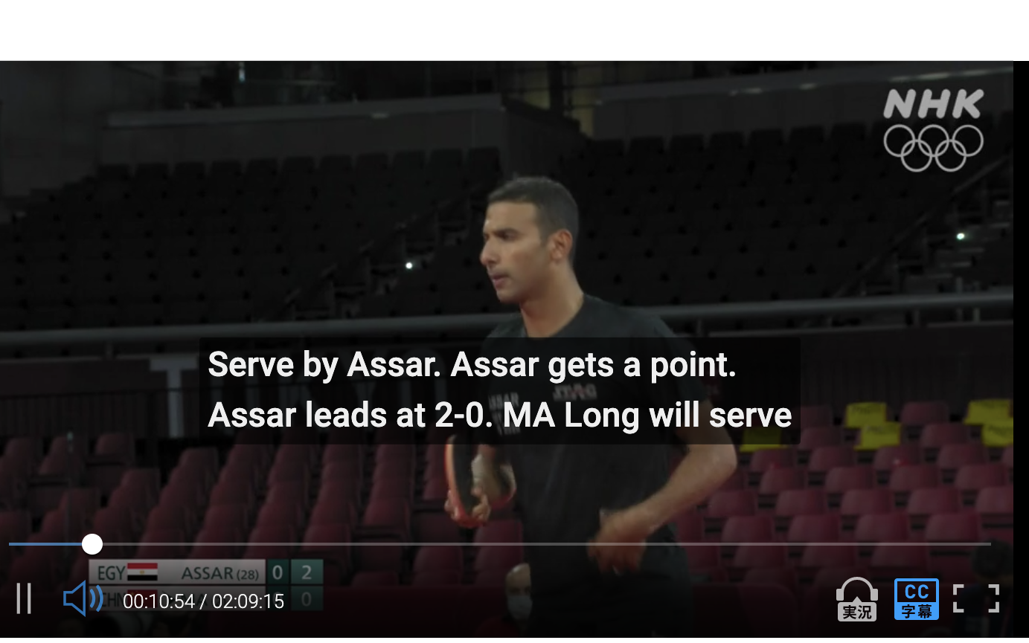

Assistive Technology: point-by-point subtitles
(2021)
"robot play-by-play broadcast" subtitles automatically generated by computers using data provided by the organizer of the event.
⇠ subtitle

Slide 8
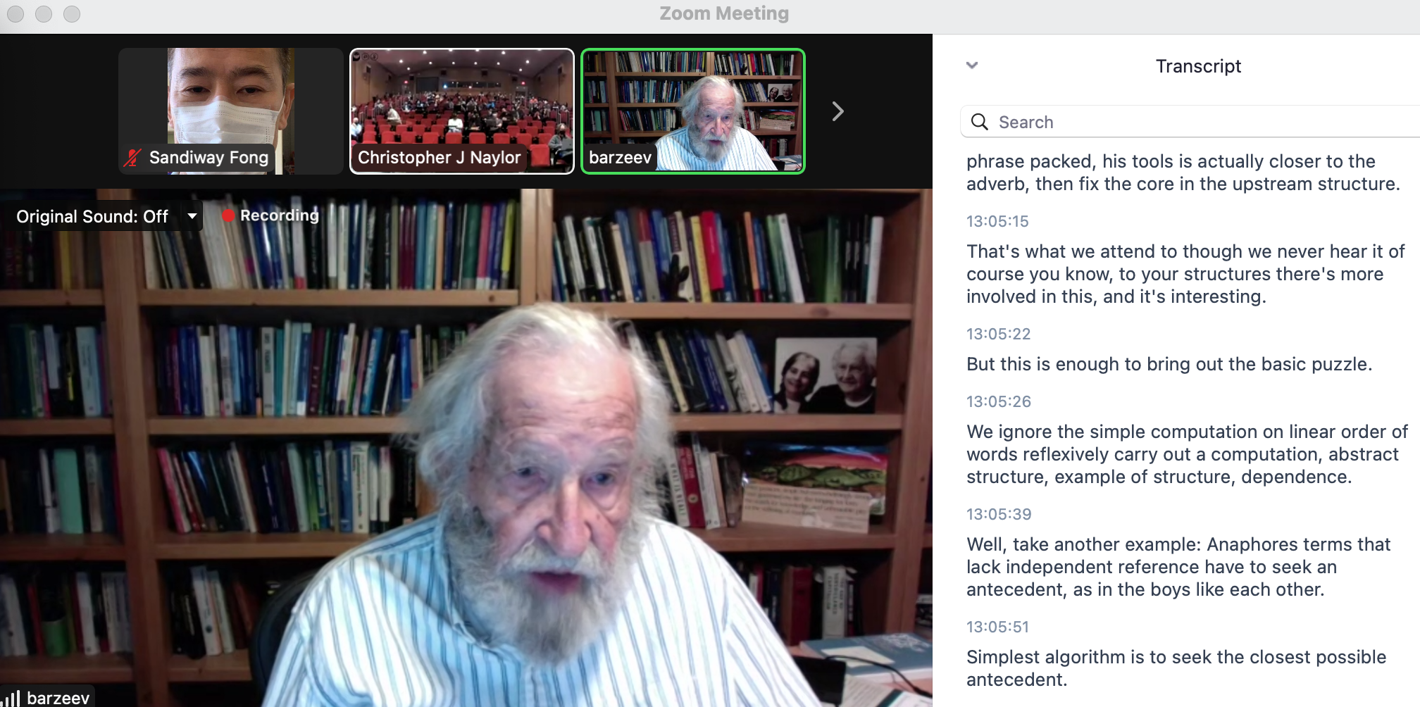

Assistive Technology: Zoom transcript
Alt Text

Slide 9
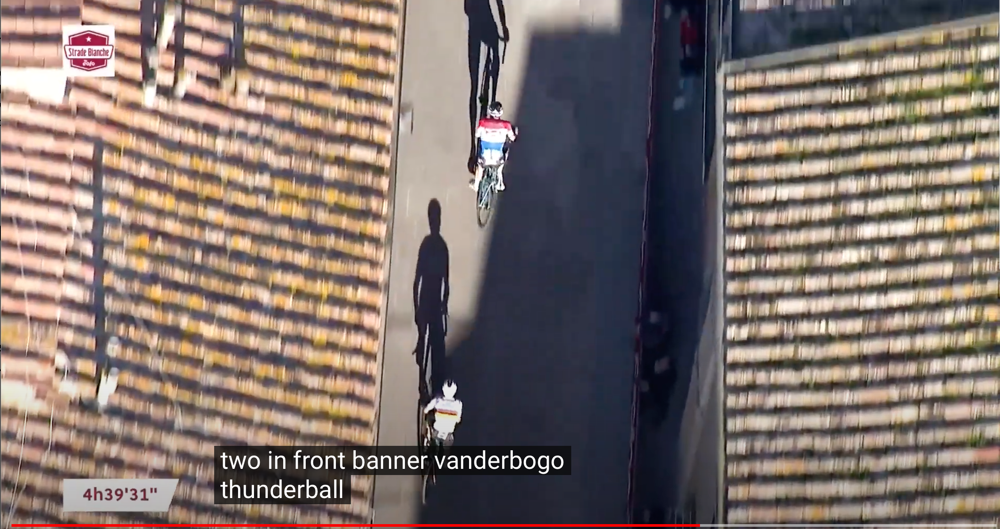
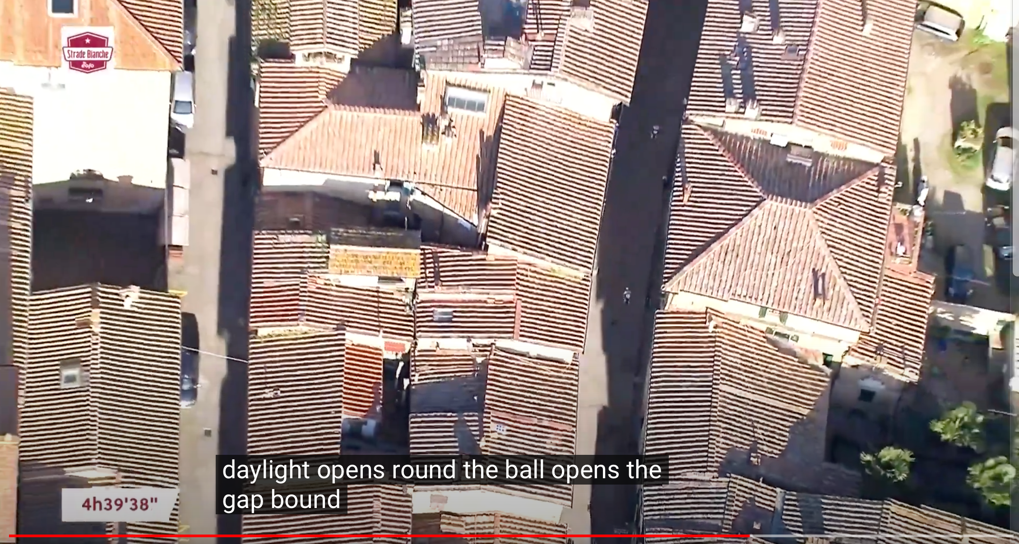
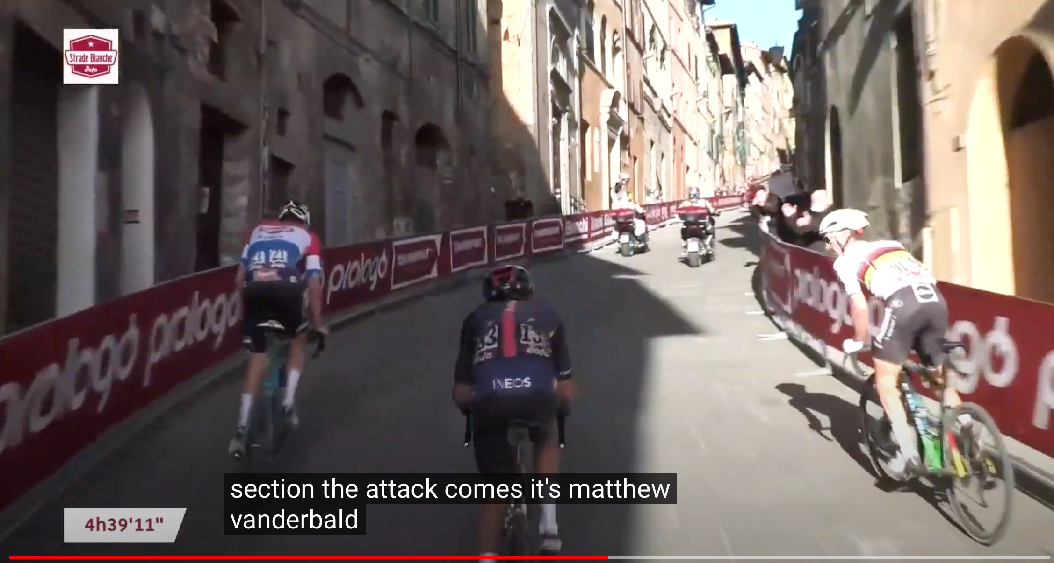
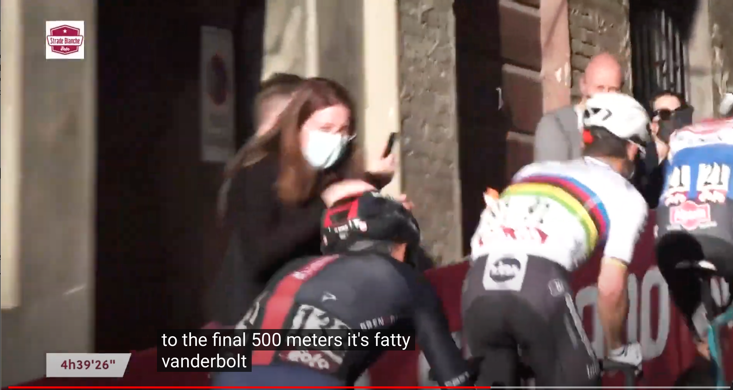
Harder task: names (CC)
banner vanderbogo
round the ball
matthew vanderbald
vanderbolt
Mathieu van der Poel

Slide 10
Language and Computers
(Un)fortunately, we’re not quite there yet…
  still a gap between what computers can do and what we want them to be able to do
Often quoted (but never verified):
"The spirit is strong, but the flesh is weak" was translated into
Russian and then back to English, the result was
"The vodka is good, but the meat is rotten."
but with Google translate or babelfish, it’s not difficult to find (funny) examples…

Slide 11
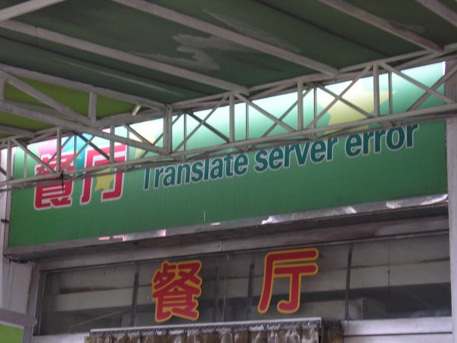
Language and Computers
and how can we tell if the translation is right anyway?
http://fun.drno.de/pics/english/only-in-china/TranslateServerError.jpg
Notes:
餐廳 餐厅

Slide 12
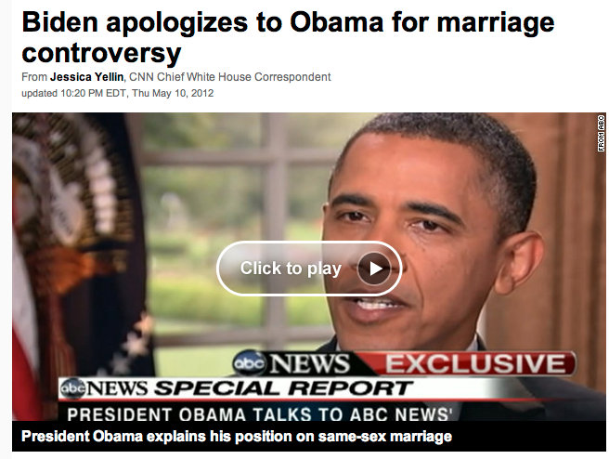
Summarization
We can exploit the recursive nature of language …

Slide 13
Summarization
Obama: "At a certain point, I've just concluded that for me personally it is important for me to go ahead and affirm that I think same-sex couples should be able to get married."
Is this sentence complicated? Why?

Slide 14
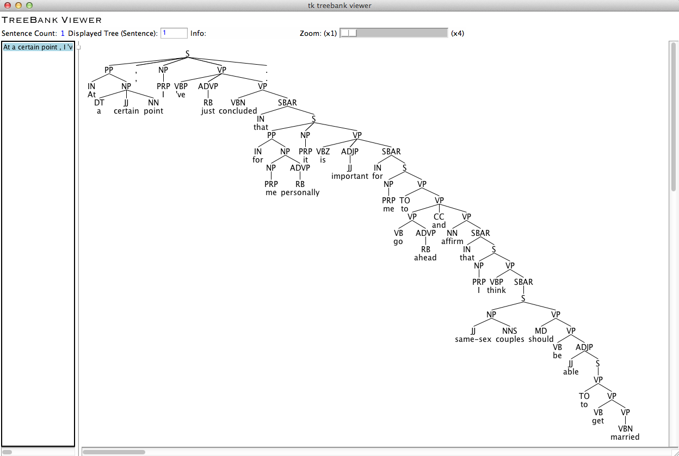
Summarization
Structure: it's cool that computer programs can (correctly) diagram this long sentence!

Slide 15
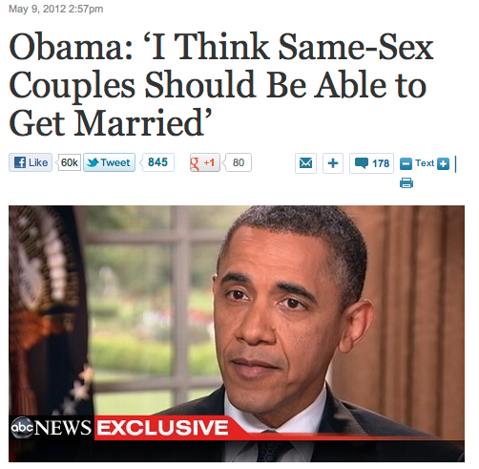
Summarization
Executive
Summarization

Slide 16
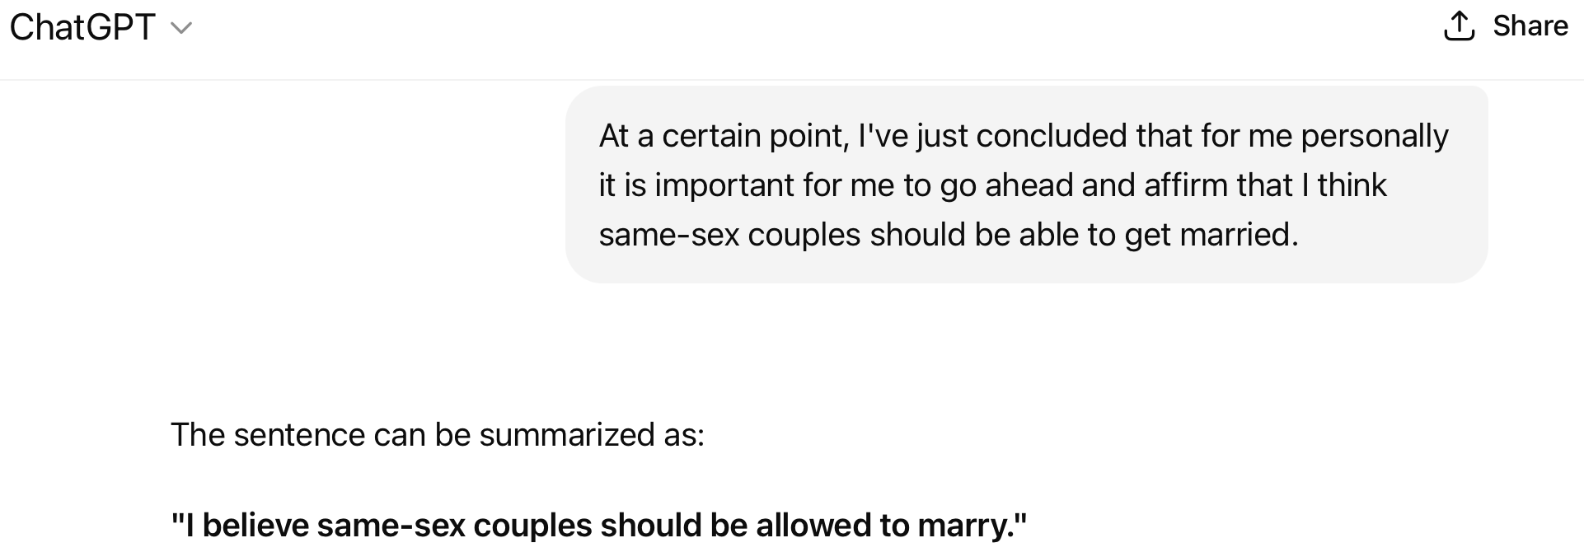
Summarization
Obama: "At a certain point, I've just concluded that for me personally it is important for me to go ahead and affirm that I think same-sex couples should be able to get married."
Obama: "At a certain point, I've just concluded that for me personally it is important for me to go ahead and affirm that I think same-sex couples should be able to get married."
Summarizers prior to the AI revolution couldn't do this …

Slide 17
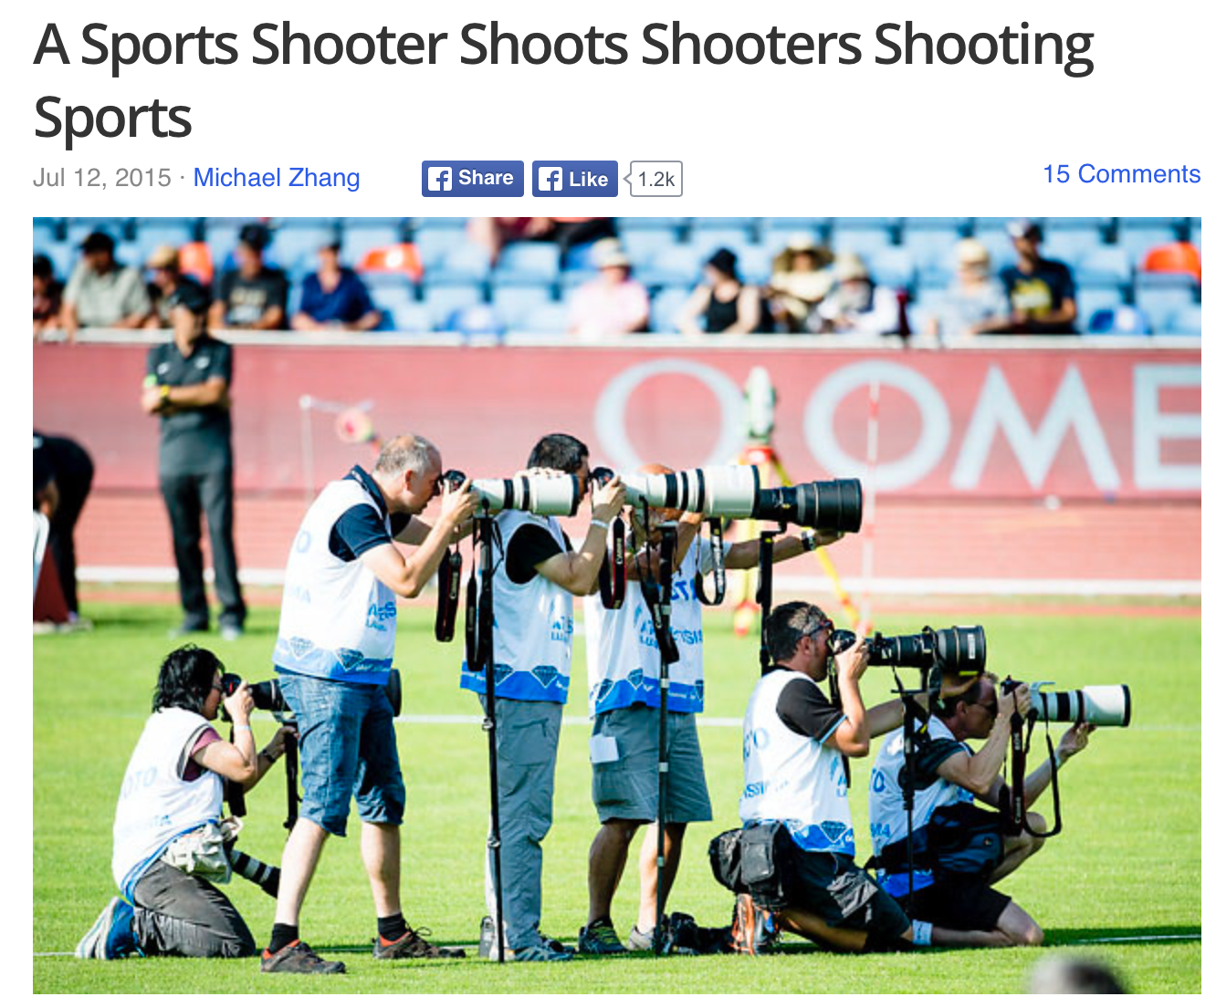
Syntactic Structure

Slide 18
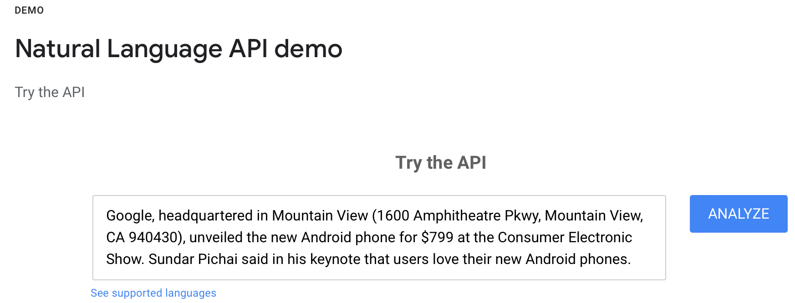
Syntactic Structure
Natural language parsers (produce syntax diagrams)
Let's get some idea of what these (popular) systems produce.
Sadly, all once had an easily accessible working demo page:
  Stanford Parser (deprecated? Try https://corenlp.run)
  Berkeley Parser (deprecated? B. Neural Parser: https://parser.kitaev.io)
  Google Natural Language (https://cloud.google.com/natural-language)

Slide 19
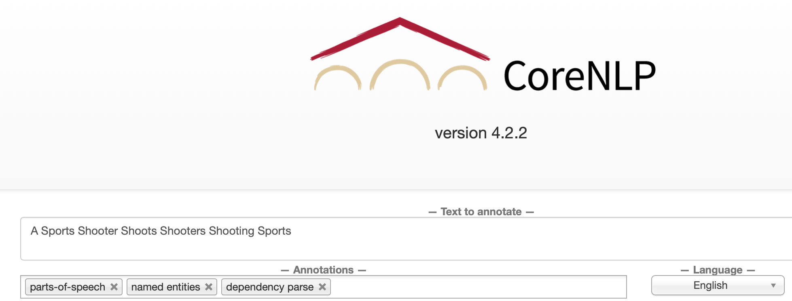
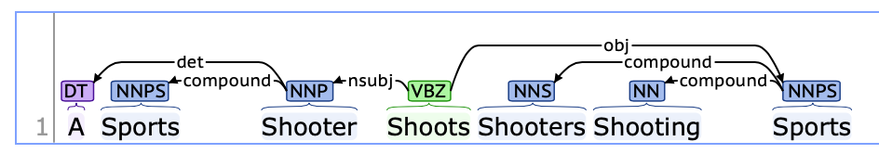
Syntactic Structure
Natural language parsers
  Stanford CoreNLP
  Java-based
  Demo!
  (https://corenlp.run)

Slide 20
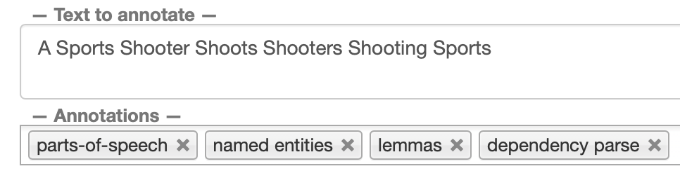
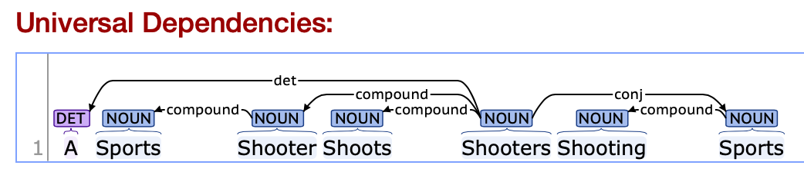
Syntactic Structure
Natural language parsers
  (Stanford) Stanza
  Python-based (CoreNLP)
  Demo!
  http://stanza.run

Slide 21
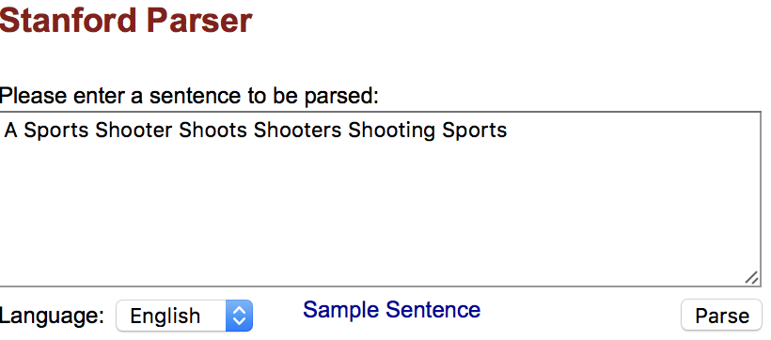
Syntactic Structure
Stanford parser (no longer online) http://nlp.stanford.edu:8080/parser/index.jsp
Part of Speech Tagging:
DT = determiner;
NNP = Proper Noun; NNPS = Plural Proper Noun;
VBZ = Verb 3rd Person Singular Present; VBG = Verb Gerund Form

Slide 22
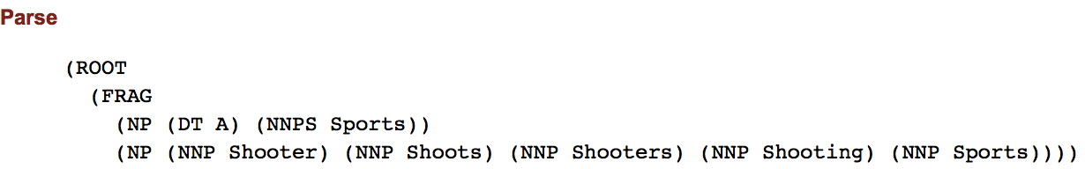
Syntactic Structure
Constituency-based structure (indicated by bracketing):
Constituents:
FRAG = Fragment (of a sentence)
S = Sentence, NP = Noun Phrase, VP = Verb Phrase
Parts of Speech:
DT Determiner, NNP Proper Noun, NNPS Plural Proper Noun.

Slide 23
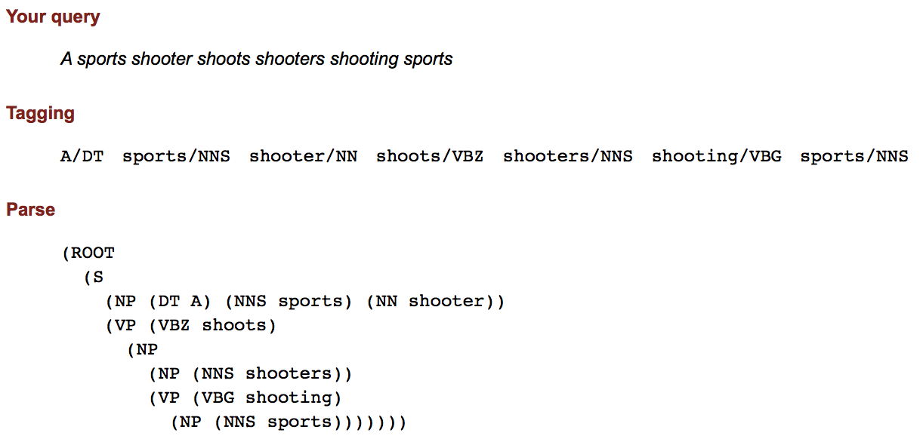
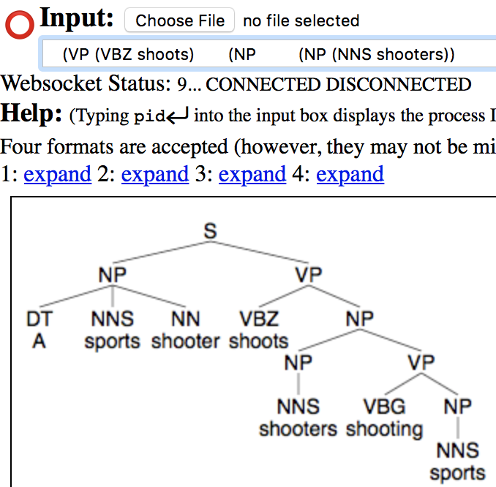
Syntactic Structure
FRAG = Fragment (of a sentence)
S = Sentence
NP = Noun Phrase
VP = Verb Phrase

Slide 24
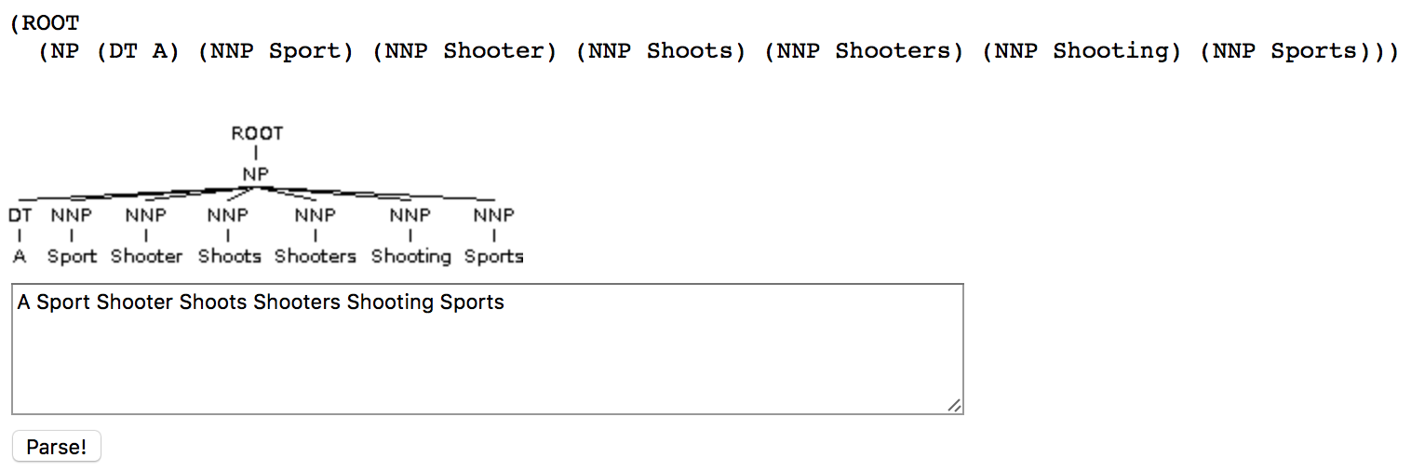
Syntactic Structure
Berkeley Parser (downloadable, but no longer available online)
http://tomato.banatao.berkeley.edu:8080/parser/parser.html

Slide 25
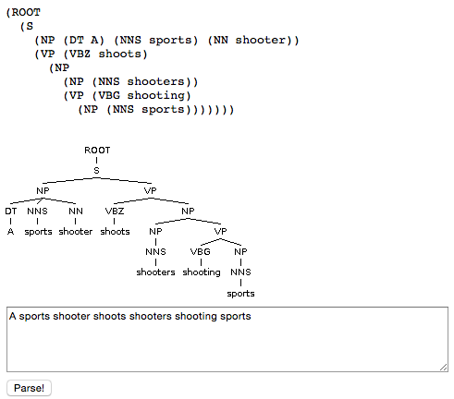
Syntactic Structure
Berkeley Parser
http://tomato.banatao.berkeley.edu:8080/parser/parser.html
This newer one is available
Berkeley Neural Parser
https://parser.kitaev.io
FRAG = Fragment (of a sentence)
S = Sentence
NP = Noun Phrase
VP = Verb Phrase

Slide 26
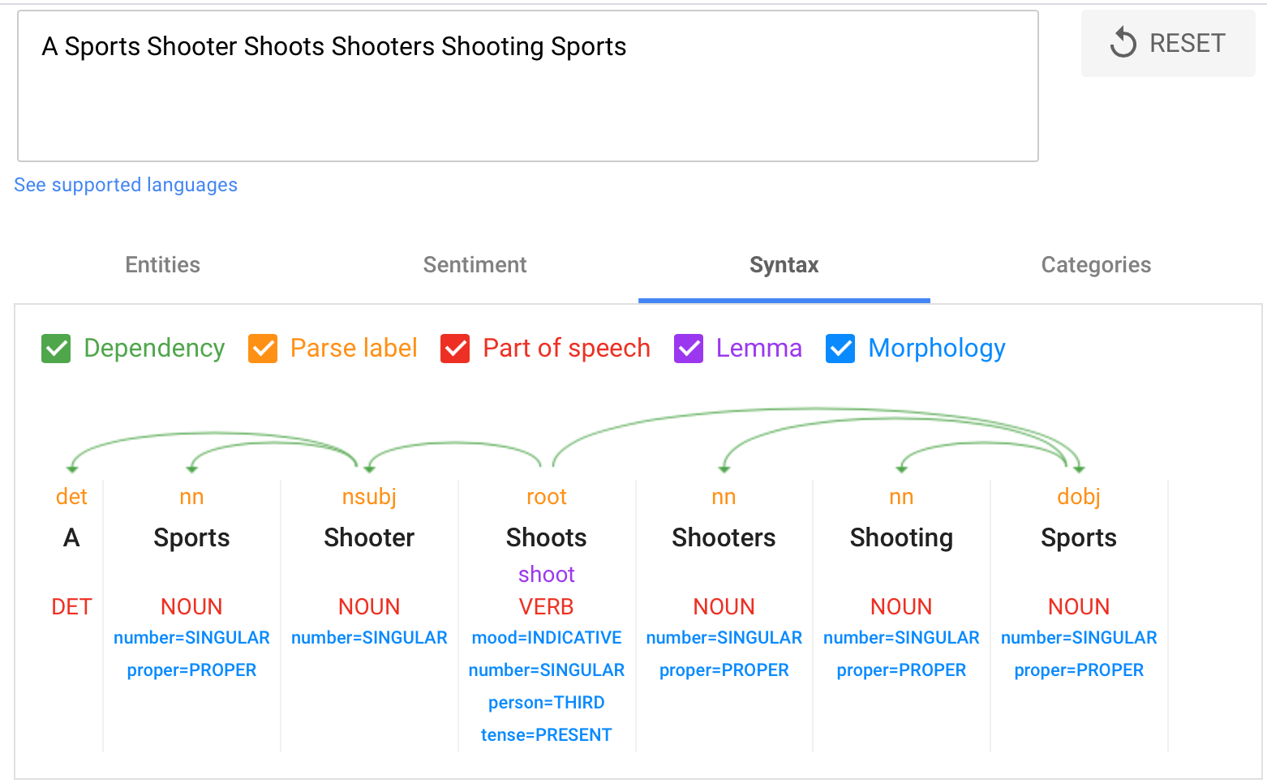
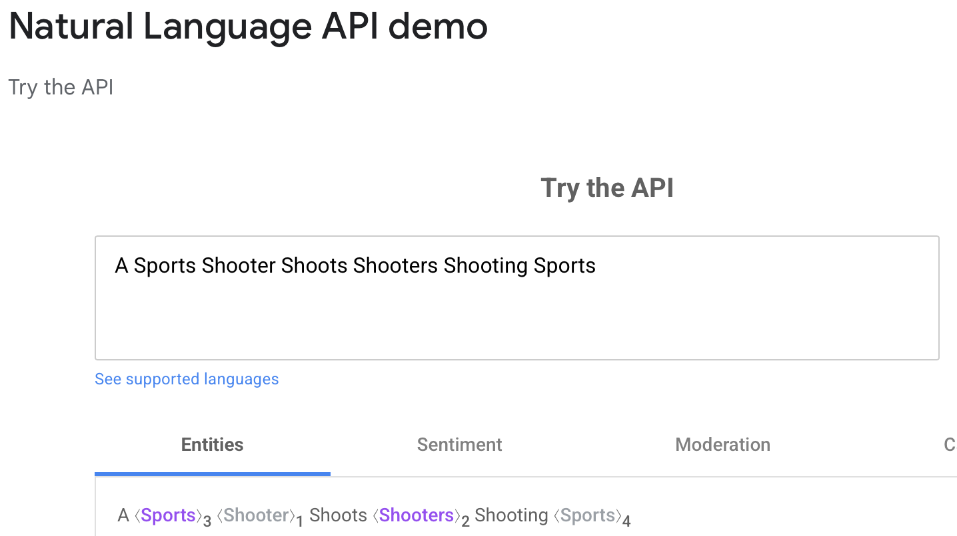
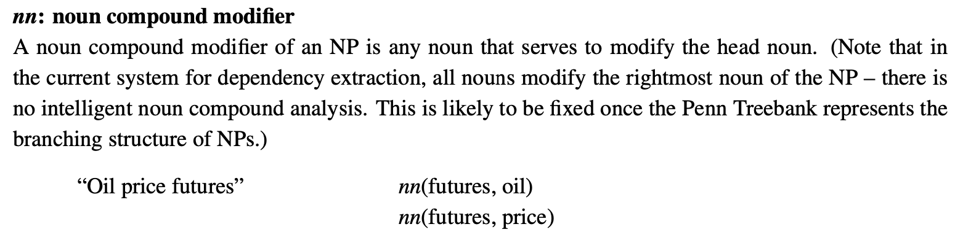
Syntactic Structure
https://cloud.google.com/natural-language
?
Word to Word
Dependency

Slide 27
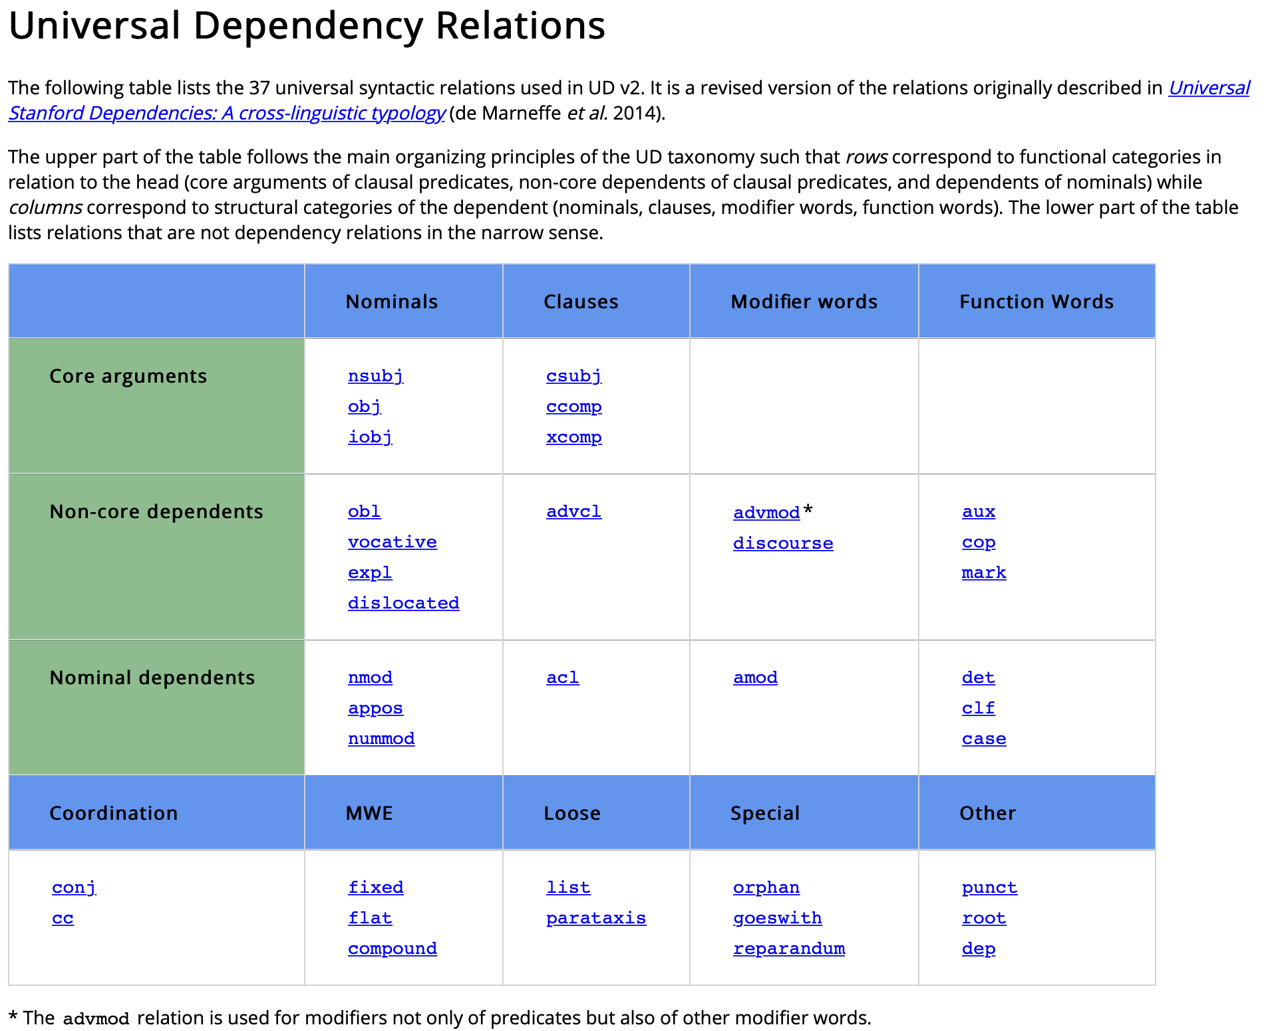
Syntactic Structure: Word Dependency Relations
https://universaldependencies.org/u/dep/index.html

Slide 28
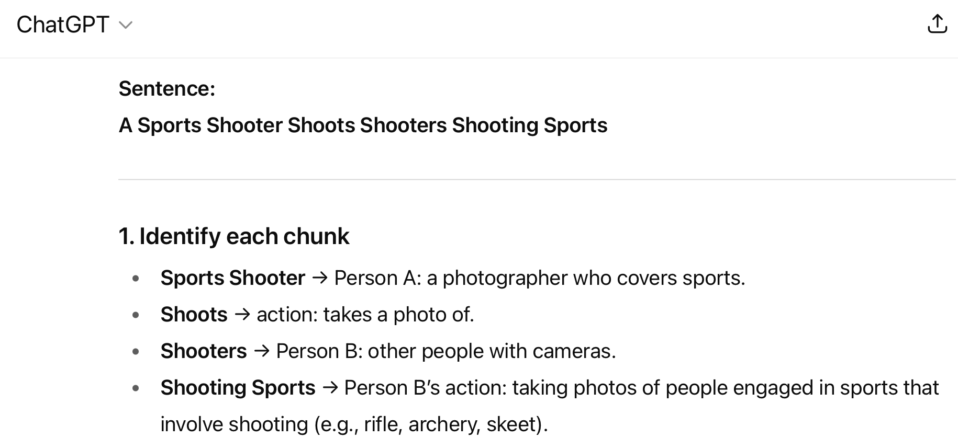
Syntactic Structure: ChatGPT

Slide 29
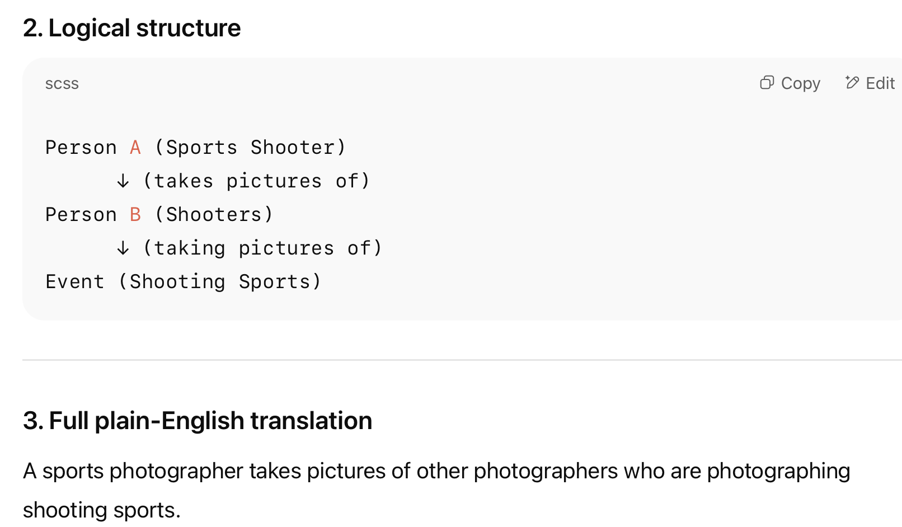
Syntactic Structure: ChatGPT

Slide 30
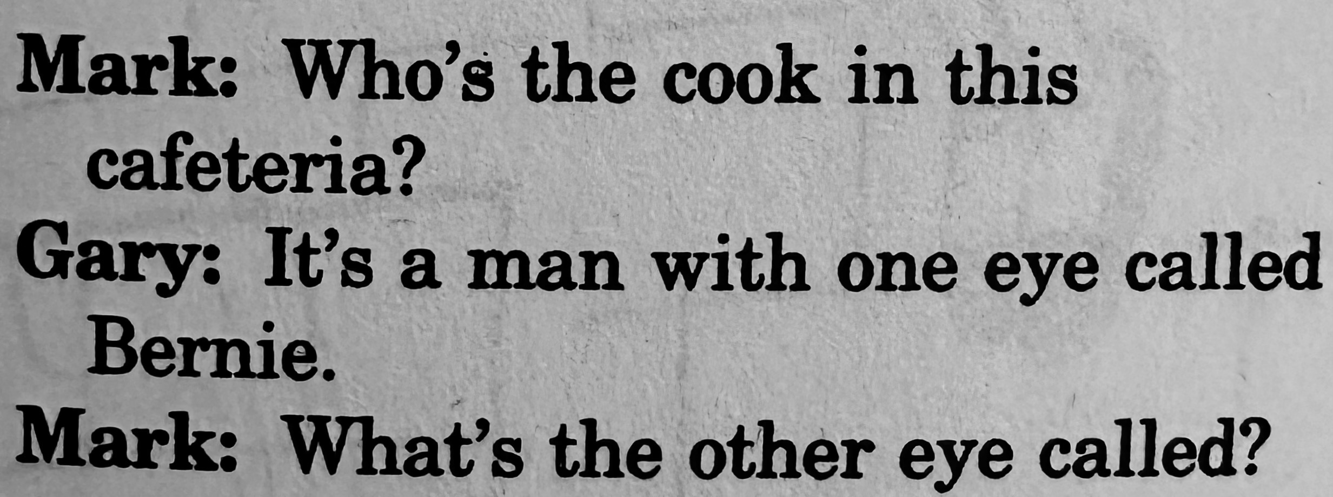
Homework 3
Computer Programs are unambiguous
A sentence is ambiguous if multiple, alternative linguistic structures can be built for it.
Is Caesar's murder ambiguous? Explain.
What's funny about this? Can you identify a structural difference?

Slide 31

Homework 3
What's funny about this?
  Can you point to a relevant structural difference?

Slide 32
Homework 3
Email to sandiway@arizona.edu
Due by Sunday midnight (no late homeworks, please)
  Will be reviewed in class on Tuesday
Email SUBJECT: 438/538 Homework 3: YOUR NAME
Either Plain Text or PDF accepted (no Word files please!)

