Slide 1
LING/C SC/PSYC 438/538
Lecture 1
Prof. Sandiway Fong

Slide 2
Contents
The Big Picture
Syllabus
Questions about the Syllabus
Homeworks 1 and 2 (possibly the null homework)
A note on Programming Languages
Some real intro next time!

Slide 3
Computation and Language
We assume human language can be modeled as a formal system
  Research Question:
  What is the nature of this formal system for human language?
  How is it different from other (mathematical) formal systems?
What we study here has much to do with formal systems
  Examples:
  programming (languages)
  regular expressions (regex), finite state automata (FSA)
  context-free (CFG) and context-sensitive grammars
  parse trees, word dependencies, sets

Slide 4
Computation and Language
Why only us?
  50 billion species since life emerged on earth almost 4 billion years ago (Mayr, 1995)
  Modern humans a recent arrival (300TYA) through a remarkable series of accidents
Language and thought is a species-specific property (Chomsky)
  closest relatives to modern humans have about the same auditory system
  only a human infant reflexively develops complex systems for constructing and expressing thought
Language shows peculiar properties
  not arbitrary (there are rules: man-made or otherwise?)
  Research question: why is it the way it is, and not some other way?

Slide 5
Syllabus
Description of Course
An introductory level course at the advanced level for computational linguistics. Required core course for the Master’s Human Language Technology (HLT) program.
Course Pre-requisites
438: LING 388 or familiarity with one or more of the following: formal languages, syntax, data structures, or compilers.
538: no formal pre-requisites.

Slide 6
Syllabus
Instructor and Contact Information
Instructor: Sandiway Fong (sandiway@arizona.edu, submit homeworks here)
Homepage: sandiway.arizona.edu
Dept. of Linguistics Office: Douglass 311
Hours:
make appointments by email or drop by my office
Meet:
Rm 206, Psychology Building: 9:30-10:45am Tuesdays/Thursdays
another good time to ask questions is right after class!

Slide 7
Syllabus
Course Format and Teaching Methods
Lecture with slides. Panopto videos (when available) for lecture review.
All homeworks will be introduced and reviewed in class.
Course Objectives
Topics covered include:
Introductory programming relevant to computational linguistics in two or more programming languages. We will use Perl, Python and Prolog this semester.
Introduction to a range of topics in computational linguistics, see detailed list of topics later below.

Slide 8
Syllabus
Course Learning Outcomes
After completing this course, students will:
Have acquired the ability to read and write programs in two or more programming languages.
Relates to Linguistics Department HLT program outcome #1.
Be familiar with basic concepts, techniques and applications in computational linguistics.
Relates to Linguistics Department HLT program outcome #2 and Linguistics Department Undergraduate program outcome #1.
538-only: be able to present and explain advanced concepts in computational linguistics. (See chapter presentation requirement.)
Be equipped to take more advanced classes in computational linguistics, e.g. 581 (Spring) or 439/539 (Statistical NLP).

Slide 9
Syllabus
Absence and Class Participation Policy
I expect you to attend lectures (though attendance will not be taken).
The UA’s policy concerning Class Attendance, Participation, and Administrative Drops is available at: http://catalog.arizona.edu/policy/class-attendance-participation-and-administrative-drop.
Tell me ahead of time so we can make alternative arrangements in the case of missed homeworks. No homework will be accepted late. Explained below.
Absences pre-approved by the UA Dean of Students (or Dean Designee) will be honored. See: https://deanofstudents.arizona.edu/absences.
The UA policy regarding absences for any sincerely held religious belief, observance or practice will be accommodated where reasonable, http://policy.arizona.edu/human-resources/religious-accommodation-policy.

Slide 10
Syllabus
Accessibility and Accommodations
At the University of Arizona, we strive to make learning experiences as accessible as possible. If you anticipate or experience barriers based on disability or pregnancy, please contact the Disability Resource Center (520-621-3268, https://drc.arizona.edu/) to establish reasonable accommodations.
UA Nondiscrimination and Anti-harassment Policy
The University is committed to creating and maintaining an environment free of discrimination; see http://policy.arizona.edu/human-resources/nondiscrimination-and-anti-harassment-policy.

Slide 11
Syllabus
Required Text
438: None.
538 Presentations: Speech and Language Processing, Jurafsky & Martin, draft 3rd edition (PDF available).
Required or Special Materials
All necessary software will be available online at no cost to the student.
However, students are expected to either have a laptop/desktop capable of handling homework and classwork, or make use of UA lab computers (?)
Mac, PC (Windows 11) or Linux.

Slide 12
Syllabus
Assignments and Examinations: Schedule/Due Dates
All homeworks will be introduced and reviewed in class.
Homework submissions by email to me.
Late homeworks will be not accepted since all homeworks will be solved in class.
Quick homeworks are normally due at midnight before the next class, and are generally assigned in class on a Tuesday and due Wednesday midnight (before Thursday class).
Homeworks not categorized as quick are normally assigned in class on a Thursday and due the following Sunday or Monday midnight (before next Tuesday's class). (Some longer homeworks may have an extended due date.)
Students can expect a total of 10-14 homeworks over the course.

Slide 13
Syllabus
Final Examination or Project
No examinations, e.g. mid-term or final, are scheduled for this course.
Grading Scale and Policies
438:
  100% of the grade comes from the homework assignments.
538:
  75% of the grade comes from the homework assignments (possibly a superset of the 438 assignments), 25% of the grade comes from a textbook chapter presentation.
Requests for incomplete (I) or withdrawal (W) must be made in accordance with University policies, which are available at http://catalog.arizona.edu/policy/grades-and-grading-system#incomplete and http://catalog.arizona.edu/policy/grades-and-grading-system#Withdrawal respectively.

Slide 14

Syllabus
Scheduled Topics/Activities
Topics will be drawn from the following:
– Programming Languages: Perl and Python
– Regular Expressions (Theoretical and practical)
– Automata (Finite State) and Transducers (Finite State)
– Programming Language: Prolog (definite clause grammars)
– NLTK (Natural Language Toolkit)
– Part of Speech (POS) Tagging
– Stemming (Morphology)
– Edit Distance (Spelling)
– Grammars (Regular, Context-free)
– Parsing (Syntax trees, dependency trees, algorithms)
– and more ...

Slide 15
Syllabus
Code of Academic Integrity
You may discuss homework questions with anyone (or anything).
You may look things up on the web and use answers found therein; however, you must write it up yourself (in your own words/own code etc.).
You must cite all (web) references including ChatGPT, and your classmates (in the case of shared discussion).
Students are encouraged to share intellectual views and discuss freely the principles and applications of course materials.
However, graded work/exercises must be the product of independent effort unless otherwise instructed.
Students are expected to adhere to the UA Code of Academic Integrity as described in the UA General Catalog. See: http://deanofstudents.arizona.edu/academic-integrity/students/academic-integrity.

Slide 16
Syllabus
Subject to Change Statement
Information contained in the course syllabus, other than the grade and absence policy, may be subject to change with advance notice, as deemed appropriate by the instructor.
Questions?

Slide 17
UofA website
Download lecture slides from my homepage
  sandiway.arizona.edu
  sandiway.arizona.edu/ling538-25
  available from just before class time
    (afterwards, please look again for updates and corrections)
  in .pptx (good for animations) and .pdf formats

Slide 18
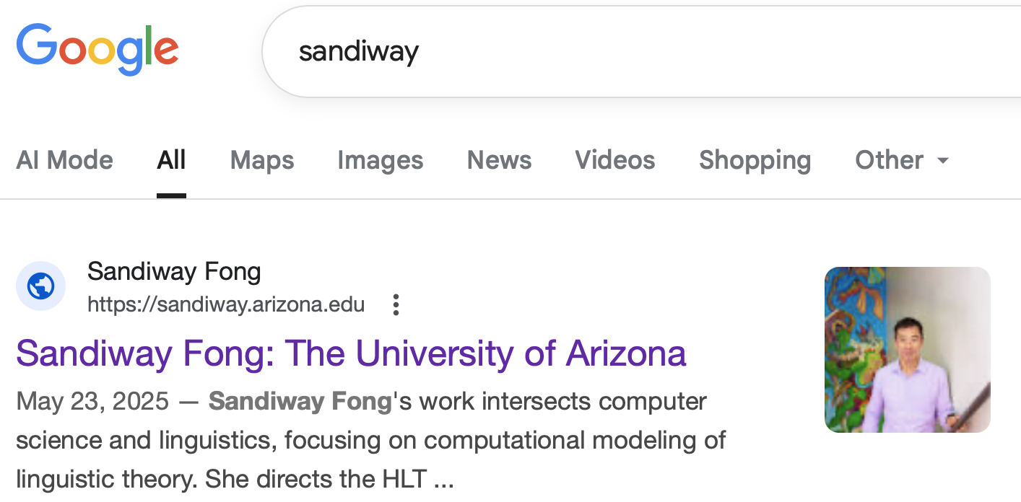
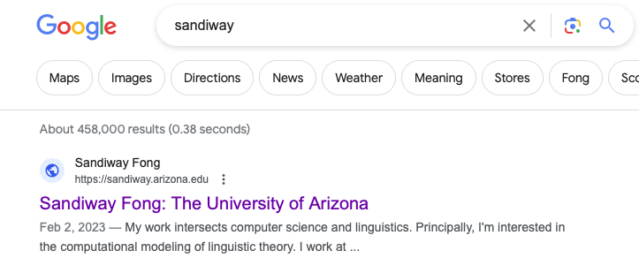
UofA website
Notice a difference between 2023 & 2025?

Slide 19
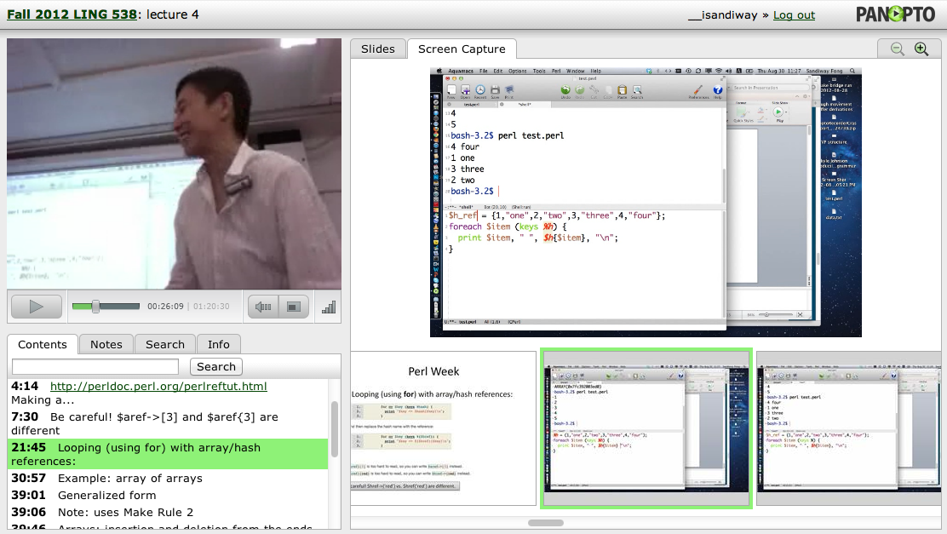
Panopto
Lectures will be recorded using the Panopto system
  accessible via the course webpage and your browser
  sometimes crashes
  (video, laptop screen, synchronized slides, keyword search)

Slide 20
Syllabus
I’m gonna assume you don’t know how to program at all (yet)
  we’re going to use Perl and Python
  good to learn both …
  good to be polyvalent, you'll also get some Prolog

Slide 21
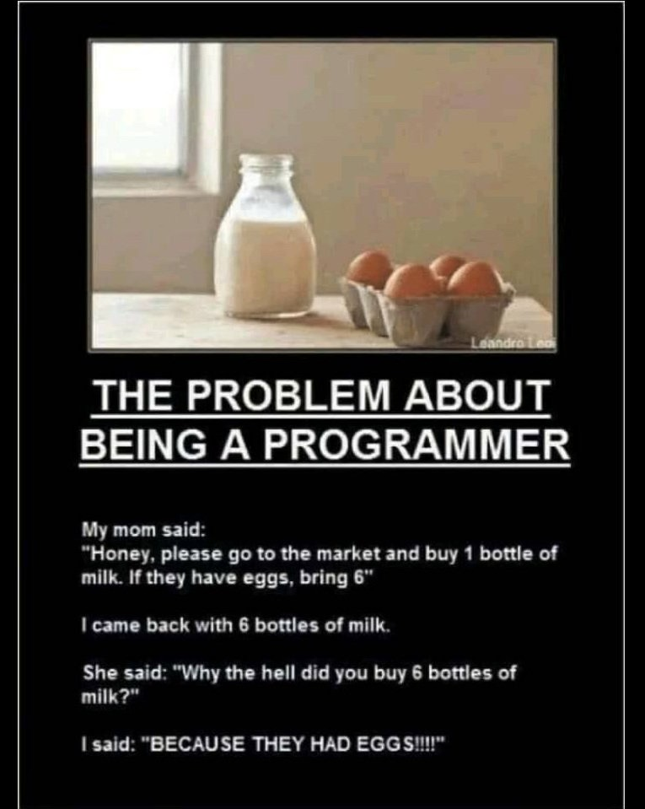
Being Precise
Always check to see if you typed something in exactly right.
saw this on my Facebook feed
Do you understand the joke?
if condition:
do command

Slide 22
Homework: Reading
Homework 1:
Chapter 1 from JM (2nd ed)
  READ IT before next time!
  in-class Quiz on Thursday
  available on course webpage as:
sandiway.arizona.edu/ling538-25/1.pdf

Slide 23
Homework 2
Could be the null homework for many of you:
Install Perl, and
Install Python (version 3.X, not obsolete 2.7)

Slide 24
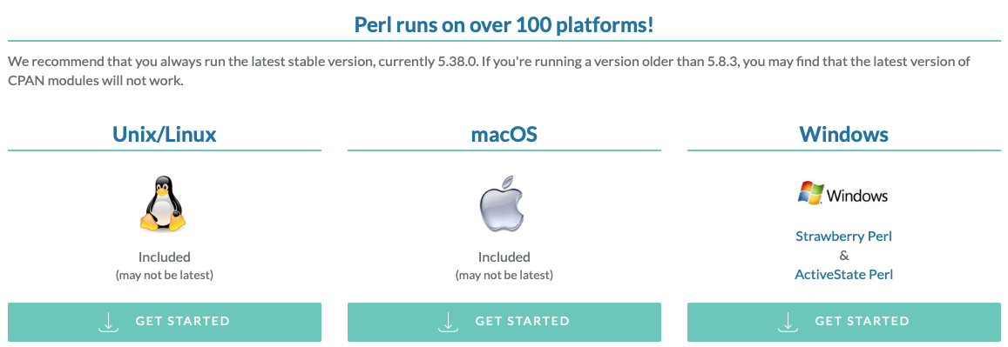
Homework 2: Install Perl
Install Perl on your computer
  pre-installed on macOS and Linux, check your machine from the Terminal/command line
  on Windows PCs, if you don’t already have it, it’s freely available here
  https://www.perl.org/get.html

Slide 25
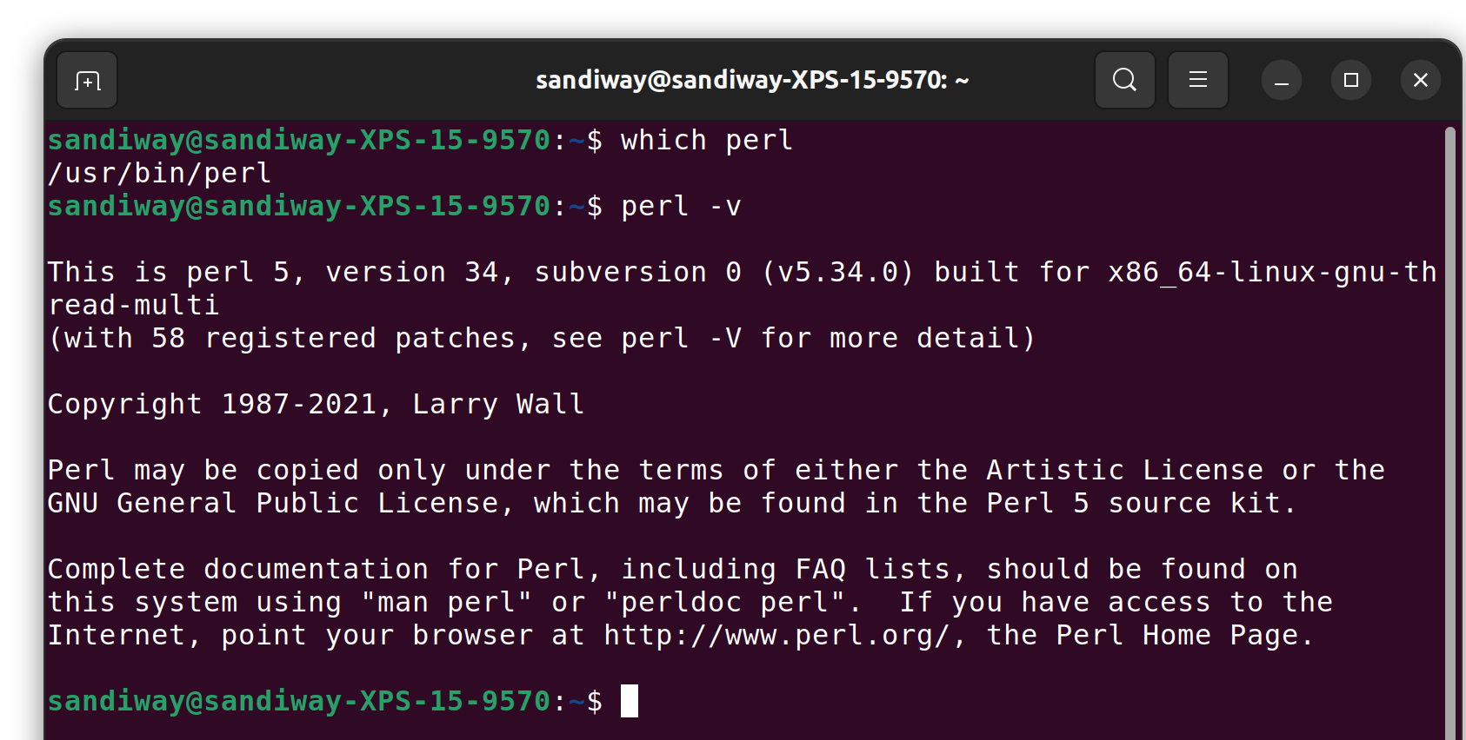
Homework 2: Install Perl
How to check?
  which perl
  perl -v
Ubuntu (Terminal):

Slide 26
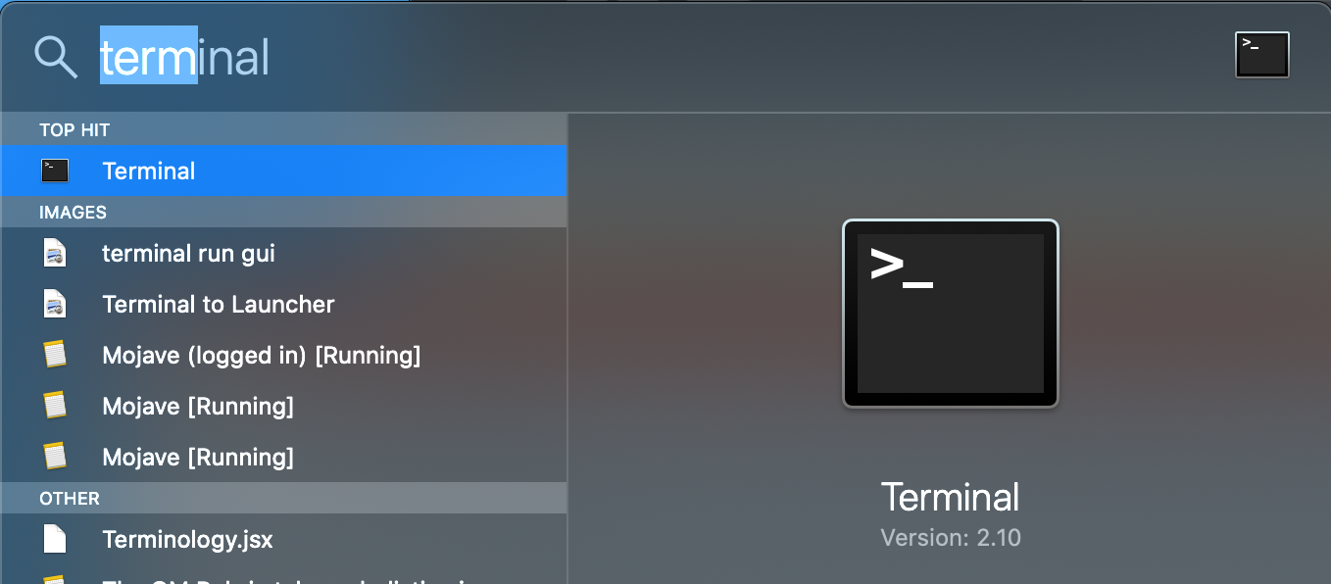
Homework 2: Install Perl
macOS (Terminal): (complete path specified here)
  /usr/bin/perl
  /opt/homebrew/bin/perl (Homebrew package manager brew.sh)
  /opt/local/bin/perl (MacPorts package manager)
PATH
commands:
perl (hangs; type Control-D)
perl –v
perl –V (much more verbose)

Slide 27
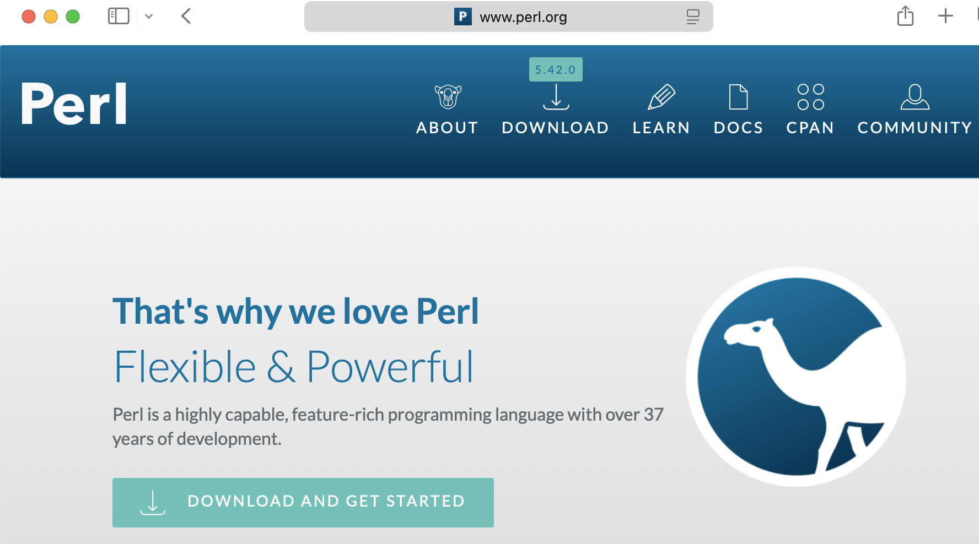

Homework 2: Install Perl
https://www.perl.org/learn.html
start here soon

Slide 28
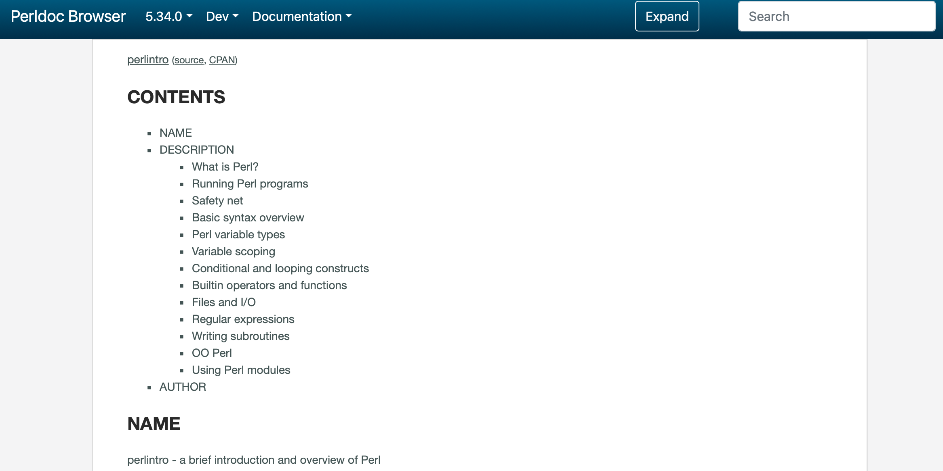
Learning Perl
Learn Perl
  https://perldoc.perl.org/perlintro.html

Slide 29
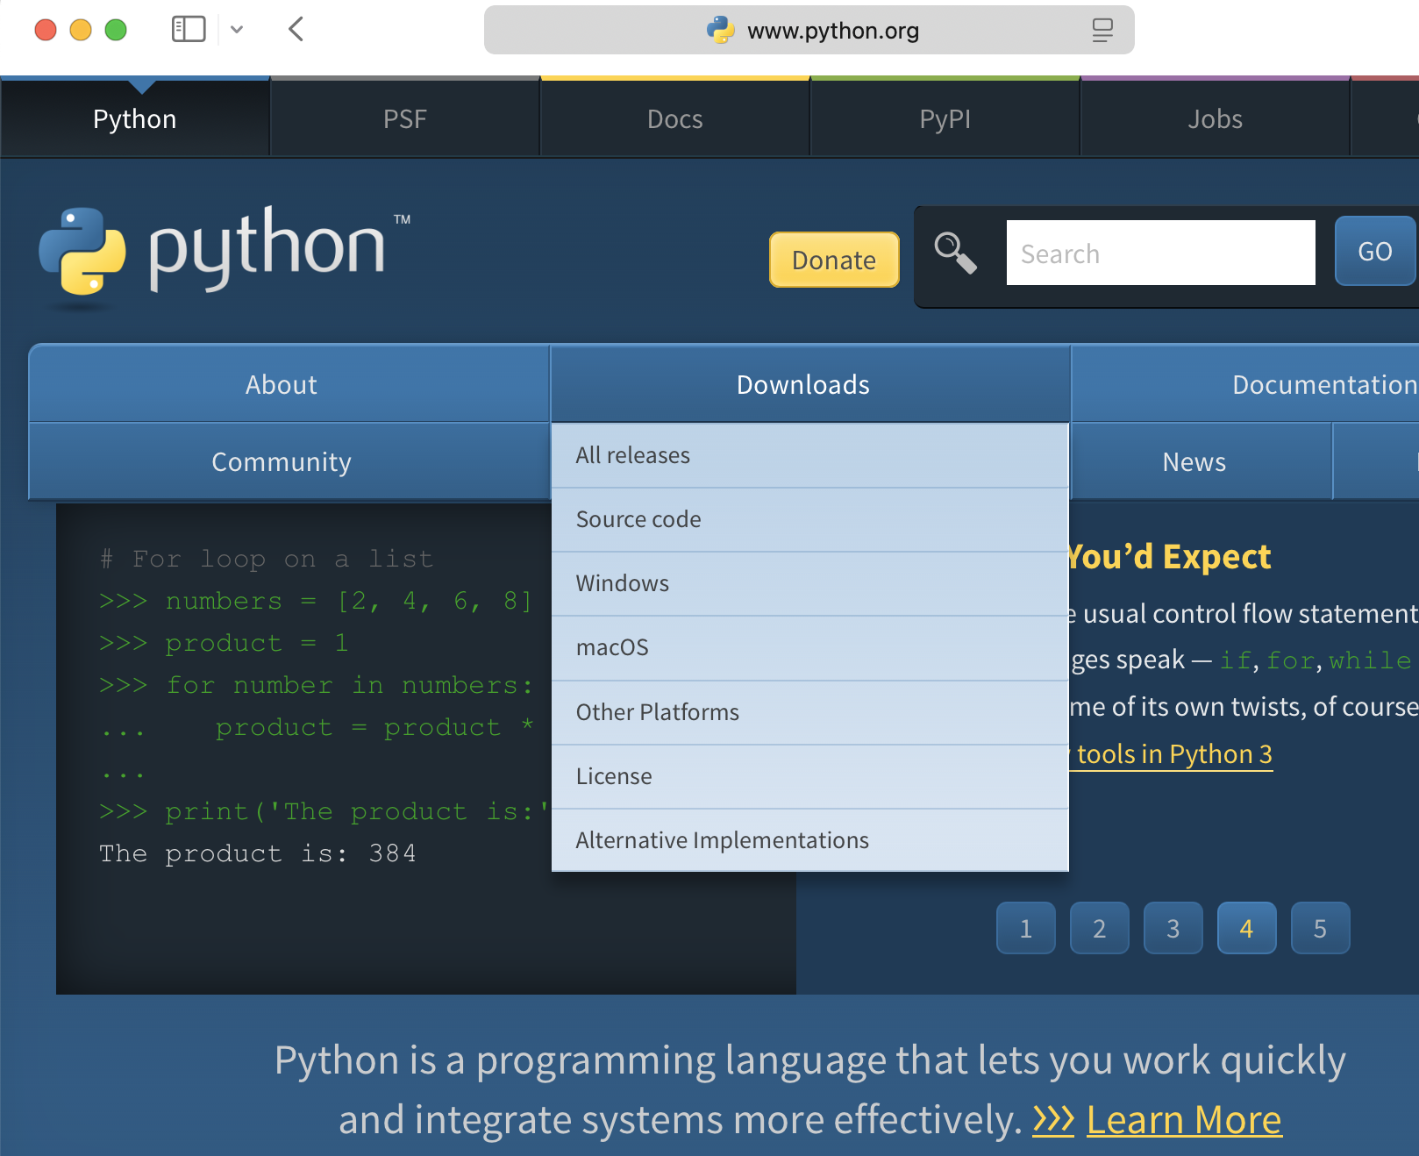
Homework 2: Install Python
www.python.org
Note: 3.x is not backwards compatible with Python 2.7!

Slide 30
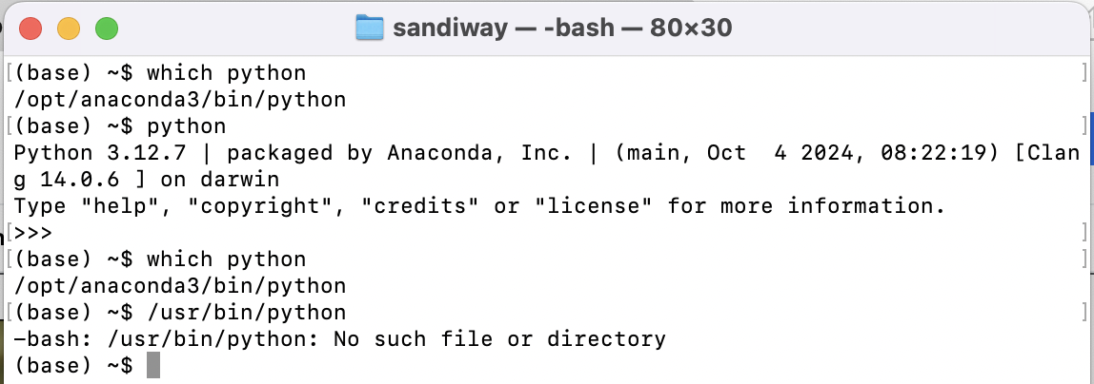
Homework 2: Install Python
Why?
many pre-built packages
On my Mac laptop, I have the Anaconda version:
exit: type Control-D
no longer part of macOS

Slide 31
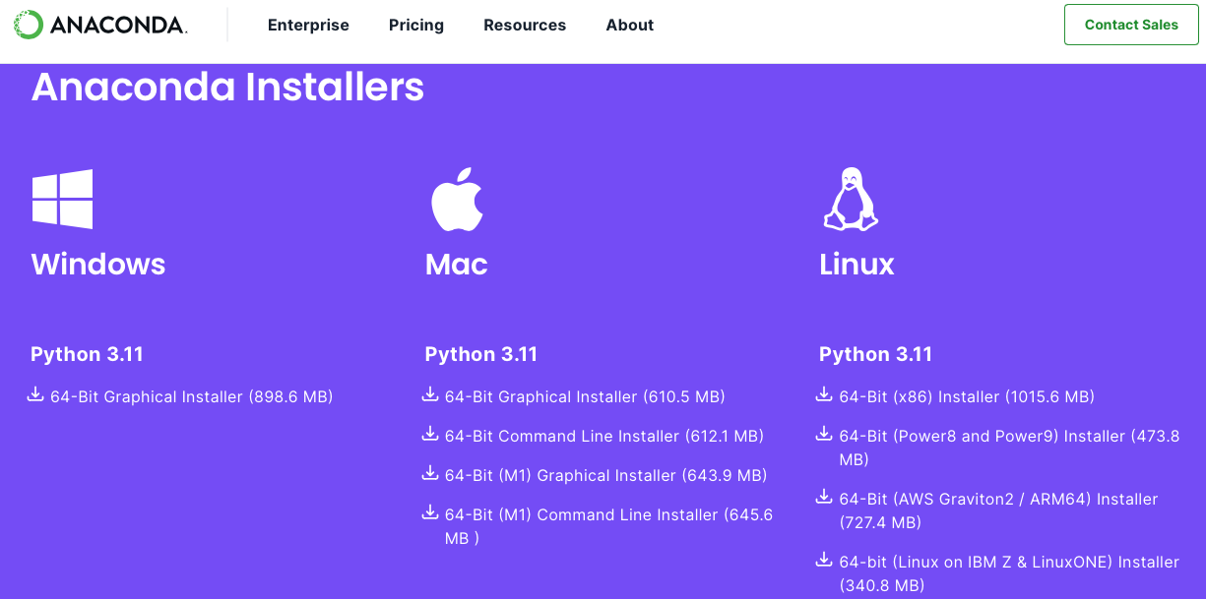
Homework 2: Install Python
https://www.anaconda.com/download

Slide 32

Which language is easier?
A subjective question …
All good programmers know more than one programming language, always an advantage to be versatile.
In NLP, Python is overwhelmingly popular, but we will do both Perl and Python. AND for writing grammars, Prolog.

Slide 33
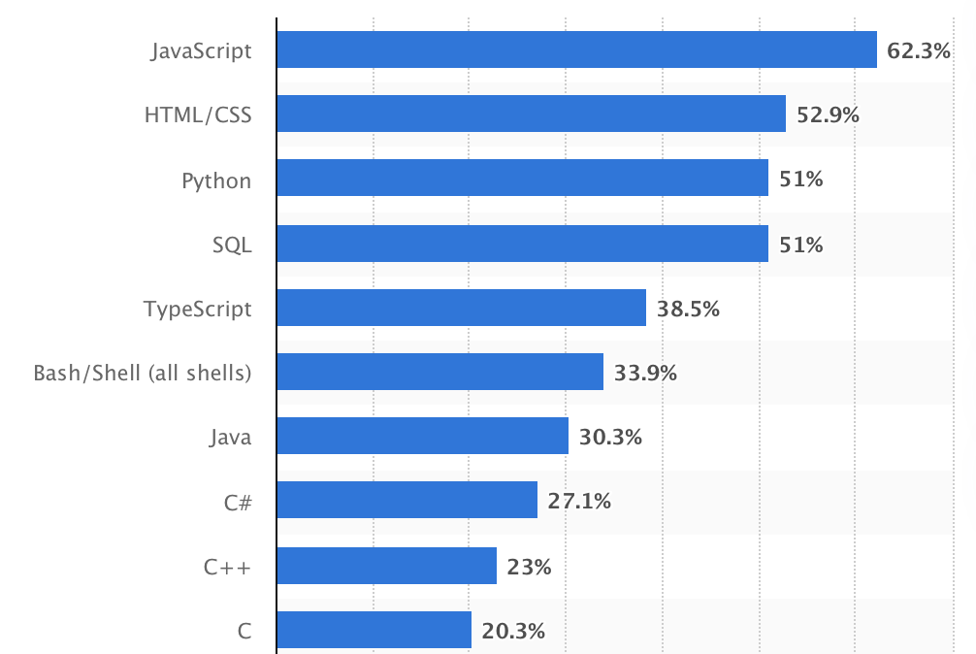
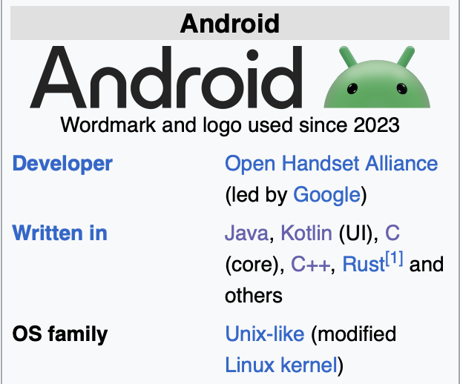
Development work (2024 survey)
1995
1990/1996
1991
1973
2012
1989
1995
2000
1985
1972
www.statista.com/statistics/793628/worldwide-developer-survey-most-used-languages/

Slide 34
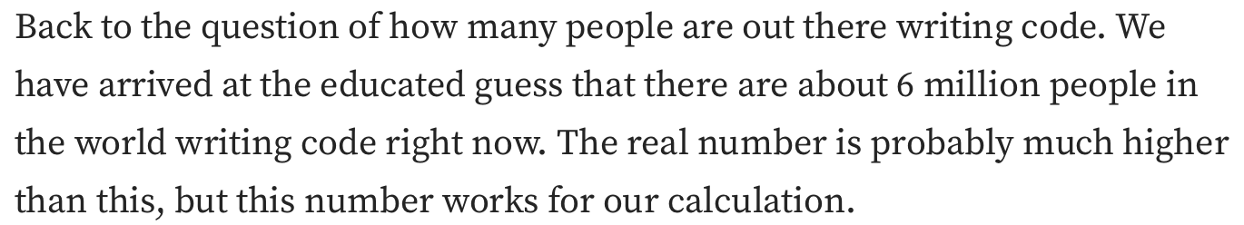
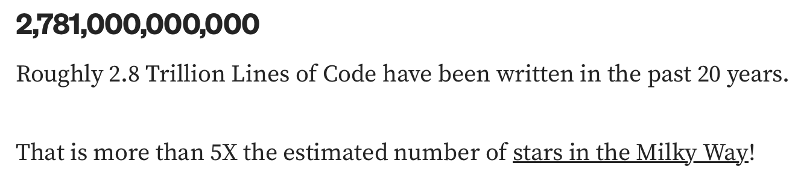
How many programmers, how many lines?
medium.com/modern-stack/how-much-computer-code-has-been-written-c8c03100f459

Slide 35
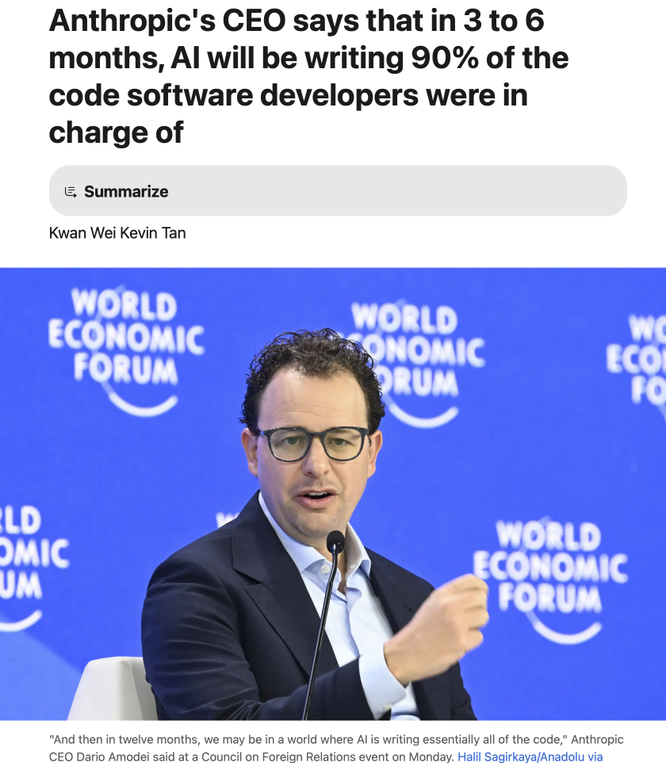
AI and Coding
www.businessinsider.com/anthropic-ceo-ai-90-percent-code-3-to-6-months-2025-3

Slide 36
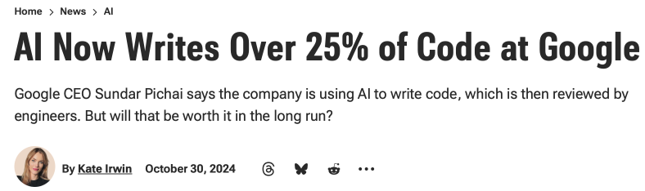
AI and Coding
www.pcmag.com/news/ai-now-writes-over-25-percent-of-code-at-google

