Slide 1
LING/C SC/PSYC 438/538
Lecture 8
Sandiway Fong

Slide 2
Today's Topics
Perl hash (recap) and Python dict comparison
Perl anonymous array […]
Part of Speech tagset example
Homework 6
has two themes: part 1 and part 2

Slide 3
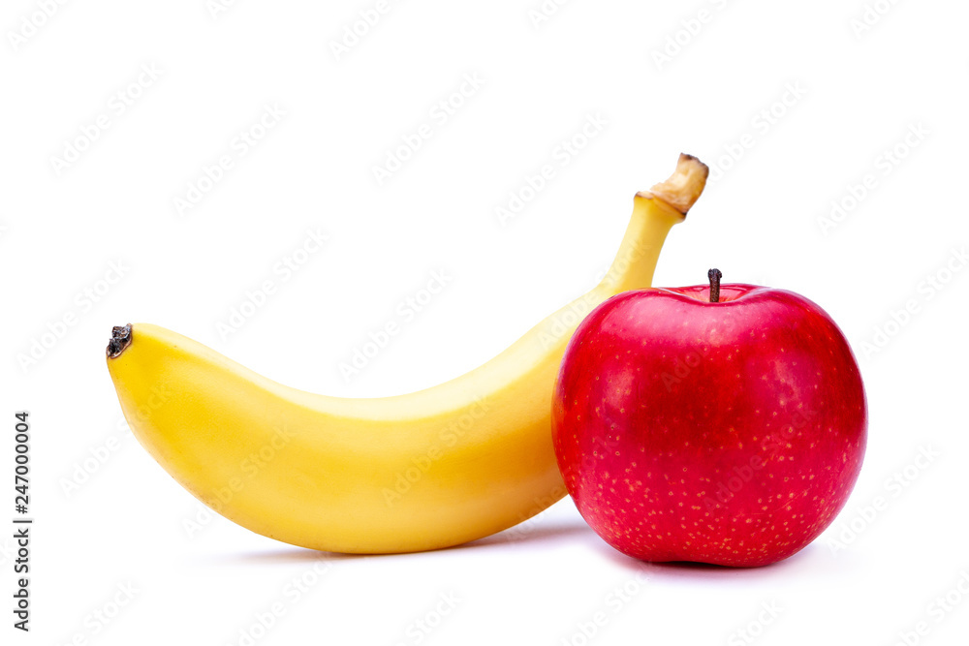
Perl Hashes
aka dict in Python
Notation:
Perl array: @ […]
Perl hash: % {…}
fat comma
banana
yellow
apple
red

Slide 4
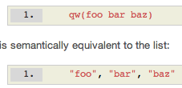
Perl Hashes
Compare (@) arrays and (%) hashes
arrays are indexed using integers (0, 1, 2, 3,…) as keys
hashes are like arrays with user-defined indexing (aka keys)
aka associative array or hash table or dict (Python)
Initialization (use list notation (or shortcut): round brackets and commas)
@a = ("zero", "one", "two", "three", "four");
%h = ("zero", 0, "one", 1, "two", 2, "three", 3, "four", 4); (key/value pairs)
Access to individual elements
(square brackets vs. curly braces)
$a[1] "one"
$h{zero} 0
Shortcut (no quotes, no commas needed):
no quotes needed for strings
'zero' "zero" cf. Python

Slide 5
Perl Hashes
Compare (@) arrays and (%) hashes
@a = ("zero", "one", "two", "three", "four");
%h = (zero => 0, one => 1, two => 2, three => 3, four => 4);
h = {'zero':0, 'one':1, 'two':2, 'three':3, 'four':4} (Python)
output
print @a zeroonetwothreefour
print "@a" zero one two three four
print %h two2three3one1zero0four4 (note: order)
print "%h" %h (no interpolation done)
h (Python)
{'zero': 0, 'one': 1, 'two': 2, 'three': 3, 'four': 4}

Slide 6
More on Hash tables
Looping over the array of keys:
Output:
www.freeimages.com
$ perl -e '%fruitColor = qw(apple red banana yellow kiwi green); for (keys %fruitColor) {print "$_ => $fruitColor{$_}\n"}'
kiwi => green
banana => yellow
apple => red
Notice: order is not guaranteed! (Implementation dependent)

Slide 7
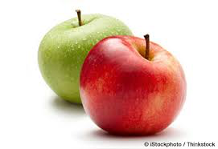
More on Hash tables
Unique key constraint:
perl -e '%h = qw(apple red banana yellow apple green); print $h{apple}, "\n"'
green
>>> fruitColor = {'apple':'red', 'banana':'yellow', 'kiwi':'green', 'apple':'green'}
>>> fruitColor['apple']
'green'

Slide 8
Perl each and Python .items()
Use a for-loop and method .items(): k,v is a tuple
perl -e '%knights = (gallahad => "the pure", robin => "the brave"); while (($key, $val) = each %knights) { print "$key $val\n"}'
robin the brave
gallahad the pure

Slide 9
More on Hash tables
%fruitColor = qw(apple red banana yellow kiwi green)
Delete key/value entry:
delete $fruitColor{apple}
Exists (condition):
exists $fruitColor{kiwi}
1 (true)
exists $fruitColor{orange}
"" (false)
lookup:
$fruitColor{orange}
""
fruitColor = {'apple':'red', 'banana':'yellow', 'kiwi':'green'}
Python:
del fruitColor['apple']
Python:
'kiwi' in fruitColor
True
'orange' in fruitColor
False
fruitColor['orange']
Traceback (most recent call last):
File "<stdin>", line 1, in <module>
KeyError: 'orange'

Slide 10
Python dict
Dictionary order preservation depends on the version of Python used …
Python 3.6 onwards

Slide 11
More on Hash tables
Hash slice:
perl -e '%h = qw(mon Monday tue Tuesday wed Wednesday thu Thursday fri Friday sat Saturday sun Sunday); print "@h{(sat, sun)}\n"'
Saturday Sunday
Delete hash:
%h = ()
h = {} (Python)

Slide 12
Python dict
similar syntax to a list comprehension
[… for var in ITERABLE ]

Slide 13
Python Part-of-Speech dict
likes is both a verb (3.sg.present) and a noun (plural)
He has his likes and dislikes as well as we. (OED: 1735)
Facebook: 2004

Slide 14
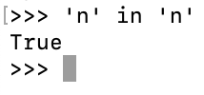
Python Part-of-Speech dict
All values are lists
Advantage: simplifies the code
Trade-off
Values are lists or a string
Advantage: simpler-looking dict
can be
simplified
because

Slide 15
Python Part-of-Speech dict
Works too!
Less transparent:
relies on a Python-particular quirk …
and doesn't always work!

Slide 16
Perl Part-of-Speech hash
[…] = reference to an array (scalar)
@$refname dereferences the scalar reference (gets you the array)
in scalar context grep block array returns number of matches:
perl -e '%pos=(likes => ["n","v"], car=>["n"], smiled=>["v"]); while(($word,$tagset)=each %pos){print "$word\n" if grep {$_ eq "n"} @$tagset}'
car
likes
in array context, grep block array returns the array of matches:
perl -e '@a = qw(1 3 5 7 9 11 13 15 17); @lt10 = grep {$_ < 10} @a; print "@lt10\n"'
1 3 5 7 9

Slide 17
Python dict
function zip() pairs up elements from two lists into an iterable

Slide 18
Homework 6: Part 1
Well-known English spelling rule:
I before E except after C
Orthography:
receive (digraph ie)
science (I before E after C: exception to the rule, type 1)
foreign (E before I not after C: exception to the rule type 2)

Slide 19
Homework 6: Part 1
Adapt the code from the Homework 5 review to find exceptions in the nletters.txt files for n ≥ 3.
type 1: make use of the Perl index function (see next slide)
type 2: use a regex condition match if ($_ =~ /[^C]EI/)
=~ means match pattern /…/
[^C] means not a C character, so
[^C]EI means not a C followed by EI
How many exceptions did you find for types 1 and 2 for the nletters.txt files?

Slide 20
perl -e '$s="license"; print index($s, "ice"), "\n"'
1

Slide 21
Homework 6: Part 2
https://en.wikipedia.org/wiki/Disemvoweling

Slide 22
Homework 6: Part 2

Slide 23
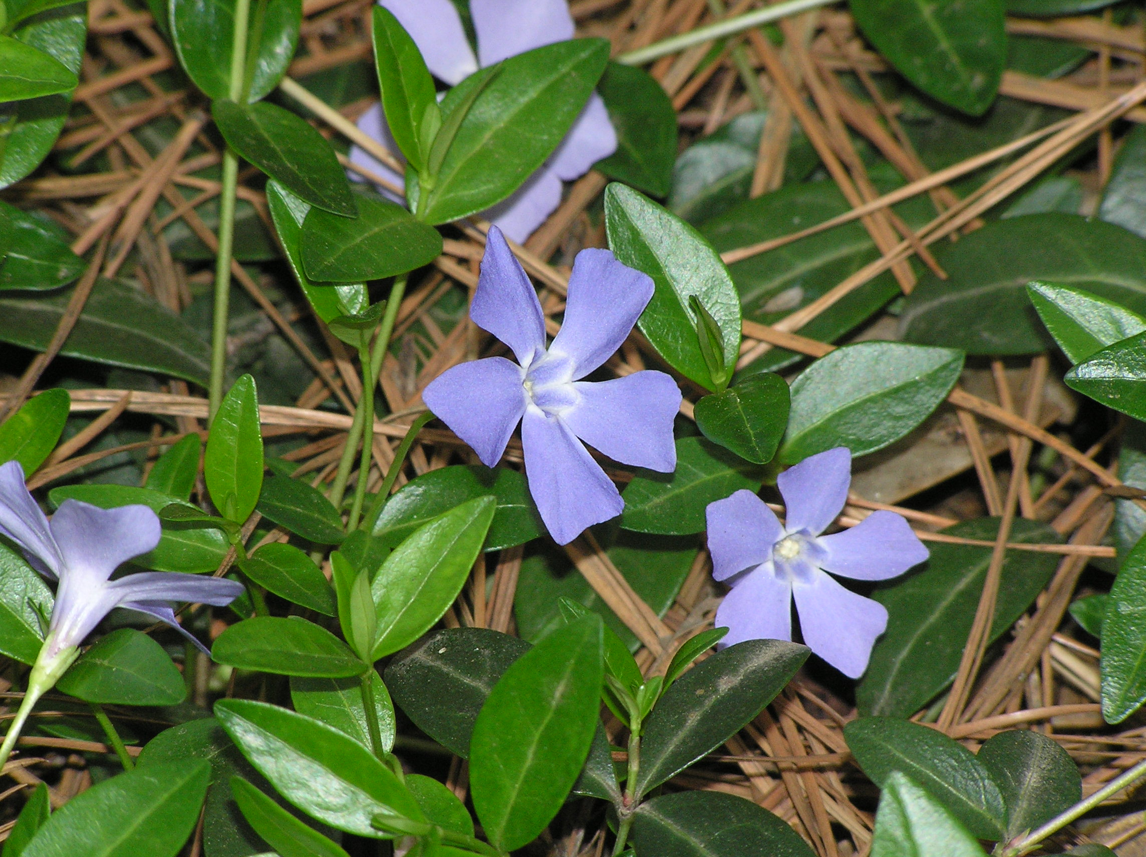
Background
Finnegan's Wake by James Joyce
Book 3: Episode 3
disemvowelled
wordplay: periwhelker = periwinkle
how about?
Nnn ttt wrd? (Not a word)
Dmn ttt thg. (Damn that thing)
clemsonhgic.wpengine.com/

Slide 24
Background
https://www.nytimes.com/2018/12/29/style/vowels-no-more.html
tech companies like Tumblr and Flickr arrived on the scene, dropping e’s both for distinctiveness and because the altered names made it easier to trademark, claim domain names on the internet and conduct other practical business.

Slide 25
Homework 6: Part 2
Read https://en.wikipedia.org/wiki/Disemvoweling
Part A:
write a Perl program to remove vowels a, e, i, o, u from words typed into the command line. (Don't worry about y.)
Hint: use split, read the documentation (see next slide)
Possible template for your program (see slide ahead)
Example:
perl hw6.perl quick brown fox
qck brwn fx

Slide 26
Homework 6: Part 2
https://perldoc.perl.org/functions/split

Slide 27
Homework 6: Part 2
File: hw6.perl
Simple Recipe (but not resulting in the shortest program)
Take each word from the command line, e.g. rabbit
Split it into characters, e.g. r a b b i t
for each character, print it if it's not a vowel
at the end of a word, print a space
at the end of all the words, print a newline
Could make use of hash %vowel:
suppose $char is a consonant or a vowel, what happens with $vowel{$char} ?

Slide 28
Homework 6: Part 2
Part B:
Modify your program for part A to not delete leading vowels
Example:
If a sentence is unreadable
f sntnc s nrdbl (leading vowels deleted)
If a sntnc is unrdbl (more legible)

Slide 29
Homework 6
Email to me: sandiway@arizona.edu
Subject: 438/538 Homework 8: YOUR NAME
Submit code and example runs in one PDF file
submit partial code if you cannot complete it
Due Sunday midnight: reviewed next Tuesday

