Slide 1
LING/C SC/PSYC 438/538
Lecture 30
Sandiway Fong

Slide 2
Announcements
Homework 14 graded
Please fill out the class survey! Response rate 62.07%
538 Presentations contd.

Slide 3
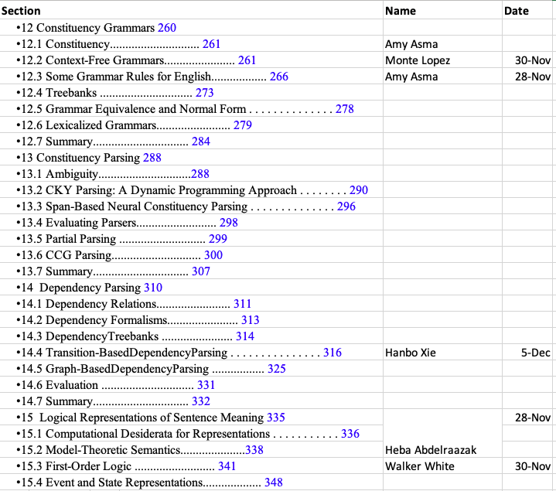
538 Presentations

Slide 4
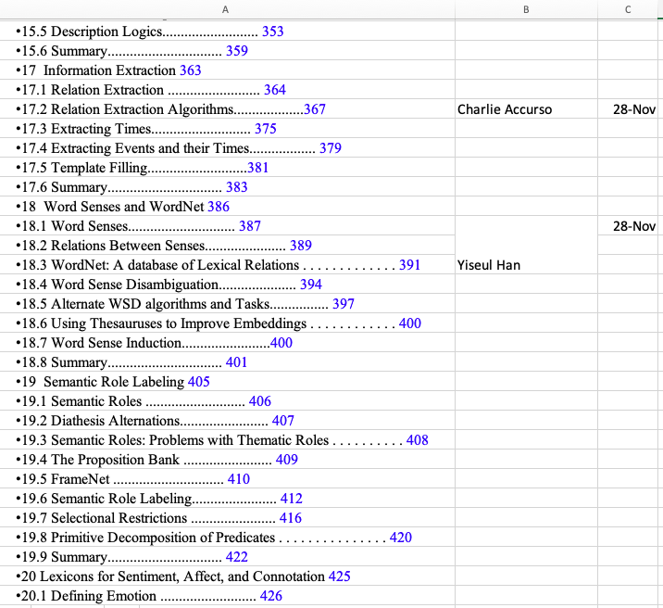
538 Presentations

Slide 5
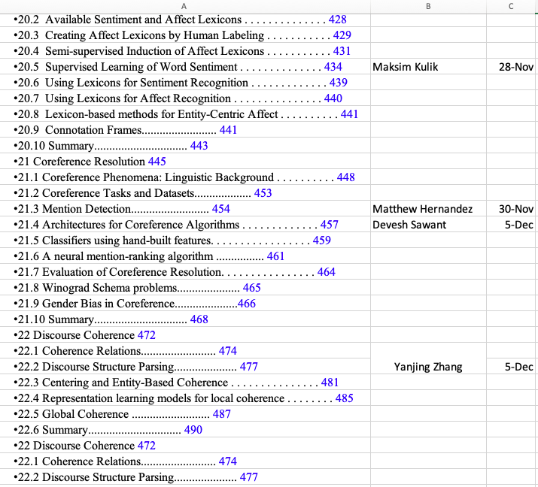
538 Presentations

Slide 6
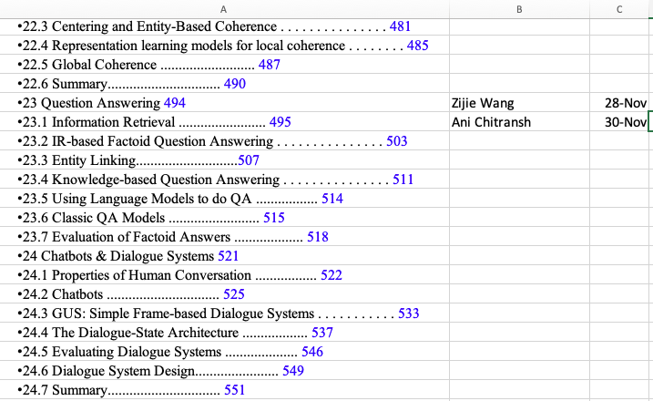
538 Presentations

