Slide 1
LING/C SC/PSYC 438/538
Lecture 2
Sandiway Fong

Slide 2
Administrivia
Do you have Perl and Python3 installed on your computer?
That was Homework 2
Please try to have it ready by next week!

Slide 3
Today's Lecture
Chapter 1 of JM Reading:
That was Homework 1. A brief quiz today. End of lecture.
Introduction
Sentence analysis

Slide 4
Language and Computers
We’d like computers to be smart about language
there's plenty of training data around
feed AI/machine learning, make the machines learn by themselves
pass the Turing Test, but not be too smart?
HAL 9000 in 2001: A Space Odyssey

Slide 5
Assistive Technology: point-by-point subtitles
The subtitles in this stream are brought by "robot play-by-play broadcast". It is automatically generated by computers using data provided by the organizer of the event. The contents may differ from the actual live voice coverage.
⇠ subtitle

Slide 6
Assistive Technology: Zoom transcript
Alt Text

Slide 7
Harder task: names (CC)
banner vanderbogo
round the ball

Slide 8
Harder task: names (CC)
Mathieu van der Poel
matthew vanderbald
vanderbolt

Slide 9
Language and Computers
(Un)fortunately, we’re not quite there yet…
still a gap between what computers can do and what we want them to be able to do
Often quoted (but never verified):
"The spirit is strong, but the flesh is weak" was translated into
Russian and then back to English, the result was
"The vodka is good, but the meat is rotten."
but with Google translate or babelfish, it’s not difficult to find (funny) examples…

Slide 10
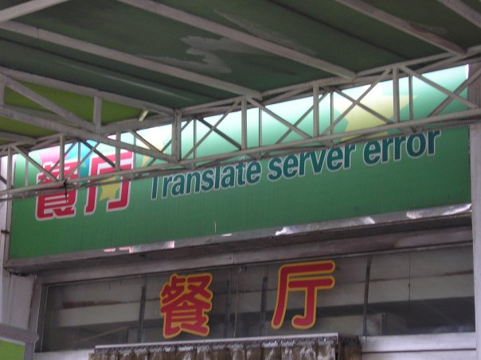
Language and Computers
and how can we tell if the translation is right anyway?
http://fun.drno.de/pics/english/only-in-china/TranslateServerError.jpg
Notes:
餐廳 餐厅

Slide 11
Applications
ChatGPT dialog sentences are natural and grammatical
a pretty big achievement IMHO
but even if we are willing to pay...
machine translation has been worked on since after World War II
still not perfected today
why?
what are the properties of human languages that make it hard?

Slide 12
Language and Computers
We can exploit the recursive nature of language …

Slide 13
Language and Computers
Obama: "At a certain point, I've just concluded that for me personally it is important for me to go ahead and affirm that I think same-sex couples should be able to get married."
Is this sentence complicated? Why?

Slide 14
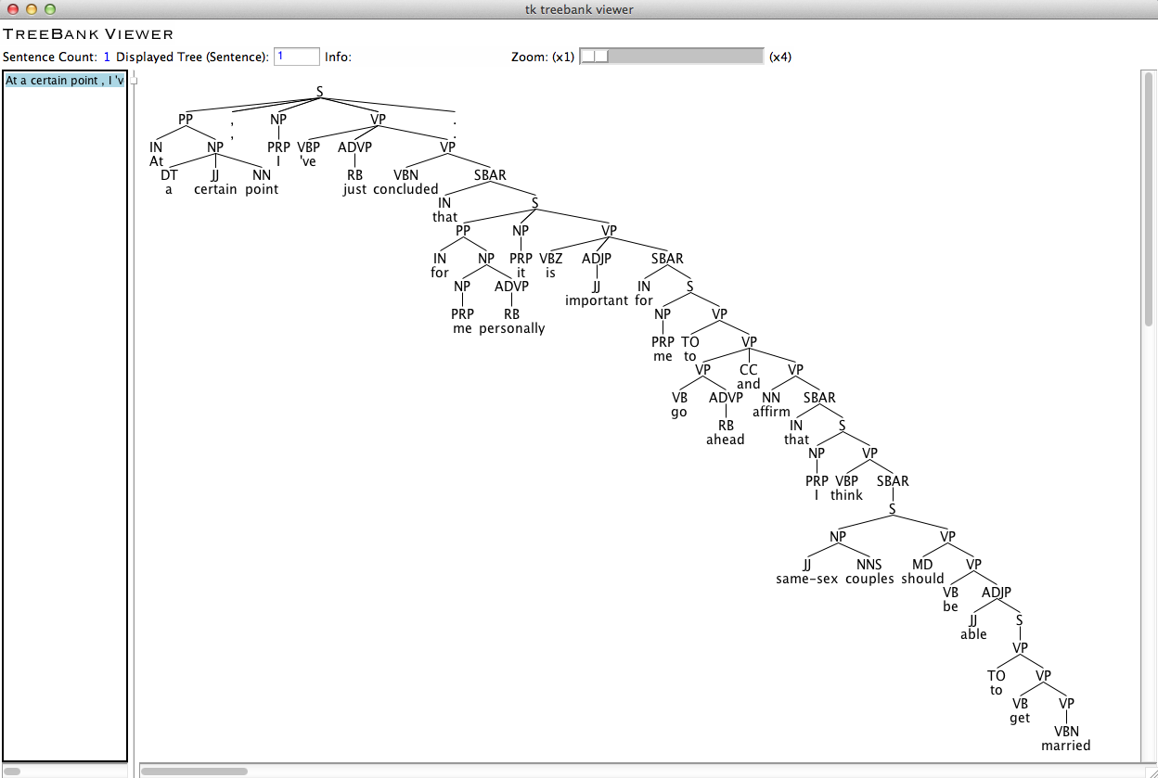
Language and Computers
It's cool that computer programs
can (correctly) diagram this long
sentence!

Slide 15
Language and Computers
Executive
Summarization

Slide 16
Language and Computers
Obama: "At a certain point, I've just concluded that for me personally it is important for me to go ahead and affirm that I think same-sex couples should be able to get married."
Obama: "At a certain point, I've just concluded that for me personally it is important for me to go ahead and affirm that I think same-sex couples should be able to get married."
Most summarizer programs can't do this …

Slide 17
Language and Computers

Slide 18
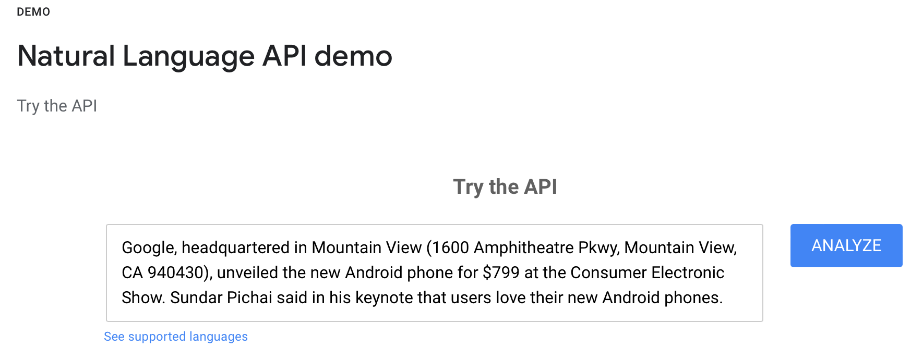
Language and Computers
Natural language parsers
Let's get some idea of what these (popular) systems produce.
Sadly, all once had an easily accessible working demo page:
Stanford Parser (deprecated? Try https://corenlp.run)
Berkeley Parser (deprecated? B. Neural Parser: https://parser.kitaev.io)
Google Natural Language (https://cloud.google.com/natural-language)

Slide 19
Language and Computers
http://nlp.stanford.edu:8080/parser/
You can download the code.
Server no longer up and running.

Slide 20
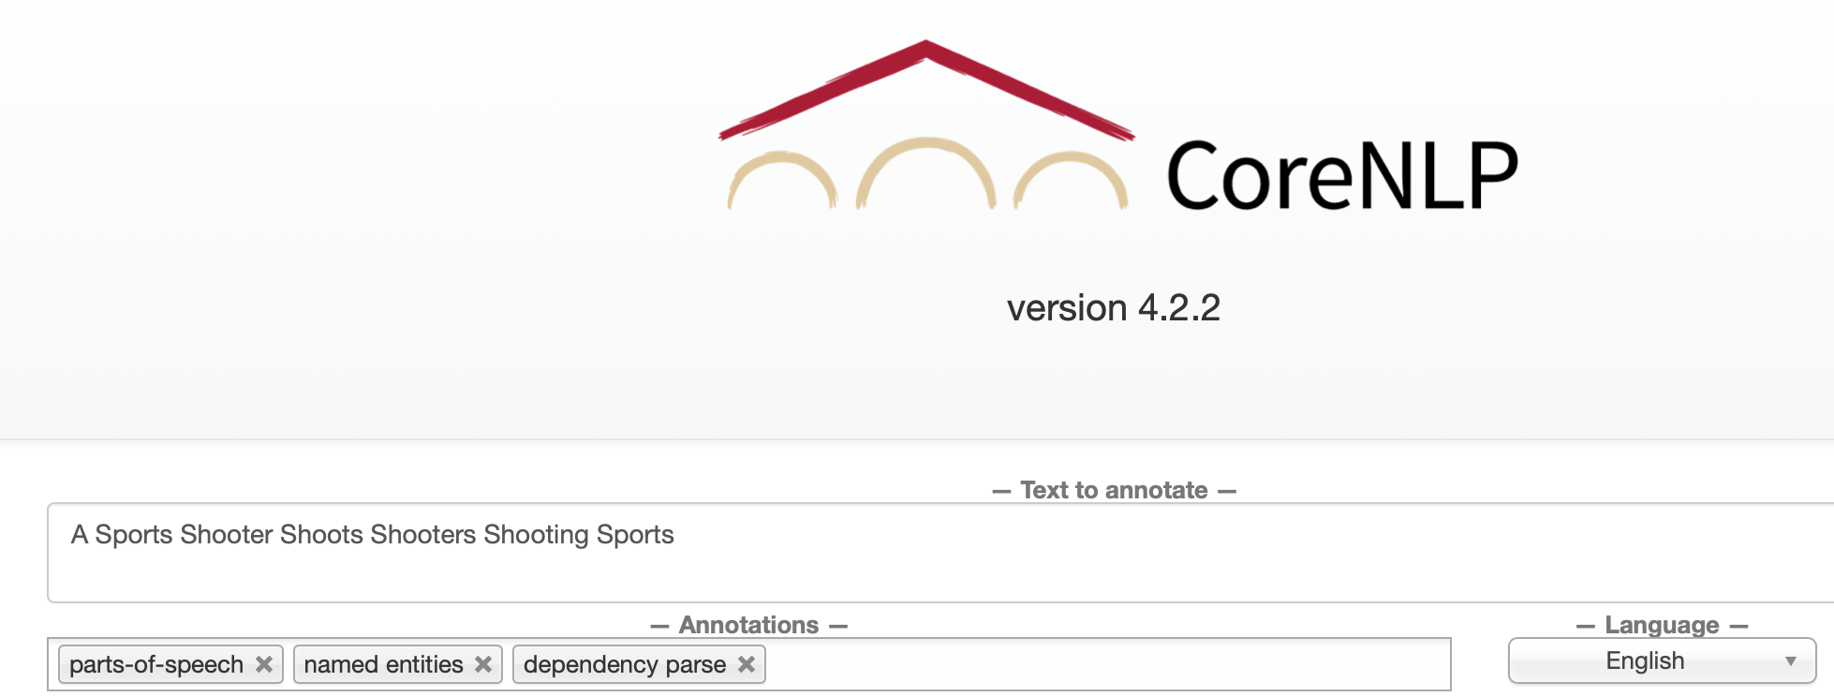
Language and Computers
Natural language parsers
Stanford CoreNLP
Java-based
Demo!
(https://corenlp.run)

Slide 21
Language and Computers
Natural language parsers
(Stanford) Stanza
Python-based (CoreNLP)
Demo!
http://stanza.run

Slide 22
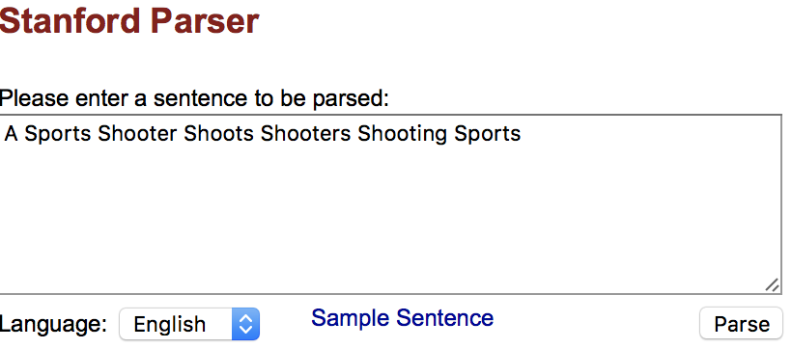
Language and Computers
Stanford parser http://nlp.stanford.edu:8080/parser/index.jsp
Part of Speech Tagging:
DT = determiner; NNP = Proper Noun; NNPS = Plural Proper Noun;
VBZ = Verb 3rd Person Singular Present; VBG = Verb Gerund Form

Slide 23
Language and Computers
Syntax (Constituency-based):
Constituents:
FRAG = Fragment (of a sentence)
S = Sentence, NP = Noun Phrase, VP = Verb Phrase
Parts of Speech:
DT Determiner, NNP Proper Noun, NNPS Plural Proper Noun.

Slide 24
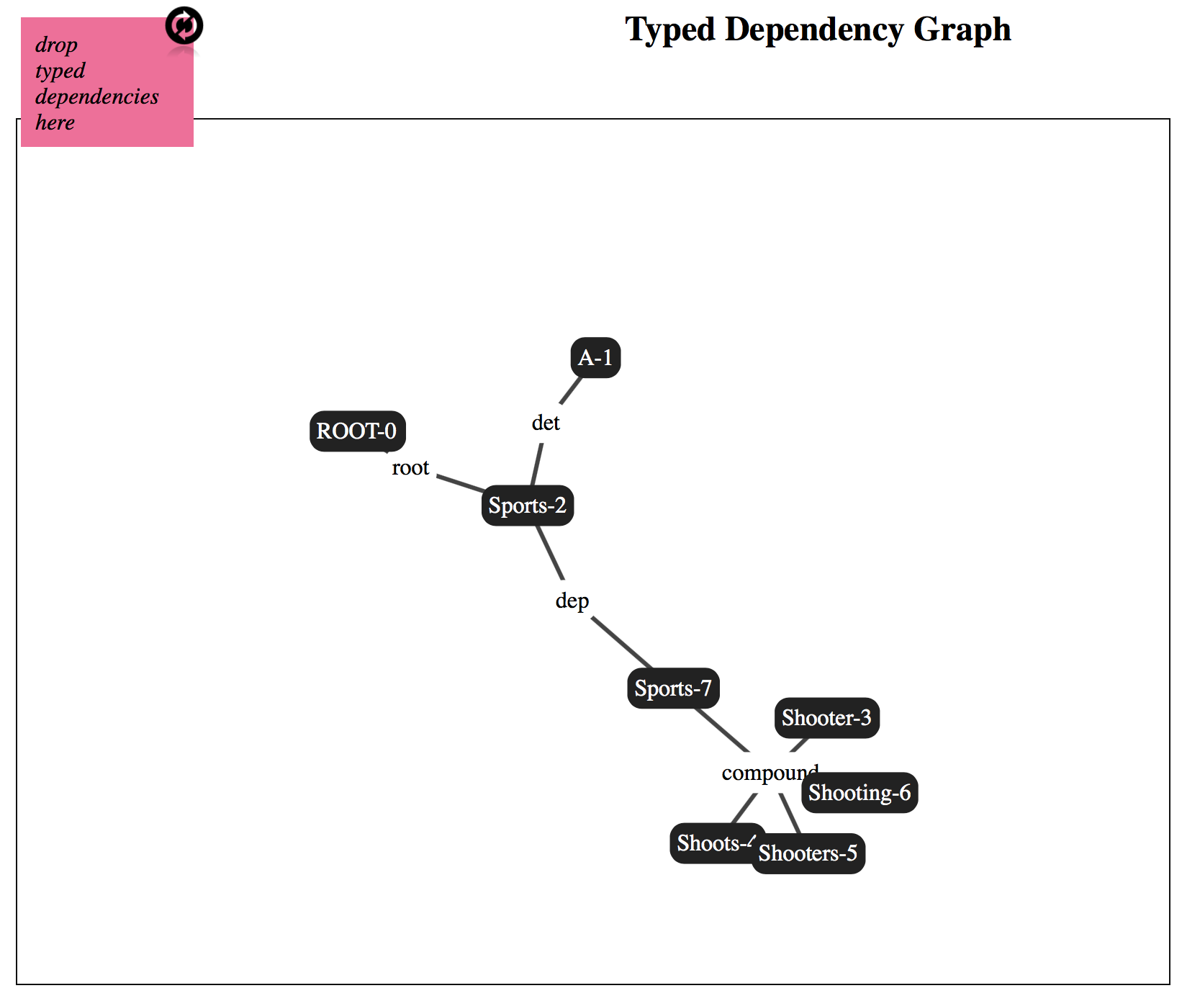
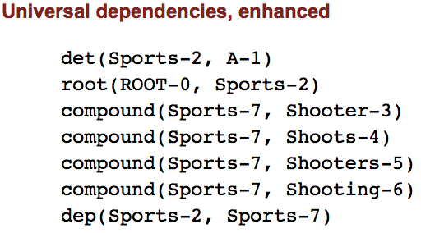
Language and Computers
Syntax (Dependencies):
RELATION(depends-on, dependent)

Slide 25
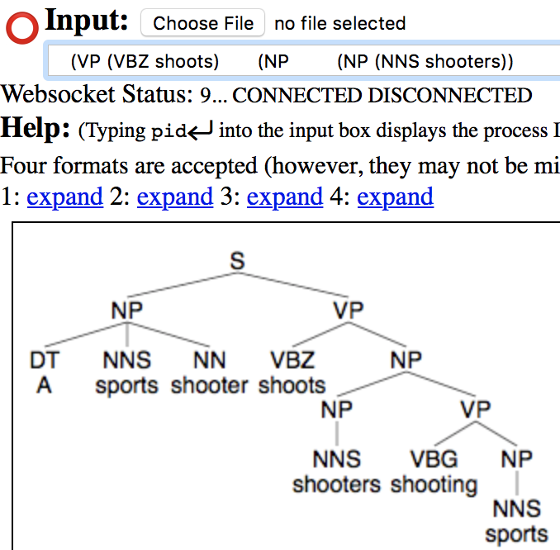
Language and Computers
FRAG = Fragment (of a sentence)
S = Sentence
NP = Noun Phrase
VP = Verb Phrase

Slide 26
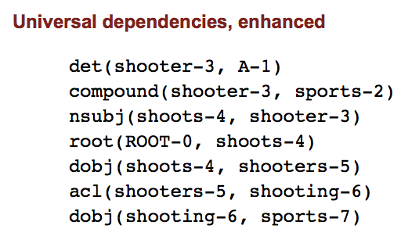
Language and Computers
acl: clausal modifier of noun (adjectival clause)
nsubj: nominal subject
dobj: direct object

Slide 27
Language and Computers
Berkeley Parser (downloadable, but no longer available online)
http://tomato.banatao.berkeley.edu:8080/parser/parser.html

Slide 28
Language and Computers
Berkeley Parser
http://tomato.banatao.berkeley.edu:8080/parser/parser.html
This one is available
Berkeley Neural Parser
https://parser.kitaev.io
FRAG = Fragment (of a sentence)
S = Sentence
NP = Noun Phrase
VP = Verb Phrase

Slide 29
Language and Computers
https://cloud.google.com/natural-language

Slide 30
Language and Computers
https://universaldependencies.org/u/dep/index.html

Slide 31
Homework 3: Quick Quiz Questions
(Knowledge of) Semantics — knowledge of meaning
What is the difference between a picture of John and a picture of John's?
Which is right? A) a friend of John, B) a friend of John's, or C) both
Which is right? A) a friend of mine, B) a friend of me, or C) both
Which is right? A) a friend of hers, B) a friend of her, or C) both
Which is right? A) glass of water, B) water's glass, C) both
What is the difference between at the water's edge and at the edge of water? Or no difference.
We say some input is ambiguous if multiple, alternative linguistic structures can be built for it.
Is Caesar's murder ambiguous? Explain.

Slide 32
Homework 3
Email to sandiway@arizona.edu
By Friday midnight
SUBJECT: 438/538 Homework 3: YOUR NAME
Either Plain Text or PDF accepted (no Word files please)

