Slide 1
LING/C SC/PSYC 438/538
Lecture 14
Sandiway Fong

Slide 2
Today's Topics
Predicate-Argument Structure contd.
  Framenet: verbs and their semantic roles
  Stanford CoreNLP: dependency parses
Homework 9

Slide 3
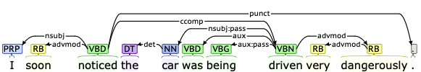
Background: CoreNLP
Examples (from Framenet):
  [_{Cognizer}I] soon NOTICED [_{Phenomenon} the car was being driven very dangerously] .
Verb (VBD) = noticed, Cognizer = nsubj, Phenomenon = ccomp
Verb(VBN) = driven, Vehicle = nsubj:pass
root
VERB(NSUBJ, CCOMP)
noticed(I, driven(…))
VERB(NSUBJ, NSUBJ:PASS)
driven(Driver?, car)

Slide 4
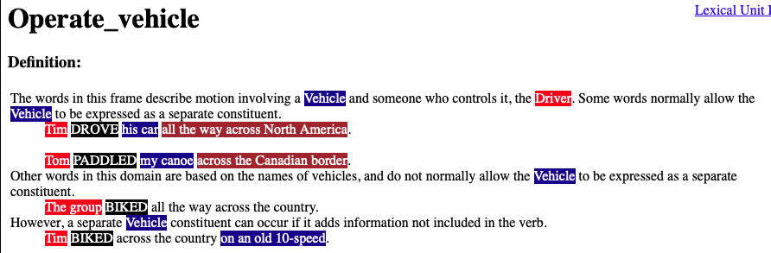
Background: Framenet: drive

Slide 5
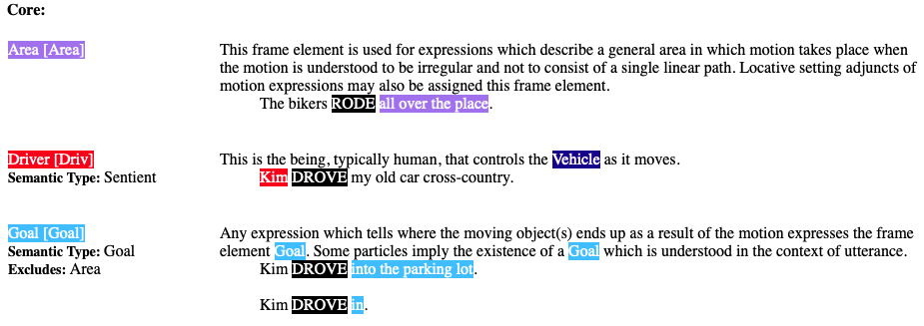
Background: Framenet: drive

Slide 6
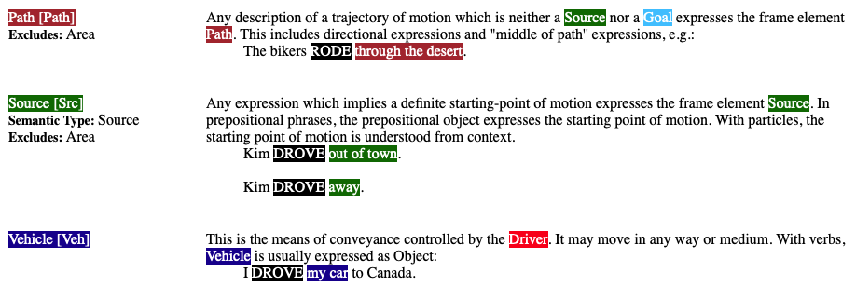
Background: Framenet: drive

Slide 7
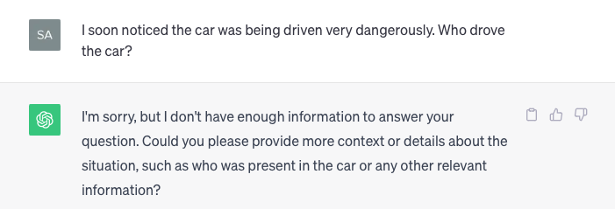
ChatGPT

Slide 8
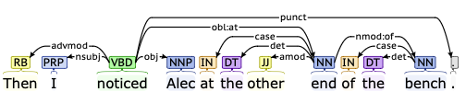
Background: CoreNLP
Examples (from Framenet):
  Then [_{Cognizer}I] NOTICED [_{Phenomenon}Alec] [_{Ground}at the other end of the bench] .
root
VERB(NSUBJ, OBJ)
noticed(I, Alec)
event(e, noticed) &
cognizer(e, I) &
phenomenon(e, Alec) &
ground(e, other end of the bench)

Slide 9
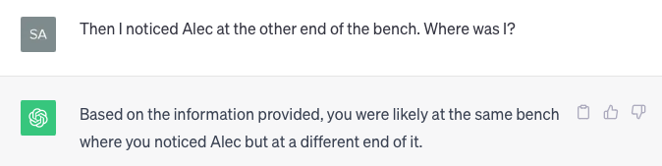
ChatGPT

Slide 10
Background: Stanford Dependencies
Some definitions you may find useful https://nlp.stanford.edu/software/dependencies_manual.pdf
  ccomp: clausal complement
  A clausal complement of a verb or adjective is a dependent clause
  dobj: direct object
  The direct object of a VP is the noun phrase which is the (accusative) object of the verb.
  iobj: indirect object
  The indirect object of a VP is the noun phrase which is the (dative) object of the verb.
  nsubj: nominal subject
  A nominal subject is a noun phrase which is the syntactic subject of a clause.
  rcmod: relative clause modifier
  A relative clause modifier of an NP is a relative clause modifying the NP. The relation points from the head noun of the NP to the head of the relative clause, normally a verb.
  vmod: reduced non-finite verbal modifier
  A reduced non-finite verbal modifier is a participial or infinitive form of a verb heading a phrase (which may have some arguments, roughly like a VP).

Slide 11
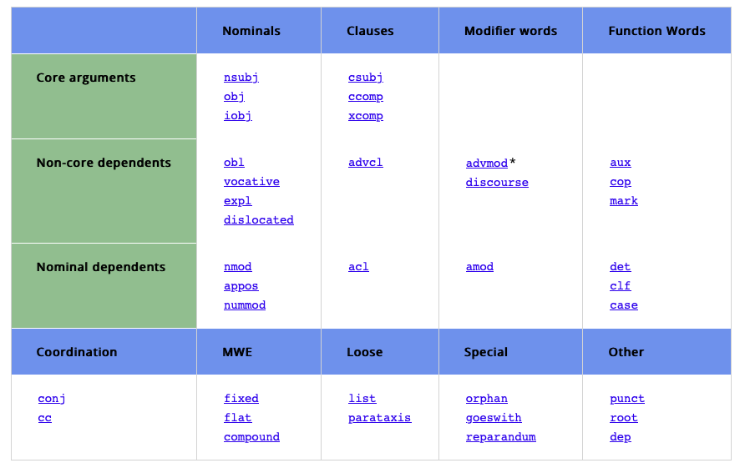
Background: Universal Dependencies
https://universaldependencies.org/u/dep/index.html

Slide 12
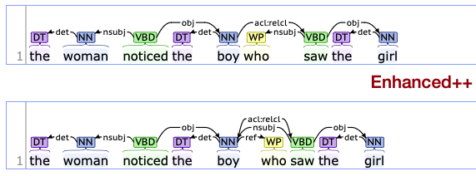
Background: CoreNLP
Root: noticed(woman, boy)
ACL:RELCL points back to NOUN boy
ACL:RELCL/VERB(NSUBJ/PRON, OBJ)
We infer saw(boy, girl)

Slide 13
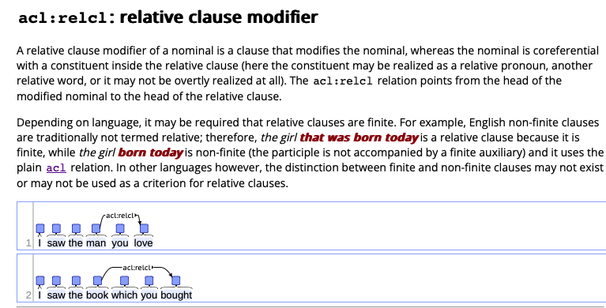
Background: Universal Dependencies
acl = adnominal clause (basically, a sentence that modifies a noun)

Slide 14
Homework 9
Question 1: We will compute predicate-argument structure using Perl regex with recursively embedded subject relative clauses:
  the woman encountered the boy
  the woman encountered the boy who encountered the girl
  the woman encountered the boy who encountered the girl who found the man
  the woman encountered the boy who encountered the girl who found the man who chased the cat
You can assume fixed expression the noun for noun phrases (NPs) and who for the relative pronoun. Also for simplicity, you may assume exactly one space between words.

Slide 15
Homework 9
Write a Perl program using a regex to compute the predicate-argument relations for sentences 1-4 and print them.
Examples:
  the woman encountered the boy
  encountered(woman, boy)
  the woman encountered the boy who encountered the girl
  encountered(woman, boy)
  encountered(boy, girl)
etc.

Slide 16
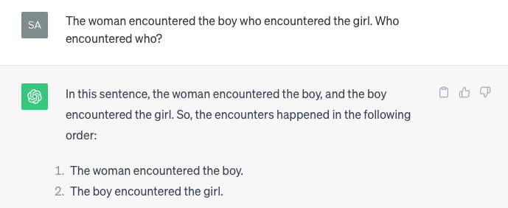
Homework 9: ChatGPT

Slide 17
Homework 9
Code should be general, i.e. you can swap out the verbs and common nouns etc., and it should still work.
For simplicity, you may assume the patterns:
  the noun₁ verb the noun₂ ➠ verb(noun₁, noun₂)
  the noun₁ who verb the noun₂ ➠ verb(noun₁, noun₂)
Hints:
  note the pattern overlap, use lookahead (?=pattern)
  Recommend you write a Perl program (not a one-liner)
  Input taken from the command line
  you can collect the words together on the command line into a single string with $sentence = qq/@ARGV/;

Slide 18
Homework 9
Examples:
$ perl hw9.perl the woman encountered the boy
encountered(woman, boy)
$ perl hw9.perl the woman encountered the boy who encountered the girl who found the man
encountered(woman, boy)
encountered(boy, girl)
found(girl, man)
$ perl hw9.perl the woman encountered the boy who encountered the girl who found the man who chased the cat
encountered(woman, boy)
encountered(boy, girl)
found(girl, man)
chased(man, cat)

Slide 19
Homework 9
Question 2: consider a second type of embedded relative clauses.
Examples:
  the woman discovered the boy the girl encountered
  the woman discovered the boy the girl the man found encountered
  the woman discovered the boy the girl the man the cat chased found encountered
Explain the differences between sentences in 5–7 from Q2 vs. 2–4 from Q1 with respect to:
  predicate-argument structure, and
  the relative pronoun.

Slide 20
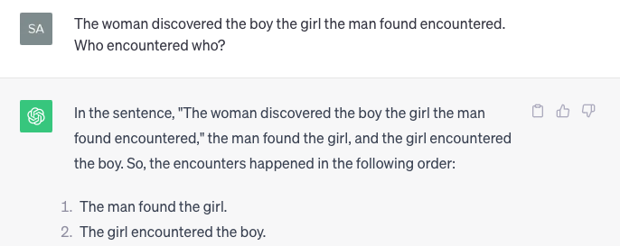
Homework 9: ChatGPT

Slide 21
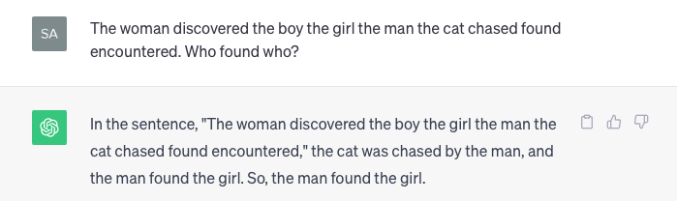
Homework 9: ChatGPT

Slide 22
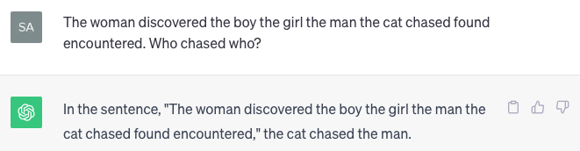
Homework 9: ChatGPT

Slide 23
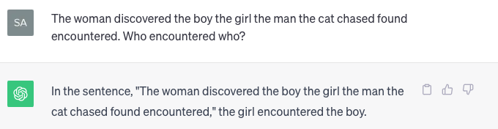
Homework 9: ChatGPT

Slide 24
Homework 9
Question 3: try CoreNLP on the sentences with relative clauses from Q2.
  the woman discovered the boy the girl encountered
  the woman discovered the boy the girl the man found encountered
  the woman discovered the boy the girl the man the cat chased found encountered
Which one(s) does/do CoreNLP get wrong or are they all correct?
As a human processor, which of 5–7 do you find difficult to parse?

Slide 25
Background: Universal Dependencies
https://universaldependencies.org/u/dep/index.html

Slide 26
Homework 9
Extra Credit Question 4:
  based on what we've learnt so far, do you think it's possible to write a Perl regex program that prints the correct predicate-argument structure for the examples from Q2?

