Slide 1
LING/C SC/PSYC 438/538
Lecture 13
Sandiway Fong

Slide 2
Today's Topic
Homework 8 Review
Last Time:
two ways of inserting Perl code into regex
s/regex/code/e
(?{code})
More on powerful features in Perl regex:
lookahead
lookbehind
Predicate-Argument Structure
preparing you for Thursday's Homework 9
Framenet
Stanford CoreNLP

Slide 3
Homework 8 Review
In the real world, i.e. with real datasets, we can't be absolutely sure:
we matched everything we want (Recall ratio)
we don't have spurious matches (Precision ratio)
we can't even know what the overall Precision/Recall is
but we can get a sample estimate

Slide 4
Homework 8 Review
Question 1a:
in English, names typically begin with an Upper case letter. Other characters may be lower/upper case or include a hyphen/dash (-), e.g. ABC-CDE.
Write a regex and find all the matching words in the article. How many are there?
Code:
perl -le 'open $f, "pandora.txt"; while (<$f>) {while (/\b[A-Z][A-Za-z-]*\b/g) {print $&}}' | wc -l
1097
Permit single letter names? If not, \b[A-Z][A-Za-z-]+\b
Gets more than named entities: words at the start of sentence: e.g. The
Doesn't get names beginning with lowercase letter, e.g. al-XYZ, de or bin.

Slide 5
Homework 8 Review
https://www.thefashionlaw.com

Slide 6
Homework 8 Review
Question 1b: last lecture we mentioned use of
open qw(:std :utf8);
Find the differences in the words reported when running your code with this declaration.
Hint: you may want to think about [A-Za-z-] vs [\w-]
Code:
perl -le 'use open qw(:std :utf8); open $f, "pandora.txt"; while (<$f>) {while (/\b[A-Z][A-Za-z-]*\b/g) {print $&}}' | wc -l
1092 (vs. 1097: Alem Erdo O Piau R)
perl -le 'use open qw(:std :utf8); open $f, "pandora.txt"; while (<$f>) {while (/\b[A-Z][\w-]*\b/g) {print $&}}' | wc -l
1097
Alemán Erdoğan Oštro Piauí Rönesans

Slide 7
Homework 8 Review
Question 1c:
do all name words begin with an Upper case letter? Find two that don't.
al-Zayanis
Zayed bin Rashid al-Zayani
Helena de Chair
then-President
1MDB
maybe others?

Slide 8
Homework 8 Review
Question 2:
abbreviations/acronyms often consist of words, #letters ≥2, containing only Upper case letters, possibly with periods separating them,
e.g. TV, US, U.S., TASS.
Write a regex for this. How many are there?
Code:
perl -le 'open $f, "pandora.txt"; while (<$f>) {while (/\b[A-Z\.]{2,}\b/g) {print $&}}' | wc -l
90
Gets uppercase words too:
WANT MORE STORIES THAT ROCK THE WORLD

Slide 9
Homework 8 Review
Question 3:
many named entities are n-grams, n≥2, a sequence of words:
e.g. Al Mawarid Bank, British Prime Minister Tony Blair
each beginning with an Upper case letter, optionally beginning with a title with leading capitalization:
e.g. Mr(s), Ms, Dr, (Prime) Minister, President or King/Queen (of).
e.g. King of Jordan
Write a regex and find all the matching sequences (#words ≥2). Print them. How many are there?
Code:
perl -le 'use open qw(:std :utf8); open $f, "pandora.txt"; while (<$f>) {while (/\b[A-Z][\w-]*((\s+of)?\s+[A-Z][\w-]*)+/g) {print $&}}' | wc -l
221
Jackal of Zacapa / House of Commons

Slide 10
Homework 8 Review
The Pandora Papers
King of Jordan
Czech Republic
British Prime Minister Tony Blair
Russian President Vladimir Putin
United States
French Riviera
Czech Republic
Great Plains
United States
King of Jordan
Arab Spring
Pandora Papers
The International Consortium of Investigative Journalists
Pandora Papers
An ICIJ
British Virgin Islands
Paris-based Organization
Economic Cooperation
WANT MORE STORIES THAT ROCK THE WORLD
The Pandora Papers
Sachin Tendulkar
Claudia Schiffer
Fat One
Sachin Tendulkar
Claudia Schiffer Image
Getty Images
Raffaele Amato
United Kingdom
The Pandora Papers
Pandora Papers
British Virgin Islands
Morgan Stanley
A Morgan Stanley
The Pandora Papers
Baker McKenzie
Baker McKenzie
Ihor Kolomoisky
Baker McKenzie
Jho Low
Baker McKenzie
Hong Kong
Baker McKenzie
Baker McKenzie
The Pandora Papers
Panama Papers
The Panama Papers
Mossack Fonseca
The Pandora Papers
The Pandora Papers
The Washington Post
The Guardian
Radio France
Oštro Croatia
Indian Express
The Standard
Le Desk
Diario El Universo
Persian Gulf
South China Sea
The Pandora Papers
British Virgin Islands
King Abdullah II
King Abdullah II
Jordan Pix
Getty Images
Middle East
Annelle Sheline
Middle East
Pandora Papers
Najib Mikati
Hassan Diab
Riad Salameh
Marwan Kheireddine
Al Mawarid Bank
Pandora Papers
Al Mawarid Bank
Wafaa Abou Hamdan
Imran Khan
Panama Papers
The Panama Papers
Nawaz Sharif
The Guardian
Panama Papers
Pandora Papers
Chaudhry Moonis Elahi
Pandora Papers
Kenyan President Uhuru Kenyatta
Czech Prime Minister Andrej Babis
Czech Prime Minister Andrej Babis
Stefan Wermuth
Getty Images
Chateau Bigaud
In February
Tony Blair Institute
Global Change
Labour Party
West Midlands
The Pandora Papers
British Virgin Islands
The London
Cherie Blair
Cherie Blair
Middle East
The Blairs
Cherie Blair
Robert Palmer
Tax Justice UK
The Guardian
In June
Paulo Guedes
The Pandora Papers
Dreadnoughts International Group
British Virgin Islands

Slide 11
Homework 8 Review
Revista Piauí
In December
Some Bahamian
Latin American
South Dakota
Dominican Republic
Vice President Carlos Morales Troncoso
Sioux Falls
South Dakota
South Dakota
South Dakota
The Pandora Papers
South Dakota
Trident Trust Co
Sioux Falls
South Dakota
Salwan Georges
The Washington Post
South Dakota
The U
New York-based
The U
Cayman Islands
South Dakota
South Dakota
Susan Wismer
Adam Hofri-Winogradow
Pandora Papers
The Washington Post
Federico Kong Vielman
Kong Vielman
Sioux Falls
Carlos Manuel Arana Osorio
Jackal of Zacapa
Guatemala City
President Jimmy Morales
Kong Vielman
Pasion River
Nacional Agro Industrial SA
Kong Vielman
South Dakota
Latin American
South Dakota
Guillermo Lasso
South Dakota
South Dakota
South Dakota
Corporate Transparency Act
Yehuda Shaffer
The U
Billionaire Erman Ilicak
The Turkish
Rönesans Holding
Recep Tayyip Erdoğan
Ayse Ilicak
British Virgin Islands
Pandora Papers
Covar Trading Ltd
Covar Trading
Pandora Papers
The American
Robert F
Robert T
Glenn Godfrey
A U
Neither CILTrust
Nicos Chr
Pandora Papers
Cyprus President Nicos Anastasiades
Leonid Lebedev
The Cypriot
Alexander Abramov
President Putin
Theophanis Philippou
Another Russian
Pandora Papers
Konstantin Ernst
Russian TV
Konstantin Ernst
Artyom Geodakyan
Getty Images
The Pandora Papers
Winter Olympics
Mae Buenaventura
Ferdinand Marcos
The Marcos
An ICIJ
Mossack Fonseca
Panama Papers
Jacob Rees-Mogg
British Conservative Party
House of Commons
The Pandora Papers
Mossack Fonseca
Iqbal Memon
New Delhi
Pandora Papers
Juan Andres Donato Bautista
Presidential Commission
Good Government
British Virgin Island
Panama Papers
The Philippines
President Rodrigo Duterte
Alexander Abramov
Countering America
Adversaries Through Sanctions Act

Slide 12
Homework 8 Review
Question 4:
using the Perl hash table described in a previous lecture, re-do Question 3 and collect together mentions of named entities, e.g. Baker McKenzie occurs multiple times. Then print names and number of occurrences in tabular form.
Code:
perl -le 'use open qw(:std :utf8); open $f, "pandora.txt"; while (<$f>) {while (/\b[A-Z][\w-]*((\s+of)?\s+[A-Z][\w-]*)+/g) {$ne{$&}++}}; for (sort {$ne{$b} <=> $ne{$a}} (keys %ne)) {print "$_, $ne{$_}"}'

Slide 13
Homework 8 Review
South Dakota, 14
Pandora Papers, 13
The Pandora Papers, 13
Baker McKenzie, 6
British Virgin Islands, 6
Panama Papers, 5
Getty Images, 4
The Washington Post, 3
The Guardian, 3
Cherie Blair, 3
Middle East, 3
The U, 3
Mossack Fonseca, 3
Sioux Falls, 3
Kong Vielman, 3
King Abdullah II, 2
King of Jordan, 2
An ICIJ, 2
Latin American, 2
United States, 2
Czech Republic, 2
Konstantin Ernst, 2
Sachin Tendulkar, 2
Alexander Abramov, 2
Al Mawarid Bank, 2
Czech Prime Minister Andrej Babis, 2
The Panama Papers, 2
Pasion River, 1
Mae Buenaventura, 1
Oštro Croatia, 1
Carlos Manuel Arana Osorio, 1
Adam Hofri-Winogradow, 1
Hassan Diab, 1
Iqbal Memon, 1
Jacob Rees-Mogg, 1
Radio France, 1
The Cypriot, 1
Annelle Sheline, 1
A Morgan Stanley, 1
Ayse Ilicak, 1
Najib Mikati, 1
British Virgin Island, 1
Le Desk, 1
Yehuda Shaffer, 1
Nicos Chr, 1
In February, 1
Ihor Kolomoisky, 1
Arab Spring, 1
The Philippines, 1
Artyom Geodakyan, 1
Adversaries Through Sanctions Act, 1

Slide 14
Regex Lookahead and Lookbehind
We've already seen some zero-width regexs:
^ (start of string)
$ (end of string)
\b (word boundary)
matches the imaginary position between \w\W or \W\w, or just before beginning of string if ^\w, just after the end of the string if \w$
zero-width because position of match (so far), pos, doesn't change!
(?=regex) (lookahead from current position)
(?<=regex) (lookbehind from current position)
(?!regex) (negative lookahead)
(?<!regex) (negative lookbehind)

Slide 15
Lookahead (and lookbehind)
lookbehind for pattern
negative lookbehind for pattern

Slide 16
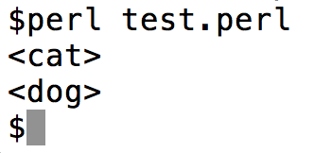
Regex Lookahead and Lookbehind
Example:
looks for a word beginning with _ such that
there is a duplicate ahead (without the _ )
(?= ..) means lookahead

Slide 17
Regex Lookahead and Lookbehind
Some restrictions apply:
lookbehind (in most versions of Perl) cannot be of variable length
From perlretut:
Lookahead can match arbitrary regexps,
but lookbehind prior to 5.30 (?<=fixed-regexp)only works for regexps of fixed width, i.e., a fixed number of characters long. Thus (?<=(ab|bc)) is fine, but (?<=(ab)*) prior to 5.30 is not.

Slide 18
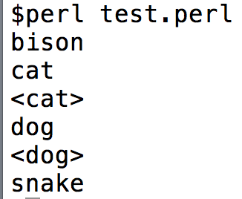
Debugging Perl regex
(?{ Perl code }) can be inserted anywhere in a regex
can assist with debugging
Example:

Slide 19
Regex Lookahead and Lookback
/(?<!bar)foo/

Slide 20
Background
Background stuff you should familiar yourself with …
Predicate-argument structure
Stanford CoreNLP

Slide 21
Background
Predicate-Argument Structure (typically for verbs)
Example
John saw/noticed the javelina
notice(experiencer, theme) or see(experiencer, theme)
John noticed that Mary saw the javelina
notice(perceiver, proposition) 1st argument: subject, 2nd argument: direct object
the cat chased the mouse
chase(agent, theme) 1st argument: subject, 2nd argument: direct object
the mouse was chased by the cat (passivization)
*John was jogged for an hour (*passivization)
John jogged for an hour (intransitive)
jog(agent)

Slide 22
Background
Different representations exist in the literature.
Simple:
John saw/noticed the javelina
notice(experiencer, theme)
Neo-Davidsonian:
event(e) & experiencer(e, John) & theme(e, javelina)

Slide 23
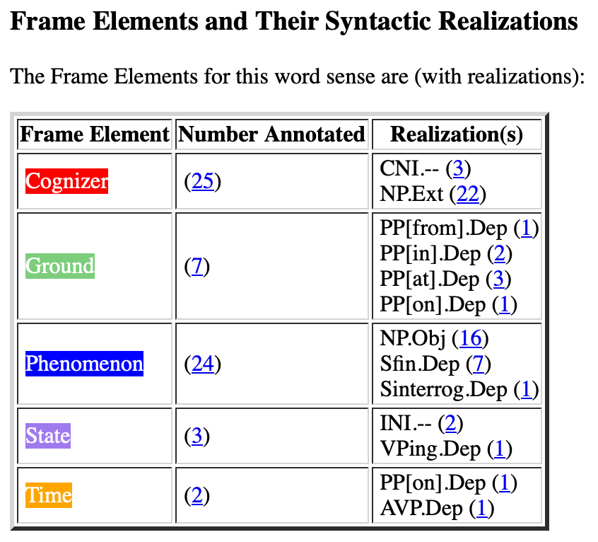
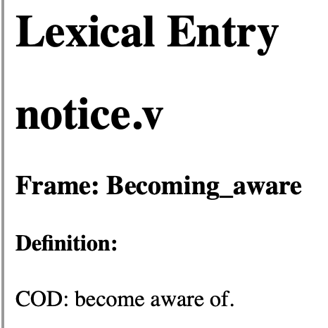
Background
Framenet
https://framenet.icsi.berkeley.edu/fndrupal/luIndex
Words in this frame have to do with a Cognizer adding some Phenomenon to their model of the world.
core
core

Slide 24
Background
Framenet Examples:
420-that-sfin
[_{Cognizer}I] soon NOTICED [_{Phenomenon}that the car was being driven very dangerously] .
Then off they went but [_{Cognizer}I] had NOTICED [_{Phenomenon}that Mrs Taylor was really crying] .
[_{Cognizer}You] will NOTICE that there is , [_{Ground}in the wording of that letter] , [_{Phenomenon}something curious] .
430-sfin
NOTICE [_{Phenomenon}the street names] [_{Ground}in the centre of Bristol] .[_{Cognizer}CNI]
[_{Cognizer}You] may NOTICE [_{Phenomenon}that food tastes different when you are pregnant] .
` I do n't suppose [_{Cognizer}anyone] will even NOTICE [_{Phenomenon}you 're not there] .
[_{Cognizer}Nobody] even NOTICED [_{Phenomenon}I was in the room !]
480-swh
On the way [_{Cognizer}he] NOTICED [_{Phenomenon}how quiet the school seemed] .
520-np-vping
` Did [_{Cognizer}you] NOTICE [_{Phenomenon}any knives] [_{State}lying about] ? "
570-np-ppabout
` I see [_{Cognizer}you] have NOTICED [_{Phenomenon}a certain peculiarity about my appearance .] "
570-np-ppat
When examining the wound , [_{Cognizer}I] NOTICED [_{Phenomenon}a dark area] [_{Ground}at each end of the cut] .
[_{Cognizer}Users of the main car park at Park Royal] will have NOTICED [_{Phenomenon}a new fence] [_{Ground}at the back of the site] .
Then [_{Cognizer}I] NOTICED [_{Phenomenon}Alec] [_{Ground}at the other end of the bench] .

Slide 25
Background
Lexical Units:
chance (across).v, chance (on).v, come (across).v, come (upon).v, descry.v, detect.v, discern.v, discover.v, discovery.n, encounter.v, espy.v, fall (on).v, find (oneself).v, find out.v, find.v, happen (on).v, learn.v, locate.v, note.v, notice.v, observe.v, perceive.v, pick up.v, recognize.v, register.v, spot.v, spy out.v, tell.v
Not present Perception_experience verbs:
detect.v, experience.n, experience.v, feel.v, hear.v, overhear.v, perceive.v, perception.n, see.v, sense.v, smell.v, taste.v, witness.v
Not present Perception_active verbs:
admire.v, attend.v, eavesdrop.v, eye.v, feel.v, gape.v, gawk.v, gaze.n, gaze.v, glance.n, glance.v, goggle.v, listen.v, look.n, look.v, observation.n, observe.v, palpate.v, peek.n, peek.v, peep.v, peer.v, savour.v, smell.v, sniff.n, sniff.v, spy.v, squint.v, stare.n, stare.v, taste.n, taste.v, view.v, watch.v

Slide 26
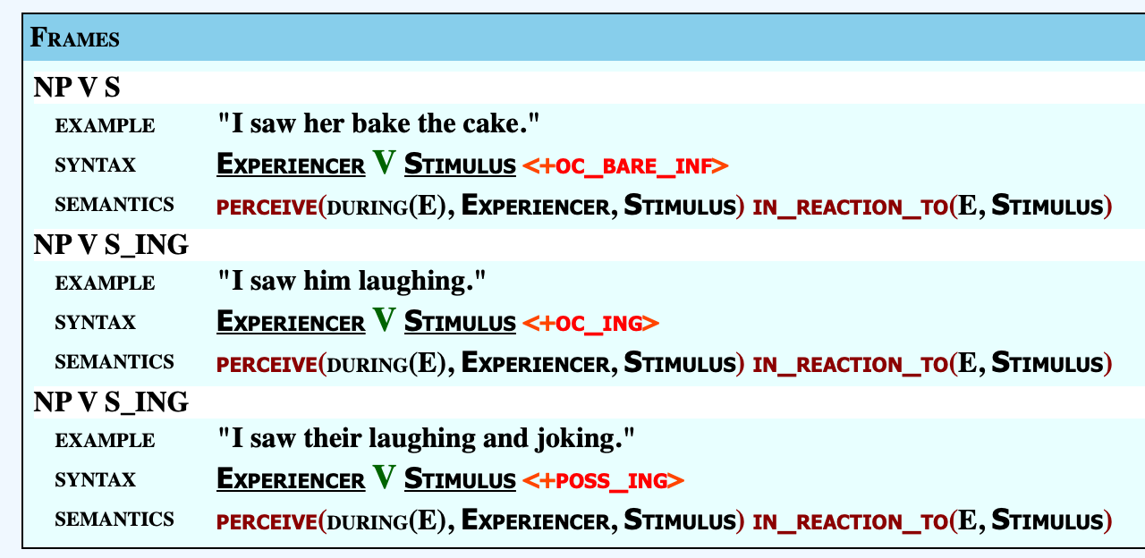
Background
Unified Verb Index
https://verbs.colorado.edu/verb-index/vn3.3/

Slide 27
Background: Propbank
Propbank:
• ARGn-PAG ... proto-agent • ARGn-PPT ... proto-patient

Slide 28
Background: Propbank
notice-v; 2 Senses
Sense Number 1: observe, perceive or become aware of something
Examples: Did you notice what he had in his hand? I noticed that he avoided mentioning her name. Mary waved at the man but he didn't seem to notice. Starting in 1987, scientists noticed large drops in the amount of phytoplankton. Her musical talent was first noticed by the critics at the age of 12.
Mappings: VerbNet: see-30.1-1-1 FrameNet: Becoming_aware PropBank: notice.01 WordNet 3.0 Sense Numbers: 1, 2, 4

Slide 29
Background: Propbank
notice-v; 2 Senses
Sense Number 2: bring to attention; give notice or announce
Examples: The Solicitor General noticed the court of a change in Justice Department police. The foundation noticed the Council of the new approach.
Mappings: VerbNet: NM FrameNet: NM PropBank: NM

Slide 30
Background
Predicate-Argument Structure (typically for verbs)
Example
*the librarian put the book
the librarian put the book on the table
put(agent, theme, location)
Mary gave John the textbook
*Mary gave John
give(agent, goal, theme)
Mary gave the textbook to John

Slide 31
Background: Framenet
give:
put:

Slide 32
Background: CoreNLP
http://corenlp.run
Defaults

Slide 33
Background: CoreNLP
Examples (from Framenet):
[_{Cognizer}I] soon NOTICED [_{Phenomenon} the car was being driven very dangerously] .
Then [_{Cognizer}I] NOTICED [_{Phenomenon}Alec] [_{Ground}at the other end of the bench] .
root
ROOT/VERB(NSUBJ, CCOMP)
noticed(I, driven(…))

Slide 34
Background: CoreNLP
Examples (from Framenet):
[_{Cognizer}I] soon NOTICED [_{Phenomenon} the car was being driven very dangerously] .
Then [_{Cognizer}I] NOTICED [_{Phenomenon}Alec] [_{Ground}at the other end of the bench] .
ROOT/VERB(NSUBJ, OBJ)
noticed(I, Alec)

Slide 35
Background: Stanford Dependencies
Some definitions you may find useful https://nlp.stanford.edu/software/dependencies_manual.pdf
ccomp: clausal complement A clausal complement of a verb or adjective is a dependent clause
dobj: direct object The direct object of a VP is the noun phrase which is the (accusative) object of the verb.
iobj: indirect object The indirect object of a VP is the noun phrase which is the (dative) object of the verb.
nsubj: nominal subject A nominal subject is a noun phrase which is the syntactic subject of a clause.
rcmod: relative clause modifier A relative clause modifier of an NP is a relative clause modifying the NP. The relation points from the head noun of the NP to the head of the relative clause, normally a verb.
vmod: reduced non-finite verbal modifier A reduced non-finite verbal modifier is a participial or infinitive form of a verb heading a phrase (which may have some arguments, roughly like a VP).

Slide 36
Background: Universal Dependencies
https://universaldependencies.org/u/dep/index.html

Slide 37
Background: CoreNLP
Root: noticed(woman, boy)
ACL:RELCL points back to NOUN boy
ACL:RELCL/VERB(NSUBJ/PRON, OBJ)
We infer saw(boy, girl)

Slide 38
Background: Universal Dependencies
acl = adnominal clause (basically, a sentence that modifies a noun)

