Slide 1
LING/C SC/PSYC 438/538
Lecture 10
Sandiway Fong

Slide 2
Today's Topics
Homework 7: a fun one
Perl regex

Slide 3
Digital advertising
Spectacular growth

Slide 4
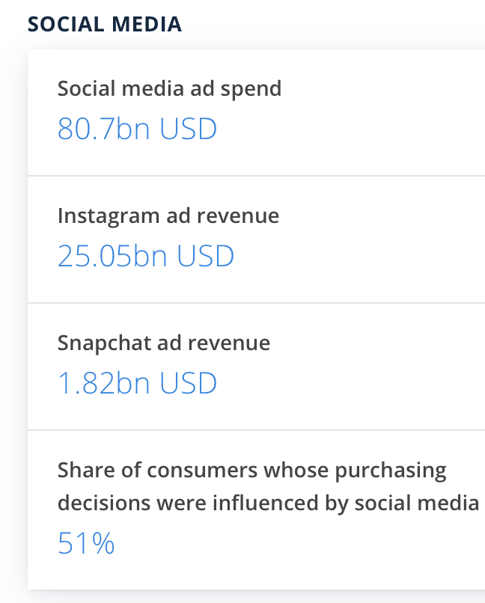
Digital advertising
www.statista.com

Slide 5
Digital advertising: biggest sellers
Revenue share
Facebook
Google
Note(s): United States; 2019
Further information regarding this statistic can be found on page 8.
Source(s): eMarketer; ID 237208
4

Slide 6
Digital advertising
digital ad fraud
click fraud
(bots)
Hidden ads: the user doesn't actually see it. This kind of fraud targets ad networks that pay based on impressions (views), not clicks.

Slide 7
Clickbait headlines: all about the curiosity gap
uses the word
revealed
without revealing
anything of note …

Slide 8
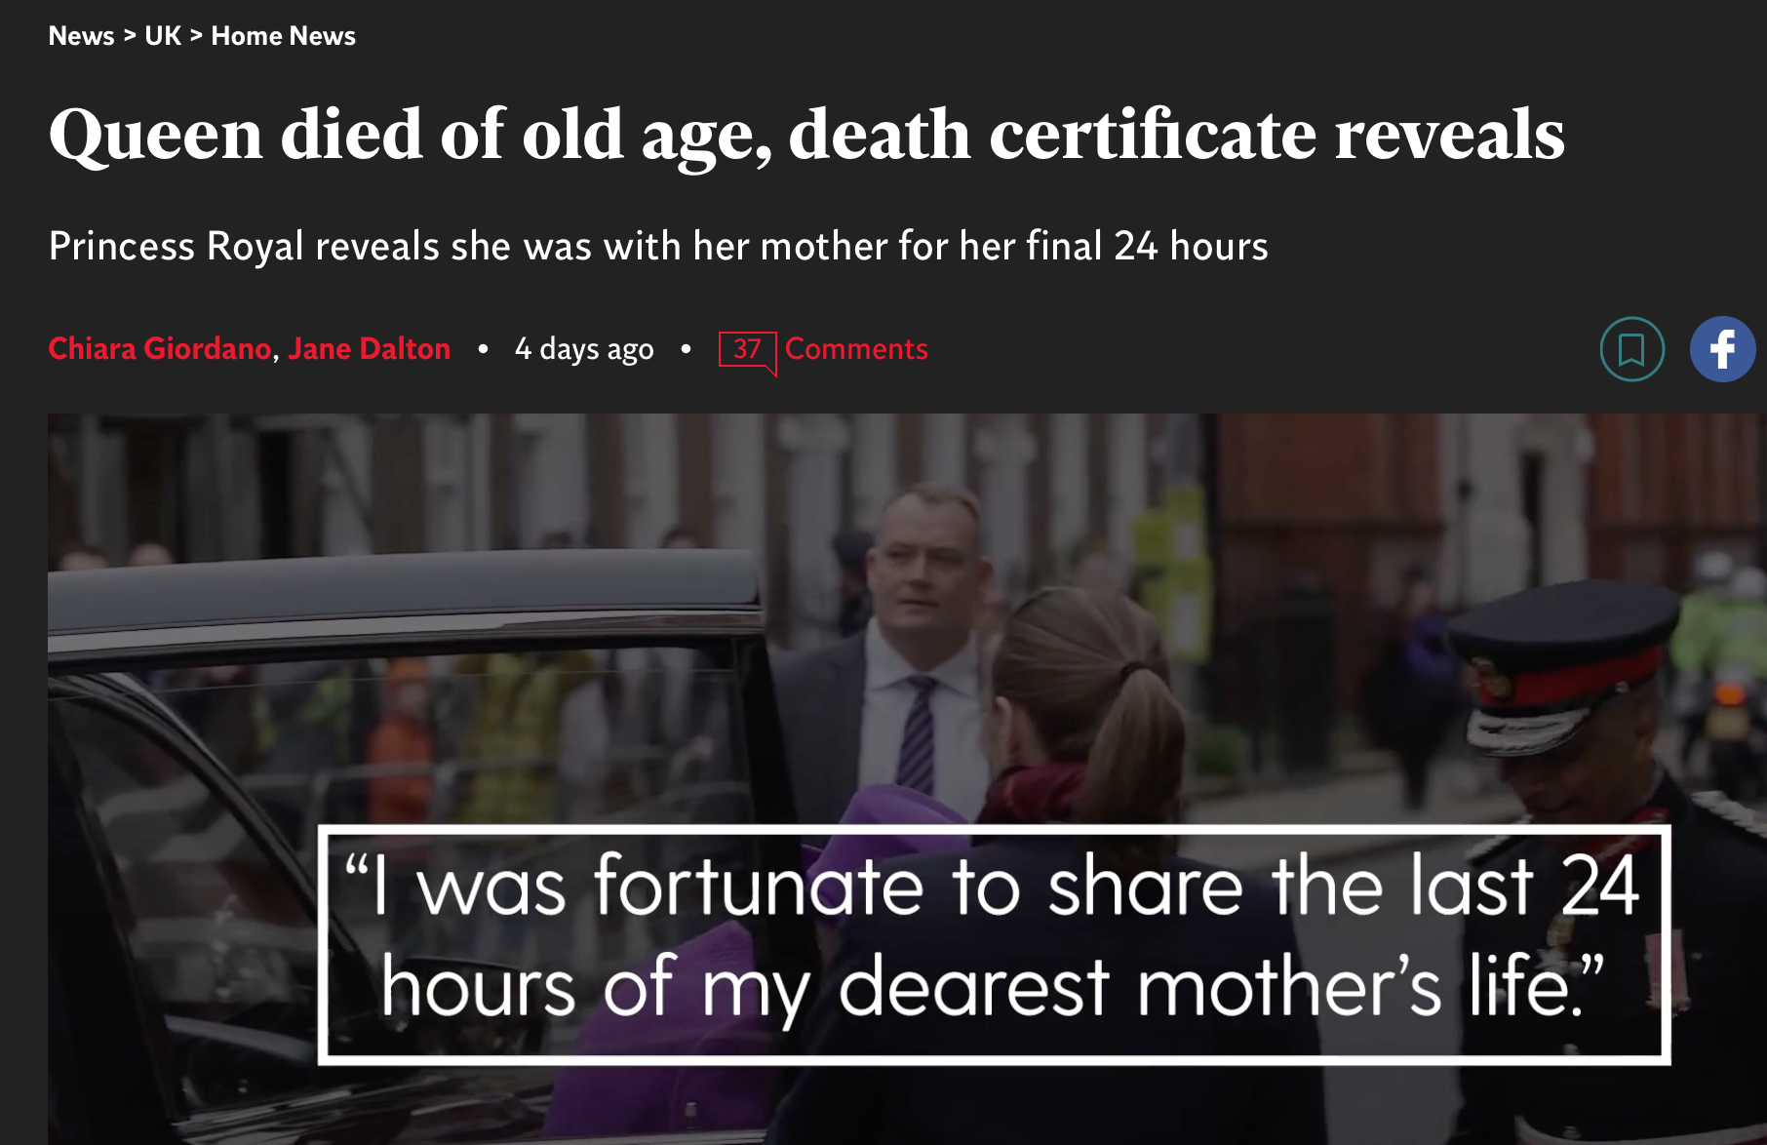
Clickbait headlines: all about the curiosity gap
The Independent:
https://www.independent.co.uk/news/uk/home-news/queen-elizabeth-death-age-cause-b2178021.html

Slide 9
Generally not clickbait
same newspaper

Slide 10
Clickbait headlines: all about the curiosity gap

Slide 11
Clickbait Example
Fannie Mae and Freddie Mac are government-sponsored entities (GSEs).
Fannie and Freddie don’t make loans themselves. Instead, they … [buy] mortgages from lenders and [package] them into bonds that are sold to investors with guarantees of interest and principal.
The GSEs are among the most profitable companies in the world.
https://www.americanbanker.com/articles/fannie-mae-freddie-mac-investors-fighting-profit-sweep-get-key-court-win

Slide 12
Clickbait Example
Easy answer

Slide 13
Clickbait Examples
Others:
Before you do X, read this.
You won't believe what X said (about Y).
The real reason why …
N ways to …
A statistically sensationalized headline ☞
etc.

Slide 14
Lots of recent interest on spotting clickbait
https://www.fastcompany.com/90649160/you-wont-read-this-life-changing-study-about-clickbait-headlines
2016

Slide 15
Homework 7
Visit mashable.com, vox.com and slate.com
Question 1: which site do you think is more clickbaity? Why?
Question 2: find 3 clickbait headlines
Carefully:
Explain why they are clickbait headlines.
Figure out the crucial missing information from the article.
Can text summarization help bridge the gap?
(Use Open Text Summarizer tool or Summarize on your Mac or any other summarization tool you can find.)
Propose a way that a computer program can figure whether the article should be flagged as clickbait. Or argue that it can't be done.

Slide 16
Regular Expressions to the rescue
https://xkcd.com/208/

Slide 17
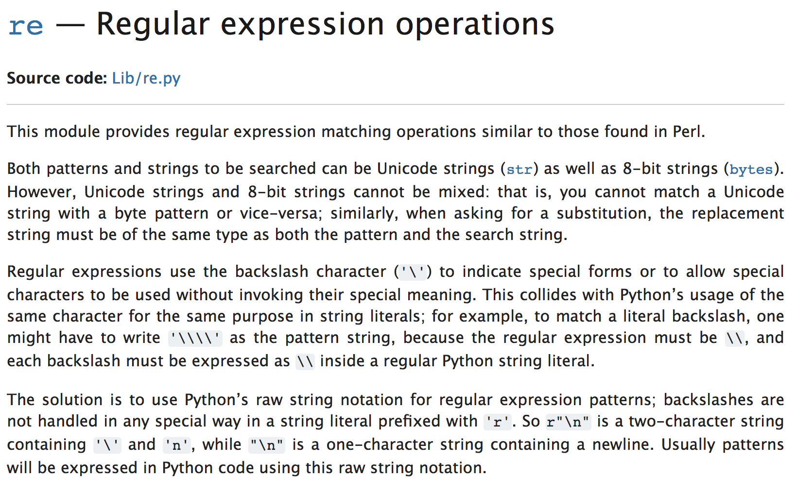
Perl regex
Python re
import re
slightly complicated string handling: use raw r'…' format
https://docs.python.org/3/library/re.html
(there's also a 3rd party regex module)

Slide 18
Perl regex
https://www.pcre.org

Slide 19
A regex from Hell
Email validation: RFC 5322 (Internet Message Format):
(?:[a-z0-9!#$%&'*+/=?^_`{|}~-]+(?:\.[a-z0-9!#$%&'*+/=?^_`{|}~-]+)*|"(?:[\x01-\x08\x0b\x0c\x0e-\x1f\x21\x23-\x5b\x5d-\x7f]|\\[\x01-\x09\x0b\x0c\x0e-\x7f])*")@(?:(?:[a-z0-9](?:[a-z0-9-]*[a-z0-9])?\.)+[a-z0-9](?:[a-z0-9-]*[a-z0-9])?|\[(?:(?:(2(5[0-5]|[0-4][0-9])|1[0-9][0-9]|[1-9]?[0-9]))\.){3}(?:(2(5[0-5]|[0-4][0-9])|1[0-9][0-9]|[1-9]?[0-9])|[a-z0-9-]*[a-z0-9]:(?:[\x01-\x08\x0b\x0c\x0e-\x1f\x21-\x5a\x53-\x7f]|\\[\x01-\x09\x0b\x0c\x0e-\x7f])+)\])
https://www.rfc-editor.org/rfc/rfc5322

Slide 20
Online regex tester
https://regex101.com

Slide 21
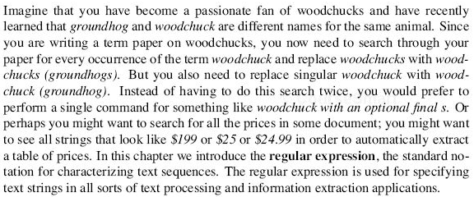
regex
Read JM textbook chapter 2: section 1 on regex (if you have it)

Slide 22
Perl regex
Read up on the syntax of Perl regular expressions
Online tutorials
http://perldoc.perl.org/perlrequick.html
http://perldoc.perl.org/perlretut.html

Slide 23
Perl regex
Perl regex matching:
$s =~ /foo/ (/…/ contains a regex)
can use in a conditional:
e.g. if ($s =~ /foo/) …
evaluates to true/false depending on what’s in $s
can also use as a statement:
e.g. $s =~ /foo/;
global variable $& contains the match
Examples:

Slide 24
Perl regex
Match is not exact:

Slide 25
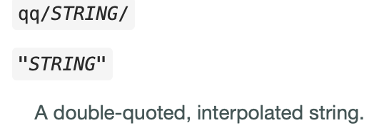
Perl regex
Perl regex match and substitute:
$s =~ s/foo/bar/
s/…match… /…substitute… / contains two expressions
will modify $s by looking for a single occurrence of match and replacing that with substitute
s/…match… /…substitute… /g global substitution
Examples:
https://perldoc.perl.org/perlop#Quote-Like-Operators

Slide 26
Perl regex
Most useful with template.perl for reading in a file line-by-line:
open($fh, $ARGV[0]) or die "$ARGV[0] not found!\n";
while ($line = <$fh>) {
$line =~ /…/
}
close($fh)
Or on the command line in abbreviated form as:
perl -le 'open $f, filename; while (<$f>) {while (/regex/g) {print $&}}'
Let’s practice this after we've introduced the notation …

Slide 27
Chapter 2: JM
spaces matter!
character class: Perl lingo

Slide 28
Chapter 2: JM
range: in ASCII table
backslash lowercase letter for class
Uppercase variant for all but class

Slide 29
Chapter 2: JM

Slide 30
Chapter 2: JM
Can use parentheses(…) to group around a sub-expression if > 1 char
e.g. (ab)* vs. ab*

Slide 31
Perl regex
Example: \S+ing\b
\s is a whitespace, so \S is a non-whitespace
+ is repetition (1 or more)
\b is a word boundary, (words are made up of \w characters)

Slide 32
Perl regex
\b or \b{wb}
Perl global variables set during regex matching:
other boundary metacharacters: ^ (beginning of line), $ (end of line)

Slide 33
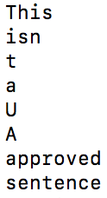
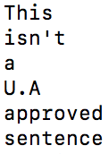
Perl regex: Unicode and \b
\b
\b{wb}
Note: global match in while-loop
Note: .*? is the non-greedy version of .*

Slide 34
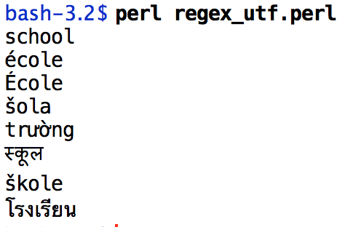
Perl regex: Unicode and \w
list context
\w is [0-9A-Za-z_]
Definition is expanded for Unicode:
use utf8;
use open qw(:std :utf8);
my $str = "school école École šola trường स्कूल škole โรงเรียน";
@words = ($str =~ /(\w+)/g);
foreach $word (@words) { print "$word\n" }
use pragma: https://perldoc.perl.org/open.html

Slide 35
Chapter 2: JM
Why is a backslash needed?
* means zero or more repetitions of the previous char/expr
. means any single character
? means previous char/expr is optional (zero or one occurrence)

Slide 36
Chapter 2: JM
Precedence of operators
Example: Column 1 Column 2 Column 3 …
/Column [0-9]+ */
/(Column [0-9]+ *)*/
/house(cat(s|)|)/ (| = disjunction; ? = optional)
Perl:
in a regular expression the pattern matched by within the pair of parentheses is stored in global variables $1 (and $2 and so on).
(?: … ) group but exclude from $n variable storage
Precedence Hierarchy:
space

Slide 37
Perl regex
Recall last lecture about time?
http://perldoc.perl.org/perlretut.html
returns 1 (true) or "" (empty if false)
A shortcut: list context for matching
returns a list

