Slide 1
408/508 Computational Techniques for Linguists
Lecture 9

Slide 2
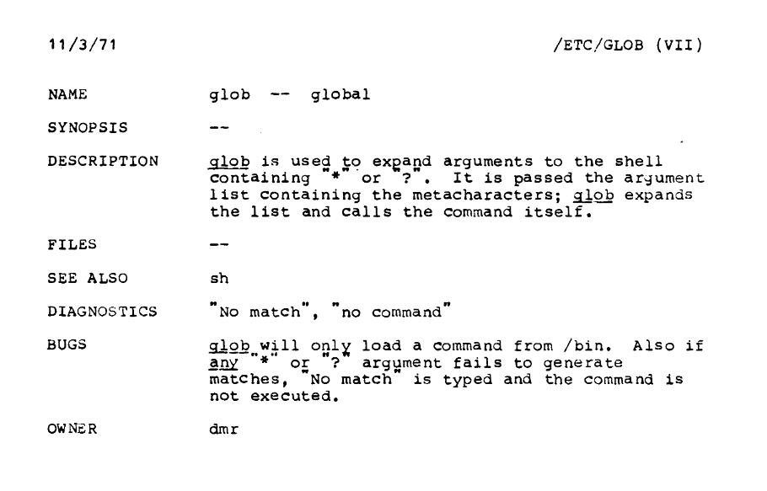
Today's Topics
Homework 4 review
A bit more Bash shell scripting (we'll finish this week)
  remember the cool thing is that you can test everything on the command line!
  deleting suffixes and prefixes, string manipulation
  loops
  cp (copy)
  positional parameters: $0, $1, $2 …
  filename expansion: globbing

Slide 3
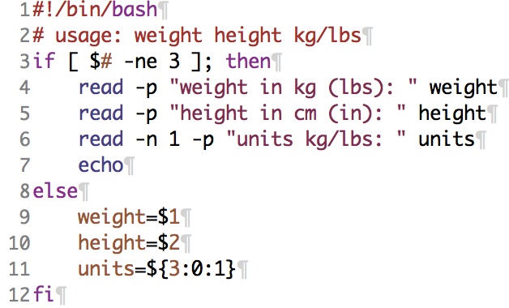
Homework 4 review
Notice variables weight, height and units
are set no matter whether the inputs come from command line arguments or the Terminal
$3 substring
(1st character)

Slide 4
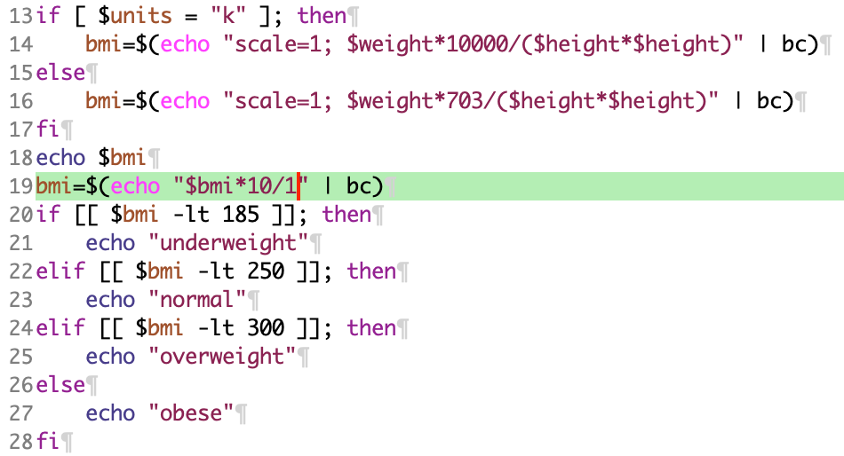
Homework 4 review
Recall Bash doesn't do floating point numbers, so scale by ten. Then 18.9 becomes 189.0. Then trick divide by 1 to get 189

Slide 5
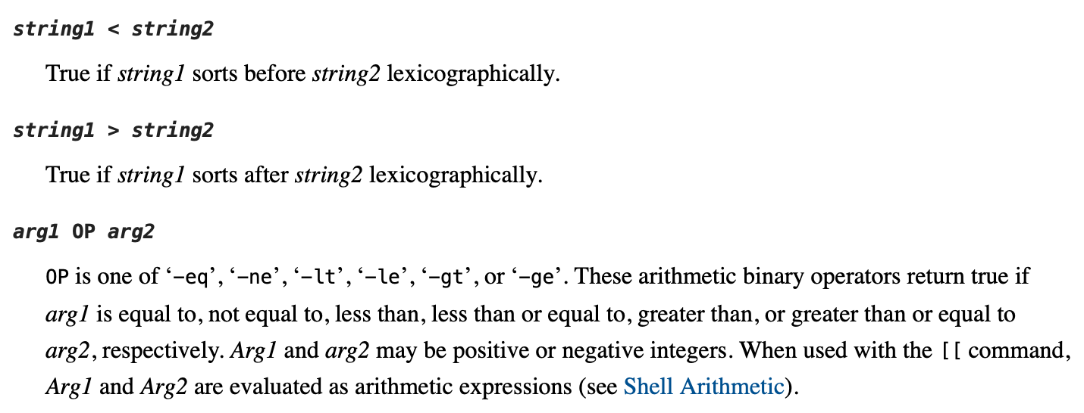
Homework 4 review
www.gnu.org/software/bash/manual/html_node/Bash-Conditional-Expressions.html
Note: incorrect to use < for arithmetic comparisons

Slide 6
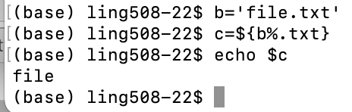
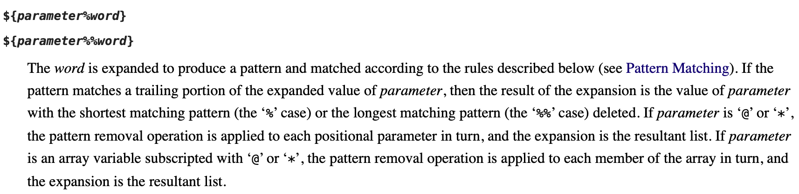
Delete Word Suffix
3.5.3 Shell Parameter Expansion
https://www.gnu.org/software/bash/manual/html_node/Shell-Parameter-Expansion.html#Shell-Parameter-Expansion

Slide 7
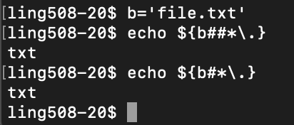
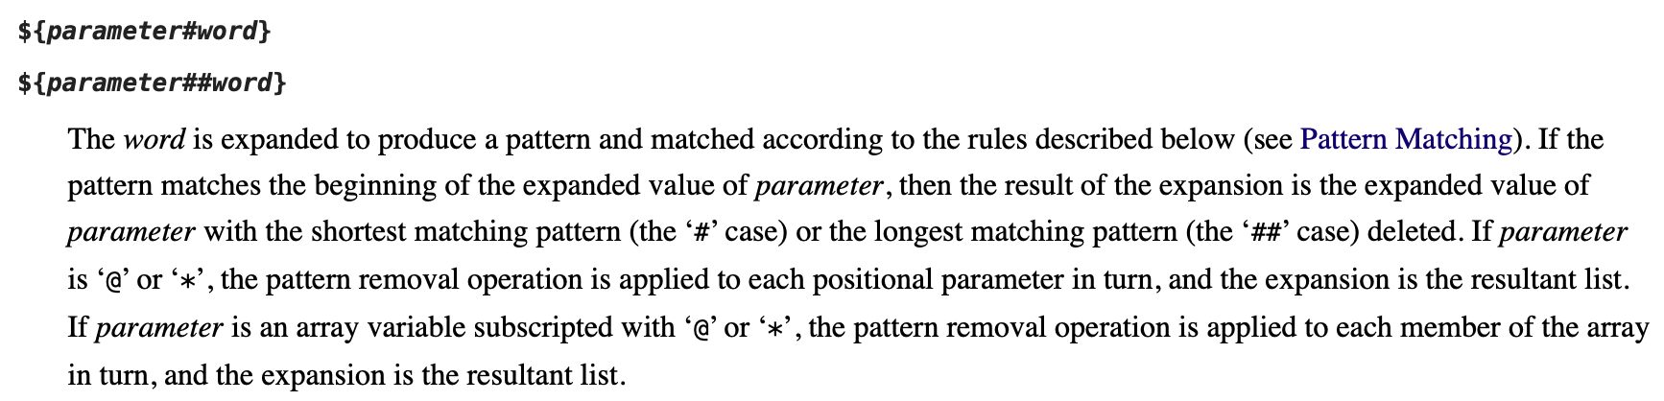
Delete Word Prefix

Slide 8
More string manipulation
String length:
  ${#var}
Substring:
  ${var:position} starting at position (0,1,2…), (-N) from the end
  ${var:position:length}
Delete prefix:
  ${var#substring} shortest match
  ${var##substring} longest match
Delete suffix:
  ${var%substring} shortest match
  ${var%%substring} longest match
Substring substitution:
  ${var/substring/replacement} replace first match
  ${var//substring/replacement} replace all matches
Prefix substitution: ${var/#substring/replacement}
Suffix substitution: ${var/%substring/replacement}
See 3.5.3 Shell Parameter Expansion
units=${3:0:1}
cp $file ${file%.*}.bak

Slide 9
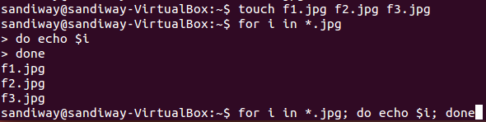
loops
For-loop:
  for VAR [in LIST]; do …; done
Example:
  create backup copies of files using cp (copy)
  (let's create a few empty .jpg files first using the touch command)
  for i in *.jpg; do echo $i ; done
  for i in *.jpg; do cp $i $i.orig ; done
touch f1.jpg f2.jpg f3.jpg
Brace expansion also possible:
touch f{1,2,3}.jpg

Slide 10
A note on cp (copy)
man cp
-p Cause cp to preserve the following attributes of each source file in the copy: modification time, access time, file flags, file mode, user ID, and group ID, as allowed by permissions.
EXAMPLES
Make a copy of file foo named bar:
$ cp foo bar
Copy a group of files to the /tmp directory:
$ cp *.txt /tmp
Copy the directory junk and all of its contents (including any
subdirectories) to the /tmp directory:
$ cp -R junk /tmp

Slide 11
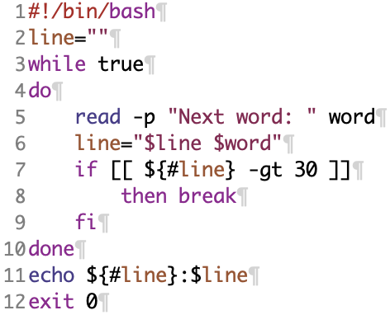
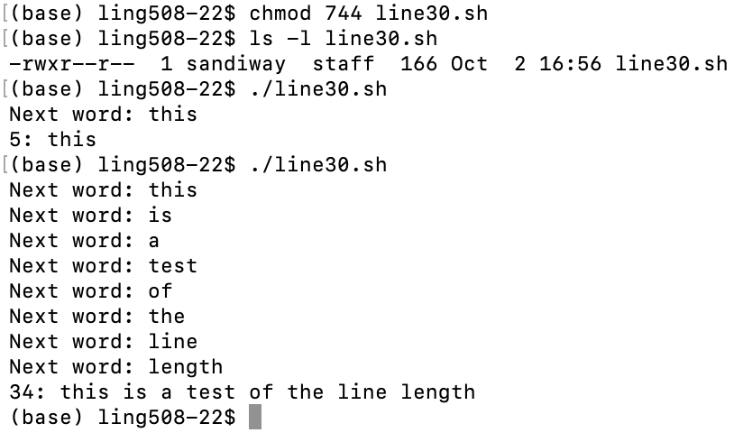
loops
until COND; do …; done
file: line30.sh
${#var} length of string stored in var
while-loop:
  while COND; do …; done
  break (out of while-loop)

Slide 12
Shell positional parameters
command line to script (or function):
  $0, $1, $2 etc. $1 = 1st parameter and so on, $0 = name of script
  $# number of parameters passed
  $* all parameters as a single word: a "b c" => a b c
  $@ each parameter is a quoted string
  shift removes one parameter (use with $#)
  ("…" quoted variables below just in case there are spaces in the values)
for arg in "$*"
do
echo $arg
done
for arg in "$@"
do
echo $arg
done

Slide 13
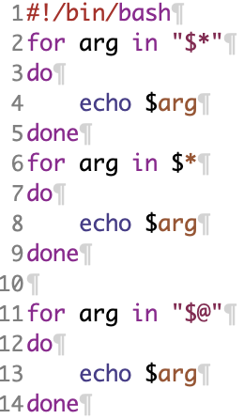
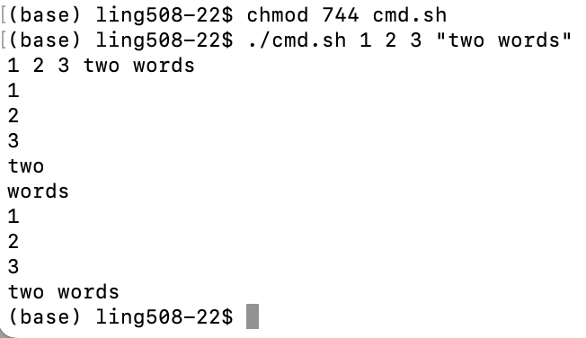
Positional Parameters

Slide 14
Expansion: different kinds
Arithmetic expansion (we've seen before):
  $(( … expression ..))
    x=$(($x+1))
Pathname expansion (aka globbing):
  similar (but not the same) as regular expressions
    * (wild card string)
    ? (wild card character)
    [ab] (a or b)
    [^ab] (not (a or b))
(curly) Brace expansion:
    mkdir ~/class/examples/{ex1,ex2} (recall ~ means home directory)
    echo x{1,2,3,4}
Use command ls
in conjunction with globbing
e.g. ls –l *.txt

Slide 15
Expansion
Pathname expansion (aka globbing):
  similar (but not the same) as regular expressions (regexp)
    * (wild card string)
    ? (wild card character)
    [ab] (a or b)
    [^ab] (not (a or b))
Examples:
  ls f[23]*.jpg
  ls f[^4]*.jpg

Slide 16
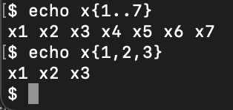
Expansion
(curly) Brace expansion:
    mkdir ~/class/examples/{ex1,ex2}
    shorthand for:
    mkdir ~/class/examples/ex1 ~/class/examples/ex2
    echo x{1,2,3,4} (or echo x{1..4})
    shorthand for:
    echo x1 x2 x3 x4

Slide 17
File extension renaming
Exercise: create a subdirectory with some .JPG files, rename to .jpg
$ chmod 744 rmext.sh
$ mkdir tmp
$ cd tmp
$ touch f{1..7}.JPG
$ ls
f1.JPG f2.JPG f3.JPG f4.JPG f5.JPG f6.JPG f7.JPG
$ ../rmext.sh JPG jpg
$ ls
f1.jpg f2.jpg f3.jpg f4.jpg f5.jpg f6.jpg f7.jpg
Script (rmext.sh):
#!/bin/bash
if [[ $# -ne 2 ]]; then
echo “usage: ext1 ext2”
exit 1
fi
for filename in *.$1
do
mv "$filename" "${filename%$1}$2"
done
exit 0
⇑ delete suffix: ${string%substring}
"… " just in case there are spaces in the filenames

Slide 18
File renaming
Substring substitution:
${string/substring/replacement}
Example:
  append a suffix -1 to all jpg files
  for f in *.jpg; do mv $f ${f/./-1.}; done
Levels of quoting:
$ echo text ~/*.txt {a,b} $(echo foo) $((2+2)) $USER
text /home/me/ls-output.txt a b foo 4 me
$ echo "text ~/*.txt {a,b} $(echo foo) $((2+2)) $USER"
text ~/*.txt {a,b} foo 4 me
$ echo 'text ~/*.txt {a,b} $(echo foo) $((2+2)) $USER'
text ~/*.txt {a,b} $(echo foo) $((2+2)) $USER
http://linuxcommand.org

