Slide 1
408/508 Computational Techniques for Linguists
Lecture 8

Slide 2
Today's Topics
re-cap + ChatGPT on the worked example (2cities.txt)
bc (command)
a note on positional parameters
Homework 4
  hope everyone is comfortable typing at the Terminal now
  a shell script program for you to write

Slide 3

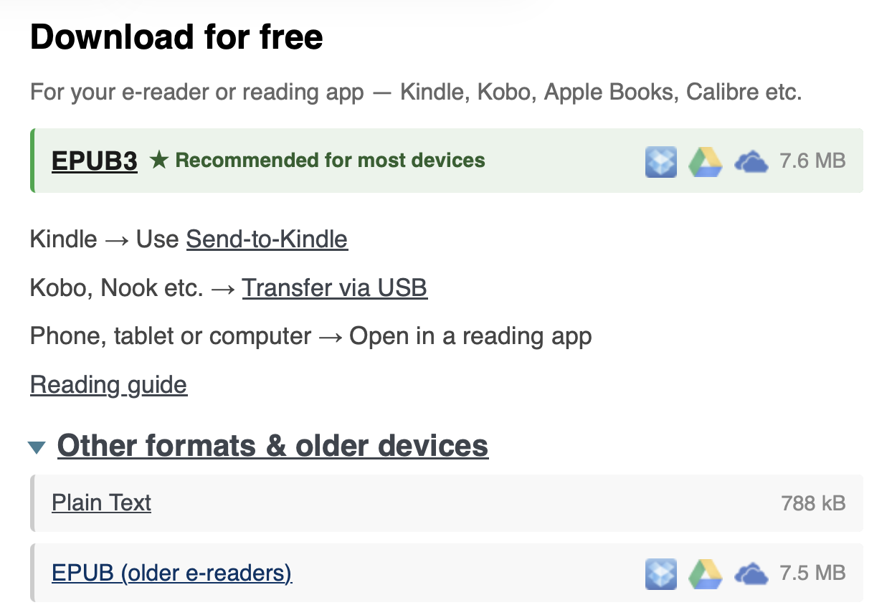
Worked Example

Slide 4
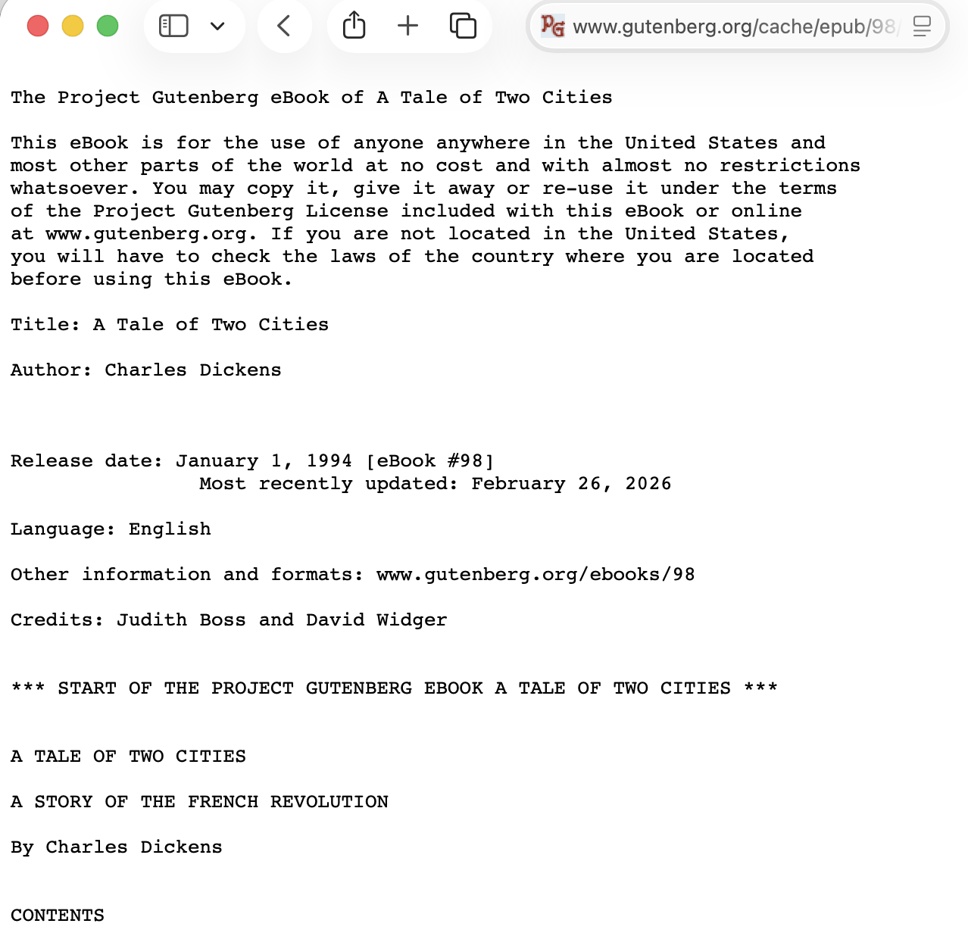
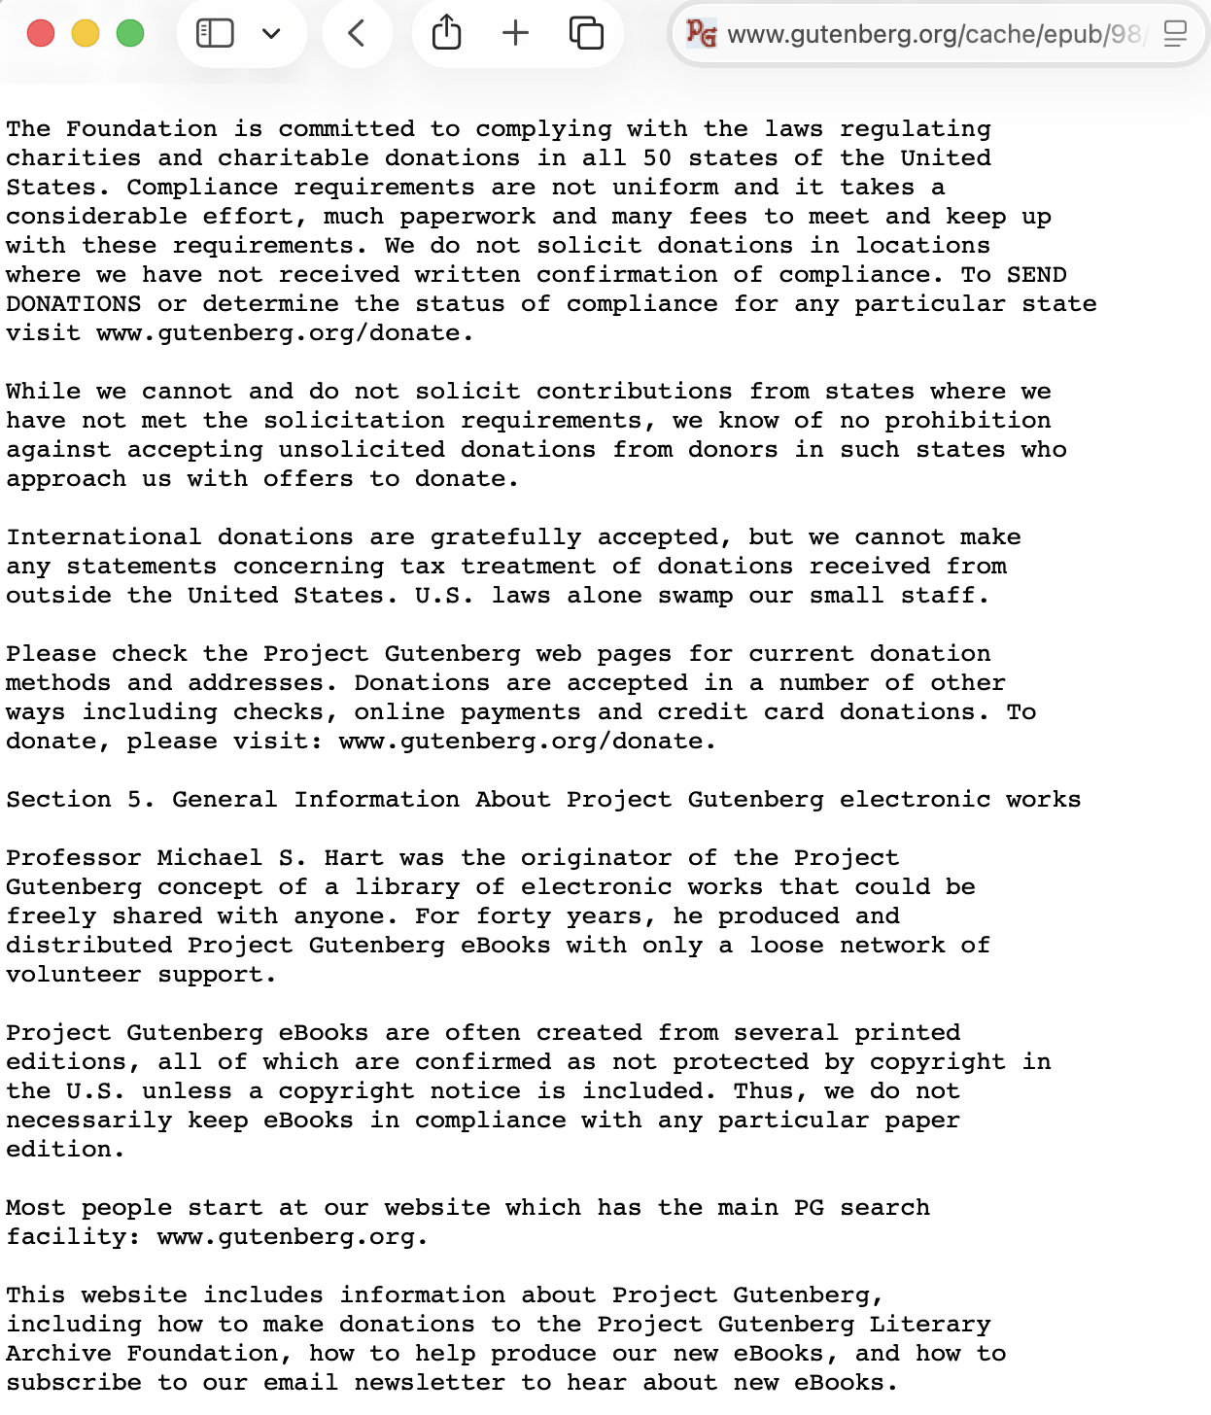
Worked Example

Slide 5
Worked Example
Fails!
  cat 2cities.txt | tr '[:punct:]' ' ' | tr ' ' '\n' | sort | uniq -c | sort -rn | tail -n +2 | head -n 20 | awk '{print $2, $1}' | termgraph
Error:
  Traceback (most recent call last):
  File "/Library/Frameworks/Python.framework/Versions/3.14/bin/termgraph", line 6, in <module>
  sys.exit(main())
  ~~~~^^
  File "/Library/Frameworks/Python.framework/Versions/3.14/lib/python3.14/site-packages/termgraph/termgraph.py", line 106, in main
  data_obj = Data.from_file(args["filename"], args)
  File "/Library/Frameworks/Python.framework/Versions/3.14/lib/python3.14/site-packages/termgraph/data.py", line 116, in from_file
  return cls(data, labels, categories)
  File "/Library/Frameworks/Python.framework/Versions/3.14/lib/python3.14/site-packages/termgraph/data.py", line 45, in __init__
  self.dims = self._find_dims(data, labels)
  ~~~~~~~~~~~~~~~^^^^^^^^^^^^^^
  File "/Library/Frameworks/Python.framework/Versions/3.14/lib/python3.14/site-packages/termgraph/data.py", line 128, in _find_dims
  raise Exception(
  f"The inner dimensions of the data are different\nThe dimensions of {data[i - 1]} is different than the dimensions of {data[i]}"
  )
  Exception: The inner dimensions of the data are different
  The dimensions of [] is different than the dimensions of [6769.0]

Slide 6
Worked Example
Works!
  cat 2cities.txt | tr '[:punct:]' ' ' | tr ' ' '\n' | sort | uniq -c | sort -rn | tail -n +3 | head -n 20 | awk '{print $2, $1}' | termgraph
26159
8077
6769 the
4469 and
3748 of
3293 to
2601 a
2340 in
1904 I
1770 his

Slide 7
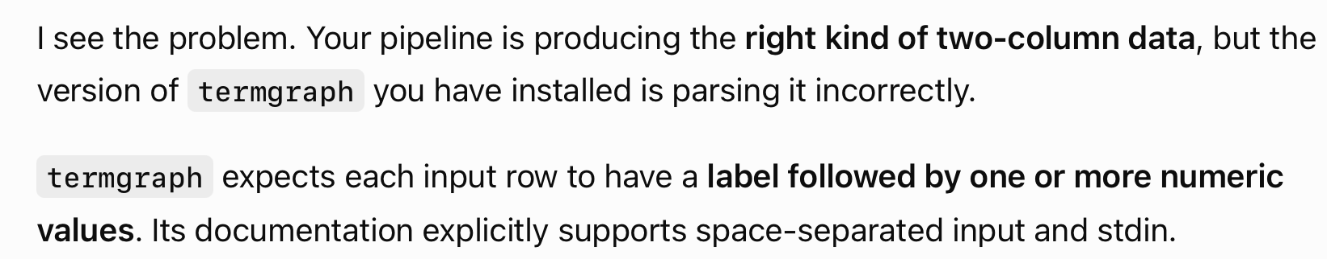

Worked Example
ChatGPT:

Slide 8
Worked Example
the : ▇▇▇▇▇▇▇▇▇▇▇▇▇▇▇▇▇▇▇▇▇▇▇▇▇▇▇▇▇▇▇▇▇▇▇▇▇▇▇▇▇▇▇▇▇▇▇▇▇▇ 7.42 K
and : ▇▇▇▇▇▇▇▇▇▇▇▇▇▇▇▇▇▇▇▇▇▇▇▇▇▇▇▇▇▇▇▇ 4.85 K
of : ▇▇▇▇▇▇▇▇▇▇▇▇▇▇▇▇▇▇▇▇▇▇▇▇▇▇ 3.99 K
to : ▇▇▇▇▇▇▇▇▇▇▇▇▇▇▇▇▇▇▇▇▇▇▇ 3.53 K
a : ▇▇▇▇▇▇▇▇▇▇▇▇▇▇▇▇▇▇ 2.81 K
in : ▇▇▇▇▇▇▇▇▇▇▇▇▇▇▇▇ 2.49 K
I : ▇▇▇▇▇▇▇▇▇▇▇▇▇ 1.99 K
his : ▇▇▇▇▇▇▇▇▇▇▇▇▇ 1.94 K
that: ▇▇▇▇▇▇▇▇▇▇▇▇ 1.83 K
was : ▇▇▇▇▇▇▇▇▇▇▇ 1.76 K
it : ▇▇▇▇▇▇▇▇▇▇▇ 1.73 K
he : ▇▇▇▇▇▇▇▇▇ 1.46 K
had : ▇▇▇▇▇▇▇▇ 1.30 K
with: ▇▇▇▇▇▇▇▇ 1.27 K
you : ▇▇▇▇▇▇▇▇ 1.19 K
as : ▇▇▇▇▇▇▇ 1.05 K
her : ▇▇▇▇▇▇ 1.01 K
at : ▇▇▇▇▇▇ 985.00
him : ▇▇▇▇▇▇ 970.00
for : ▇▇▇▇▇▇ 901.00
tr '[:punct:]' ' ' < 2cities.txt |
> tr -s '[:space:]' '\n' |
> sort |
> uniq -c |
> sort -rn |
> head -n 20 |
> awk 'NF == 2 {print $2, $1}' |
> termgraph
That handles spaces, tabs, and newlines and collapses repeated whitespace.

Slide 9
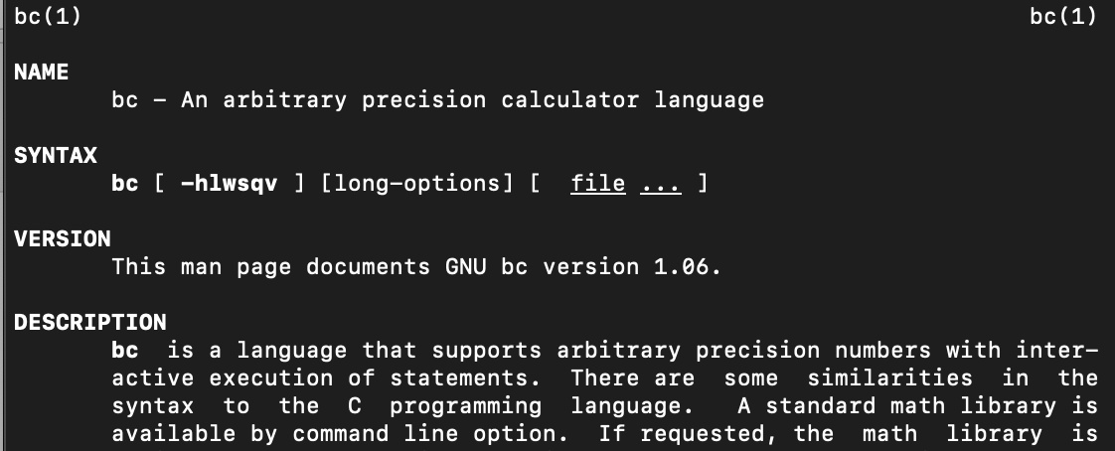
Shell Arithmetic: use command bc instead
Bash shell arithmetic, e.g. ((z= x+y)), is integer only.
What if you needed floating point numbers?
man bc command brings up this page
bc runs interactively
Note:
bc –l loads the math library first

Slide 10
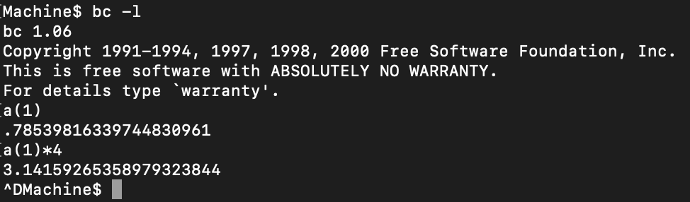

command bc
Examples:
  we know tan(π/4) = 1, so (arctan) tan⁻¹(1) = π/4 (π/4 in radians = 45°)
  function a(radians) computes arctan when bc -l is used
  Control-D (EOF) to exit bc
  can use echo with an expression and then pipe (|) it into bc

Slide 11

command bc
Bash shell trick:
  $(command) is a modern synonym for `command` (` = backtick character, not single quote ') which stands for command substitution;
  it means run command and put its output here (see next slide).
From man bc:
  the following [Terminal command] will assign the value of "pi" to the shell variable pi.

Slide 12
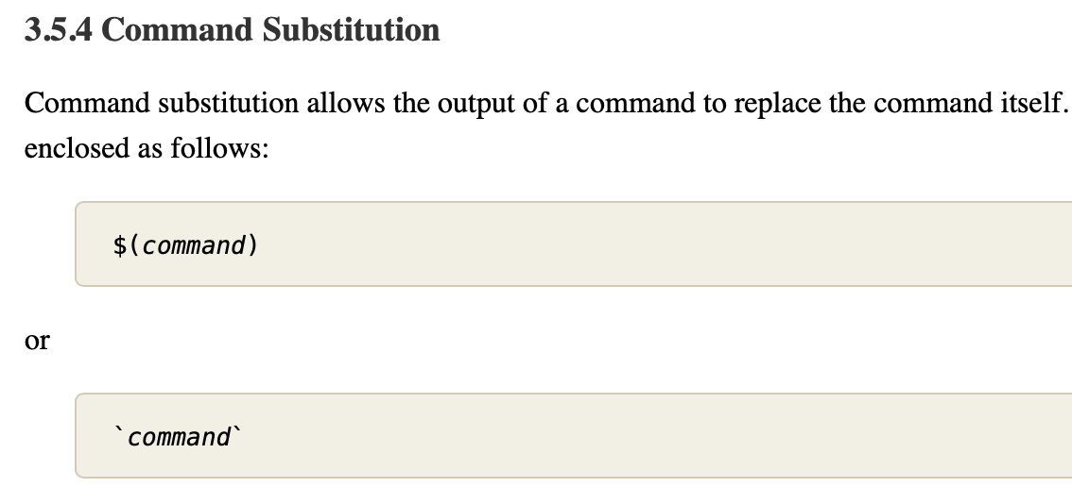

command bc
https://www.gnu.org/software/bash/manual/html_node/Command-Substitution.html#Command-Substitution
pi=$(echo "scale=10; 4*a(1)" | bc -l)
pi=`echo "scale=10; 4*a(1)" | bc -l`

Slide 13
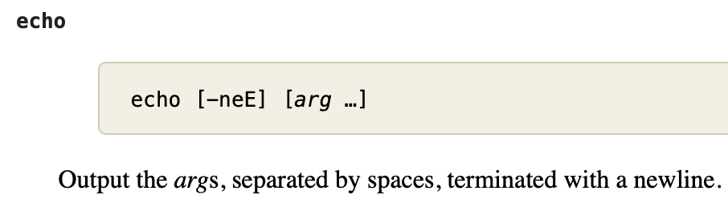
command bc
https://www.gnu.org/software/bash/manual/html_node/Bash-Builtins.html#index-echo
pi=$(echo "scale=10; 4*a(1)" | bc -l)
send string as a file of one line as input to bc

Slide 14

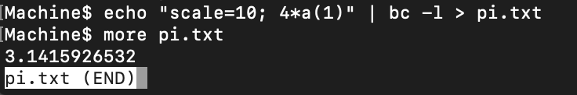
command bc
pi is a Bash shell variable here
with re-direction (>) into a file pi.txt, spacebar to get out of more/less

Slide 15
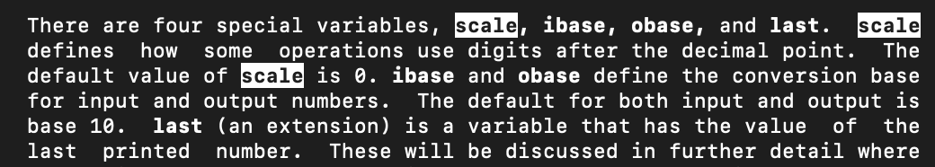
command bc
scale variable in bc:

Slide 16
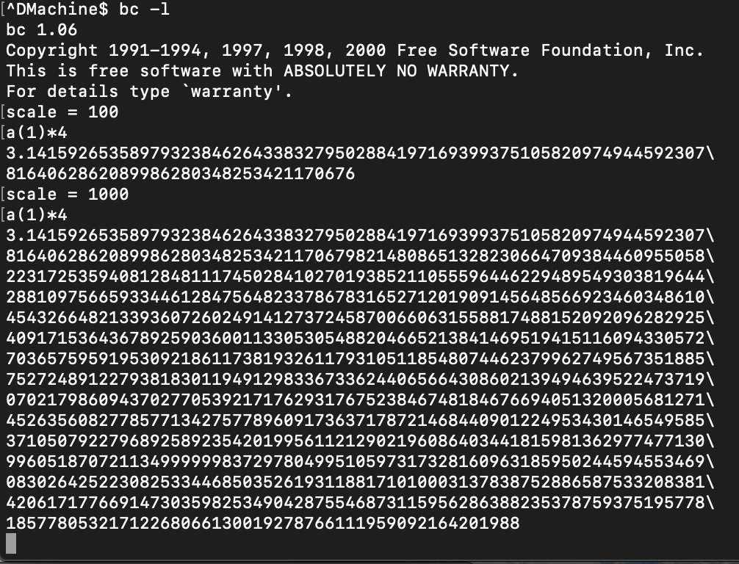
command bc
scale = 1000

Slide 17
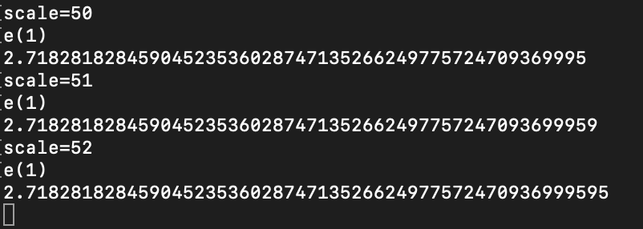
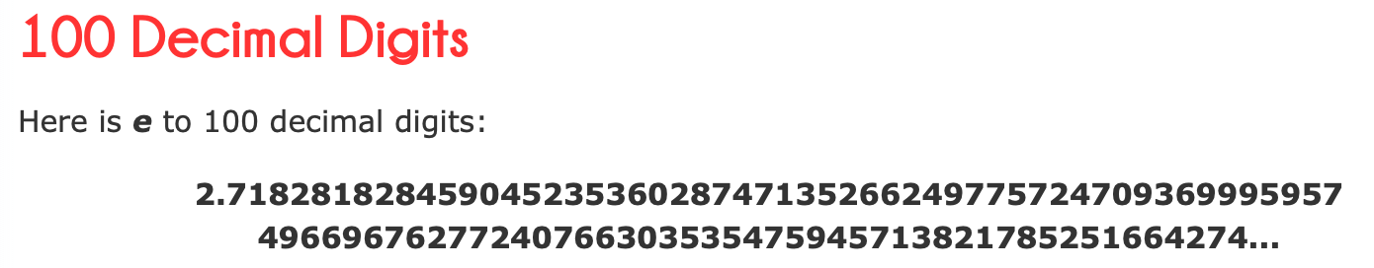
Math constant e
https://www.mathsisfun.com/numbers/e-eulers-number.html

Slide 18
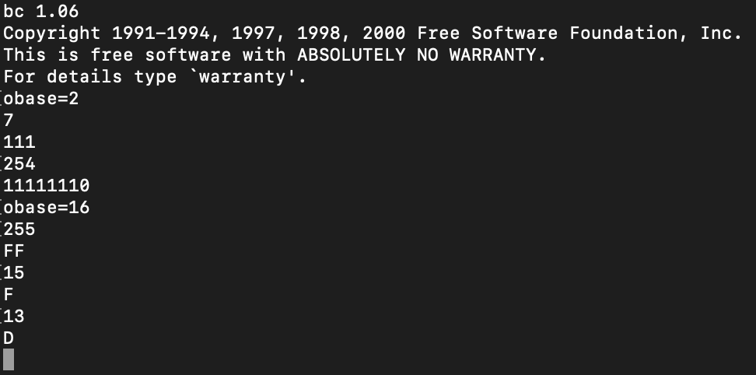
command bc
Output base (obase) variable:
obase=2 (binary)
obase=16 (hexadecimal)
0..9,A..F
Recall: control-D to exit

Slide 19
Positional Parameters
Inside a Bash shell script, these $ variables have values:
  $1: first parameter
  $2: 2nd parameter and so on…
  $#: # of parameters
Program on webpage test.sh:
#!/bin/bash
echo "Number of parameters: $#"
if [ $# -eq 1 ]; then
echo "1st parameter: $1"
fi
Output:
  bash test.sh
  Number of parameters: 0
  bash test.sh 45
  Number of parameters: 1
  1st parameter: 45
  bash test.sh 45 56
  Number of parameters: 2
or do chmod u+x test.sh
Run using: ./test.sh

Slide 20

If-test
Program on webpage test2.sh
Spaces around [ and ] are important!
$ bash test2.sh 1 2
Number of parameters: 2
test2.sh: line 3: [2: command not found
$

Slide 21
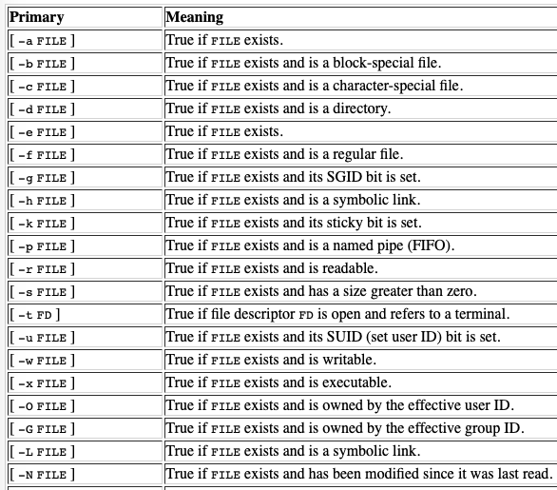
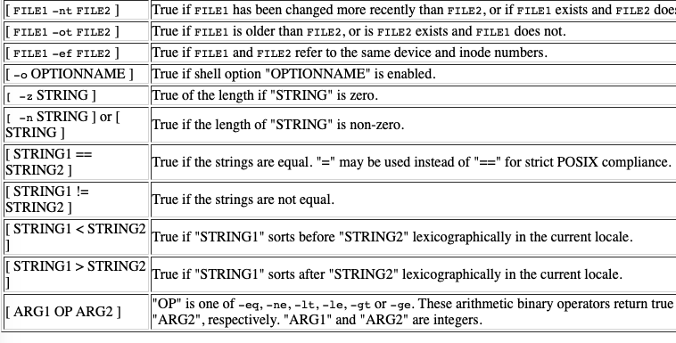
If-test
Note the spaces between the [ … ] !

Slide 22
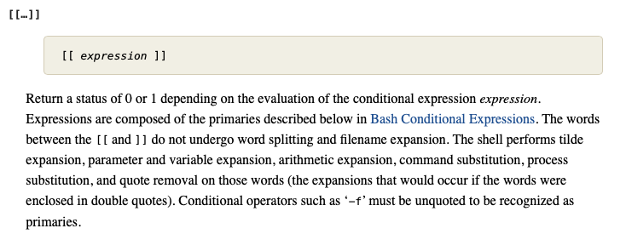

If-test
https://www.gnu.org/software/bash/manual/bash.html
if [[ condition ]] (newer test: older test […] also supported)
$ bash test3.sh 1
Number of parameters: 1
1st parameter: 1
$ bash test3.sh 10
Number of parameters: 1
$
see previous slide, plus pattern matching, e.g. regex =~
[[ $# -eq 1 && $1 -lt 10 ]] vs. [ $# -eq 1 ] && [ $1 -lt 10 ]

Slide 23
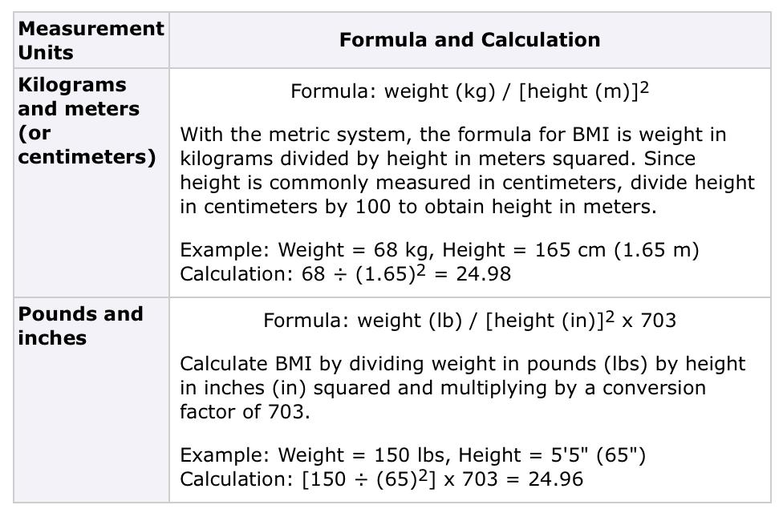
Homework 4
Let’s write a simple shell-script BMI calculator
  solicit input from the terminal (using read) or from the command line ($1 $2) arguments
try the metric one first

Slide 24
Homework 4
You can use if-test, bc (from this lecture), and shell scripting to build your program
Submit your shell script and screenshots of your runs
To get you started, let's play on the command line first:
  your instructor weights 75kg and is 1.72 meters tall
  ((bmi = 75 / (1.72 * 1.72)))
  echo $bmi
  won't work: why?
  syntax error: invalid arithmetic operator (error token is ".72 * 1.72)")

Slide 25
Homework 4
One approach is to scale height in cm instead of meters to make numbers be whole ones (100cm = 1m):
  ((bmi = 75 / (172 * 172)))
  echo $bmi
  how to scale it properly if we use cm instead of m?
  100 cm in a meter, multiply by what?
  e.g. ((bmi = 75 * 100 * 100 / (172 * 172)))

Slide 26
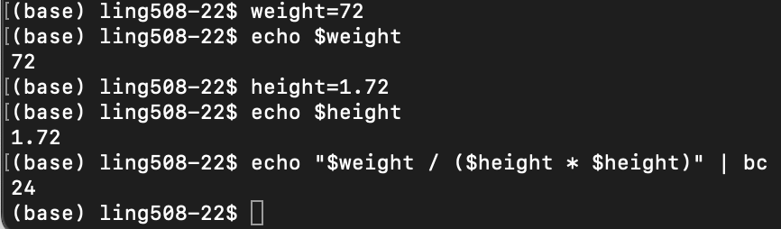
Homework 4
Instead of scaling to integer, we could pipe floating point numbers to bc directly:
or use variables:

Slide 27
Homework 4
After you figure out how to do on the command line, put it in a shell script, and try to add the following three embellishments:
  accept either command line arguments or read from the terminal if they’re missing
  recall read –p "Enter : " variablename
    if [ $# -ne N ]; then
    N = number of command line arguments.

Slide 28
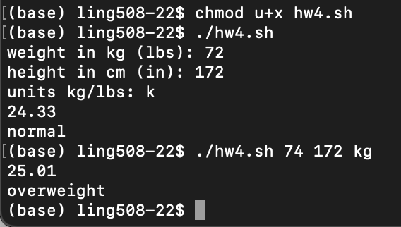
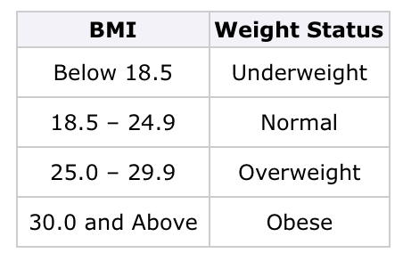
Homework 4
  print the weight status message according to the following table:
  modify the calculator to accept input in both metric and traditional units
make sure you supply examples of your program working!
no command line arguments!
read -p
command line arguments!

Slide 29
Homework 4
Instructions:
  email sandiway@arizona.edu
  submit everything in one PDF file!
  subject of email: 408/508 Homework 4 your name
  cite any discussion or source
  due date: next Sunday by midnight

