Slide 1
408/508 Computational Techniques for Linguists
Lecture 7

Slide 2
Today's Topics
Homework 3 review
  Step-by-step Bash shell exercises
Other things we can 'pipe' (|) into our workflow:
  tail
  awk
  termgraph
a note on file permissions

Slide 3
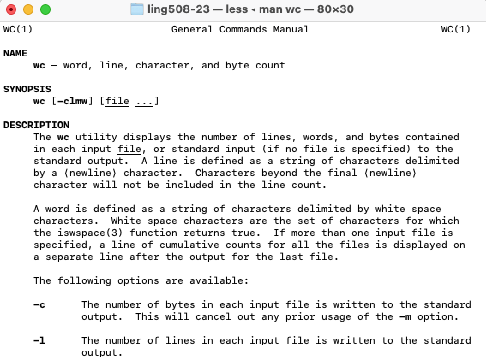
Homework 3: Exercise 1 Review
Relevant bit:
  The wc utility displays the number of lines, words, and bytes

Slide 4
Homework 3: Exercise 1
ling508-26$ file text.txt
text.txt: Unicode text, UTF-8 text
ling508-26$ ls -l text.txt
-rw-r--r--@ 1 sandiway staff 4616 Sep 8 13:00 text.txt
ling508-26$ wc text.txt
111 847 4616 text.txt
ling508-26$ wc -w text.txt
847 text.txt

Slide 5
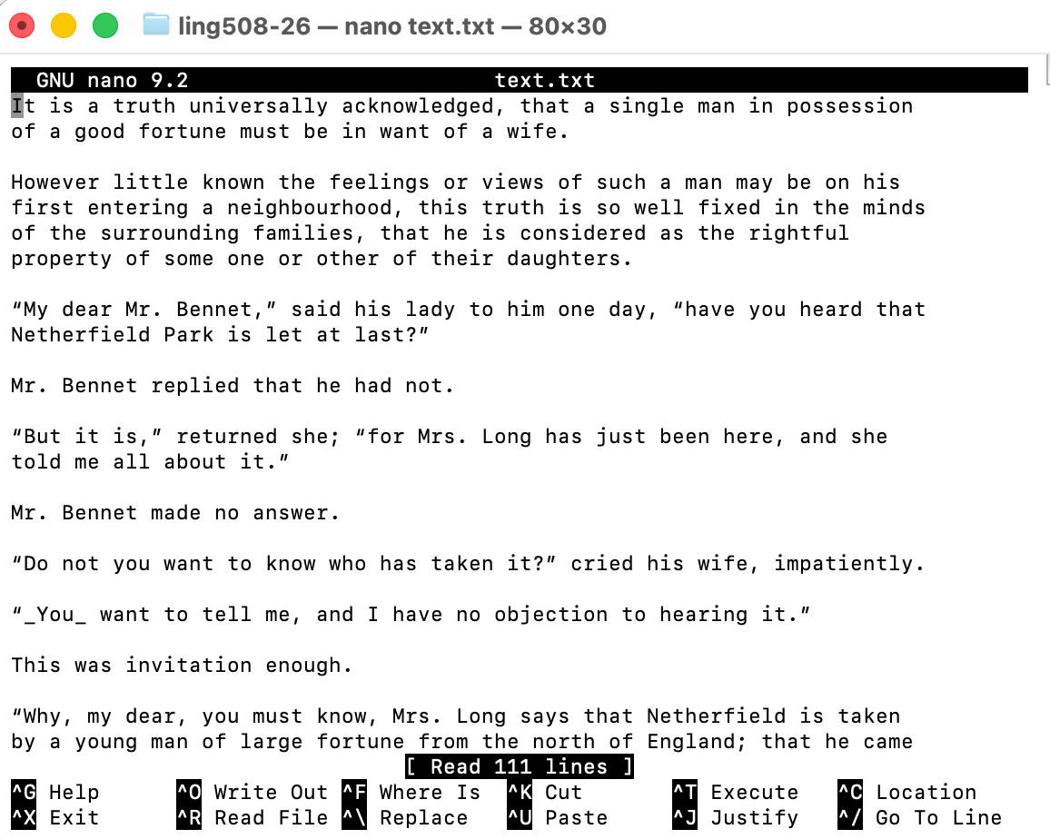
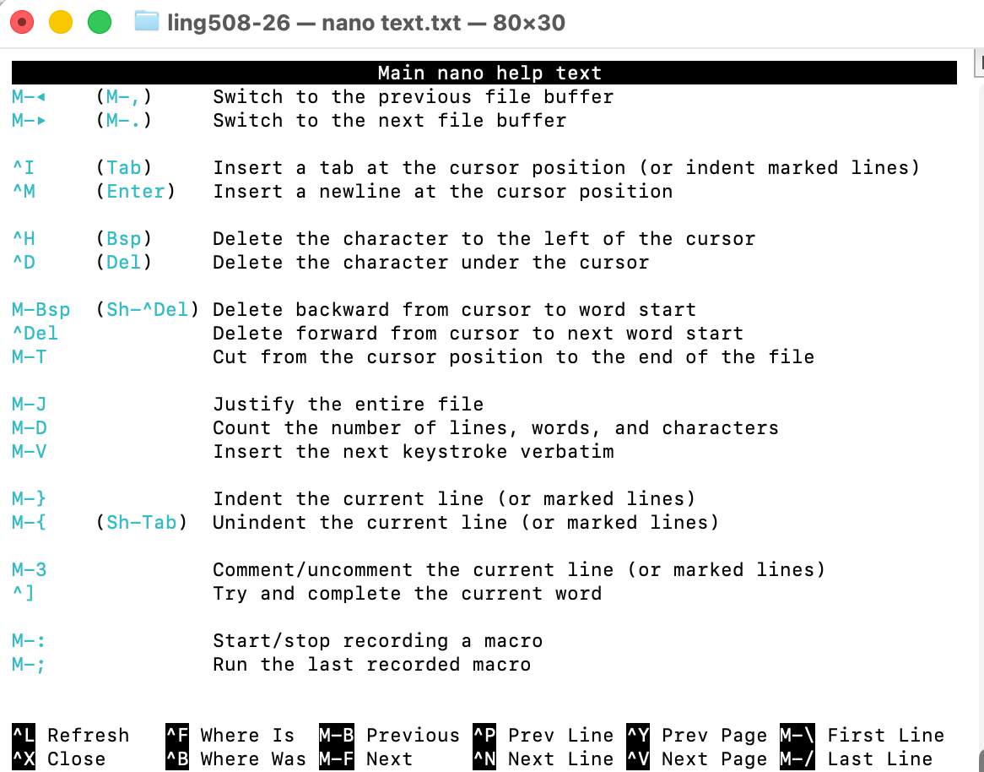
Homework 3: Exercise 1

Slide 6
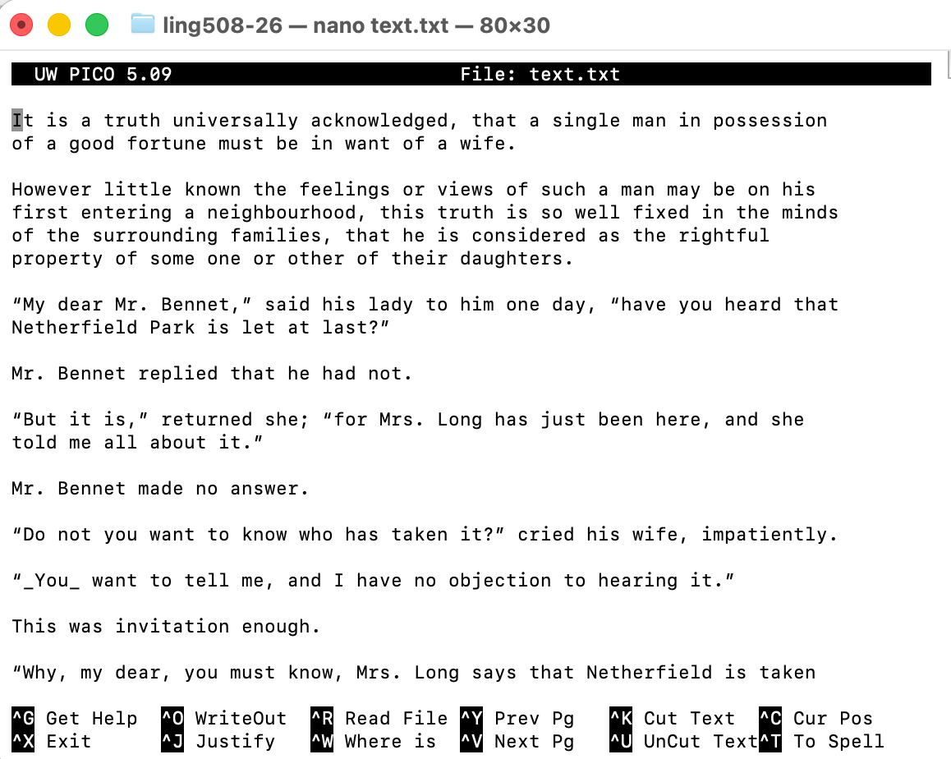
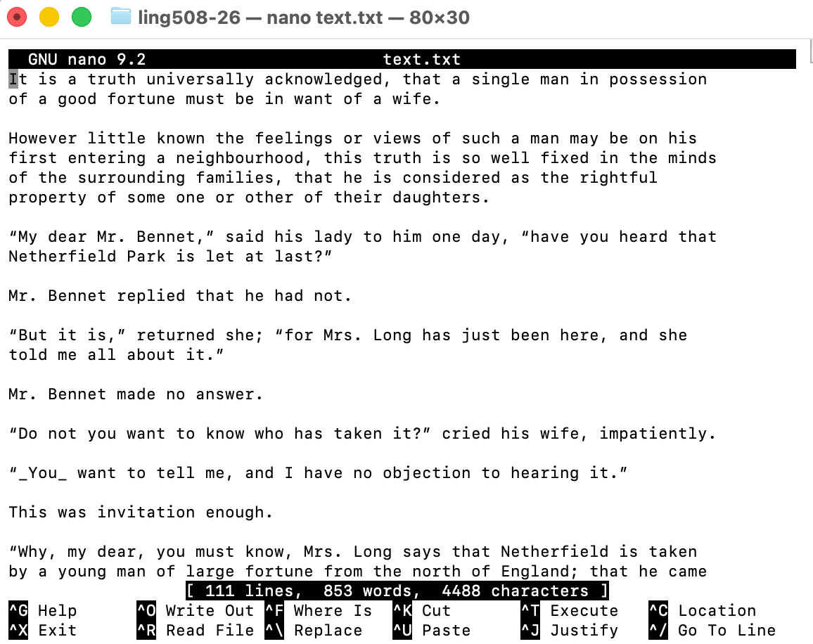
Homework 3: Exercise 1
$ wc text.txt
111 847 4616 text.txt

Slide 7
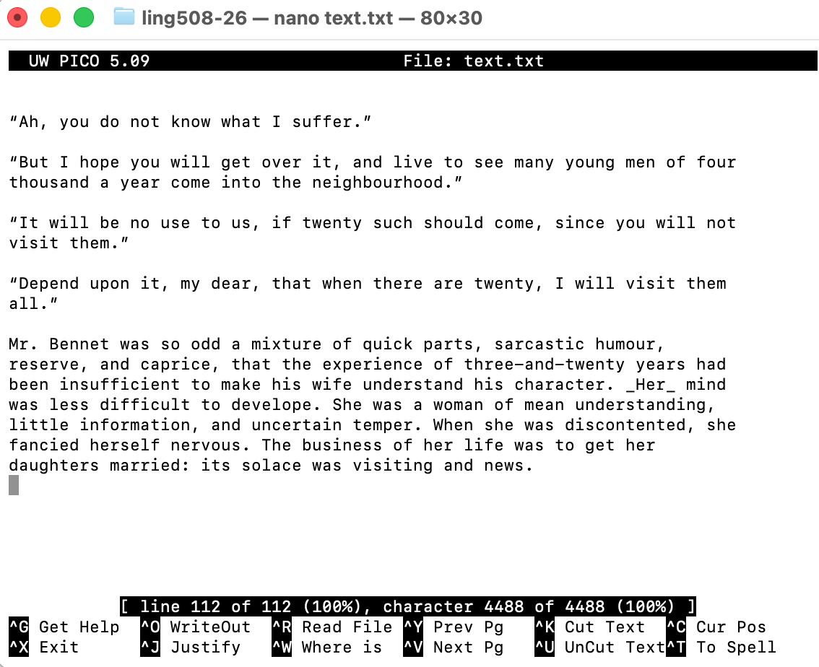
Homework 3: Exercise 1
$ wc text.txt
111 847 4616 text.txt

Slide 8
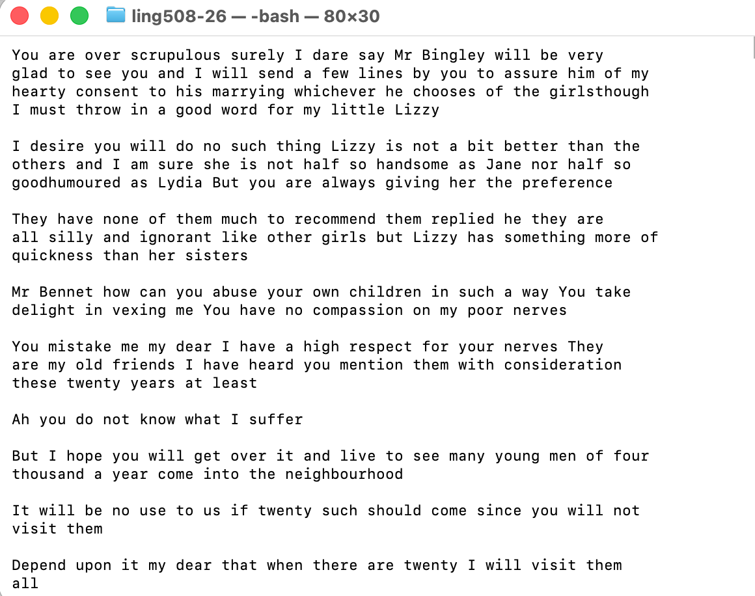
Homework 3: Exercise 2
tr command:
  tr -d '[:punct:]'
  -d deletes punctuations, may combine words inadvertantly

Slide 9
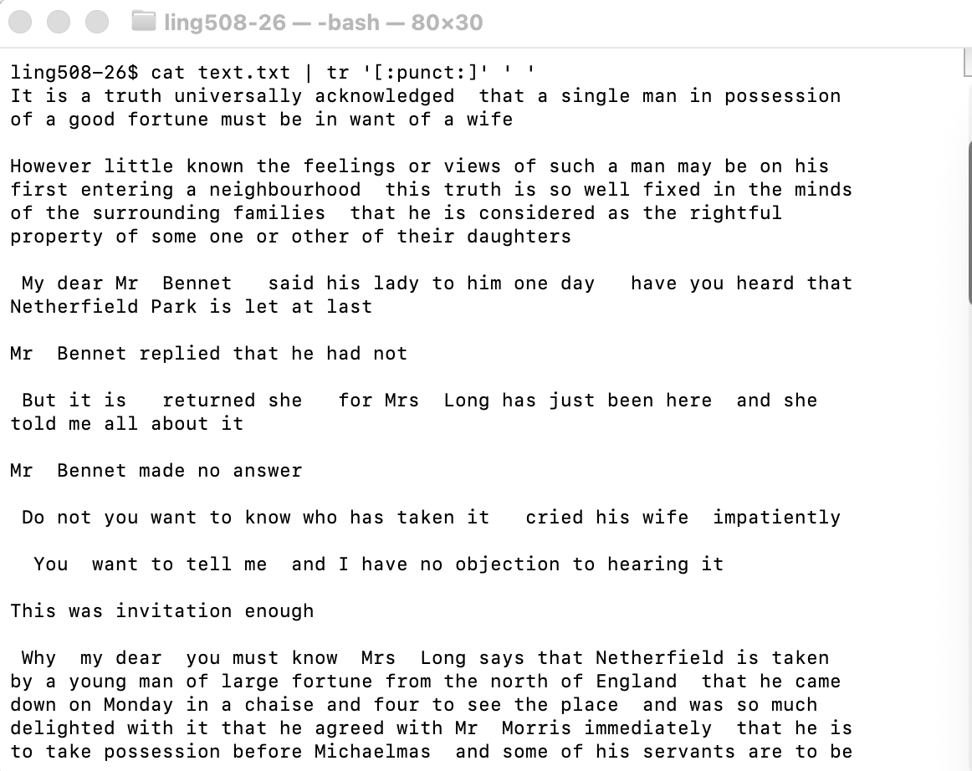
Homework 3: Exercise 2
tr command:
  tr '[:punct:]' ' ' replaces punctuation with a space character

Slide 10
Homework 3: Exercise 2
$ cat text.txt | tr '[:punct:]' ' ' | tr ' ' '\n' | sort | uniq -c | sort -rn
247
29 of
24 you
22 to
20 a
17 the
17 I
17 and
15 that
12 is
11 them
11 it
11 in
11 his
11 he
11 for
11 be
10 my
10 Mr
9 will
9 not
8 was
8 so
8 dear
8 as
8 are
7 You
7 no
7 must
7 have
6 she
6 But
6 Bennet
5 visit
5 such
5 see
5 or
5 one
5 me
5 know
5 her
5 has
4 with
4 wife
4 twenty
4 single
4 on
4 may
4 man
4 how
4 him
4 go
4 girls
4 do
4 daughters
4 can
4 by
4 Bingley
3 your
…

Slide 11
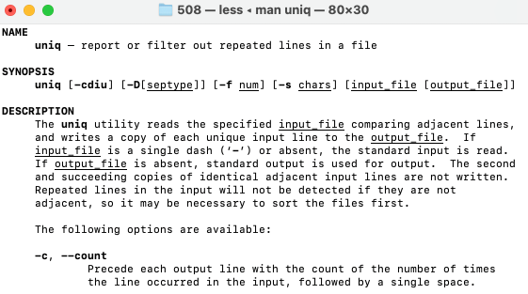
Homework 3: Exercise 2
See adjacency requirement for repeating lines!

Slide 12
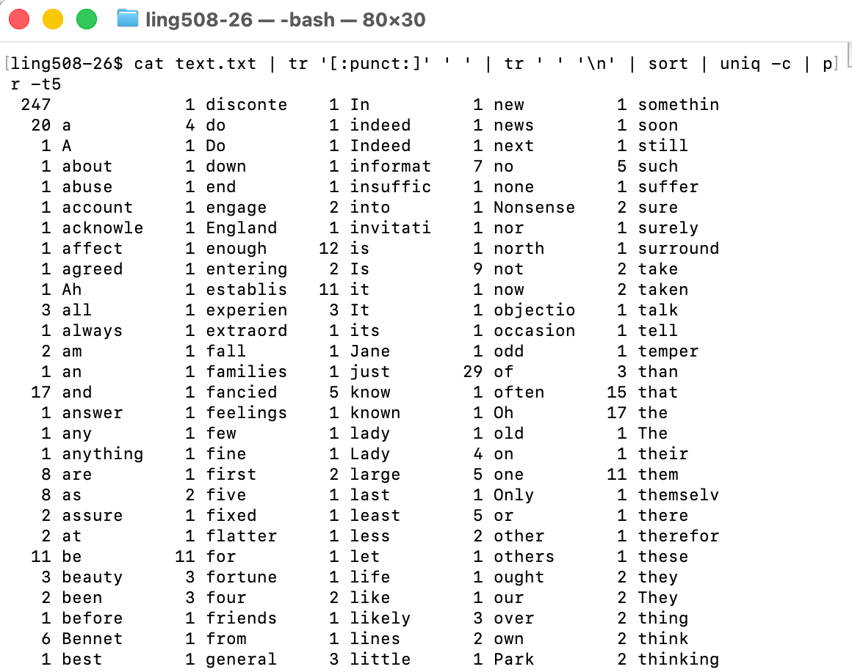
Homework 3: Exercise 2

Slide 13
A step beyond Homework 3
Let's graph our homework result!
There's something called termgraph (written in Python) but you can use it on the command line
Assume you have python3 already installed
Check whether it's already installed
  which termgraph
  /Users/sandiway/opt/anaconda3/bin/termgraph
if not:
  pip3 install termgraph

Slide 14
termgraph install
$ which termgraph (no response means can't find the command)
$ pip3 install termgraph
Collecting termgraph
Downloading termgraph-0.7.6-py3-none-any.whl.metadata (8.1 kB)
Collecting colorama>=0.4.6 (from termgraph)
Using cached colorama-0.4.6-py2.py3-none-any.whl.metadata (17 kB)
Downloading termgraph-0.7.6-py3-none-any.whl (18 kB)
Using cached colorama-0.4.6-py2.py3-none-any.whl (25 kB)
Installing collected packages: colorama, termgraph
Successfully installed colorama-0.4.6 termgraph-0.7.6
$ which termgraph
/Library/Frameworks/Python.framework/Versions/3.14/bin/termgraph
/opt/miniconda3/bin/termgraph

Slide 15
termgraph install
It may place the executable in a directory that's not in your PATH.
If so:
  export PATH=/home/yourname/.login/bin:$PATH
  will prepend
  /home/yourname/.login/bin to your PATH
To make the change permanent, you can add this line to your startup file, either .bashrc or .bash_profile or .zprofile (for zsh users) in your home directory (depending on which one exists)
  cd (goto home)
  nano your_starup_file (save change and exit)

Slide 16
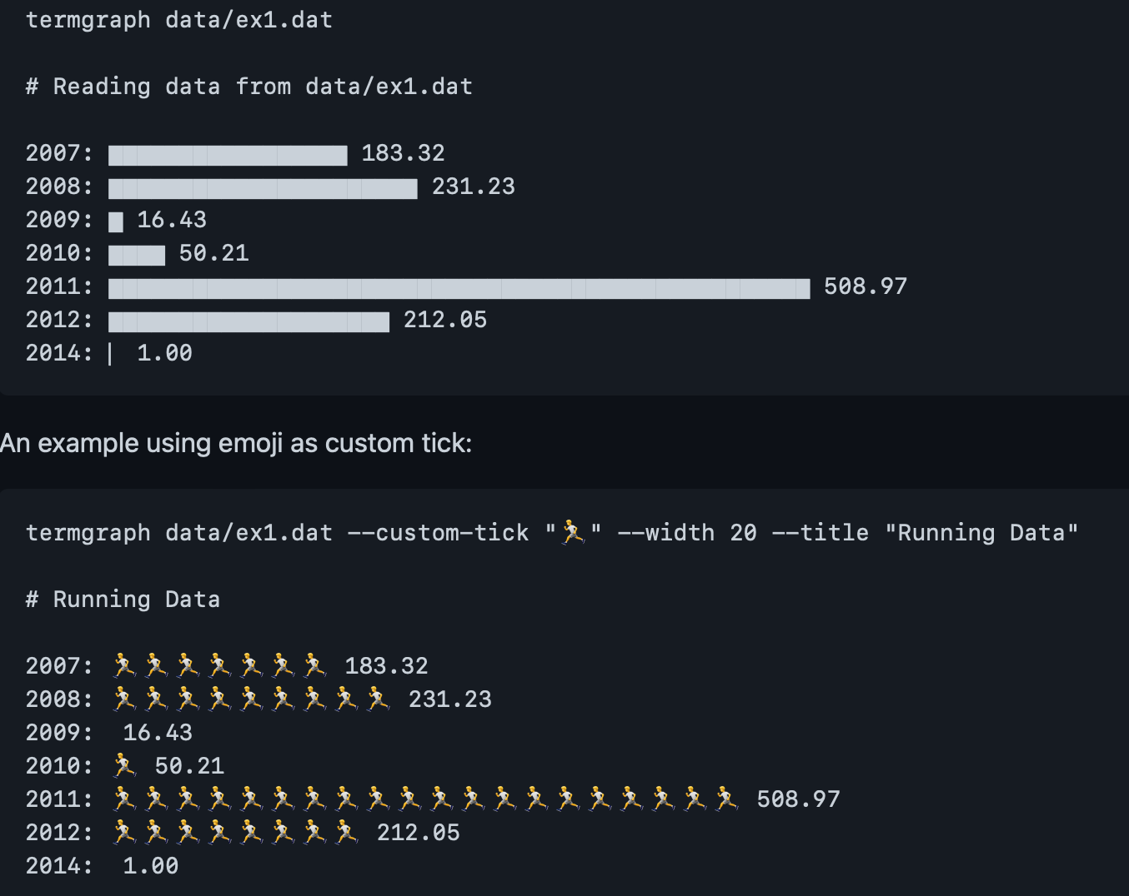
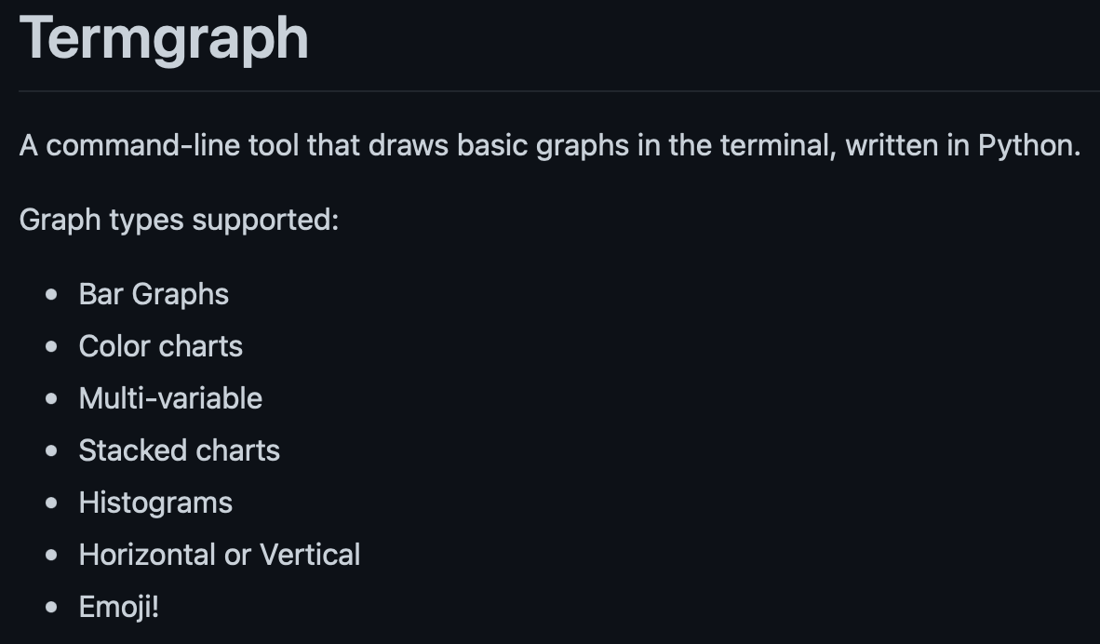
termgraph
Google termgraph
  https://github.com/mkaz/termgraph

Slide 17
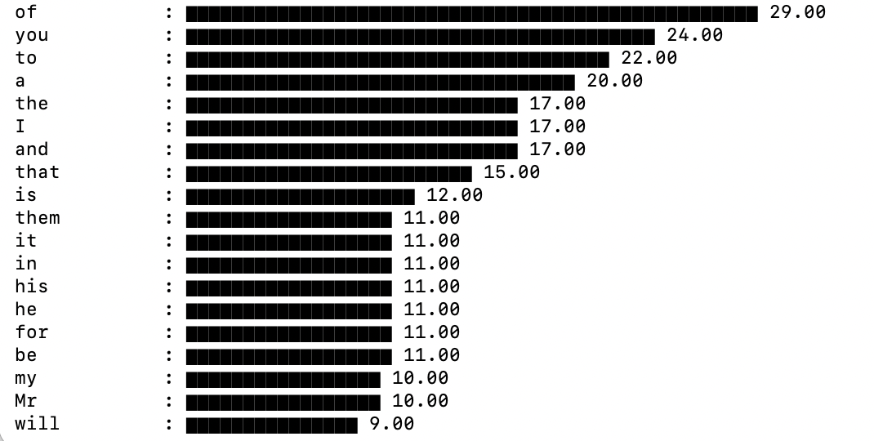
termgraph
cat text.txt | tr '[:punct:]' ' ' | tr ' ' '\n' | sort | uniq -c | sort -rn | tail -n +2 | awk '{print $2, $1}' | termgraph
ASCII graphics!

Slide 18
tail –n +2
NAME
tail – display the last part of a file
SYNOPSIS
tail [-F | -f | -r] [-q] [-b number | -c number | -n number] [file ...]
DESCRIPTION
The tail utility displays the contents of file or, by default, its standard input,
to the standard output.
Numbers having a leading plus (‘+’) sign are relative to the beginning of the
input, for example, “-c +2” starts the display at the second byte of the input.
Numbers having a leading minus (‘-’) sign or no explicit sign are relative to the
end of the input, for example, “-n 2” displays the last two lines of the input.
-n number, --lines=number
The location is number lines.

Slide 19
tail –n +2
cat text.txt | tr '[:punct:]' ' ' | tr ' ' '\n' | sort | uniq -c | sort -rn
221
56 the
26 and
22 of
20 a
19 it
18 was
15 she
15 in
14 her
12 to
11 one
+2

Slide 20
awk '{print $2, $1}'
NAME
awk - pattern-directed scanning and processing language
SYNOPSIS
awk [ -F fs ] [ -v var=value ] [ 'prog' | -f progfile ] [ file ... ]
DESCRIPTION
Awk scans each input file for lines that match any of a set of patterns
specified literally in prog or in one or more files specified as -f progfile.
With each pattern there can be an associated action that will be performed when
a line of a file matches the pattern.
A pattern-action statement has the form:
pattern { action }
A missing { action } means print the line; a missing pattern always matches.
The print statement prints its arguments on the standard output
{ print $2, $1 }
Print first two fields in opposite order.

Slide 21
tail –n +2
cat text.txt | tr '[:punct:]' ' ' | tr ' ' '\n' | sort | uniq -c | sort –rn | awk '{print $2, $1}' | termgraph
221
56 the
26 and
22 of
20 a
19 it
18 was
15 she
15 in
14 her
12 to
11 one
+2
awk '{print $2, $1}'
the 56
and 26
of 22
a 20
it 19
was 18
she 15
in 15
her 14
to 12
one 11

Slide 22
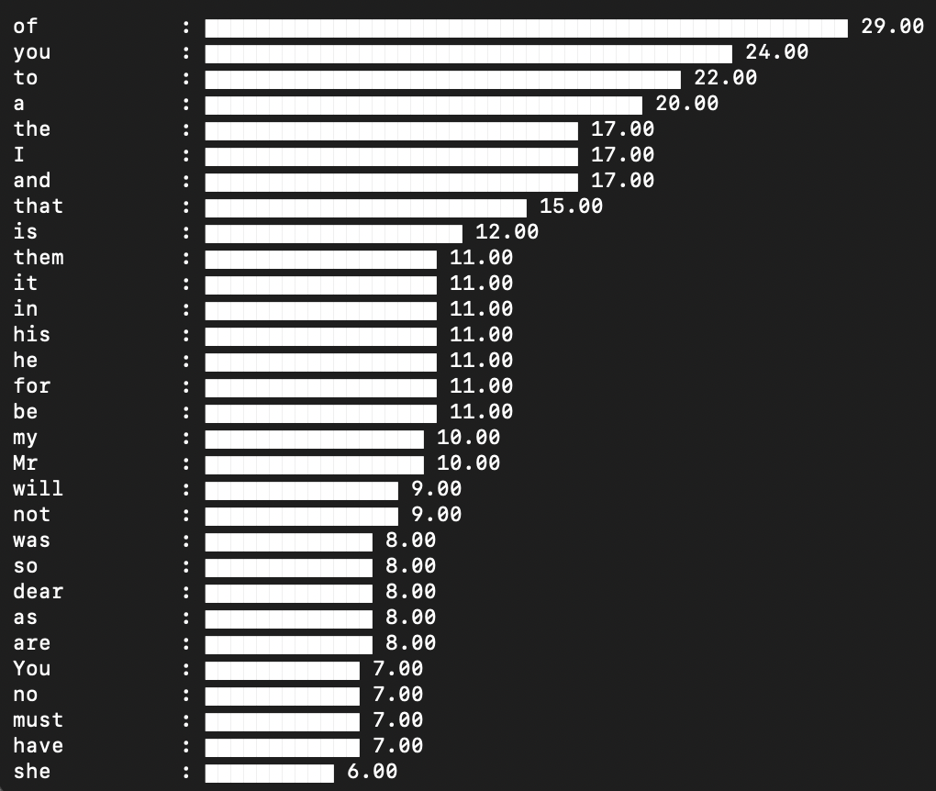
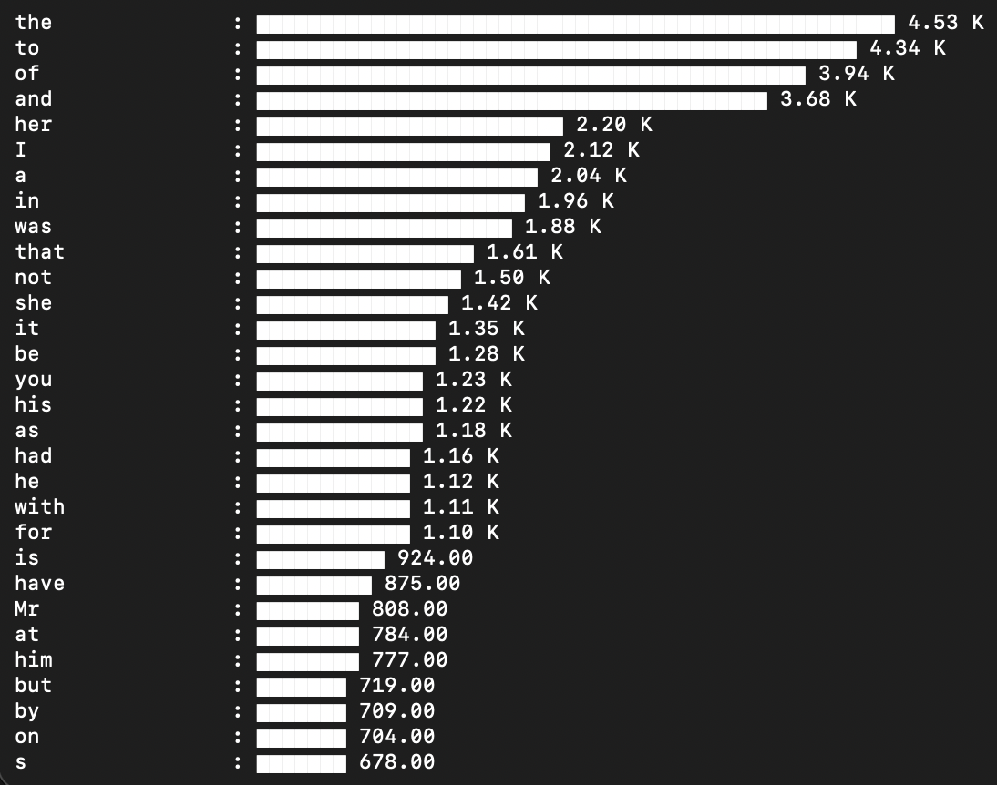
Pride and Prejudice
truncated vs. full corpus

Slide 23
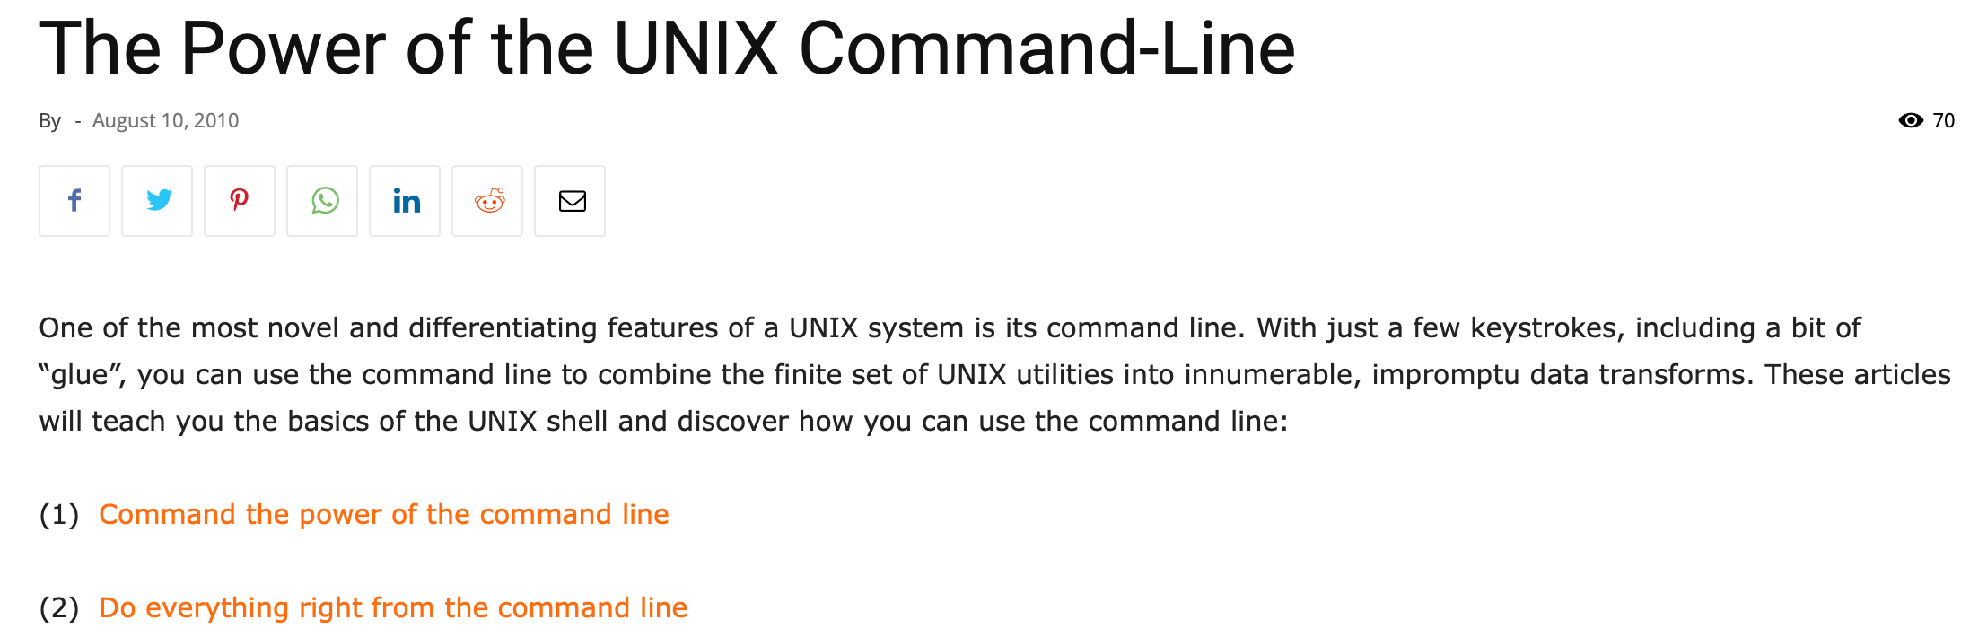
The spirit of Unix (Linux)
wc
sort
uniq
tr
tail
cat
echo
pr

Slide 24
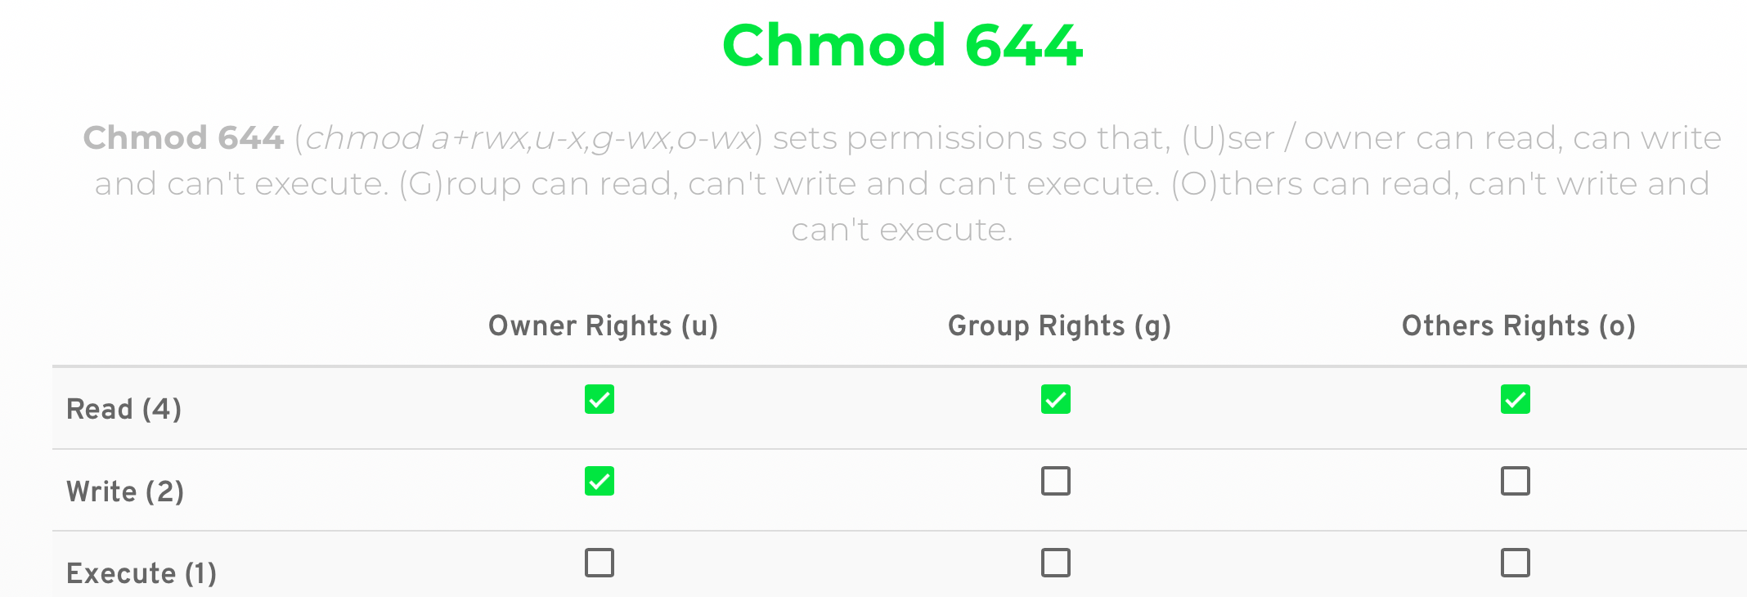
Running shell scripts
number (binary)
1
1
0
1
0
0
1
0
0
Command:
chmod permissions filename
permissions: e.g. u+x (user add execute) or a number
Recall everything is binary:
110 = 6, 100 = 4
644 = 110100100 (3 groups of binary)

