Slide 1
408/508 Computational Techniques for Linguists
Lecture 6

Slide 2
Today's Topics
the cat (concatenate & print) command
Shell scripting
  writing a program using an editor and running it!
Homework 3 (due Sunday midnight)
  Step-by-step Bash shell exercises

Slide 3
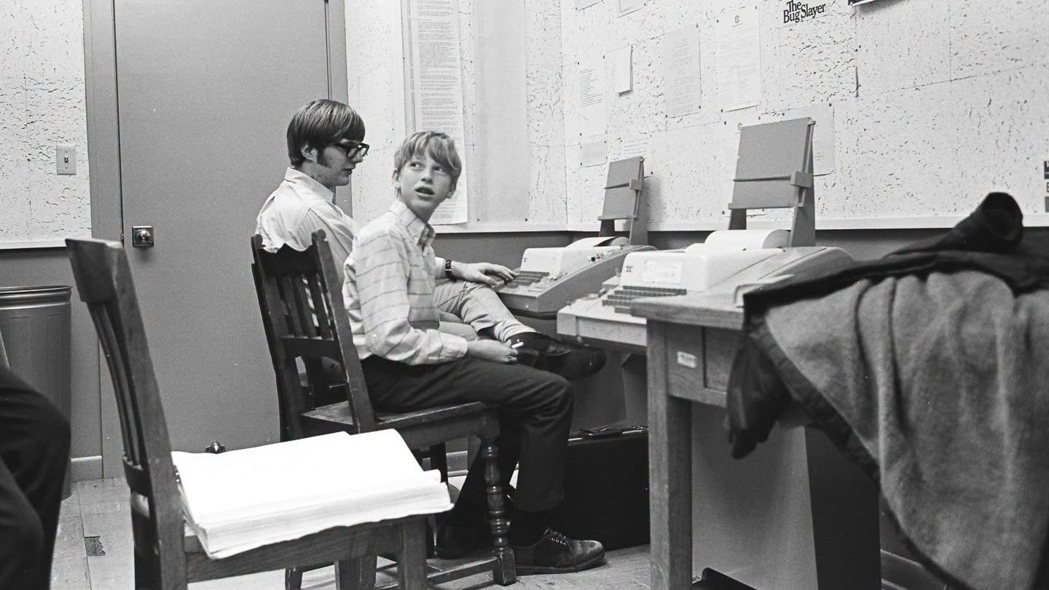
Recall the ASR 33 Teletype I mentioned?

Slide 4
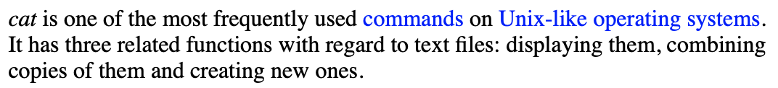
cat command
See http://www.linfo.org/cat.html
Let's use nano (text editor to create three files from scratch)
  file1 - put more than one screenfull of text in this one
  file2
  file3

Slide 5
cat command
An exercise:
  cat file1 (print contents of file1)
  cat file1 | more (‘|’ = pipe output to pagination command more or less)
  more file1 (nowadays aliased to less)
  less file1 (stops at screen bottom, space or f to show more, b up)
  cat > file1 (create file1, input from terminal until Control-D EOF)
  cat (weird! input from terminal goes to terminal)
  cat >> file1 (append input from terminal to file file1)
  cat file1 > file2 (file copy)
  cp file1 file2 – easier (cp = copy)
  cat file1 file2 file3 (prints file[1-3] in order)
  cat file[1-3] > file4 (prints all 3 files to file4)
  cat file[1-3] | sort > file4 (3 files sorted by ASCII to file4)
  cat – file5 > file6 (‘-’ = input from terminal)
  cat file7 - > file8

Slide 6
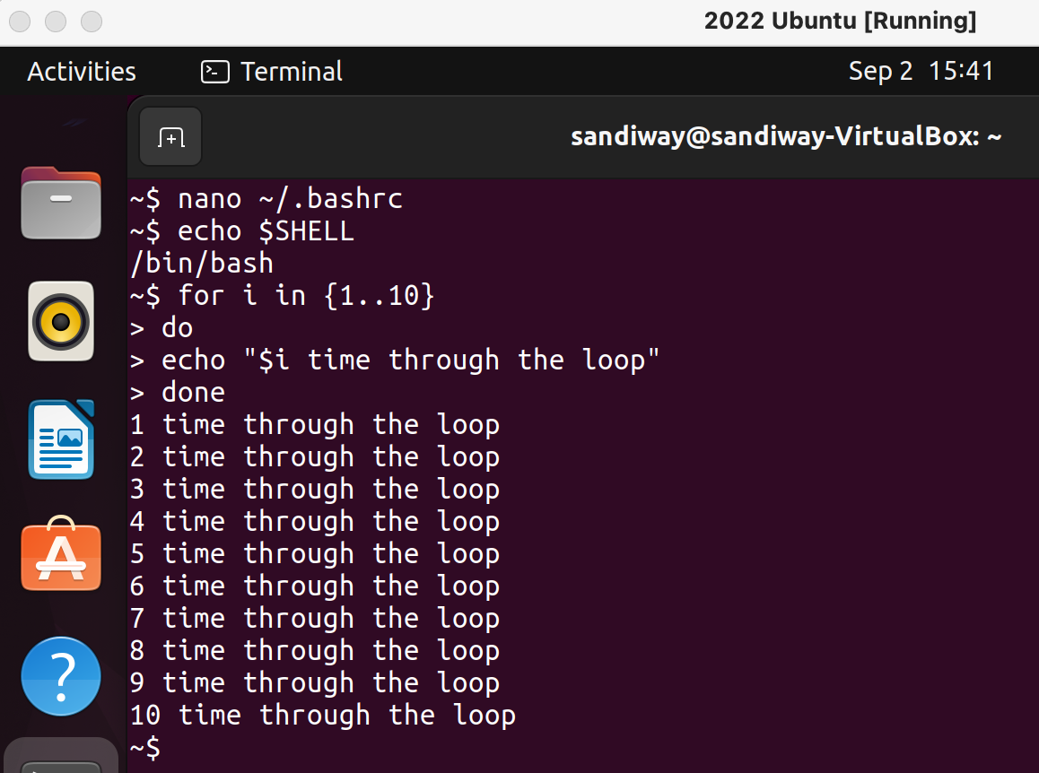
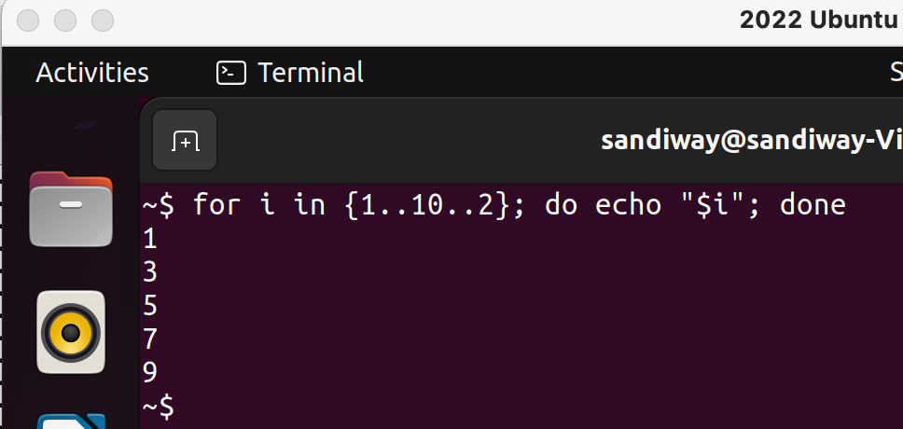
Shell program
{1..10..2} means range from 1 to 10 incrementing by 2
; (semicolon) or newline terminates/separates statements
echo means print
not in macOS
~$ for ((i=1; i<=10; i=i+2)); do echo "$i by 2"; done
1 by 2
3 by 2
5 by 2
7 by 2
9 by 2
macOS

Slide 7
Input
At a terminal:
  read –p "Name: " name
  read –p "Enter X and Y: " x y
  echo $x
  echo $y

Slide 8
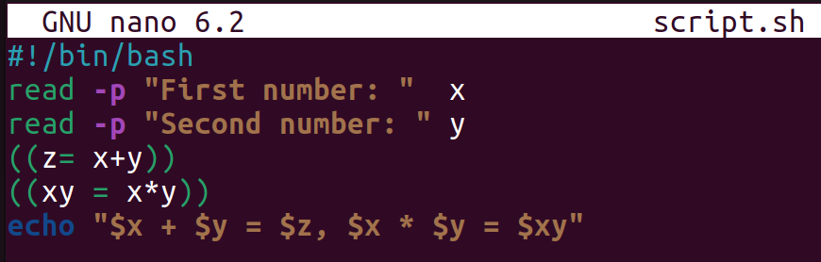
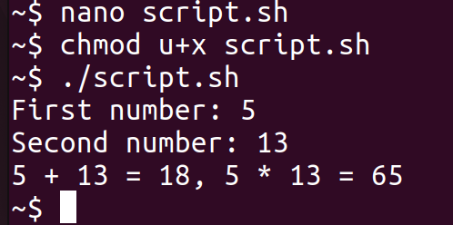
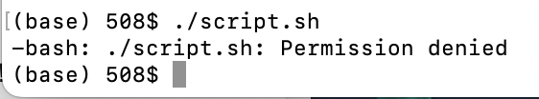
Shell script
Use nano to create a new file named script.sh (convention .sh for script filetype):
  nano script.sh
Enter:
Run it!
./script.sh means run the script in file script.sh in the current directory (.)
chmod u+x filename means add (+) execute (x) permission for user (u) to filename
Without chmod!

Slide 9
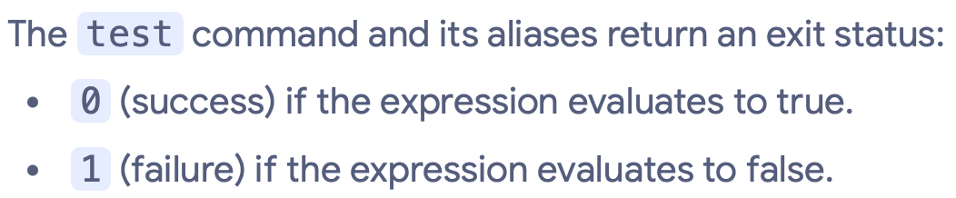
Comparison operators: if-then
Format:
  if [ $x OP $y ]; then
  …
  (else/elif…)
  fi
  [ …. ] is known as test (need spaces)
  OP (numeric):
    -eq equals
    -ne not equals
    -gt greater than
    -ge greater than or equals
    -lt less than
    -le less than or equals
Examples:
  echo $x $i
  2 5
  test $x -le $i
  echo $? (exit status)
  0
  test $x -le $i -a $i -lt $x
  echo $?
  1

Slide 10
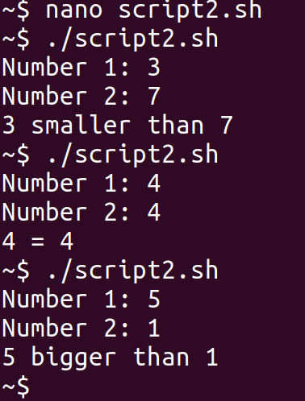
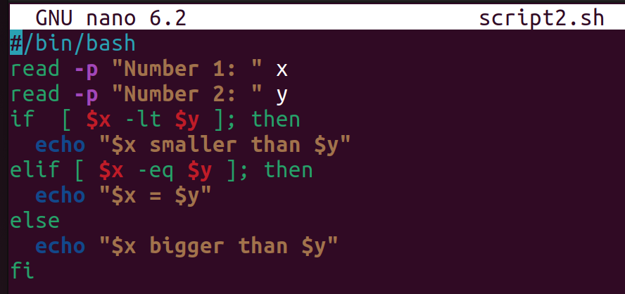
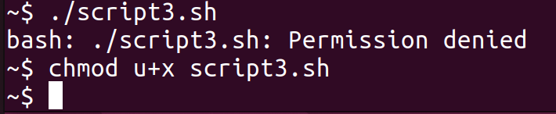
Shell script 2
using the same approach as in the first shell script …
Beware of execute permissions!

Slide 11
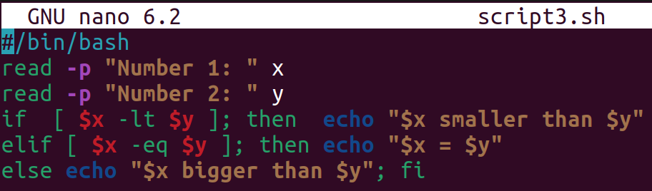
Shell script 2
Compare these two files:
newlines sometimes matter
; separator must be used in some cases
  if condition; then
  vs.
  if condition
  then
  see also ; fi

Slide 12
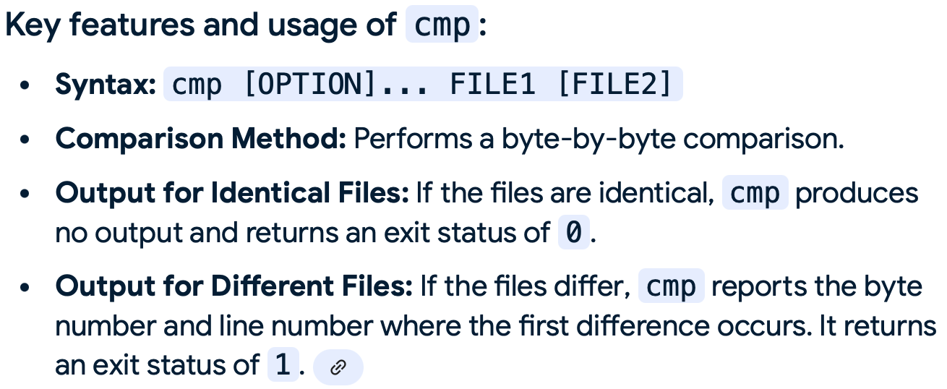
exit value: if-then
https://tldp.org/LDP/abs/html/testconstructs.html
Examples:
if cmp a b &> /dev/null # &> /dev/null means suppress output then echo "Files a and b are identical." else echo "Files a and b differ." fi
$ cmp file1 file2
file1 file2 differ: char 1, line 1
$ cmp file1 file2 &> /dev/null
$ echo $?
1

Slide 13
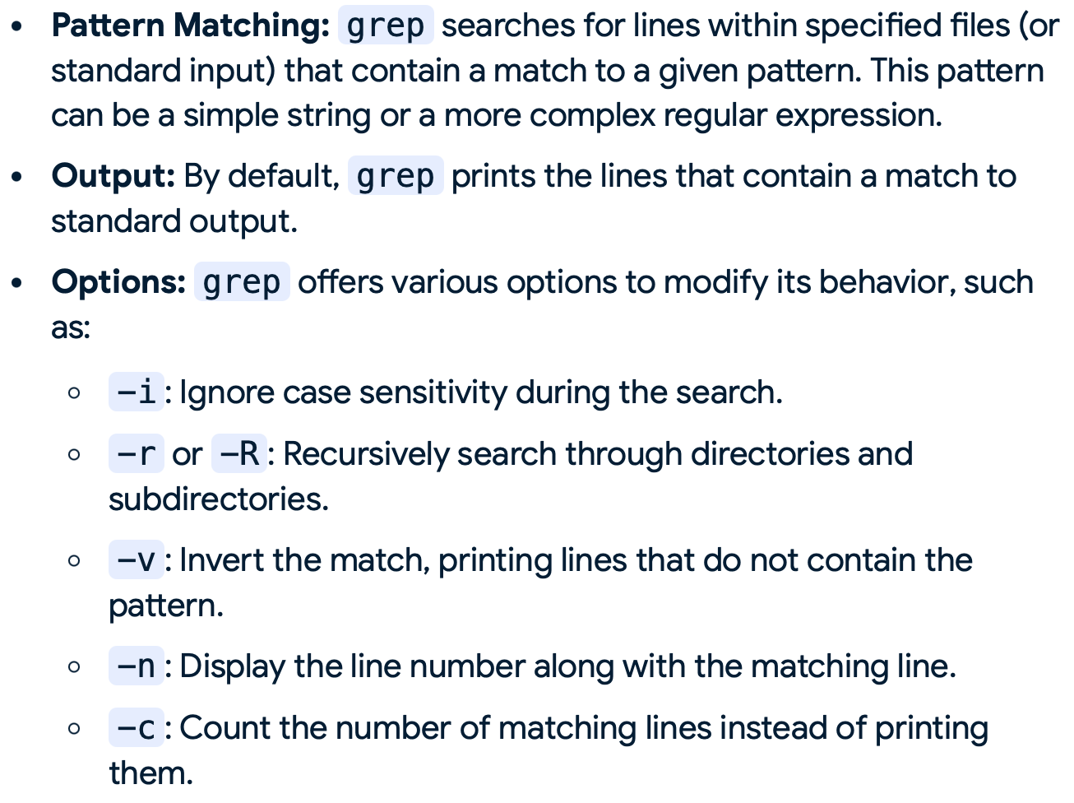
exit value: if-then
# The very useful "if-grep" construct:
if grep -q Bash file
then echo "File contains at least one occurrence of Bash."
fi

Slide 14
exit value: if-then
word=Linux
letter_sequence=inu
if echo "$word" | grep -q "$letter_sequence" # "-q" suppresses output.
then
echo "$letter_sequence found in $word"
else
echo "$letter_sequence not found in $word"
fi

Slide 15
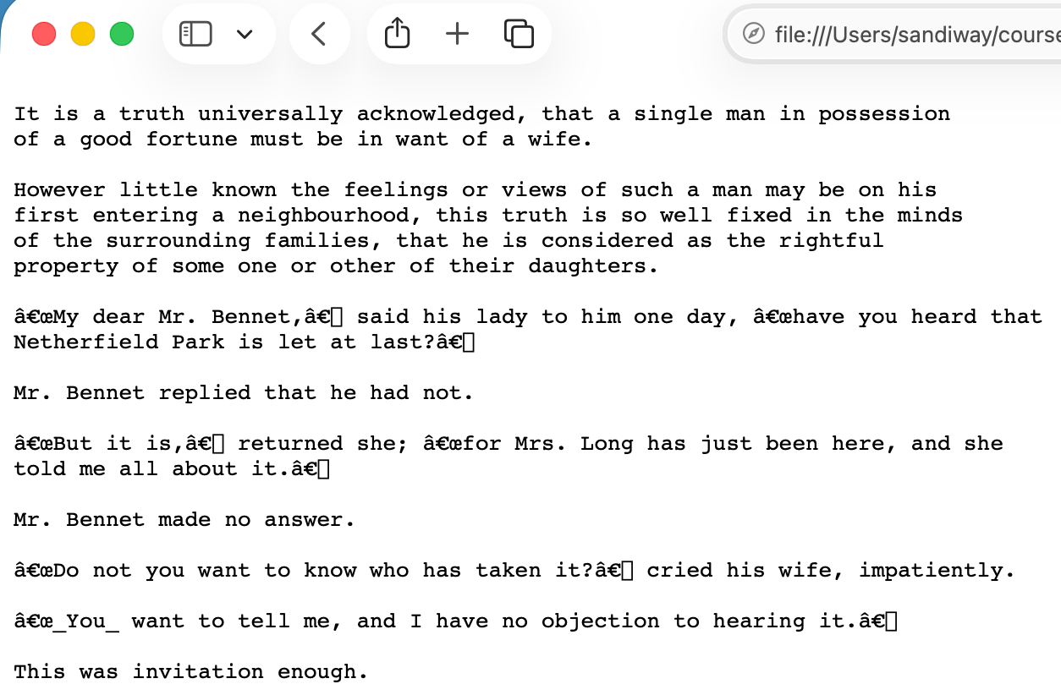
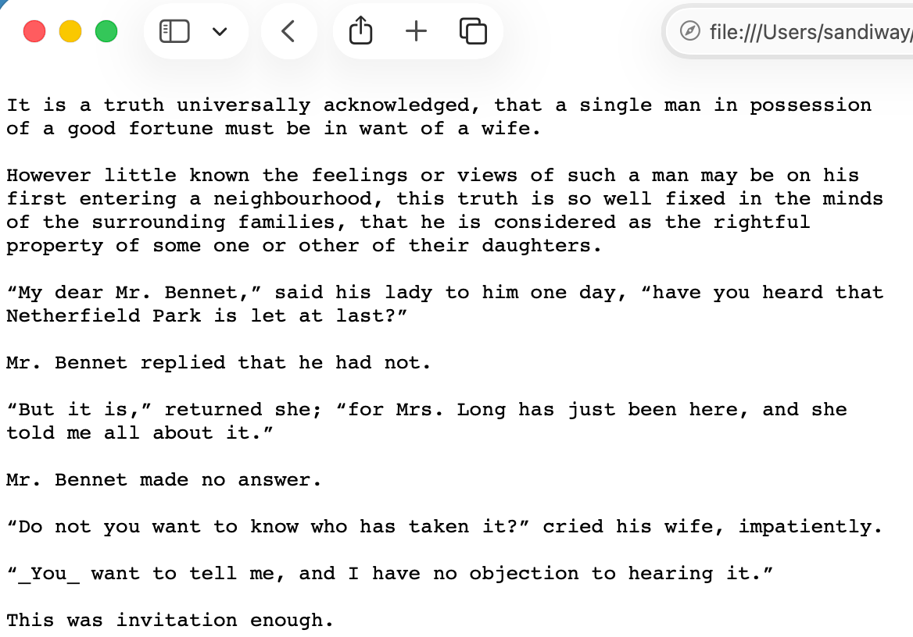
Homework 3: Exercise 1
Download file text.txt from the course website
  You can use the browser (copy) and save the file as plain text
Default encoding: Safari
utf-8: Safari

Slide 16
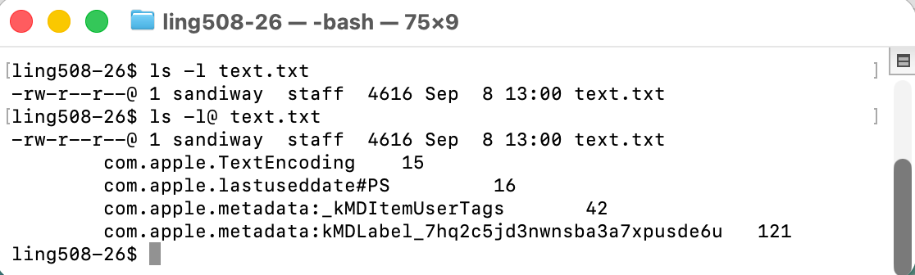
Homework 3: Exercise 1
Check to see the file exists in your directory in the Terminal
4616 bytes in size

Slide 17
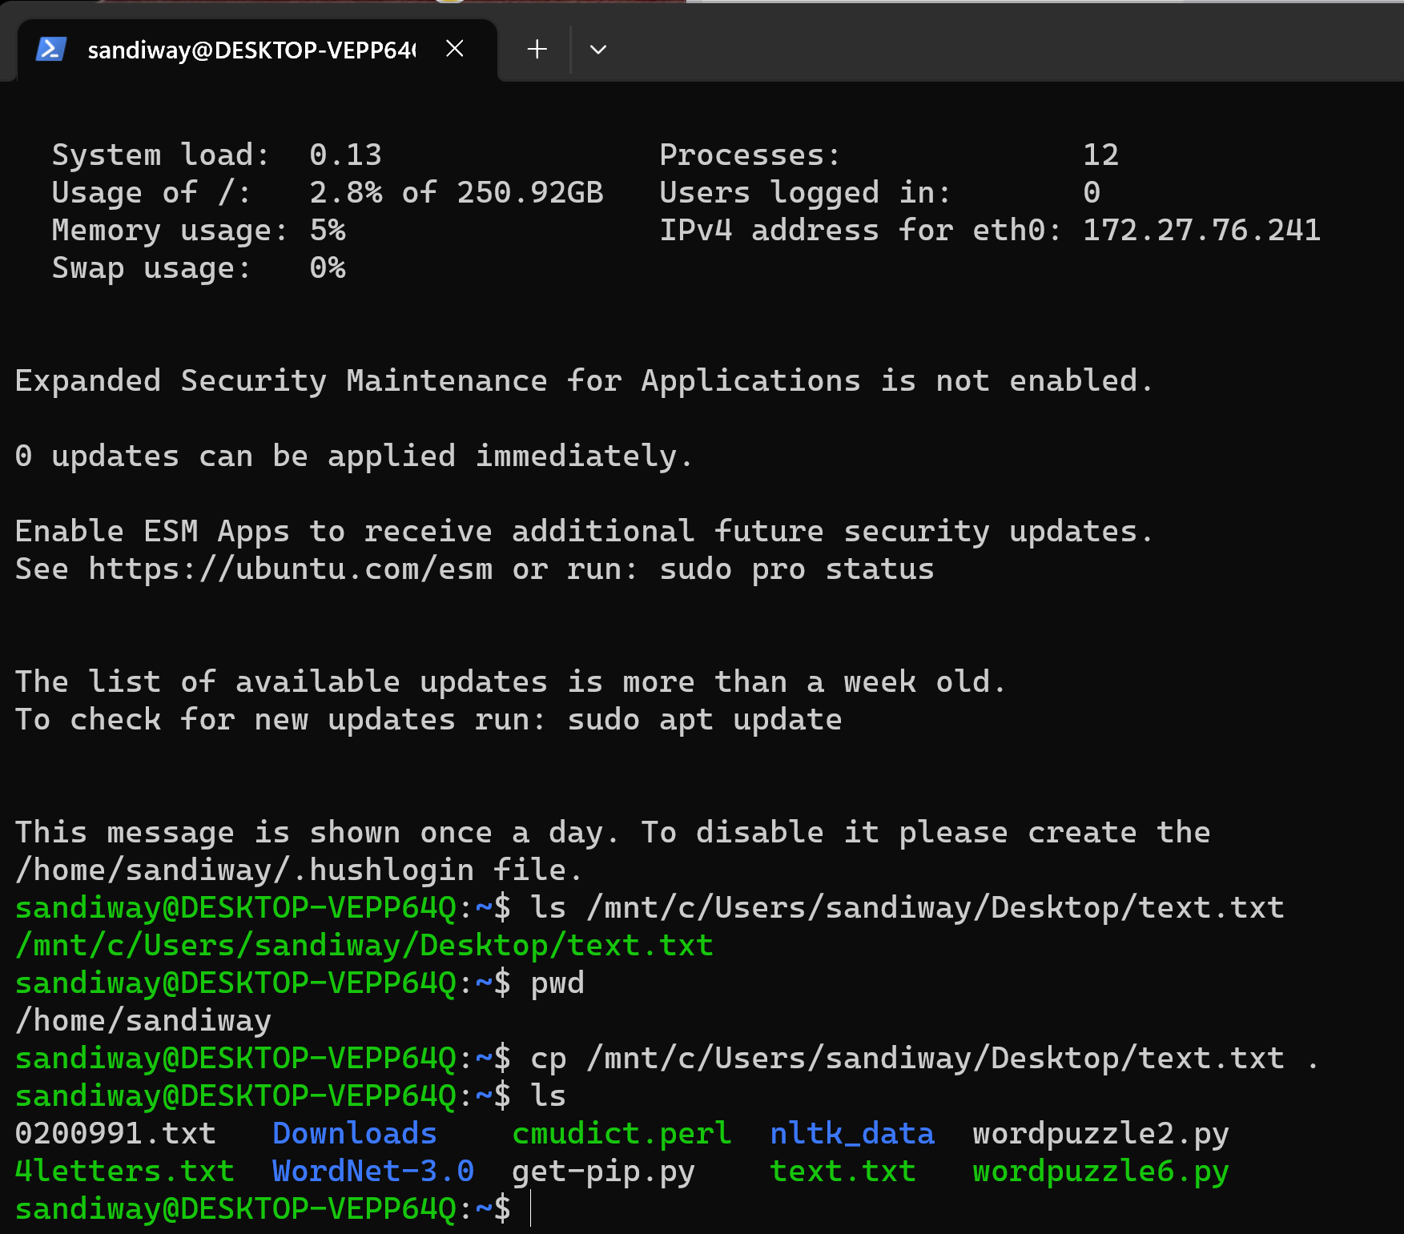
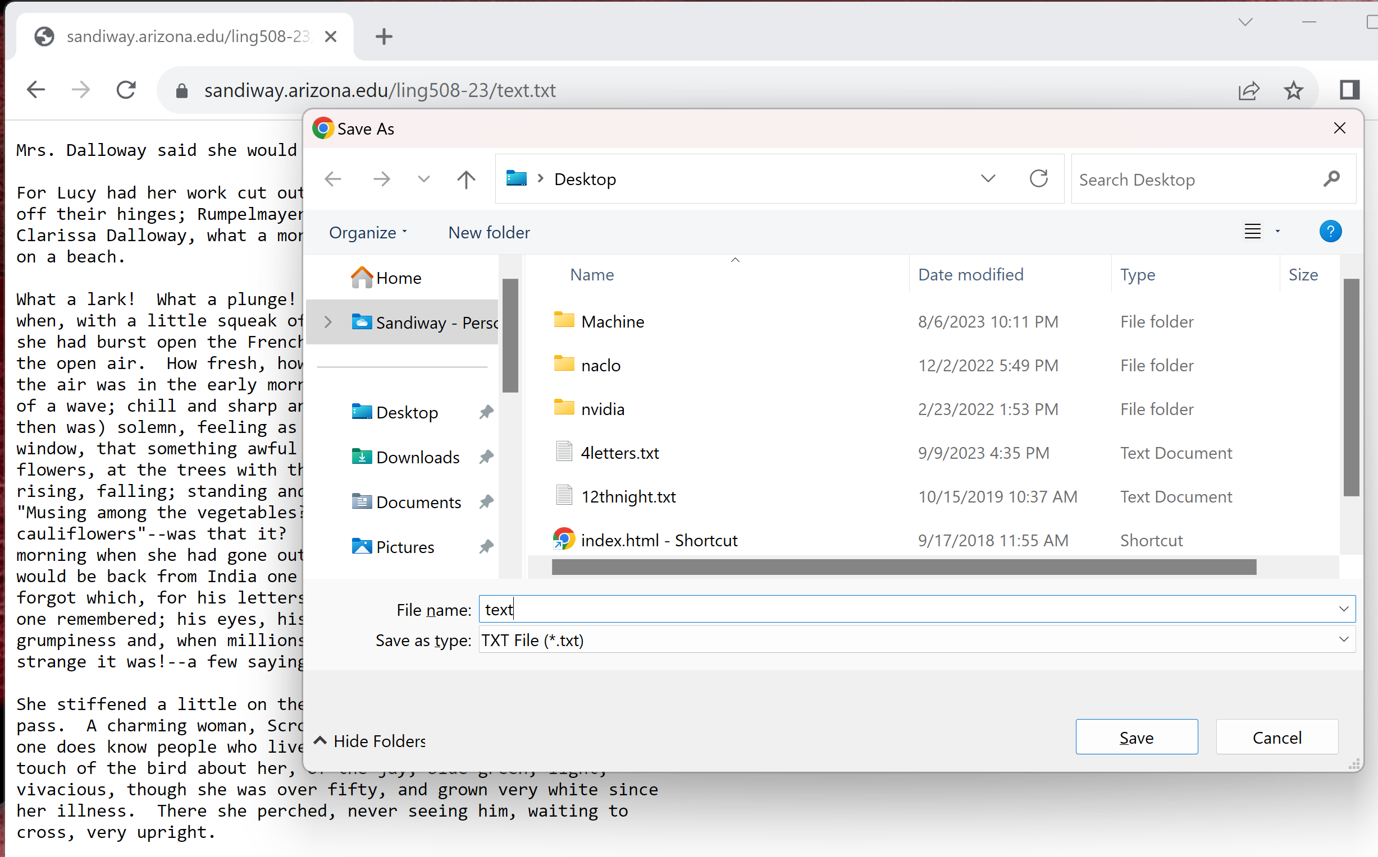
Note: Windows file access from Ubuntu
Lecture 4: can cp (copy)
can access your Windows C: drive
(from within Ubuntu) via directory /mnt/c

Slide 18
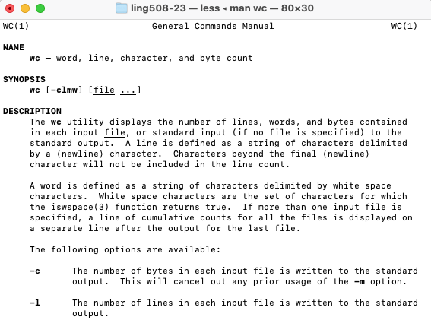
Homework 3: Exercise 1
wc is a useful command.
3. Do man wc to see the manual page (manpage).

Slide 19
Homework 3: Exercise 1
Try file text.txt. What does it report?
Try wc text.txt. Find out from the manpage what the three numbers reported mean. Screenshot it.
What's the wc option that prints the number of words only? Try it.

Slide 20
Homework 3: Exercise 1
nano text.txt.
  Type Control-G in the text editor to see the help text.
  You can type Control-X or Control-G to go back to displaying the contents of text.txt
  Ubuntu:
    Scroll down and see if you can find the command for counting number of words, lines and characters.
    What is that command and how do you type it? What is reported?
    Screenshot its output for text.txt.
  macOS: nano is pico unfortunately:
    The counting command is not directly available
    Use Control-C to see the line number at your cursor position.
    Screenshot the relevant output for text.txt.
  In either case, compare your answer with that obtained in 5.

Slide 21
Homework 3: Exercise 2
Let's use the Terminal to make a frequency list of the words in text.txt
First, look at the manpage for command tr.
Next, let's replace all the punctuation characters by spaces.
Observe the output of both commands below. See any difference?
Which command do we want?
  cat text.txt | tr '[:punct:]' ' '
  cat text.txt | tr -d '[:punct:]'
Note 1: pipe ('|') sends the output of the cat command as input to the next command tr.
note: a space here

Slide 22
Homework 3: Exercise 2
Note 2: we can redirect ('>') the output of the above command into a file, e.g. text2.txt, as follows:
  command > text2.txt
Next, we can put each word on a separate line using:
  tr ' ' '\n'
Note 3: \n stands for a newline character.
Combine the previous two steps (1 & 2) together.
Note 4: you can use text2.txt (if you saved the output), or just chain the command onto the end, i.e. do:
  commands-so-far | tr ' ' '\n'
note: a space here

Slide 23
Homework 3: Exercise 2
Next, look at the manpage for command uniq.
Let's make a table of the frequency counts for each word using:
  sort | uniq -c
by running the above command on the output of Step 3 above.
  Note 5: you can chain this command as mentioned earlier, or save the output of step 4 into another file, e.g. text3.txt. Example:
  command | sort | uniq -c
Why do we sort first? Read the uniq manpage to find out.

Slide 24
Homework 3: Exercise 2
Let's put the results in sorted order of frequency (descending) by appending another command:
  sort –rn
to our list of commands so far (step 4 above).
Be sure to chain it using the pipe ('|').
  consult the sort manpage to find out what the options –r and –n above do.
Show your output.

Slide 25
Instructions
Email to sandiway@arizona.edu
By Sunday midnight (will be graded on Monday)
SUBJECT: 408/508 Homework 3: YOUR NAME
ONE PDF file please
  screenshots should be inside,
  not as a bunch separate attachments
do not submit Word .docx or .doc files
do not submit a link to your PDF file, submit the actual file

