Slide 1
408/508 Computational Techniques for Linguists
Lecture 5

Slide 2
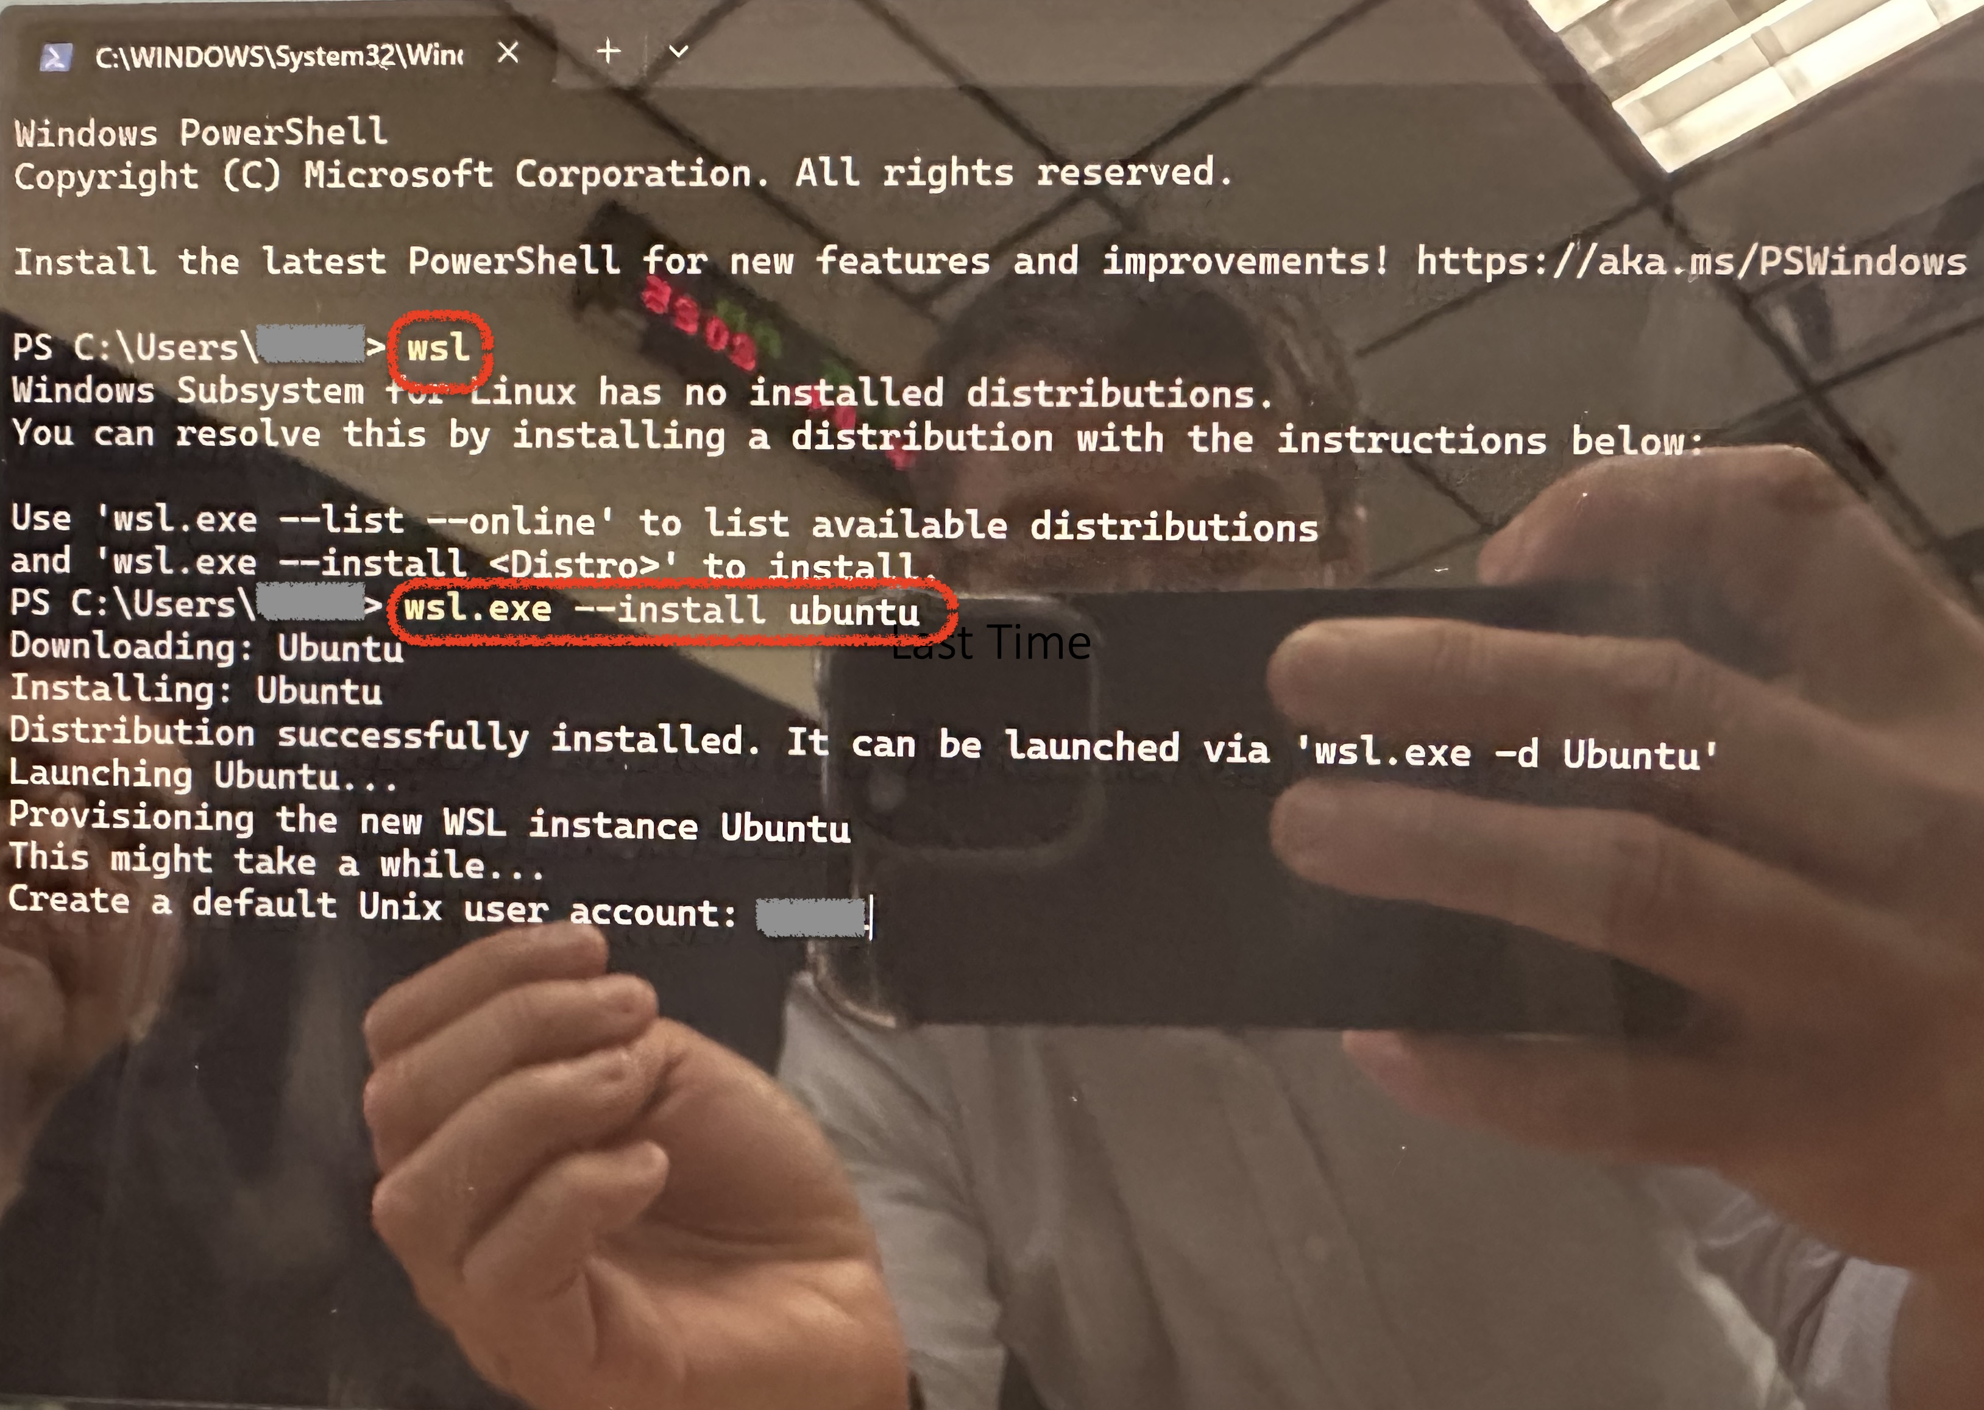
Install WSL2 https://learn.microsoft.com/en-us/windows/wsl/install wsl wsl.exe --install ubuntu

Slide 3
Today's Topics
Terminal commands in Ubuntu

Slide 4
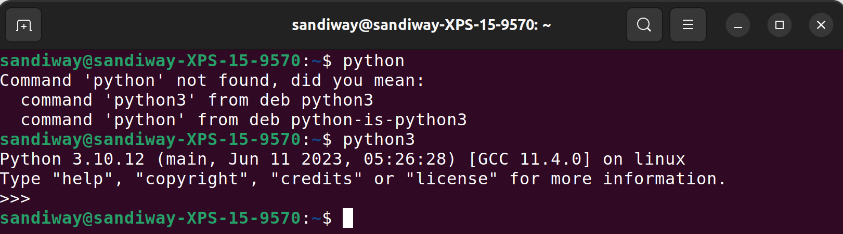
Ubuntu: bash
bash contains a programming language!
Terminal:
  runs a shell: typically bash (or a lightweight clone of bash, e.g. zsh on macOS)
  enter commands:
    some are built-in to the shell (programming language)
    others are executable files in specified directories ($PATH)
    still others will require package apt-get install or apt install
    Example:
Type Control-D to exit

Slide 5
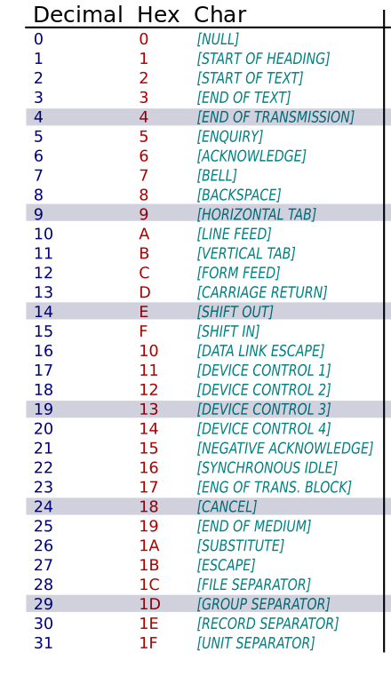
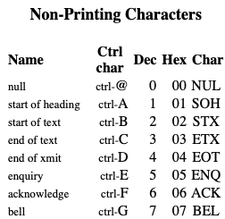
Ubuntu: bash
What is Control-D?
  why does it quit?
Well, let's ring the bell!

Slide 6
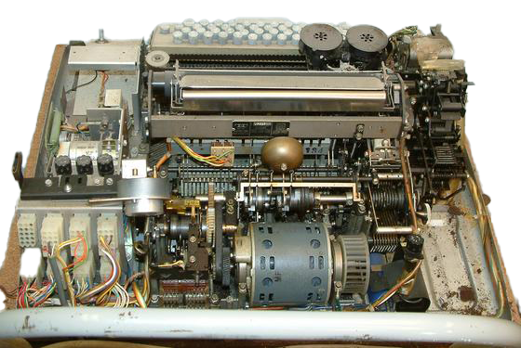
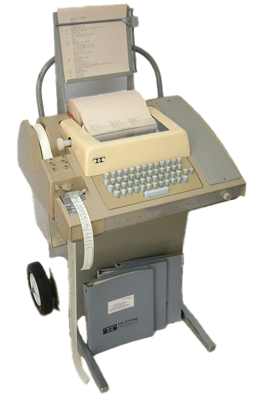
Ubuntu: bash
a real bell!
Teletype
ASR 33
1974 price:
$755 to
$1220
Today:
$7550
pdp8online.com

Slide 7

Ubuntu: bash
BTW: 1974 price: $1220 Today: $7550
$3700

Slide 8
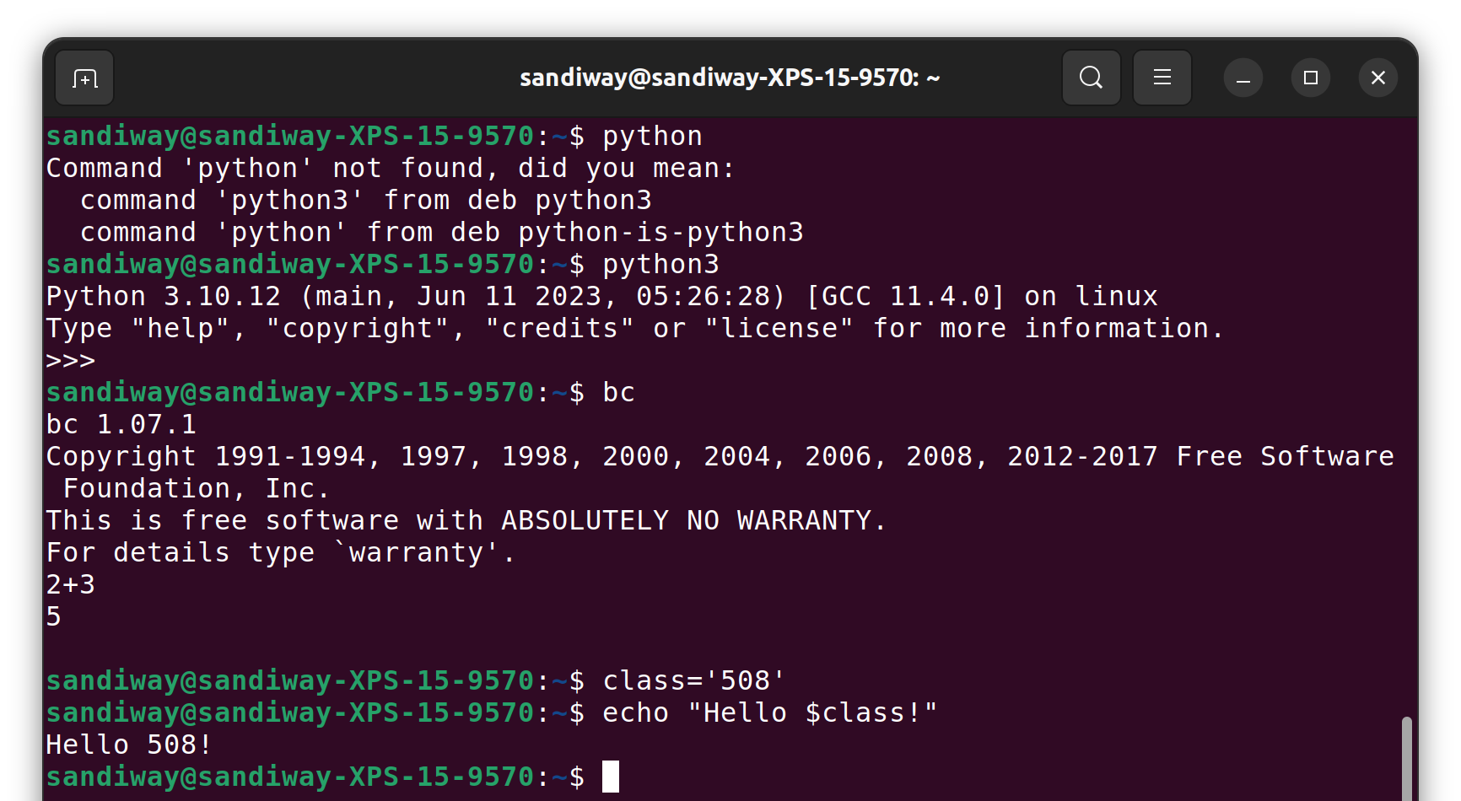
Ubuntu: bash
Control-D to exit
bc calculator
class shell variable
echo string

Slide 9
Ubuntu: bash
Terminal:
  there's a (customizable) prompt
  command history is editable (up-arrow for previous command …)
  pre-defined environment variables: env
  lots of packages are pre-loaded: python, perl, etc.
  dpkg (package manager for Debian)
  man command-name (brings up manual page)
dpkg –l (list)

Slide 10
Ubuntu: bash
simple commands:
  pwd print working directory
  ls (ls -a) list current directory
  (-a option: show . (dot) files too)
  cd change directory
  mkdir create a new directory
  which name prints the directory where command
  name is located, or nothing if it can’t be
  found in the PATH
  man name display manual page for command name
  echo $SHELL prints the shell ($ prefixes a variable)
  echo $PATH shows the directories where the shell will
  look for commands

Slide 11
Ubuntu: bash
Directory shortcuts (abbreviations):
your home directory: ~
current directory: .
parent directory: ..
Examples:
  cd .. (go to parent directory)
  mkdir ~/tmp (create a new directory called tmp in your home directory)
  touch tmp (create a new file tmp in the current directory if tmp
  doesn’t already exist, or update the timestamp)
  ls -l tmp (list attributes of file tmp in long format)
  -rw-r--r-- 1 sandiway staff 0 Sep 4 09:26 tmp
permissions
user group all
r = read
w = write
x = execute
owner
group
size
(bytes)
date
time
modified
filename

Slide 12
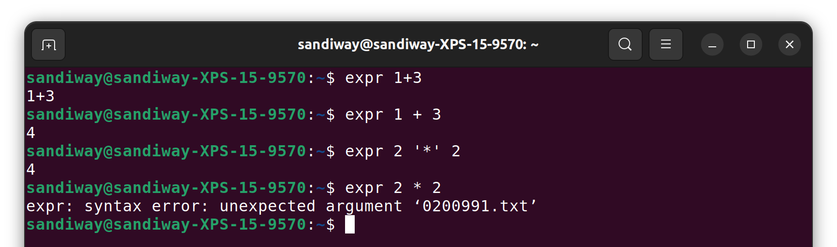
Shell Arithmetic (very primitive -> less rigid)
at the shell prompt:
  expr 1 + 3 (Need spaces cf. expr 1+3)
  expr 2 '*' 2 (cf. expr 2 * 2)
  echo `expr 7 + 3`
* is a file wildcard character

Slide 13
Shell Arithmetic (very primitive -> less rigid)
at the shell prompt:
  i=2 (NO SPACES! cf. i = 2)
  expr $i + 1
  let x=1+3 (cf. let x=1 + 3)
  echo $x
  let i=$i+1 (also ok let i=i+1)
  echo $i

Slide 14
Shell Arithmetic (very primitive -> less rigid)
at the shell prompt ((…)) – easier to use, less rigid syntax:
  i=$((1+3)) (set variable i to value of expr 1 + 3)
  ((x = 1+ 3)) (spaces not significant)
  echo $x
  echo $((1+3))
  ((i=i+1)) (also ok let i=$i+1)

Slide 15
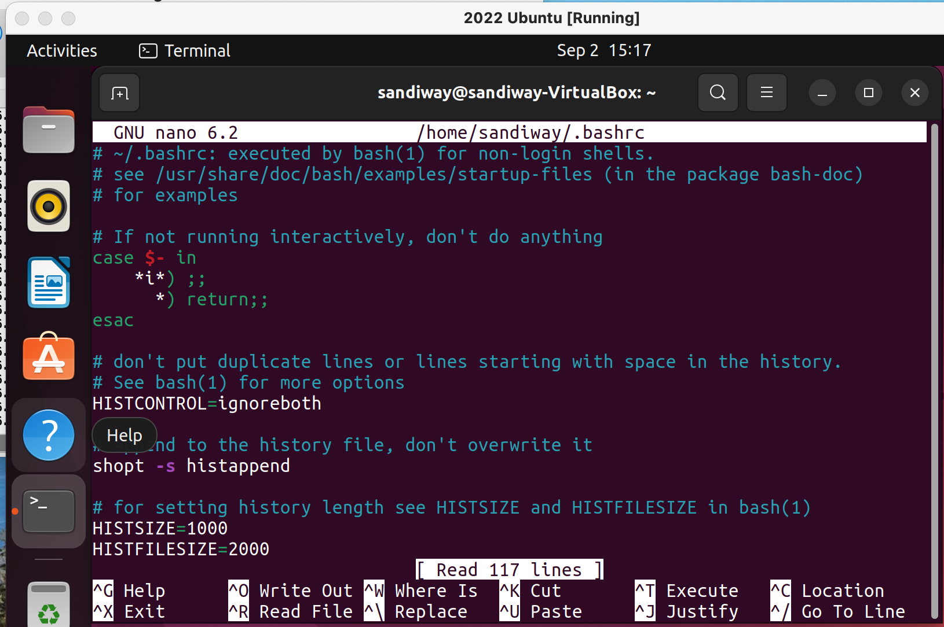
Ubuntu
nano ~/.bashrc (run the nano text editor on the startup file)

Slide 16
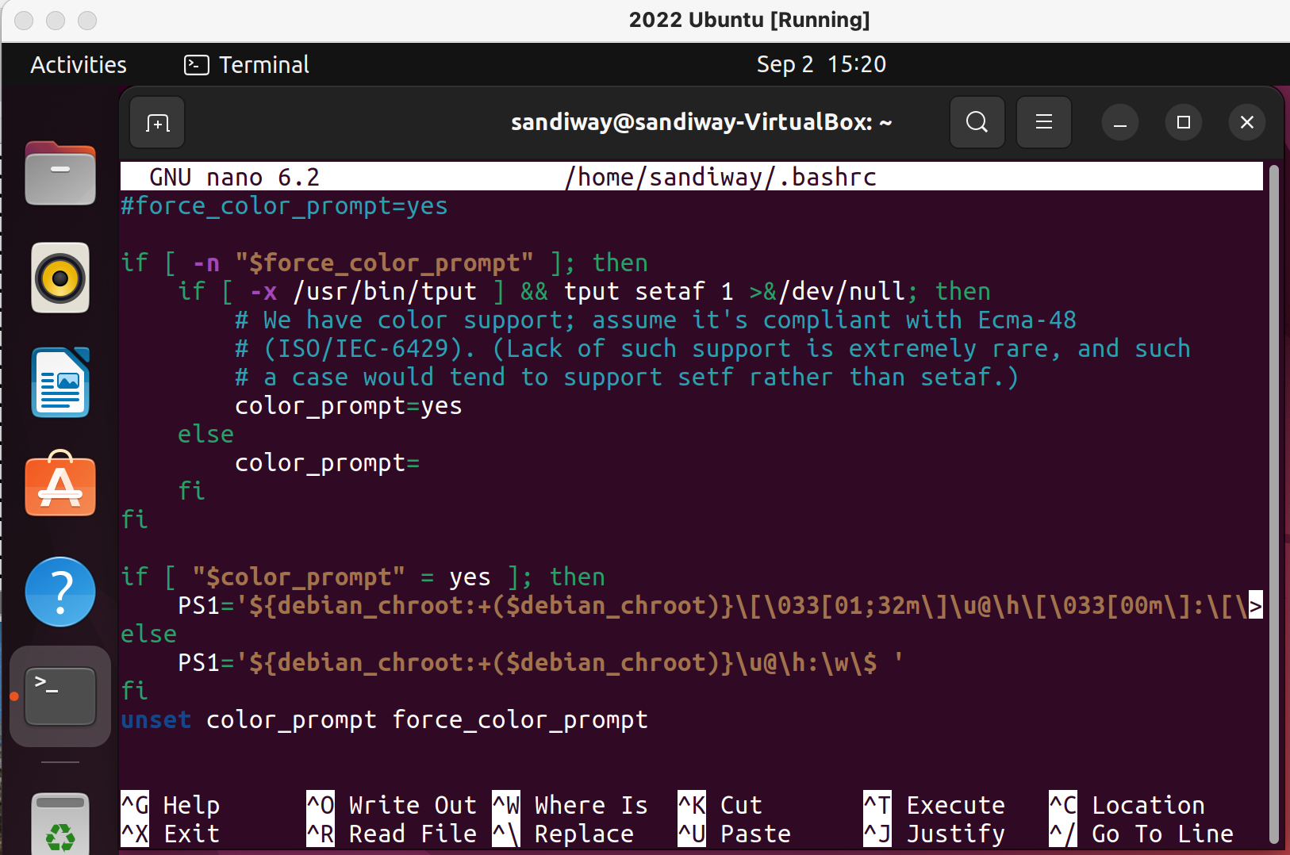
Ubuntu
scroll down (arrow keys) until you see PS1=
let's insert a line PS1='\w\$ '
  PS1 is the variable holding the prompt string
  '\w\$ ' is a single-quoted string
  \w means print working directory
  \$ means print $
Then Control-O RETURN (to write out the change)
Then Control-X to Exit Nano
Then close the Terminal and restart it
here!

Slide 17
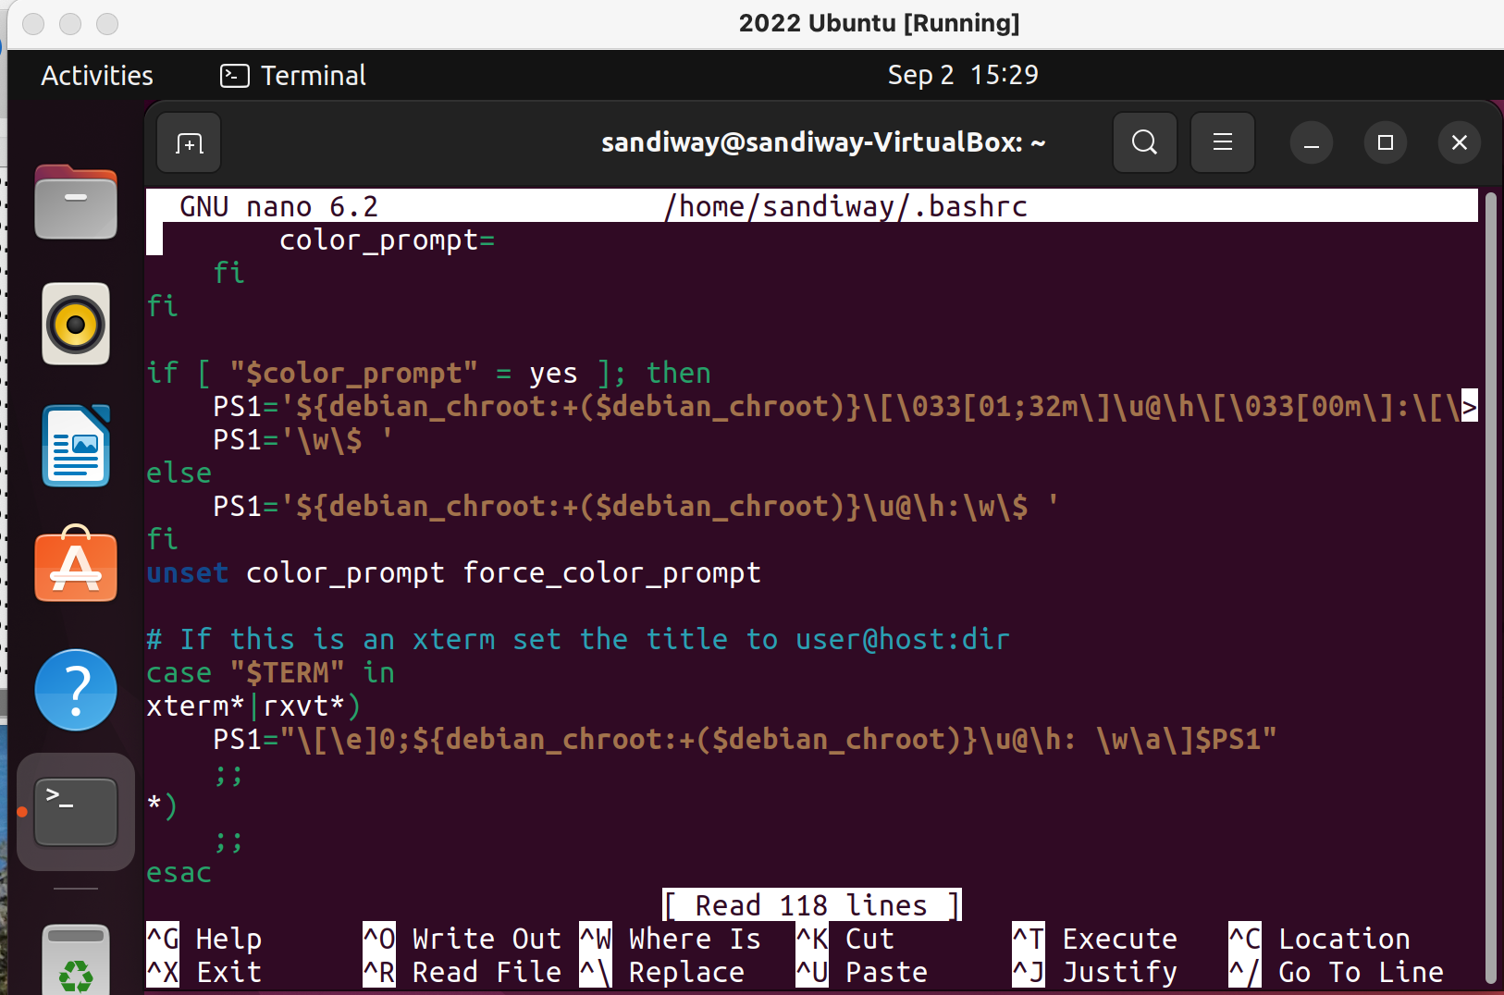
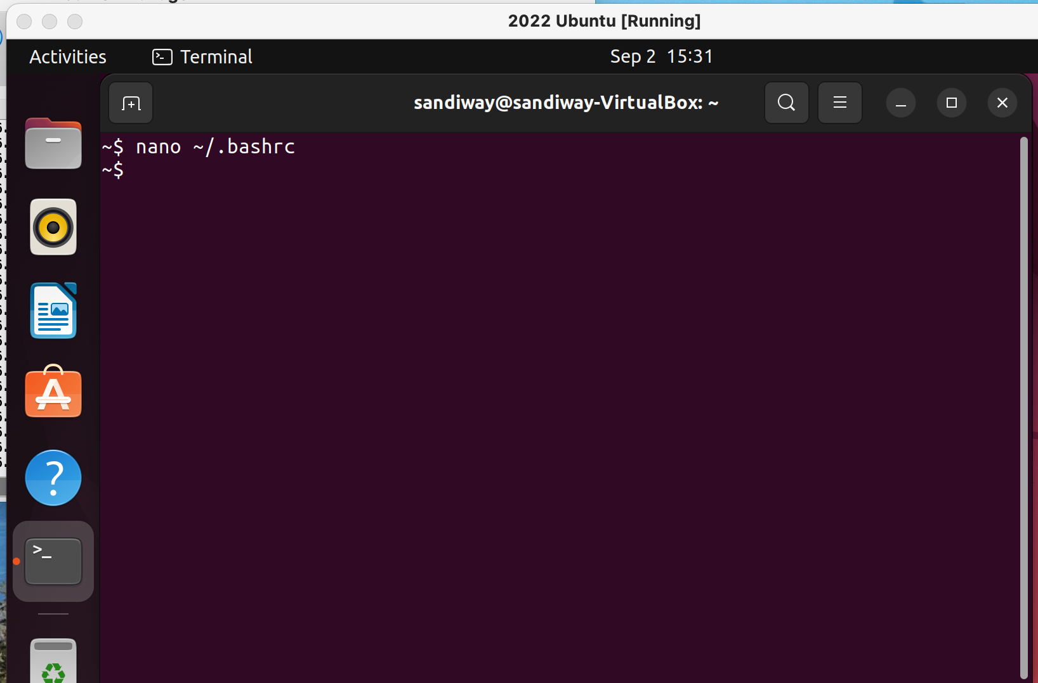
Ubuntu
modified ~/.bashrc file (~ means your home directory)
~$ is a nice and short prompt!

Slide 18
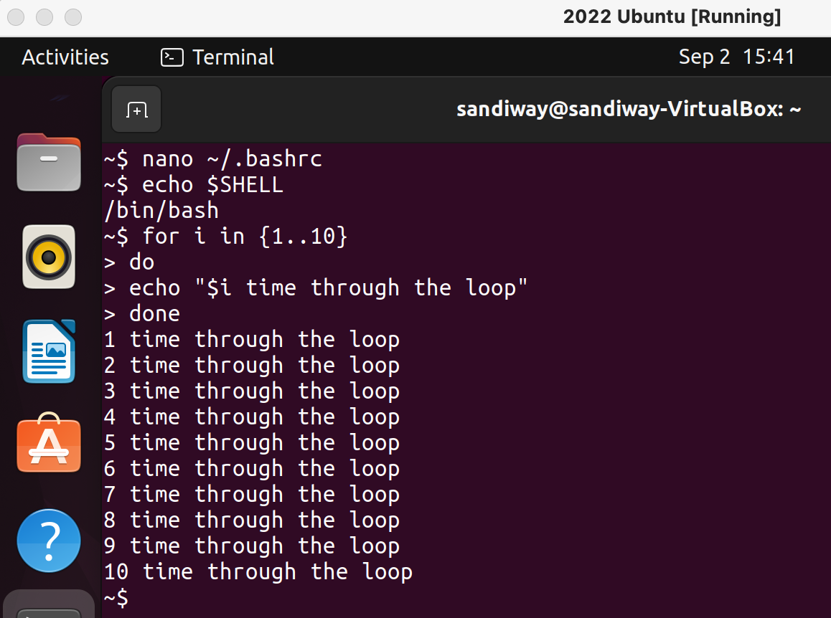
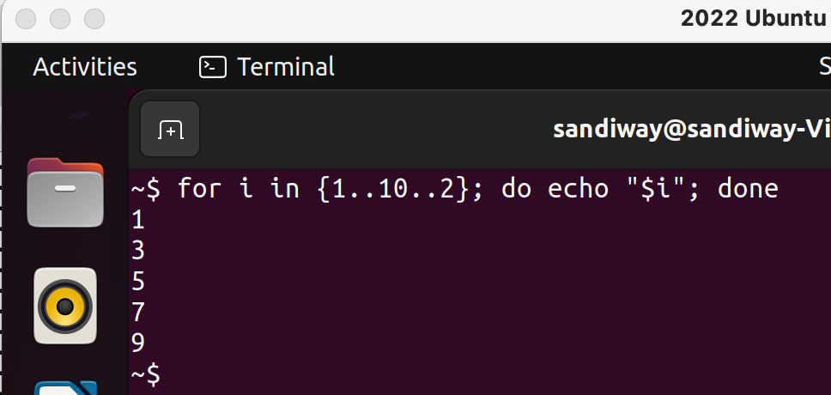
Shell program
{1..10..2} means range from 1 to 10 incrementing by 2
; (semicolon) or newline terminates/separates statements
echo means print
~$ for ((i=1; i<=10; i=i+2)); do echo "$i by 2"; done
1 by 2
3 by 2
5 by 2
7 by 2
9 by 2
macOS

