Slide 1
408/508 Computational Techniques for Linguists
Lecture 4

Slide 2
Today's Topics
Homework 1 Review
Finish up with HTML and character encoding
We're gonna need the Terminal
  but we don't want our mistakes to kill the machine
  can run stuff inside a guest Operating System, or be very careful
    Example: rm -rf *
Homework 2:
  for Windows 11 users, install Microsoft WSL
  for Apple Silicon users, use existing Terminal
  for Linux users, do nothing

Slide 3
Quick Homework 1 Review
2,147,483,659 is a prime number.
Does the 32 bit binary integer representation have enough bits to represent this prime? Explain.
2³¹ | 2³⁰ | 2²⁹ | 2²⁸ | 2²⁷ | 2²⁶ | 2²⁵ | 2²⁴ | … |  | … | 2⁷ | 2⁶ | 2⁵ | 2⁴ | 2³ | 2² | 2¹ | 2⁰
byte 3 | byte 2 | byte 1 | byte 0
~$ python
>>> 2_147_483_659
2147483659
>>> bin(2_147_483_659)
'0b10000000000000000000000000001011'
>>> len(bin(2_147_483_659))
34
only as an unsigned number
NOT using 2's complement

Slide 4
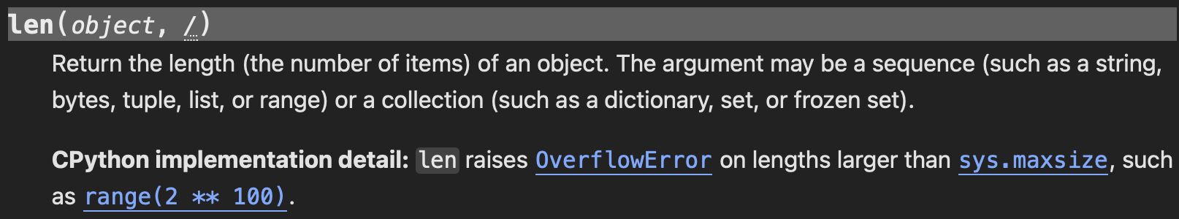
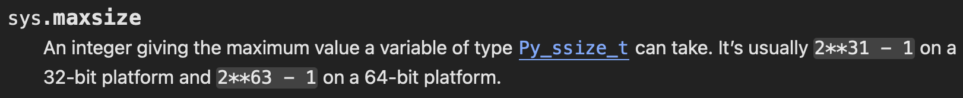
Quick Homework 1 Review
docs.python.org/3/library/functions.html#len

Slide 5
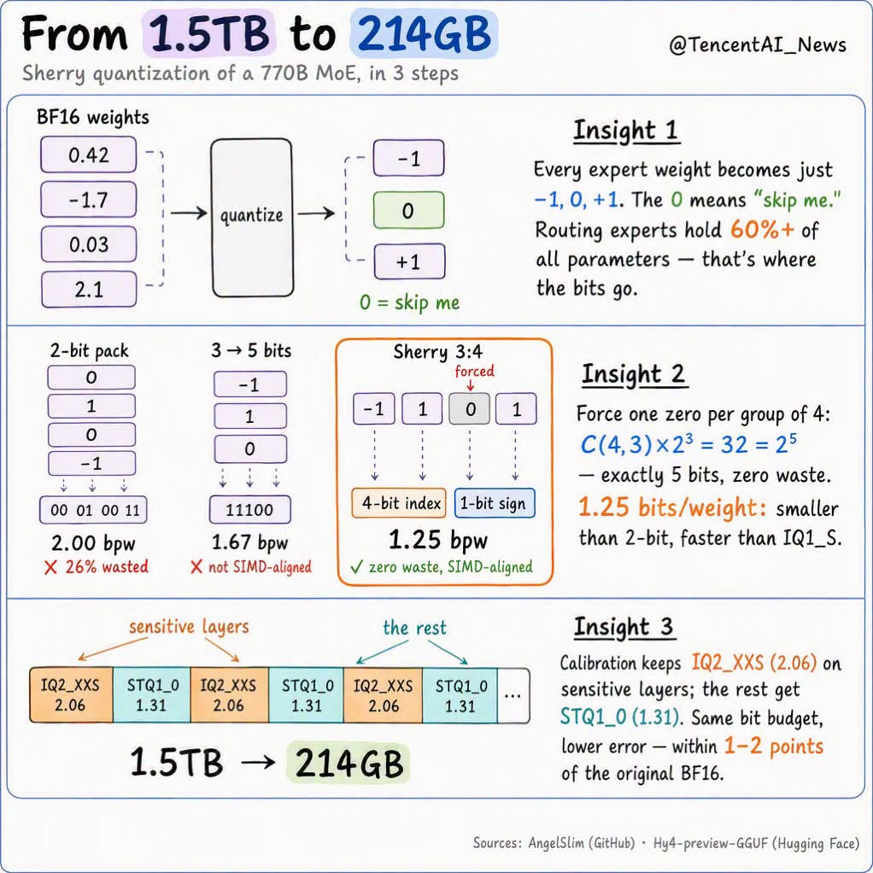
Making LLMs smaller
https://huggingface.co/AngelSlim/Hy4-preview-GGUF
Idea: reduce # of bits "needed" per floating number
(V)RAM needed:
  1,500GB –> 200GB
Performance on benchmarks:
  - MCP Atlas 83.7 to 83.2 (AI agents)
  - SWE-Bench Multi 82.9 to 81.3 (Coding)
  - MRCR 81.3 to 81.1(Coreference retrieval task)

Slide 6
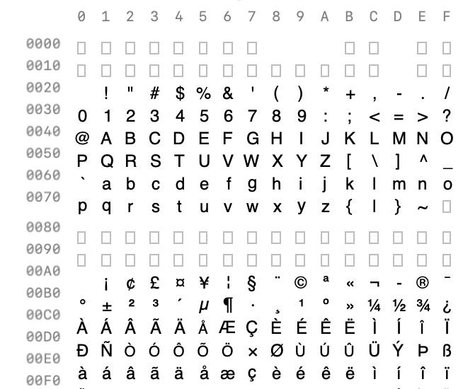
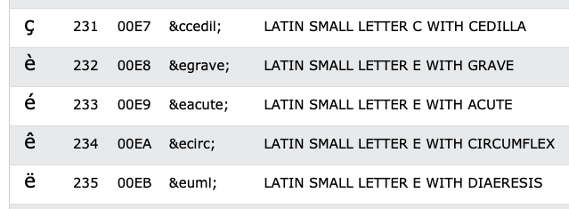
Introduction: data types
In your browser, which runs HTML5, UTF-8, is the default character encoding

Slide 7
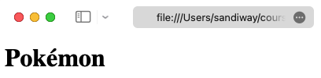
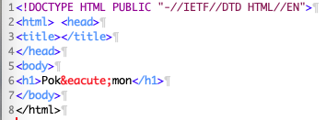
Introduction: data types
File: pokemon.html

Slide 8
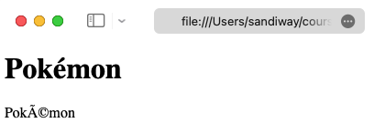
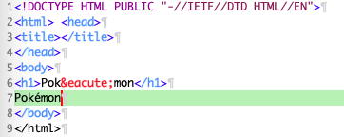
Introduction: data types
line 7: é typed on my mac keyboard using OPT-e e
File: pokemon2.html

Slide 9
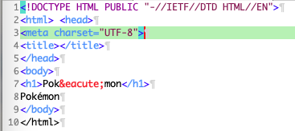
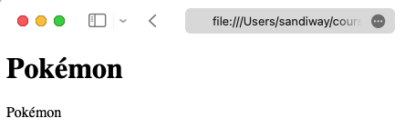
Introduction: data types
File: pokemon3.html

Slide 10
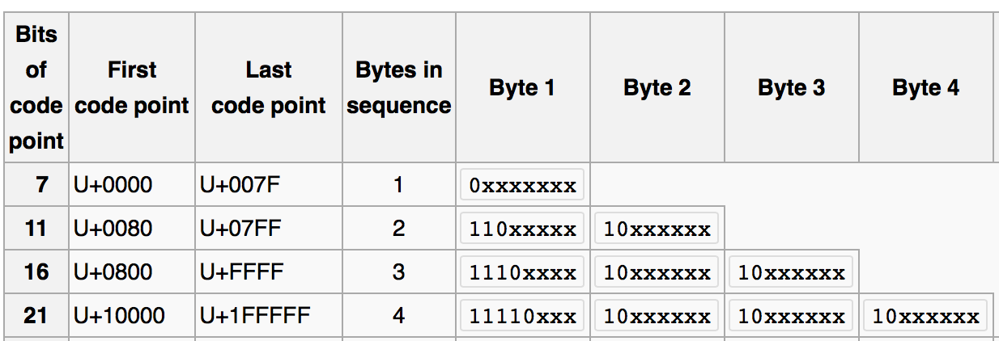
Introduction: data types
Example:
  あ Hiragana letter A: UTF-8: E38182
  Byte 1: E = 1110, 3 = 0011
  Byte 2: 8 = 1000, 1 = 0001
  Byte 3: 8 = 1000, 2 = 0010
  い Hiragana letter I: UTF-8: E38184
Shift-JIS (Hex):
あ: 82A0
い: 82A2

Slide 11


Introduction: data types
No <meta charset="UTF-8">
あ Hiragana letter A: UTF-8: E3 81 82
い Hiragana letter I: UTF-8: E3 81 84
Latin-1 character set (8 bits) https://kb.iu.edu/d/aepu

Slide 12
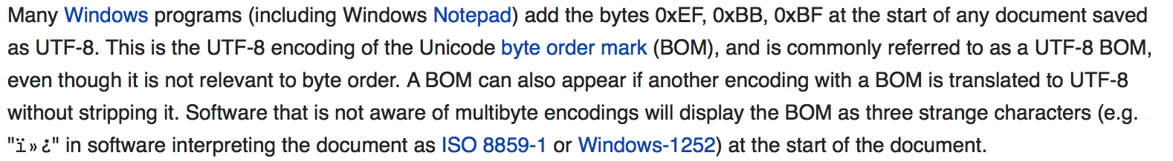
Introduction: data types

Slide 13
Introduction: data types
How can you tell what encoding your file is using?
Detecting UTF-8
  Microsoft:
    1st three bytes in the file is EF BB BF
    (not all software understands this; not everybody uses it)
  HTML:
    <meta http-equiv="Content-Type" content="text/html;charset=UTF-8">
    (not always present)
  Analyze the file:
    Find non-valid UTF-8 sequences: if found, not UTF-8…
    Interesting paper:
      http://www-archive.mozilla.org/projects/intl/UniversalCharsetDetection.html

Slide 14
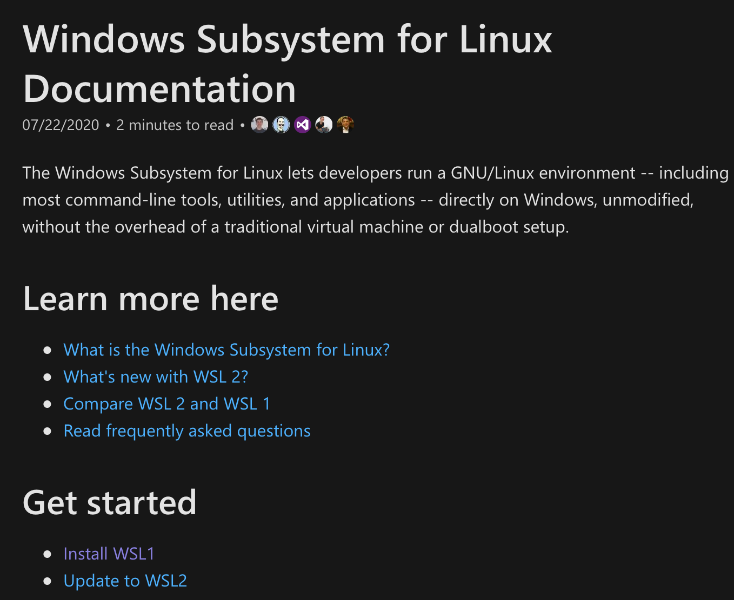
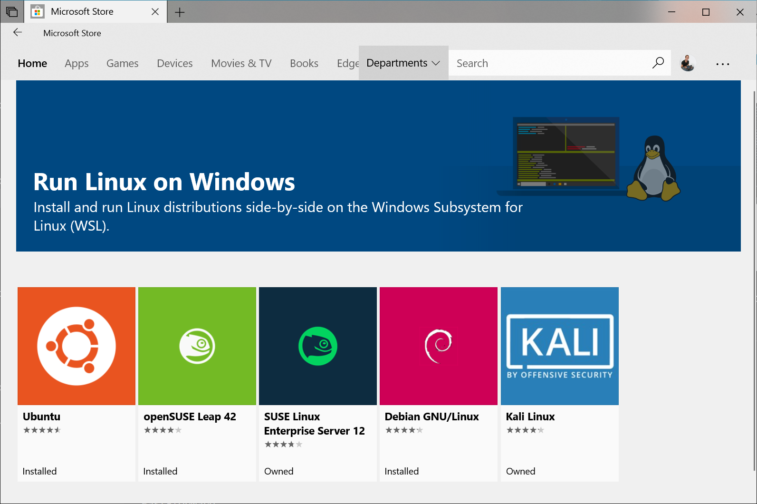
WSL2
Windows Subsystem for Linux
  https://docs.microsoft.com/en-us/windows/wsl/

Slide 15
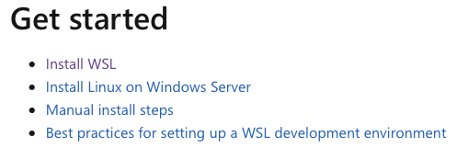
WSL2
Consider installing WSL2 (Windows Subsystem for Linux 2)
  https://learn.microsoft.com/en-us/windows/wsl/
Why?
  gives you a Bash shell (with quoting consistent with the lecture slides)
  (simultaneously) use Linux under Windows 10/11 (not dual-booting)
  can access your Windows C: drive from Ubuntu via directory /mnt/c

Slide 16

WSL2
I installed Ubuntu

Slide 17
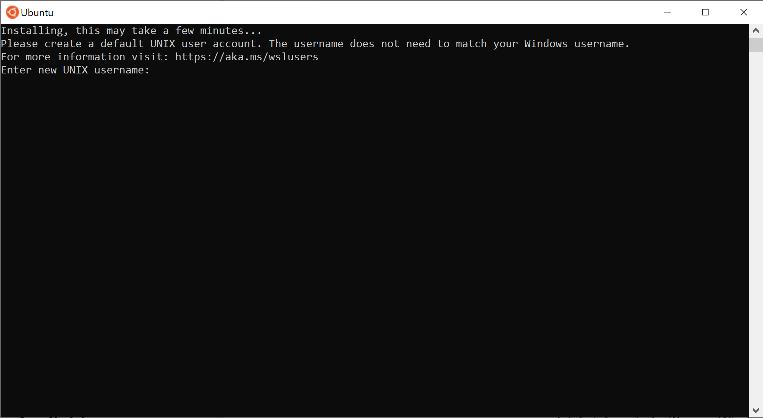
WSL2

Slide 18
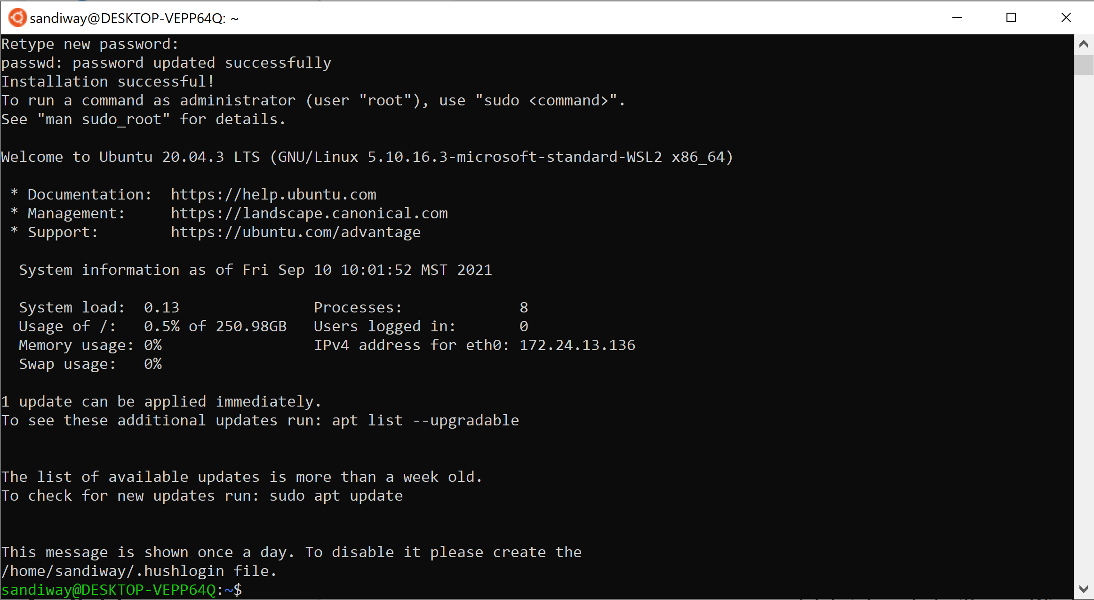
WSL2

Slide 19
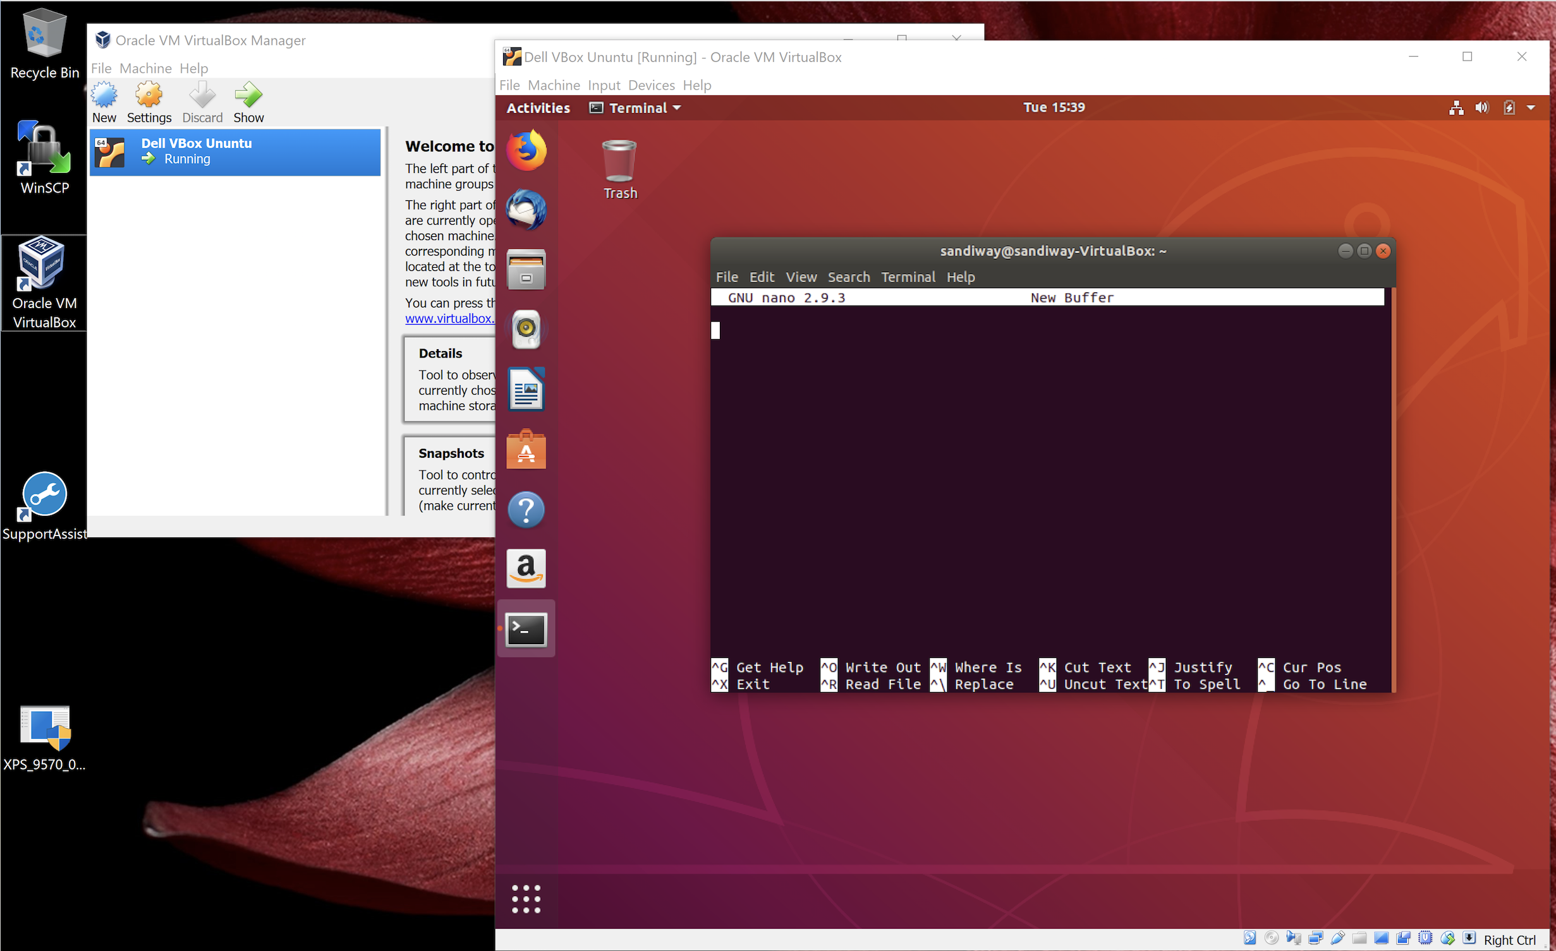
Ubuntu Text Editor: nano
Text editor (built in)
  nano is a decent one for (use inside Terminal)
  You might prefer it, but I can't stand vi
  can install others via
    sudo apt-get install
  or
    sudo apt install

Slide 20
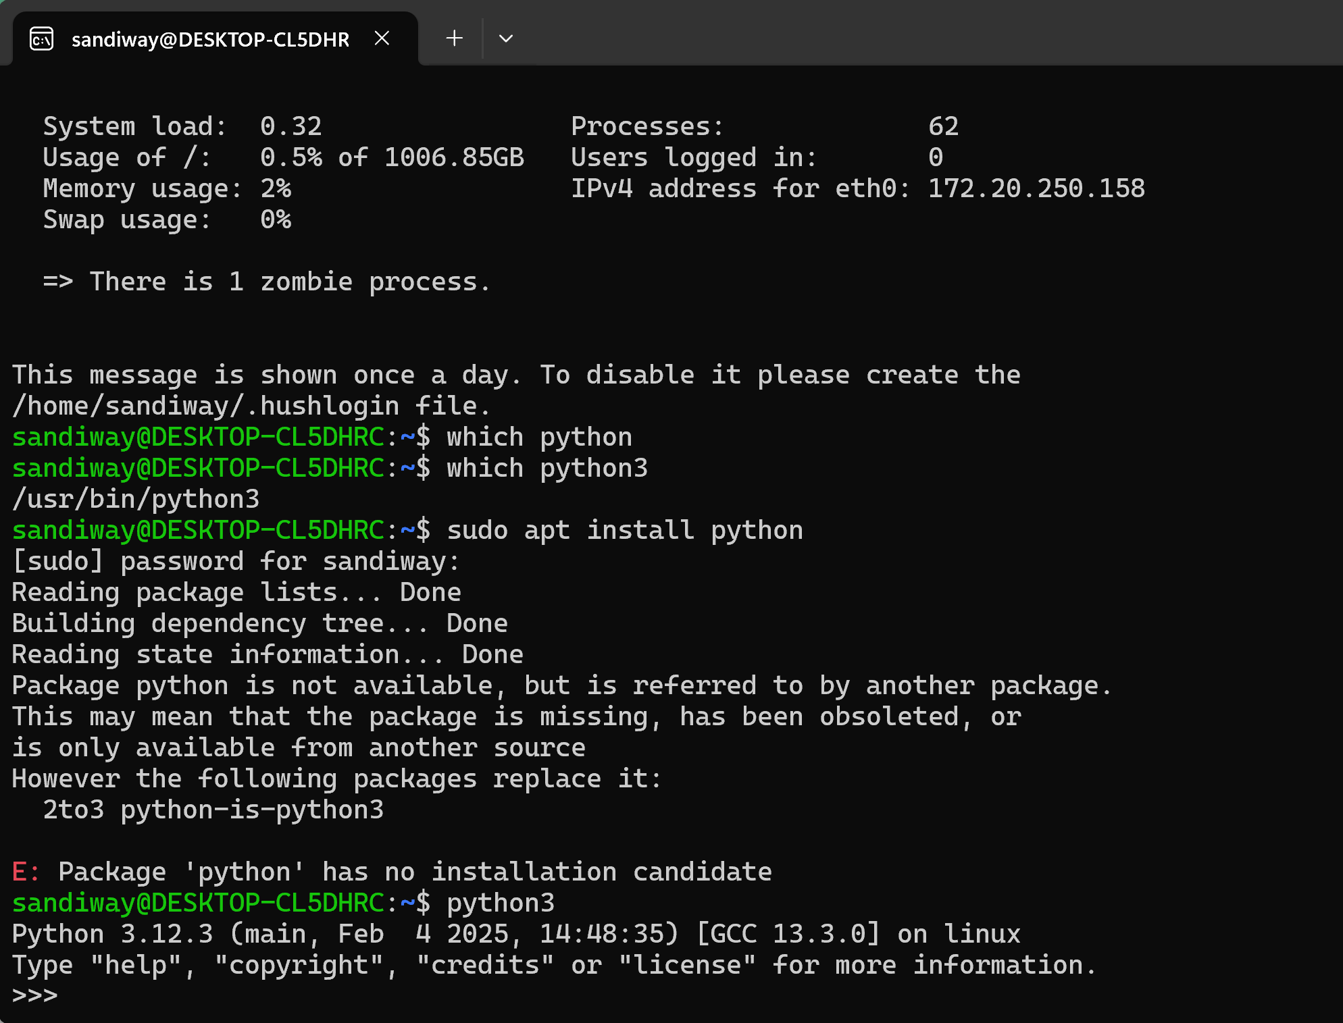
Ubuntu: python3 is already installed!
which python
returns nothing
apt install python
doesn't work: 1) not adminstrator, and 2) there's no such package!
sudo apt install python3
if it says it's already there, then
[sudo may ask you for your password]
python3
places you in the interpreter at the prompt >>>
<Control>-D
quits Python

Slide 21
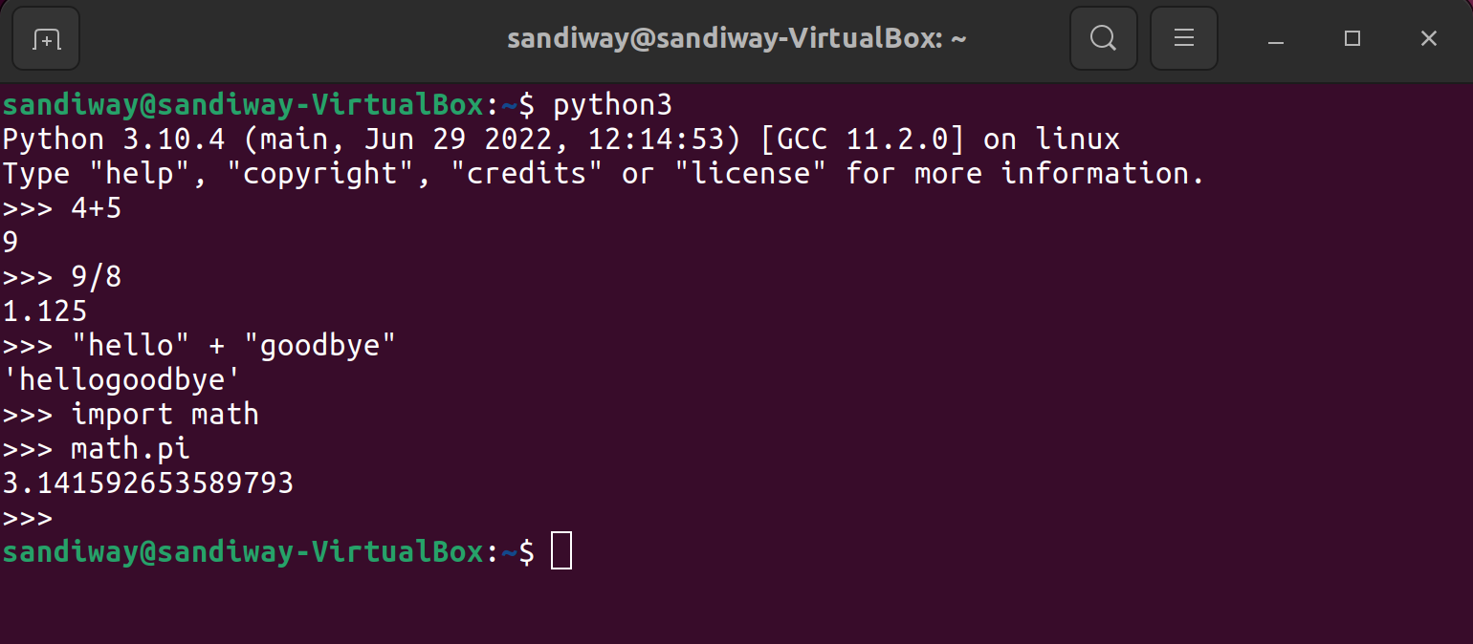
Ubuntu: python3 is already installed!

Slide 22
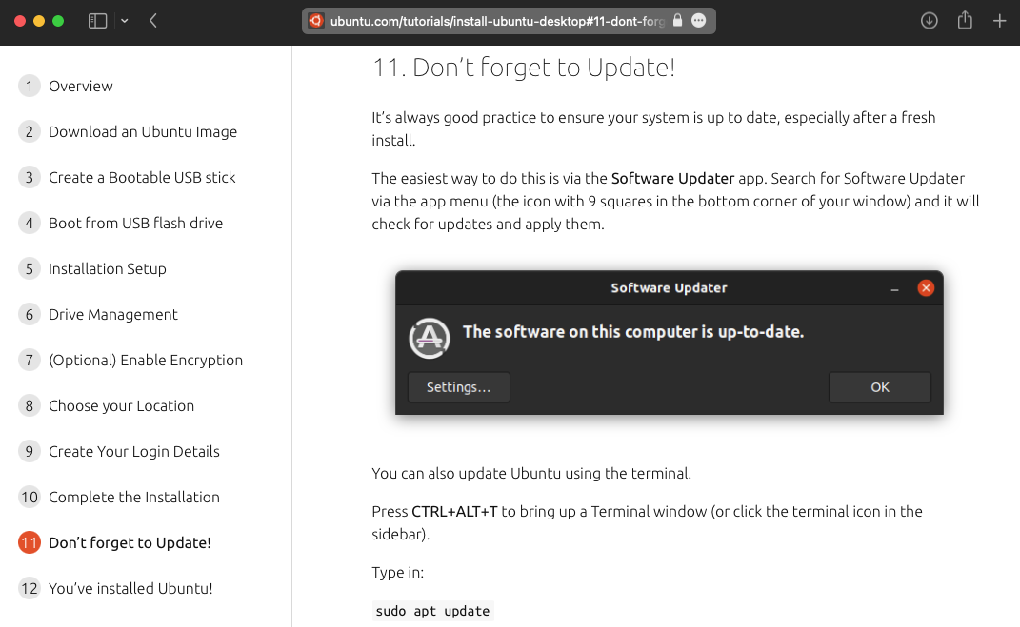
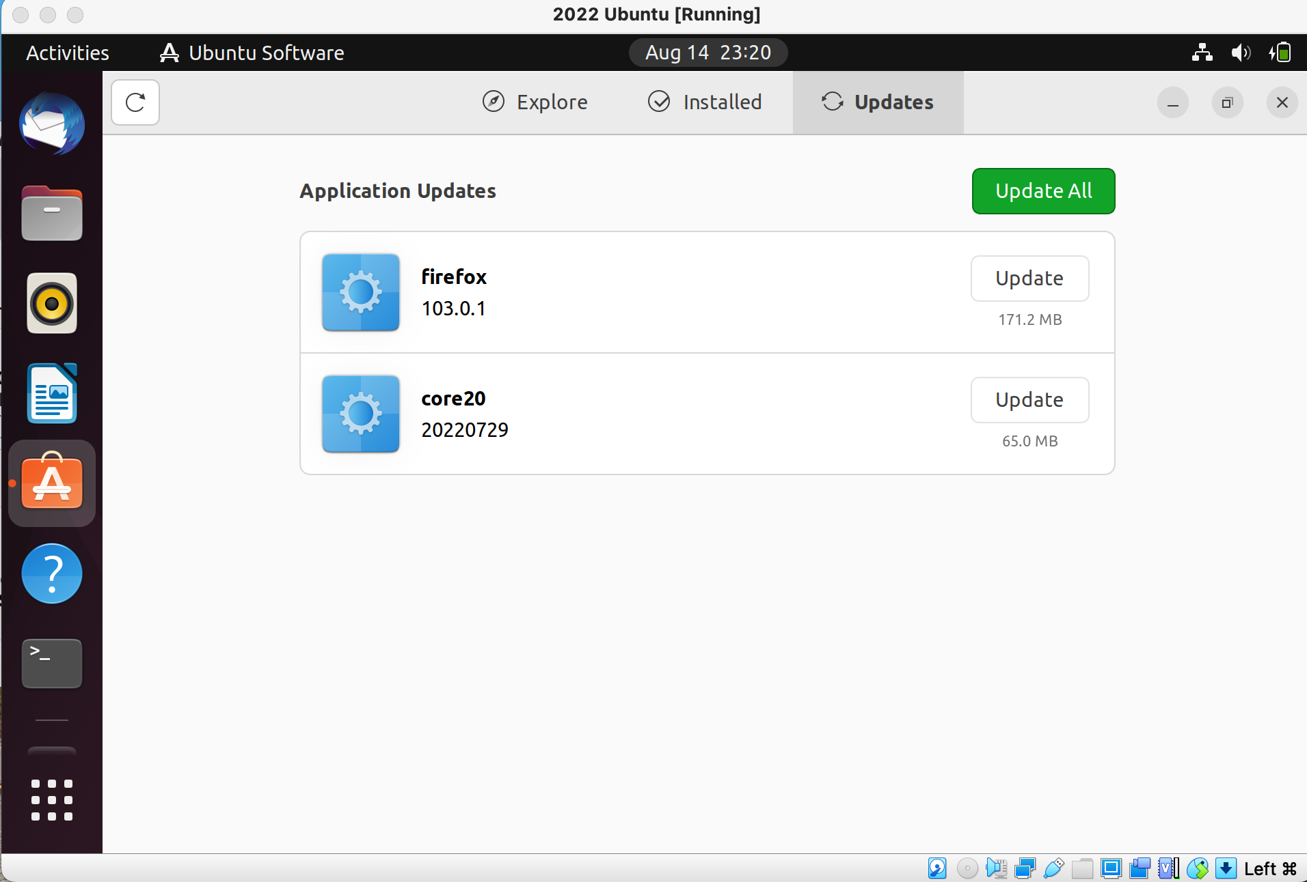
Keep Ubuntu up to date
https://ubuntu.com/tutorials/install-ubuntu-desktop#1-overview

Slide 23
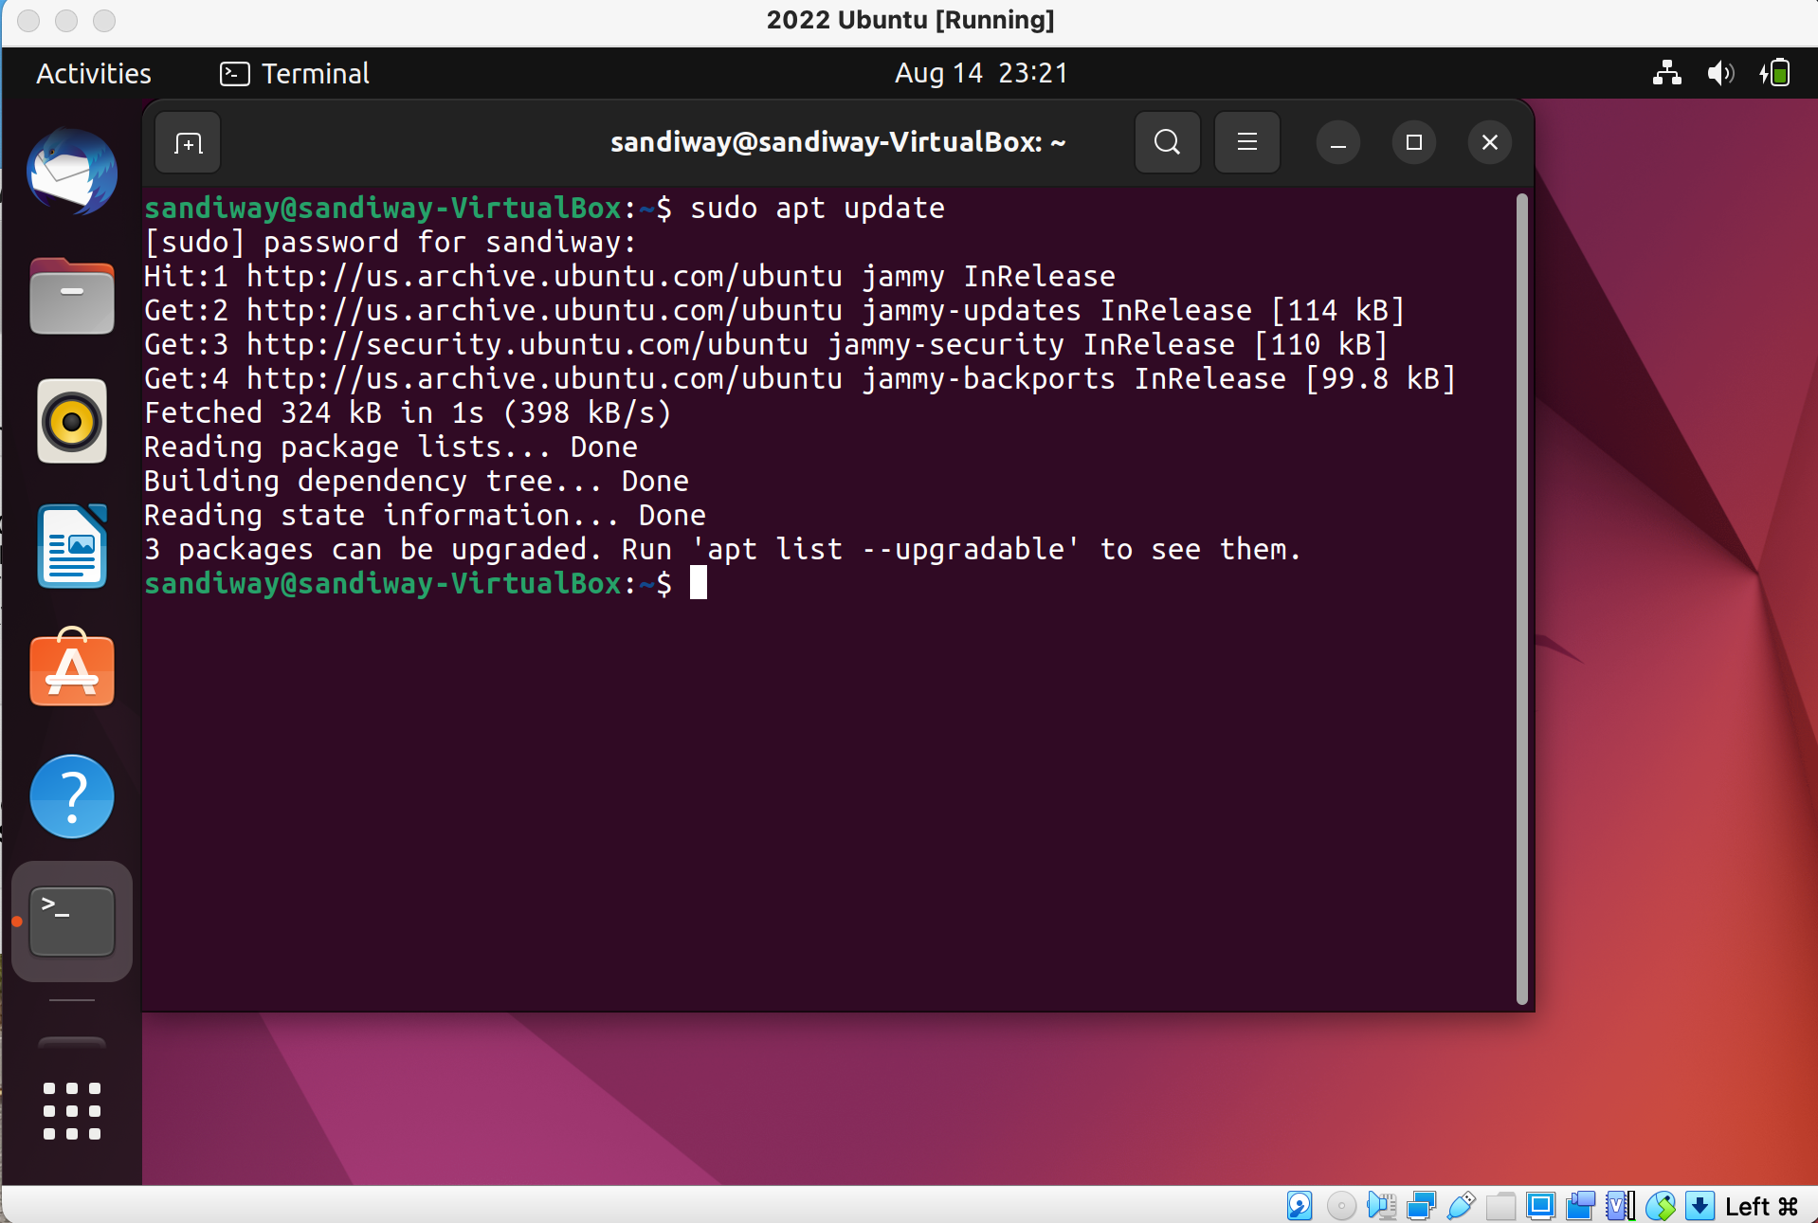
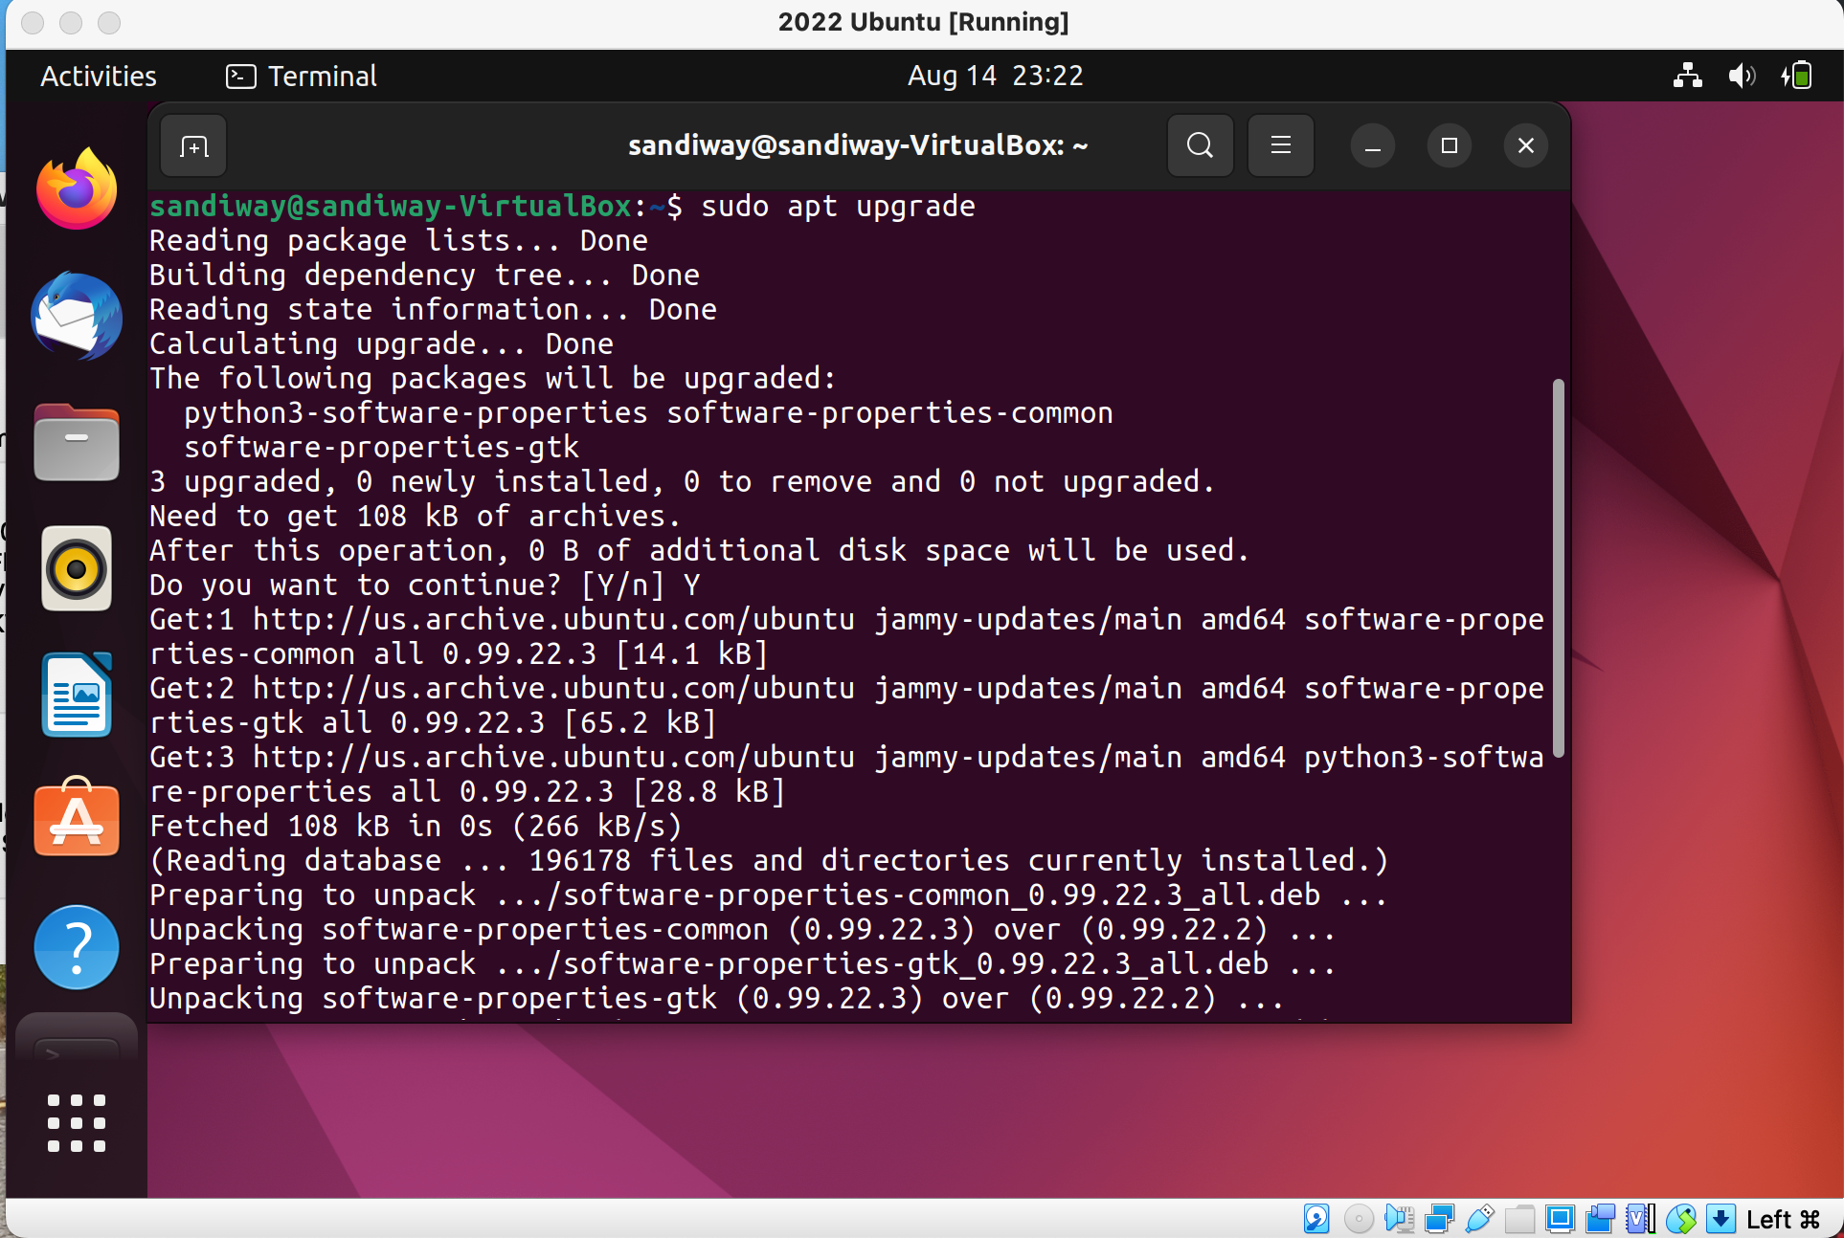
Keep Ubuntu up to date
sudo apt update
sudo apt upgrade

Slide 24
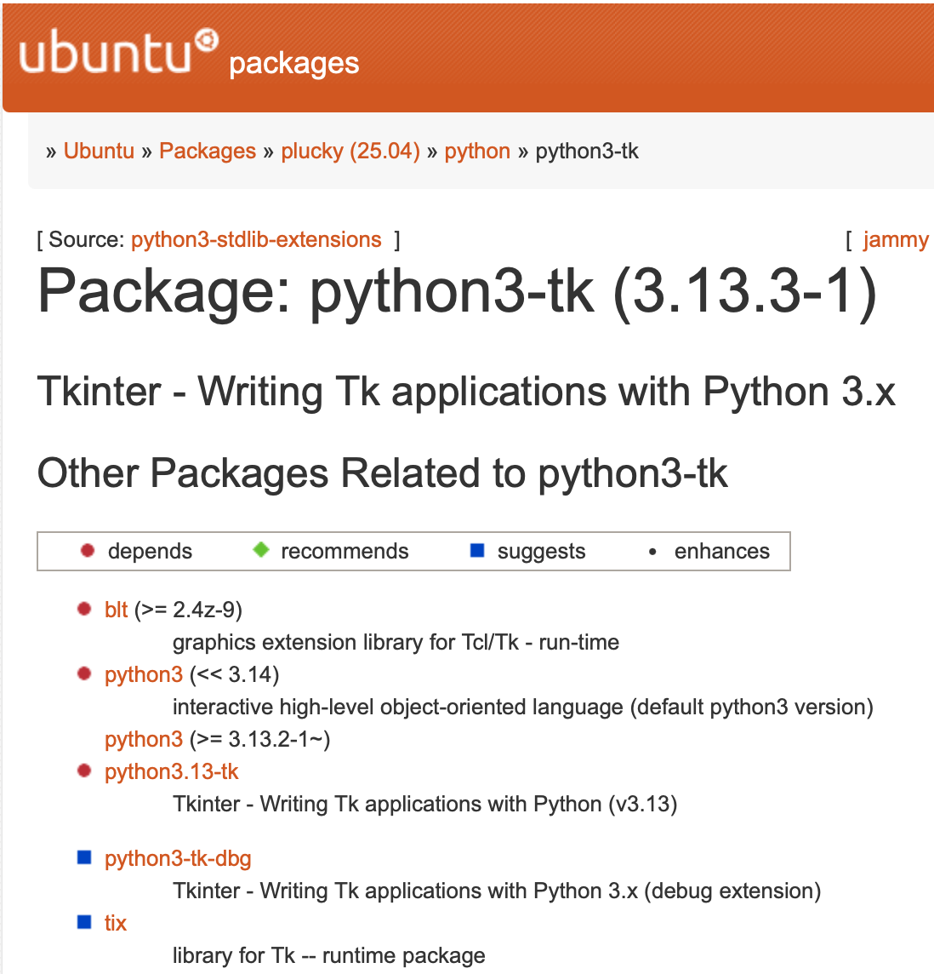
Ubuntu tidbits
Latest version (LTS = Long Term support)
  Ubuntu 24.04 LTS Noble Numbat
  lsb_release -a
Tk graphics with Python 3
  sudo apt install python3-tk
Python's Package Manager PIP
  sudo apt install python3-pip
  pip3 --version

