Slide 1
408/508 Computational Techniques for Linguists
Lecture 3

Slide 2
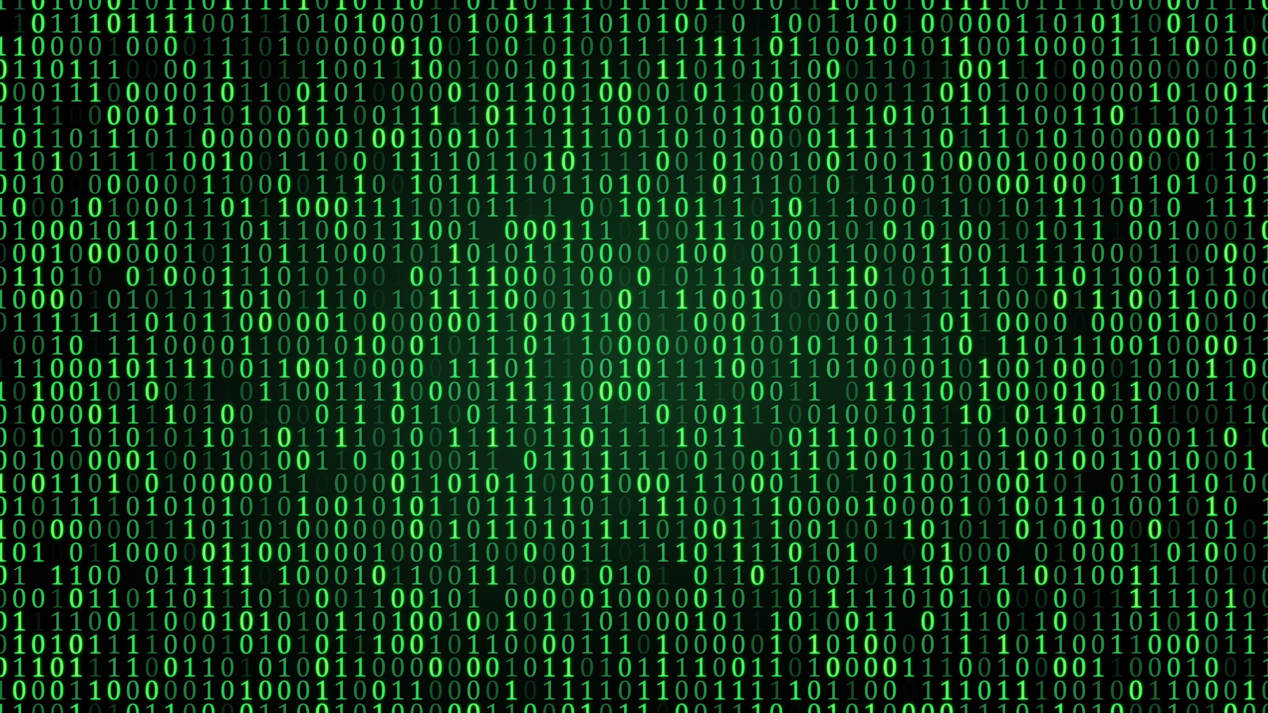
From Last Time … everything is binary

Slide 3
Introduction
Storage:
  based on digital logic
  binary (base 2) – everything is a power of 2
  Byte: 8 bits
    01011011
    = 2⁶+2⁴+2³+2¹+2⁰
    = 64 + 16 + 8 + 2 + 1
    = 91 (in decimal)
  Hexadecimal (base 16)
    0-9,A,B,C,D,E,F (need 4 bits)
    5B (= 1 byte)
    = 5*16¹ + 11
    = 80 + 11
    = 91
2⁷ | 2⁶ | 2⁵ | 2⁴ | 2³ | 2² | 2¹ | 2⁰
2⁷ | 2⁶ | 2⁵ | 2⁴ | 2³ | 2² | 2¹ | 2⁰
0 | 1 | 0 | 1 | 1 | 0 | 1 | 1
2³ | 2² | 2¹ | 2⁰ | 2³ | 2² | 2¹ | 2⁰
0 | 1 | 0 | 1
2³ | 2² | 2¹ | 2⁰ | 2³ | 2² | 2¹ | 2⁰
2³ | 2² | 2¹ | 2⁰ | 2³ | 2² | 2¹ | 2⁰
0 | 1 | 0 | 1 | 1 | 0 | 1 | 1
16¹ | 16⁰
5 | B
5
B
16¹ | 16⁰

Slide 4
Introduction: data types
Integers
  In one byte (= 8 bits), what’s the largest and smallest number, we can represent?
  00000000 = 0
  01111111 = 127
  10000000 = -128
  11111111 = -1
  Number line:
00000000 (all zeros)
11111111 (all ones)
0 | … |  |  |  |  |  | 127 | -128 | -127 |  |  |  |  |  | -1
2’s complement representation

Slide 5
Introduction: data types
Integers
  In one byte, what’s the largest and smallest number, we can represent?
  Answer: -128 .. 0 .. 127 using the 2’s complement representation
  Why? super-convenient for arithmetic operations
  “to convert a positive integer X to its negative counterpart, flip all the bits, and add 1”
  Example:
  00001010 = 2³ + 2¹ = 10 (decimal)
  11110101 + 1 = 11110110 = -10 (decimal)
  11110110 flip + 1 = 00001001 + 1 = 00001010
Addition:
-10 + 10
= 11110110
+ 00001010 = 0 (ignore overflow)

Slide 6
Introduction: data types
Typically 32 bits (4 bytes) are used to store an integer
  range: -2,147,483,648 (2⁽³¹⁻¹⁾ -1) to 2,147,483,647 (2⁽³²⁻¹⁾ -1)
what if you want to store even larger numbers?
  Binary Coded Decimal (BCD)
  code each decimal digit separately, use a string (sequence) of decimal digits …
2³¹ | 2³⁰ | 2²⁹ | 2²⁸ | 2²⁷ | 2²⁶ | 2²⁵ | 2²⁴ | … |  | … | 2⁷ | 2⁶ | 2⁵ | 2⁴ | 2³ | 2² | 2¹ | 2⁰
byte 3 | byte 2 | byte 1 | byte 0
C:
int i;
Python
(no declaration)

Slide 7
Introduction: data types
what if you want to store even larger numbers?
  Binary Coded Decimal (BCD)
  1 byte can code two digits (0-9 requires 4 bits)
  1 nibble (4 bits) codes the sign (+/-), e.g. hex C/D
2³ | 2² | 2¹ | 2⁰
0 | 0 | 0 | 0
0
2 | 0 | 1 | 4
2 bytes (= 4 nibbles)
2³ | 2² | 2¹ | 2⁰
0 | 0 | 0 | 1
1
+ | 2 | 0 | 1 | 4
2.5 bytes (= 5 nibbles)
2³ | 2² | 2¹ | 2⁰
1 | 0 | 0 | 1
9
credit (+)
debit (-)
2³ | 2² | 2¹ | 2⁰
1 | 1 | 0 | 0
C
2³ | 2² | 2¹ | 2⁰
1 | 1 | 0 | 1
D

Slide 8
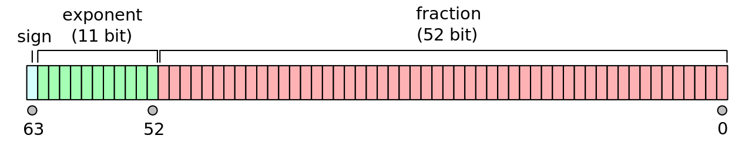
Introduction: data types
e.g. probabilities
Typically, 64 bits (8 bytes) are used to represent floating point numbers (double precision)
  c = 2.99792458 x 10⁸ (m/s)
  coefficient: 52 bits (implied 1, therefore treat as 53)
  exponent: 11 bits (usually not 2’s complement, unsigned with bias 2⁽¹⁰⁻¹⁾-1 = 511)
  sign: 1 bit (+/-)
C:
float
double
x86 CPUs have a built-in
floating point coprocessor (x87)
80 bit long registers
wikipedia

Slide 9
Example 1
The speed of light:
    c = 2.99792458 x 10⁸ (m/s)
Can a 4 byte integer be used to represent c exactly?
  4 bytes = 32 bits
  32 bits in 2’s complement format
  Largest positive number is
  2³¹-1 = 2,147,483,647
  c = 299,792,458

Slide 10
Example 2
Recall the speed of light:
    c = 2.99792458 x 10⁸ (m/s)
How much memory would you need to encode c using BCD notation as an integer?
  9 digits
  each digit requires 4 bits (a nibble)
  BCD notation includes a sign nibble
  total is 5 bytes

Slide 11
Example 3
Recall the speed of light:
    c = 2.99792458 x 10⁸ (m/s)
Can the 64 bit floating point representation (double) encode c without loss of precision?
  Recall significand precision: 53 bits (52 explicitly stored)
  2⁵³-1 = 9,007,199,254,740,991
  almost 16 digits
  (we only need 9 digits of precision)

Slide 12
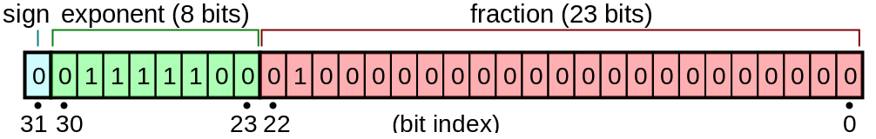
Example 4
Recall the speed of light:
    c = 2.99792458 x 10⁸ (m/s)
The 32 bit floating point representation (float) – sometimes called single precision - is composed of 1 bit sign, 8 bits exponent (unsigned with bias 2⁽⁸⁻¹⁾-1), and 23 bits coefficient (24 bits effective).
Can it represent c without loss of precision?
  2²⁴-1 = 16,777,215
  Nope (7 digits of precision)

Slide 13
Example 5
Wikipedia: when the atom is irradiated with electromagnetic radiation having an energy corresponding to the energetic difference between the two sub-levels the radiation is absorbed and the atom is excited, going from the F = 3 sub-level to the F = 4 one. After some time the atom will re-emit the radiation and return to its F = 3 ground state.
Atomic clocks use the caesium standard. Frequency is exactly 9 192 631 770 Hz.
Does the 32 bit binary integer representation have enough bits to represent this frequency?
Relevant integer is:
  9 192 631 770 (Hz)
  Largest possible integer using 2's complement is:
  2³¹ – 1 = 2 147 483 648 (too small)
  Largest possible integer even if we use unsigned representation is:
  2³² – 1 = 4 294 967 296 (still too small)

Slide 14
Example 5
Kinda tedious to calculate the binary bit pattern by hand
At the Terminal (on Mac or Linux):
$ which bc
/usr/bin/bc (bc - arbitrary-precision calculator)
$ bc
>>> obase=2
>>> 9192631770
1000100011111011000110110111011010
10 0010 0011 1110 1100 0110 1101 1101 1010 (group by nibbles)

Slide 15
Example 5
In Python:
$ python
Python 3.9.16 | packaged by conda-forge | (main, Feb 1 2023, 21:38:11)
[Clang 14.0.6 ] on darwin
Type "help", "copyright", "credits" or "license" for more information.
>>> bin(9192631770)
'0b1000100011111011000110110111011010'

Slide 16
Example 5
In Python, function bin() expects an integer:
>>> bin(9.19263177e9)
Traceback (most recent call last):
File "<stdin>", line 1, in <module>
TypeError: 'float' object cannot be interpreted as an integer
>>> 9.19263177e9
9192631770.0
function int() converts number into an integer:
>>> bin(int(9.19263177e9))
'0b1000100011111011000110110111011010'

Slide 17
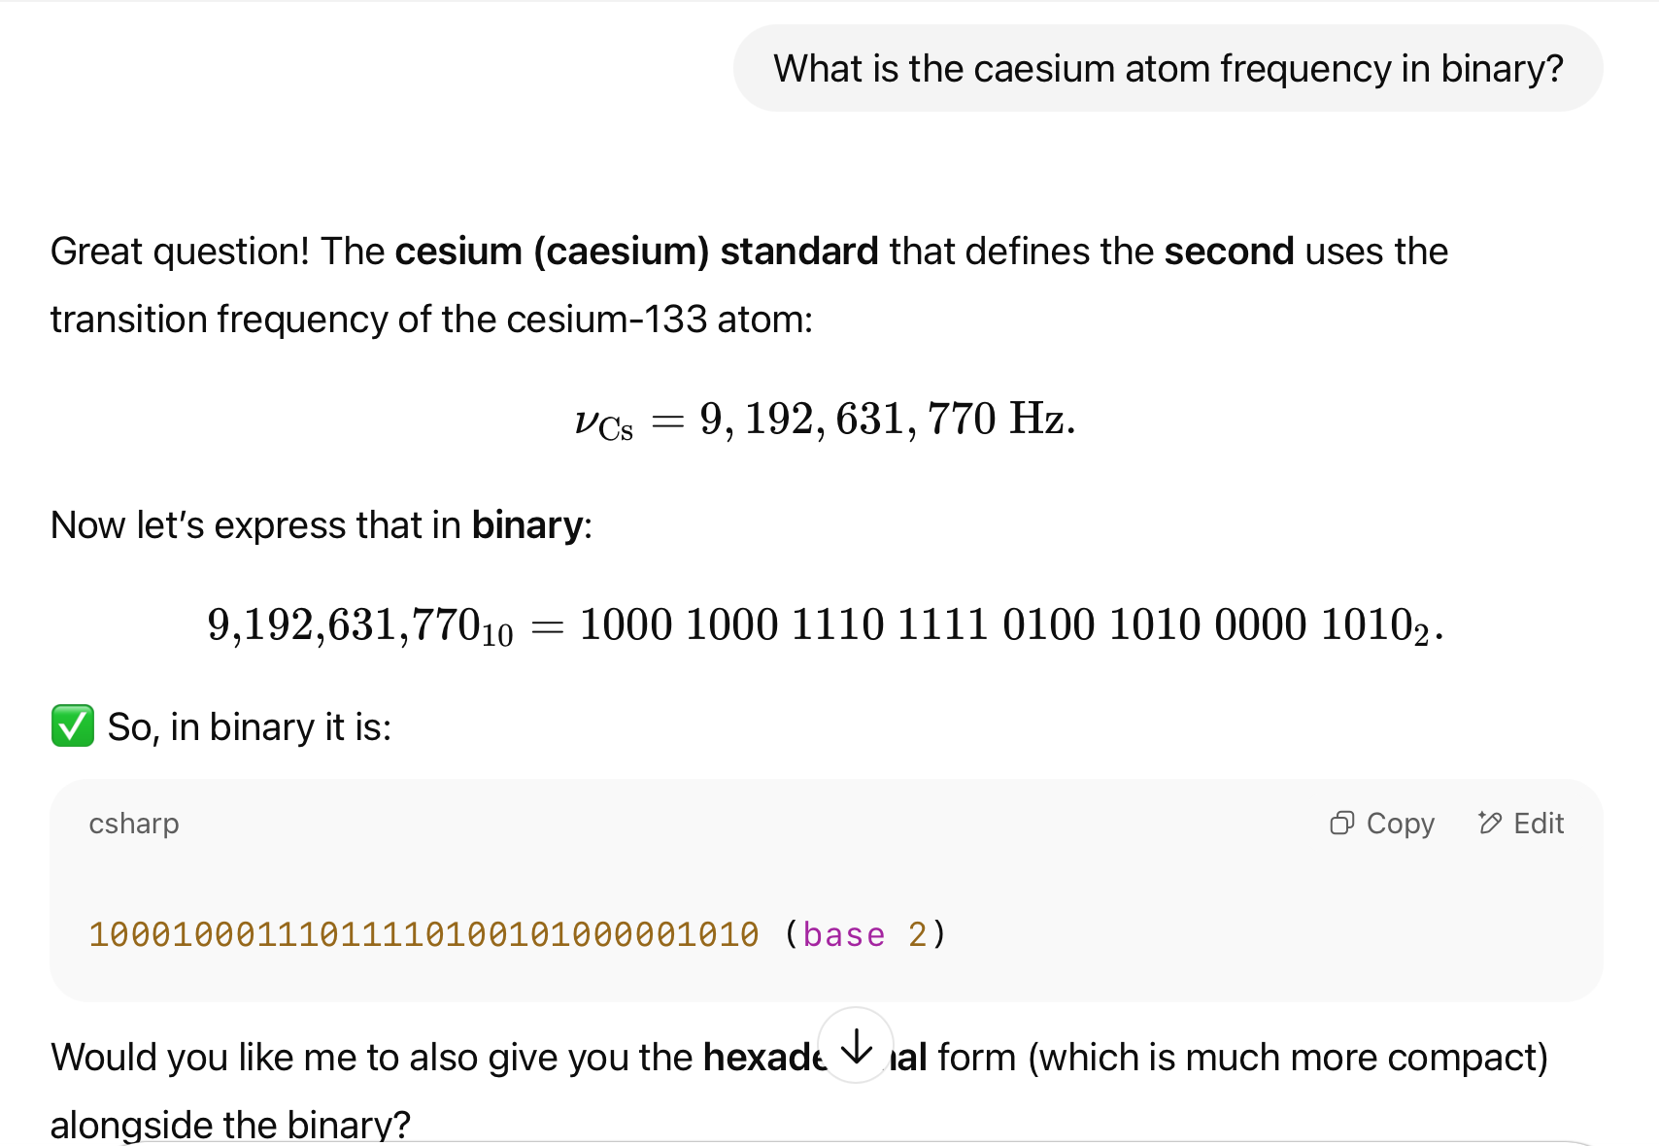
ChatGPT: Example 5

Slide 18
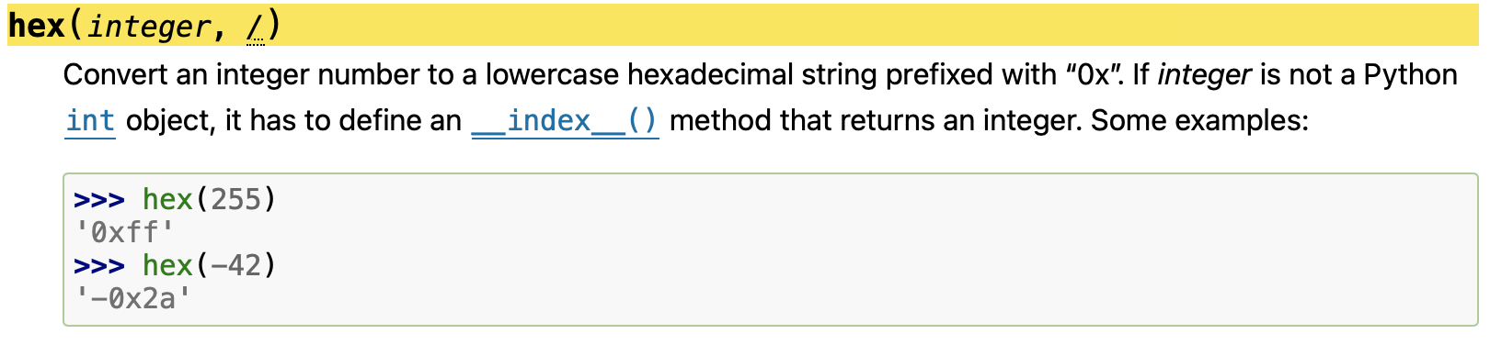
Example 5
Since binary and hexadecimal are so common, Python has built-in functions bin() and hex()
  docs.python.org/3/library/functions.html#hex
192 631 770 Hz in hexadecimal?

Slide 19
Quick Homework 1: Binary Exercise
2,147,483,659 is a prime number.
Does the 32 bit binary integer representation have enough bits to represent this prime? Explain.
2³¹ | 2³⁰ | 2²⁹ | 2²⁸ | 2²⁷ | 2²⁶ | 2²⁵ | 2²⁴ | … |  | … | 2⁷ | 2⁶ | 2⁵ | 2⁴ | 2³ | 2² | 2¹ | 2⁰
byte 3 | byte 2 | byte 1 | byte 0

Slide 20
Instructions
Email to sandiway@arizona.edu
By tomorrow midnight
SUBJECT: 408/508 Homework 1: YOUR NAME
Send me the binary bit pattern!
Either Plain Text or PDF accepted
  no MS Word .doc/.docx files please

Slide 21
New Topic
Enough about numbers for now.
How about language data, i.e. characters we type?

Slide 22
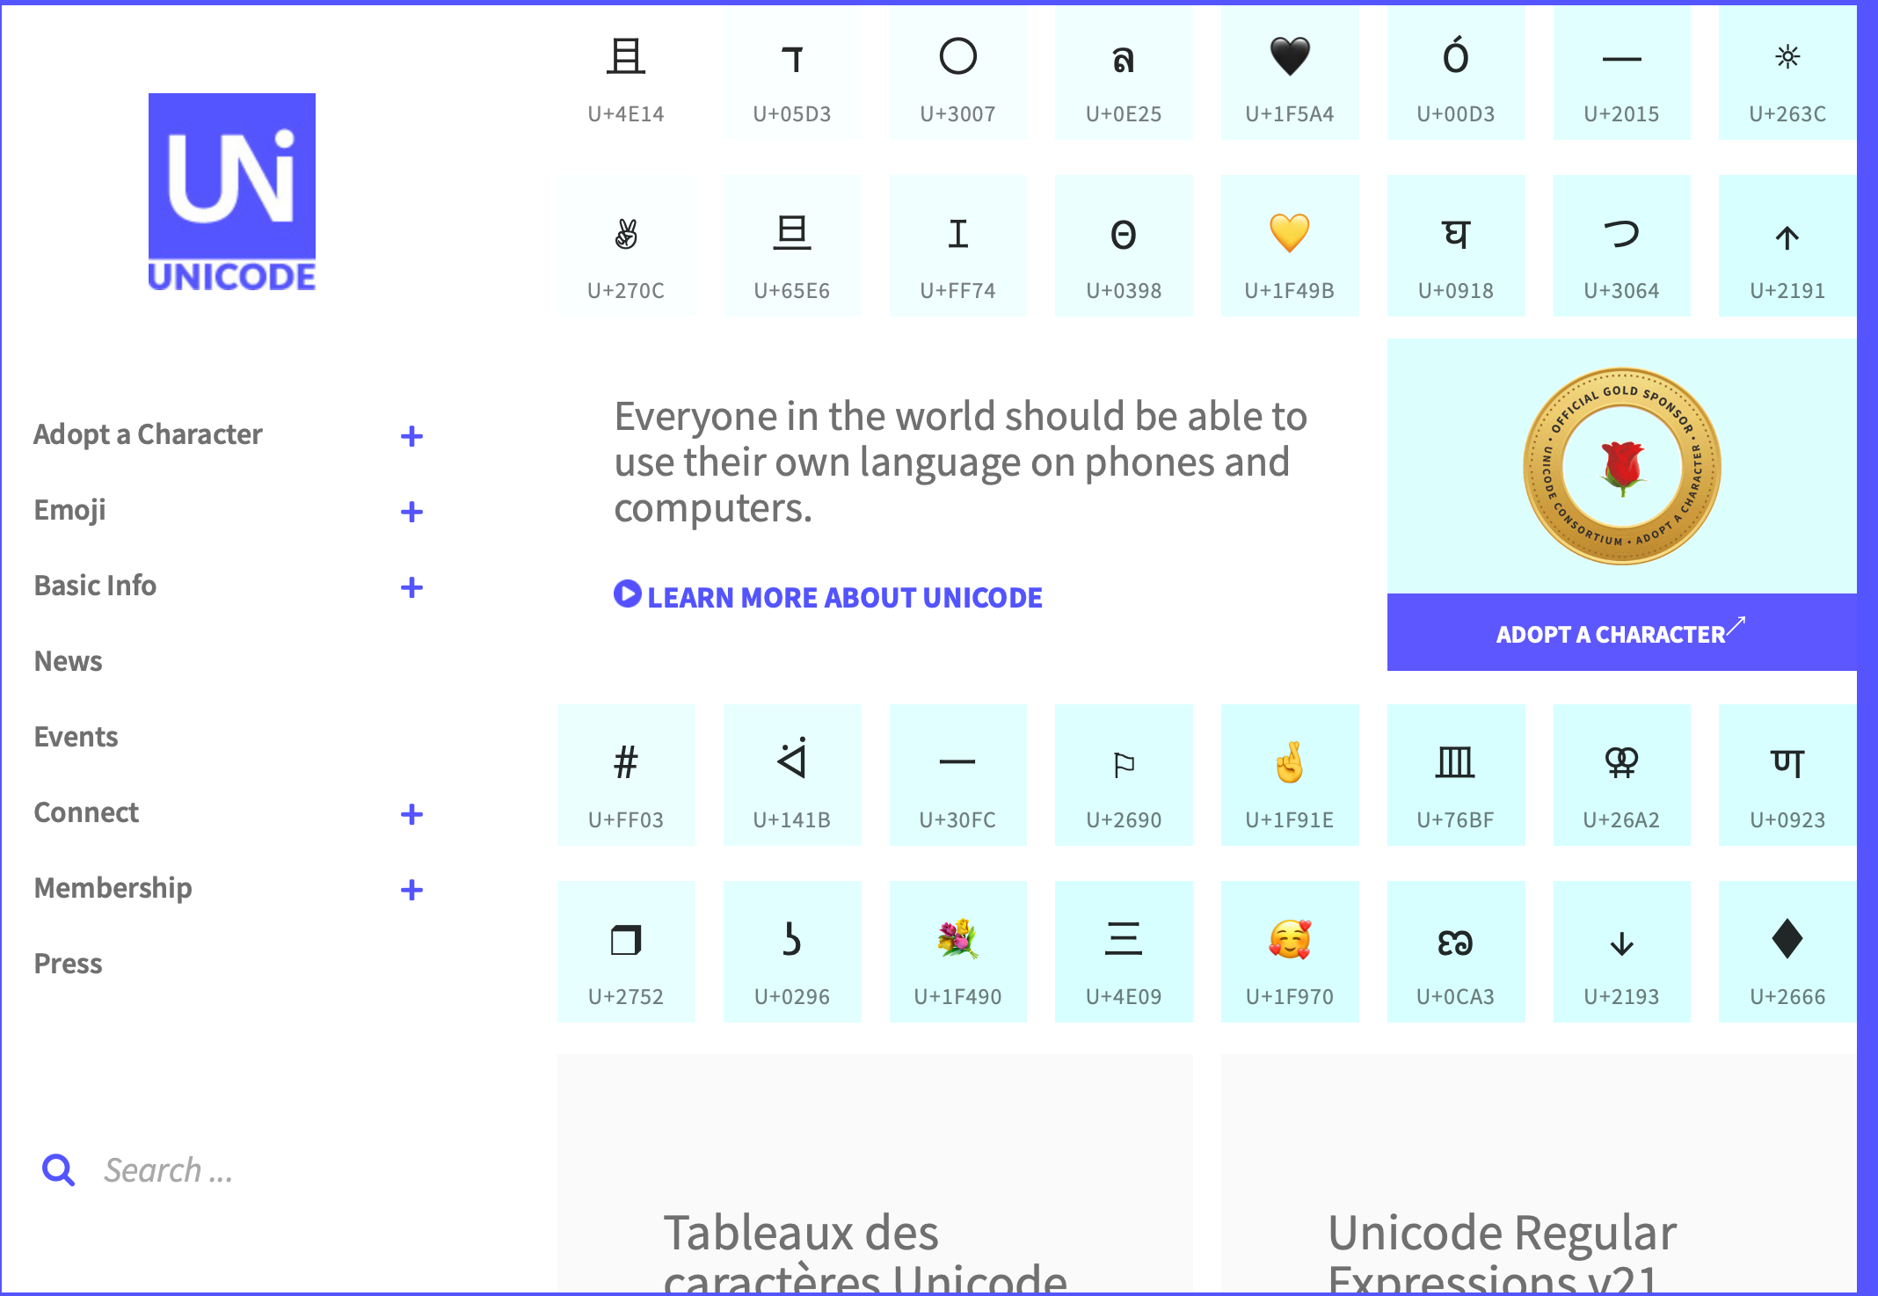
Unicode number of encoded characters in Unicode 17.0: 159,845
https://home.unicode.org

Slide 23

Unicode adoption:
MacOS Tahoe 26.2.1 and i/Pad/OS 26.2.1 include Unicode standard 16.0. Apple's iOS 18.4 or later contains Unicode standard 16.0. Earlier versions of iOS 18 contain Unicode standard 15.1.

Slide 24
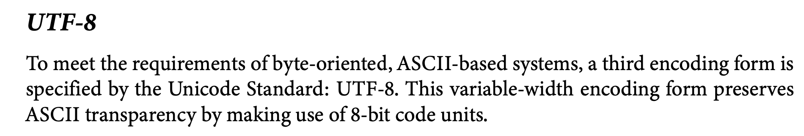
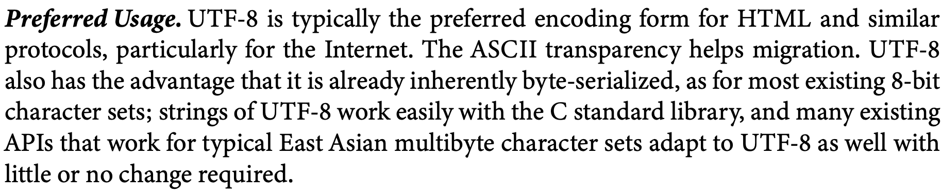
Unicode
https://www.unicode.org/versions/Unicode13.0.0/UnicodeStandard-13.0.pdf

Slide 25
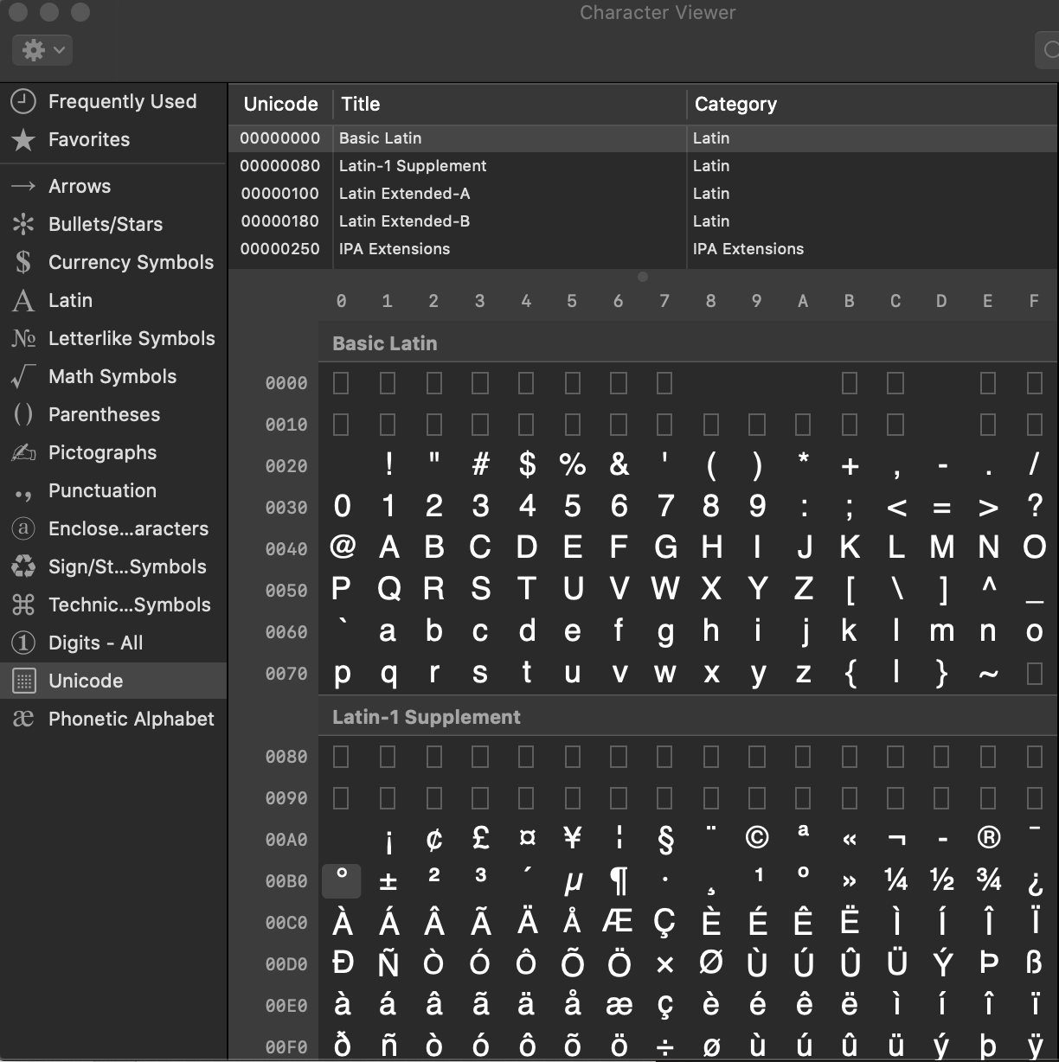
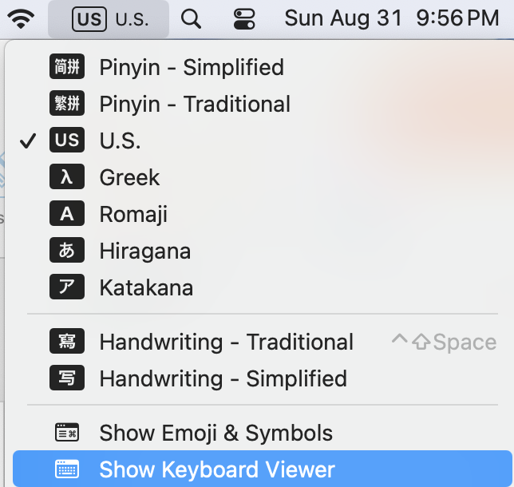
On the Mac
Show Emojis and Symbols > Unicode
ASCII
Latin-1 supplement

Slide 26
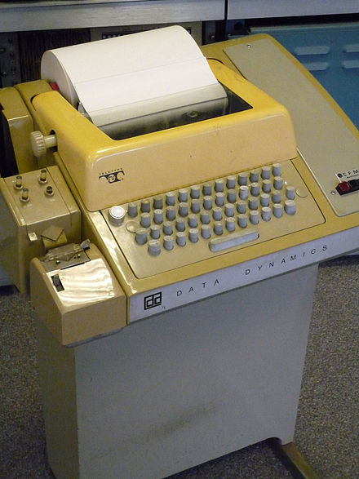
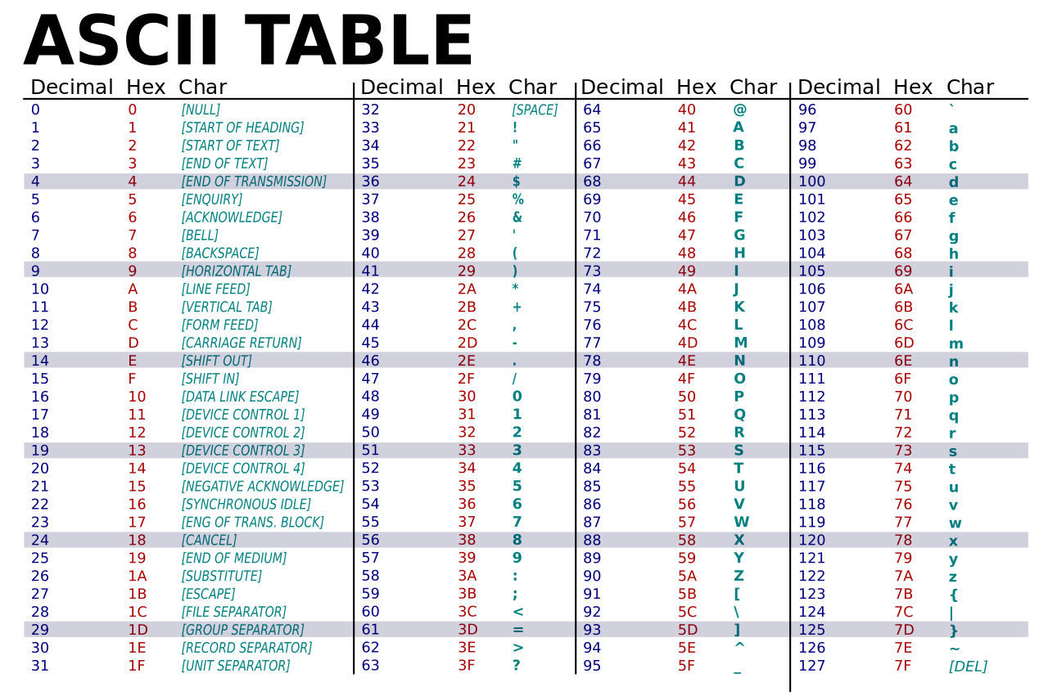
Introduction: data types
C:
char
How about letters, punctuation, etc.?
ASCII
  American Standard Code for Information Interchange
  Based on English alphabet (upper and lower case) + space + digits + punctuation + control (Teletype Model 33)
  Question: how many bits do we need?
  7 bits + 1 bit parity
  Remember everything is in binary …
Teletype Model 33 ASR
Teleprinter (Wikipedia)

Slide 27
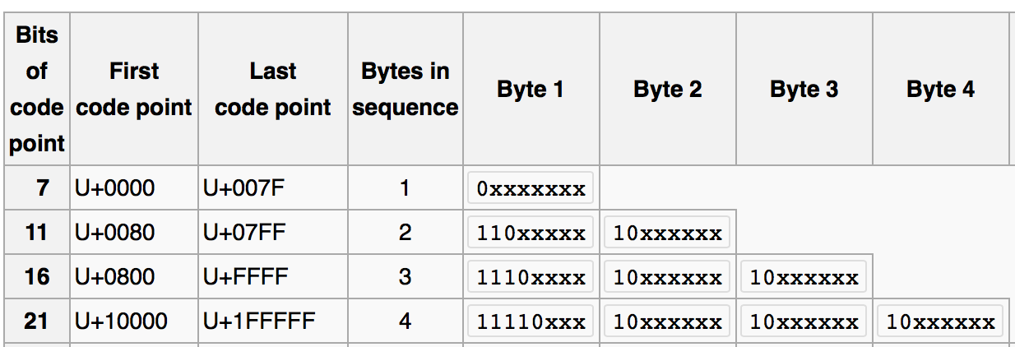
Introduction: data types
UTF-8
  standard in the post-ASCII world
  backwards compatible with ASCII
  (previously, different languages had multi-byte character sets that clashed)
  Universal Character Set (UCS) Transformation Format 8-bits
(Wikipedia)

Slide 28
Introduction: data types
order is important in sorting!
0-9: there’s a connection with BCD. Notice: code 30 (hex) through 39 (hex)

Slide 29
Introduction: data types
Parity bit:
  transmission can be noisy over telephone lines
  parity bit can be added to ASCII code (total: 8 bits, byte)
  can spot single bit transmission errors
  even/odd parity:
    receiver understands each byte should be even/odd
  Example:
    0 (zero) is ASCII 30 (hex) = 011000 (binary)
    even parity: 0011000, odd parity: 1011000
  Checking parity:
    Exclusive or (XOR): basic machine instruction
      A xor B true if either A or B true but not both
  Example:
    (even parity 0) 0011000 xor bit by bit
    0 xor 0 = 0 xor 1 = 1 xor 1 = 0 xor 0 = 0 xor 0 = 0 xor 0 = 0 xor 0 = 0
x86 assemby language:
PF: even parity flag set by
arithmetic ops.
TEST: AND (don’t store result), sets PF
JP: jump if PF set
Example:
MOV al,<char>
TEST al, al
JP <location if even>
<go here if odd>

Slide 30
Introduction: data types
UTF-8
  standard in the post-ASCII world
  backwards compatible with ASCII
  (previously, different languages had multi-byte character sets that clashed)
  Universal Character Set (UCS) Transformation Format 8-bits
ASCII
(Wikipedia)

Slide 31
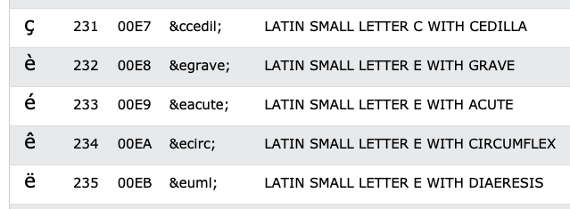
Introduction: data types
In your browser, which runs HTML5, UTF-8, is the default character encoding

Slide 32

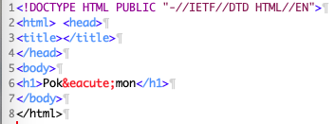
Introduction: data types
File: pokemon.html

Slide 33

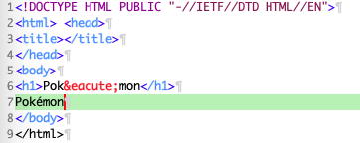
Introduction: data types
line 7: é typed on my mac keyboard using OPT-e e
File: pokemon2.html

Slide 34
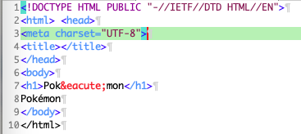
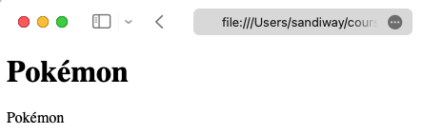
Introduction: data types
File: pokemon3.html

Slide 35
Introduction: data types
Example:
  あ Hiragana letter A: UTF-8: E38182
  Byte 1: E = 1110, 3 = 0011
  Byte 2: 8 = 1000, 1 = 0001
  Byte 3: 8 = 1000, 2 = 0010
  い Hiragana letter I: UTF-8: E38184
Shift-JIS (Hex):
あ: 82A0
い: 82A2

Slide 36


Introduction: data types
No <meta charset="UTF-8">
あ Hiragana letter A: UTF-8: E3 81 82
い Hiragana letter I: UTF-8: E3 81 84
Latin-1 character set (8 bits) https://kb.iu.edu/d/aepu

Slide 37
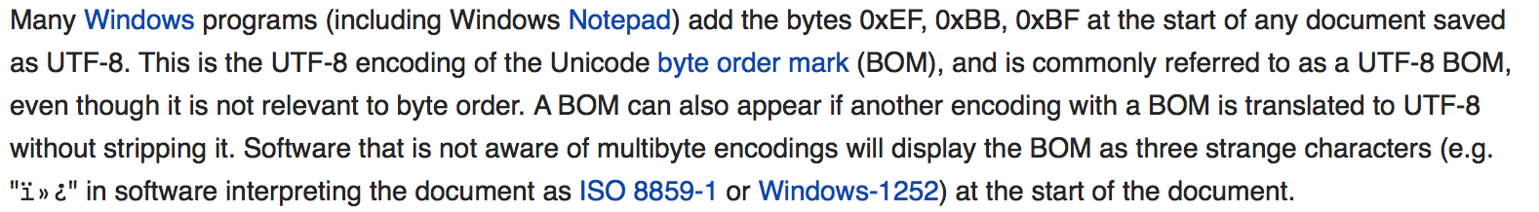
Introduction: data types

Slide 38
Introduction: data types
How can you tell what encoding your file is using?
Detecting UTF-8
  Microsoft:
    1st three bytes in the file is EF BB BF
    (not all software understands this; not everybody uses it)
  HTML:
    <meta http-equiv="Content-Type" content="text/html;charset=UTF-8">
    (not always present)
  Analyze the file:
    Find non-valid UTF-8 sequences: if found, not UTF-8…
    Interesting paper:
      http://www-archive.mozilla.org/projects/intl/UniversalCharsetDetection.html

