Slide 1
408/508 Computational Techniques for Linguists
Lecture 2

Slide 2
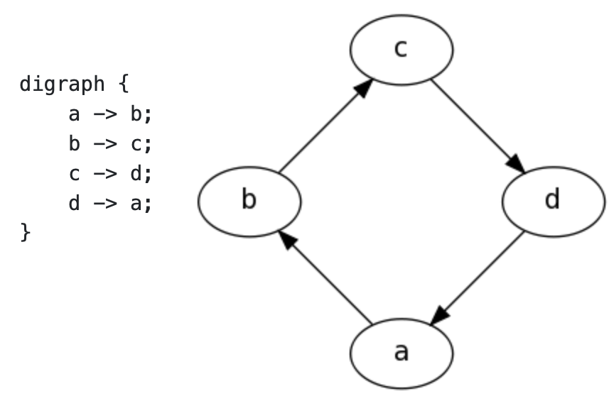
Computer Languages
Think of two basic kinds:
  Sequence of instructions
  Description (data)
graphviz: dot language
fh = open(filename)
raw = fh.read()
import nltk
words = nltk.word_tokenize(raw)
print(len(words)/len(raw))
https://graphviz.org/doc/info/lang.html

Slide 3
Introduction
Computers
  Memory (several kinds)
    Store programs and data
  CPU (Central Processing Unit)
    Interprets primitive machine instructions (not Turing Machine)
  I/O (Input/Output) require drivers
    keyboard, mouse, microphone, speaker
    touchpad, (touch) screen, (3D) printer
    Bluetooth, USB, Thunderbolt, Ethernet, NAS (Network …)
    WiFi, cellular, satellite …

Slide 4
Introduction
Memory Hierarchy: fast to slow, small to large
  CPU registers
  L1/L2 cache
  L3 cache
  RAM (sometimes NUMA)
  SSD/hard drive
  blu ray/dvd/cd drive
  (.iso file: fake cd)
  LAN
  WAN (Internet)
fast
invisible to
programmers
access time is not always uniform
e.g. 16GB.. 128GB
e.g. 1TB.. 8TB
open file
read/write
slow
Notes:
NUMA = non-uniform memory access

Slide 5
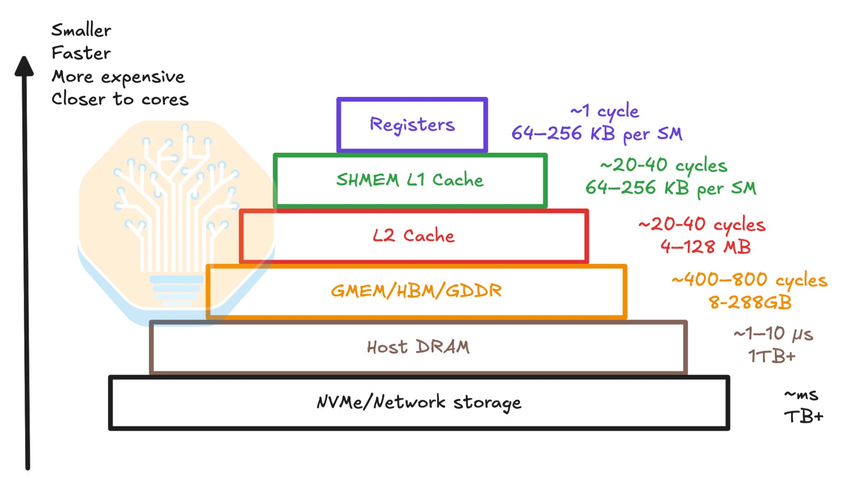
Introduction
A 4 GHz processor performs 4,000,000,000 cycles per second
semianalysis.com

Slide 6
Introduction
1 byte (8 bits) wide
array
a[23]
0
addressable
Memory
(RAM)
RAM memory (your program's view)
  the area to store your program and data (after I/O read)
Underlying representation
  binary: zeros and ones (1 bit)
  organized into bytes (8 bits) and nibbles (4 bits)
    memory is byte-addressable
  word (32 bits)
    e.g. integer
    (64 bits: floating point number)
  big-endian/little-endian
    most significant byte first or least significant byte
    matters for communication …
addresses managed by your programming language
your Intel and ARM CPUs
hexadecimal notation
FFFFFFFF

Slide 7
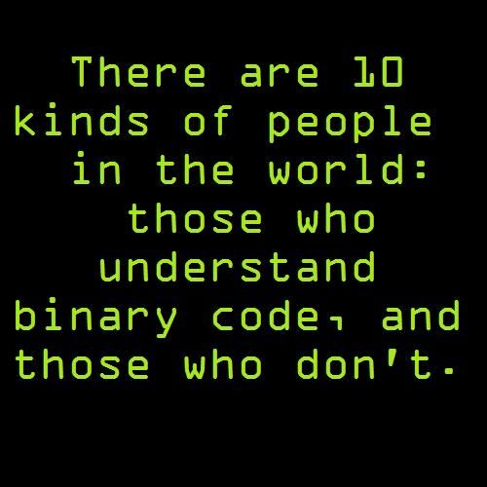
Joke
Continue with the introduction
  binary representation (base 2) and arithmetic
2¹ | 2⁰ | Total (decimal)
1 | 0 | 2
10¹ | 10⁰ | Total
1 | 0 | 10

Slide 8
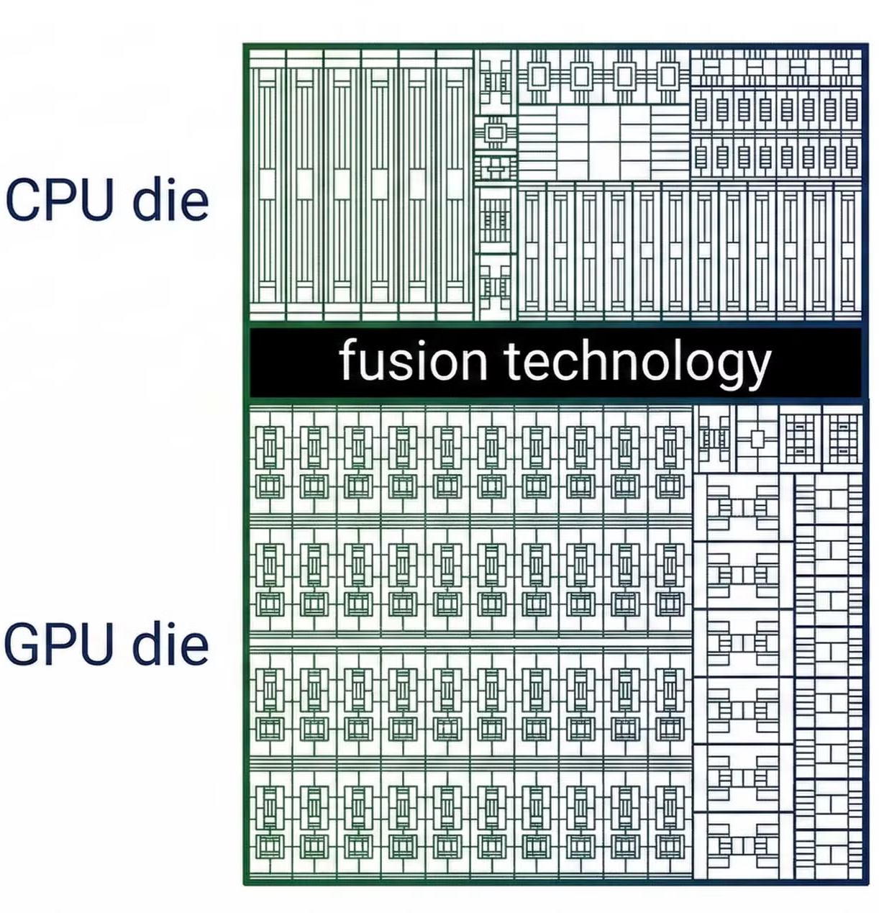
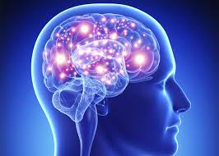
Background
18 core CPU
6 S-cores + 12 P-cores
Apple M5 Max (100 billion transistors)
dual-die
Human brain: 86 billion neurons¹
40 core GPU (+ Neural)
16 core Neural Engine
(just a fn.
diagram)
Memory (RAM)
128GB
20W of power (oft-cited figure)
¹Herculano-Houzel, S. The Human Brain in Numbers: A Linearly Scaled-up Primate Brain . Frontiers in Human Neuroscience. 2009;3:31. doi:10.3389/neuro.09.031.2009.
TDP: 72W power
Media Engine

Slide 9
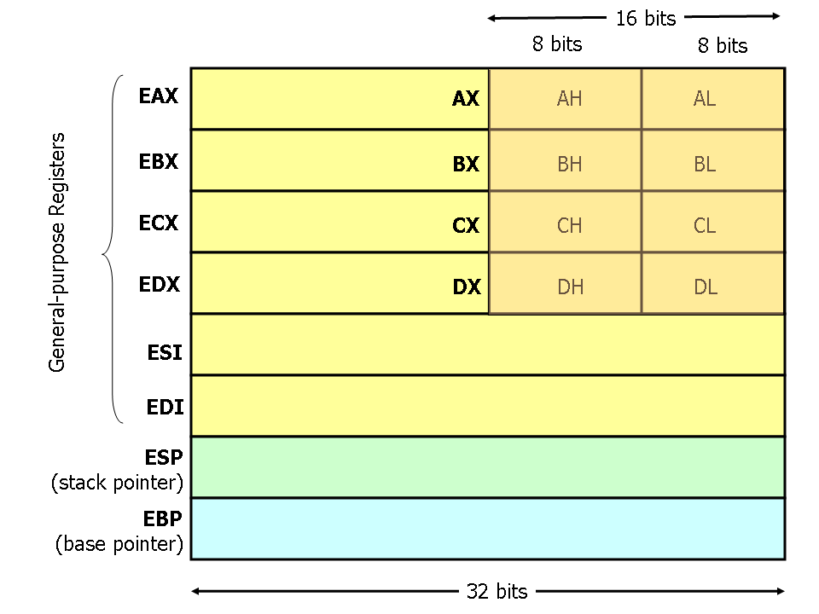
Introduction
Machine Language
  A CPU understands only one language: machine language (Intel/AMD x86)
    all other languages must be translated into machine language
  Primitive instructions include:
    MOV
    PUSH
    POP
    ADD / SUB
    INC / DEC
    IMUL / IDIV
    AND / OR / XOR / NOT
    NEG
    SHL / SHR
    JMP
    CMP
    JE / JNE / JZ / JG / JGE / JL / JLE
    CALL / RET
Assembly Language: (this notation)
by definition, nothing built on it is more powerful
http://www.cs.virginia.edu/~evans/cs216/guides/x86.html

Slide 10
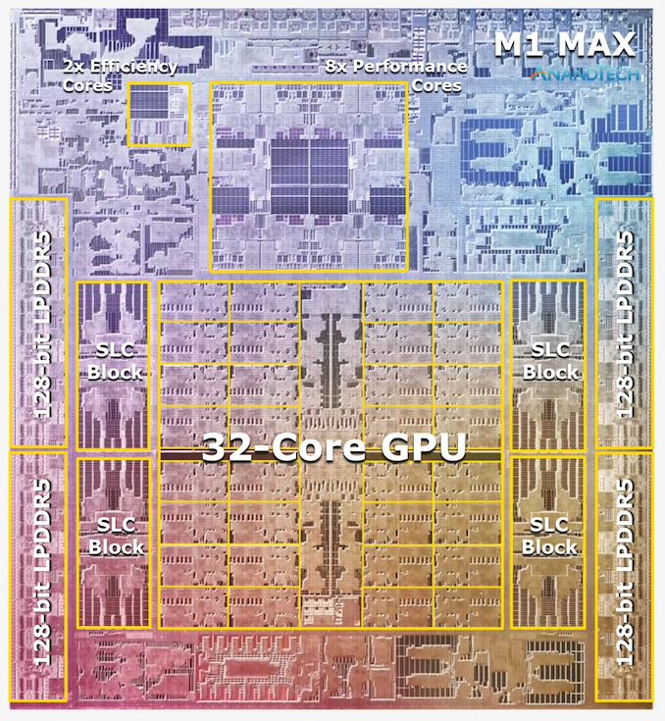
Background
10 core CPU
8 + 2
Machine Language (ML)
A CPU understands only Machine Language (ARM64)
all other languages must be translated into ML
Each core is an independent CPU itself:
  31 general purpose registers X0..X31
  32 floating point/vector registers
  SP
Primitive instructions include:
  ADD X0, X1, X2
  MOV X0, #1
  LDR X0, [<address>]
  STRW X0, [<address>]
  CBZ <Xn> <label> and CBNZ <Xn> <label>
  BL <label> / RET
32 core GPU
https://developer.arm.com/documentation/ddi0602/2022-12/?lang=en

Slide 11
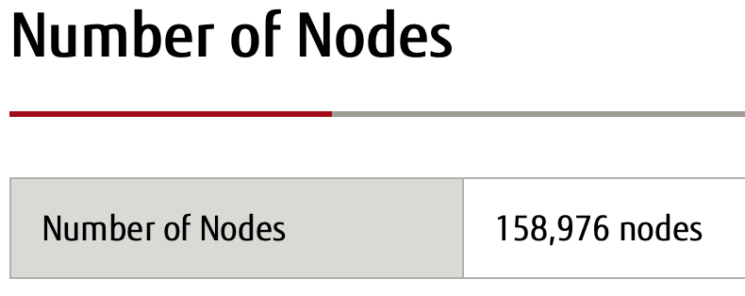
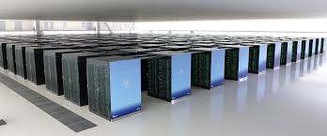
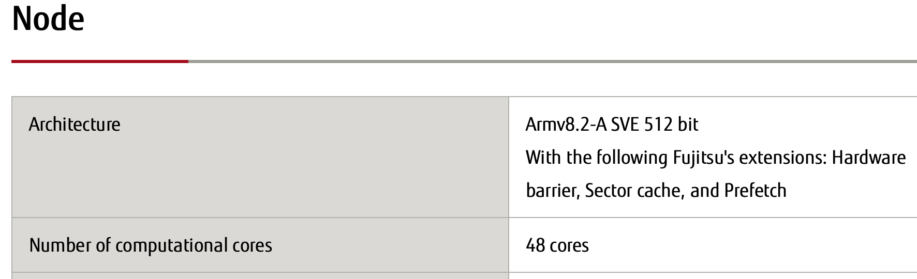
Fugaku supercomputer
World's fastest computer (using the ARM instruction set) until May 2022 (now #7)
Power consumption of 30 (to 40) megawatts (#1)
https://www.fujitsu.com/global/about/innovation/fugaku/
FukugakuNEXT coming
100x faster hybrid AI-HPC

Slide 12
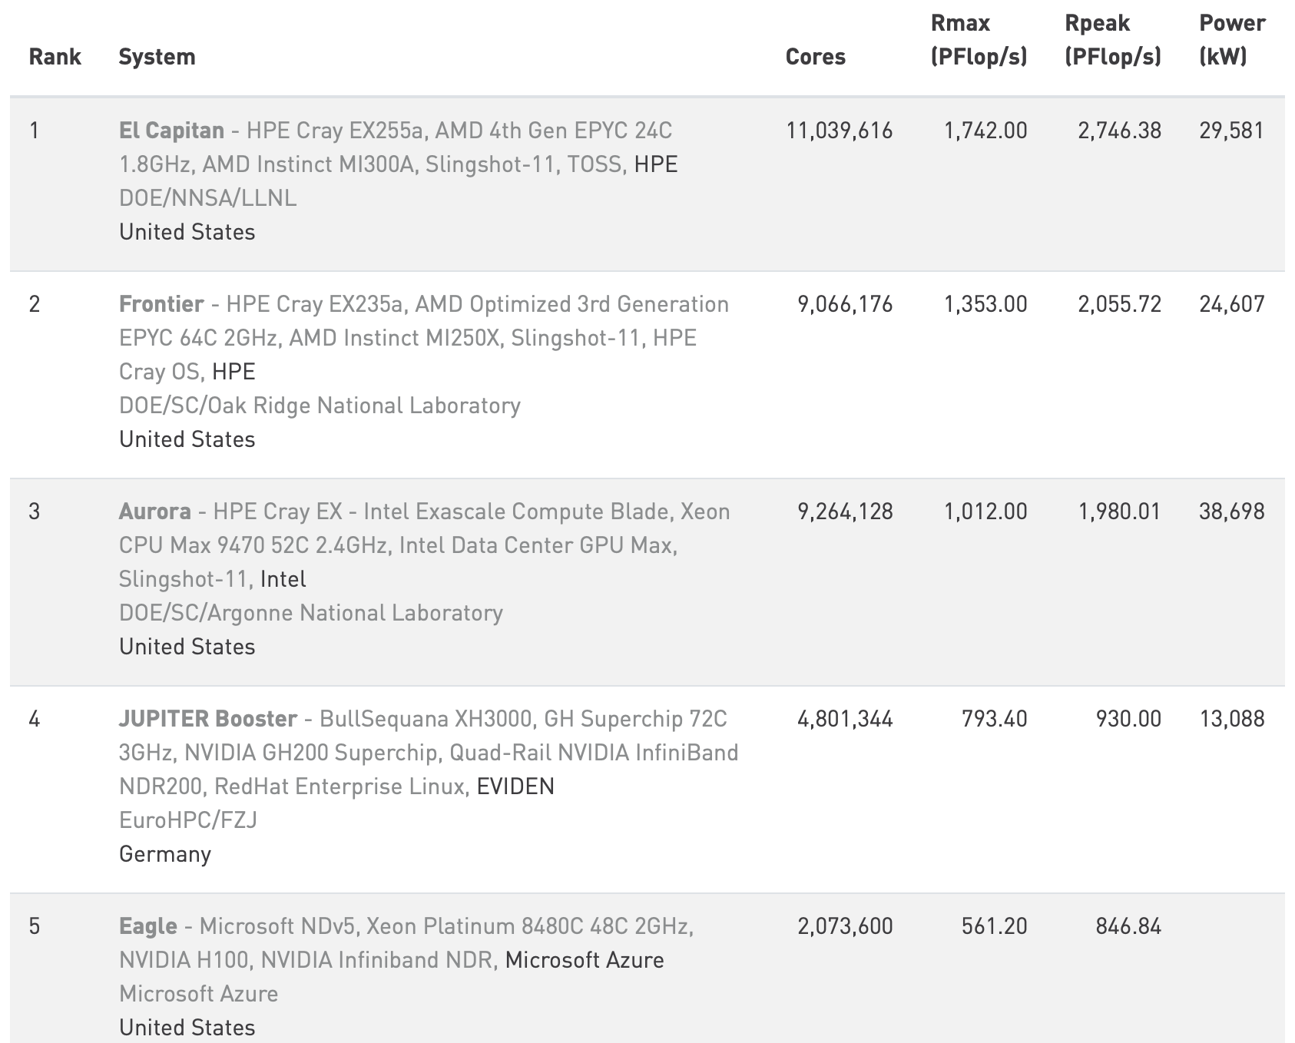
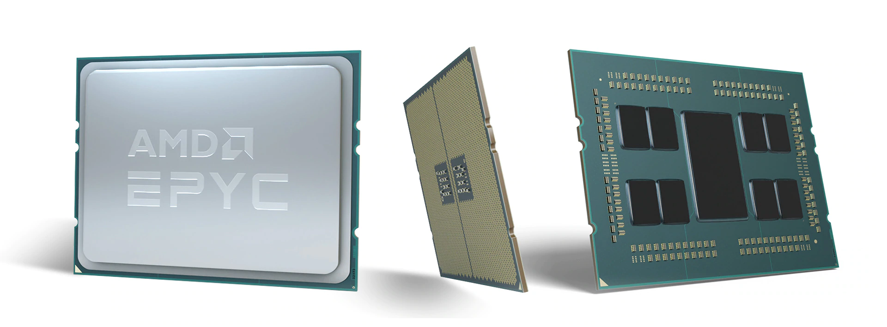
Supercomputers rely on parallelism
each CPU may have 64 cores each + GPUs
Not all tasks are easily parallelizable.
  Can you use 8 million cores?
  e.g. analyze 8 million sentences at a time?
https://www.top500.org

Slide 13
Introduction
Not all machine instructions are conceptually necessary
  many provided for speed/efficiency
Theoretical Computer Science
  All mechanical computation can be carried out using a TURING MACHINE (a-machine; Turing, 1936)
  Finite state table + (infinite) tape
  Tape instructions:
    at the tape head: Erase, Write, Move (Left/Right/NoMove)
  Finite state table:
    Current state x Tape symbol --> new state x New Tape symbol x Move
Assembly Language instructions:
MOV/ADD/JMP/JZ/CALL/RET

Slide 14
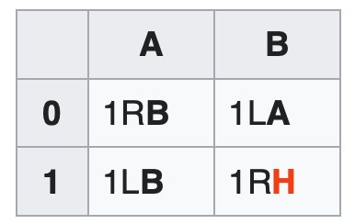
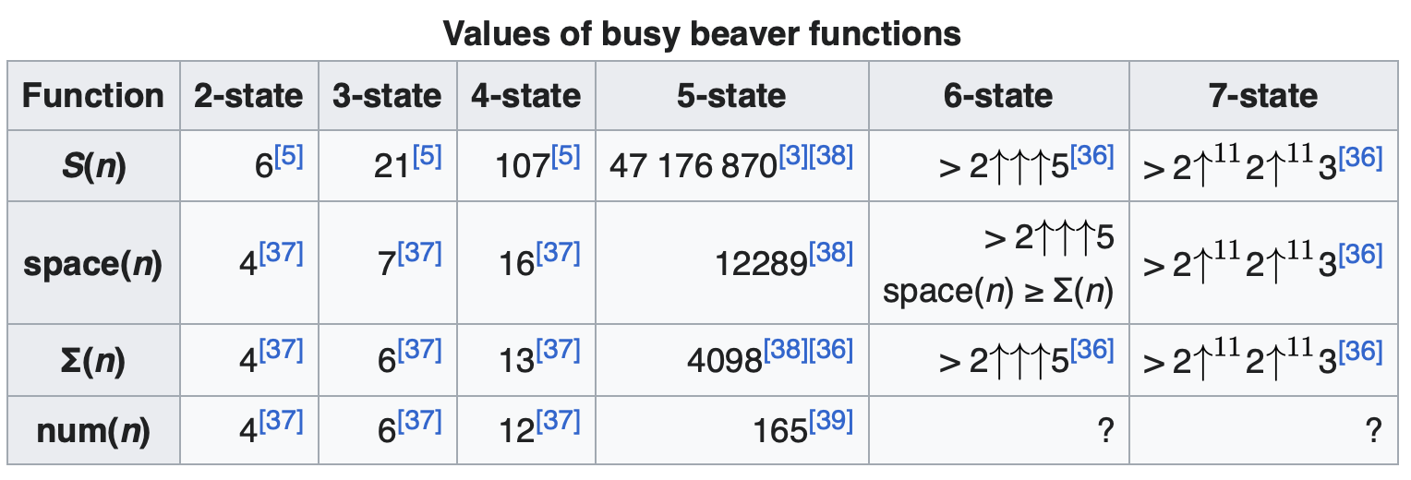
Recall the Busy Beaver Turing Machine?
A 0 (Initially, all 0's, state A)
B 10
A 11
B 011
A 0111
B 1111
H 1111
State
symbol
@ tape
head
en.wikipedia.org/wiki/Busy_beaver
Halt state H not counted as one of the states

Slide 15
Introduction
Storage:
  based on digital logic
  binary (base 2) – everything is a power of 2
  Byte: 8 bits
    01011011
    = 2⁶+2⁴+2³+2¹+2⁰
    = 64 + 16 + 8 + 2 + 1
    = 91 (in decimal)
  Hexadecimal (base 16)
    0-9,A,B,C,D,E,F (need 4 bits)
    5B (= 1 byte)
    = 5*16¹ + 11
    = 80 + 11
    = 91
2⁷ | 2⁶ | 2⁵ | 2⁴ | 2³ | 2² | 2¹ | 2⁰
2⁷ | 2⁶ | 2⁵ | 2⁴ | 2³ | 2² | 2¹ | 2⁰
0 | 1 | 0 | 1 | 1 | 0 | 1 | 1
2³ | 2² | 2¹ | 2⁰ | 2³ | 2² | 2¹ | 2⁰
0 | 1 | 0 | 1
2³ | 2² | 2¹ | 2⁰ | 2³ | 2² | 2¹ | 2⁰
2³ | 2² | 2¹ | 2⁰ | 2³ | 2² | 2¹ | 2⁰
0 | 1 | 0 | 1 | 1 | 0 | 1 | 1
16¹ | 16⁰
5 | B
5
B
16¹ | 16⁰

Slide 16
Introduction: data types
Integers
  In one byte (= 8 bits), what’s the largest and smallest number, we can represent?
  00000000 = 0
  01111111 = 127
  10000000 = -128
  11111111 = -1
  Number line:
00000000 (all zeros)
11111111 (all ones)
0 | … |  |  |  |  |  | 127 | -128 | -127 |  |  |  |  |  | -1
2’s complement representation

Slide 17
Introduction: data types
Integers
  In one byte, what’s the largest and smallest number, we can represent?
  Answer: -128 .. 0 .. 127 using the 2’s complement representation
  Why? super-convenient for arithmetic operations
  “to convert a positive integer X to its negative counterpart, flip all the bits, and add 1”
  Example:
  00001010 = 2³ + 2¹ = 10 (decimal)
  11110101 + 1 = 11110110 = -10 (decimal)
  11110110 flip + 1 = 00001001 + 1 = 00001010
Addition:
-10 + 10
= 11110110
+ 00001010 = 0 (ignore overflow)

Slide 18
Introduction: data types
Typically 32 bits (4 bytes) are used to store an integer
  range: -2,147,483,648 (2⁽³¹⁻¹⁾ -1) to 2,147,483,647 (2⁽³²⁻¹⁾ -1)
what if you want to store even larger numbers?
  Binary Coded Decimal (BCD)
  code each decimal digit separately, use a string (sequence) of decimal digits …
2³¹ | 2³⁰ | 2²⁹ | 2²⁸ | 2²⁷ | 2²⁶ | 2²⁵ | 2²⁴ | … |  | … | 2⁷ | 2⁶ | 2⁵ | 2⁴ | 2³ | 2² | 2¹ | 2⁰
byte 3 | byte 2 | byte 1 | byte 0
C:
int

Slide 19
Introduction: data types
what if you want to store even larger numbers?
  Binary Coded Decimal (BCD)
  1 byte can code two digits (0-9 requires 4 bits)
  1 nibble (4 bits) codes the sign (+/-), e.g. hex C/D
2³ | 2² | 2¹ | 2⁰
0 | 0 | 0 | 0
0
2 | 0 | 1 | 4
2 bytes (= 4 nibbles)
2³ | 2² | 2¹ | 2⁰
0 | 0 | 0 | 1
1
+ | 2 | 0 | 1 | 4
2.5 bytes (= 5 nibbles)
2³ | 2² | 2¹ | 2⁰
1 | 0 | 0 | 1
9
credit (+)
debit (-)
2³ | 2² | 2¹ | 2⁰
1 | 1 | 0 | 0
C
2³ | 2² | 2¹ | 2⁰
1 | 1 | 0 | 1
D

Slide 20
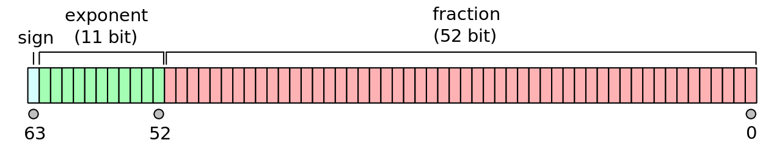
Introduction: data types
e.g. probabilities
Typically, 64 bits (8 bytes) are used to represent floating point numbers (double precision)
  c = 2.99792458 x 10⁸ (m/s)
  coefficient: 52 bits (implied 1, therefore treat as 53)
  exponent: 11 bits (usually not 2’s complement, unsigned with bias 2⁽¹⁰⁻¹⁾-1 = 511)
  sign: 1 bit (+/-)
C:
float
double
x86 CPUs have a built-in
floating point coprocessor (x87)
80 bit long registers
wikipedia

Slide 21
Example 1
The speed of light:
    c = 2.99792458 x 10⁸ (m/s)
Can a 4 byte integer be used to represent c exactly?
  4 bytes = 32 bits
  32 bits in 2’s complement format
  Largest positive number is
  2³¹-1 = 2,147,483,647
  c = 299,792,458

Slide 22
Example 2
Recall the speed of light:
    c = 2.99792458 x 10⁸ (m/s)
How much memory would you need to encode c using BCD notation as an integer?
  9 digits
  each digit requires 4 bits (a nibble)
  BCD notation includes a sign nibble
  total is 5 bytes

Slide 23
Example 3
Recall the speed of light:
    c = 2.99792458 x 10⁸ (m/s)
Can the 64 bit floating point representation (double) encode c without loss of precision?
  Recall significand precision: 53 bits (52 explicitly stored)
  2⁵³-1 = 9,007,199,254,740,991
  almost 16 digits
  (we only need 9 digits of precision)

Slide 24
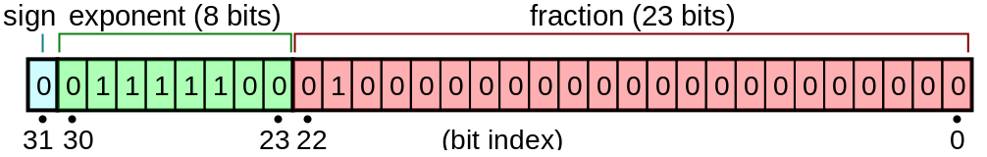
Example 4
Recall the speed of light:
    c = 2.99792458 x 10⁸ (m/s)
The 32 bit floating point representation (float) – sometimes called single precision - is composed of 1 bit sign, 8 bits exponent (unsigned with bias 2⁽⁸⁻¹⁾-1), and 23 bits coefficient (24 bits effective).
Can it represent c without loss of precision?
  2²⁴-1 = 16,777,215
  Nope (7 digits of precision)

Slide 25
Example 5
Atomic clocks use the caesium standard. Frequency is exactly 9 192 631 770 Hz.
Does the 32 bit binary integer representation have enough bits to represent this frequency?
Relevant integer is:
  9 192 631 770 (Hz)
  Largest possible integer using 2's complement is:
  2³¹ – 1 = 2 147 483 648 (too small)
  Largest possible integer even if we use unsigned representation is:
  2³² – 1 = 4 294 967 296 (still too small)

Slide 26
Homework 1: Binary Exercise
2,147,483,659 is a prime number.
Does the 32 bit binary integer representation have enough bits to represent this prime? Explain.
2³¹ | 2³⁰ | 2²⁹ | 2²⁸ | 2²⁷ | 2²⁶ | 2²⁵ | 2²⁴ | … |  | … | 2⁷ | 2⁶ | 2⁵ | 2⁴ | 2³ | 2² | 2¹ | 2⁰
byte 3 | byte 2 | byte 1 | byte 0

Slide 27
Instructions
Email to sandiway@arizona.edu
By Sunday midnight
SUBJECT: 408/508 Homework 1: YOUR NAME
Send me the binary bit pattern!
Either Plain Text or PDF accepted
  no MS Word .doc/.docx files please

