Slide 1
408/508 Computational Techniques for Linguists
Lecture 17

Slide 2
Today's Topics
Homework 6 (Tic-Tac-Toe) Code Review

Slide 3
Today's Topics
Creating a webserver (httpd)
  install the Apache2 webserver
    installed by default on macOS,
    install using apt install on Ubuntu
  how to start/stop service
  DocumentRoot
  User web files
Homework 7 (heads-up):
  set up your own webserver
  given out on Thursday

Slide 4

Delay Issue Example
Why does it happen?
single thread of execution
  cell innerHTML write doesn't happen until after alert()

Slide 5
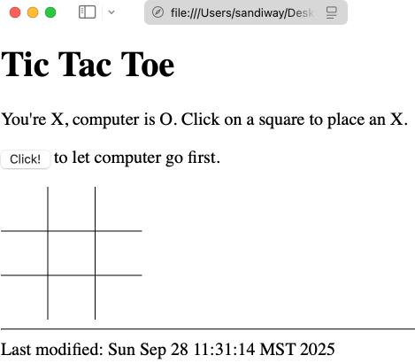
Example

Slide 6

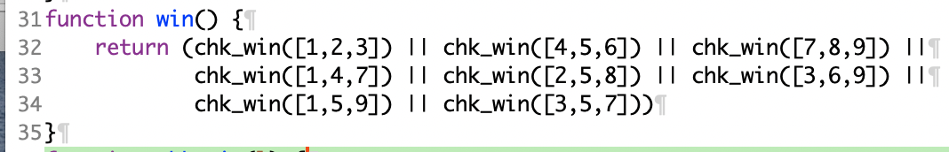
chk_win()
horizontal
vertical
diagonal

Slide 7
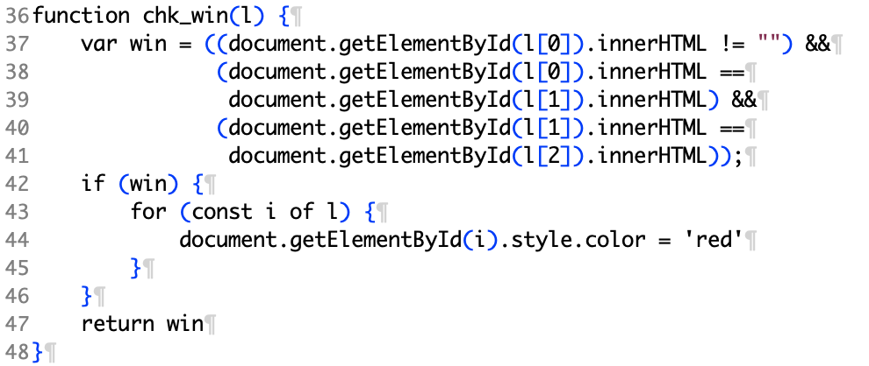
chk_win()

Slide 8
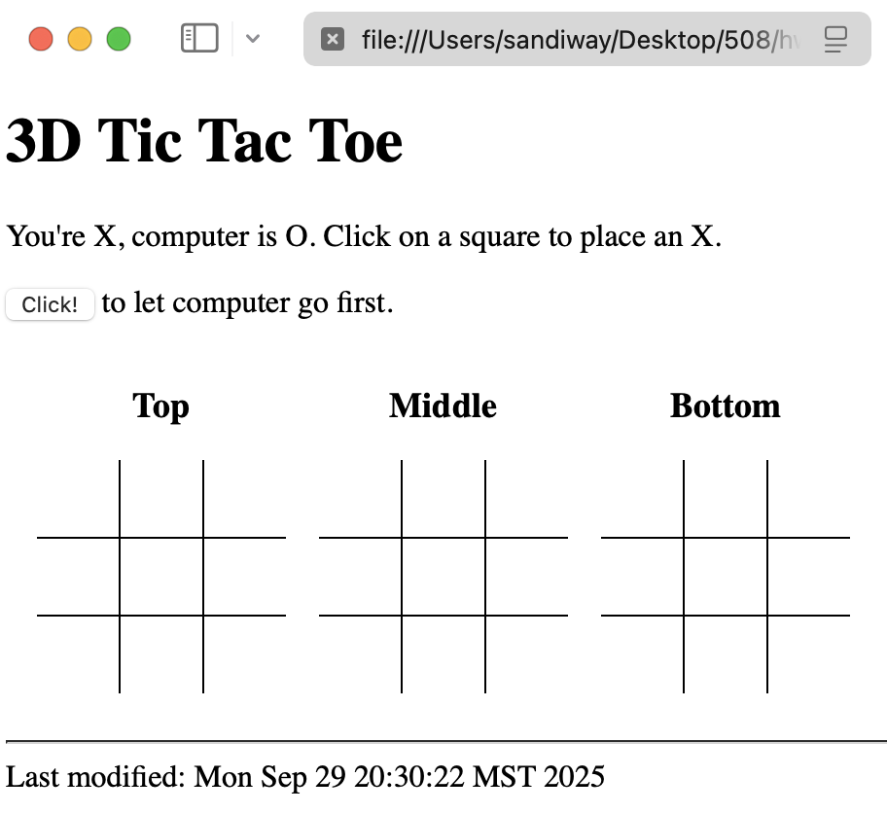
Generalize to 3D Tic Tac Toe

Slide 9
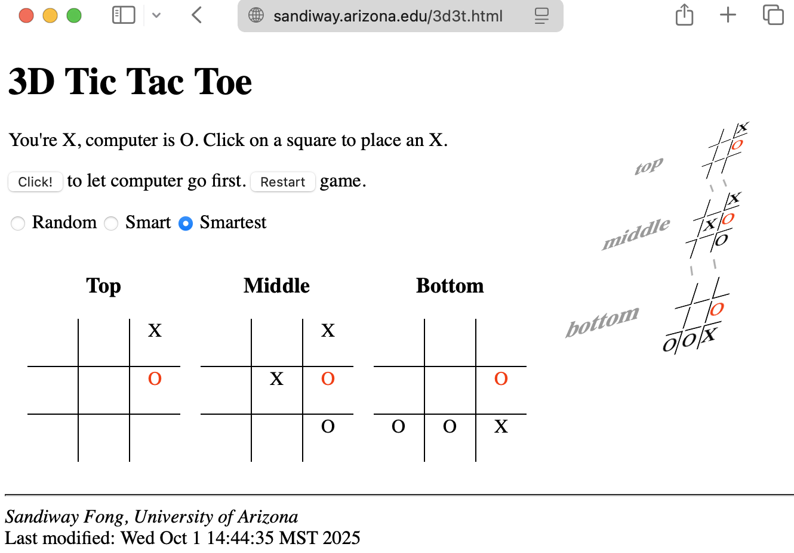

Generalize to 3D Tic Tac Toe

Slide 10
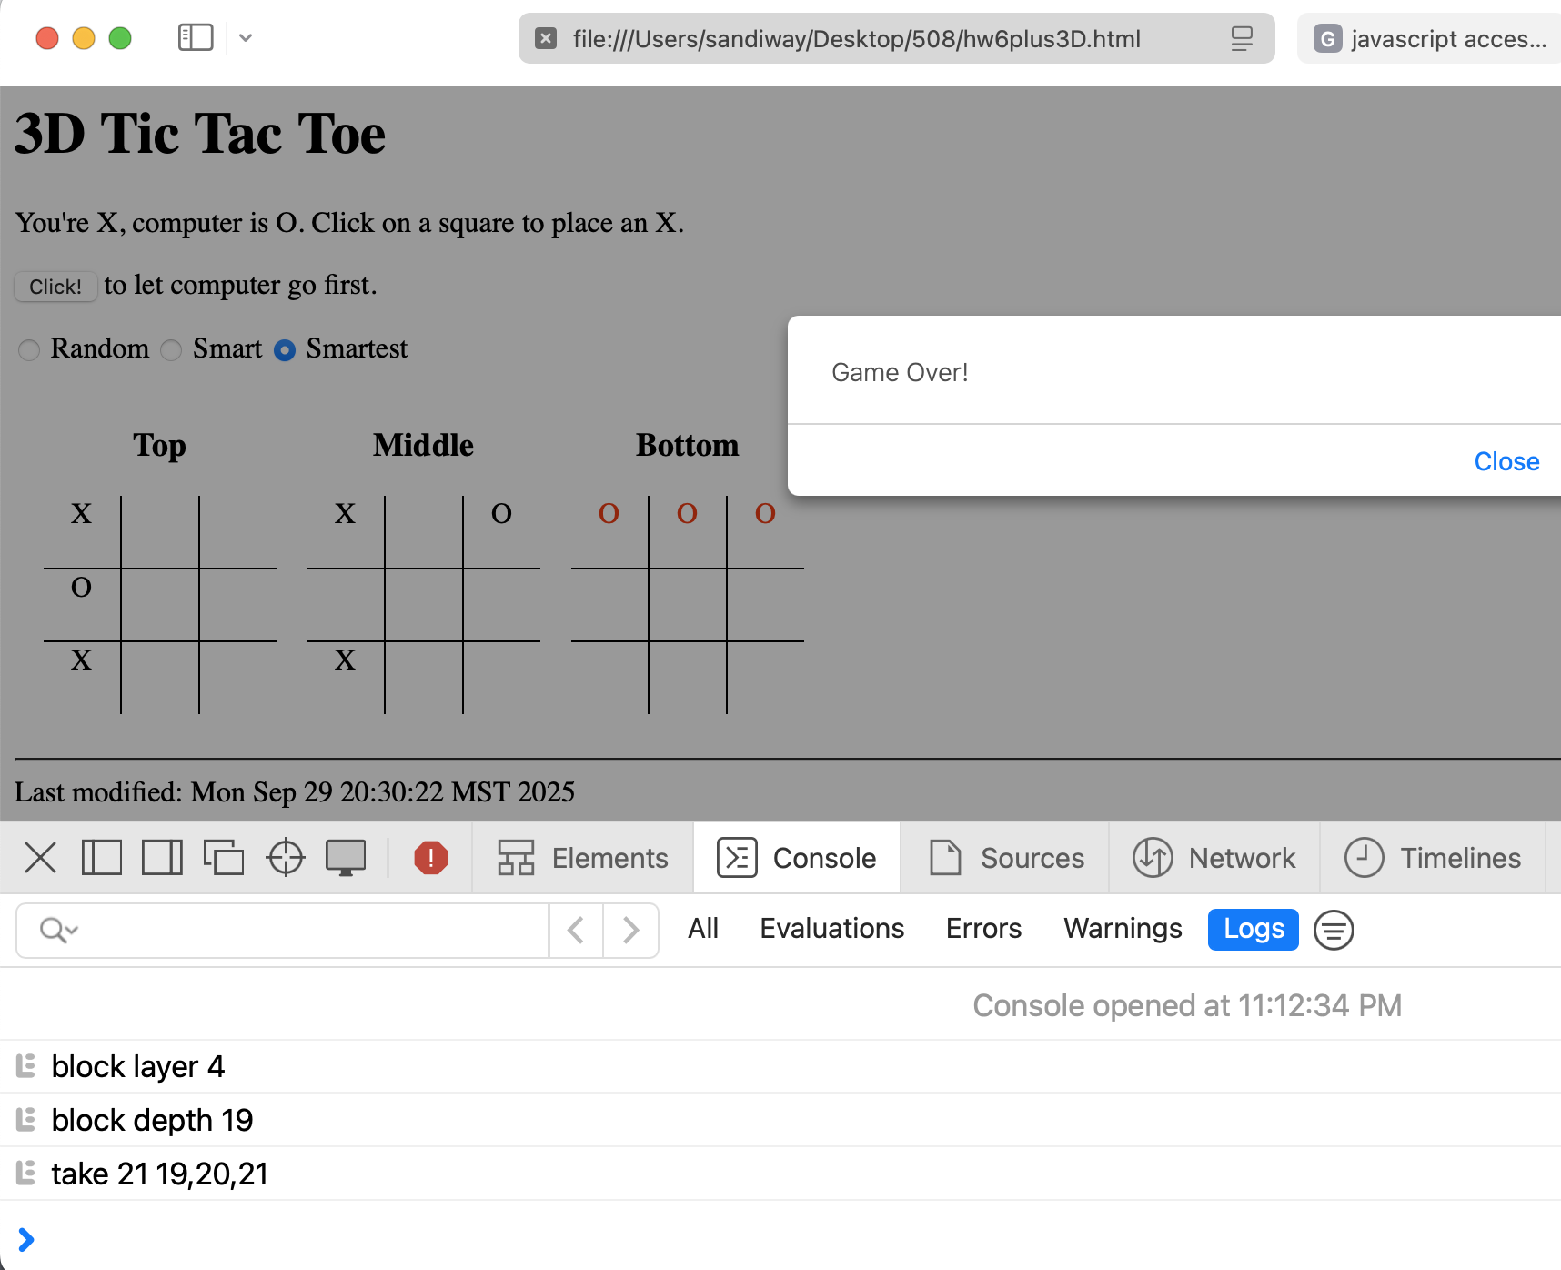
"Smart" 3D Tic Tac Toe

Slide 11
Building a Webserver
We'll use cgi-bin and bash scripts initially …
Apache2 is the most common webserver software
  https://httpd.apache.org
  has been around more than a quarter century
  unfortunately, configurations are similar but different on macOS and Ubuntu
  (we will cover both today)

Slide 12


Common Gateway Interface (CGI)
The glue between a webserver and programs that run on the computer (= server) hosting the webserver
Normally, a webserver sends out static webpages in response to (URL) requests from a client (your web browser).
Sometimes, we want the request to run a program (a script or binary) on the server that does some computation and generates some result to be displayed on the client (as a webpage).
client
http://server/index.html
http://server/cgi-bin/program?parameter
server:
webserver
Today's class
Next
time
generated.html

Slide 13
httpd
httpd is the Apache HyperText Transfer Protocol (HTTP) server program.
  It is designed to be run as a standalone daemon process. When used like this it will create a pool of child processes or threads to handle requests.
  "We fancifully began to use the word daemon to describe background processes that worked tirelessly to perform system chores". (Prof. Corbató, MIT)
  In general, httpd should not be invoked directly, but rather should be invoked via apachctl on Unix-based systems

Slide 14
Apache Webserver on macOS
Commands to be entered at a Terminal
  ~$ which httpd
  /usr/sbin/httpd
Apache version (macOS 26.7 Tahoe):
  ~$ httpd -v
  Server version: Apache/2.4.67 (Unix)
  Server built: Aug 18 2026 19:55:09
Apache version (macOS 14.0 Sonoma):
  ~$ httpd -v
  Server version: Apache/2.4.56 (Unix)
  Server built: Aug 5 2023 06:30:16
Apache version (OSX 10.13 High Sierra):
  ~$ httpd -v
  Server version: Apache/2.4.33 (Unix)
  Server built: Apr 3 2018 17:54:07
Apache 2.4
Apache 2.4 released in 2012

Slide 15
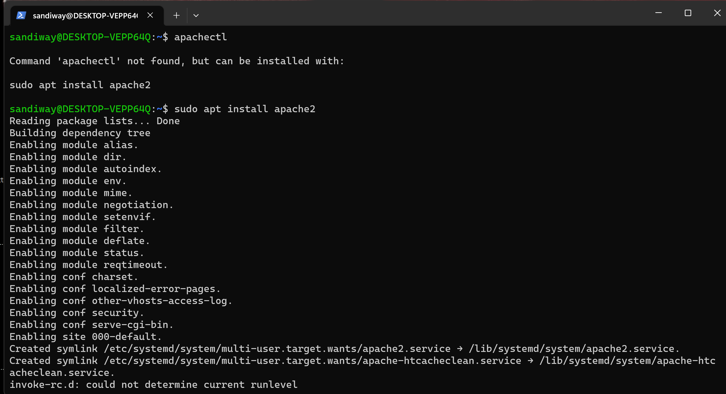
Apache Webserver on Ubuntu
Apache Webserver on Ubuntu (on WSL)
Ubuntu:
  sudo apt-get update

Slide 16
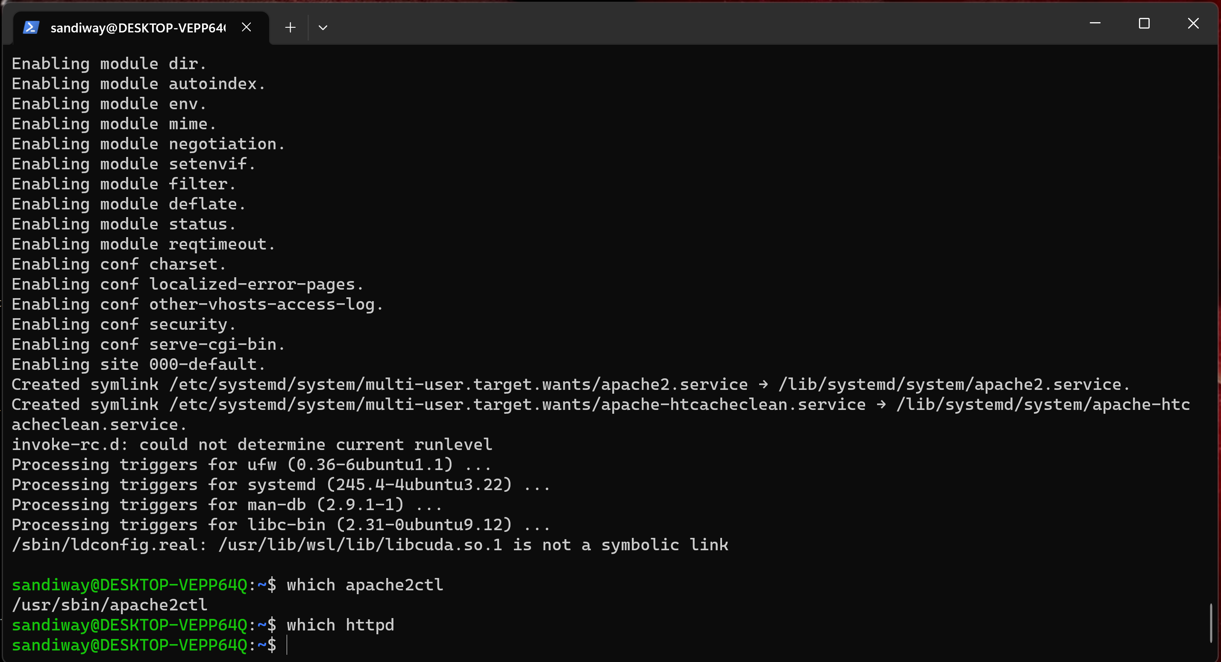
Apache Webserver on Ubuntu
apache2ctl command

Slide 17
Apache Webserver on macOS
Commands to be entered at a Terminal
Apache webserver control:
  ~$ which apachectl
  /usr/sbin/apachectl
  sudo apachectl start
  sudo apachectl stop
  sudo apachectl –k restart (after configuration change)
  apachectl configtest (check configuration)
  Syntax OK
  ps -ax | grep httpd (ps = process status)
  sudo apachectl stop
  ps -ax | grep httpd

Slide 18
Apache Webserver on WSL2 (Ubuntu)
From Windows Powershell:
  wsl
Default page (Document Root):
  /var/www/html/index.html
  owner of file is root, so use the sudo prefix to edit it
  e.g. sudo nano /var/www/html/index.html
Commands (or apache2ctl):
  sudo service apache2 start
  sudo service apache2 stop
  sudo service apache2 restart

Slide 19
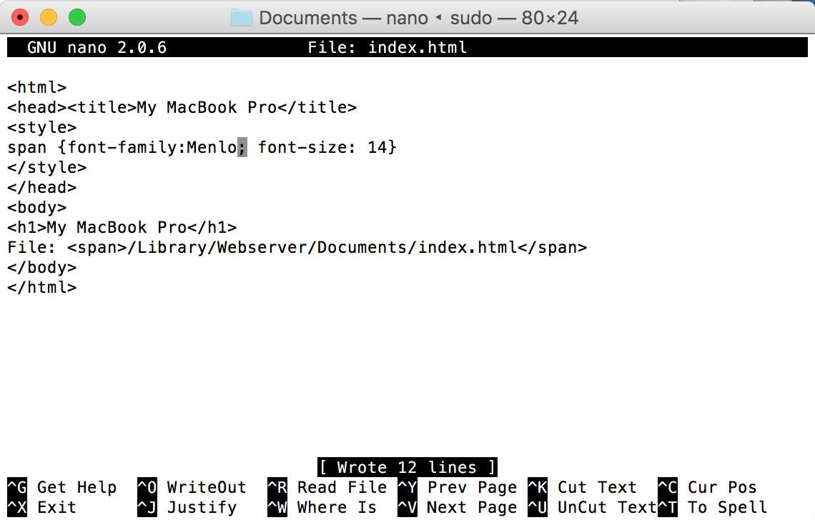
Apache Webserver on macOS
Default static webpage storage location:
  http://localhost/
  /Library/WebServer/Documents/index.html.en~orig
  Let's create index.html ourselves!
  sudo nano /Library/Webserver/Documents/index.html.en~orig
  nano is a simple text editor
  ^ means use the Control key
  save file as
  /Library/Webserver/Documents/index.html

Slide 20
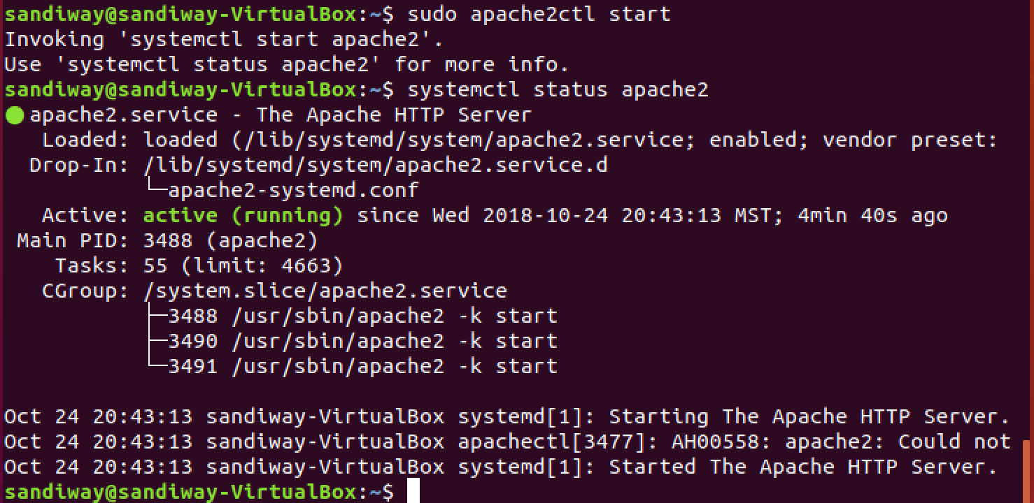
Apache2 on Ubuntu
Apache2 webserver (on VirtualBox or WSL2):
  sudo apache2ctl start
  sudo apache2ctl stop
  sudo apache2ctl restart
Note: macOS is different, uses apachectl

Slide 21
ps command
NAME
ps – process status
SYNOPSIS
ps [-AaCcEefhjlMmrSTvwXx] …
DESCRIPTION
The ps utility displays a header line, followed by lines containing
information about all of your processes that have controlling terminals.
-a Display information about other users' processes as well as your
own. This will skip any processes which do not have a
controlling terminal, unless the -x option is also specified.
-x When displaying processes matched by other options, include
processes which do not have a controlling terminal.

Slide 22
grep command
NAME
grep, egrep, fgrep, rgrep, bzgrep, bzegrep, bzfgrep, zgrep, zegrep,
zfgrep – file pattern searcher
SYNOPSIS
grep … [pattern] [file ...]
DESCRIPTION
The grep utility searches any given input files, selecting lines that
match one or more patterns. By default, a pattern matches an input line
if the regular expression (RE) in the pattern matches the input line
without its trailing newline. An empty expression matches every line.
Each input line that matches at least one of the patterns is written to
the standard output.

Slide 23
Apache Webserver on macOS
~$ ps -ax | grep httpd
154 ?? 0:19.63 /usr/sbin/httpd -D FOREGROUND
517 ?? 0:00.00 /usr/sbin/httpd -D FOREGROUND
17404 ttys001 0:00.00 grep httpd
~$ sudo apachectl stop
Password:
~$ ps -ax | grep httpd
17409 ttys001 0:00.00 grep httpd
(base) ~$ sudo apachectl start
(base) ~$ ps -ax | grep httpd
17414 ?? 0:00.13 /usr/sbin/httpd -D FOREGROUND
17430 ?? 0:00.00 /usr/sbin/httpd -D FOREGROUND
17432 ttys001 0:00.00 grep httpd

Slide 24
Apache Webserver on macOS
~$ sudo apachectl start
Password:
/System/Library/LaunchDaemons/org.apache.httpd.plist: service already loaded
Load failed: 37: Operation already in progress
~$ apachectl configtest
AH00558: httpd: Could not reliably determine the server's fully qualified domain name, using Sandiways-MacBook-4.local. Set the 'ServerName' directive globally to suppress this message
Syntax OK

Slide 25
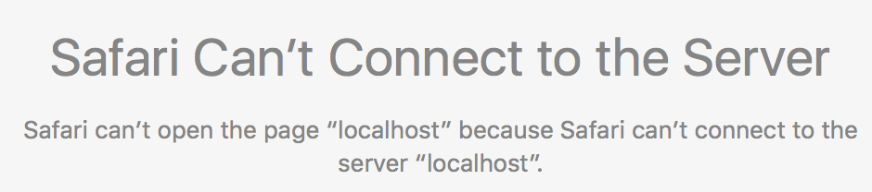
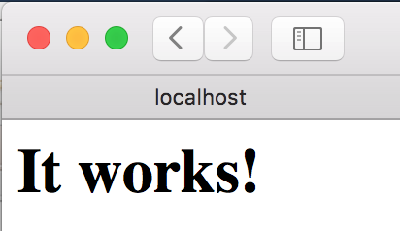
Apache Webserver on macOS
sudo apachectl start
On a browser, enter: http://localhost/ this displays as default the file
  /Library/WebServer/Documents/index.html
not
running…
running

Slide 26
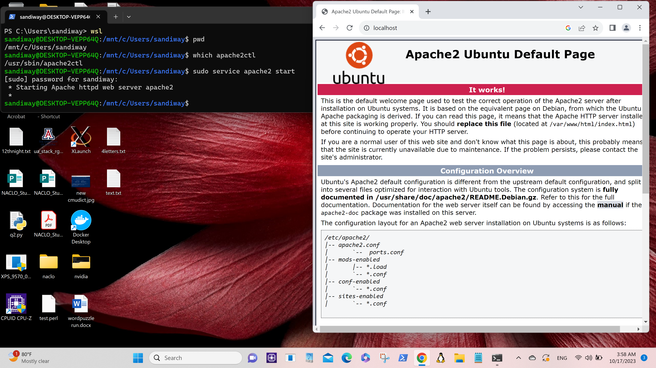
Apache Webserver on WSL2 (Ubuntu)

Slide 27
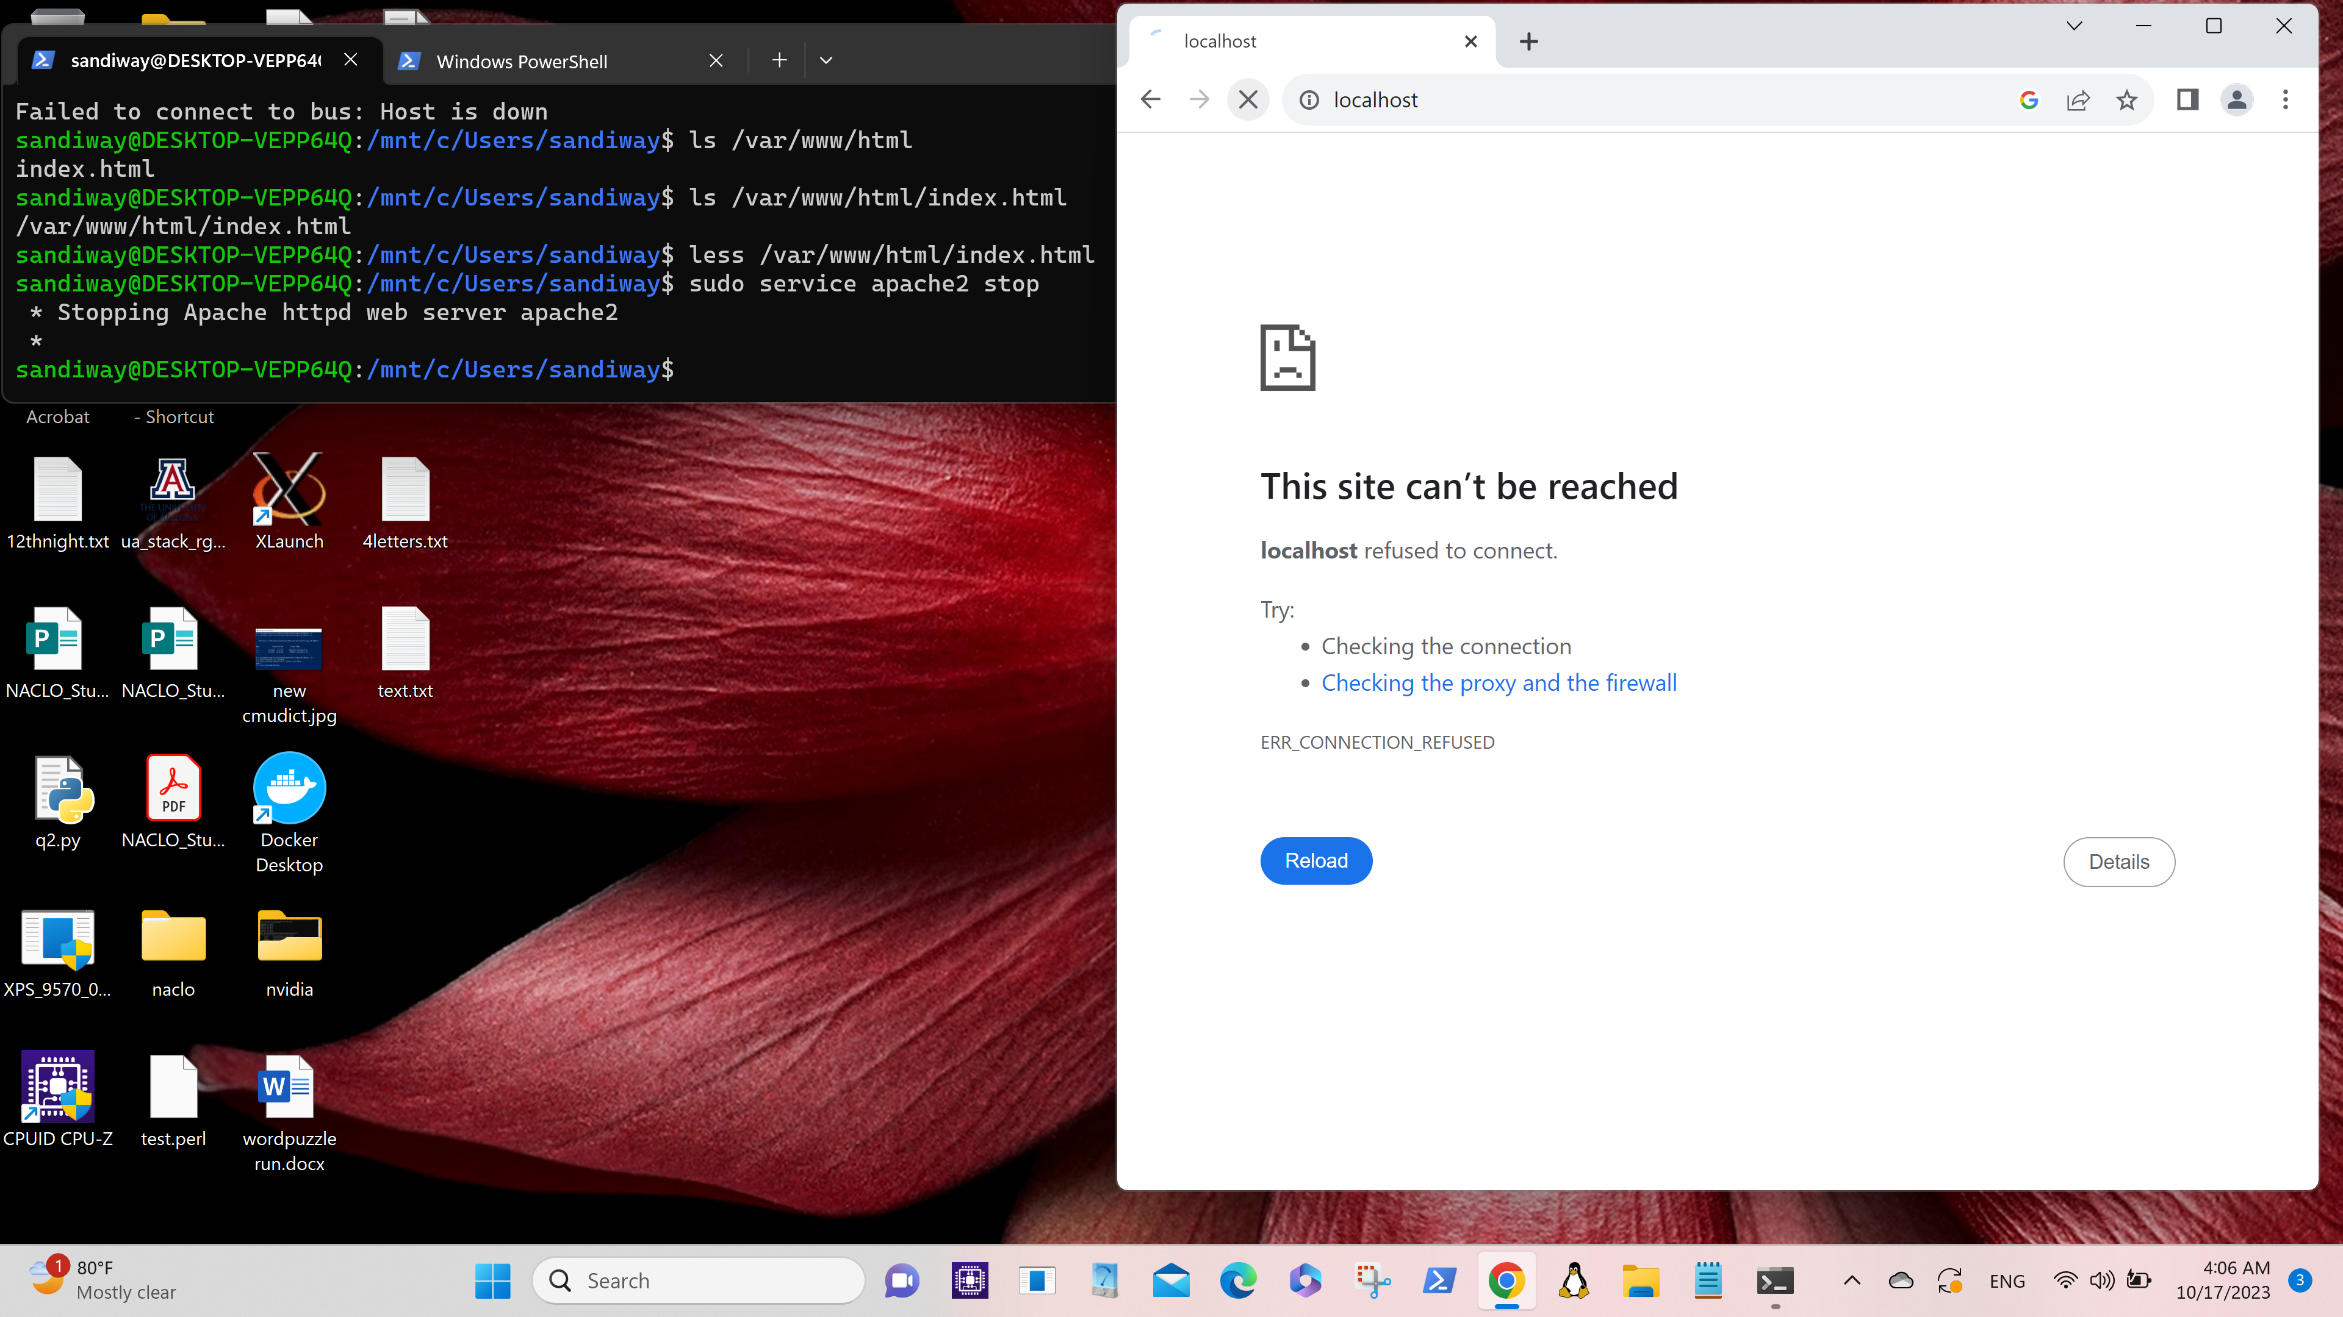
Apache Webserver on WSL2 (Ubuntu)

Slide 28
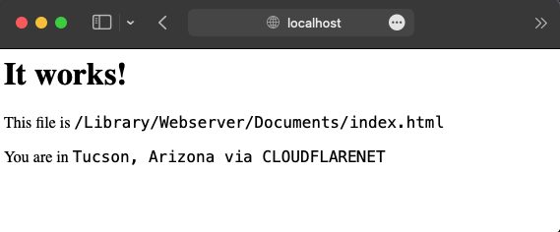
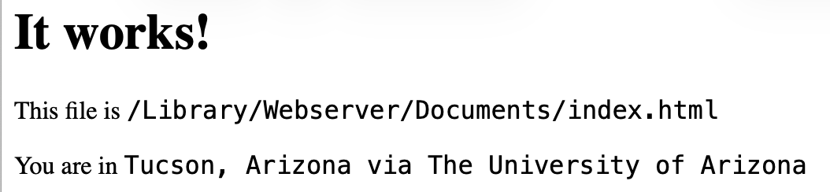
Apache Webserver on macOS

Slide 29
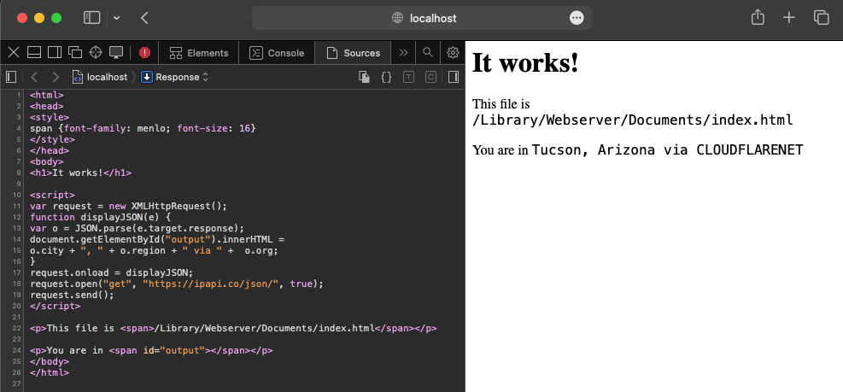
Apache Webserver on macOS
On macOS:

Slide 30
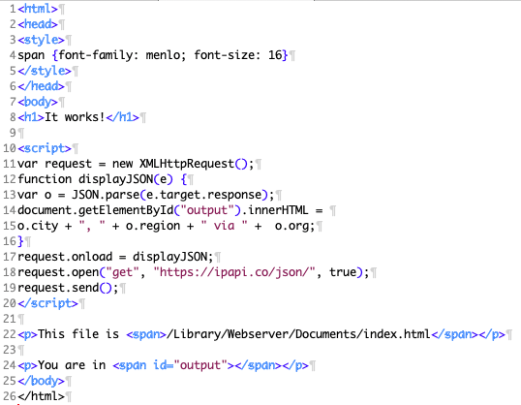
Sample Site webpage
Normally, Javascript in the browser is sandboxed for security.
  It has no access to your machine details, e.g. IP address or filesystem
So how did we do this?
File:
  sample-index.html
  I renamed it as index.html on my computer

Slide 31
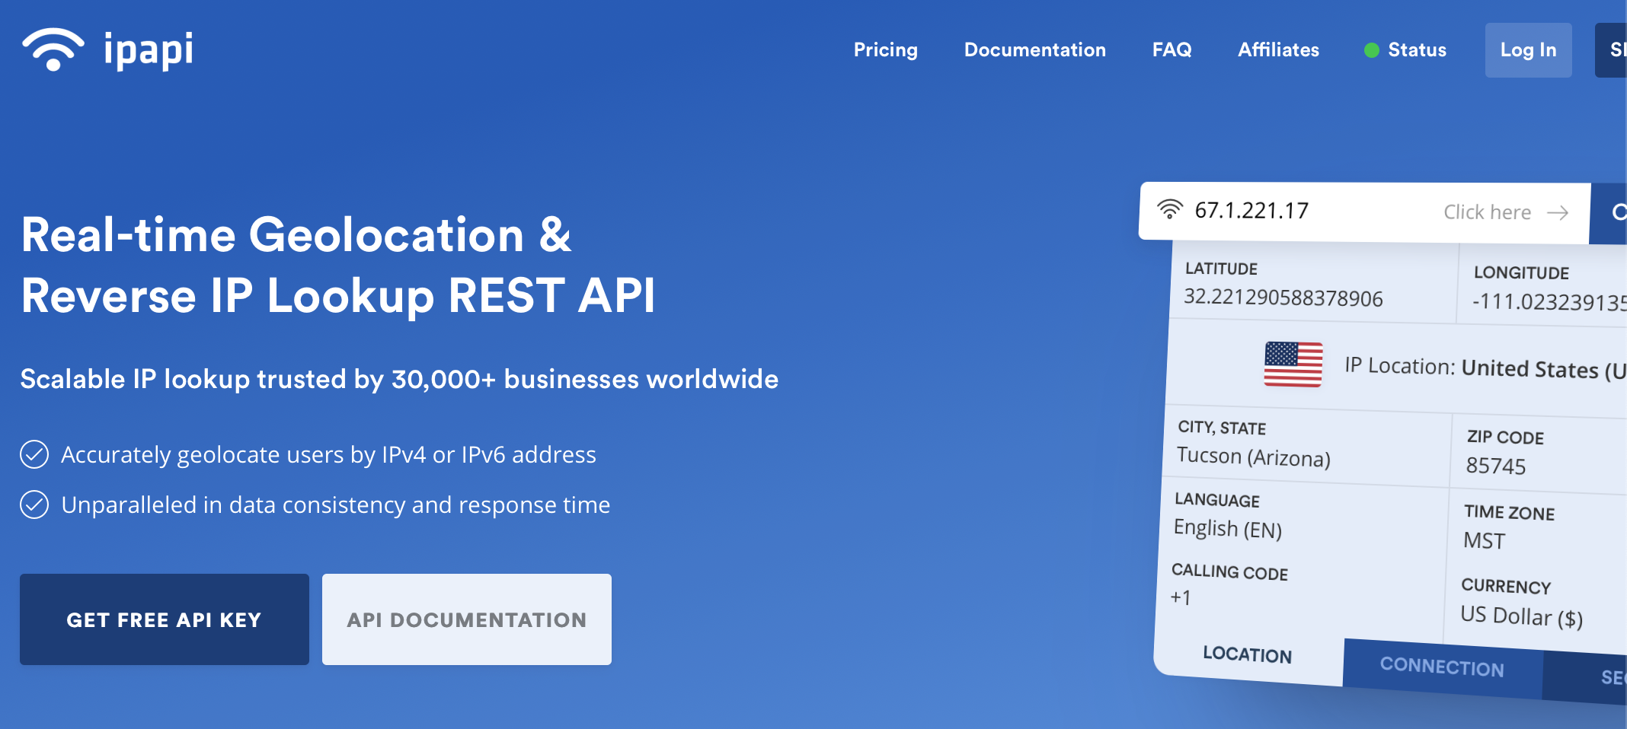
Lookup
Terminal:
~$ curl ifconfig.co/
2a09:bac3:6066:296::42:3d
https://ipapi.co/json/

Slide 32
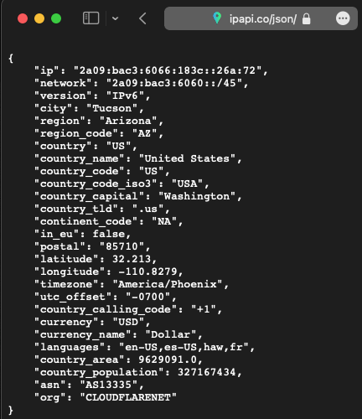
Lookup
JSON = Javascript Object Notation
IPv6 format
  x:x:x:x:x:x:x:x
  each x is 4 hex digits
  total: 128 bits
IPv4 format (since 1983)
  x.x.x.x each x is 2 hex digits
  total: 32 bits

