Slide 1
408/508 Computational Techniques for Linguists
Lecture 16

Slide 2
Today's Topic
Reminder: Homework 6 (Tic-Tac-Toe) due this Sunday
Calendar Puzzle (some more details)
Example of a "real" webpage's structure (Guardian news article)
BMI Gauge animated display (recap)
  using <form> elements
  using <table>
  using Javascript to compute BMI value
  using the gaugeSVG.js widget to display the BMI value
Gauge for a random number generator

Slide 3
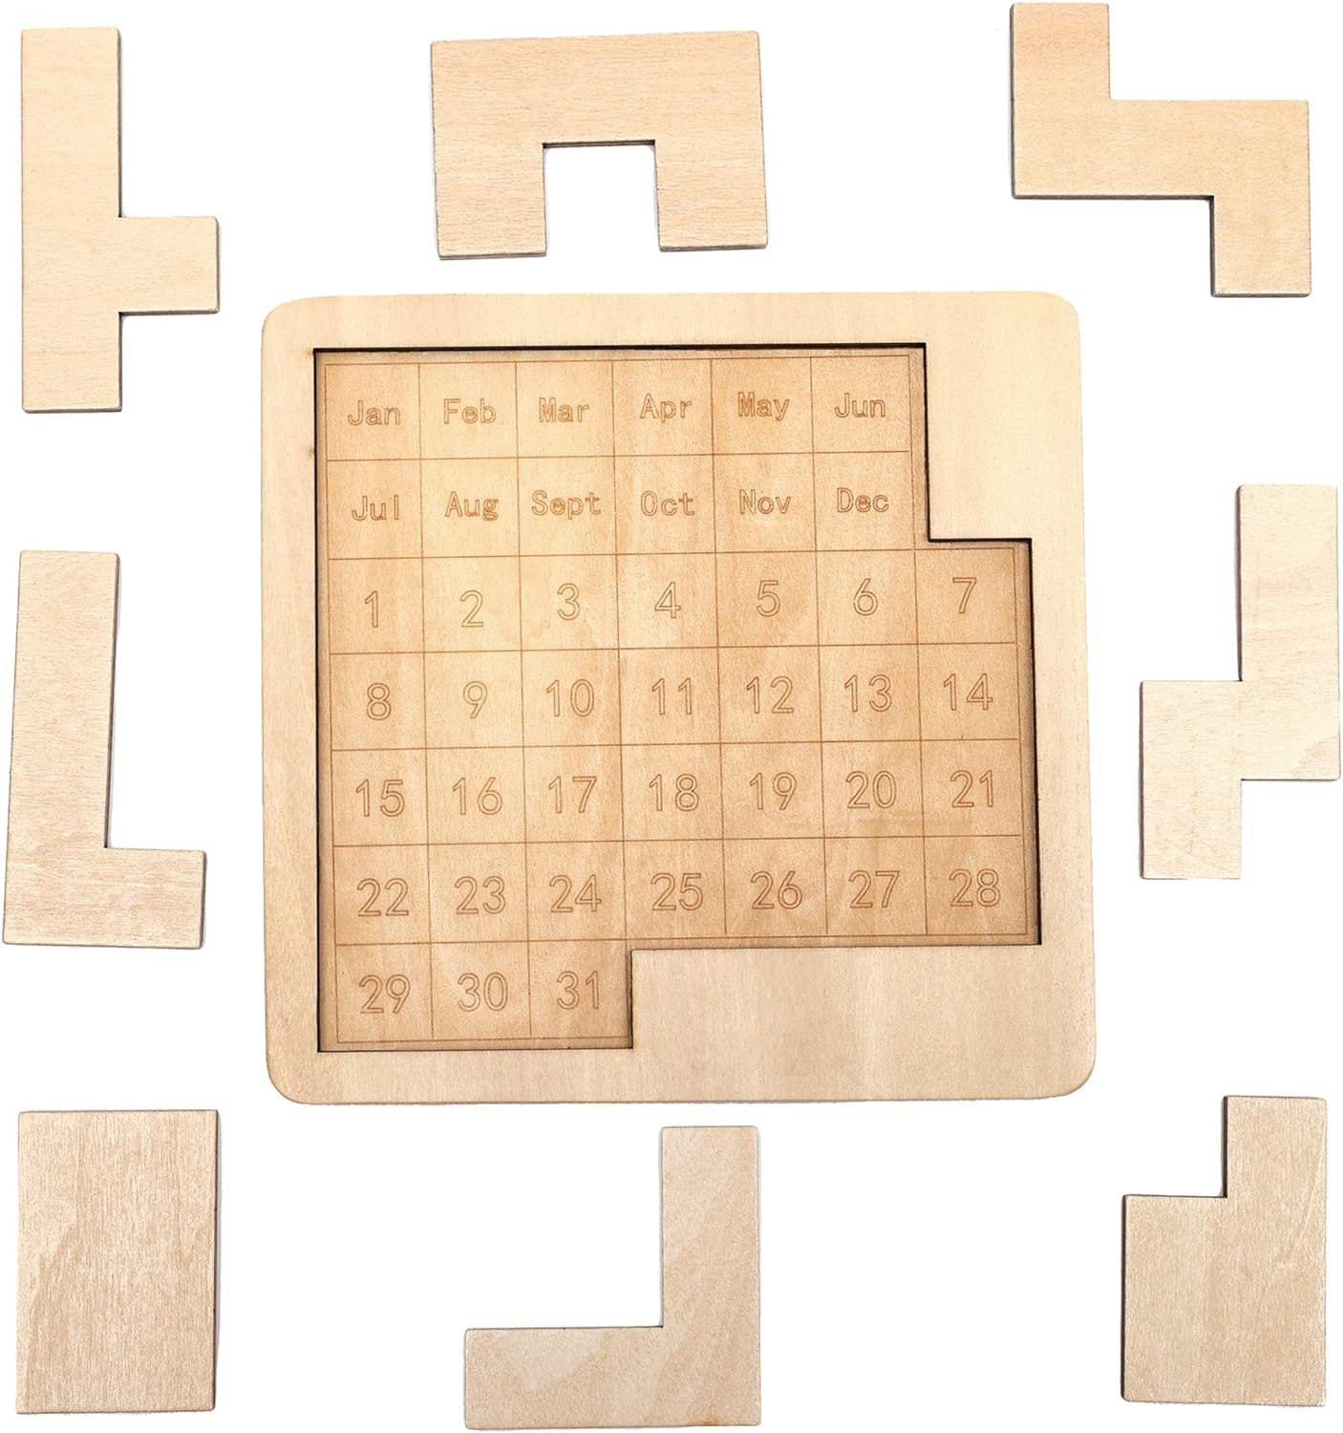
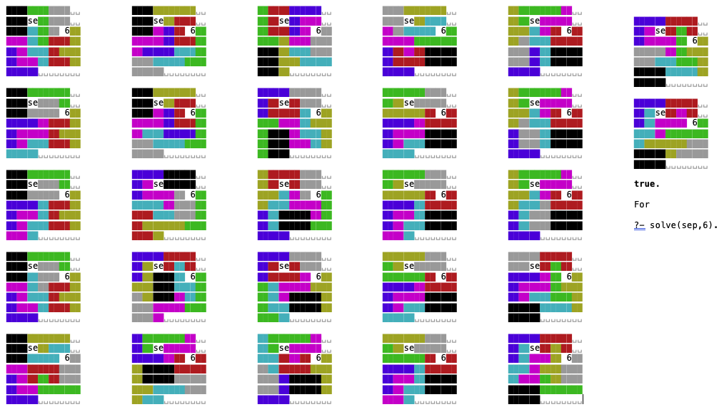
Calendar Puzzle (from last time)
Solutions for Sept 6th (my ASCII graphics code)

Slide 4
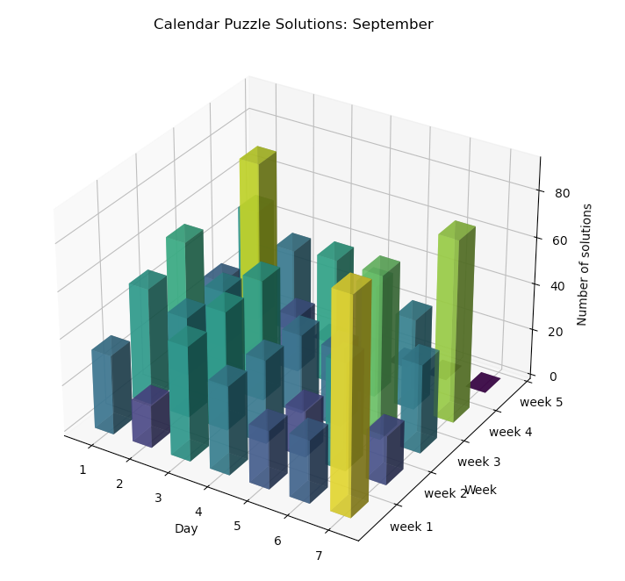
# of solutions for September
1st – 31st

Slide 5
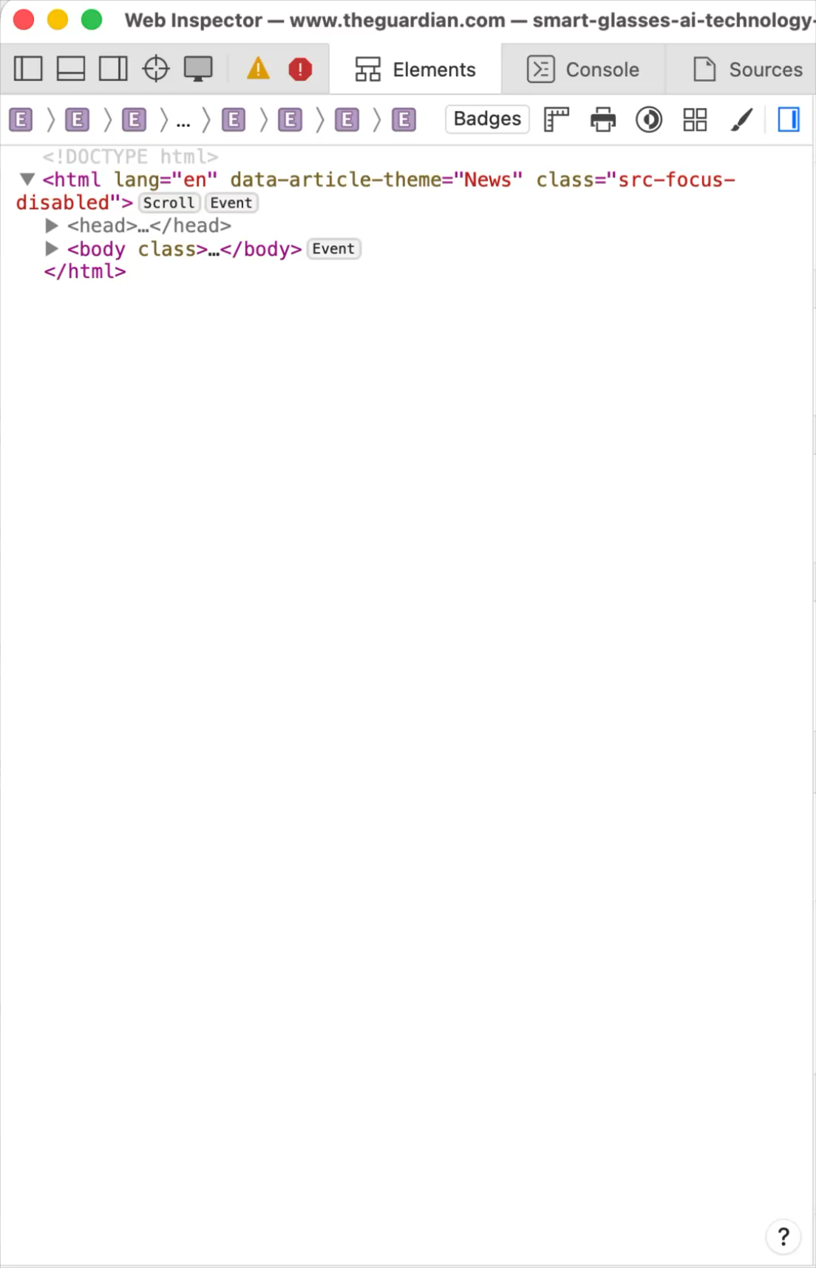
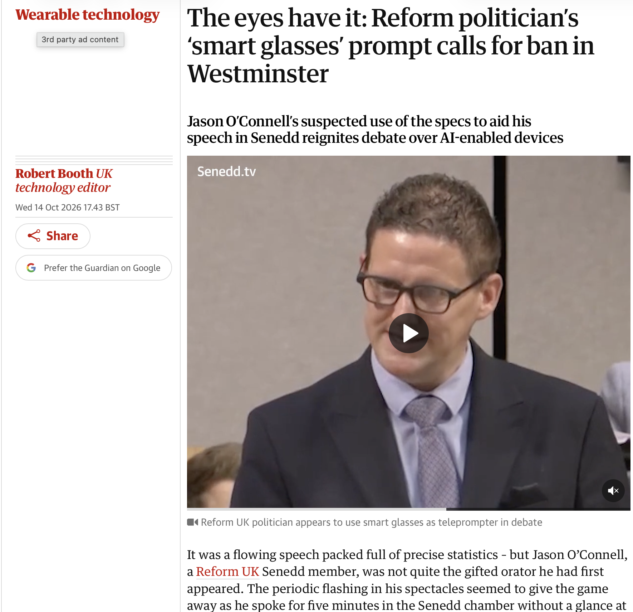
Guardian News Article (on AI glasses)

Slide 6

Guardian News Article (on AI glasses)

Slide 7
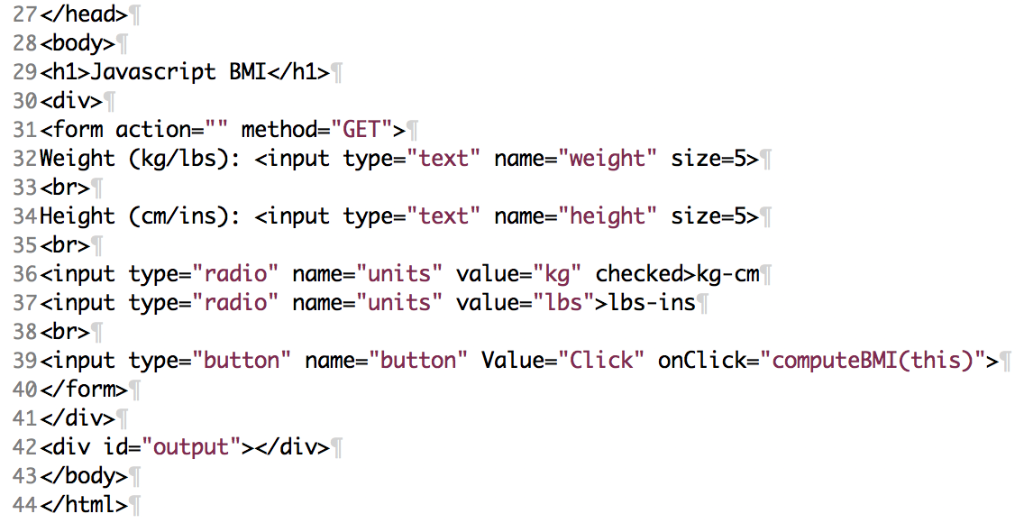
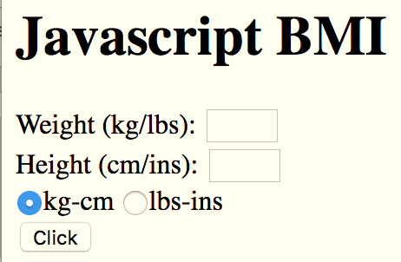
BMI: <form>… </form>
"weight"
"height"
"units"
"output" is (currently) an empty division
File: bmi-js.html

Slide 8
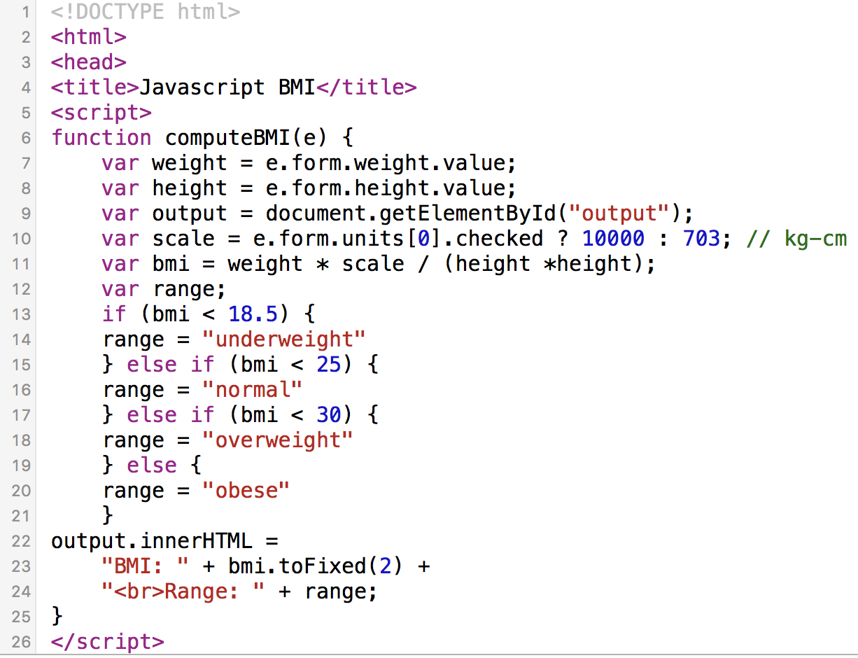
BMI: Javascript function computeBMI()
File: bmi-js.html
e.form.weight.value
e.form.height.value
e.form.units[0].checked
0 = 1st radio button
computeBMI(this)

Slide 9
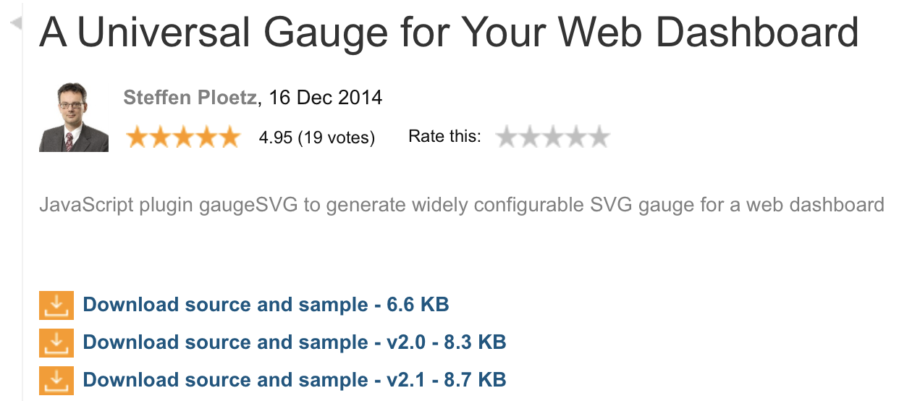
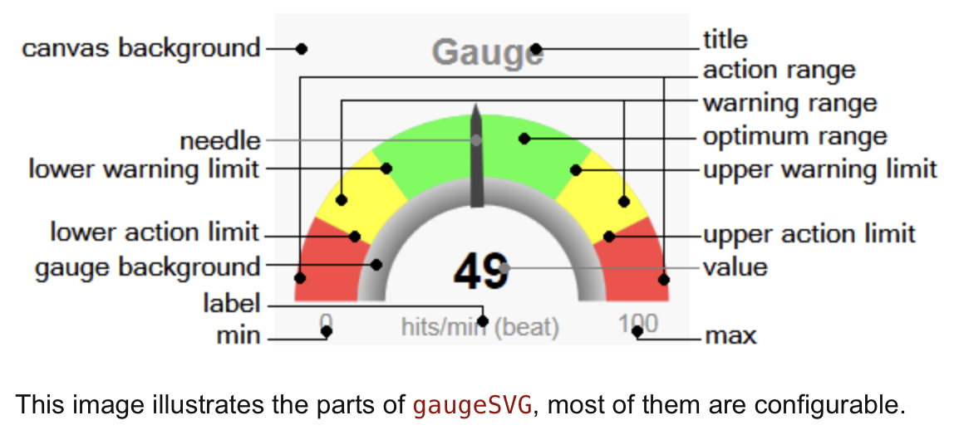
BMI: gaugeSVG.js
http://www.codeproject.com/Articles/604502/A-universal-gauge-for-your-web-dashboard
bmi-gauge.html
Download gaugeSVG.js from the course webpage
(I've modified the original code a bit)

Slide 10
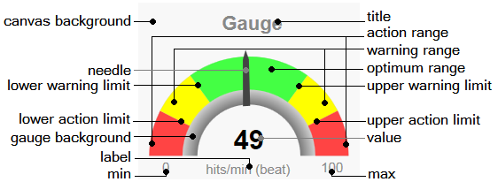
BMI: gaugeSVG.js
Note: I've modified his code slightly to allow for different colors for lower and upper warning ranges

Slide 11
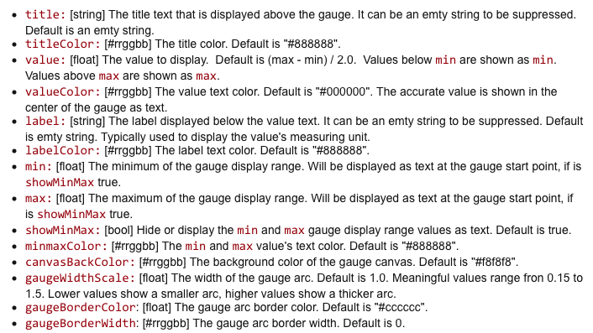
BMI: gaugeSVG.js

Slide 12
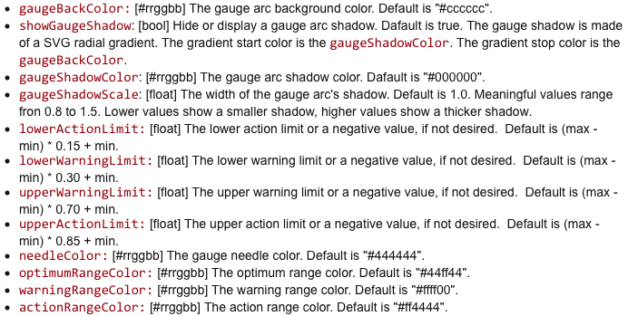
BMI: gaugeSVG.js

Slide 13
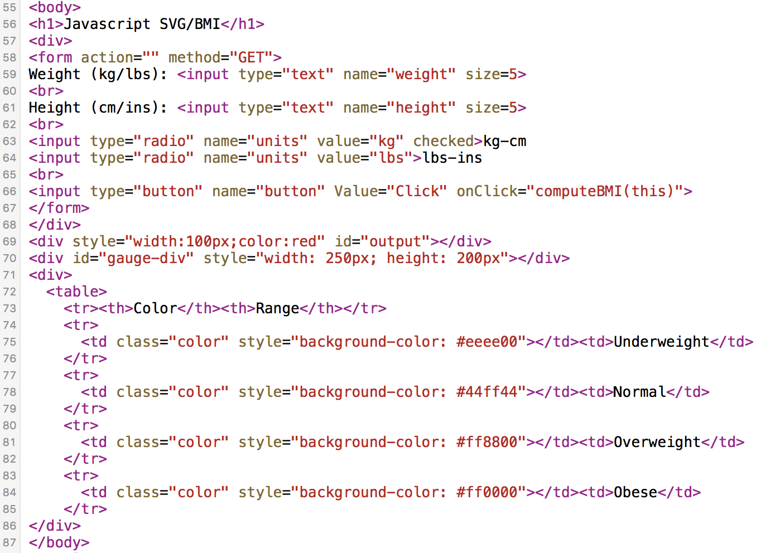
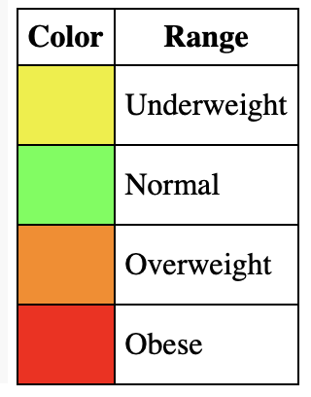
BMI: <table>… </table>
<table>

Slide 14
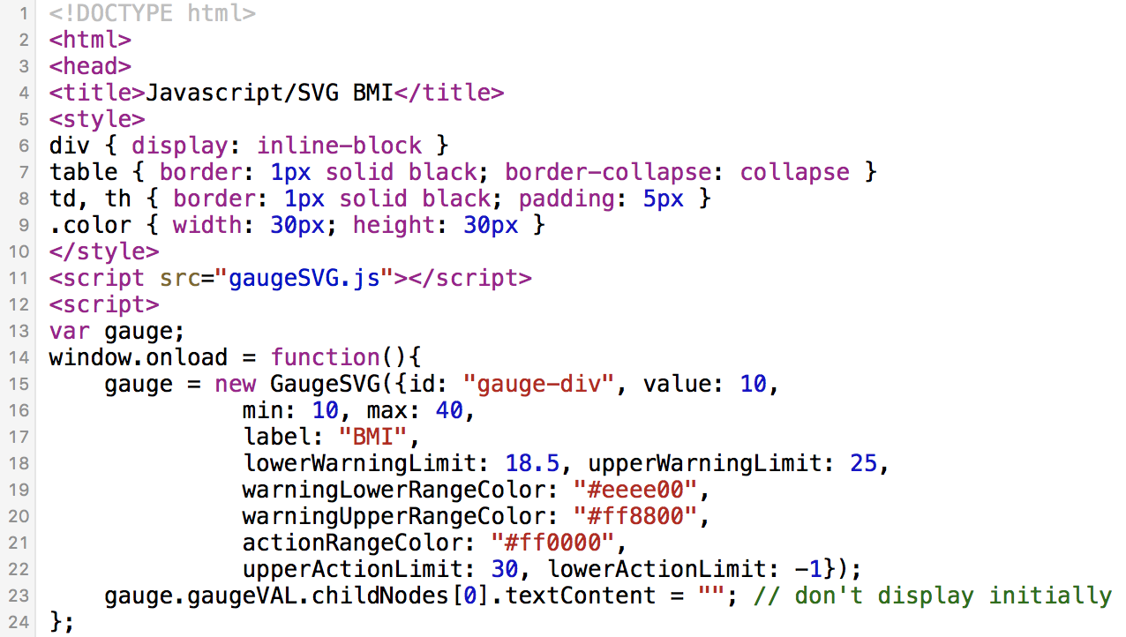
BMI: new GaugeSVG()

Slide 15
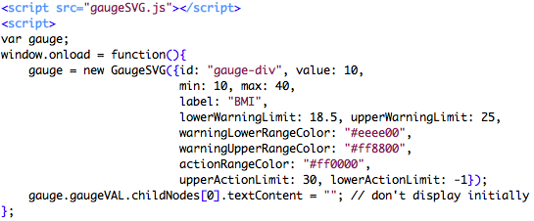
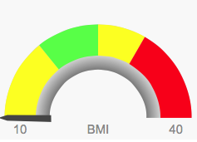
BMI: new GaugeSVG()
25 (upperWarningLimit)
(lowerWarningLimit)
18.5
To set the value:
gauge.refresh(bmi, true);
30 (upperActionLimit)
""
see animation? true|false

Slide 16
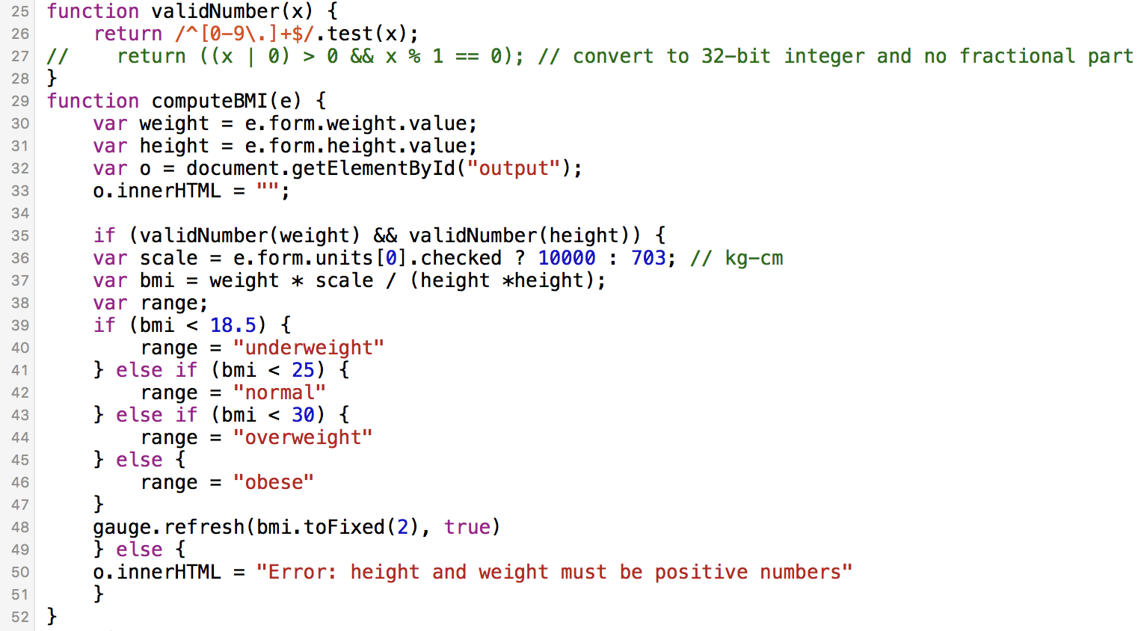
bmi-gauge.html

Slide 17
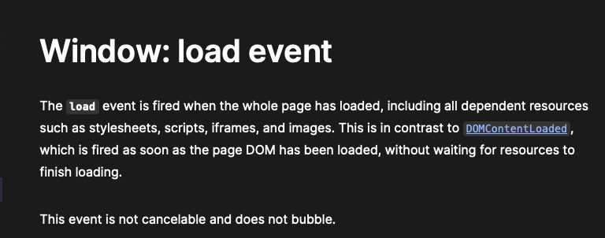
window.onload()
https://developer.mozilla.org/en-US/docs/Web/API/Window/load_event

Slide 18
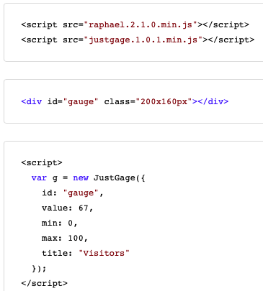
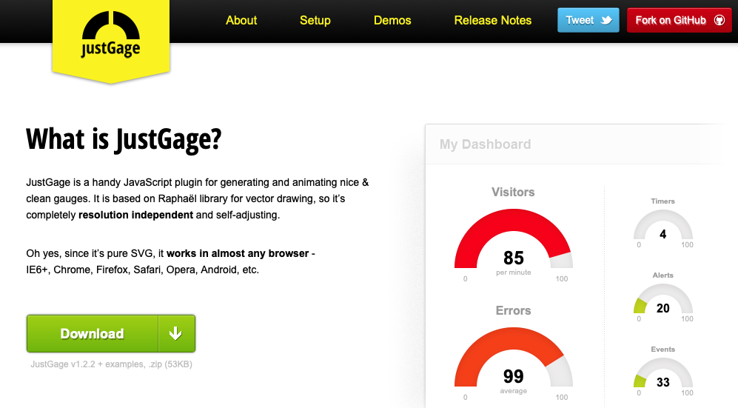
JustGage
gaugeSVG author cites JustGage as inspiration.
https://toorshia.github.io/justgage/

Slide 19
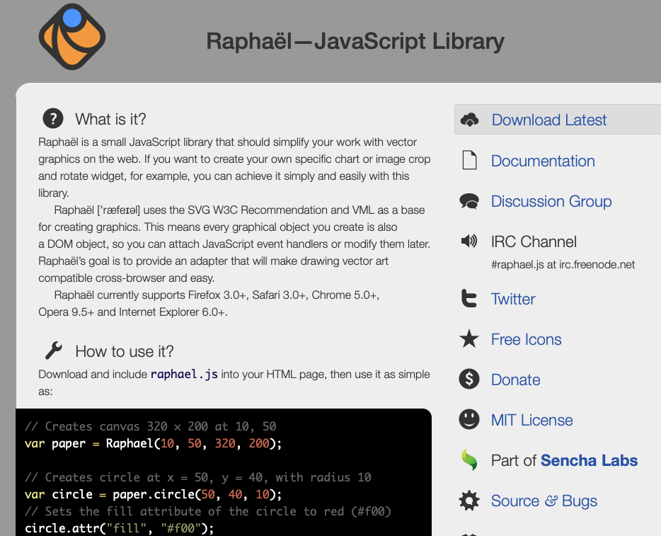
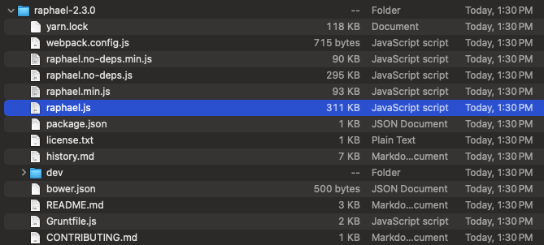
Raphaël Javascript graphics library
https://dmitrybaranovskiy.github.io/raphael/

Slide 20

JustGage
copy raphael-2.1.4.min.js and justgage.js into the current directory where you have your .html file
inside directory examples, there is a simple file counter.html
  I've modified it slightly to refer to the .js files for the same directory
  and simplified the code

Slide 21
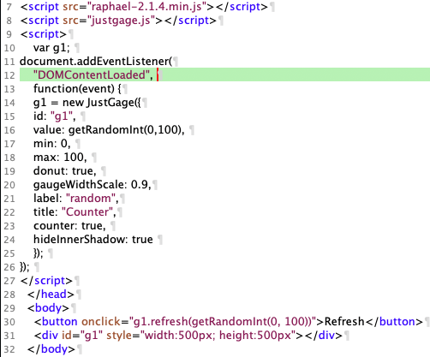
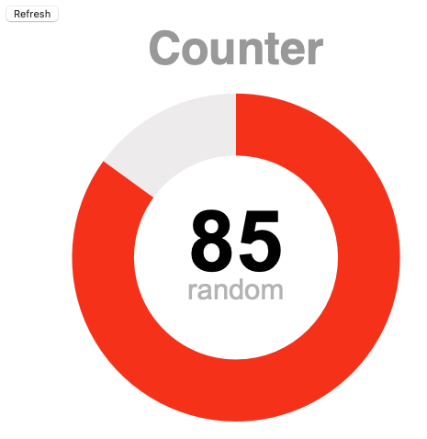
counter.html
an event to be signaled (by the browser)
on the course website:
let's run it a few times!

Slide 22

JustGage
getRandomInt():
  Math.random() returns value [0,1) (float)
  Max – Min + 1 gives range, e.g. 50-20+1=31, so [0,31)
  Math.floor() gives 0..30 (whole number)
  + Min offset, so 20..50

Slide 23
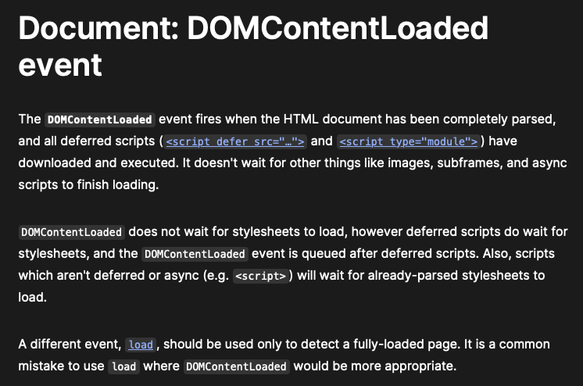
DOMContentLoaded
https://developer.mozilla.org/en-US/docs/Web/API/Document/DOMContentLoaded_event

