Slide 1
408/508 Computational Techniques for Linguists
Lecture 14

Slide 2
Today's Topics
More Javascript functionality:
  strings, operators, conditionals, loops
  a quirk with assignment (=)
Tic-tac-toe example contd. (step by step)
  Files: sample3.html, sample4.html, sample5.html, sample6.html and sample7.html
  on course webpage
Homework 6: your job, make it playable!

Slide 3
Javascript: Strings
Use either double quotes or single quotes (no difference)
  escape using backslash, e.g. \", \n, \\
Properties:
  "string".length
Methods (like a function but object-based):
  .indexOf(string) returns position (0…length), -1 if not found
  .search(regex) returns position
  .replace(regex,string) replaces with string, returns result
  .slice(index,index) substring from position to position
  .substr(index,length) substring
  .toLowerCase() case conversion
  .toUpperCase()
  .trim() remove whitespace from both ends
  .charAt(index) single character at position
  .split(separator) returns array, single characters if separator=""

Slide 4
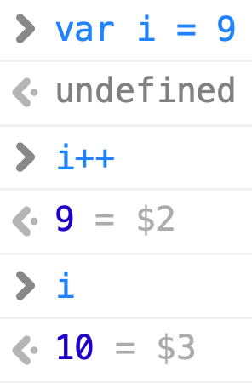
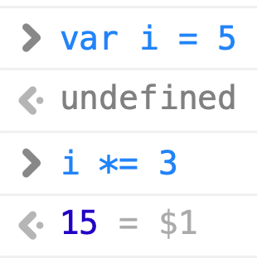

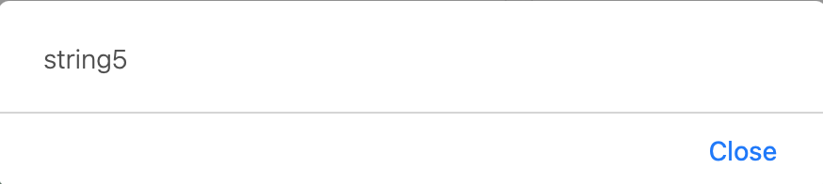
Javascript: Operators
Arithmetic Operators:
+, -, *, /, % (mod), ++, -- e.g. i++ means add 1 to the value of variable i
Assignment Operators:
=, +=, -=, *= /=, %=
String Operators:
+ concatenation
+= append to string
Comparison Operators:
== can be made equal (type coercion)
!= not equal
=== same type and equal (no type coercion)
!== not equal (no type coercion)
>, <, >=, <=
&& logical and (Javascript: Boolean true/false)
|| logical or
! negation
Note: & , !, ~ (not), ^ (xor) are bitwise operators

Slide 5


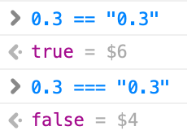
Javascript: equality (== and ===)
Example:

Slide 6
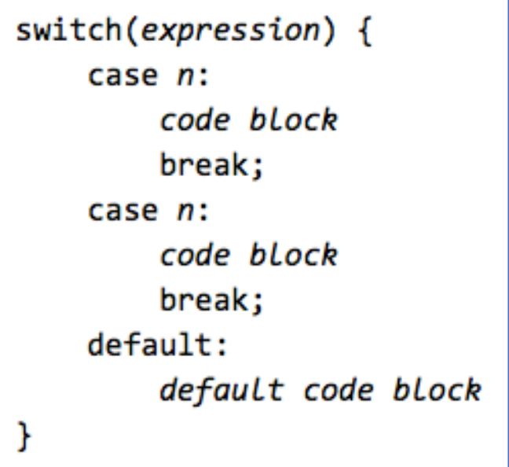
Javascript: Conditionals
if-then
  if (condition) { … }
  else if (condition) { … }
  else { … }
switch
  switch (expression) {
  case value: … break;
  …
  default: …
  }
Idea: compute expression first
2nd stage: compare computed value
with each case

Slide 7
Javascript: Loops
for loop (just like C):
  example:
    for (i = 0; i < 100; i++) { … }
for/in loop (object properties):
  for (x in object) { … }
while loop:
  example:
    while (true) { … }
do/while loop (like traditional repeat/until):
  do { … } while (condition)
loop exit:
  break (jump out of loop immediately)
  continue (skip rest of current iteration)

Slide 8
Javascript: Miscellaneous
A bit quirky:
Swapping two variables (normally requires a third variable):
  var a; var b; var temp;
  temp = a;
  a = b;
  b = temp;
Javascript arithmetic):
  var a; var b;
  b=a+(a=b)-b;
  a = b + (b=a, 0);
Arithmetic priority:
Set a to the value of b first,
(a=b) evaluates to b,
then evaluate rest of expression

Slide 9
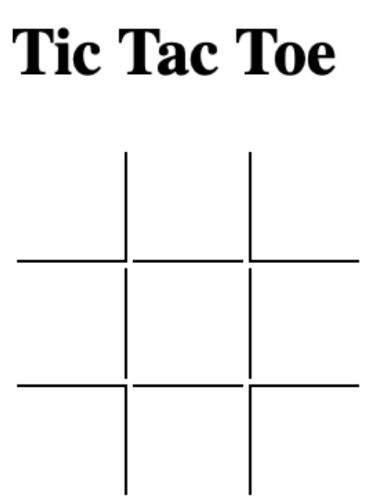
Tic Tac Toe contd.
Last time:
sample3.html
<table>
<tr>
<td id="1" style="border-right: 1px solid black; border-bottom: 1px solid black"></td>
<td id="2" style="border-bottom: 1px solid black"></td>
<td id="3" style="border-left: 1px solid black; border-bottom: 1px solid black"></td>
</tr>
<tr>
<td id="4" style="border-right: 1px solid black"></td>
<td id="5"></td>
<td id="6" style="border-left: 1px solid black"></td>
</tr>
<tr>
<td id="7" style="border-right: 1px solid black; border-top: 1px solid black"></td>
<td id="8" style="border-top: 1px solid black"></td>
<td id="9" style="border-left: 1px solid black; border-top: 1px solid black" ></td>
</tr>
</table>

Slide 10
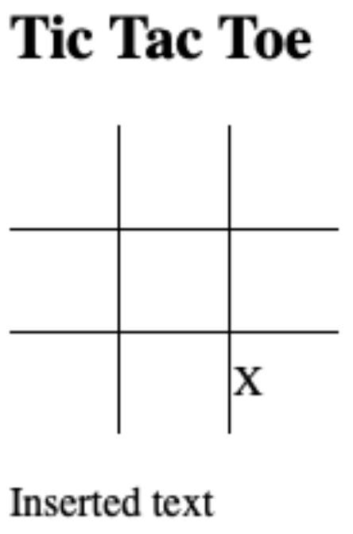
Tic Tac Toe: sample4.html
put code in a <script>
suppose we define a function f():
  function f(txt) {
  document.body.appendChild(document.createElement("br"))
  document.body.appendChild(document.createTextNode(txt))
  }
then call that the function from the html file
  put this somewhere after the function definition
  <script>
  f("inserted text.")
  <script>

Slide 11
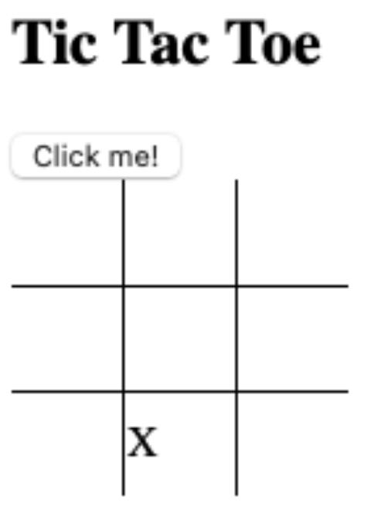
Tic Tac Toe: sample5.html
Call the function with a button:
  <button onclick="f('Inserting new line of text.')">Click me!</button>

Slide 12
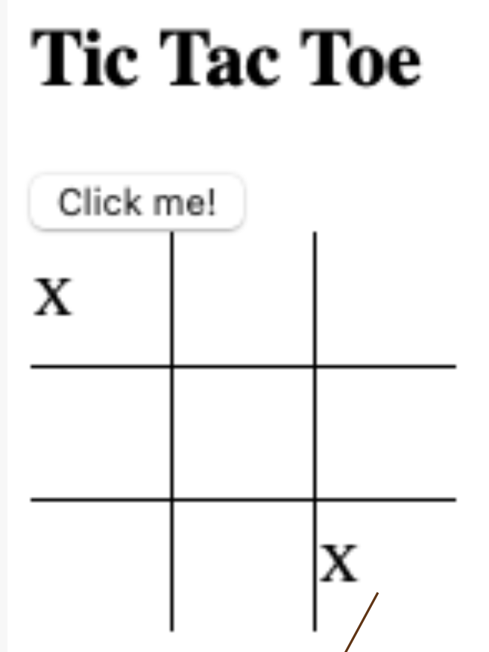
Tic Tac Toe: sample6.html
make a <td> cell clickable using the onclick attribute
  table cell:
  <td onclick="mark(this)">..</td>
  this: a special identifier containing the <td> element
  necessary why?
  function mark() needs to know which cell it came from
  (to set the mark X).
  function definition:
  <script>
  function mark(element) {
  .. code ..
  }
  </script>
Let's place a mark X in the cell:
  in .. code .. write element.innerHTML = "X"
clicked!
puts a mark X

Slide 13
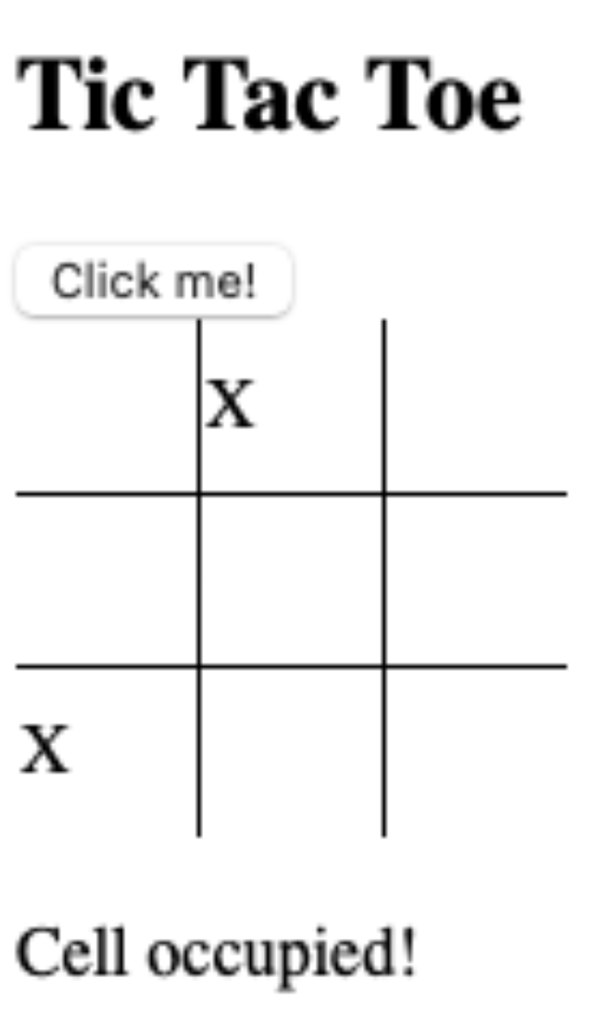
Tic Tac Toe: sample7.html
No overwriting! Only write in an empty <td> cell
  <script>
  function mark(element) {
  if (condition) {
  element.innerHTML = "X"
  } else {
  f("Cell occupied!")
  }
  }
  </script>
What's the empty condition?
  element.innerHTML == ""
  recall == is equality

Slide 14
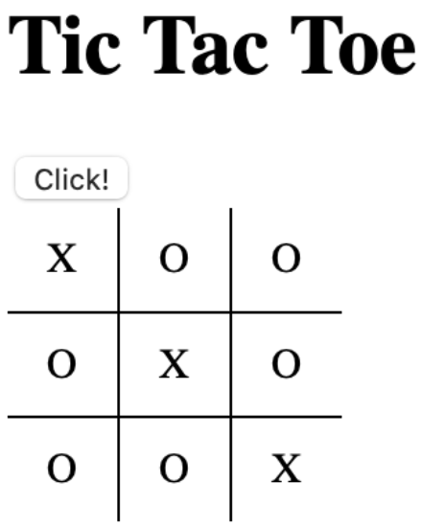
Homework 6
Question 1: modify sample7.html to make an interactive tic tac toe player
Using the random number generator described in the previous lecture, add a button "Click!" that inserts a O in an empty cell.
  var o = Math.floor(Math.random()*9)+1;
  https://developer.mozilla.org/en-US/docs/Web/JavaScript/Reference/Global_Objects/Math/random
Note A:
  use onclick with a new function, e.g. insert_o() that you write
Note B:
  it should not overwrite an existing cell, i.e. one that has X or O already.
Note C:
  you can click again if it fails to insert, or you can repeatedly generate a random number until it happens upon an empty cell

Slide 15
Homework 6
Question 2: attempt only after you successfully complete Q1!
  add a variable called total that counts the number of cells already filled. Start with:
  var total = 0
Note:
  function mark(), which inserts an X, should increment total by 1 (assuming you click on an empty cell correctly)
  function insert_o(), which inserts an O, should also increment total
  total += 1

Slide 16
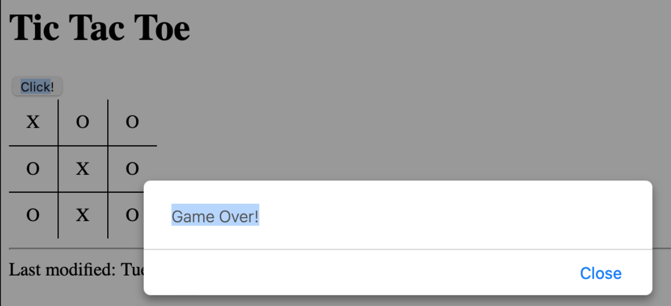
Homework 6
Question 3: check the value of total after each insertion of an X or O.
  If total is 9, print a message saying Game Over! using alert("Game Over!").

Slide 17
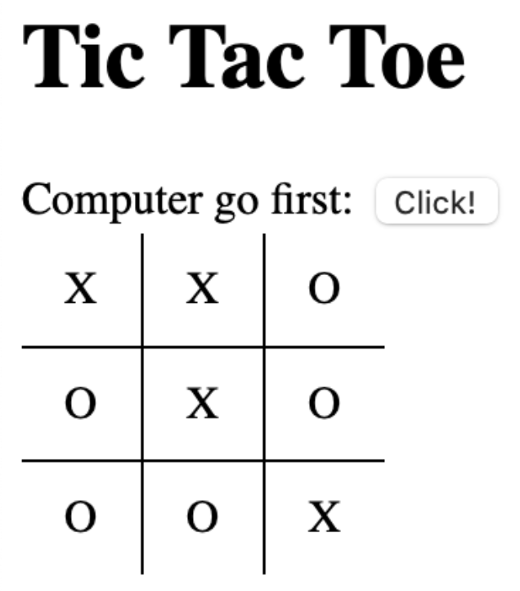
Homework 6
Question 4: modify mark() to call insert_o() directly after you click on an empty cell.
  Idea: you no longer have to press Click! for the computer to take its turn.
Note:
  To restart the game, reload the page in the browser.
  Then the Click! button means the computer gets to go first.

Slide 18
Homework 6
Extra Credit Question 5:
  modify your program to spot when the game has been won and print a message
  Note: to solve this you need a big if-condition
    e.g. when:
    cells: 1 2 3 have the same non-zero value (X or O)
    cells: 4 5 6 have the same non-zero value (X or O)
    cells: 7 8 9 have the same non-zero value (X or O)
    cells: 1 4 7 have the same non-zero value (X or O)
    cells: 2 5 8 have the same non-zero value (X or O)
    cells: 3 6 9 have the same non-zero value (X or O)
    cells: 1 5 9 have the same non-zero value (X or O)
    cells: 3 5 7 have the same non-zero value (X or O)
    && is conjunction, || is disjunction, != is not equals

Slide 19
Homework 6
Do as many questions as you can.
Due date NEXT SUNDAY midnight
Subject: 408/508 Homework 6 YOUR NAME
Submit screenshots in your PDF
If you have errors, you can screenshot the Javascript console
Attach a copy of your .html file separately to your email
  (so I can play your tic-tac-toe program)

