Slide 1
408/508 Computational Techniques for Linguists
Lecture 12

Slide 2
Today's Topics
Homework 5
Javascript console
  is interactive: a bit like the Terminal/Bash shell
Introduction to Javascript, the browser programming language
Tic-tac-toe example
Files: sample.html, sample2.html and sample3.html
  on course webpage

Slide 3
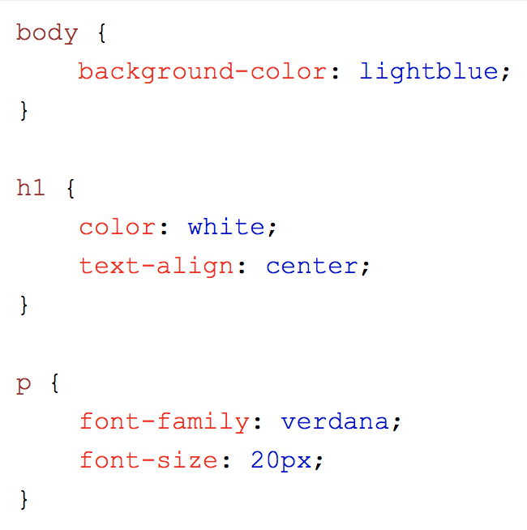
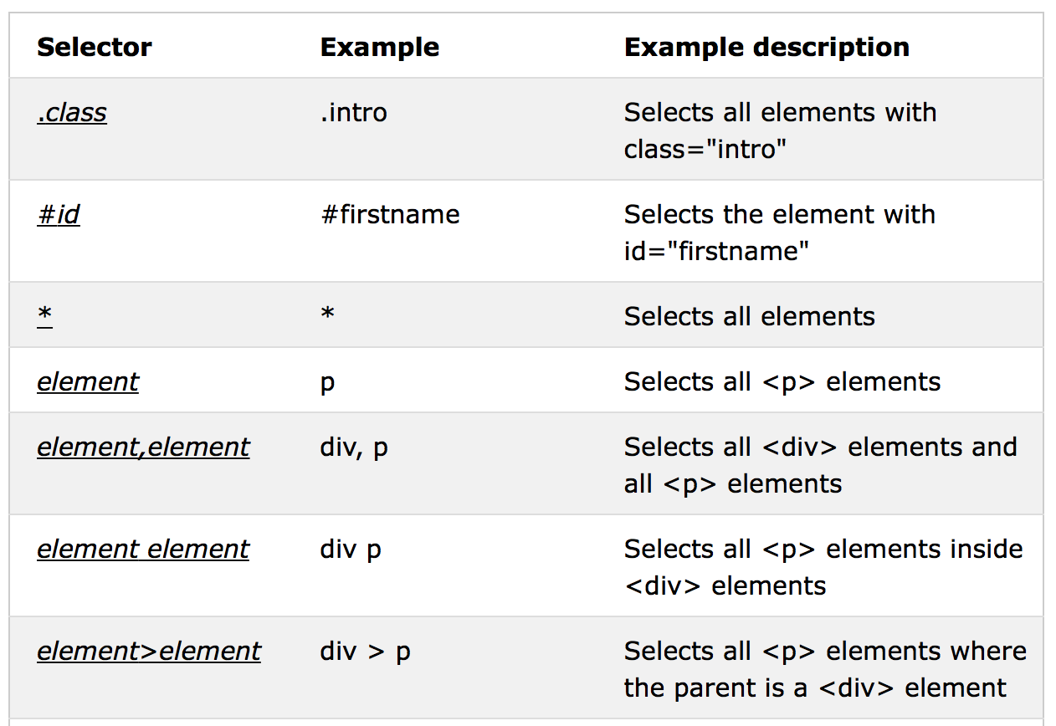
CSS in <style> in <head>
https://www.w3schools.com/css/

Slide 4
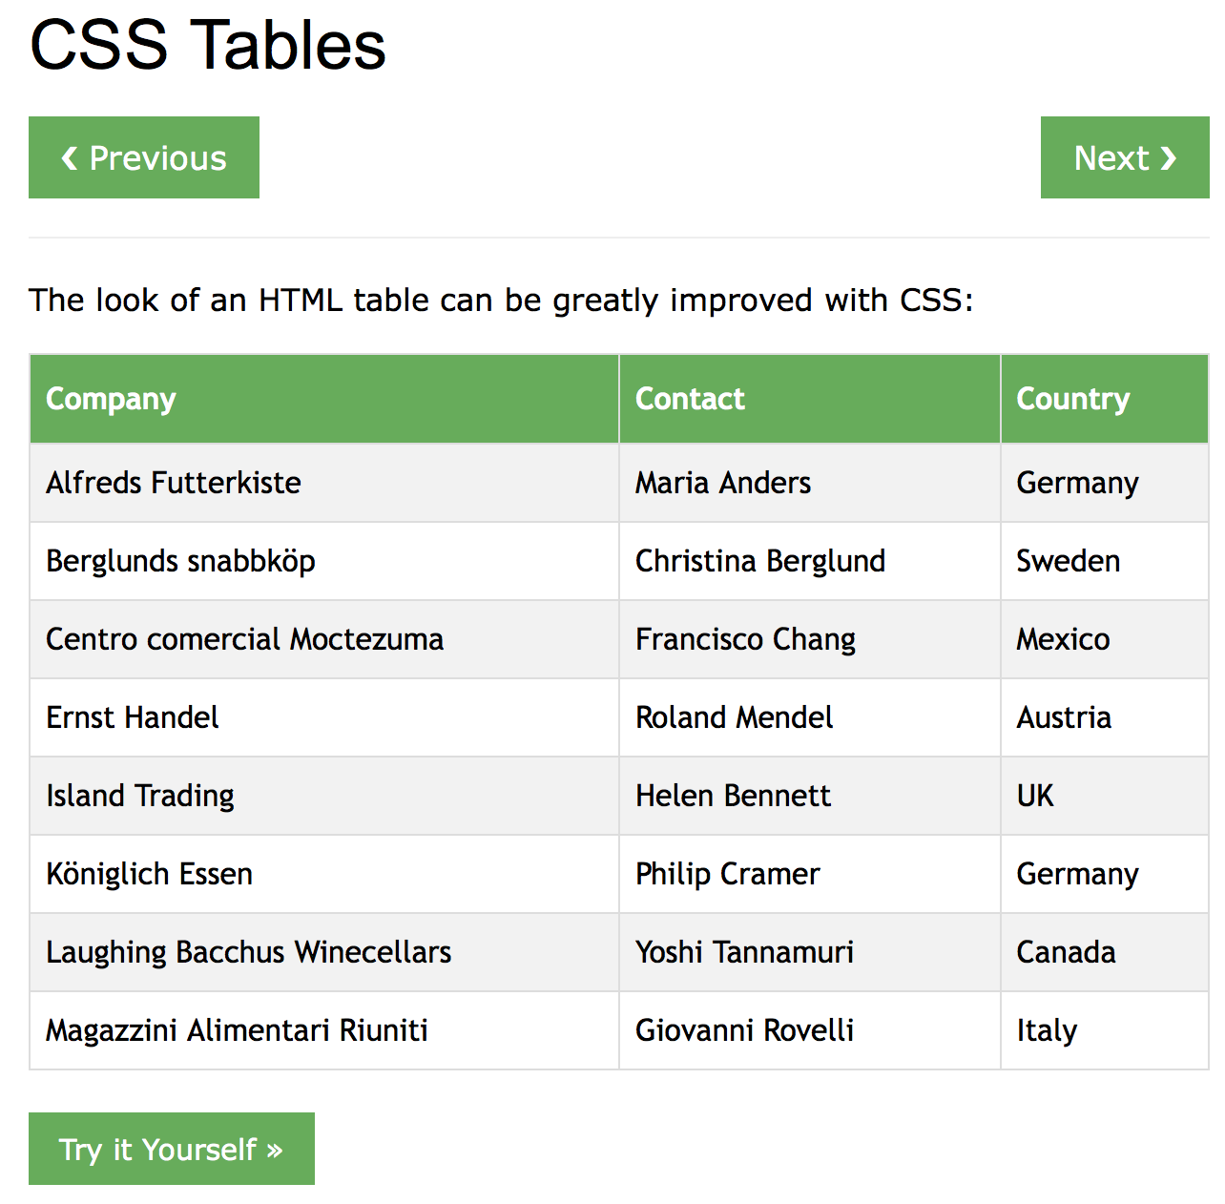
CSS
Inline (could go inside <head> … </head>):
  <style> … </style>
Good way to see what's possible.
  Google, e.g. css table style
  https://www.w3schools.com/css/css_table.asp

Slide 5
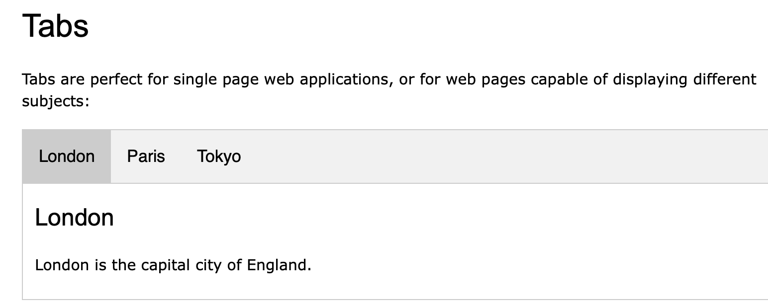
Tabs
Read:
  https://www.w3schools.com/howto/howto_js_tabs.asp

Slide 6
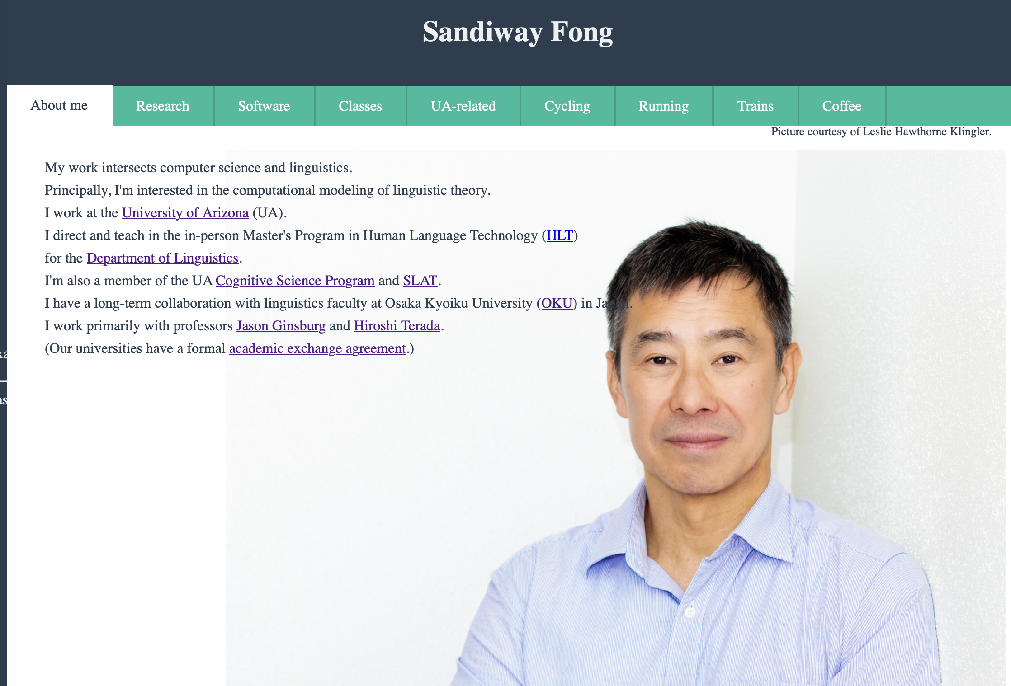
Tabs

Slide 7
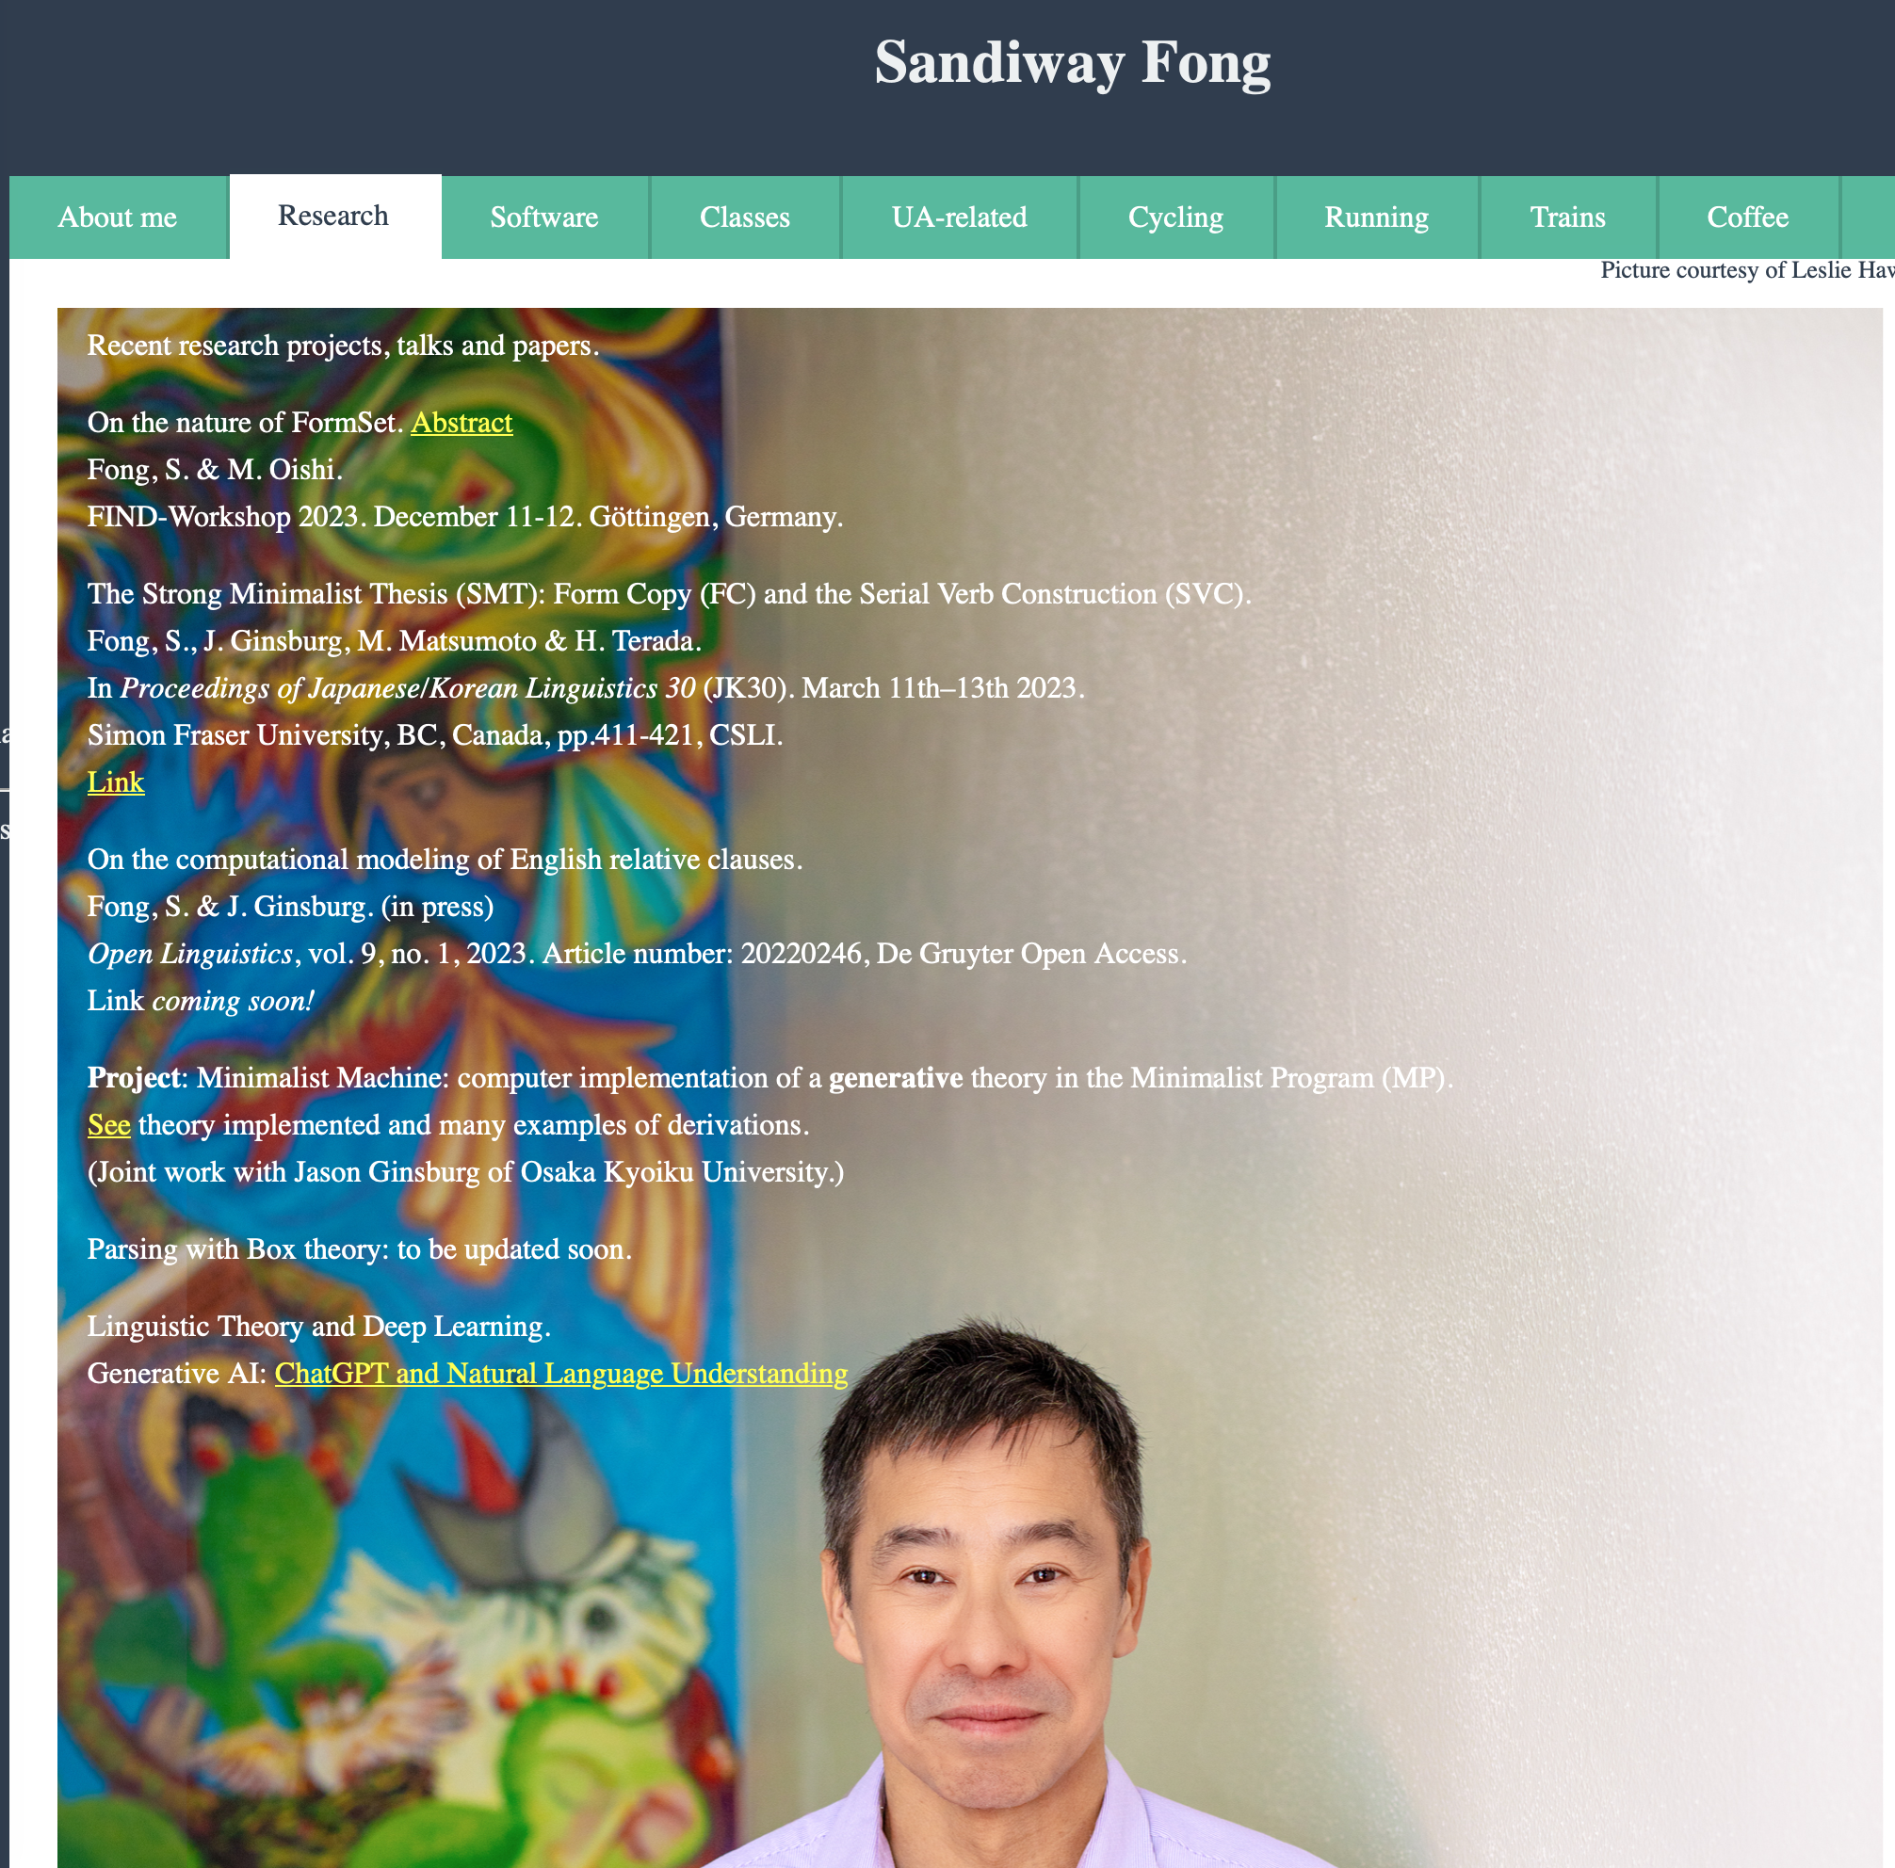
Tabs

Slide 8
Tabs
<!DOCTYPE html>
<html>
<head>
<meta name="viewport" content="width=device-width, initial-scale=1">
<style>
body {font-family: Arial;}
/* Style the tab */
.tab {
overflow: hidden;
border: 1px solid #ccc;
background-color: #f1f1f1;
}
/* Style the buttons inside the tab */
.tab button {
background-color: inherit;
float: left;
border: none;
outline: none;
cursor: pointer;
padding: 14px 16px;
transition: 0.3s;
font-size: 17px;
}
/* Change background color of buttons on hover */
.tab button:hover {
background-color: #ddd;
}
/* Create an active/current tablink class */
.tab button.active {
background-color: #ccc;
}
/* Style the tab content */
.tabcontent {
display: none;
padding: 6px 12px;
border: 1px solid #ccc;
border-top: none;
}
</style>
</head>

Slide 9
Tabs
<body>
<h2>Tabs</h2>
<p>Click on the buttons inside the tabbed menu:</p>
<div class="tab">
<button class="tablinks" onclick="openCity(event, 'London')">London</button>
<button class="tablinks" onclick="openCity(event, 'Paris')">Paris</button>
<button class="tablinks" onclick="openCity(event, 'Tokyo')">Tokyo</button>
</div>
<div id="London" class="tabcontent">
<h3>London</h3>
<p>London is the capital city of England.</p>
</div>
<div id="Paris" class="tabcontent">
<h3>Paris</h3>
<p>Paris is the capital of France.</p>
</div>
<div id="Tokyo" class="tabcontent">
<h3>Tokyo</h3>
<p>Tokyo is the capital of Japan.</p>
</div>
<script>
function openCity(evt, cityName) {
var i, tabcontent, tablinks;
tabcontent = document.getElementsByClassName("tabcontent");
for (i = 0; i < tabcontent.length; i++) {
tabcontent[i].style.display = "none";
}
tablinks = document.getElementsByClassName("tablinks");
for (i = 0; i < tablinks.length; i++) {
tablinks[i].className = tablinks[i].className.replace(" active", "");
}
document.getElementById(cityName).style.display = "block";
evt.currentTarget.className += " active";
}
</script>
</body>
</html>

Slide 10
Homework 5
Build your own html file, play with the tags
Embed a picture of yourself encoded in base64
Make sure your page has various tabs

Slide 11
Homework 5
Instructions:
  email sandiway@arizona.edu
  submit everything in one PDF file!
    screenshot of the webpage you built
    the source html of the webpage
  subject of email: 408/508 Homework 5 your name
  cite any discussion or source
  due date: next Sunday by midnight

Slide 12
Javascript (JS)
Javascript:
  invented in 1995 as a browser programming language
  not the same as Java (also appeared in 1995)
Javascript code goes in the .html file:
  <script> .. </script>
  <script src="filename.js"></script>
HTML element events:
  onclick="js code"
  onmouseover="js code"
  onkeydown="js code"
Reference:
    http://www.w3schools.com/jsref/dom_obj_event.asp
  code snippets can be placed in
  <head>..</head>
  or
  <body>..</body>

Slide 13
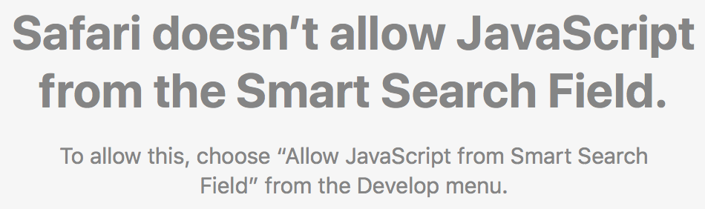
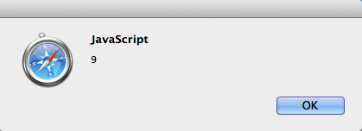
Javascript pop-up notification
For browser programming:
  alert(string)
  no print function
Example (from address bar):
  instead of http: or https:
  javascript:alert(4+5)
  produces a pop-up
Changing the html document using Javascript:
  document.write(string) overwrites html document
  html_element.innerHTML = "string" modifies html_element

Slide 14
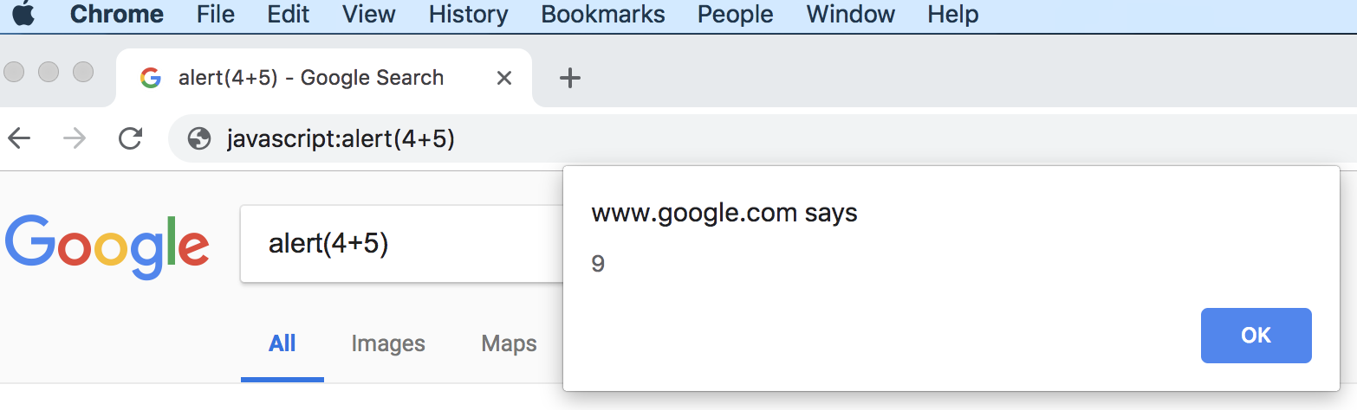
Javascript pop-up notification

Slide 15
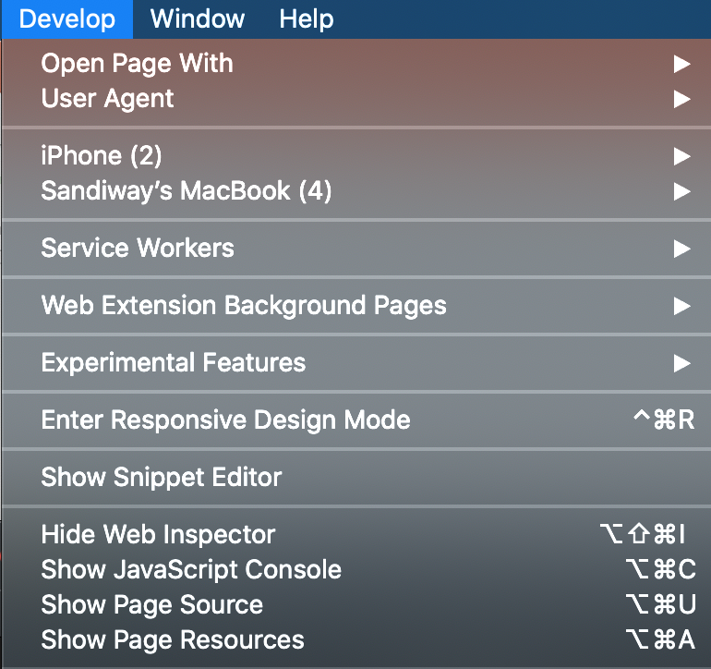
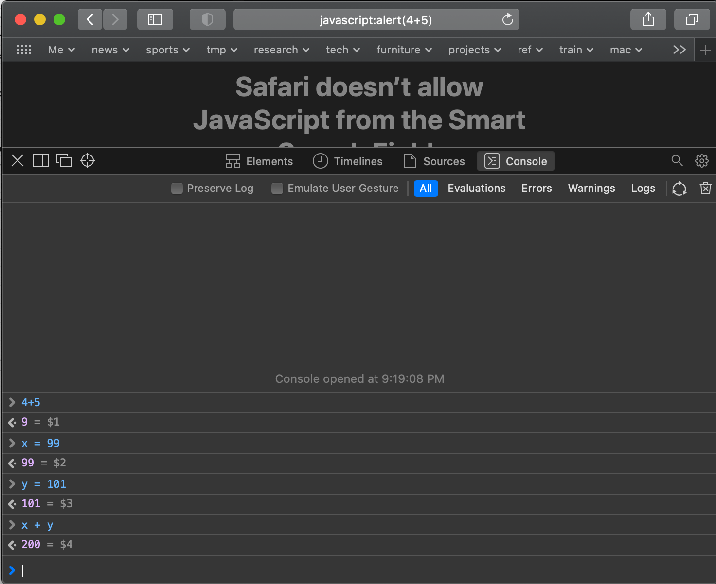
Javascript Console

Slide 16
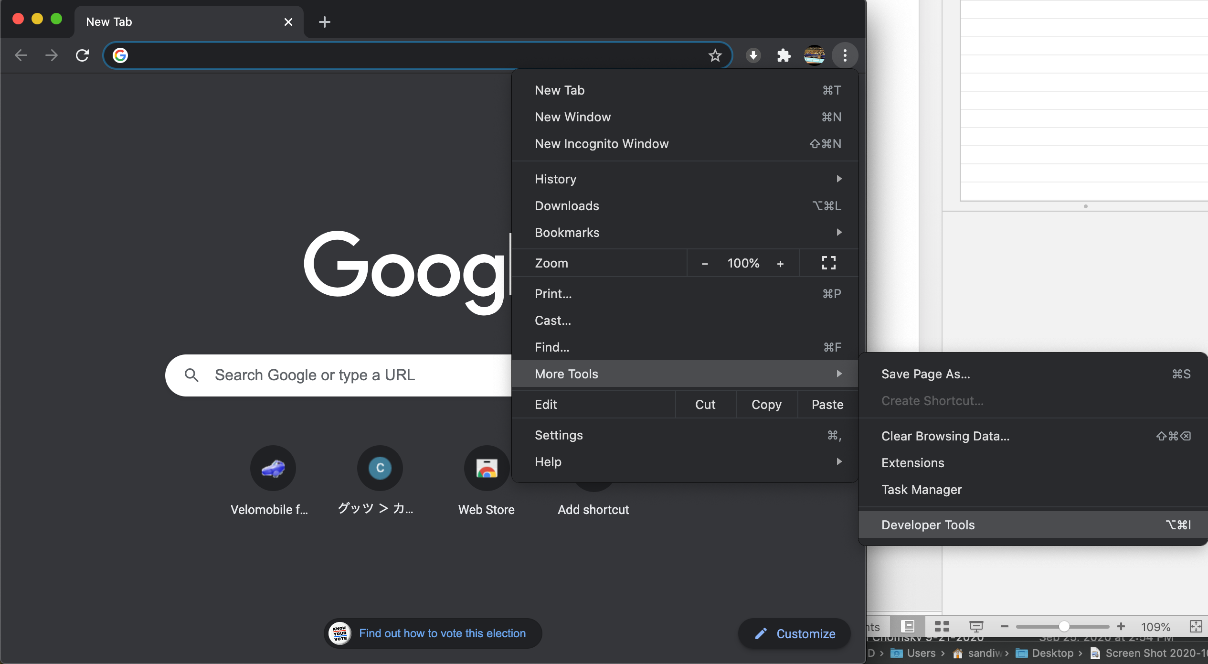
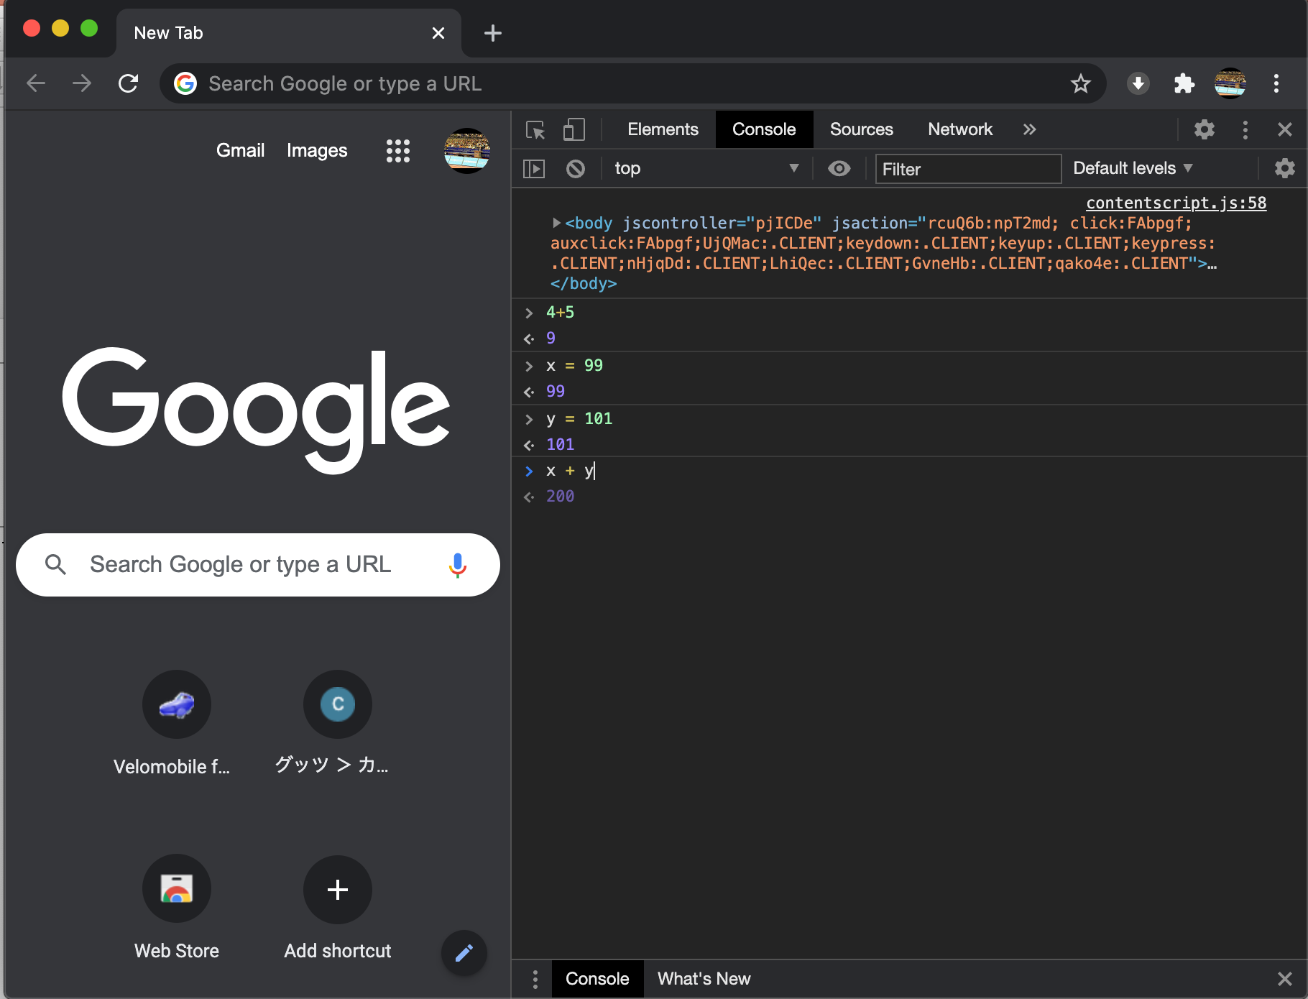
Javascript Console: Chrome

Slide 17
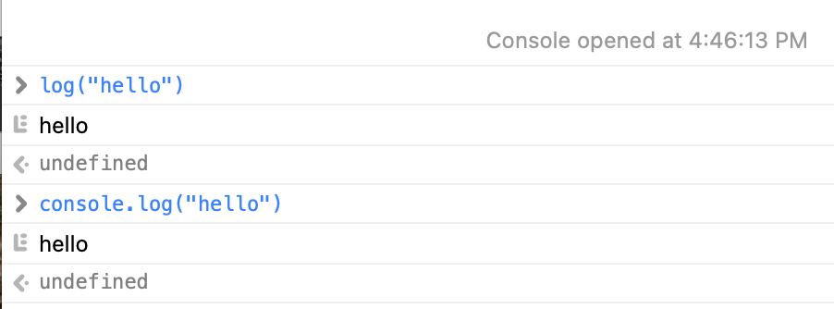
console.log(object)
From Javascript code or the address bar (using javascript:console.log(object)) or the console directly:
undefined is the result, as console.log() does not return a value

Slide 18
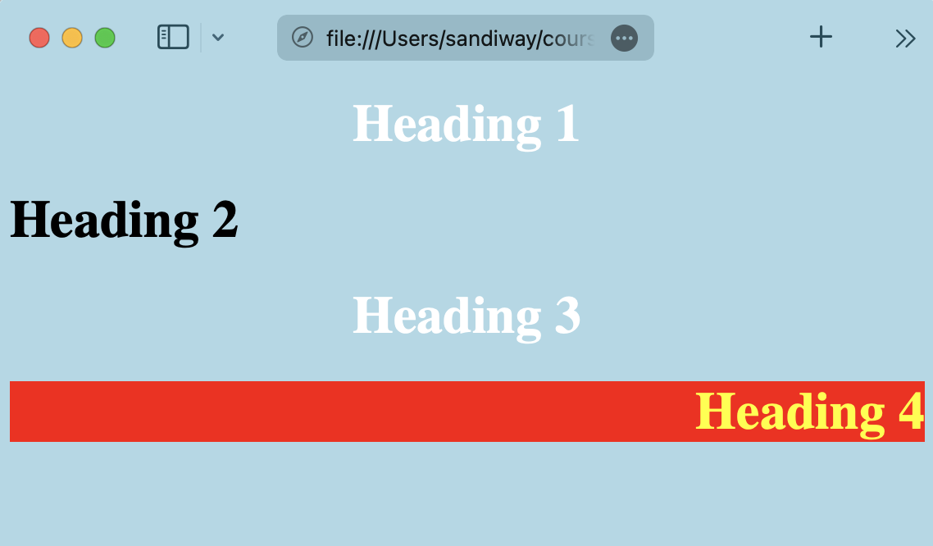
Javascript Console
Suppose we have a file sample.html loaded (see course website)
Show Javascript Console
Changing the html document:
  document.write(string)
    overwrites html document
  html_element.innerHTML = "string"
    modifies html_element

Slide 19
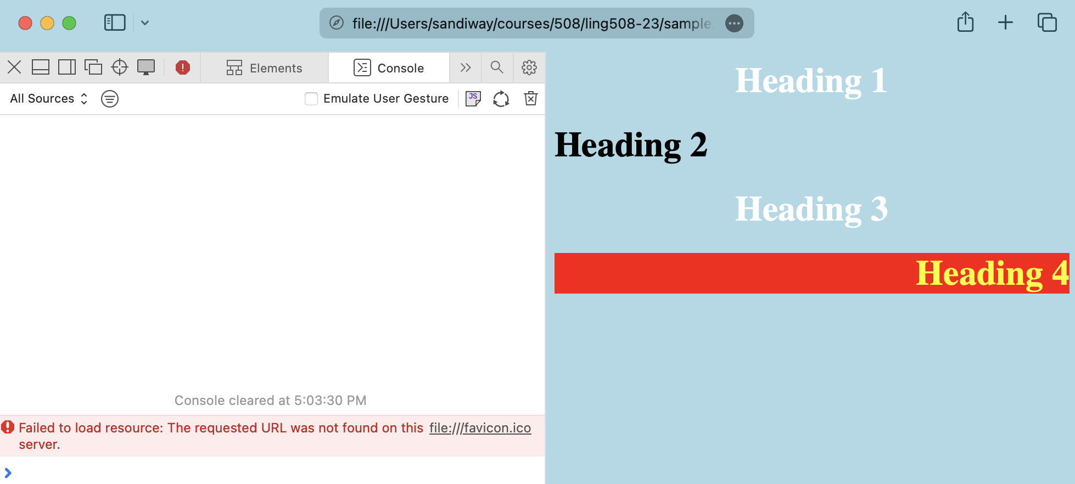
Javascript Console

Slide 20
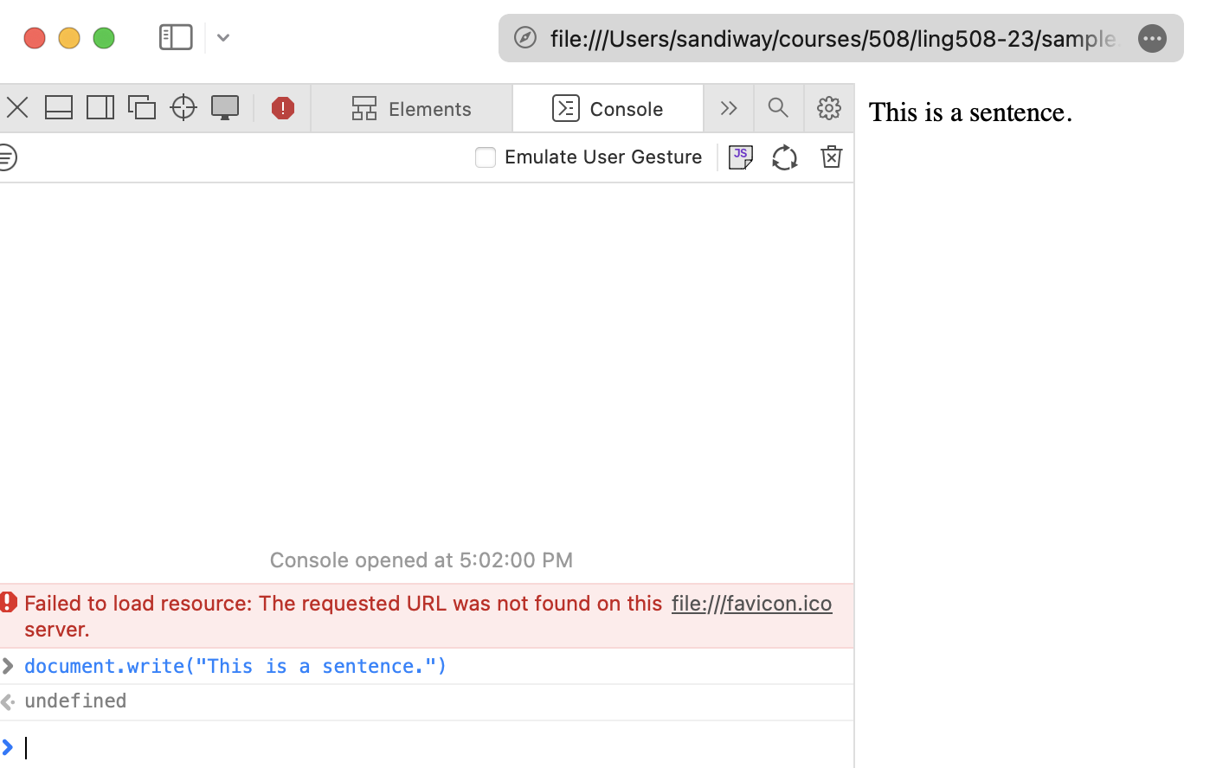
Javascript Console
Changing the html document: document.write(string)
    overwrites html document

Slide 21
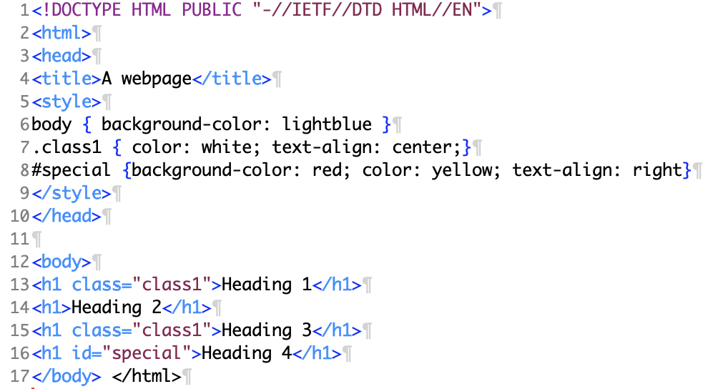
Javascript Console
Unique id attribute:
  id="special"

Slide 22
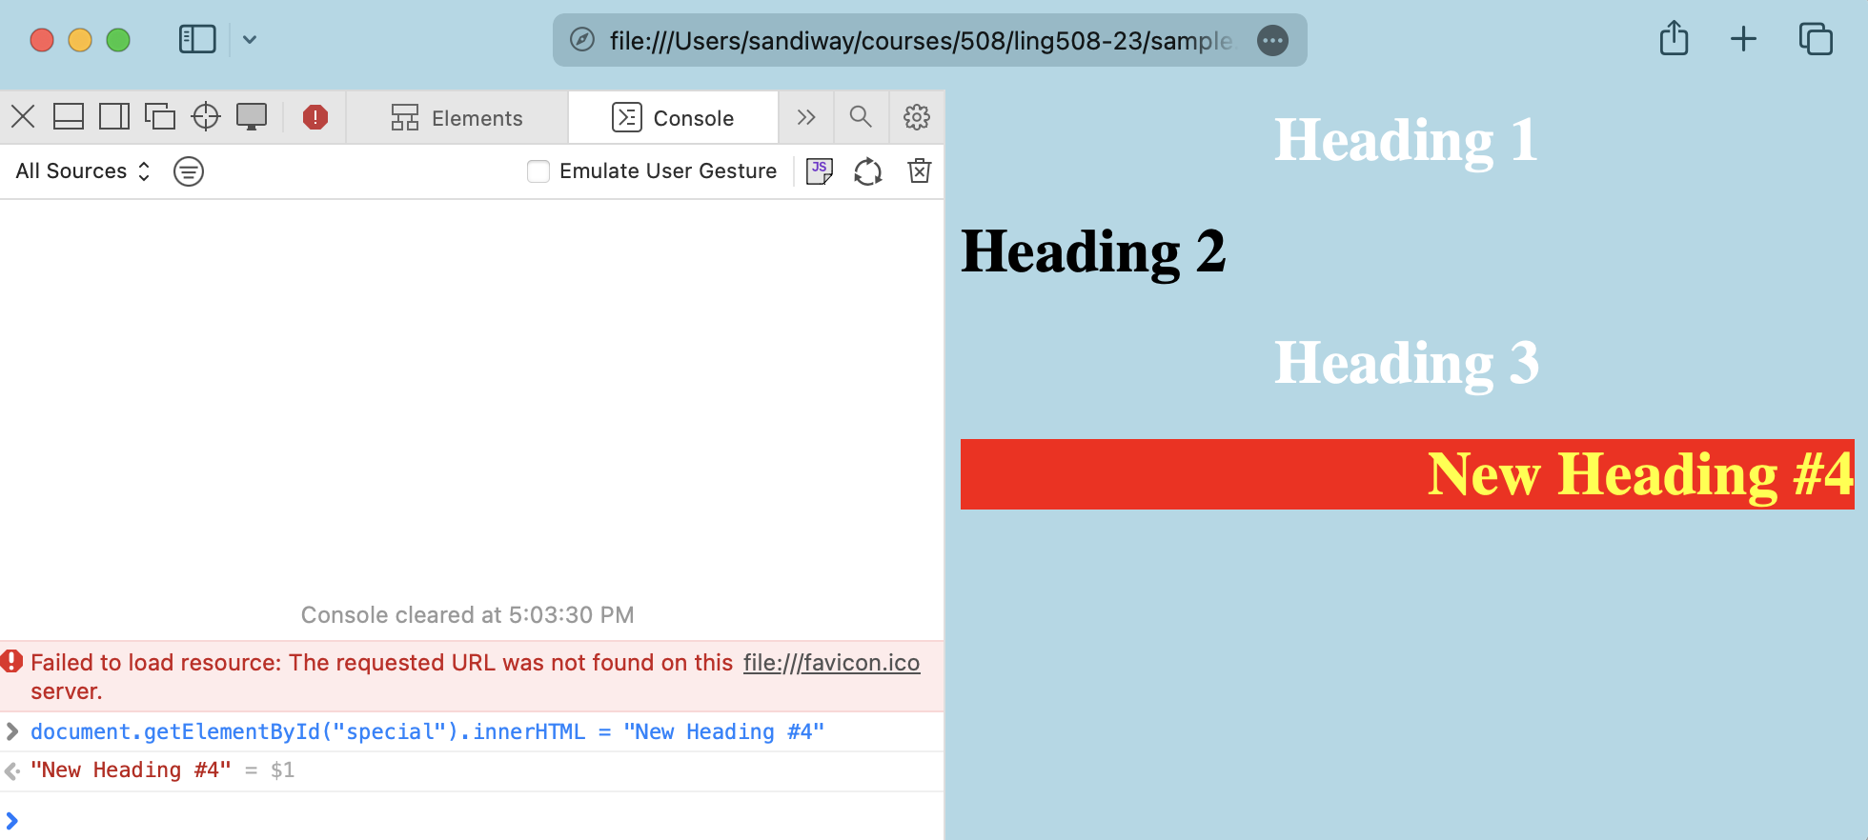
Javascript Console
  html_element.innerHTML = "string"

Slide 23
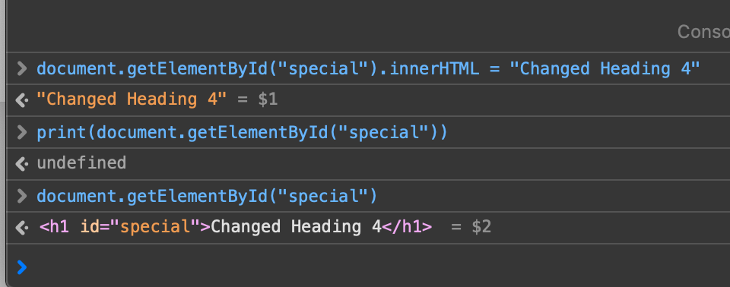
Javascript Console
DOM (Domain Object Model): document.getElementById(ID)

Slide 24
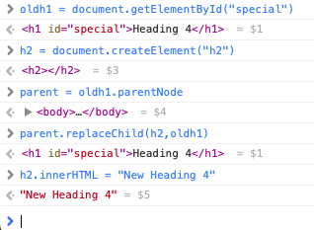
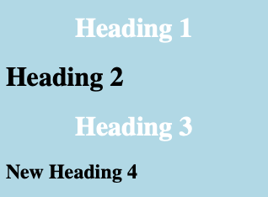
Javascript Console
Suppose you want to change Heading 4 with tag h1 to tag h2?
but you can't change the tag of an existing element
What you can do is create a new tag and replace the child of the parent element:

Slide 25
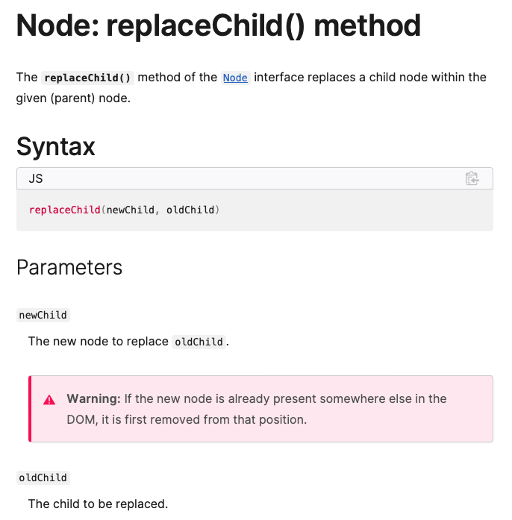
Javascript Console
Documented here:
  https://developer.mozilla.org/en-US/docs/Web/API/Node/replaceChild

Slide 26
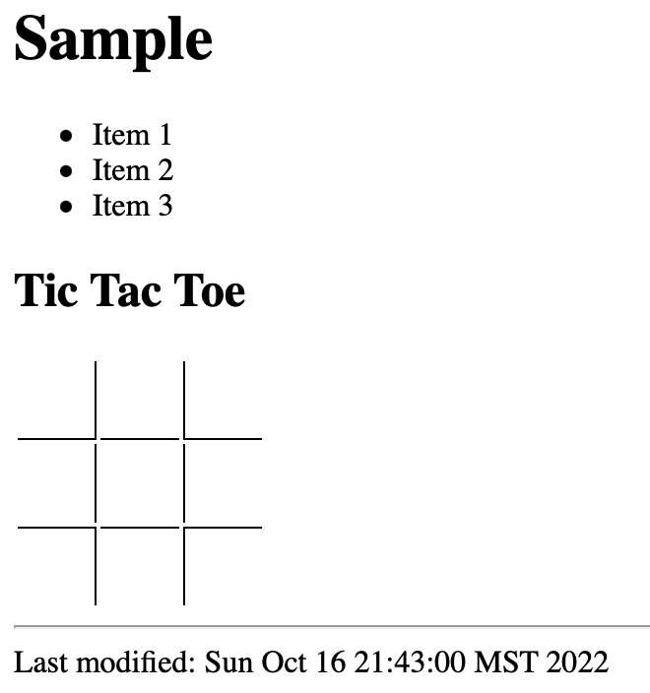
Tic Tac Toe: sample2.html
<table>
<tr>
<td id="1" style="border-right: 1px solid black; border-bottom: 1px solid black"></td>
<td id="2" style="border-bottom: 1px solid black"></td>
<td id="3" style="border-left: 1px solid black; border-bottom: 1px solid black"></td>
</tr>
<tr>
<td id="4" style="border-right: 1px solid black"></td>
<td id="5"></td>
<td id="6" style="border-left: 1px solid black"></td>
</tr>
<tr>
<td id="7" style="border-right: 1px solid black; border-top: 1px solid black"></td>
<td id="8" style="border-top: 1px solid black"></td>
<td id="9" style="border-left: 1px solid black; border-top: 1px solid black" ></td>
</tr>
</table>
1
2
3
9

Slide 27
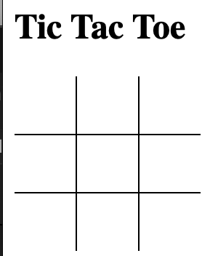
Tic Tac Toe: sample2.html
CSS:
<style>
table {
border-collapse: collapse;
}
td {
height: 40px; width: 40px
}
</style>
collapse:
  removes the tiny gap between cells, see below:

Slide 28
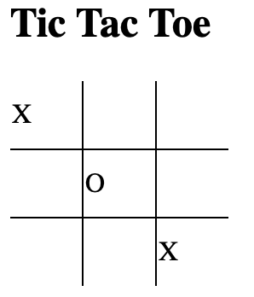
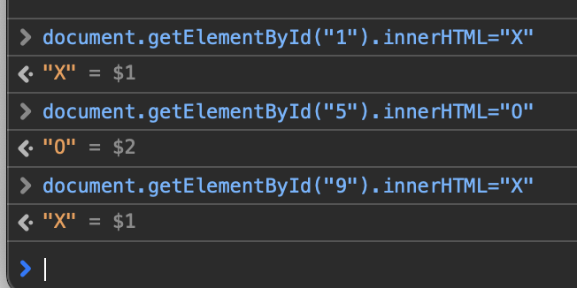
Javascript Console
Suppose we have sample2.html loaded
Show Javascript Console
Changing the html document:
  html_element.innerHTML = "string"
    modifies html_element
DOM:
  document.getElementById(ID)
Let's play tic tac toe!

Slide 29
Javascript Console
Notice td cell text are left aligned (by default)
CSS property:
  text-align: center
    https://developer.mozilla.org/en-US/docs/Web/CSS/text-align
  vertical-align: top|middle|bottom
    https://developer.mozilla.org/en-US/docs/Web/CSS/vertical-align

Slide 30
Javascript: Variables
Declared variables:
  var x = 9; // number variable
  var name = "String"; // string variable
  Note: names are case sensitive, no $ like the bash shell, // for in-line comments
function local variables:
  function f() {
  var x = 99;
  }
Not declared:
  i.e. just used without declaration
  treated as a global variable
Strict: prevents use of undeclared variables etc.
  "use strict"; quotes for backwards compatibility with older versions
Comments:
  // until the end of the line
  /* … */ multiline (same as CSS)

Slide 31
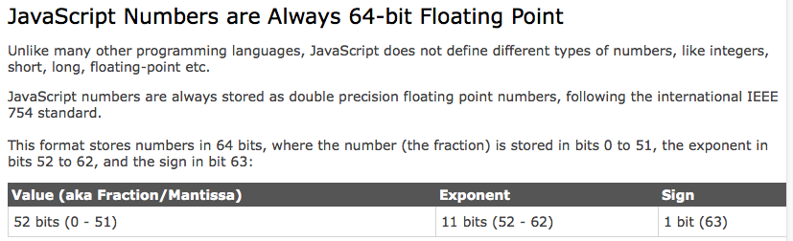
Javascript: Numbers
http://www.w3schools.com/js/js_numbers.asp
Recall the discussion at the beginning of the semester about number representation?
  Integers are considered accurate up to 15 digits.

Slide 32
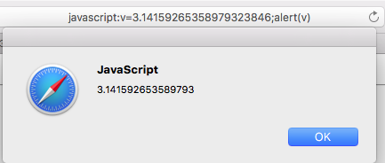
Javascript: Numbers
Pi to 20 decimal places
  3.14159 26535 89793 23846
  3.14159 26535 89793 (Javascript)

Slide 33
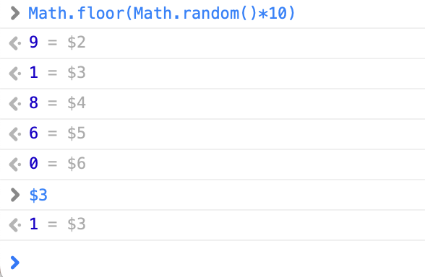
Javascript: Miscellaneous
Generate a random number in range [0,n-1]:
  Math.floor(Math.random()*n)

Slide 34
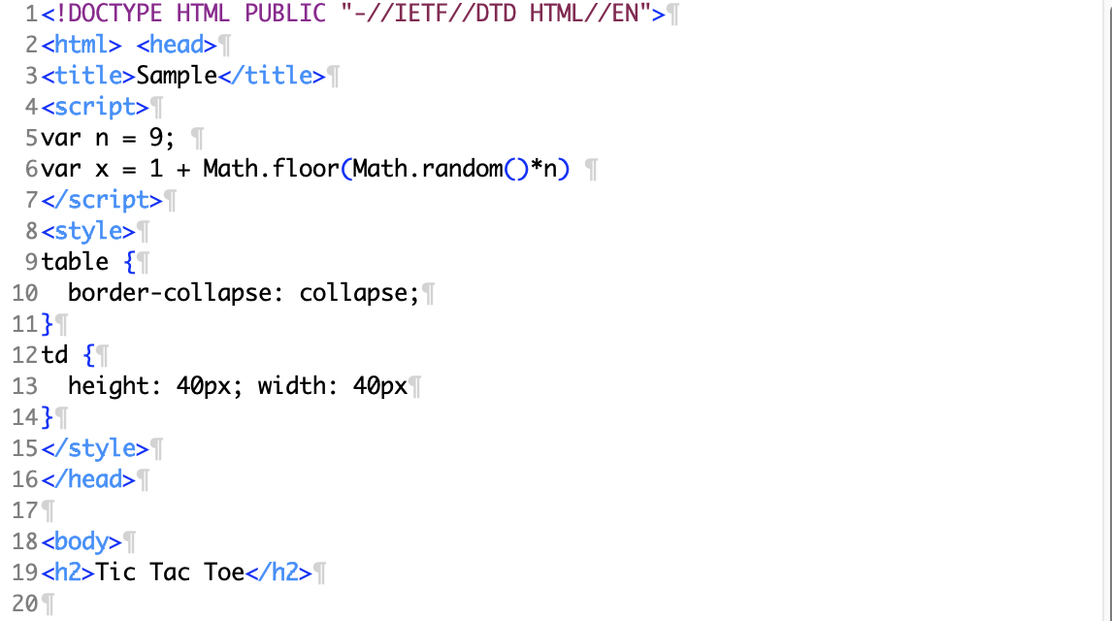
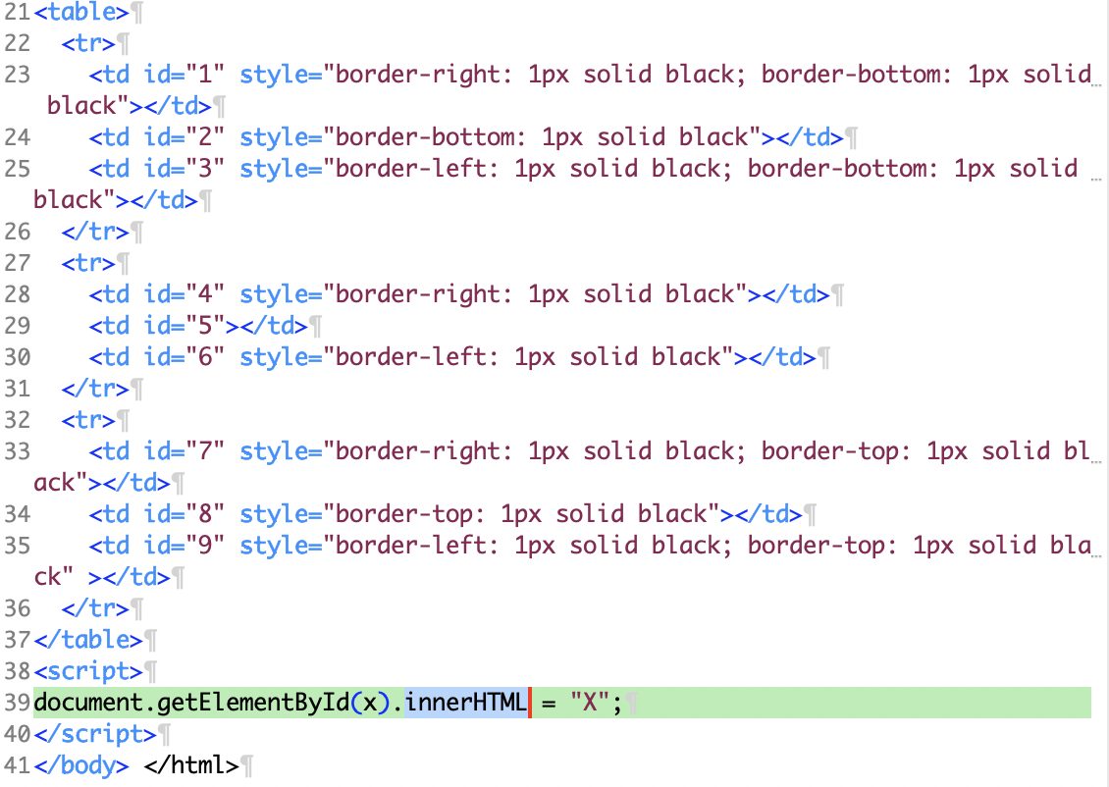
Tic Tac Toe Revisited
File: sample3.html

