Slide 1
408/508 Computational Techniques for Linguists
Lecture 11

Slide 2
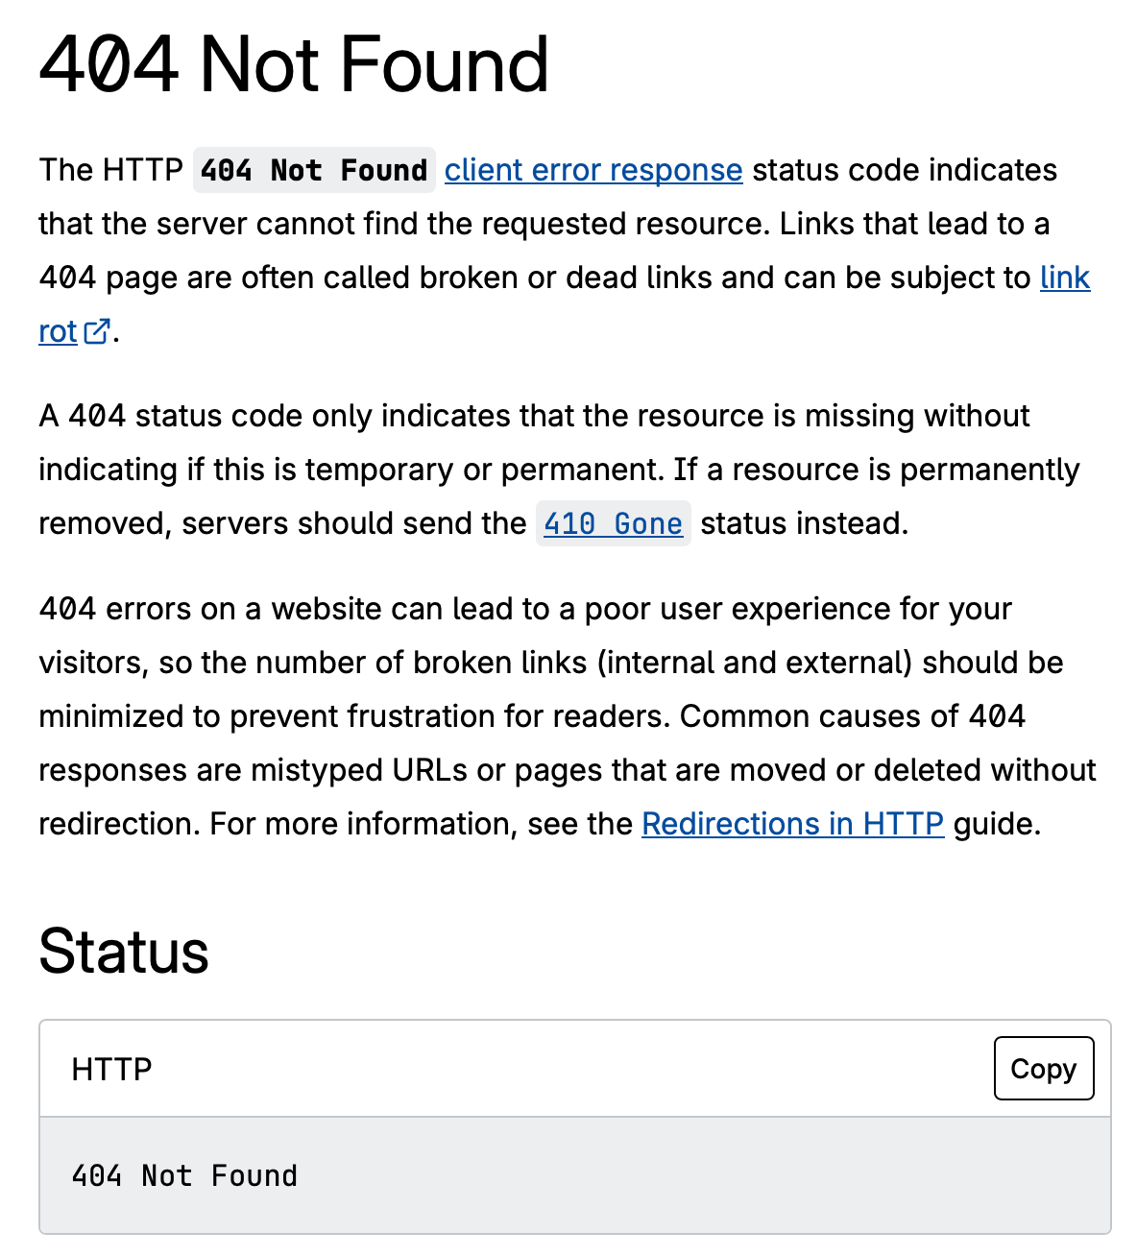
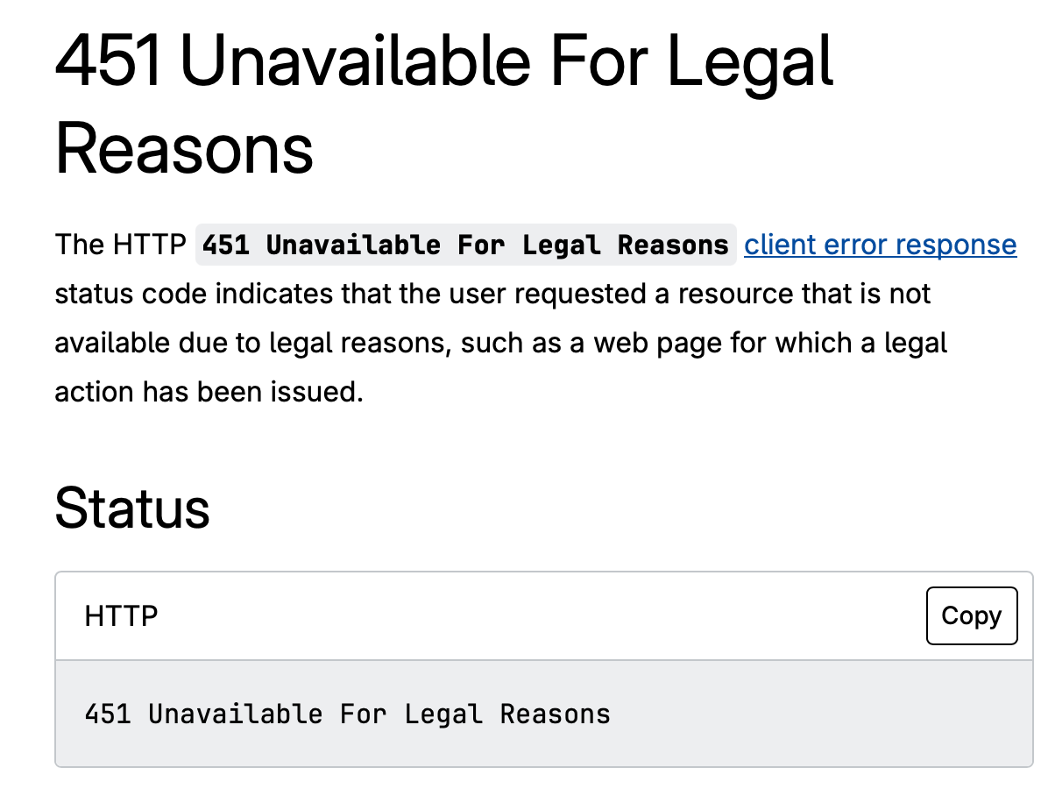
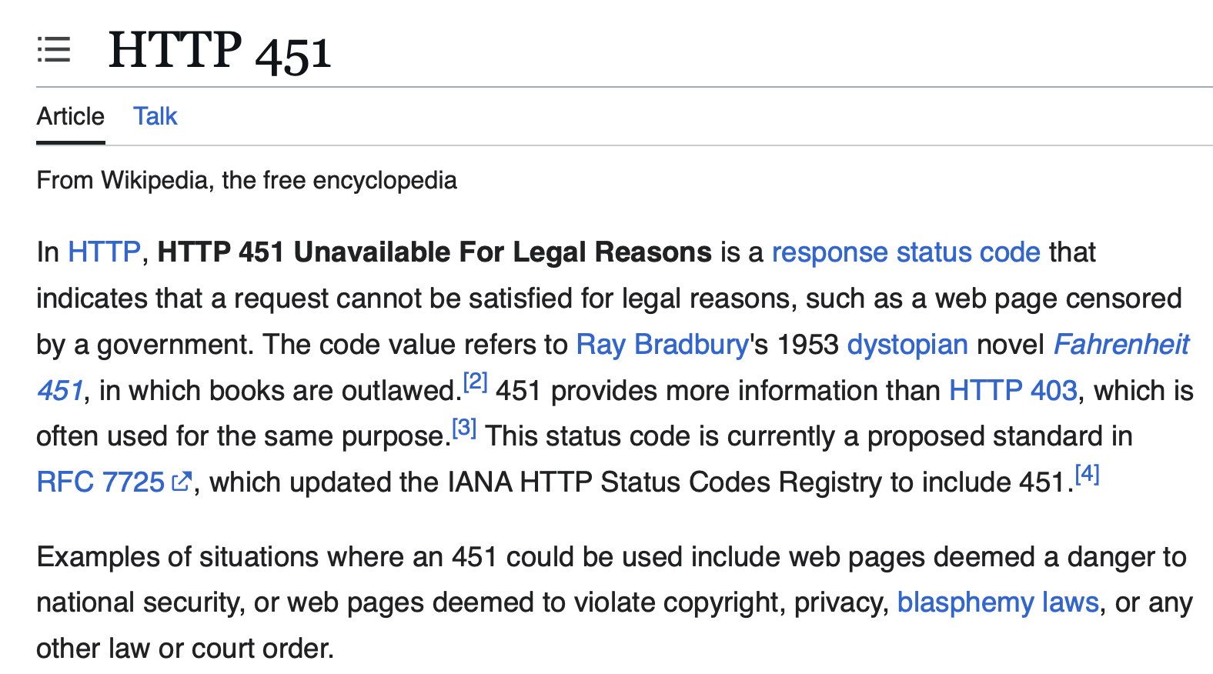
Hypertext Transport Protocol (http)

Slide 3

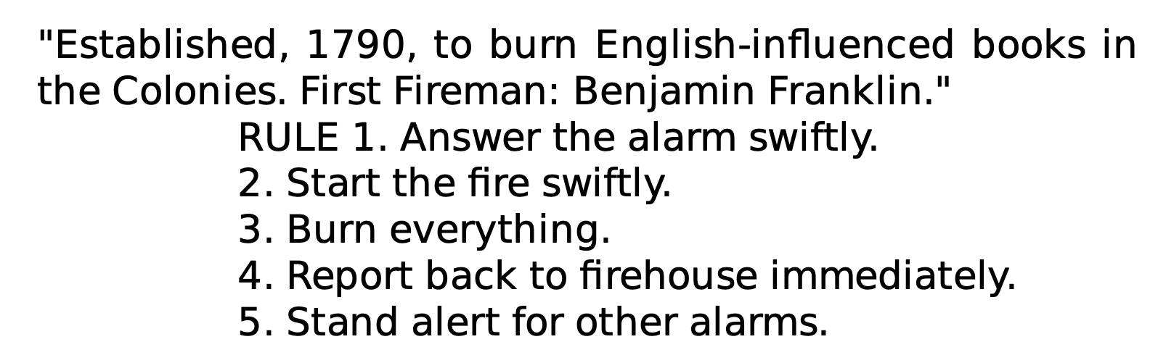
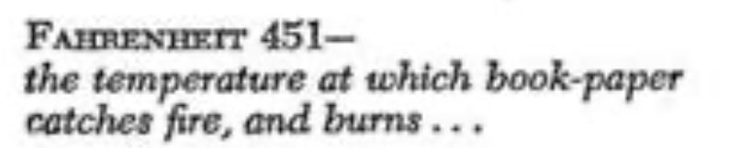
Hypertext Transport Protocol (http)
Firemen of America
1953

Slide 4
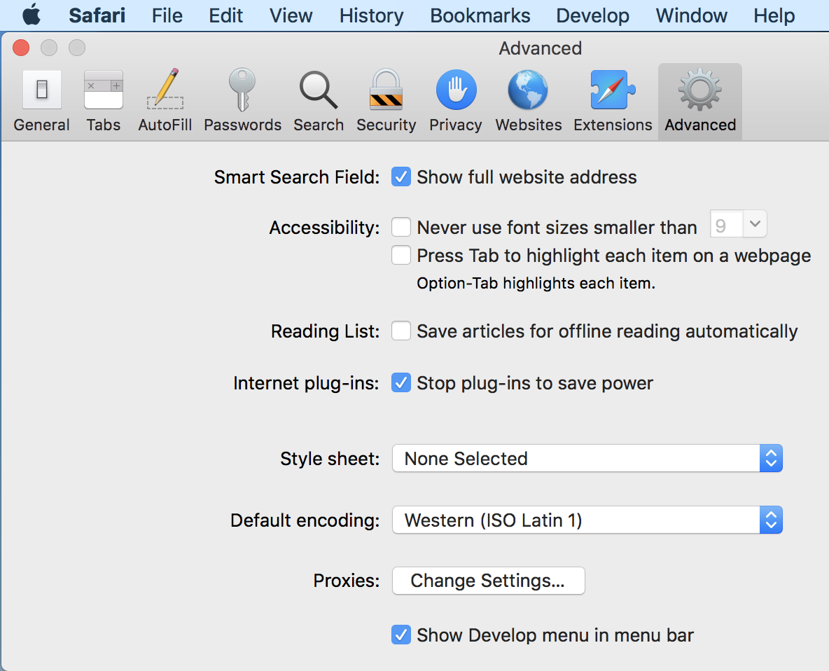
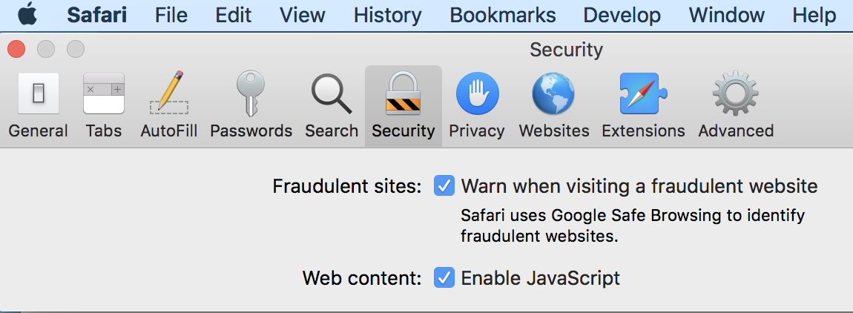
Debugging
In Safari:
  Preferences > Advanced > Show Develop menu in menu bar

Slide 5
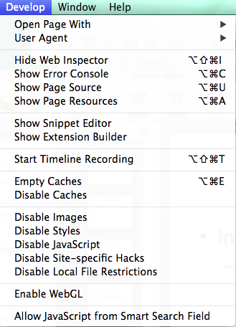
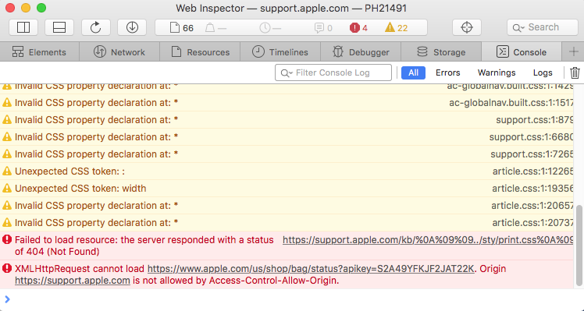
Debugging
In the Develop menu:
  Allow JavaScript from Smart Search Field
    javascript: ok in address bar
  Show Page Source
  Show Web Inspector

Slide 6
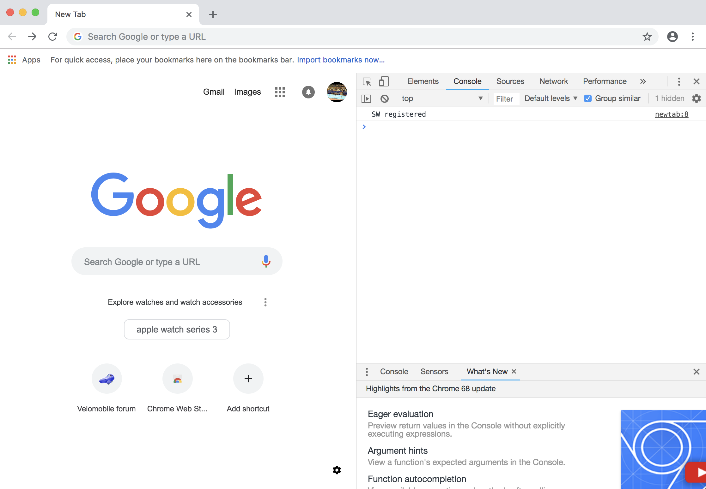
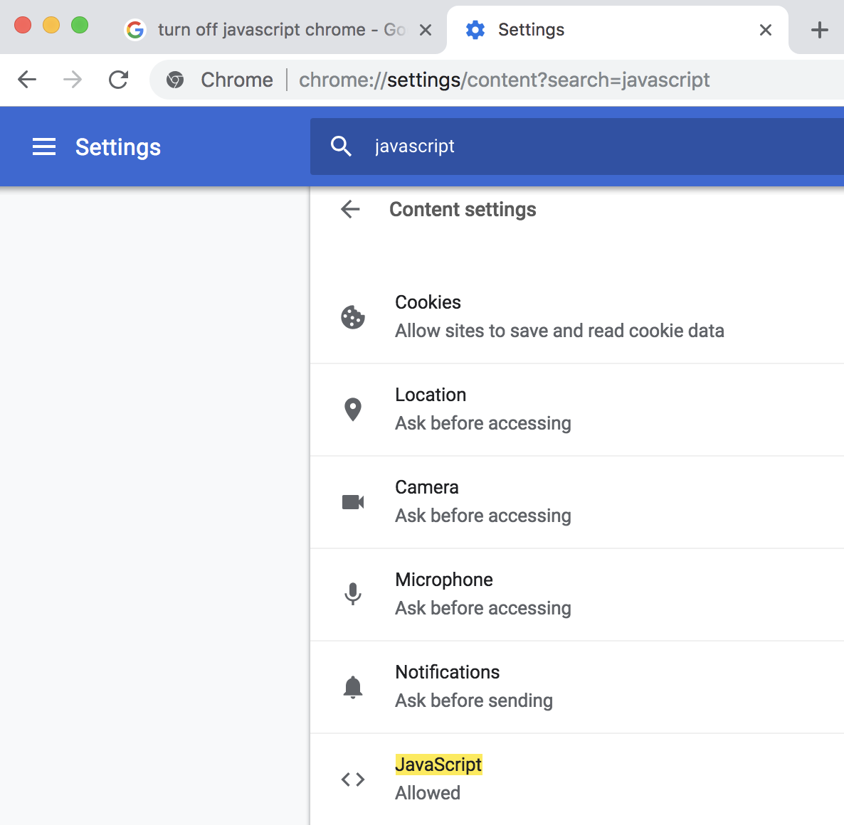
Debugging
Developer Tools and Javascript in Google Chrome:

Slide 7
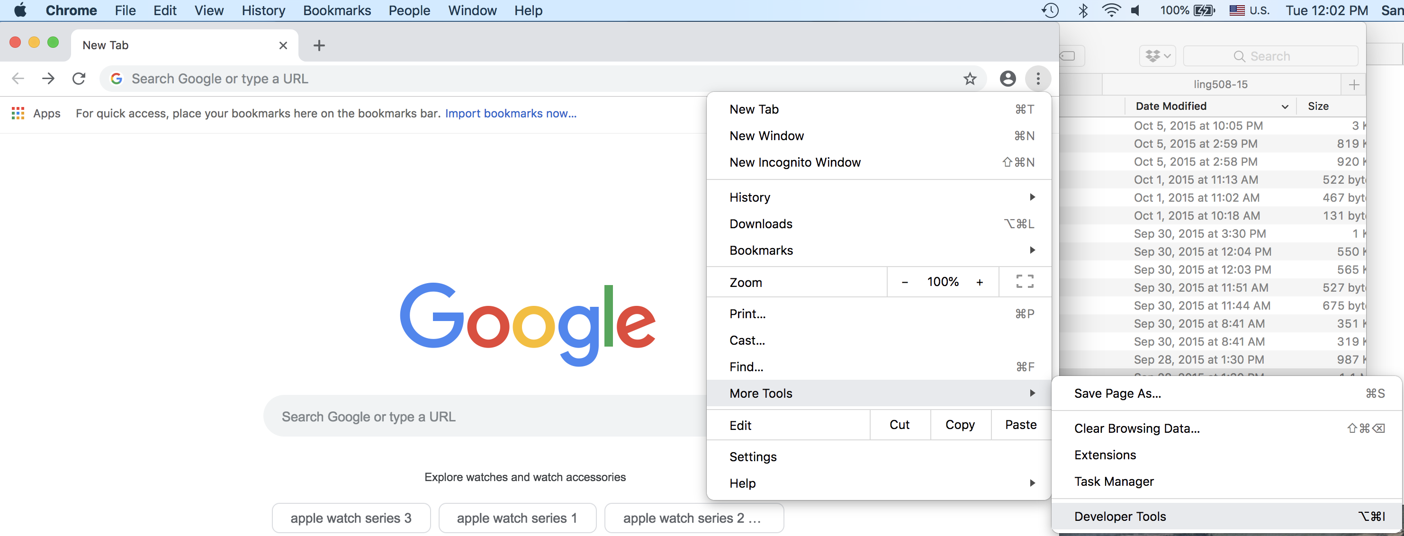
Debugging
In Google Chrome:

Slide 8
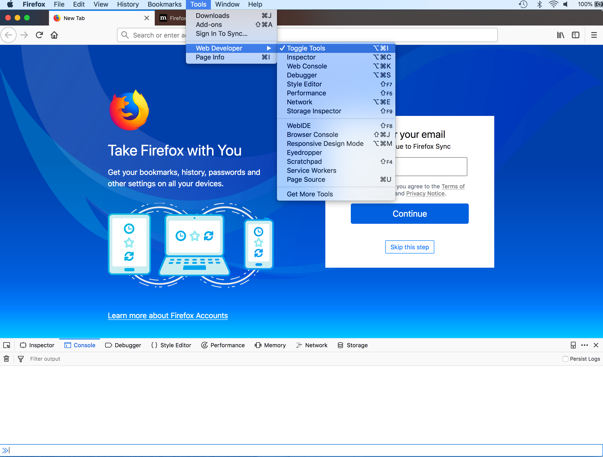
Debugging
Firefox:

Slide 9
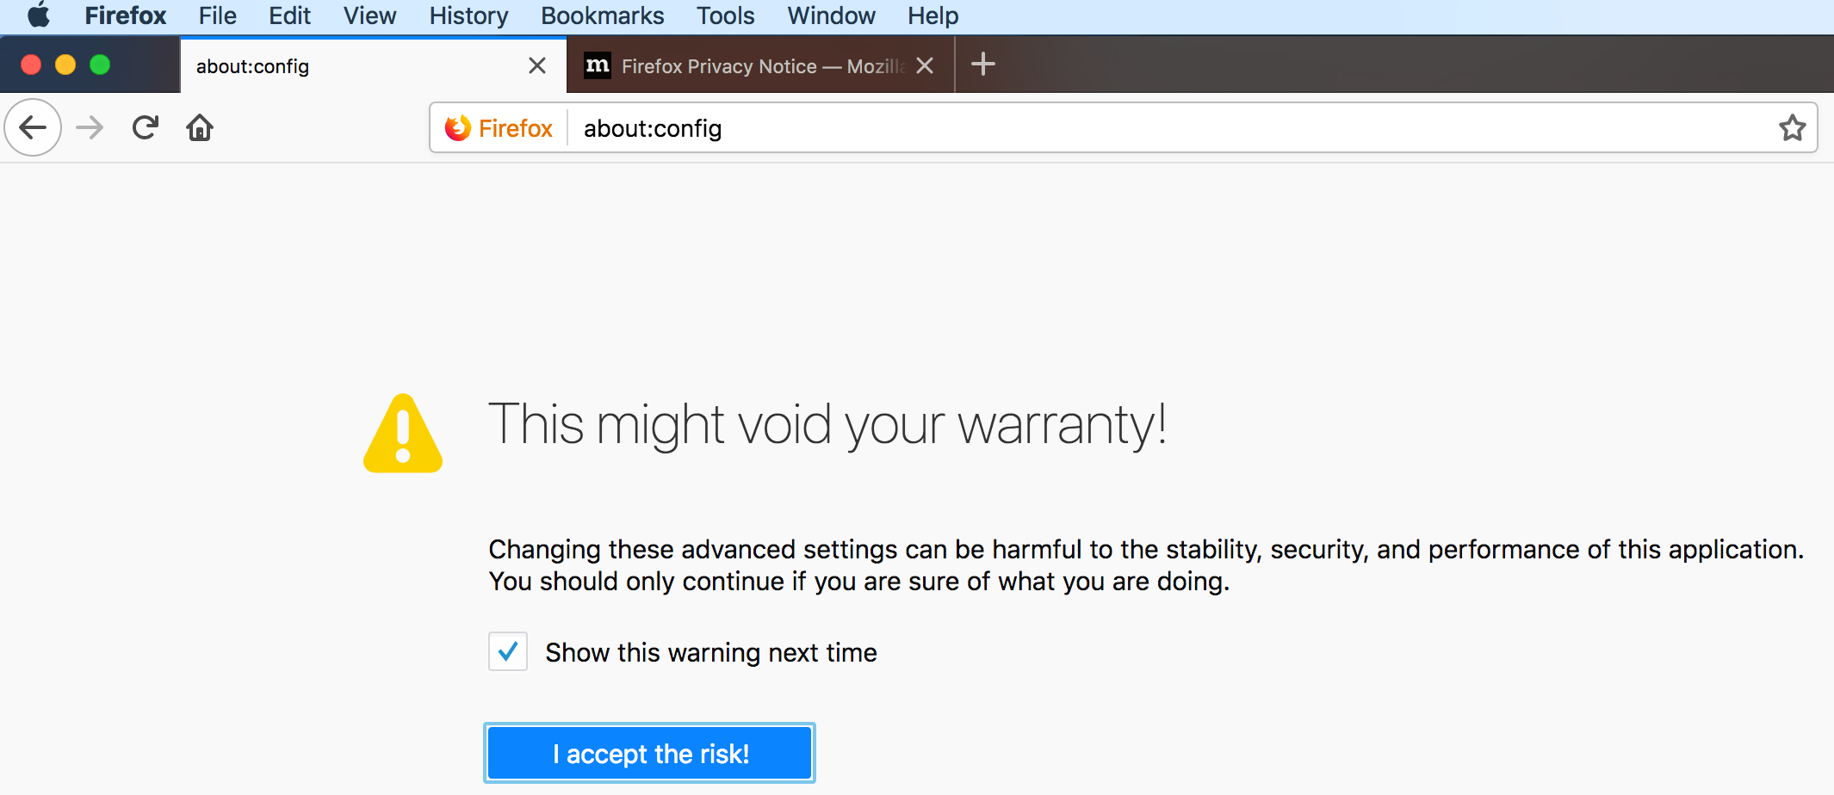
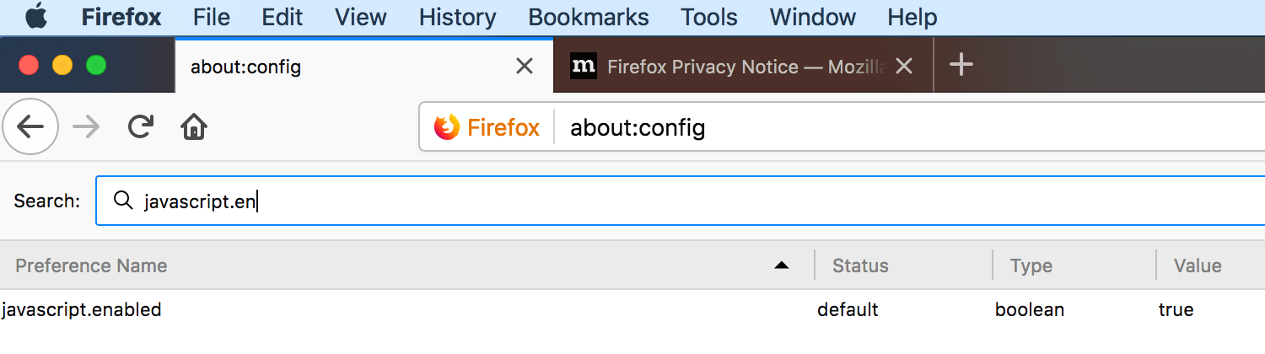
Debugging
Firefox:

Slide 10
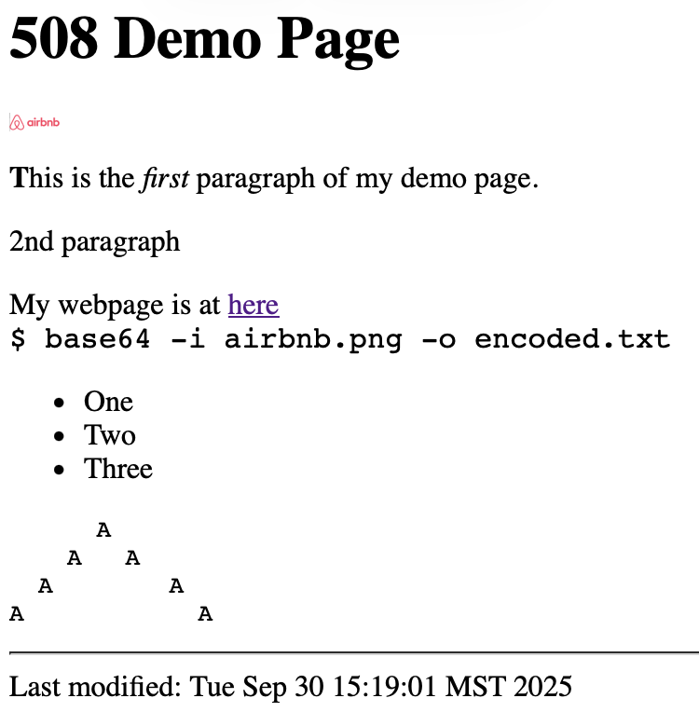
Example
See example source for =>

Slide 11
HTML
inline styling applied to text elements:
e.g. <span> (inline text) vs. <div> (block text)
  https://developer.mozilla.org/en-US/docs/Web/HTML/Element/span
  <span style="…; …"> … </span>
  style attributes:
    font-size: Xpx (px = pixel)
    font-family: name, name …
    color: name (or hex RGB) e.g. #00CC00 for hex
    background-color: name (or RGB)
    text-align: left|right|center
  note: serif, sans-serif, monospace are generic font families
  note: X11 color names are okay, http://en.wikipedia.org/wiki/X11_color_names

Slide 12
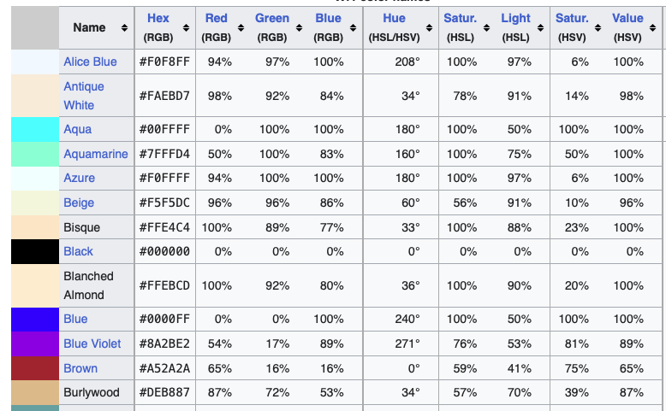
X11 Colors
https://en.wikipedia.org/wiki/X11_color_names#Color_name_chart

Slide 13

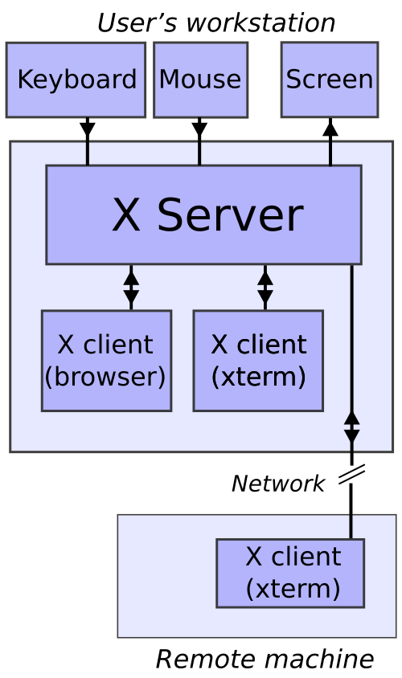
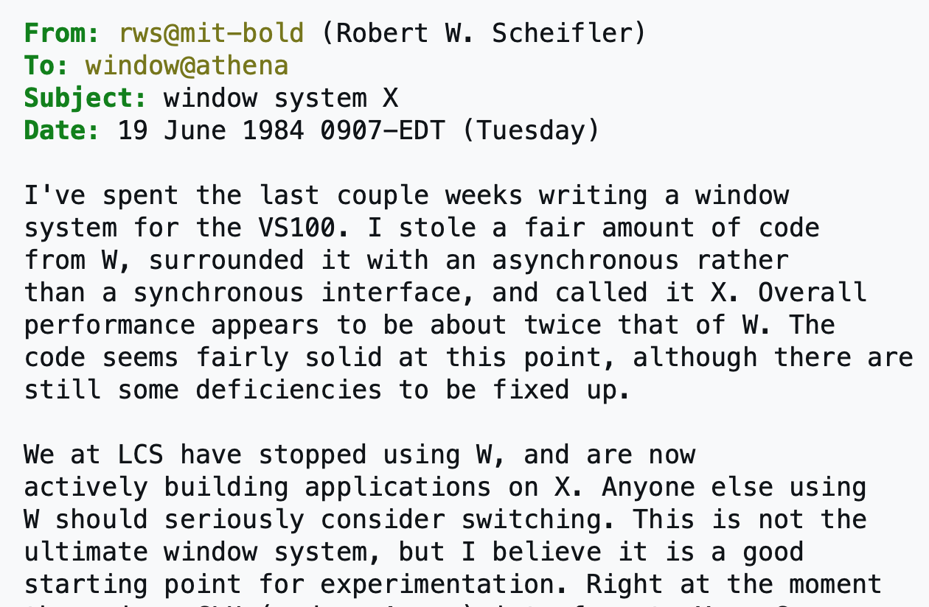

What is X11?
X Window System: Project Athena at MIT (1983)
  Distributed computing with graphics terminals connected to bigger computers
  stuck at version 11
  On Linux, X11 is still in operation
Originally,
X terminal
was a real thing.
Now a PC/mac

Slide 14
UTF-8
<head>
…
<meta charset="utf-8">
…
</head>
The <meta> HTML element represents metadata that cannot be represented by other HTML meta-related elements, like <base>, <link>, <script>, <style> or <title>.
charset
  This attribute declares the document's character encoding. If the attribute is present, its value must be an ASCII case-insensitive match for the string "utf-8", because UTF-8 is the only valid encoding for HTML5 documents. <meta> elements which declare a character encoding must be located entirely within the first 1024 bytes of the document.

Slide 15
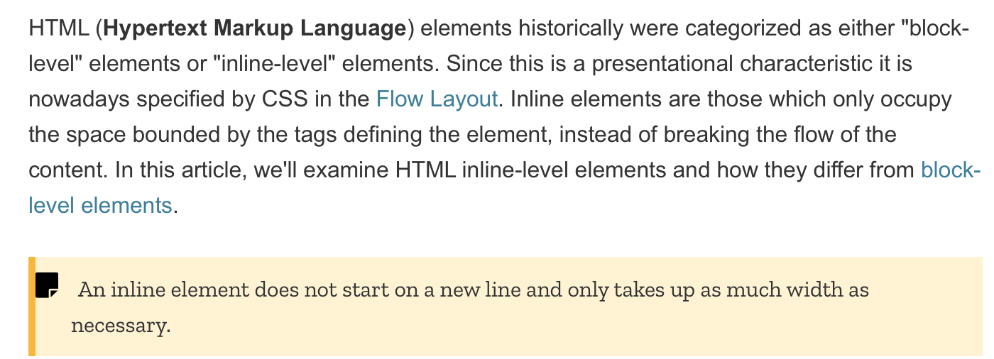
HTML
https://developer.mozilla.org/en-US/docs/Web/HTML/Inline_elements

Slide 16
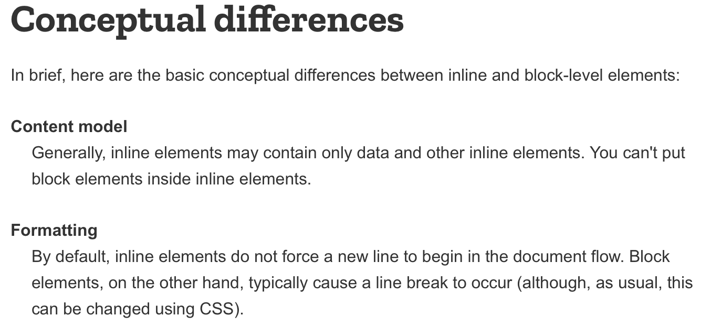
HTML
Block:
  lists
  headings:
    <h1> … <h4>
  <p>
  <div>
    general container

Slide 17
HTML
Tables:
  <table> … </table>
  <tr> … </tr> table row
  <th> … </th> table heading element
  <td> .. </td> table data (one cell)
  Attributes:
    border="size" e.g. 1px
    colspan="number" e.g. 2 (span next two columns)
    style="…;…"
      border: width style color also border-left, border-top, border-right, etc.
      border-width: top right bottom left
      border-style: top right bottom left e.g. type=solid|dotted|dashed|double|none
      border-color: top right bottom left
      border-collapse: collapse|separate
      padding: size
      text-align: left|center|right
      vertical-align: top|middle|bottom
      width, height e.g. 100px or 100%
  Newer stuff:
    <thead> … </thead>
    <tbody> .. </tbody>

Slide 18
HTML
General chunks of html:
  <div style="…"> … </div>
    a division (block-level)
  <span style="…"> … </span>
    small chunks (inline)
(optional) unique identifier id=
  used to refer to the "chunk" in CSS or DOM
  <div style="…" id="…"> … </div> a division
  <span style="…" id="…"> … </span> a span for inline text

Slide 19


CNN Webpage
Look at the errors on loading cnn.com!
Look at the bounty offered to developers! ⇧

Slide 20
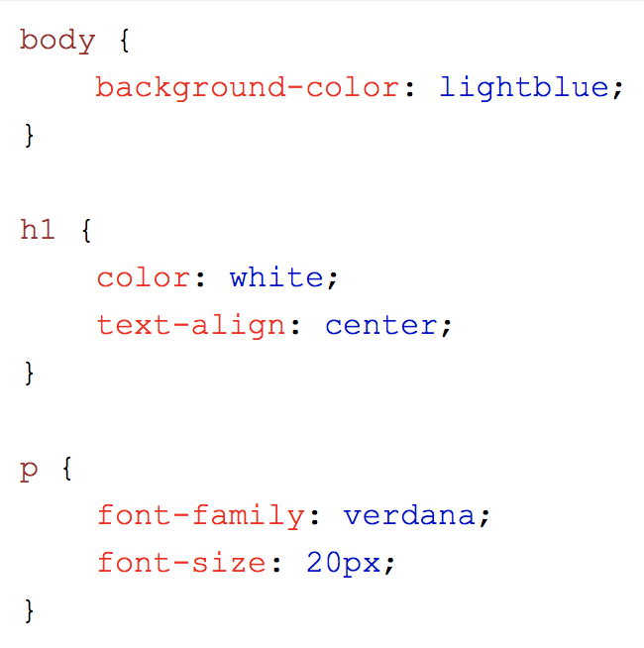
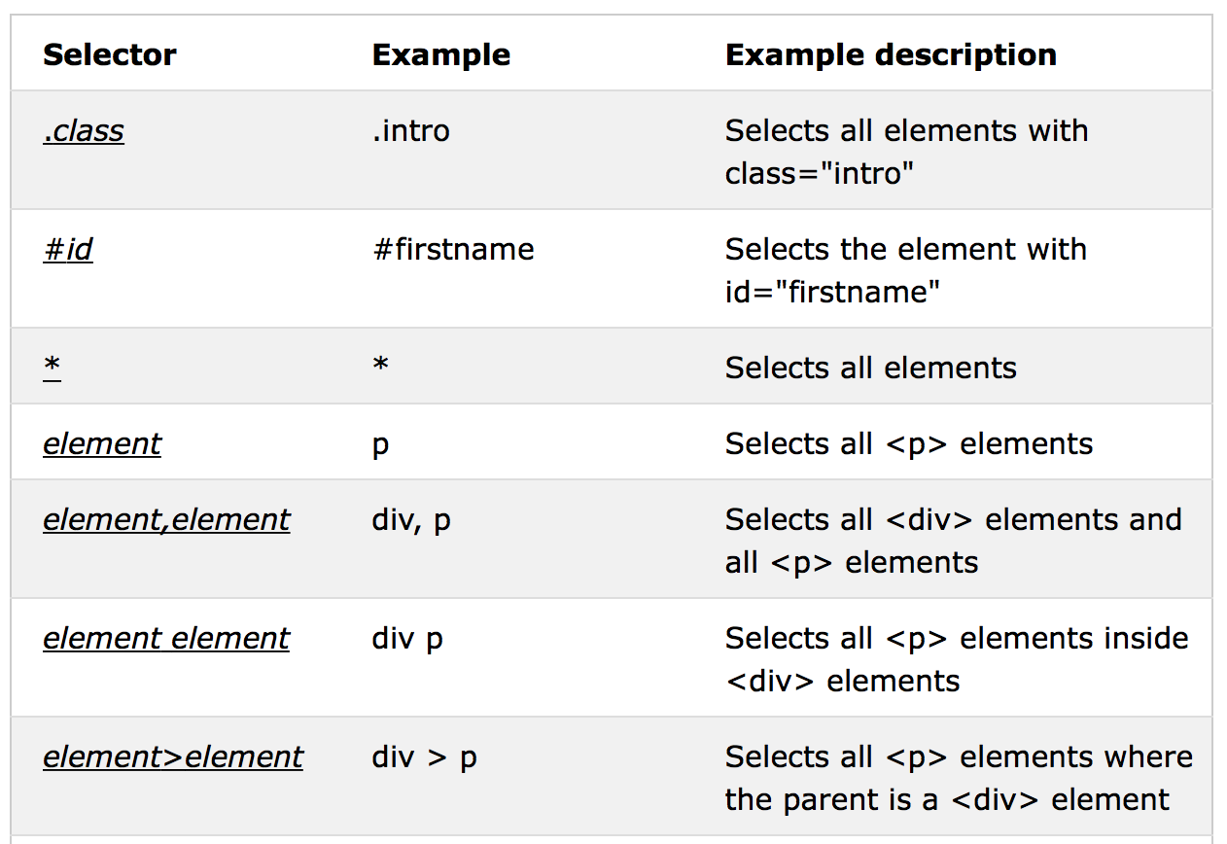
CSS
https://www.w3schools.com/css/

