Slide 1
408/508 Computational Techniques for Linguists
Lecture 3

Slide 2
Today's Topic
Homework 1 Review
Character representations: ASCII and Unicode
Looking ahead, Homework 2 out on Thursday:
for Windows 10/11 users, install Microsoft WSL2
for Apple Intel users, can install VirtualBox
for Apple Silicon users, install Multipass or do nothing
for Linux users, do nothing

Slide 3
Homework 1 Review
What would the integer representation of the speed of light (in m/s) look like in binary representation as a 32 bit number?
byte 3 | byte 2 | byte 1 | byte 0
2³¹ | 2³⁰ | 2²⁹ | 2²⁸ | 2²⁷ | 2²⁶ | 2²⁵ | 2²⁴ | … | 2¹⁵ | 2¹⁴ | 2¹³ | 2¹² | 2¹¹ | 2¹⁰ | 2⁹ | 2⁸ | 2⁷ | 2⁶ | 2⁵ | 2⁴ | 2³ | 2² | 2¹ | 2⁰
0
1
1
1
1
0
0
0
0
1
0
0
1
0
1
0
c = 2.99792458 x 10⁸ (m/s)
Integer: 299792458, not odd
÷2: 149896229 + 0
÷2: 74948114 + 1
÷2: 37474057 + 0
÷2: 18737028 + 1
÷2: 9368514 + 0
÷2: 4684257 + 0
÷2: 2342128 + 1
÷2: 1171064 + 0
÷2: 585532 + 0
÷2: 292766 + 0
÷2: 146383 + 0
÷2: 73191 + 1
÷2: 36595 + 1
÷2: 18297 + 1
÷2: 9148 + 1
÷2: 4574 + 0

Slide 4
Homework 1 Review
Kinda tedious, isn't it?
299 792 458 = 0001 0001 1101 1110 0111 1000 0100 1010
At the Terminal (on Mac or Linux):
$ which bc
/usr/bin/bc (bc - arbitrary-precision decimal arithmetic language and calculator)
$ bc
>>> obase=2
>>> 10
1010
>>> 299792458
10001110111100111100001001010

Slide 5
Homework 1 Review
In Python:
$ python
Python 3.9.16 | packaged by conda-forge | (main, Feb 1 2023, 21:38:11)
[Clang 14.0.6 ] on darwin
Type "help", "copyright", "credits" or "license" for more information.
>>> bin(299792458)
'0b10001110111100111100001001010'

Slide 6
Homework 1 Review
In Python:
>>> bin(2.99792458e8)
Traceback (most recent call last):
File "<stdin>", line 1, in <module>
TypeError: 'float' object cannot be interpreted as an integer
>>> 2.99792458e8
299792458.0
>>> bin(int(2.99792458e8))
'0b10001110111100111100001001010'
>>>

Slide 7
Homework 1 with ChatGPT

Slide 8
Homework 1 with ChatGPT

Slide 9
Homework 1 with ChatGPT

Slide 10
New Topic
Enough about numbers for now.
How about language data, i.e. characters we type?

Slide 11
Unicode
https://home.unicode.org

Slide 12
Unicode
https://www.unicode.org/versions/Unicode13.0.0/UnicodeStandard-13.0.pdf

Slide 13
On the Mac
ASCII
Latin-1 supplement

Slide 14
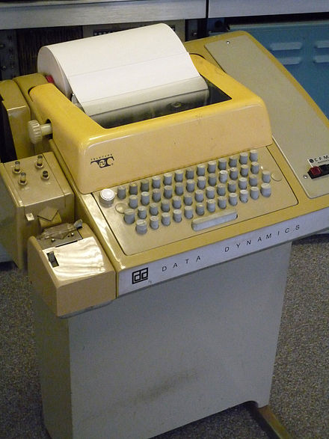
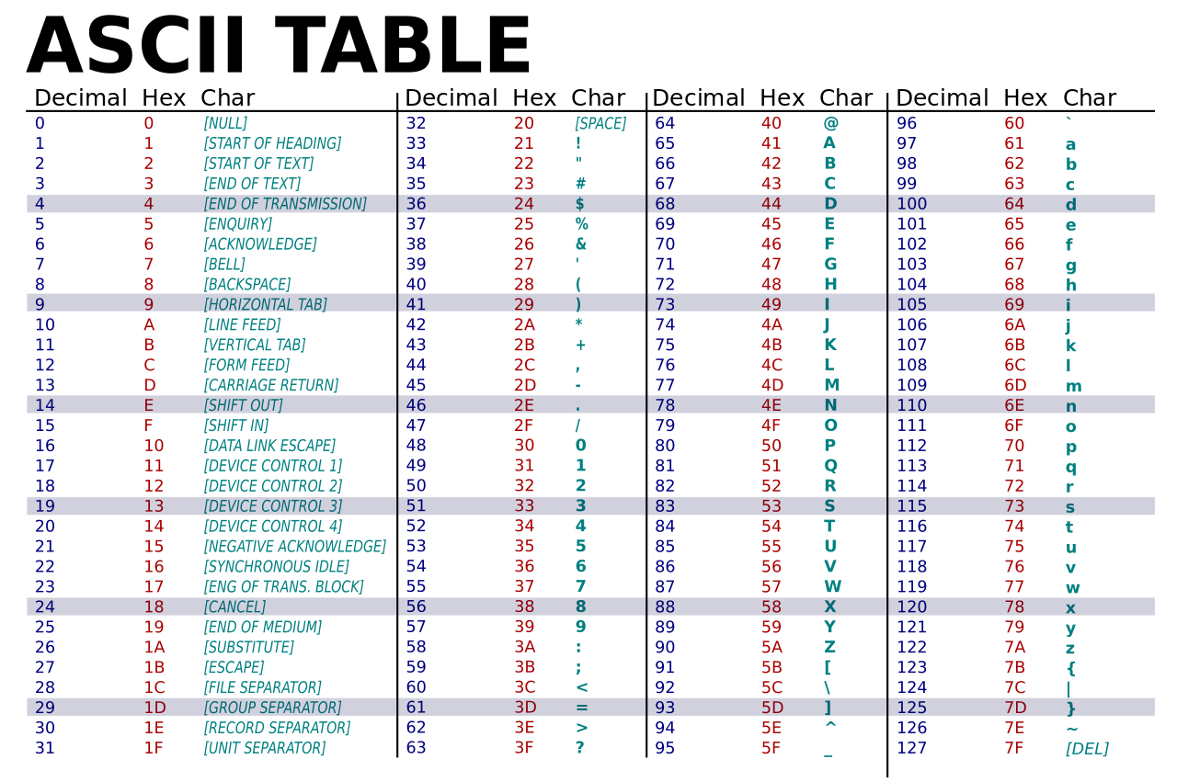
Introduction: data types
C:
char
How about letters, punctuation, etc.?
ASCII
American Standard Code for Information Interchange
Based on English alphabet (upper and lower case) + space + digits + punctuation + control (Teletype Model 33)
Question: how many bits do we need?
7 bits + 1 bit parity
Remember everything is in binary …
Teletype Model 33 ASR
Teleprinter (Wikipedia)

Slide 15
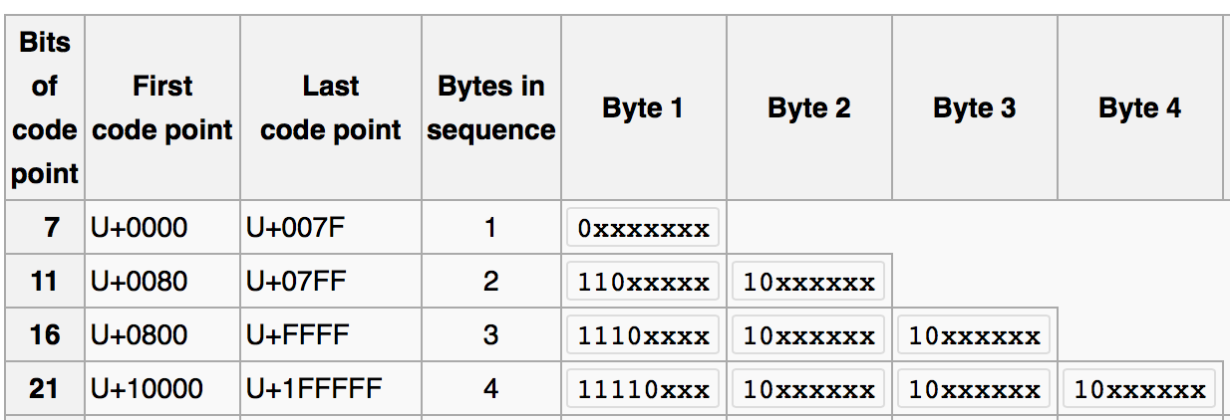
Introduction: data types
UTF-8
standard in the post-ASCII world
backwards compatible with ASCII
(previously, different languages had multi-byte character sets that clashed)
Universal Character Set (UCS) Transformation Format 8-bits
(Wikipedia)

Slide 16
Introduction: data types
order is important in sorting!
0-9: there’s a connection with BCD. Notice: code 30 (hex) through 39 (hex)

Slide 17
Introduction: data types
Parity bit:
transmission can be noisy over telephone lines
parity bit can be added to ASCII code (total: 8 bits, byte)
can spot single bit transmission errors
even/odd parity:
receiver understands each byte should be even/odd
Example:
0 (zero) is ASCII 30 (hex) = 011000 (binary)
even parity: 0011000, odd parity: 1011000
Checking parity:
Exclusive or (XOR): basic machine instruction
A xor B true if either A or B true but not both
Example:
(even parity 0) 0011000 xor bit by bit
0 xor 0 = 0 xor 1 = 1 xor 1 = 0 xor 0 = 0 xor 0 = 0 xor 0 = 0 xor 0 = 0
x86 assemby language:
PF: even parity flag set by
arithmetic ops.
TEST: AND (don’t store result), sets PF
JP: jump if PF set
Example:
MOV al,<char>
TEST al, al
JP <location if even>
<go here if odd>

Slide 18
Introduction: data types
UTF-8
standard in the post-ASCII world
backwards compatible with ASCII
(previously, different languages had multi-byte character sets that clashed)
Universal Character Set (UCS) Transformation Format 8-bits
ASCII
(Wikipedia)

Slide 19
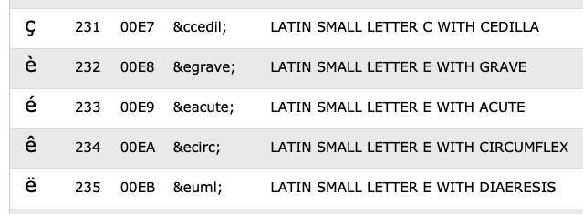
Introduction: data types
In your browser, which runs HTML5, UTF-8, is the default character encoding

Slide 20
Introduction: data types
File: pokemon.html

Slide 21
Introduction: data types
line 7: é typed on my mac keyboard using OPT-e e
File: pokemon2.html

Slide 22
Introduction: data types
File: pokemon3.html

Slide 23
Introduction: data types
Example:
あ Hiragana letter A: UTF-8: E38182
Byte 1: E = 1110, 3 = 0011
Byte 2: 8 = 1000, 1 = 0001
Byte 3: 8 = 1000, 2 = 0010
い Hiragana letter I: UTF-8: E38184
Shift-JIS (Hex):
あ: 82A0
い: 82A2

Slide 24
Introduction: data types
No <meta charset="UTF-8">
あ Hiragana letter A: UTF-8: E3 81 82
い Hiragana letter I: UTF-8: E3 81 84
Latin-1 character set (8 bits) https://kb.iu.edu/d/aepu

Slide 25
Introduction: data types

Slide 26
Introduction: data types
How can you tell what encoding your file is using?
Detecting UTF-8
Microsoft:
1st three bytes in the file is EF BB BF
(not all software understands this; not everybody uses it)
HTML:
<meta http-equiv="Content-Type" content="text/html;charset=UTF-8">
(not always present)
Analyze the file:
Find non-valid UTF-8 sequences: if found, not UTF-8…
Interesting paper:
http://www-archive.mozilla.org/projects/intl/UniversalCharsetDetection.html

