Slide 1
408/508 Computational Techniques for Linguists
Lecture 29

Slide 2
Last Time
Conditional Frequency Distributions
nltk.ConditionalFreqDist(tuples)
Pairs of words: list of tuples (word1, word2)
For each word1, compute possible word2 nltk.FreqDist()
Bigram Random Text Generation

Slide 3
Today's Topics
List some other nltk.corpus
And show other uses of nltk.ConditionalFreqDist()

Slide 4
NLTK Book
filename is the fileid
Statistics:
average # letters per word
average # words per sentence
average # times each word is used

Slide 5
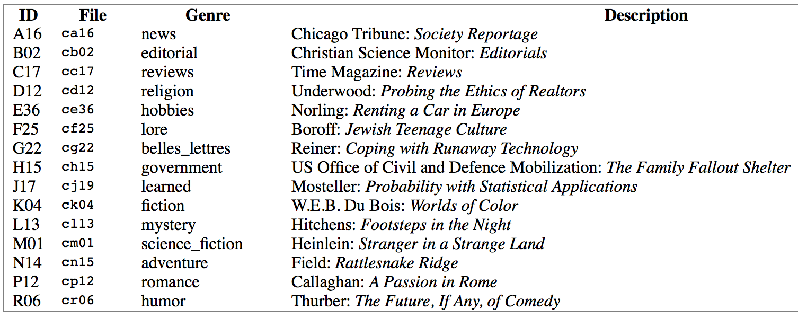
NLTK Book: Chapter 2
Other types (genres) of corpora:
from nltk.corpus import webtext Web text corpus
from nltk.corpus import nps_chat NPS chat corpus
from nltk.corpus import brown Brown corpus
Brown corpus
Kučera and Francis (1967)
"A balanced corpus"
A million words

Slide 6
NLTK Book: Chapter 2
modals = ['can', 'could', 'may', 'might', 'must', 'will']
>>> from nltk.corpus import brown
>>> len(brown.fileids()) #number of files = 500
500
>>> brown.categories() #number of categories = 15
['adventure', 'belles_lettres', 'editorial', 'fiction', 'government', 'hobbies', 'humor', 'learned', 'lore', 'mystery', 'news', 'religion', 'reviews', 'romance', 'science_fiction']
>>> news = brown.words(categories='news')
>>> import nltk
>>> fd = nltk.FreqDist([w.lower() for w in news])
>>> for m in modals:
... print('{}: {}'.format(m,fd[m]), end=' ')
...
can: 94 could: 87 may: 93 might: 38 must: 53 shall: 5 should: 61 will: 389 would: 246

Slide 7
NLTK Book: Chapter 2
>>> modals = ['can', 'could', 'may', 'might', 'must', 'shall', 'should', 'will', 'would']
>>> cfd = nltk.ConditionalFreqDist([(cat,word) for cat in brown.categories() for word in brown.words(categories=cat)])
>>> cfd
<ConditionalFreqDist with 15 conditions>
>>> len(brown.categories())
15
>>> cfd.tabulate(conditions=brown.categories(), samples=modals)
List comprehension
[(cat,word) for cat in brown.categories() for word in brown.words(categories=cat)]

Slide 8
NLTK Book: Chapter 2
modals = ['can', 'could', 'may', 'might', 'must', 'shall', 'should', 'will', 'would']
>>> cfd.tabulate(conditions=brown.categories(), samples=modals)
can could may might must shall should will would
adventure 46 151 5 58 27 7 15 50 191
belles_lettres 246 213 207 113 170 34 102 236 392
editorial 121 56 74 39 53 19 88 233 180
fiction 37 166 8 44 55 3 35 52 287
government 117 38 153 13 102 98 112 244 120
hobbies 268 58 131 22 83 5 73 264 78
humor 16 30 8 8 9 2 7 13 56
learned 365 159 324 128 202 40 171 340 319
lore 170 141 165 49 96 12 76 175 186
mystery 42 141 13 57 30 1 29 20 186
news 93 86 66 38 50 5 59 389 244
religion 82 59 78 12 54 21 45 71 68
reviews 45 40 45 26 19 1 18 58 47
romance 74 193 11 51 45 3 32 43 244
science_fiction 16 49 4 12 8 3 3 16 79
NLTK book says, "Observe that the most frequent modal in the news genre is will, while the most frequent modal in the romance genre is could (actually would).
Would you have predicted this?'

Slide 9
NLTK Book: Chapter 2
Other types of corpora:
from nltk.corpus import reuters Reuters news corpus
>>> reuters.categories()
['acq', 'alum', 'barley', 'bop', 'carcass', 'castor-oil', 'cocoa', 'coconut', 'coconut-oil', 'coffee', 'copper', 'copra-cake', 'corn', 'cotton', 'cotton-oil', 'cpi', 'cpu', 'crude', 'dfl', 'dlr', 'dmk', 'earn', 'fuel', 'gas', 'gnp', 'gold', 'grain', 'groundnut', 'groundnut-oil', 'heat', 'hog', 'housing', 'income', 'instal-debt', 'interest', 'ipi', 'iron-steel', 'jet', 'jobs', 'l-cattle', 'lead', 'lei', 'lin-oil', 'livestock', 'lumber', 'meal-feed', 'money-fx', 'money-supply', 'naphtha', 'nat-gas', 'nickel', 'nkr', 'nzdlr', 'oat', 'oilseed', 'orange', 'palladium', 'palm-oil', 'palmkernel', 'pet-chem', 'platinum', 'potato', 'propane', 'rand', 'rape-oil', 'rapeseed', 'reserves', 'retail', 'rice', 'rubber', 'rye', 'ship', 'silver', 'sorghum', 'soy-meal', 'soy-oil', 'soybean', 'strategic-metal', 'sugar', 'sun-meal', 'sun-oil', 'sunseed', 'tea', 'tin', 'trade', 'veg-oil', 'wheat', 'wpi', 'yen', 'zinc']
>>> len(reuters.categories())
90

Slide 10
NLTK Book: Chapter 2
File IDs are divided into test and training datasets (for machine learning purposes)
>>> reuters.fileids('strategic-metal')
['test/15420', 'test/15838', 'test/15872', 'test/17480', 'test/17486', 'test/17783', 'test/17805', 'test/18348', 'test/18466', 'test/18872', 'test/18944', 'training/10151', 'training/11999', 'training/12007', 'training/13052', 'training/13251', 'training/14719', 'training/2186', 'training/2936', 'training/2942', 'training/3010', 'training/309', 'training/346', 'training/3460', 'training/3497', 'training/5693', 'training/7775']
>>> reuters.categories('test/15420')
['palladium', 'platinum', 'strategic-metal']

Slide 11
NLTK Book: Chapter 2
Other types of corpora:
from nltk.corpus import inaugural Inaugural address corpus
>>> inaugural.fileids()
['1789-Washington.txt', '1793-Washington.txt', '1797-Adams.txt', '1801-Jefferson.txt', '1805-Jefferson.txt', '1809-Madison.txt', '1813-Madison.txt', '1817-Monroe.txt', '1821-Monroe.txt', '1825-Adams.txt', '1829-Jackson.txt', '1833-Jackson.txt', '1837-VanBuren.txt', '1841-Harrison.txt', '1845-Polk.txt', '1849-Taylor.txt', '1853-Pierce.txt', '1857-Buchanan.txt', '1861-Lincoln.txt', '1865-Lincoln.txt', '1869-Grant.txt', '1873-Grant.txt', '1877-Hayes.txt', '1881-Garfield.txt', '1885-Cleveland.txt', '1889-Harrison.txt', '1893-Cleveland.txt', '1897-McKinley.txt', '1901-McKinley.txt', '1905-Roosevelt.txt', '1909-Taft.txt', '1913-Wilson.txt', '1917-Wilson.txt', '1921-Harding.txt', '1925-Coolidge.txt', '1929-Hoover.txt', '1933-Roosevelt.txt', '1937-Roosevelt.txt', '1941-Roosevelt.txt', '1945-Roosevelt.txt', '1949-Truman.txt', '1953-Eisenhower.txt', '1957-Eisenhower.txt', '1961-Kennedy.txt', '1965-Johnson.txt', '1969-Nixon.txt', '1973-Nixon.txt', '1977-Carter.txt', '1981-Reagan.txt', '1985-Reagan.txt', '1989-Bush.txt', '1993-Clinton.txt', '1997-Clinton.txt', '2001-Bush.txt', '2005-Bush.txt', '2009-Obama.txt', '2013-Obama.txt', '2017-Trump.txt', '2021-Biden.txt']

Slide 12
NLTK Book: Chapter 2
fileid is a string
fileid[:4] is 1st 4 characters
Other types of corpora:
from nltk.corpus import inaugural Inaugural address corpus
>>> [fileid[:4] for fileid in inaugural.fileids()]
['1789', '1793', '1797', '1801', '1805', '1809', '1813', '1817', '1821', '1825', '1829', '1833', '1837', '1841', '1845', '1849', '1853', '1857', '1861', '1865', '1869', '1873', '1877', '1881', '1885', '1889', '1893', '1897', '1901', '1905', '1909', '1913', '1917', '1921', '1925', '1929', '1933', '1937', '1941', '1945', '1949', '1953', '1957', '1961', '1965', '1969', '1973', '1977', '1981', '1985', '1989', '1993', '1997', '2001', '2005', '2009', '2013', '2017', '2021']
>>> len(inaugural.fileids())
59

Slide 13
NLTK Book: Chapter 2
america/citizen
year
>>> cfd = nltk.ConditionalFreqDist((word,fileid[:4]) for fileid in inaugural.fileids() for w in inaugural.words(fileid) for word in ['america','citizen'] if w.lower().startswith(word))
>>> cfd.plot()

Slide 14
NLTK Book: Chapter 2
List comprehension explained:
[(word,fileid[:4]) for fileid in inaugural.fileids() for w in inaugural.words(fileid) for word in ['america','citizen'] if w.lower().startswith(word)]
str.startswith(prefix[, start[, end]])
Return True if string starts with the prefix, otherwise return False.
str.lower()
Return a copy of the string with all the cased characters converted to lowercase.
america/citizen
year

Slide 15
NLTK Book: Chapter 2
cfd = nltk.ConditionalFreqDist((word,fileid[:4]) for fileid in inaugural.fileids() for w in inaugural.words(fileid) for word in ['black','negro','african','mexican','hispanic','colored','native','indian'] if w.lower().startswith(word))
>>> cfd.plot()
some of these
terms are
obviously
outdated
(and offensive
today)

Slide 16
NLTK Book: Chapter 2

Slide 17
NLTK Book: Chapter 2
Not an exhaustive list…

Slide 18
NLTK Book: Chapter 2
Methods:

Slide 19
NLTK Book: Chapter 2
>>> nltk.corpus.indian.words('hindi.pos')
['पूर्ण', 'प्रतिबंध', 'हटाओ', ':', 'इराक', 'संयुक्त', ...]
>>> nltk.corpus.udhr.fileids()
['Abkhaz-Cyrillic+Abkh', 'Abkhaz-UTF8', 'Achehnese-Latin1', 'Achuar-Shiwiar-Latin1', 'Adja-UTF8', 'Afaan_Oromo_Oromiffa-Latin1', 'Afrikaans-Latin1', 'Aguaruna-Latin1', 'Akuapem_Twi-UTF8', 'Albanian_Shqip-Latin1', 'Amahuaca', 'Amahuaca-Latin1', 'Amarakaeri-Latin1', 'Amuesha-Yanesha-UTF8', 'Arabela-Latin1', 'Arabic_Alarabia-Arabic', 'Asante-UTF8', 'Ashaninca-Latin1', 'Asheninca-Latin1', 'Asturian_Bable-Latin1', 'Aymara-Latin1', 'Balinese-Latin1', 'Bambara-UTF8', 'Baoule-UTF8', 'Basque_Euskara-Latin1', 'Batonu_Bariba-UTF8', 'Belorus_Belaruski-Cyrillic', 'Belorus_Belaruski-UTF8', 'Bemba-Latin1', 'Bengali-UTF8', 'Beti-UTF8', 'Bichelamar-Latin1', 'Bikol_Bicolano-Latin1', 'Bora-Latin1', 'Bosnian_Bosanski-Cyrillic', 'Bosnian_Bosanski-Latin2', 'Bosnian_Bosanski-UTF8', 'Breton-Latin1', 'Bugisnese-Latin1', 'Bulgarian_Balgarski-Cyrillic', 'Bulgarian_Balgarski-UTF8', 'Cakchiquel-Latin1', 'Campa_Pajonalino-Latin1', 'Candoshi-Shapra-Latin1', 'Caquinte-Latin1', 'Cashibo-Cacataibo-Latin1', 'Cashinahua-Latin1', 'Catalan-Latin1', 'Catalan_Catala-Latin1', 'Cebuano-Latin1', 'Chamorro-Latin1', 'Chayahuita-Latin1', 'Chechewa_Nyanja-Latin1', 'Chickasaw-Latin1', 'Chinanteco-Ajitlan-Latin1', 'Chinanteco-UTF8', 'Chinese_Mandarin-GB2312', 'Chuuk_Trukese-Latin1', 'Cokwe-Latin1', 'Co …
… tin1', 'WesternSotho_Tswana-Setswana-Latin1', 'Wolof-Latin1', 'Xhosa-Latin1', 'Yagua-Latin1', 'Yao-Latin1', 'Yapese-Latin1', 'Yoruba-UTF8', 'Zapoteco-Latin1', 'Zapoteco-SanLucasQuiavini-Latin1', 'Zhuang-Latin1', 'Zulu-Latin1']
UDHR = Universal Declaration of Human Rights

Slide 20
NLTK Book: Chapter 2
UDHR = Universal Declaration of Human Rights
>>> len(nltk.corpus.udhr.fileids())
310
>>> nltk.corpus.udhr.words('Chinese_Mandarin-GB2312')
['世界人权宣言', '联合国大会一九四八年十二月十日第217A', '(', 'III', ')', ...]
>>> nltk.corpus.udhr.words('English-Latin1')[:20]
['Universal', 'Declaration', 'of', 'Human', 'Rights', 'Preamble', 'Whereas', 'recognition', 'of', 'the', 'inherent', 'dignity', 'and', 'of', 'the', 'equal', 'and', 'inalienable', 'rights', 'of']

Slide 21
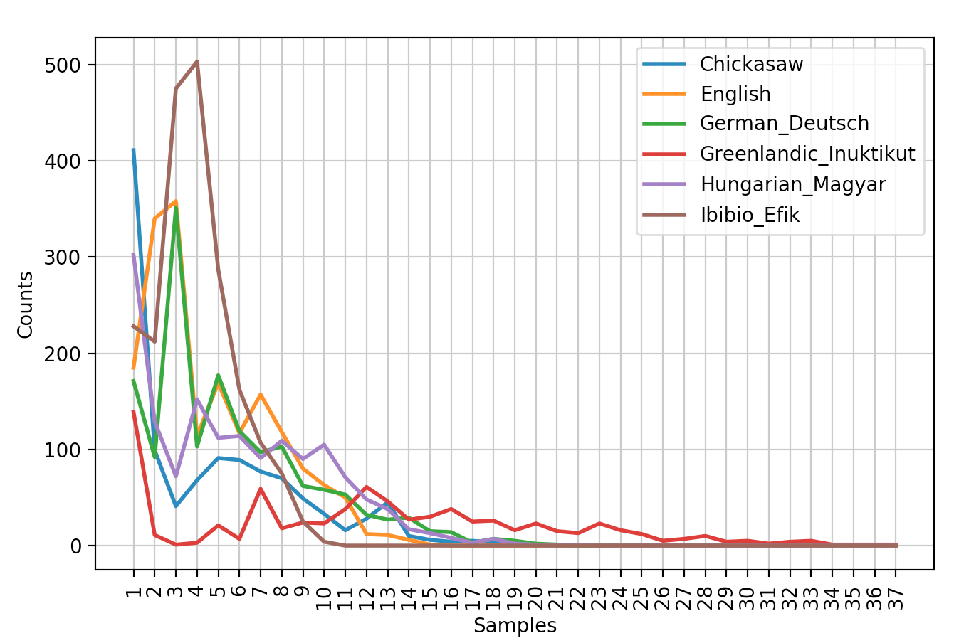
NLTK Book: Chapter 2
cfd = nltk.ConditionalFreqDist([(lang, len(word)) for lang in languages for word in nltk.corpus.udhr.words(lang + '-Latin1')])
>>> cfd.plot()

Slide 22
NLTK Book: Chapter 2
>>> len(udhr.words('English-Latin1'))
1781
>>> import numpy as np
>>> import matplotlib.pyplot as plt
>>> from nltk.corpus import udhr
>>> udhr_len = [len(udhr.words(fid)) for fid in udhr.fileids()]
>>> plt.hist(udhr_len, 20, facecolor='green', alpha=0.5)
(array([ 3., 3., 11., 8., 25., 29., 30., 61., 43., 26., 25.,
15., 10., 9., 5., 2., 1., 0., 1., 3.]), array([ 508. , 680.65, 853.3 , 1025.95, 1198.6 , 1371.25,
1543.9 , 1716.55, 1889.2 , 2061.85, 2234.5 , 2407.15,
2579.8 , 2752.45, 2925.1 , 3097.75, 3270.4 , 3443.05,
3615.7 , 3788.35, 3961. ]), <a list of 20 Patch objects>)
>>> plt.show()

Slide 23
NLTK Book: Chapter 2
http://www.nltk.org/book/ch02.html
import nltk
from nltk.corpus import brown
days = set(['Monday','Tuesday','Wednesday','Thursday','Friday','Saturday','Sunday'])
categories = ['news', 'romance']
cfd = nltk.ConditionalFreqDist([(category, w) for category in categories for w in brown.words(categories=category) if w in days])
cfd.tabulate(conditions=categories, samples=days)
Monday Tuesday Wednesday Thursday Friday Saturday Sunday
news 54 43 22 20 41 33 51
romance 2 3 3 1 3 4 5
Collect counts for pairs:
conditions
samples

Slide 24
NLTK Book: Chapter 2

Slide 25
NLTK Book: Chapter 2
4.1 Wordlist Corpora
def unusual_words(text):
text_vocab = set(w.lower() for w in text if w.isalpha())
english_vocab = set(w.lower() for w in nltk.corpus.words.words())
unusual = text_vocab - english_vocab
return sorted(unusual)
>>> len(unusual_words(nltk.corpus.gutenberg.words('austen-emma.txt')))
1934
… 'wives', 'women', 'wondered', 'wonderings', 'wonders', 'woodhouses', 'woods', 'woollen', 'words', 'workbags', 'workmen', 'worlds', 'worshipped', 'worshipping', 'worthies', 'wrapt', 'wretchedest', 'wretches', 'writes', 'xii', 'xiii', 'xiv', 'xix', 'xv', 'xvi', 'xvii', 'xviii', 'yards', 'years', 'yielded', 'youngest', 'zigzags']
wc -l /usr/share/dict/words
235886

Slide 26
NLTK Book: Chapter 2
Stopwords usually have little lexical content, and their presence in a text fails to distinguish it from other texts.

Slide 27
NLTK Book: Chapter 2
>>> emma = nltk.corpus.gutenberg.words('austen-emma.txt')
>>> len(emma)
192427
>>> vocab = set(emma)
>>> len(vocab)
7811
>>> from nltk.corpus import stopwords
>>> len(stopwords.words('english'))
179 (Note: 7811 - 179 = 7632)
>>> type(stopwords.words('english'))
<class 'list'>
>>> len(vocab - set(stopwords.words('english')))
7682

Slide 28
NLTK Book: Chapter 2
>>> set(stopwords.words('english')) - vocab
{'hasn', 'doesn', 'weren', 'm', 'shouldn', 'mightn', 'wouldn', 'didn', 'until', "hasn't", 'haven', 'won', "should've", "aren't", "haven't", 'wasn', "mustn't", "you'd", 'needn', 've', "hadn't", 'y', "doesn't", "you're", 'aren', 'yourselves', "wasn't", "you'll", 'isn', "shouldn't", "mightn't", "isn't", "it's", "needn't", 'll', "weren't", "couldn't", 'mustn', 'ain', 'couldn', "didn't", "don't", "wouldn't", "won't", 'hadn', "you've", "that'll", "shan't", 'i', "she's"}
>>> len(set(stopwords.words('english')) - vocab)
50
Why?
>>> cfd = nltk.ConditionalFreqDist(nltk.bigrams(emma))
>>> cfd["'"]
FreqDist({'s': 932, 't': 19, 'am': 11, 'clock': 8, 'ye': 6, 'd': 4, 'absence': 2, 'coming': 1, 'imaginations': 1, 'understanding': 1, ...})
Note: tokenization turned Emma's into Emma + ' + s
>>> nltk.corpus.gutenberg.sents('austen-emma.txt')[9]
['The', 'real', 'evils', ',', 'indeed', ',', 'of', 'Emma', "'", 's', 'situation', 'were', 'the', 'power', 'of', 'having', 'rather', 'too', 'much', 'her', 'own', 'way', ',', 'and', 'a', 'disposition', 'to', 'think', 'a', 'little', 'too', 'well', 'of', 'herself', ';', 'these', 'were', 'the', 'disadvantages', 'which', 'threatened', 'alloy', 'to', 'her', 'many', 'enjoyments', '.']

Slide 29
NLTK Book: Chapter 2
One more wordlist corpus is the Names corpus, containing 8,000 first names categorized by gender. The male and female names are stored in separate files.
>>> names = nltk.corpus.names
>>> males = set(names.words('male.txt'))
>>> len([name for name in names.words('female.txt') if name in males])
365
>>> [name for name in names.words('female.txt') if name in males][:50]
['Abbey', 'Abbie', 'Abby', 'Addie', 'Adrian', 'Adrien', 'Ajay', 'Alex', 'Alexis', 'Alfie', 'Ali', 'Alix', 'Allie', 'Allyn', 'Andie', 'Andrea', 'Andy', 'Angel', 'Angie', 'Ariel', 'Ashley', 'Aubrey', 'Augustine', 'Austin', 'Averil', 'Barrie', 'Barry', 'Beau', 'Bennie', 'Benny', 'Bernie', 'Bert', 'Bertie', 'Bill', 'Billie', 'Billy', 'Blair', 'Blake', 'Bo', 'Bobbie', 'Bobby', 'Brandy', 'Brett', 'Britt', 'Brook', 'Brooke', 'Brooks', 'Bryn', 'Cal', 'Cam']
>>> len(names.words("female.txt"))
5001
>>> len(names.words("male.txt"))
2943

Slide 30
NLTK Book: Chapter 2
Names ending in?
>>> cfd = nltk.ConditionalFreqDist([(fileid, name[-1]) for fileid in names.fileids() for name in names.words(fileid]))
>>> cfd.plot()

