Slide 1
408/508 Computational Techniques for Linguists
Lecture 28

Slide 2
Reminder
You should be working on your term project
Short write-up etc. due end of next week
Please fill out the course survey!

Slide 3
Today's Topic
We've seen nltk.FreqDist(words) previously
  counts how many times each word appears in words
Conditional Frequency Distributions
  nltk.ConditionalFreqDist(tuples)
  Pairs of words: list of tuples (word1, word2)
Bigrams
  n-gram: n = 2, bigram is a sequence word1 word2 in text
  n = 3, trigram is word1 word2 word3 in text
Application: Random Text Generation

Slide 4
Bigrams
NLTK Book 2.4 Generating Random Text with Bigrams
>>> import nltk
>>> from nltk.corpus import genesis
>>> genesis
<PlaintextCorpusReader in '.../corpora/genesis' (not loaded yet)>
>>> g = genesis.words('english-kjv.txt')
>>> len(g)
44764
>>> g[:30]
['In', 'the', 'beginning', 'God', 'created', 'the', 'heaven', 'and', 'the', 'earth', '.', 'And', 'the', 'earth', 'was', 'without', 'form', ',', 'and', 'void', ';', 'and', 'darkness', 'was', 'upon', 'the', 'face', 'of', 'the', 'deep']

Slide 5
Bigrams
Unigrams (simple list of words):
  ['In', 'the', 'beginning', 'God', 'created', 'the', 'heaven', 'and', 'the', 'earth', '.', 'And', 'the', 'earth', 'was', 'without', 'form', ',', 'and', 'void', ';', 'and', 'darkness', 'was', 'upon', 'the', 'face', 'of', 'the', 'deep']
Bigrams (list of tuples (word1, word2)):
  [('In', 'the'), ('the', 'beginning'), ('beginning', 'God'), ('God', 'created'), ('created', 'the'), …]

Slide 6
nltk.bigrams()
>>> bigrams = nltk.bigrams(g)
>>> bigrams
<generator object bigrams at 0x11d540200>
>>> b = list(bigrams)
>>> len(b)
44763
>>> b[:30]
[('In', 'the'), ('the', 'beginning'), ('beginning', 'God'), ('God', 'created'), ('created', 'the'), ('the', 'heaven'), ('heaven', 'and'), ('and', 'the'), ('the', 'earth'), ('earth', '.'), ('.', 'And'), ('And', 'the'), ('the', 'earth'), ('earth', 'was'), ('was', 'without'), ('without', 'form'), ('form', ','), (',', 'and'), ('and', 'void'), ('void', ';'), (';', 'and'), ('and', 'darkness'), ('darkness', 'was'), ('was', 'upon'), ('upon', 'the'), ('the', 'face'), ('face', 'of'), ('of', 'the'), ('the', 'deep'), ('deep', '.')]

Slide 7
nltk.ConditionalFreqDist()
Summary:
nltk.ConditionalFreqDist() takes as input a bigram corpus (actually a list of (word1,word2) tuples) produced by nltk.bigrams(text)
Usage:
cfd = nltk.ConditionalFreqDist(nltk.bigrams(text))
cfd[word1] returns a nltk.FreqDist for word2.
Example:
>>> cfd = nltk.ConditionalFreqDist(b)
>>> cfd['In']
FreqDist({'the': 9, 'my': 2, 'thee': 1})
cfd[word] gives a count dict of which words can follow word

Slide 8
nltk.ConditionalFreqDist()
Case sensitive: the vs. The
>>> cfd['The']
FreqDist({'sons': 5, 'children': 4, 'LORD': 4, 'man': 3, 'days': 2, 'three': 2, 'name': 1, 'woman': 1, 'serpent': 1, 'earth': 1, ...})
>>> cfd['the']
FreqDist({'land': 156, 'LORD': 154, 'earth': 105, 'sons': 69, 'name': 42, 'field': 39, 'men': 36, 'man': 34, 'waters': 30, 'children': 30, ...})
cfd[word].N() tells us the size (total # words in the corpus) that can follow word:
>>> cfd['the'].N()
2411
>>> cfd['The'].N()
50

Slide 9
nltk.ConditionalFreqDist()
cfd[word1].max() tells us what word is most likely to follow word1.
>>> cfd['In'].max()
'the'
cfd[word1].N() tells us the size (total # words in the corpus) that can follow word1.
>>> cfd['In'].N()
12
cfd[word1].keys() gives the keys to the count dict; i.e. list of words that can follow word1.
>>> cfd['In'].keys()
dict_keys(['the', 'my', 'thee'])
cfd[word1][word2] gives the number of times word2 can follow word1.

Slide 10
nltk.ConditionalFreqDist()
cfd[word1][word2] gives the number of times word2 can follow word1.
>>> cfd['The']['name']
1
>>> cfd['The']['sons']
5

Slide 11
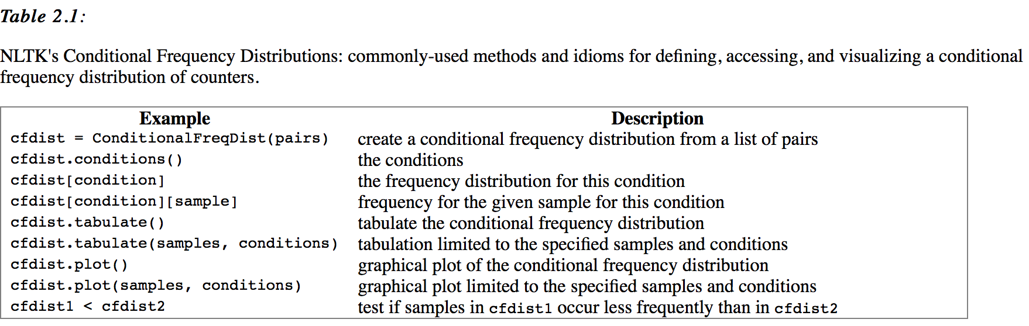
nltk.ConditionalFreqDist()

Slide 12
NLTK Book: Chapter 2
File: nwords.py
def next_word(w):
return choice([k for k in cfd[w].keys() for i in range(cfd[w][k])])
def nwords(n, w):
for i in range(n):
print(w, end=' ')
w = next_word(w)
print()
python -i nwords.py
>>> nwords(5, 'The')
The field , by two
>>> nwords(5, 'The')
The sons of many colours
>>> nwords(5, 'The')
The sons ' wives ,
>>> nwords(5, 'The')
The sons of Haran ;

Slide 13
NLTK Book: Chapter 2
def next_word(w):
return choice([k for k in cfd[w].keys() for i in range(cfd[w][k])])
Function explained:
>>> cfd['beginning']
FreqDist({'of': 2, ',': 1, '.': 1, 'God': 1})
>>> cfd['beginning'].keys()
dict_keys(['God', 'of', '.', ','])
>>> cfd['beginning']['God']
1
>>> cfd['beginning']['of']
2
>>> [k for k in cfd['beginning'].keys() for i in range(cfd['beginning'][k])]
['God', 'of', 'of', '.', ',']
random.choice(seq)
Return a random element from the non-empty sequence seq. If seq is empty, raises IndexError.
NB. Python 3.6 has a function called
choices()

Slide 14
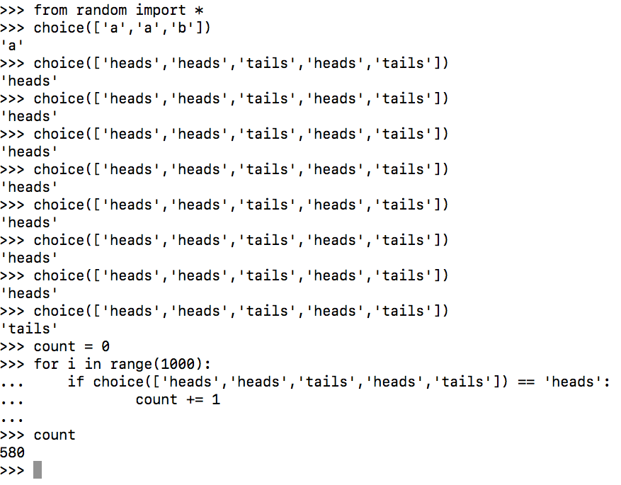
NLTK Book: Chapter 2
1000 trials:
  580 heads
Expected number of heads?
  600
  Since 3 out of 5 in ['heads','heads','tails','heads','tails'] are heads

Slide 15
NLTK Book: Chapter 2
def nwords(n, w):
for i in range(n):
print(w, end=' ')
w = next_word(w)
print()
>>> nwords(5,'The')
The purchase of the LORD
i in range(5) | w
0 | The
1 | purchase
2 | of
3 | the
4 | LORD

Slide 16
NLTK Book: Chapter 2
def nwords2(n, w): # A more useful function returning a list of words
result = []
for i in range(n):
result.append(w)
w = next_word(w)
return result
Examples:
>>> nwords(8, 'The')
The children of Abram ' s cup into
>>> nwords2(8, 'The')
['The', 'sons', 'with', 'me', ',', 'for', 'yet', 'alive']
>>> nwords2(8, 'The')
['The', 'man', 'child', 'grew', ',', 'and', 'a', 'dream']

Slide 17
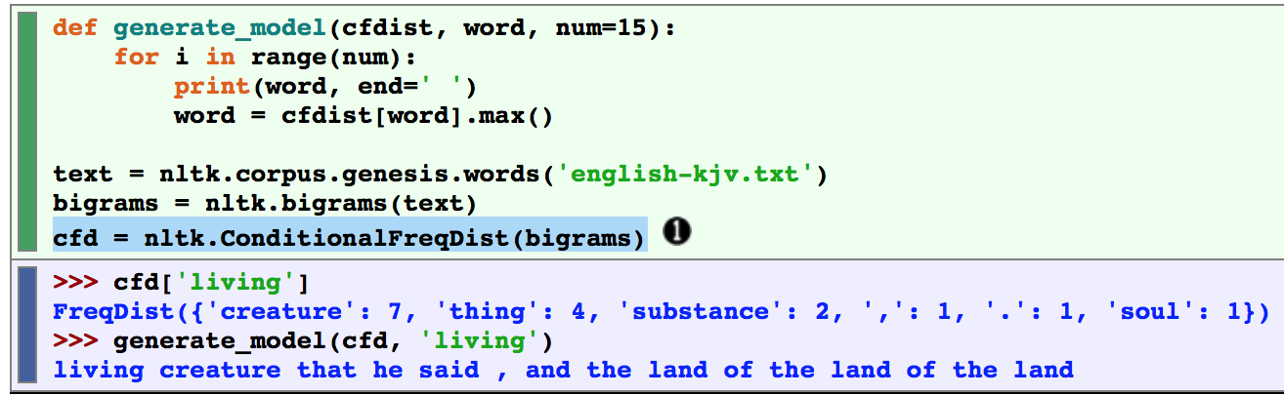
NLTK Book: Chapter 2
.max() is most frequent following word

Slide 18
Let's play with Oliver Twist by Charles Dickens
File: oliver_twist0-53.txt
>>> raw = open('oliver_twist0-53.txt', encoding='utf-8').read()
>>> words = nltk.word_tokenize(raw)
>>> len(words)
197947
>>> cfd = nltk.ConditionalFreqDist(nltk.bigrams(words))
>>> cfd
<ConditionalFreqDist with 12379 conditions>

Slide 19
Let's play with Oliver Twist by Charles Dickens
File: oliver_twist0-53.txt
>>> cfd['The']
FreqDist({'old': 35, 'Jew': 35, 'man': 25, 'girl': 25, 'boy': 18, 'two': 12, 'dog': 11, 'gentleman': 9, 'child': 8, 'young': 8, ...})
>>> cfd['the']
FreqDist({'Jew': 268, 'old': 201, 'girl': 173, 'door': 150, 'same': 136, 'boy': 122, 'other': 106, 'doctor': 103, 'young': 102, 'man': 100, ...})
nwords(20, 'The')

