Slide 1
408/508 Computational Techniques for Linguists
Lecture 22

Slide 2
Today's Topics
Homework 9 okay?
That was installing Python 3
Homework 10 today:
install nltk (natural language toolkit)
see nltk.org install

Slide 3
Today's Topics
More on Python:
range()
example of use in calculating compound interest
print('format string'.format())
formatted printing
type coercion:
converting numbers and strings
def
defining functions
strings and lists
sys.arg
command line argument vector (ARGV)

Slide 4
Python: range()
range(): equivalent to producing a list of numbers (sequence)
range(n) [0, 1, .., n-1]
range(start,n) [start, start+1, .., n-1]
range(start,n,step) [start, start+step,…, last]
last: start + k * step < n
range(n,stop,-step) counts down to stop
note: excludes n!
range(Start, End, Step) (integers only!)
>>> range(1,10,2)
range(1, 10, 2)
>>> list(range(1,10,2))
[1, 3, 5, 7, 9]
note: list() converts sequence into a list

Slide 5
Python: range()
python
>>> for odd in range(1,9,2):
... print(odd*odd)
...
1
9
25
49
>>> for odd in range(9,1,2):
... print(odd*odd)
...
>>> for odd in range(9,1,-2):
... print(odd*odd)
...
81
49
25
9
>>>
note: hit ENTER
note: 81 not printed!
note: 1 not printed!

Slide 6
Python Program: using range()
File: futval.py
float() converts string to a floating
point number
can use int() to convert to dollars.
How about to 2 decimal places?

Slide 7
Python numbers
explicit type coercion:
float()
int()
long()
64 bit integer: not in Python 3
complex(real,imaginary)
a complex number out of two floating point numbers
complex(string)
e.g. complex('0+1j')
str(number)

Slide 8
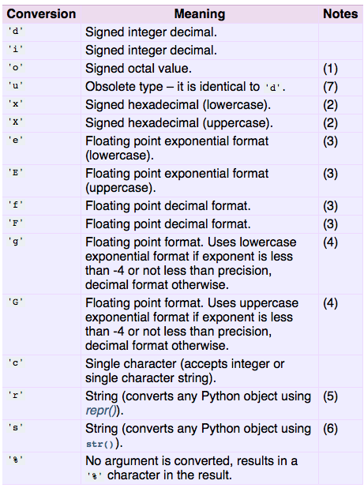
Formatted Output
Lots of ways: (old way in Python)
Notation comes originally from C's printf function
printf also is a Bash shell command
http://www.tutorialspoint.com/c_standard_library/c_function_sprintf.htm

Slide 9
Formatted Output
%<width>.<precision><type>
<type> = d, f, s
<width> = minimum number of characters; right-justified by default, -width => left-justified 0 = as wide as needed
<precision> = number of places after decimal point
e.g. 02d two digits wide, pad with 0 if needed

Slide 10
Formatted Output
Newer way:
https://docs.python.org/2/tutorial/inputoutput.html#fancier-output-formatting
Use {} for each argument
(can be numbered, e.g. {0}, {1},… or referenced by keyword {x})
{:width}
Note: use parentheses () for print in Python3

Slide 11
Formatted Output
Let's modify futval.py:
$ python futval2.py
This program calculates the future value of a 10 year investment.
Enter initial principal: 1000
Enter annual interest rate, e.g. 0.03 (3%): 0.05
Value in 10 years is: 1628.89
$

Slide 12
function my_range
def defines a function
my_range uses yield to compute a general range on the fly.
>>> def my_range(start, end, step):
... while start <= end:
... yield start
... start += step
...
>>> my_range(0,9.9,0.3)
<generator object my_range at 0x103533580>
>>> list(my_range(0,9.9,0.3))
[0, 0.3, 0.6, 0.8999999999999999, 1.2, 1.5, 1.8, 2.1, 2.4, 2.6999999999999997, 2.9999999999999996, 3.2999999999999994, 3.599999999999999, 3.899999999999999, 4.199999999999999, 4.499999999999999, 4.799999999999999, 5.099999999999999, 5.399999999999999, 5.699999999999998, 5.999999999999998, 6.299999999999998, 6.599999999999998, 6.899999999999998, 7.1999999999999975, 7.499999999999997, 7.799999999999997, 8.099999999999998, 8.399999999999999, 8.7, 9.0, 9.3, 9.600000000000001]
use TAB key to indent
hit RETURN here

Slide 13
Python
https://docs.python.org/3/tutorial/introduction.html
Numbers
Strings
Lists
Dictionaries

Slide 14
Python: Strings

Slide 15
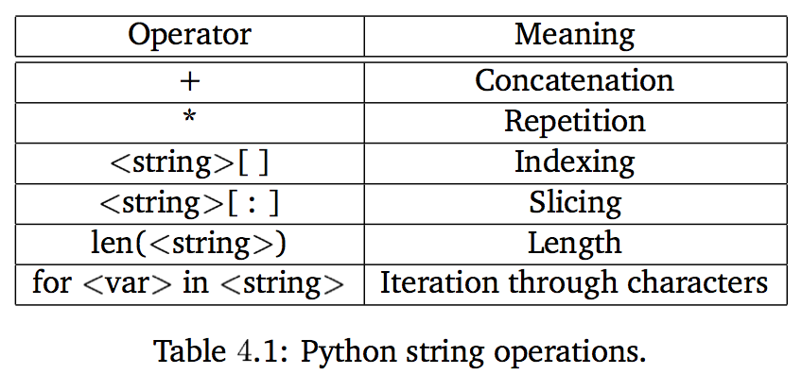
String slicing
String is like an array of characters (strings):
str[i] index i (from 0 to len(str)-1)
str[-i] index i from the end (1 = last)
str[i:j] slice from index i until index j-1
str[:j] slice from index 0 until index j-1
str[i:] slice from index i until end of the string

Slide 16
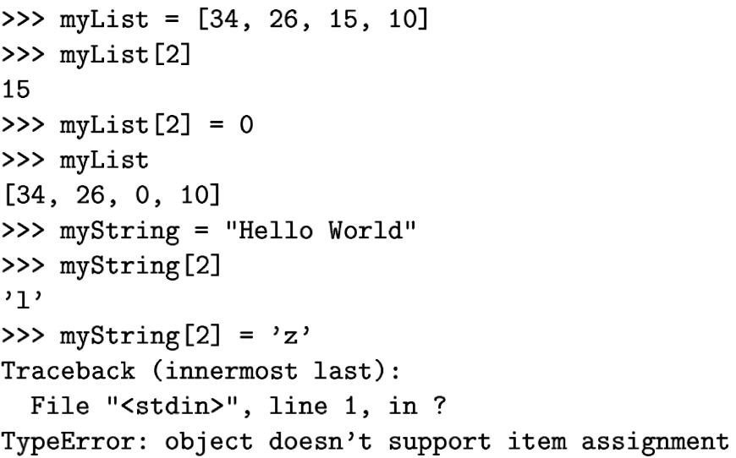
List vs. Strings
Although Strings are like Lists, Lists are mutable, Strings are not.
changed!
not mutable!

Slide 17
Python sys.argv
List of arguments from the command line: what's argv[0] then?
can use len() to calculate number of arguments
test.py
argv[1] and argv[2] ignored

Slide 18
Formatted Output
Let's modify futval.py to accept arguments on the command line or via prompts:
$ python futval3.py 1000 0.05
This program calculates the future value of a 10 year investment.
Value in 10 years is: 1628.89
$ python futval3.py 1000
This program calculates the future value of a 10 year investment.
Enter annual interest rate: 0.06
Value in 10 years is: 1790.85
$ python futval3.py
This program calculates the future value of a 10 year investment.
Enter initial principal: 1000
Enter annual interest rate: 0.07
Value in 10 years is: 1967.15

Slide 19
Homework 10
No need to submit
But if you run into trouble, email me!

Slide 20
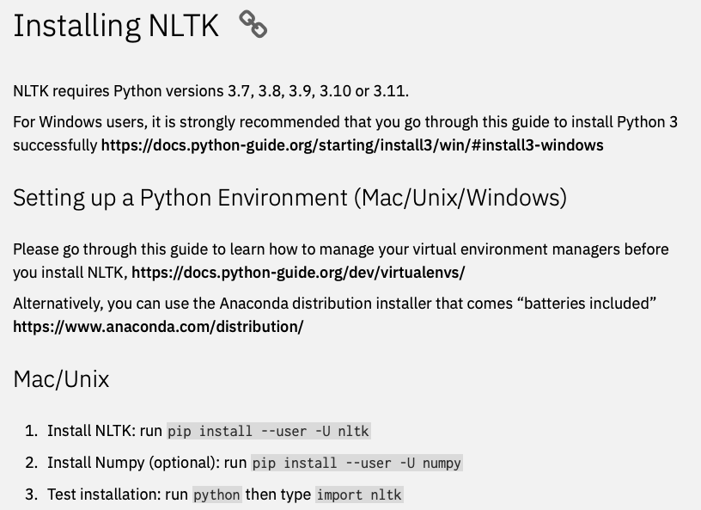
nltk.org
https://www.nltk.org/install.html

Slide 21
Get-Command

Slide 22
pip on Windows

Slide 23
nltk on Windows

Slide 24
install nltk data (select all)

Slide 25
nltk data installed

Slide 26
nltk data in WSL

