Slide 1
408/508 Computational Techniques for Linguists
Lecture 16

Slide 2
Today's Topic
BMI Gauge animated display example
using <form> elements
using <table>
using Javascript to compute BMI value
using the gaugeSVG.js widget to display the BMI value
Homework 7:
use the Gauge!

Slide 3
BMI: <form>… </form>
"weight"
"height"
"units"
"output" is (currently) an empty division
File: bmi-js.html

Slide 4
BMI: Javascript function computeBMI()
File: bmi-js.html
e.form.weight.value
e.form.height.value
e.form.units[0].checked
0 = 1st radio button
computeBMI(this)

Slide 5
BMI: gaugeSVG.js
http://www.codeproject.com/Articles/604502/A-universal-gauge-for-your-web-dashboard
bmi-gauge.html
Download gaugeSVG.js from the course webpage
(I've modified the original code a bit)

Slide 6
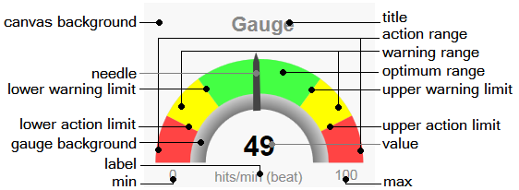
BMI: gaugeSVG.js
Note: I've modified his code slightly to allow for different colors for lower and upper warning ranges

Slide 7
BMI: gaugeSVG.js

Slide 8
BMI: gaugeSVG.js

Slide 9
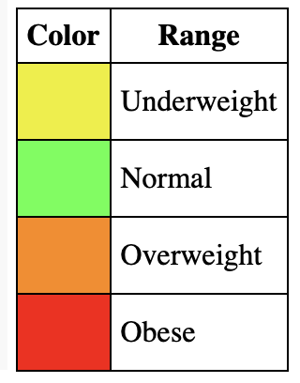
BMI: <table>… </table>
<table>

Slide 10
BMI: new GaugeSVG()

Slide 11
BMI: new GaugeSVG()
25 (upperWarningLimit)
(lowerWarningLimit)
18.5
To set the value:
gauge.refresh(bmi, true);
30 (upperActionLimit)
""
see animation? true|false

Slide 12
bmi-gauge.html

Slide 13
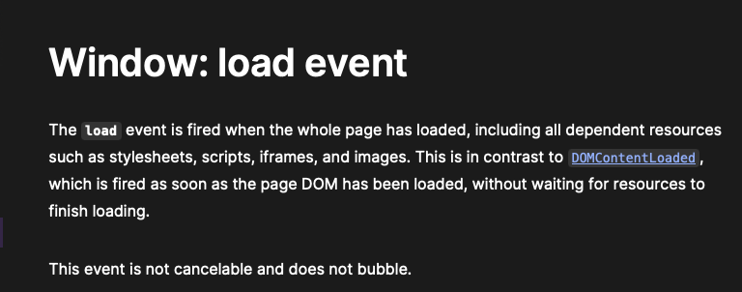
window.onload()
https://developer.mozilla.org/en-US/docs/Web/API/Window/load_event

Slide 14
JustGage
gaugeSVG author cites JustGage as inspiration.
https://toorshia.github.io/justgage/

Slide 15
Raphaël Javascript graphics library
https://dmitrybaranovskiy.github.io/raphael/

Slide 16
JustGage
copy raphael-2.1.4.min.js and justgage.js into the current directory where you have your .html file
inside directory examples, there is a simple file counter.html
I've modified it slightly to refer to the .js files for the same directory
and simplified the code

Slide 17
counter.html

Slide 18
JustGage
justgage.js

Slide 19
Homework 7
Example:

Slide 20
Homework 7
Use either the gaugeSVG.js or the JustGage widget
Write a html page that generates 100 random whole numbers between 1,2,…,12 when a button is clicked
Hint: recall tic-tac-toe code Math.floor(Math.random()*n)+1
Displays 3 gauges that counts the total number for ranges 1-4, 5-8, 9-12
Hint: use three totals, one for each range, each a variable initialized to 0.
refresh the appropriate gauge when its total is incremented

Slide 21
DOMContentLoaded
https://developer.mozilla.org/en-US/docs/Web/API/Document/DOMContentLoaded_event

Slide 22
Homework 7
Email to me
Subject: 408/508 Homework 7 YOUR NAME
Due date: Sunday midnight
A PDF file (showing screenshots)
Attachment: your .html file so I can test it

