Slide 1
408/508 Computational Techniques for Linguists
Lecture 13

Slide 2
Today's Topics
Javascript console
interactive: a bit like the Terminal/Bash shell
Introduction to Javascript, the browser programming language
Tic-tac-toe example
Files: sample.html, sample2.html and sample3.html
on course webpage

Slide 3
Javascript (JS)
Javascript:
invented in 1995 as a browser programming language
not the same as Java (also appeared in 1995)
Javascript code goes in the .html file:
<script> .. </script>
<script src="filename.js"></script>
HTML element events:
onclick="js code"
onmouseover="js code"
onkeydown="js code"
Reference:
http://www.w3schools.com/jsref/dom_obj_event.asp
code snippets can be placed in
<head>..</head>
or
<body>..</body>

Slide 4
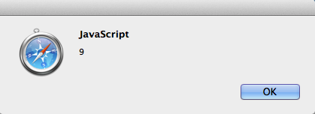
Javascript pop-up notification
For browser programming:
alert(string)
no print function
Example (from address bar):
instead of http: or https:
javascript:alert(4+5)
produces a pop-up
Changing the html document using Javascript:
document.write(string) overwrites html document
html_element.innerHTML = "string" modifies html_element

Slide 5
Javascript pop-up notification

Slide 6
Javascript Console

Slide 7
Javascript Console: Chrome

Slide 8
console.log(object)
From Javascript code or the address bar (using javascript:console.log(object)) or the console directly:
undefined is the result, as console.log() does not return a value

Slide 9
Javascript Console
Suppose we have a file sample.html loaded (see course website)
Show Javascript Console
Changing the html document:
document.write(string)
overwrites html document
html_element.innerHTML = "string"
modifies html_element

Slide 10
Javascript Console

Slide 11
Javascript Console
Changing the html document: document.write(string)
overwrites html document

Slide 12
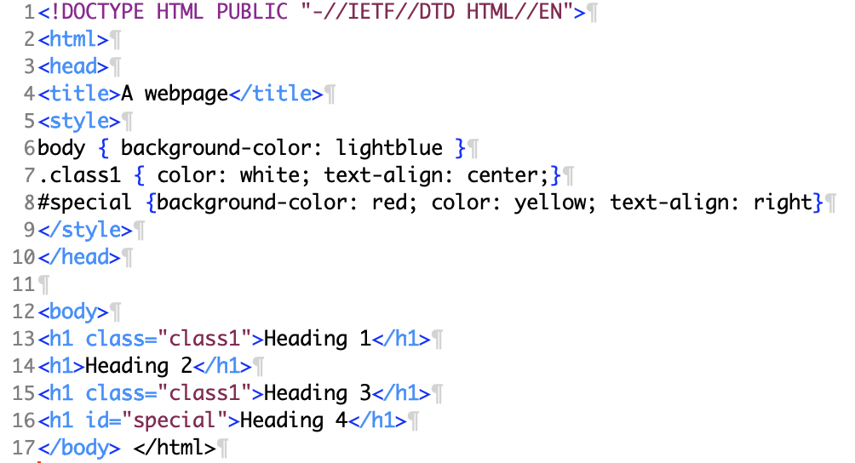
Javascript Console
Unique id attribute:
id="special"

Slide 13
Javascript Console
html_element.innerHTML = "string"

Slide 14
Javascript Console
DOM (Domain Object Model): document.getElementById(ID)

Slide 15
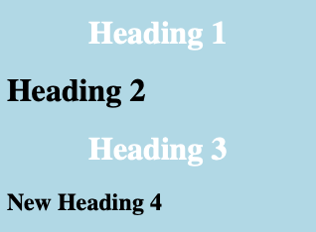
Javascript Console
Suppose you want to change Heading 4 with tag h1 to tag h2?
but you can't change the tag of an existing element
What you can do is create a new tag and replace the child of the parent element:

Slide 16
Javascript Console
Documented here:
https://developer.mozilla.org/en-US/docs/Web/API/Node/replaceChild

Slide 17
Tic Tac Toe: sample2.html
<table>
<tr>
<td id="1" style="border-right: 1px solid black; border-bottom: 1px solid black"></td>
<td id="2" style="border-bottom: 1px solid black"></td>
<td id="3" style="border-left: 1px solid black; border-bottom: 1px solid black"></td>
</tr>
<tr>
<td id="4" style="border-right: 1px solid black"></td>
<td id="5"></td>
<td id="6" style="border-left: 1px solid black"></td>
</tr>
<tr>
<td id="7" style="border-right: 1px solid black; border-top: 1px solid black"></td>
<td id="8" style="border-top: 1px solid black"></td>
<td id="9" style="border-left: 1px solid black; border-top: 1px solid black" ></td>
</tr>
</table>
1
2
3
9

Slide 18
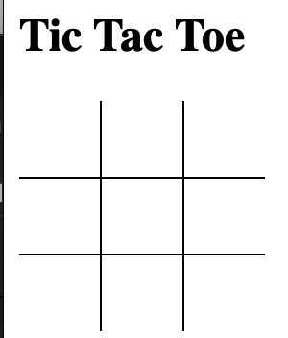
Tic Tac Toe: sample2.html
CSS:
<style>
table {
border-collapse: collapse;
}
td {
height: 40px; width: 40px
}
</style>
collapse:
removes the tiny gap between cells, see below:

Slide 19
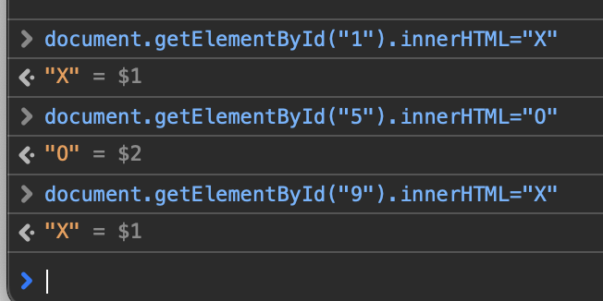
Javascript Console
Suppose we have sample2.html loaded
Show Javascript Console
Changing the html document:
html_element.innerHTML = "string"
modifies html_element
DOM:
document.getElementById(ID)
Let's play tic tac toe!

Slide 20
Javascript Console
Notice td cell text are left aligned (by default)
CSS property:
text-align: center
https://developer.mozilla.org/en-US/docs/Web/CSS/text-align
vertical-align: top|middle|bottom
https://developer.mozilla.org/en-US/docs/Web/CSS/vertical-align

Slide 21
Javascript: Variables
Declared variables:
var x = 9; // number variable
var name = "String"; // string variable
Note: names are case sensitive, no $ like the bash shell, // for in-line comments
function local variables:
function f() {
var x = 99;
}
Not declared:
i.e. just used without declaration
treated as a global variable
Strict: prevents use of undeclared variables etc.
"use strict"; quotes for backwards compatibility with older versions
Comments:
// until the end of the line
/* … */ multiline (same as CSS)

Slide 22
Javascript: Numbers
http://www.w3schools.com/js/js_numbers.asp
Recall the discussion at the beginning of the semester about number representation?
Integers are considered accurate up to 15 digits.

Slide 23
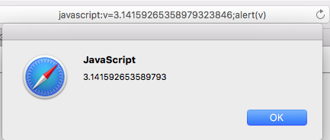
Javascript: Numbers
Pi to 20 decimal places
3.14159 26535 89793 23846
3.14159 26535 89793 (Javascript)

Slide 24
Javascript: Miscellaneous
Generate a random number in range [0,n-1]:
Math.floor(Math.random()*n)

Slide 25
Tic Tac Toe Revisited
File: sample3.html

