Slide 1
LING 388: Computers and Language
Lecture 8

Slide 2
Today's Topics
Did you manage to install nltk and nltk_data?
A note on python -m
Let's do a few exercises today in class:
alice.txt: string to words, counting, averages.
looking at the full text from nltk.corpus.gutenberg
nltk.FreqDist(corpus)
set = vocabulary
open() and .read() for files

Slide 3
A note on: python –m module

Slide 4
Project Gutenberg https://www.gutenberg.org

Slide 5
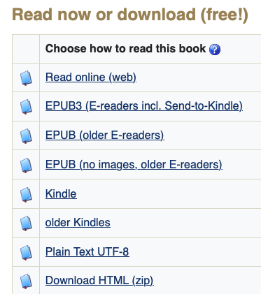
Project Gutenberg
https://www.gutenberg.org/ebooks/11
this!

Slide 6
Exercise 1
File:
alice.txt
Excerpt from Alice's Adventures in Wonderland by Lewis Carroll

Slide 7
Exercise 1
Open in a text editor the file alice.txt
Select, copy and past the text into Python as follows:
text = '''<here>'''
(triple quotes permit a multiline string)
<here>

Slide 8
Exercise 1
type ''' (3 quotes) after Paste
Hit <RETURN>

Slide 9
Exercise 1
4 questions:
len(text) counts what?
What does text.split() do?
Store the result of split into a variable text2
len(text2) counts what?
Calculate the average number of characters per word.
(note: len() works on both words – List and word - String.)
Rough answer: 5.3 (overestimate, why?)
Use a for-loop over text2 to add up the number of characters in the words. Use this total to compute the average number of characters per word.
Use a loop comprehension over text2 and mean() from (import) statistics to compute the average number of characters per word. Compare it with (5).

Slide 10
Exercise 1
Question 5, given a list:
for-loop method
chars = 0
for word in list:
chars += len(word)
chars / len(list)
list comprehension method (builds a list)
wlen = [len(word) for word in list]
from statistics import mean
mean(wlen)

Slide 11
Exercise 2
The full text of "Alice's Adventures in Wonderland" is available in nltk_data.
Example:
>>> import nltk
>>> alice = nltk.corpus.gutenberg.words('carroll-alice.txt')
>>> len(alice)
34110
>>> alice[:100]
['[', 'Alice', "'", 's', 'Adventures', 'in', 'Wonderland', 'by', 'Lewis', 'Carroll', '1865', ']', 'CHAPTER', 'I', '.', 'Down', 'the', 'Rabbit', '-', 'Hole', 'Alice', 'was', 'beginning', 'to', 'get', 'very', 'tired', 'of', 'sitting', 'by', 'her', 'sister', 'on', 'the', 'bank', ',', 'and', 'of', 'having', 'nothing', 'to', 'do', ':', 'once', 'or', 'twice', 'she', 'had', 'peeped', 'into', 'the', 'book', 'her', 'sister', 'was', 'reading', ',', 'but', 'it', 'had', 'no', 'pictures', 'or', 'conversations', 'in', 'it', ',', "'", 'and', 'what', 'is', 'the', 'use', 'of', 'a', 'book', ",'", 'thought', 'Alice', "'", 'without', 'pictures', 'or', 'conversation', "?'", 'So', 'she', 'was', 'considering', 'in', 'her', 'own', 'mind', '(', 'as', 'well', 'as', 'she', 'could', ',']
Note: .words() already tokenized the text

Slide 12
Exercise 2
Calculate the average number of characters per word of the entire book.
Compare your answer to Exercise 1
do seven paragraphs make a good approximation?

Slide 13
nltk.FreqDist()
https://www.nltk.org/api/nltk.probability.FreqDist.html

Slide 14
Exercise 3
word length distribution:
let wlen be a list of numbers, each representing the word length in characters. Then:
>>> fd = nltk.FreqDist(wlen)
>>> fd
FreqDist({3: 7205, 1: 7093, 4: 5793, 2: 5647, 5: 3340, 6: 1952, 7: 1571, 8: 723, 9: 447, 10: 181, ...})
>>> fd.plot()
<AxesSubplot:xlabel='Samples', ylabel='Counts'>

Slide 15
Python Sets
in – list/set membership
not in – not a member of
set(List) - produces a set, no duplicates permitted
set is faster than list for lookup (hashtable)

Slide 16
Exercise 4
word length distribution for the vocab of Alice (using set)
>>> vocab = set(alice)
>>> vwlen = [len(word) for word in vocab]
>>> vfd = nltk.FreqDist(vwlen)
>>> vfd
FreqDist({4: 529, 5: 502, 6: 490, 7: 447, 8: 309, 3: 263, 9: 185, 2: 103, 10: 90, 11: 36, ...})
>>> vfd.plot(percents=True)
<AxesSubplot:xlabel='Samples', ylabel='Percents'>
https://www.nltk.org/api/nltk.probability.html

Slide 17
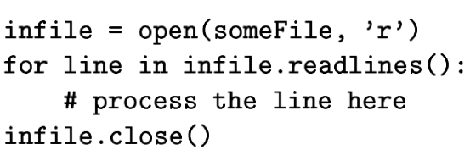
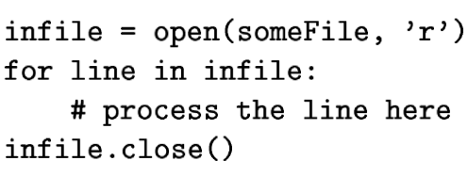
Python: Files
Like all other programming languages, uses a file handle, called file variable: open()
infile = open("file.txt","r")
outfile = open("results.txt","w")
for-loop

Slide 18
Python: Files
Python 2.7
open() and text encoding:
f = open(fname)
f = open(fname, encoding="utf-8")
f = open(fname, encoding="latin-1")
f = open(fname, encoding="ascii")
Removing the newline included with filevar.read():
line.strip()
line.rstrip()
line.lstrip()

Slide 19
Exercise 5
Recall Exercise 1.
Let's use open() and .read() to put the text of alice.txt into a variable text.

