Slide 1
LING 388: Computers and Language
Lecture 5

Slide 2
Today's Topic
Python
numbers
strings
coercion: converting between different types of numbers and strings
Homework 4

Slide 3
Python: Numbers
At the interpreter:
$ python3
Python 3.9.12 (main, Jun 1 2022, 06:34:44)
[Clang 12.0.0 ] :: Anaconda, Inc. on darwin
Type "help", "copyright", "credits" or "license" for more information.
>>> 4+5
9
>>> math.pi
Traceback (most recent call last):
File "<stdin>", line 1, in <module>
NameError: name 'math' is not defined
>>> import math
>>> math.pi
3.141592653589793
>>> math.sin(math.pi/2)
1.0
>>>
64-bit double precision, with an approximate absolute normalized range of 0 and 10⁻³⁰⁸ to 10³⁰⁸ and with a precision of about 16 decimal digits
3.1415 92653 58979 3
π ≈ 3.14159 26535 89793 23846 26433

Slide 4
Python: Numbers
type: built-in function
arithmetic operators:
>>> type(2*3-1)
<class 'int'>
>>> type(math.pi)
<class 'float'>
>>> import sys
>>> sys.maxsize
9223372036854775807
>>> type(sys.maxsize)
<class 'int'>
>>> type(sys.maxsize+1)
<class 'int'>
>>> sys.int_info
sys.int_info(bits_per_digit=30, sizeof_digit=4)
math.log(sys.maxsize)/math.log(2)
63.0 (bits)

Slide 5
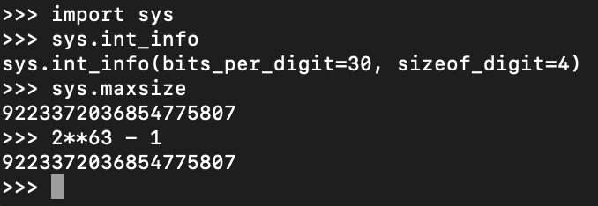
Python integers
Python 3: int can go to any size (limited by available memory):

Slide 6
Python: Numbers
import math
math.pi

Slide 7
Python: complex numbers
Example:
sqrt is the square root function, e.g. sqrt(4)=2, sqrt(9)=3 etc.
>>> math.sqrt(-1)
Traceback (most recent call last):
File "<stdin>", line 1, in <module>
ValueError: math domain error
Complex number library:
https://docs.python.org/3/library/cmath.html
i is j in Python
>>> import cmath
>>> cmath.sqrt(-1)
1j
>>> i = cmath.sqrt(-1)
>>> i*i
(-1+0j)

Slide 8
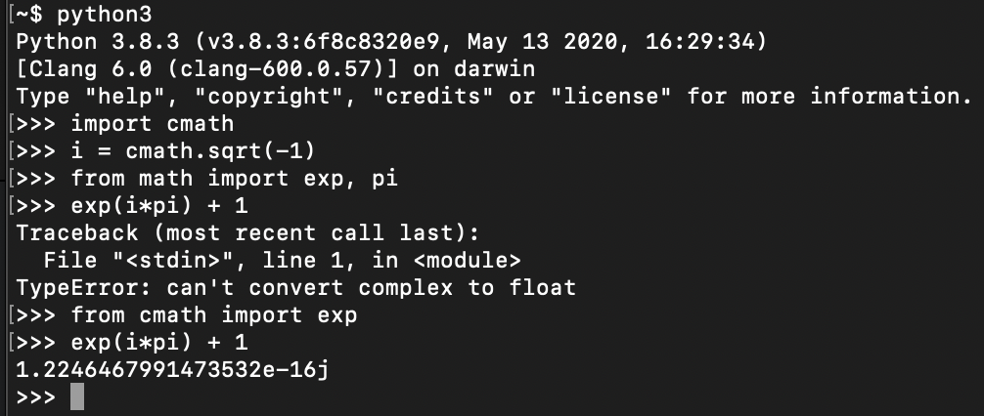
Python: complex numbers
Euler’s Identity:
https://en.wikipedia.org/wiki/Euler%27s_identity

Slide 9
Python: Strings

Slide 10
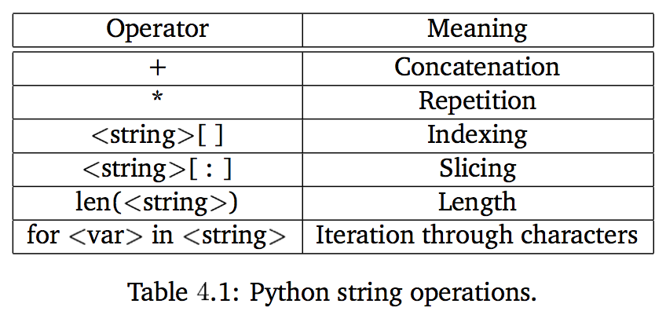
String indexing and slicing
String is like an array of characters (strings):
str[i] index i (from 0 to len(str)-1)
str[-i] index i from the end (1 = last)
str[i:j] slice from index i until index j-1
str[:j] slice from index 0 until index j-1
str[i:] slice from index i until end of the string

Slide 11
Python numbers and strings
Explicit type coercion functions:
float()
int()
long()
64 bit integer: not in Python 3
complex(real,imaginary)
a complex number out of two floating point numbers
complex(string)
e.g. complex('0+1j')
str(number)

Slide 12
Homework 4
Look up the Python function ord()
See also reference slide (next slide) presented before for other relevant functions
Compute the hexadecimal representation of the UTF-8 encoding of your first name. Put the hex characters together. Show your work.
Example: John is 4a6f686e in hex
What is the decimal and binary representation of your answer to Q1?
Example: 0x4a6f686e is 1248815214 is 0b1001010011011110110100001101110

Slide 13
Homework 4
Let's flip the bits in your name. We can use the XOR operator (^) to do this as follows. 0 ^ 1 = 1, 1 ^ 1 = 0. Convert the number back to hexadecimal.
Example:
0x4a6f686e ^ 0xffffffff is 3046152081
hex(0x4a6f686e ^ 0xffffffff) is'0xb5909791'
(note: 8 f's in 0xffffffff because we match the number of hex digits in 4a6f686e)
or John has 4 characters, each character has 2 hex digits (1 byte), total is 8.

Slide 14
Homework 4
Look up each pair of hex digits (i.e. byte) using function chr() to find your flipped name.
See also https://www.charset.org/utf-8
Example:
b5909791 is b5 90 97 91. And chr(0xb5) is 'µ'.
John flipped is µ\x90\x97\x91 printable part is just µ
\x90 etc. are not utf-8 (i.e. not a valid character)
But JOHN flipped is more interesting: µ°·±
(so I recommend starting with your name in uppercase)

Slide 15
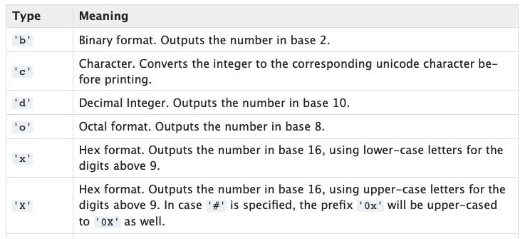
Python: number systems
$ python
Python 3.9.12 (main, Jun 1 2022, 06:34:44)
[Clang 12.0.0 ] :: Anaconda, Inc. on darwin
Type "help", "copyright", "credits" or "license" for more information.
>>> bin(91)
'0b1011011'
>>> hex(91)
'0x5b'
>>> 0b1011011
91
>>> oct(91)
'0o133'
>>>

Slide 16
Homework 4
Submit to sandiway@arizona.edu
SUBJECT: 388 Homework 4 YOUR NAME
One PDF file only
include Python terminal screenshots in your answer
Deadline:
midnight Monday
we will review the homework on Tuesday

