Slide 1
LING 388: Computers and Language
Lecture 4

Slide 2
Today's Lecture
Homework 3 Review
Continuing on with computer representations
integer and floating point numbers
characters: letters, numerals, punctuation, etc.
ASCII, Unicode, UTF-8
Unicode Transformation Format – 8-bit
Python understands UTF-8 strings

Slide 3
Homework 3
At the Python prompt >>>
recall 0b is the prefix for binary, e.g. 0b1011011, 0x is for hexadecimal.
Q1: compute binary multiplication (*)
>>> 0b1111 * 0b11
45
What is the answer in binary?
>>> bin(45)
'0b101101'
>>> bin(0b1111 * 0b11)
'0b101101'

Slide 4
Homework 3
At the Python prompt >>>
recall 0b is the prefix for binary, e.g. 0b1011011, 0x is for hexadecimal.
Q2: divide (/) binary 10001010 by hex 17
What answer do you get?
>>> 0b10001010 / 0x17
6.0
Can you explain why the answer might be a bit surprising?
6

Slide 5
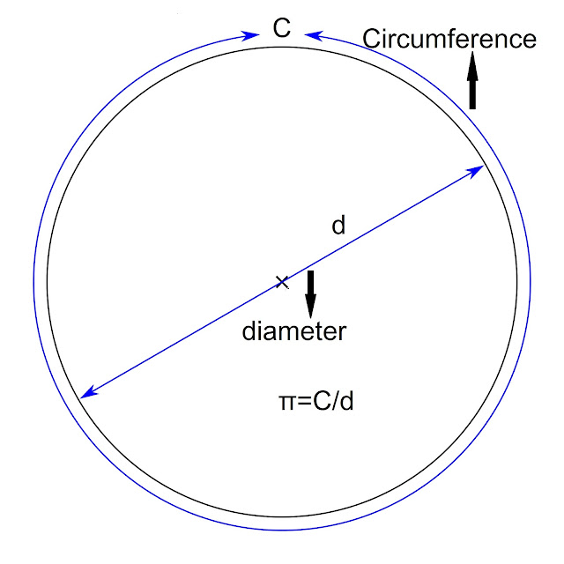
Homework 3
venkatsps.blogspot.com/
Q3: compute (the decimal)
>>> 37535589513263342053361 / 11947949225808341100193
3.141592653589793
Does the answer remind you of a famous number?
π ≈ 3.14159 26535 89793 23846 26433 83279 50288 41971 69399 37510
(50 decimal places)
Now, multiply your answer by 11947949225808341100193
Do you get the original number back?
3.7535589513263342e+22
Arbitrary precision calculator (bc):
$ bc
>>> scale = 50
>>> 37535589513263342053361 / 11947949225808341100193
3.14159 26535 89793 23846 26433 83279 50288 41971 69398 17861

Slide 6
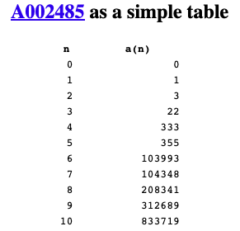
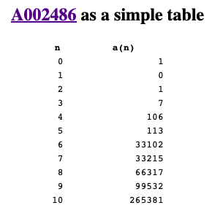
Homework 3
https://mathworld.wolfram.com/PiApproximations.html

Slide 7
Introduction: data types
Integers (2’s complement representation)
In one byte (= 8 bits), what’s the largest and smallest number, we can represent?
00000000 = 0
01111111 = 127
10000000 = -128
11111111 = -1
Number line:
0 | … |  |  |  |  |  | 127 | -128 | -127 |  |  |  |  |  | -1
00000000
(all zeros)
11111111
(all ones)

Slide 8
Introduction: data types
Typically 32 bits (4 bytes) are used to store an integer
range: -2,147,483,648 (2⁽³¹⁻¹⁾ -1) to 2,147,483,647 (2⁽³²⁻¹⁾ -1)
what if you want to store even larger numbers?
Binary Coded Decimal (BCD)
code each decimal digit separately, use a string (sequence) of decimal digits …
2³¹ | 2³⁰ | 2²⁹ | 2²⁸ | 2²⁷ | 2²⁶ | 2²⁵ | 2²⁴ | … |  | … | 2⁷ | 2⁶ | 2⁵ | 2⁴ | 2³ | 2² | 2¹ | 2⁰
byte 3 | byte 2 | byte 1 | byte 0
C:
int

Slide 9
Introduction: data types
what if you want to store even larger numbers?
Binary Coded Decimal (BCD)
1 byte can code two digits (0-9 requires 4 bits)
1 nibble (4 bits) codes the sign (+/-), e.g. hex C/D
2³ | 2² | 2¹ | 2⁰
0 | 0 | 0 | 0
0
2 | 0 | 2 | 4
2 bytes (= 4 nibbles)
2³ | 2² | 2¹ | 2⁰
0 | 0 | 0 | 1
1
+ | 2 | 0 | 2 | 4
2.5 bytes (= 5 nibbles)
2³ | 2² | 2¹ | 2⁰
1 | 0 | 0 | 1
9
credit (+)
debit (-)
2³ | 2² | 2¹ | 2⁰
1 | 1 | 0 | 0
C
2³ | 2² | 2¹ | 2⁰
1 | 1 | 0 | 1
D

Slide 10
Introduction: data types
e.g. probabilities
Typically, 64 bits (8 bytes) are used to represent floating point numbers (double precision)
c = 2.99792458 x 10⁸ (m/s)
coefficient: 52 bits (implied 1, therefore treat as 53)
exponent: 11 bits (usually not 2’s complement, unsigned with bias 2⁽¹⁰⁻¹⁾-1 = 511)
sign: 1 bit (+/-)
C:
float
double
wikipedia

Slide 11
Introduction: data types
modern x86 CPUs have a built-in
floating point coprocessor (x87)
80 bit long registers
The Intel 8087, announced in 1980, was the first floating-point coprocessor for the 8086 line of microprocessors.
The performance enhancements were from approximately 20% to over 500%, depending on the specific application.

Slide 12
New Topic
Enough about numbers for now.
How about language data, i.e. characters we type?

Slide 13
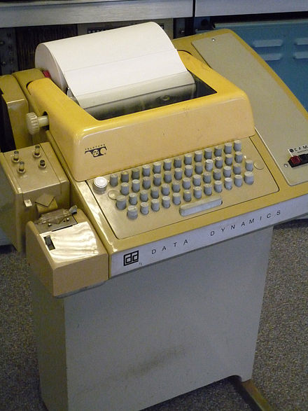
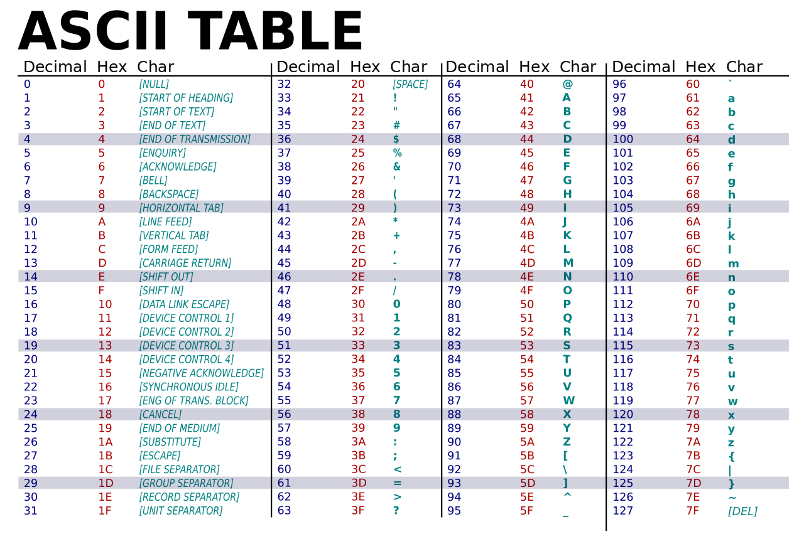
Introduction: data types
C:
char
How about letters, punctuation, etc.?
ASCII
American Standard Code for Information Interchange
Based on English alphabet (upper and lower case) + space + digits + punctuation + control (Teletype Model 33)
Question: how many bits do we need?
7 bits + 1 bit parity
Remember everything is in binary …
Teletype Model 33 ASR
Teleprinter (Wikipedia)

Slide 14
Introduction: data types
order is important in sorting!
0-9: there’s a connection with BCD. Notice: code 30 (hex) through 39 (hex)

Slide 15
Unicode
https://home.unicode.org

Slide 16
Unicode
https://www.unicode.org/versions/Unicode13.0.0/UnicodeStandard-13.0.pdf

Slide 17
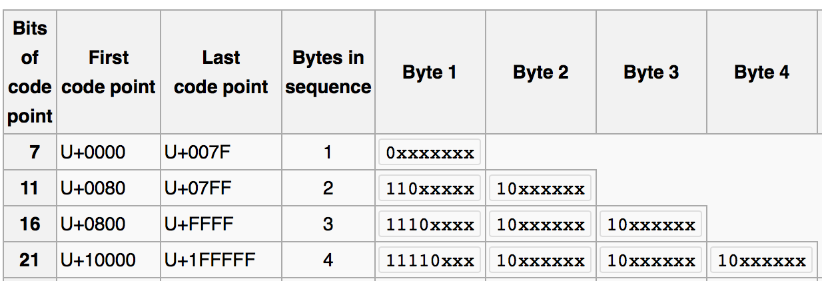
Introduction: data types
UTF-8
standard in the post-ASCII world
backwards compatible with ASCII
(previously, different languages had multi-byte character sets that clashed)
Universal Character Set (UCS) Transformation Format 8-bits
ASCII
(Wikipedia)

Slide 18
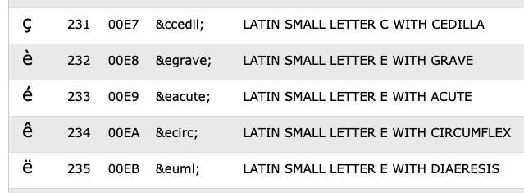
Introduction: data types
In your browser, which runs HTML5, UTF-8, is the default character encoding

Slide 19
On the Mac
ASCII
Latin-1 supplement

Slide 20
Introduction: data types

Slide 21
Introduction: data types
line 7: é typed on my mac keyboard using OPT-e e

Slide 22
Introduction: data types

Slide 23
Introduction: data types
Example:
あ Hiragana letter A: UTF-8: E38182
Byte 1: E = 1110, 3 = 0011
Byte 2: 8 = 1000, 1 = 0001
Byte 3: 8 = 1000, 2 = 0010
い Hiragana letter I: UTF-8: E38184
Shift-JIS (Hex):
あ: 82A0
い: 82A2

Slide 24
Introduction: data types
No <meta charset="UTF-8">
あ Hiragana letter A: UTF-8: E3 81 82
い Hiragana letter I: UTF-8: E3 81 84
Latin-1 character set (8 bits) https://kb.iu.edu/d/aepu

Slide 25
Maya Numerals
Maya numerals (base 20)
https://unicode.org/charts/PDF/U1D2E0.pdf

Slide 26
Introduction: data types

