Slide 1
LING 388: Computers and Language
Lecture 3

Slide 2
Today's Lecture
Quick Homework 2 review
Background:
Computer architecture
Binary, hexadecimal representations
Computers vs. human brain
Turing Machine
Python and numbers
Homework 3 (yes, we use Python!)

Slide 3
Quick Homework 2
Using Google N-grams
Question 1: foreign words
Look up pizza, sushi and taco
Which one came into the English language first? Are you surprised?

Slide 4
Quick Homework 2

Slide 5
Quick Homework 2
OED (Oxford English Dictionary)

Slide 6
Quick Homework 2
Using Google N-grams
Question 2: compounding
Look up toothpaste, tooth paste (two words: bigram), tooth-paste (hyphenated)
About how many years did it take toothpaste to overtake the other two forms?

Slide 7
Quick Homework 2

Slide 8
Quick Homework 2

Slide 9
Quick Homework 2: extra

Slide 10
Quick Homework 2: extra
https://www.etsy.com/listing/861168730/vintage-1937-listerine-toothpaste-ad

Slide 11
Quick Homework 2: extra

Slide 12
Quick Homework 2: extra
Looks like nothing… just a blip in the 1500s

Slide 13
Quick Homework 2: extra
Note, compounding never took hold, cf. toothpaste

Slide 14
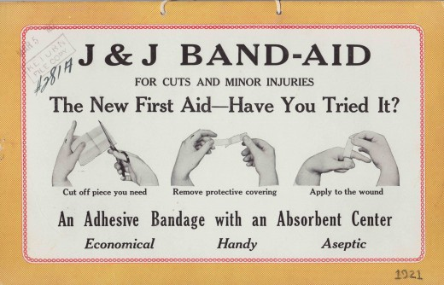
Band-Aid (Johnson & Johnson)

Slide 15
Adhesive Bandage

Slide 16
Introduction: computer architecture
Computers
Memory (several kinds)
Programs and data
CPU (Central Processing Unit)
Interprets machine instructions
GPU (Graphics Processing Unit)
graphics instructions (vertices, shading, etc.) to pixels
I/O (Input/Output)
keyboard, mouse, screen
bluetooth, usb, thunderbolt, wifi
Memory hierarchy:
CPU registers
L1/L2 cache
L3 cache
RAM (sometimes NUMA)
SSD/hard drive
blu ray/dvd/cd drive
(.iso file: fake cd)
LAN
Internet
fast
invisible to
programmers
direct access
FILES
slow

Slide 17
Introduction
1 byte (8 bits) wide
0
addressable
Memory
(RAM)
array
a[23]
= 24th item of array a
RAM memory (your program's view)
the area where your program and data are loaded into
Underlying representation
binary: zeros and ones (1 bit)
organized into bytes (8 bits) and nibbles (4 bits)
memory is byte-addressable
word (32 bits)
e.g. integer
(64 bits: floating point number)
big-endian/little-endian
most significant byte first or least significant byte first
matters for communication …
your Intel and ARM CPUs
addresses managed by your programming language /
operating system
hexadecimal (base 16) notation
FFFFFFFF

Slide 18
Joke
Continue with the introduction
binary representation (base 2) and arithmetic
2¹ | 2⁰ | Total (decimal)
1 | 0 | 2
10¹ | 10⁰ | Total
1 | 0 | 10

Slide 19
Other radix systems
Maya numerals (base 20)
https://en.wikipedia.org/wiki/Maya_numerals
12 x 400 = 4800
16 x 20 = 320
5
5 + 320 + 4800
We'll revisit these we when talk about Unicode!

Slide 20
Background
TDP 62W power (250W max?)
Apple M2 Ultra (134 billion transistors)
Human brain: 86 billion neurons¹
24 core CPU
76 core GPU
32 core Neural Engine
Memory (RAM)
192GB
20W of power (oft-cited figure)
16 x (192KB + 128KB) + 8 x (128KB + 64KB) L1 cache + 64MB L2 cache
96MB L3 cache
¹Herculano-Houzel, S. The Human Brain in Numbers: A Linearly Scaled-up Primate Brain . Frontiers in Human Neuroscience. 2009;3:31. doi:10.3389/neuro.09.031.2009.

Slide 21
Background
it was estimated that by the mid-1960s, half of the world's computers were 1401s.

Slide 22
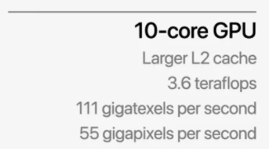
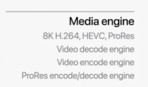
Introduction
A 8 core machine
Python

Slide 23
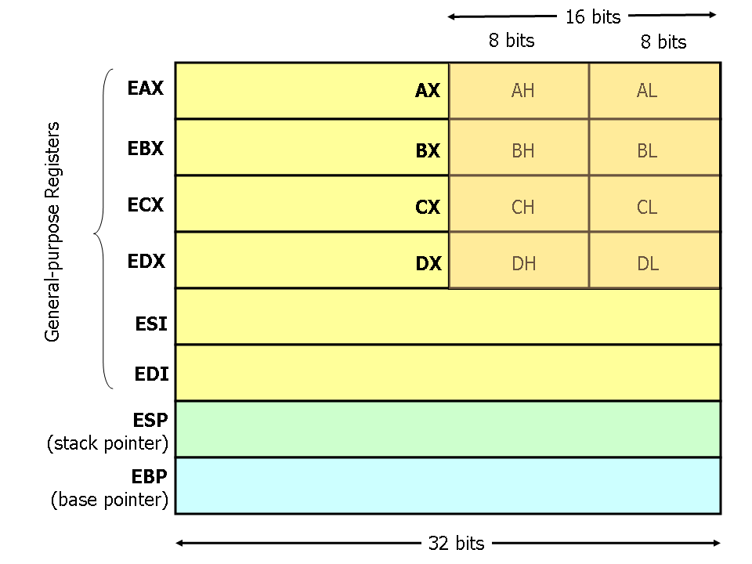
Introduction
Machine Language
A CPU understands only one language: machine language (Intel/AMD x86)
all other languages must be translated into machine language
Primitive instructions include:
MOV
PUSH
POP
ADD / SUB
INC / DEC
IMUL / IDIV
AND / OR / XOR / NOT
NEG
SHL / SHR
JMP
CMP
JE / JNE / JZ / JG / JGE / JL / JLE
CALL / RET
Assembly Language: (this notation)
by definition, nothing built on it is more powerful
http://www.cs.virginia.edu/~evans/cs216/guides/x86.html

Slide 24
Background
10 core CPU
8 + 2
Monolithic: all in one
Machine Language (ML)
A CPU understands only one language: machine language (ML), e.g. ARM64 or x86.
all other languages must be translated into ML
Each core is an independent CPU itself:
31 general purpose registers X0..X31
32 floating point/vector registers
SP (stack pointer)
Primitive instructions include:
ADD X0, X1, X2
MOV X0, #1
LDR X0, [<address>]
STRW X0, [<address>]
CBZ <Xn> <label> and CBNZ <Xn> <label>
BL <label> / RET
RAM
32 core GPU
cache (SLC)
https://developer.arm.com/documentation/ddi0602/2022-12/?lang=en

Slide 25
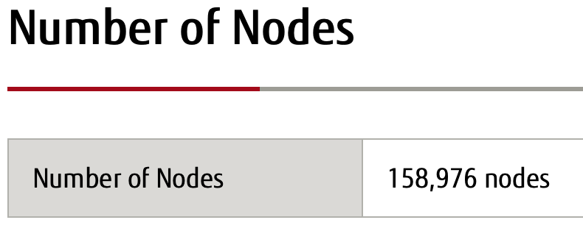
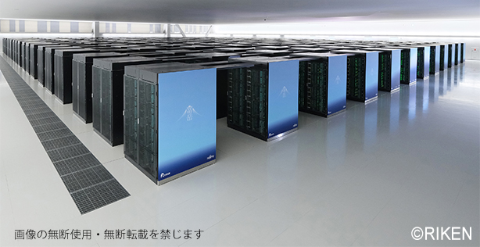
Fugaku supercomputer
World's fastest computer (using the ARM instruction set) until May 2022
Power consumption of 30 (to 40) megawatts (#1)
https://www.fujitsu.com/global/about/innovation/fugaku/

Slide 26
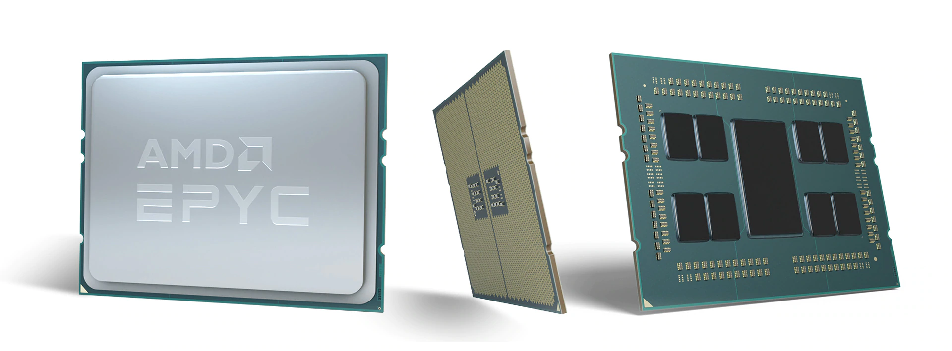
Supercomputers rely on parallelism
https://www.top500.org
each chip may have 64 cores each
Not all tasks are easily parallelizable.
Can you use 8 million cores?
e.g. analyze 8 million sentences at a time?

Slide 27
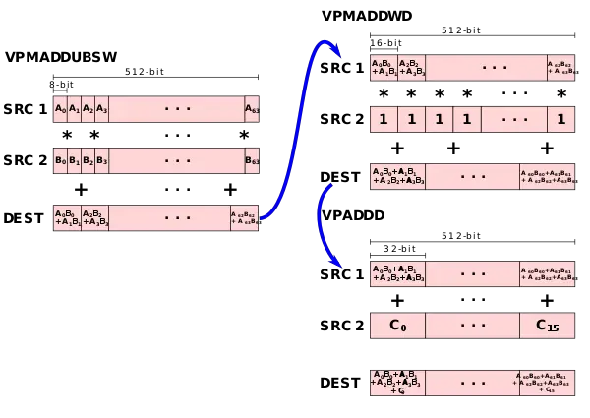
Vector Neural Net Instructions (VNNI)
3rd Generation Intel® Xeon® processor

Slide 28
Introduction
Not all machine instructions are conceptually necessary
many provided for speed/efficiency
Theoretical Computer Science
All mechanical computation can be carried out using a TURING MACHINE (a-machine; Turing, 1936)
Finite state table + (infinite) tape
Tape instructions:
at the tape head: Erase, Write, Move (Left/Right/NoMove)
Finite state table:
Current state x Tape symbol --> new state x New Tape symbol x Move

Slide 29
Introduction
tape head
0
1
http://www.thegreatbear.net/audio-tape-transfer/quarter-inch-reel-to-reel-transfer/

Slide 30
IBM 729 Magnetic Tape Unit
1950s through mid-1960s
a single 2400 ft tape could store 4,000,000 six-bit bytes
7 parallel tracks
6 data
1 parity
https://en.wikipedia.org/wiki/IBM_729

Slide 31
Introduction
Storage:
based on digital logic
binary (base 2) – everything is a power of 2
Byte: 8 bits
01011011
= 2⁶+2⁴+2³+2¹+2⁰
= 64 + 16 + 8 + 2 + 1
= 91 (in decimal)
Hexadecimal (base 16)
0-9,A,B,C,D,E,F (need 4 bits)
5B (= 1 byte)
= 5*16¹ + 11
= 80 + 11
= 91
2⁷ | 2⁶ | 2⁵ | 2⁴ | 2³ | 2² | 2¹ | 2⁰
2⁷ | 2⁶ | 2⁵ | 2⁴ | 2³ | 2² | 2¹ | 2⁰
0 | 1 | 0 | 1 | 1 | 0 | 1 | 1
2³ | 2² | 2¹ | 2⁰ | 2³ | 2² | 2¹ | 2⁰
0 | 1 | 0 | 1
2³ | 2² | 2¹ | 2⁰ | 2³ | 2² | 2¹ | 2⁰
2³ | 2² | 2¹ | 2⁰ | 2³ | 2² | 2¹ | 2⁰
0 | 1 | 0 | 1 | 1 | 0 | 1 | 1
5
B
16¹ | 16⁰
5 | B
16¹ | 16⁰

Slide 32
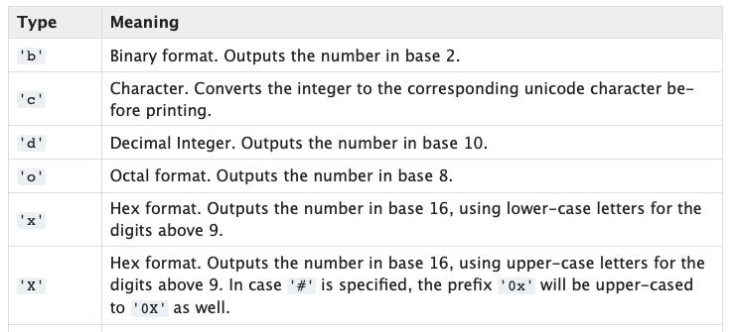
Python: number systems
Terminal:
$ python
Python 3.9.12 (main, Jun 1 2022, 06:34:44)
[Clang 12.0.0 ] :: Anaconda, Inc. on darwin
Type "help", "copyright", "credits" or "license" for more information.
>>> bin(91)
'0b1011011'
>>> hex(91)
'0x5b'
>>> 0b1011011
91
>>> oct(91)
'0o133'
>>>

Slide 33
Homework 3
At the Python prompt >>>
recall 0b is the prefix for binary, e.g. 0b1011011, 0x is for hexadecimal.
Q1: compute binary multiplication (*)
What is the answer in binary?
Q2: divide (/) binary 10001010 by hex 17
What answer do you get?
Can you explain why the answer might be a bit surprising?
Q3: compute (the decimal)
37535589513263342053361 / 11947949225808341100193
Does the answer remind you of a famous number?
Now, multiply your answer by 11947949225808341100193
Do you get the original number back?

Slide 34
Homework 3
Submit to sandiway@arizona.edu
SUBJECT: 388 Homework 3 YOUR NAME
One PDF file only
include Python terminal screenshots in your answer
Deadline:
midnight Monday
we will review the homework on Tuesday

Slide 35
HP-16C Calculator
The hex digits displayed as AbCdE with the "b" and "d" in lower case so they could be distinguished from "8" and "0"
https://www.hpmuseum.org/hp16.htm

Slide 36
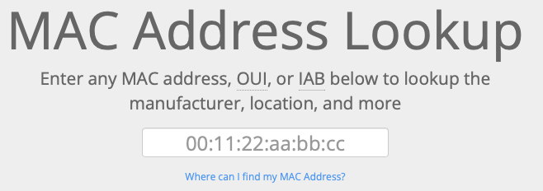
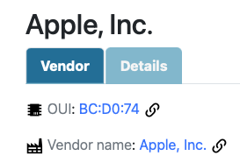
MAC address
Apple has informed Wi-Fi manufacturers that iOS and iPadOS Wi-Fi scans use a randomized MAC address and that neither Apple nor manufacturers can predict these randomized MAC addresses.
https://www.macvendorlookup.com
A media access control address (MAC address) is a unique identifier. MAC addresses are primarily assigned by device manufacturers.
six groups of two hexadecimal digits separated by colons (:)
48-bit address space contains potentially 248 (over 281 trillion) possible MAC addresses. The IEEE manages allocation of MAC addresses.
According to Edward Snowden, the NSA has a system that tracks the movements of mobile devices in a city by monitoring MAC addresses.

