Slide 1
LING 388: Computers and Language
Lecture 28

Slide 2
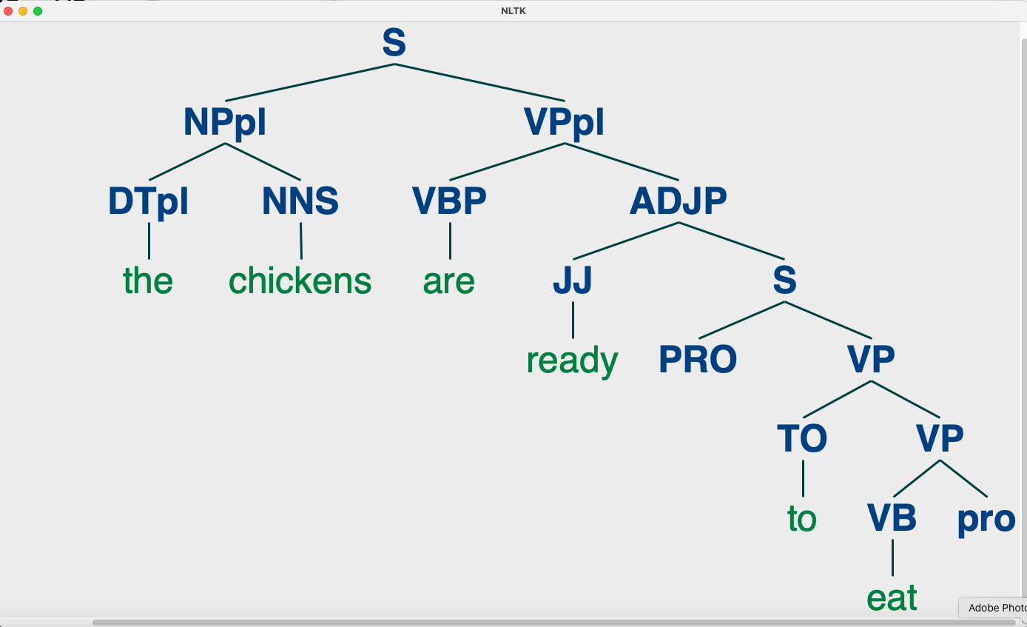
Last Time
Syntax: talked about nltk (context-free) grammar rules
ability to specify empty categories
inability to handle Control of PRO (empty subject pronoun of nonfinite clauses)
there's more but we will move on to a new topic today
Agreement:
NUMBER
{sg, pl}
*the chickens is ready …

Slide 3
Today's Topic
Fill out the course surveys please
WordNet:
a freely-available dictionary of English word senses organized by synonym (sets).
not for prepositional senses, e.g. with, from, in etc.
for open class words: nouns, verbs, adverbs and adjectives
can use it online (web interface) and inside nltk
next time, last lecture: we'll relate WordNet to word embeddings

Slide 4
WordNet
Princeton WordNet: a dictionary of English words with semantic relations connecting word senses
nltk book: chapter 2 and 4

Slide 5
WordNet
Relations between word senses grouped into synonym sets (synsets)

Slide 6
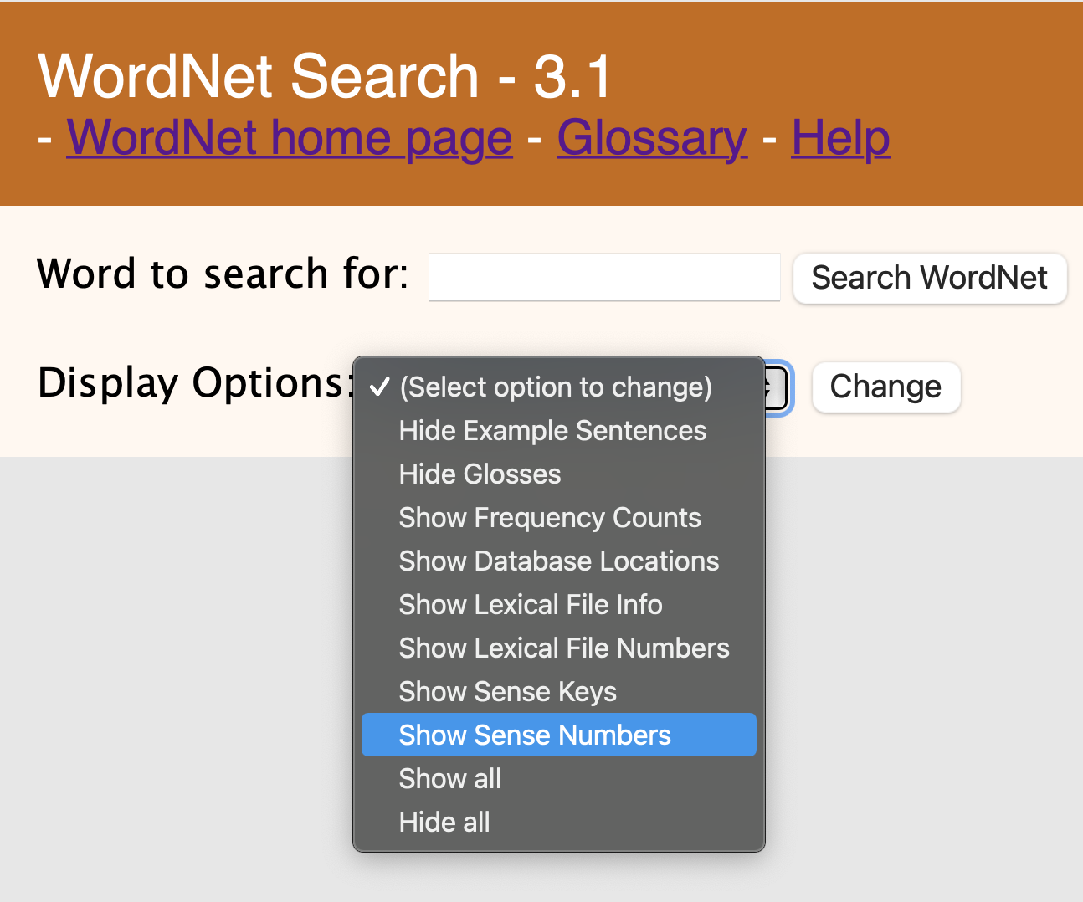
nltk book: 2.5.1 Senses and Synonyms
Synonyms:
Benz is credited with the invention of the motorcar.
Benz is credited with the invention of the automobile.
http://wordnetweb.princeton.edu/perl/webwn
turn this on!

Slide 7
nltk and WordNet
http://www.nltk.org/howto/wordnet.html

Slide 8
nltk book: 2.5.1 Senses and Synonyms
>>> from nltk.corpus import wordnet as wn
>>> wn.synsets('motorcar')
[Synset('car.n.01')]
>>> s = wn.synset('car.n.1')
>>> s
Synset('car.n.01')
>>> s.lemmas()
[Lemma('car.n.01.car'), Lemma('car.n.01.auto'), Lemma('car.n.01.automobile'), Lemma('car.n.01.machine'), Lemma('car.n.01.motorcar')]
>>> s.lemma_names()
['car', 'auto', 'automobile', 'machine', 'motorcar']
>>> s.definition()
'a motor vehicle with four wheels; usually propelled by an internal combustion engine'
>>> s.examples()
['he needs a car to get to work']
Key:
synset = synonym set
lemma = word + sense number (member of synset)
(semantic) relation = link between synset

Slide 9
nltk WordNet Notation
A synset is uniquely identified with a 3-part name of the form: word.pos.nn
word = "head" of the synset is the first lemma listed
pos = [asrnv] (part of speech: adjective/satellite/adverb/noun/verb)
wn.synsets('dog')
[Synset('dog.n.01'), Synset('frump.n.01'), Synset('dog.n.03'), Synset('cad.n.01'), Synset('frank.n.02'), Synset('pawl.n.01'), Synset('andiron.n.01'), Synset('chase.v.01')]
wn.synsets('animal')
[Synset('animal.n.01'), Synset('animal.s.01')]

Slide 10
nltk book: 2.5.2 The WordNet Hierarchy

Slide 11
nltk book: 2.5.2 The WordNet Hierarchy
s = wn.synset('car.n.1')
>>> [lemma.name() for synset in s.hyponyms() for lemma in synset.lemmas()]
['ambulance', 'beach_wagon', 'station_wagon', 'wagon', 'estate_car', 'beach_waggon', 'station_waggon', 'waggon', 'bus', 'jalopy', 'heap', 'cab', 'hack', 'taxi', 'taxicab', 'compact', 'compact_car', 'convertible', 'coupe', 'cruiser', 'police_cruiser', 'patrol_car', 'police_car', 'prowl_car', 'squad_car', 'electric', 'electric_automobile', 'electric_car', 'gas_guzzler', 'hardtop', 'hatchback', 'horseless_carriage', 'hot_rod', 'hot-rod', 'jeep', 'landrover', 'limousine', 'limo', 'loaner', 'minicar', 'minivan', 'Model_T', 'pace_car', 'racer', 'race_car', 'racing_car', 'roadster', 'runabout', 'two-seater', 'sedan', 'saloon', 'sport_utility', 'sport_utility_vehicle', 'S.U.V.', 'SUV', 'sports_car', 'sport_car', 'Stanley_Steamer', 'stock_car', 'subcompact', 'subcompact_car', 'touring_car', 'phaeton', 'tourer', 'used-car', 'secondhand_car']
not included
66 hyponyms of car sense 1

Slide 12
Full hyponymy
Let's descend:
>>> s = wn.synset('car.n.1')
>>> s.hyponyms()[0]
Synset('ambulance.n.01')
>>> s.hyponyms()[0].hyponyms()
[Synset('funny_wagon.n.01')]
>>> s.hyponyms()[0].hyponyms()[0]
Synset('funny_wagon.n.01')
>>> s.hyponyms()[0].hyponyms()[0].hyponyms()
[]

Slide 13
Full hyponymy
fullhyponyms.py
walk() walks the hyponymy tree collecting the synsets
names() computes the lemma names, i.e. the words that belong to the list of synsets
$ python -i fullhyponyms.py
>>> s = wn.synset('car.n.1')
>>> names(walk(s))

Slide 14
Full hyponymy
>>> names(walk(s))
['ambulance', 'beach_wagon', 'station_wagon', 'wagon', 'estate_car', 'beach_waggon', 'station_waggon', 'waggon', 'bus', 'jalopy', 'heap', 'cab', 'hack', 'taxi', 'taxicab', 'compact', 'compact_car', 'convertible', 'coupe', 'cruiser', 'police_cruiser', 'patrol_car', 'police_car', 'prowl_car', 'squad_car', 'electric', 'electric_automobile', 'electric_car', 'gas_guzzler', 'hardtop', 'hatchback', 'horseless_carriage', 'hot_rod', 'hot-rod', 'jeep', 'landrover', 'limousine', 'limo', 'loaner', 'minicar', 'minivan', 'Model_T', 'pace_car', 'racer', 'race_car', 'racing_car', 'roadster', 'runabout', 'two-seater', 'sedan', 'saloon', 'sport_utility', 'sport_utility_vehicle', 'S.U.V.', 'SUV', 'sports_car', 'sport_car', 'Stanley_Steamer', 'stock_car', 'subcompact', 'subcompact_car', 'touring_car', 'phaeton', 'tourer', 'used-car', 'secondhand_car', 'funny_wagon', 'shooting_brake', 'gypsy_cab', 'minicab', 'panda_car', 'berlin', 'minicab', 'finisher', 'stock_car', 'brougham']
>>> len(names(walk(s)))
76

Slide 15
Full hyponymy
car
hyponym
ambulance
used-car
hyponym
funny wagon
jeep
limousine
hyponym
berlin

Slide 16
Full hyponymy
Let's run names(walk(synset)) on some hypernyms of car#1
e.g.
names(walk(wn.synset('car.n.1').hypernyms()[0]))

Slide 17
WordNet

Slide 18
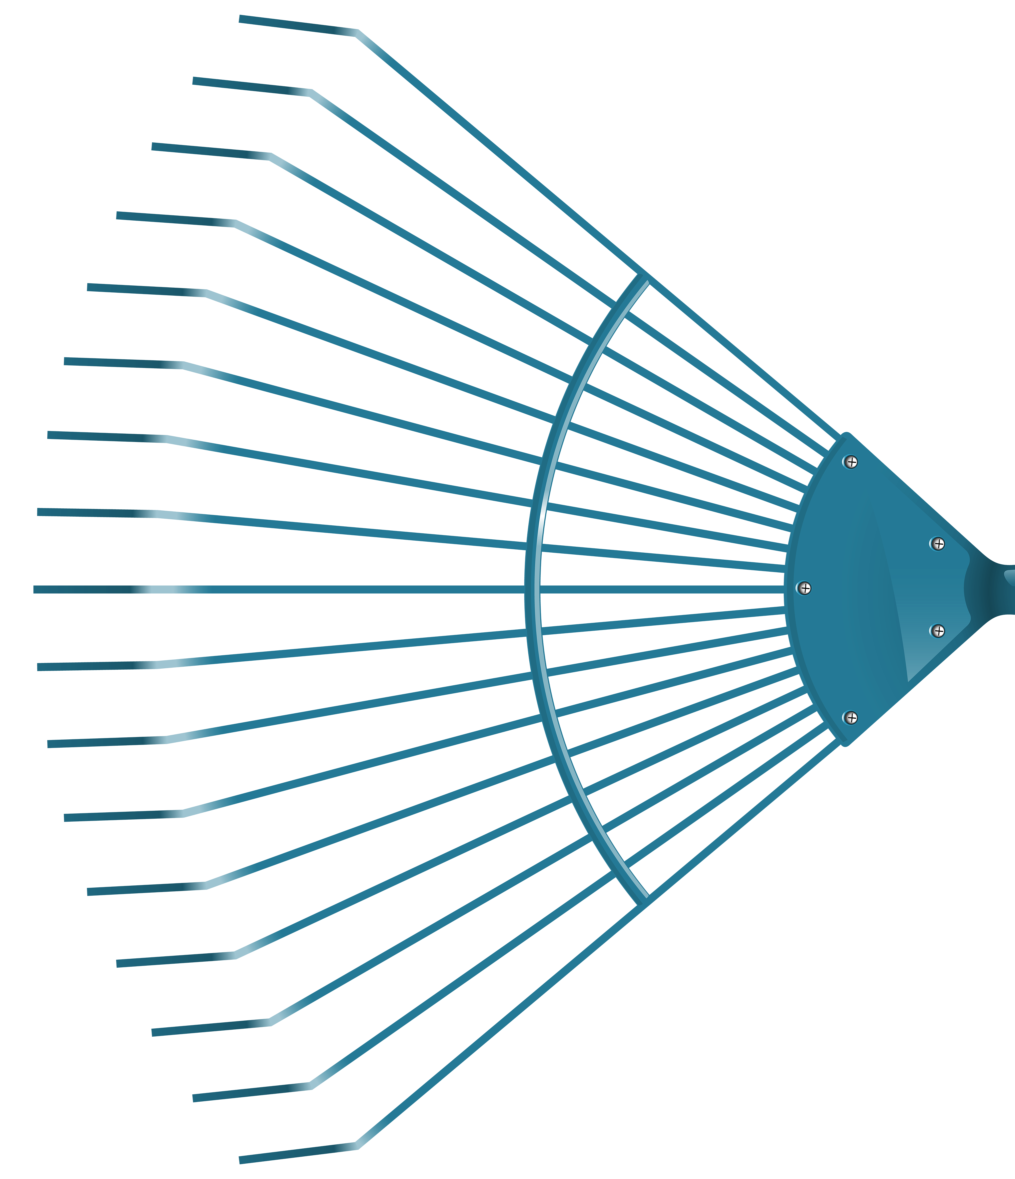
WordNet: adjectives and satellites
dry
antonym
satellites
of
"wet"
wet

Slide 19
WordNet: satellites via similar to

Slide 20
WordNet: satellites via similar to
Antonyms are defined via lemmas, not synsets!
>>> wn.synset('wet.a.1')
Synset('wet.a.01')
>>> wn.synset('wet.a.1').antonyms()
Traceback (most recent call last):
File "<stdin>", line 1, in <module>
AttributeError: 'Synset' object has no attribute 'antonyms'
>>> wn.synset('wet.a.1').lemmas()[0].antonyms()
[Lemma('dry.a.01.dry')]
>>> wn.synset('wet.a.1').lemmas()[0].similar_tos()
[]
>>> wn.synset('wet.a.1').similar_tos()
[Synset('bedewed.s.01'), Synset('besprent.s.01'), Synset('boggy.s.01'), Synset('clammy.s.01'), Synset('damp.s.01'), Synset('drippy.s.01'), Synset('humid.s.01'), Synset('misty.s.02'), Synset('muggy.s.01'), Synset('reeking.s.01'), Synset('rheumy.s.01'), Synset('showery.s.01'), Synset('sloppy.s.02'), Synset('sodden.s.01'), Synset('steaming.s.01'), Synset('sticky.s.02'), Synset('tacky.s.01'), Synset('undried.s.01'), Synset('washed.s.02'), Synset('watery.s.01')]
Note: s for satellite!

Slide 21
Lemma relations

Slide 22
Synset relations

Slide 23
NLTK and WordNet
Interlingua is English WordNet senses
eh?
犬

Slide 24
NLTK and WordNet
Assuming your Terminal and Python installation accepts all Unicode characters ('utf-8'):
(venv) (base) ~$ python3
>>> import nltk
>>> from nltk.corpus import wordnet as wn
>>> wn.synsets('犬')
[]
>>> wn.synsets('犬', lang='jpn')
[Synset('dog.n.01'), Synset('spy.n.01')]
>>> wn.synsets('chien', lang='fra')
[Synset('dog.n.01'), Synset('pooch.n.01'), Synset('hound.n.01'), Synset('andiron.n.01'), Synset('pawl.n.01'), Synset('frank.n.02'), Synset('cad.n.01'), Synset('dog.n.03'), Synset('frump.n.01')]
>>> wn.synsets('cane', lang='ita')
[Synset('dog.n.01'), Synset('cramp.n.02'), Synset('hammer.n.01'), Synset('bad_person.n.01'), Synset('incompetent.n.01')]

Slide 25
NLTK and WordNet
macOS:
Disappointed: my anaconda Python install didn't work for this.
SyntaxError: (unicode error) 'utf-8' codec can't decode bytes in position 2-3: invalid continuation byte
Use Homebrew (https://brew.sh) Python instead with a virtual environment:
install Homebrew first (see above link)
brew install python3
==> python@3.12
Python has been installed as /opt/homebrew/bin/python3
install nltk for Homebrew's Python (use a virtual environment, let's call it venv)
$ /opt/homebrew/bin/python3 -m venv ~/venv
$ source ~/venv/bin/activate
(venv) (base) ~$ which python3
/Users/sandiway/venv/bin/python3
(venv) (base) ~$ python3 -m pip install nltk (venv) (base) ~$ python3
Python 3.12.3 (main, Apr 9 2024, 08:09:14) [Clang 15.0.0 (clang-1500.3.9.4)] on darwin
>>> import nltk
>>> from nltk.corpus import wordnet as wn

Slide 26
NLTK and WordNet
using pip3 outside a virtual environment is not recommended!
$ /opt/homebrew/bin/pip3 install nltk
error: externally-managed-environment
× This environment is externally managed
╰─> To install Python packages system-wide, try brew install
xyz, where xyz is the package you are trying to
install.
If you wish to install a Python library that isn't in Homebrew,
use a virtual environment:
python3 -m venv path/to/venv
source path/to/venv/bin/activate
python3 -m pip install xyz

Slide 27
NLTK and WordNet
Turns out I should have just updated my anaconda Python:
$ conda update conda
$ conda update --all
$ conda update python
$ which python
/Users/sandiway/opt/anaconda3/bin/python
(base) ~$ python
Python 3.9.16 | packaged by conda-forge | (main, Feb 1 2023, 21:38:11)
>>> import nltk
>>> from nltk.corpus import wordnet as wn
>>> wn.synsets('犬', lang='jpn')
[Synset('dog.n.01'), Synset('spy.n.01')]

