Slide 1
LING 388: Computers and Language
Lecture 26

Slide 2
Today's Topics
Reminder:
Homework 10: Term Project Proposals
Last time:
constituency parsing using the Berkeley neural parser etc.
getting comfortable with phrase structure grammars
syntax and nltk
hands-on programming
writing grammar rules based on a parse

Slide 3
Yoda Speak
Yoda speak involves displacement:
still comprehensible to the native English speaker
…
“Lost a planet, Master Obi-Wan has.”
“That group back there, soon discovered will be.”
Berkeley Neural Parser
https://parser.kitaev.io

Slide 4
More Yoda Speak
AI generated digital art picture from the sentence:

Slide 5
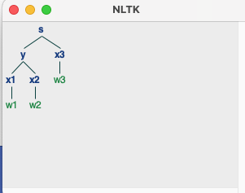
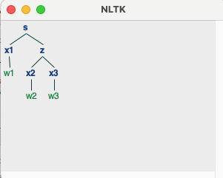
nltk.ChartParser()
Using nltk:
$ python
>>> import nltk
>>> g = open('g.txt').read()
>>> g
"s -> y x3\ns -> x1 z\ns -> y z\ny -> x1 x2\nz -> x2 x3\nx1 -> 'w1'\nx2 -> 'w2'\nx3 -> 'w3'\n"
>>> cfg = nltk.CFG.fromstring(g)
>>> cfg
<Grammar with 8 productions>
>>> p = nltk.ChartParser(cfg)
>>> for tree in p.parse(['w1','w2','w3']):
... tree.draw()
...

Slide 6
Writing a grammar
Context-free phrase structure grammar rules should be:
read in from a plain text file (e.g. g.txt)
1st line defines the start-symbol (S)
-> is the rewrite symbol ( lhs -> rhs) left/right hand side
space between grammar symbols
lexical items are quoted, e.g. 'I'
you cannot mix grammatical categories with lexical items on the rhs
PP -> 'of' NP (disallowed)
you are not permitted multi-word lexical items
not ok: NP -> 'New York'
ok: NP -> 'New_York'

Slide 7
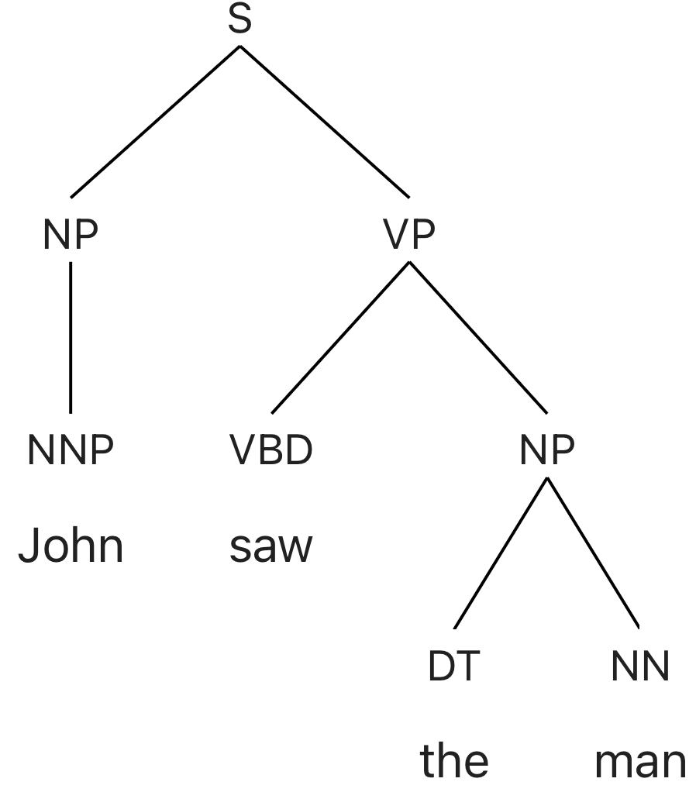
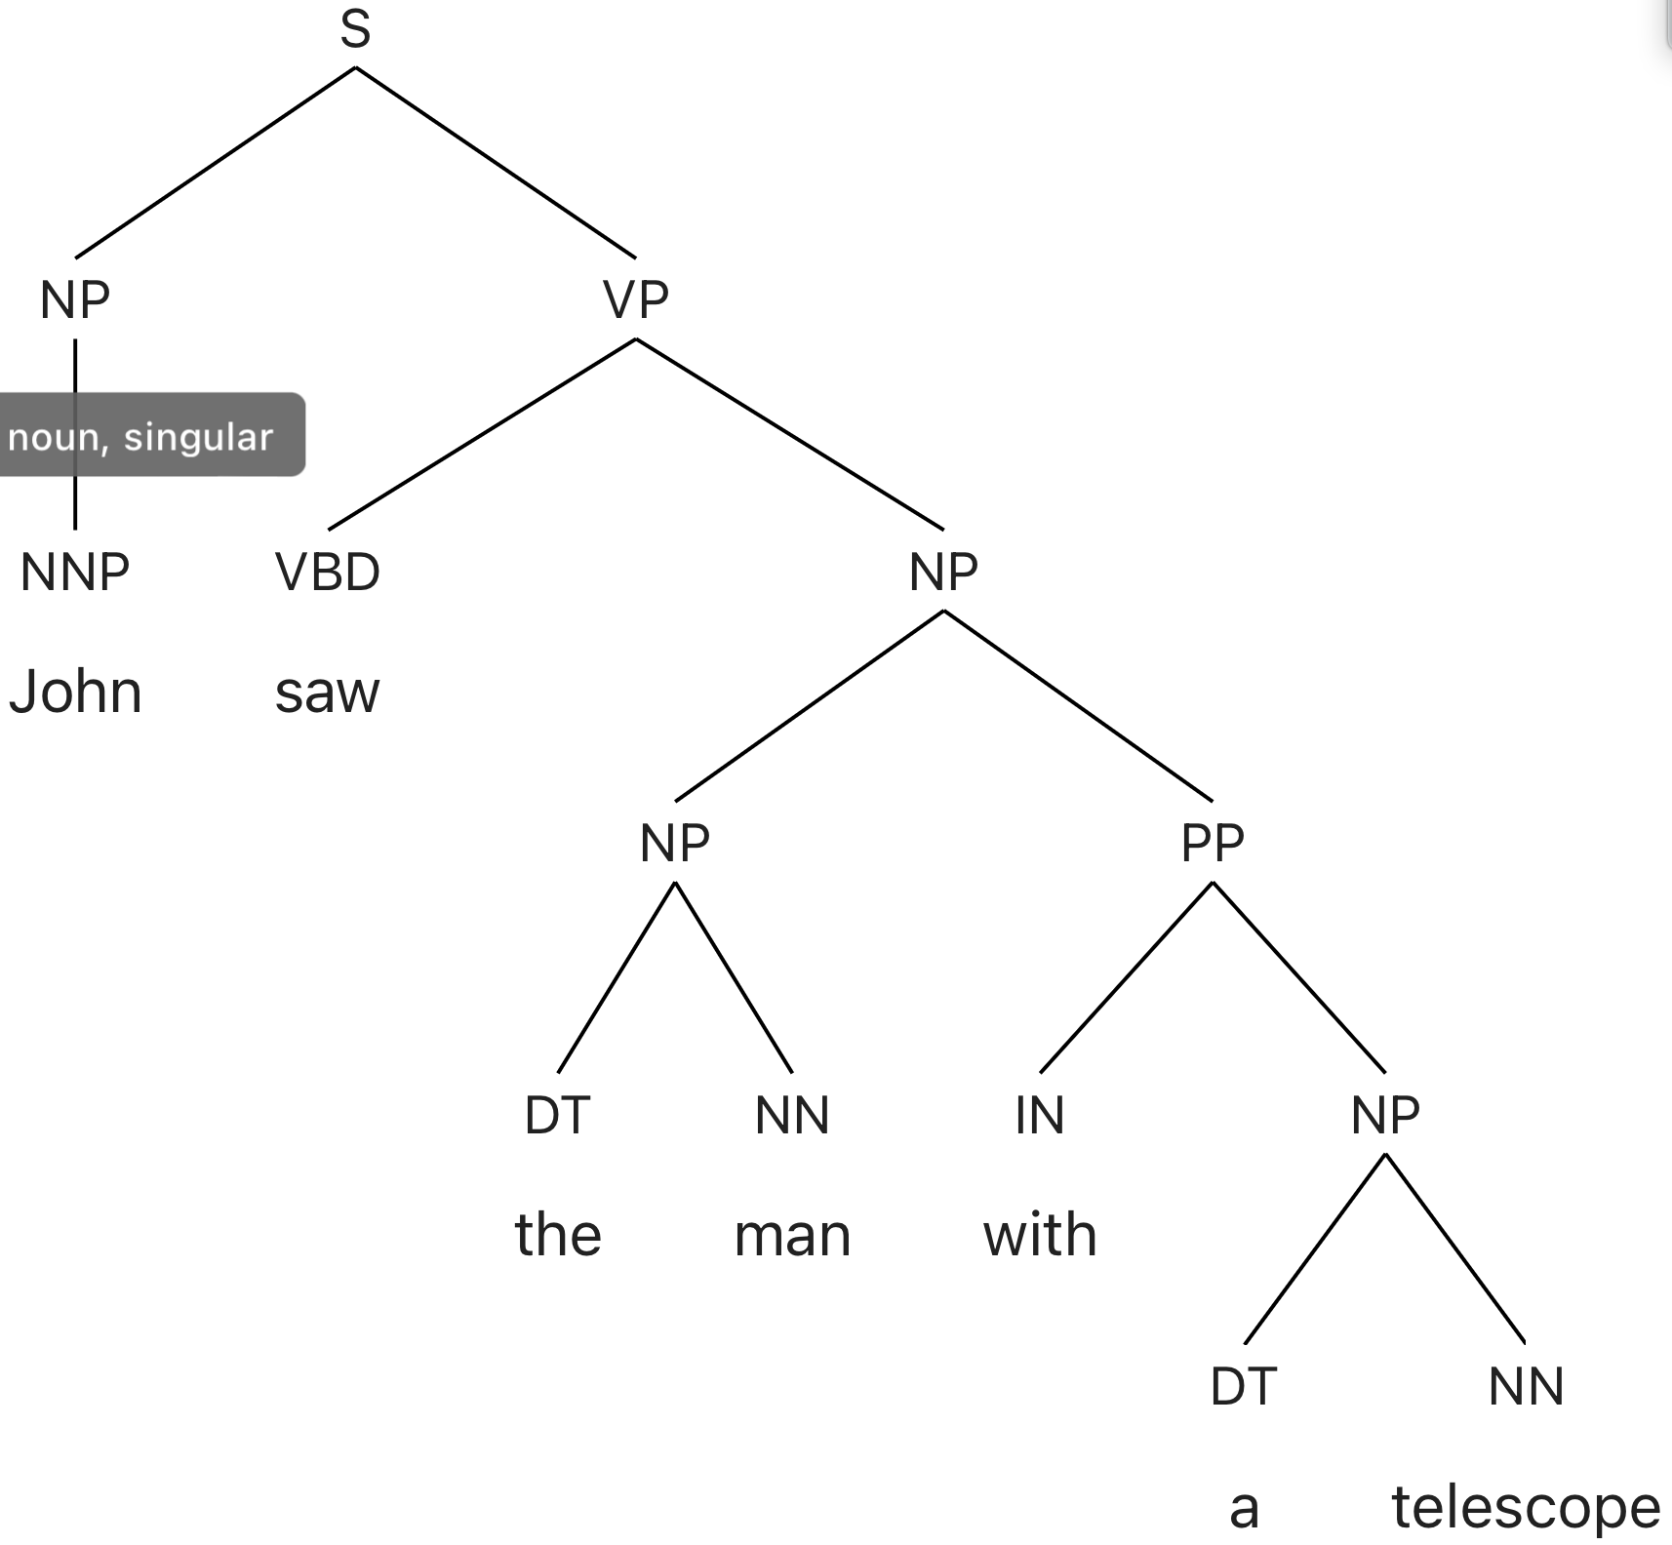
Writing a grammar
You have to know the grammar.
How?
take a syntax class, or
use something like the Berkeley Neural parser
https://parser.kitaev.io
let's assume this

Slide 8
Reference
The part of speech (POS) tags:
https://www.ling.upenn.edu/courses/Fall_2003/ling001/penn_treebank_pos.html
All the syntactic tags:
https://www.ling.upenn.edu/~beatrice/gtrc/syntax/labels.htm

Slide 9
g.txt
Based on Berkeley Neural Parser output, we can craft a context-free grammar (CFG):
S -> NP VP
NP -> NNP
NP -> DT NN
NP -> NP PP
VP -> VBD NP
VP -> VP PP
PP -> IN NP
NNP -> 'John'
NNP -> 'Mary'
VBD -> 'saw'
DT -> 'the'
DT -> 'a'
NN -> 'man'
NN -> 'boy'
NN -> 'telescope'
IN -> 'with'

Slide 10
g.txt
Let's run g.txt using nltk.ChartParser():
copy grammar into a text file called g.txt
g = open('g.txt').read()
cfg = nltk.CFG.fromstring(g)
p = nltk.ChartParser(cfg)
for tree in p.parse(nltk.word_tokenize(Sentence)):
... tree.draw()

Slide 11
Senses of preposition with
Sense diambiguation is important and humans do it reflexively.
How many senses does with have?
Source: https://www.merriam-webster.com/dictionary/with
opposition to/separation: fight/break with
to indicate a participant in an action, transaction, or arrangement: work/talk with
x is identical with y; I'm with him; can pitch with the best of them
accompaniment/addition: went there with her, costs $5 with tax
judgment/estimation: stood well with her classmates
means/cause/agent/instrumentality: hit him with a rock
manner: ran with effort
possession: came with good news; person with a sharp nose
close association in time: with the outbreak of war they went home
in spite of/except for: finds that, with one group of omissions
in the direction of: with the wind/grain

Slide 12
g2.txt
Let's update the grammar to indicate the sense of with.
Call this grammar g2.txt
Idea:
VP -> VP PP
NP -> NP PP
becomes
VP -> VP PP_instrument
NP -> NP PP_possession
Next, write a rule for PP_instrument
PP_instrument -> IN_instrument NP
IN_instrument -> 'with'
Also, write a rule for PP_possession
PP_possession -> IN_possession NP
IN_possession -> 'with'

Slide 13
g2.txt
Consider # parses for:
a man with a telescope saw the boy with a telescope

