Slide 1
LING 388: Computers and Language
Lecture 24

Slide 2
Today's Topics
Continuing from Tuesday …
Summarization Task
Then:
Word Embeddings: encoding words into vectors
Homework 9

Slide 3
Last Time: Masked Language Modeling
>>> from transformers import pipeline
>>> classifier_large = pipeline("fill-mask", model='roberta-large')
>>> ['{} {:.2f}'.format(answer['sequence'],answer['score']) for answer in classifier_large('Noam Chomsky is a <mask>.', top_k=7)]
['Noam Chomsky is a genius. 0.09',
'Noam Chomsky is a radical. 0.04',
'Noam Chomsky is a whistleblower. 0.04',
'Noam Chomsky is a visionary. 0.04',
'Noam Chomsky is a prophet. 0.03',
'Noam Chomsky is a liar. 0.03',
'Noam Chomsky is a revolutionary. 0.03']

Slide 4
Last Time: Masked Language Modeling
>>> ['{} {:.2f}'.format(answer['sequence'],answer['score']) for answer in classifier_large('Noam Chomsky lives in <mask>.', top_k=7)]
['Noam Chomsky lives in London. 0.10',
'Noam Chomsky lives in Brooklyn. 0.09',
'Noam Chomsky lives in California. 0.07',
'Noam Chomsky lives in Chicago. 0.05',
'Noam Chomsky lives in Berlin. 0.05',
'Noam Chomsky lives in Manhattan. 0.03',
'Noam Chomsky lives in Seattle. 0.03']

Slide 5
Last Time: Masked Language Modeling
>>> ['{} {:.2f}'.format(answer['sequence'],answer['score']) for answer in classifier_large('Aristotle lived in <mask>.', top_k=7)]
['Aristotle lived in Athens. 0.47',
'Aristotle lived in Alexandria. 0.11',
'Aristotle lived in Rome. 0.04',
'Aristotle lived in Babylon. 0.04',
'Aristotle lived in Greece. 0.03',
'Aristotle lived in exile. 0.02',
'Aristotle lived in Egypt. 0.02']

Slide 6
ABC News Interview

Slide 7
ABC News Interview
Obama: 'I Think Same-Sex Couples Should Be Able to Get Married'
By Rick Klein May 9, 2012
Python:
obama = "I have to tell you that over the course of several years as I have talked to friends and family and neighbors, when I think about members of my own staff who are in incredibly committed monogamous relationships, same-sex relationships, who are raising kids together; when I think about those soldiers or airmen or marines or sailors who are out there fighting on my behalf and yet feel constrained, even now that 'don't ask, don't tell' is gone, because they are not able to commit themselves in a marriage, at a certain point I've just concluded that for me personally it is important for me to go ahead and affirm that I think same sex couples should be able to get married."

Slide 8
Summary
Human-produced summary (me):
11 words:
I think same sex couples should be able to get married
9 words:
Same sex couples should be able to get married

Slide 9
Language and Computers
Executive
Summarization

Slide 10
Language and Computers
Obama: "At a certain point, I've just concluded that for me personally it is important for me to go ahead and affirm that I think same-sex couples should be able to get married."
Is this sentence complicated? Why?

Slide 11
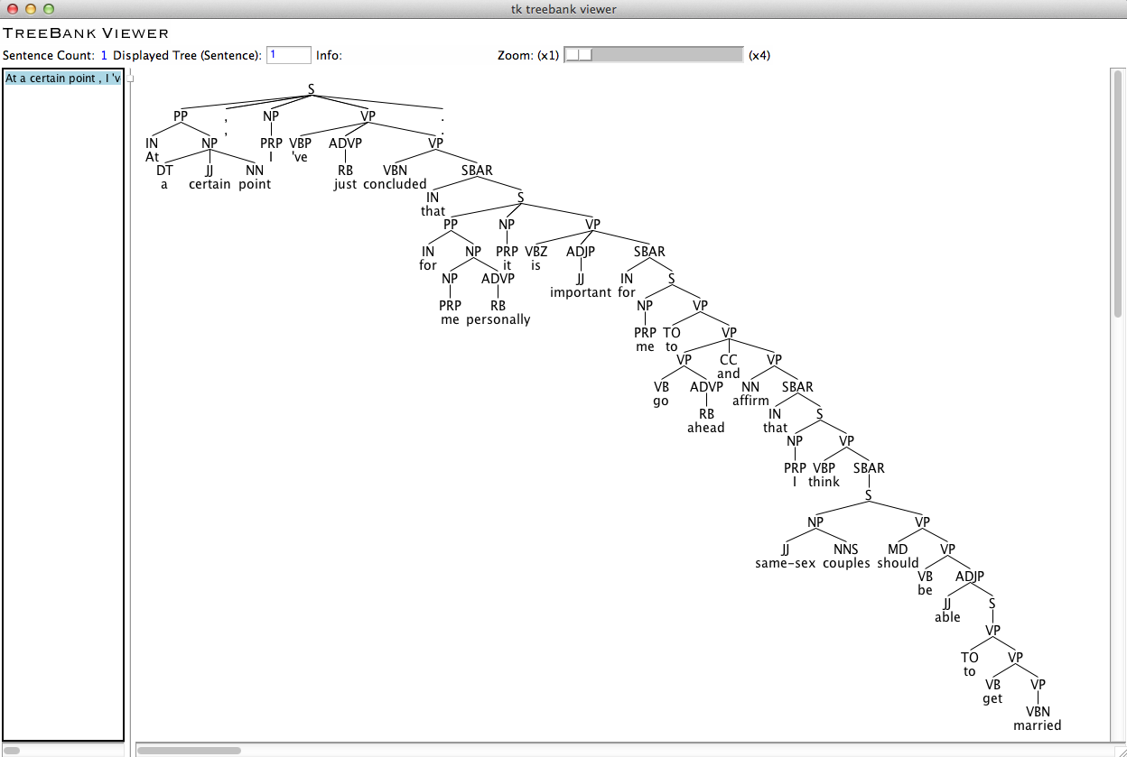
Language and Computers
It's cool that computer programs can (correctly) diagram this long (nested) sentence!

Slide 12
Language and Computers
Obama: "At a certain point, I've just concluded that for me personally it is important for me to go ahead and affirm that I think same-sex couples should be able to get married."
Obama: "At a certain point, I've just concluded that for me personally it is important for me to go ahead and affirm that I think same-sex couples should be able to get married."
Most summarizer programs can't do this …

Slide 13
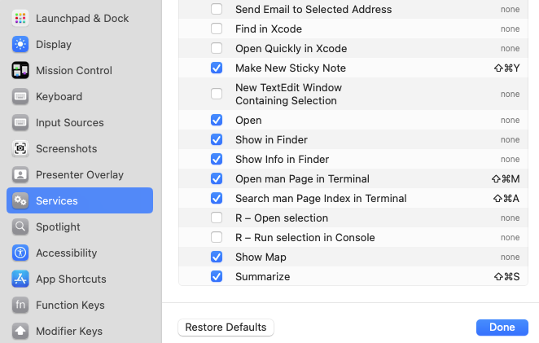
macOS Summarizer
Down to one sentence only
it doesn’t parse
it can't extract clauses
Settings > Keyboard > Shortcuts > Services

Slide 14
Summarization
https://huggingface.co/transformers/v3.2.0/task_summary.html
Default pipeline
It leverages a Bart model that was fine-tuned on the CNN / Daily Mail data set.
Bart?
Bart uses a standard seq2seq/machine translation architecture with a bidirectional encoder (like BERT) and a left-to-right decoder (like GPT).
The pretraining task involves randomly shuffling the order of the original sentences and a novel in-filling scheme, where spans of text are replaced with a single mask token.
BART is particularly effective when fine tuned for text generation but also works well for comprehension tasks. It […] achieves new state-of-the-art results on a range of abstractive dialogue, question answering, and summarization tasks.

Slide 15
sshleifer/distilbart-cnn-12-6
Code:
>>> summarizer = pipeline("summarization")
No model was supplied, defaulted to sshleifer/distilbart-cnn-12-6 and revision a4f8f3e (https://huggingface.co/sshleifer/distilbart-cnn-12-6).
Using a pipeline without specifying a model name and revision in production is not recommended.
huggingface/tokenizers: The current process just got forked, after parallelism has already been used. Disabling parallelism to avoid deadlocks...
To disable this warning, you can either:
- Avoid using `tokenizers` before the fork if possible
- Explicitly set the environment variable TOKENIZERS_PARALLELISM=(true | false)
config.json: 100%|█████████████████████████| 1.80k/1.80k [00:00<00:00, 1.73MB/s]
pytorch_model.bin: 100%|███████████████████| 1.22G/1.22G [02:21<00:00, 8.65MB/s]
tokenizer_config.json: 100%|█████████████████| 26.0/26.0 [00:00<00:00, 10.5kB/s]
vocab.json: 100%|████████████████████████████| 899k/899k [00:00<00:00, 2.17MB/s]
merges.txt: 100%|████████████████████████████| 456k/456k [00:00<00:00, 5.49MB/s]

Slide 16
sshleifer/distilbart-cnn-12-6
Max and Min:
>>> print(summarizer(obama, max_length=50, min_length=12, do_sample=False))
[{'summary_text': ' "For me personally it is important for me to go ahead and affirm that I think same sex couples should be able to get married," says President Obama . "I have to tell you that over the course of several years as I have'}]
>>> print(summarizer(obama, max_length=40, min_length=12, do_sample=False))
[{'summary_text': ' "For me personally it is important for me to go ahead and affirm that I think same sex couples should be able to get married," says President Obama . "At a certain point I'}]
>>> print(summarizer(obama, max_length=30, min_length=12, do_sample=False))
[{'summary_text': ' "For me personally it is important for me to go ahead and affirm that I think same sex couples should be able to get married,"'}]
>>> print(summarizer(obama, max_length=20, min_length=12, do_sample=False))
[{'summary_text': ' "For me personally it is important for me to go ahead and affirm that I think'}]
>>> print(summarizer(obama, max_length=15, min_length=9, do_sample=False))
[{'summary_text': ' "For me personally it is important for me to go ahead'}]
>>> print(summarizer(obama, max_length=13, min_length=9))
[{'summary_text': ' "For me personally it is important for me to'}]
>>> print(summarizer(obama, max_length=12, min_length=9, do_sample=False))
[{'summary_text': ' "For me personally it is important for me'}]

Slide 17
Google's T5 model
https://commoncrawl.org
T5 = "Text-to-Text Transfer Transformer"
Corpus:
C4 = "Colossal Clean Crawled Corpus" (750GB), a cleaned-up version of (a) Common Crawl.
Paper:
https://arxiv.org/pdf/1910.10683.pdf

Slide 18
Google's T5 model
Code:
>>> from transformers import AutoModelWithLMHead, AutoTokenizer
>>> model = AutoModelWithLMHead.from_pretrained("t5-base")
/Users/sandiway/opt/anaconda3/lib/python3.9/site-packages/transformers/models/auto/modeling_auto.py:1132: FutureWarning: The class `AutoModelWithLMHead` is deprecated and will be removed in a future version. Please use `AutoModelForCausalLM` for causal language models, `AutoModelForMaskedLM` for masked language models and `AutoModelForSeq2SeqLM` for encoder-decoder models.
warnings.warn(
config.json: 100%|██████████████████████████| 1.21k/1.21k [00:00<00:00, 429kB/s]
pytorch_model.bin: 100%|█████████████████████| 892M/892M [01:45<00:00, 8.43MB/s]
>>> tokenizer = AutoTokenizer.from_pretrained("t5-base")
spiece.model: 100%|██████████████████████████| 792k/792k [00:00<00:00, 3.81MB/s]
tokenizer.json: 100%|██████████████████████| 1.39M/1.39M [00:00<00:00, 8.01MB/s]
/Users/sandiway/opt/anaconda3/lib/python3.9/site-packages/transformers/models/t5/tokenization_t5_fast.py:156: FutureWarning: This tokenizer was incorrectly instantiated with a model max length of 512 which will be corrected in Transformers v5.
For now, this behavior is kept to avoid breaking backwards compatibility when padding/encoding with `truncation is True`.
- Be aware that you SHOULD NOT rely on t5-base automatically truncating your input to 512 when padding/encoding.
- If you want to encode/pad to sequences longer than 512 you can either instantiate this tokenizer with `model_max_length` or pass `max_length` when encoding/padding.
- To avoid this warning, please instantiate this tokenizer with `model_max_length` set to your preferred value.
warnings.warn(

Slide 19
Google's T5 model
Code:
>>> inputs = tokenizer.encode("summarize: " + obama, return_tensors="pt", max_length=512, truncation=True)
>> outputs = model.generate(inputs, max_length=50, min_length=9, length_penalty=2.0, num_beams=4, early_stopping=True)
>>> tokenizer.decode(outputs[0])
"<pad> 'don't ask, don't tell' is gone because same sex couples are not able to commit themselves in a marriage. for me personally it is important for me to go ahead and affirm that same "
Simpler code:
>>> summarizer = pipeline("summarization", model="t5-base", tokenizer="t5-base", framework="pt")
>>> print(summarizer(obama, max_length=50, min_length=9))
[{'summary_text': "'don't ask, don't tell' is gone because same sex couples are not able to commit themselves in a marriage . for me personally it is important for me to go ahead and affirm that same "}]

Slide 20
Google's T5 model
Max and Min:
>>> print(summarizer(obama, max_length=50, min_length=9))
[{'summary_text': "'don't ask, don't tell' is gone because same sex couples are not able to commit themselves in a marriage . for me personally it is important for me to go ahead and affirm that same "}]
>>> print(summarizer(obama, max_length=40, min_length=9))
[{'summary_text': "'don't ask, don't tell' is gone because same sex couples are not able to commit themselves in a marriage . for me personally it is important"}]
>>> print(summarizer(obama, max_length=30, min_length=9))
[{'summary_text': "'don't ask, don't tell' is gone because same sex couples are not able to commit themselves in "}]
>>> print(summarizer(obama, max_length=20, min_length=9))
[{'summary_text': "'don't ask, don't tell' is gone because same sex"}]
>>> print(summarizer(obama, max_length=15, min_length=9))
[{'summary_text': "'don't ask, don't tell' is gone"}]
>>> print(summarizer(obama, max_length=13, min_length=9))
[{'summary_text': 'same sex couples should be able to get married'}]
>>> print(summarizer(obama, max_length=11, min_length=9))
[{'summary_text': 'same sex couples should be able to'}]

Slide 21
Google's T5 model
A note on inputs/outputs:
>>> outputs
tensor([[ 0, 3, 31, 2029, 31, 17, 987, 6, 278, 31, 17, 817, 31, 19, 2767, 250, 337, 3, 7, 994, 11992, 33, 59, 3, 179, 12, 10042, 1452, 16, 3, 9, 5281, 3, 5, 21, 140, 4828, 34, 19, 359, 21, 140, 12, 281, 2177, 11, 11153, 24, 337, 3]])
>>> inputs
tensor([[21603, 10, 27, 43, 12, 817, 25, 24, 147, 8, 503, 13, 633, 203, 38, 27, 43, 6812, 12, 803, 11, 384, 11, 11195, 6, 116, 27, 317, 81, 724, 13, 82, 293, 871, 113, 33, 16, 3, 5828, 3454, 7414, 8758, 1162, 3079, 6, 337, 18, 7, 994, 3079, 6, 113, 33, 7954, 1082, 544, 117, 116, 27, 317, 81, 273, 10838, 42, 799, 904, 42, 8769, 7, 42, 30899, 113, 33, 91, 132, 6237, 30, 82, 6089, 11, 780, 473, 975, 22418, 6, 237, 230, 24, 3, 31, 2029, 31, 17, 987, 6, 278, 31, 17, 817, 31, 19, 2767, 6, 250, 79, 33, 59, 3, 179, 12, 10042, 1452, 16, 3, 9, 5281, 6, 44, 3, 9, 824, 500, 27, 31, 162, 131, 12179, 24, 21, 140, 4828, 34, 19, 359, 21, 140, 12, 281, 2177, 11, 11153, 24, 27, 317, 337, 3, 7, 994, 11992, 225, 36, 3, 179, 12, 129, 4464, 5, 1]])

Slide 22
Cool YouTube video
Link: https://youtu.be/wjZofJX0v4M?si=XAtk4soyHmLBaOqh

Slide 23
glove-wiki-gigaword-50
italy, germany
Pre-trained 50D glove vectors based on 2B tweets, 27B tokens, 1.2M vocab, uncased.
https://nlp.stanford.edu/projects/glove/

Slide 24
3Blue1Brown YouTube video

Slide 25
Similar vectors
building #3, skyscraper #6, roof #5, built #4, dome #8, façade #9, constructed #7, lighthouse #15
>>> import gensim.downloader
>>> model = gensim.downloader.load('glove-wiki-gigaword-50')
[==================================================] 100.0% 66.0/66.0MB downloaded
>>> model.most_similar(model['tower'])
[('tower', 1.0), ('towers', 0.8770957589149475), ('gate', 0.7934195399284363), ('building', 0.7872829437255859), ('built', 0.7803678512573242), ('roof', 0.7780845165252686), ('skyscraper', 0.7487501502037048), ('constructed', 0.74714595079422), ('dome', 0.7415344715118408), ('facade', 0.7309736013412476)]
>>> model.most_similar(model['tower'], topn=20)
[('tower', 1.0), ('towers', 0.8770957589149475), ('gate', 0.7934195399284363), ('building', 0.7872829437255859), ('built', 0.7803678512573242), ('roof', 0.7780845165252686), ('skyscraper', 0.7487501502037048), ('constructed', 0.74714595079422), ('dome', 0.7415344715118408), ('facade', 0.7309736013412476), ('entrance', 0.728020966053009), ('buildings', 0.7160825729370117), ('bridge', 0.7152626514434814), ('erected', 0.7133687138557434), ('walls', 0.7117860317230225), ('lighthouse', 0.7073187828063965), ('adjacent', 0.705715537071228), ('spire', 0.7034977674484253), ('octagonal', 0.701677143573761), ('wall', 0.6997386813163757)]

Slide 26
3Blue1Brown YouTube video

Slide 27
Similar vectors
dog #2, rabbit #3, monkey #4, cats #6, rat #5, beast 316, monster #14, pet #9, snake #7, puppy #13
>>> model.most_similar(model['cat'], topn=20)
[('cat', 1.0),
('dog', 0.9218006134033203),
('rabbit', 0.8487821221351624),
('monkey', 0.8041081428527832),
('rat', 0.7891963720321655),
('cats', 0.7865270376205444),
('snake', 0.7798910737037659),
('dogs', 0.7795815467834473),
('pet', 0.7792249917984009),
('mouse', 0.7731667757034302),
('bite', 0.7728800177574158),
('shark', 0.7655174732208252),
('puppy', 0.7625599503517151),
('monster', 0.7619763016700745),
('spider', 0.7521700859069824),
('beast', 0.7520055770874023),
('crocodile', 0.7498654127120972),
('baby', 0.7463862299919128),
('pig', 0.744558572769165),
('frog', 0.7426510453224182)]

Slide 28
3Blue1Brown YouTube video

Slide 29
Similar vectors
>>> model.most_similar(positive=['woman','king'],negative=['man'], topn=20)
[('queen', 0.8523604273796082),
('throne', 0.7664334177970886),
('prince', 0.759214460849762),
('daughter', 0.7473882436752319),
('elizabeth', 0.7460219860076904),
('princess', 0.7424570322036743),
('kingdom', 0.7337412238121033),
('monarch', 0.7214491367340088),
('eldest', 0.7184861898422241),
('widow', 0.7099431157112122),
('son', 0.7081551551818848),
('father', 0.7072948217391968),
('mother', 0.6993737816810608),
('emperor', 0.6989730596542358),
('grandson', 0.6946032047271729), ('wife', 0.6925390362739563), ('consort', 0.6895833611488342), ('family', 0.6888480186462402), ('cousin', 0.6867153644561768), ('marriage', 0.6804890632629395)]

Slide 30
3Blue1Brown YouTube video

Slide 31
Similar vectors
>>> model.most_similar(positive=['hitler','italy'],negative=['germany'], topn=20)
[('mussolini', 0.8580144047737122),
('fascist', 0.711699366569519),
('napoleon', 0.67445307970047),
('rome', 0.656495988368988),
('adolf', 0.6526973247528076),
('stalin', 0.651793897151947),
('doge', 0.6322624683380127),
('emperor', 0.6307336091995239),
('ceausescu', 0.6272734999656677),
('proclaimed', 0.6267078518867493),
('fascism', 0.6257486343383789),
('dictator', 0.6254255175590515),
('homage', 0.6243410706520081), ('giuseppe', 0.6230704188346863), ('fellini', 0.6197739839553833), ('pietro', 0.6187384724617004), ('venice', 0.6160908937454224), ('bonaparte', 0.6150253415107727), ('nero', 0.6028982400894165), ('guevara', 0.601508378982544)]

Slide 32
3Blue1Brown YouTube video

Slide 33
Similar vectors
>>> model.most_similar(positive=['sushi','germany'],negative=['japan'], topn=20)
[('gourmet', 0.7257506847381592), ('fries', 0.700195848941803), ('sausages', 0.6830171346664429), ('deli', 0.6782432198524475), ('hamburgers', 0.6579815149307251), ('burgers', 0.6539722084999084), ('hamburger', 0.6536605358123779), ('bistro', 0.6461392641067505), ('chef', 0.6452159881591797), ('pizza', 0.6415182948112488), ('chefs', 0.6304028034210205), ('sandwiches', 0.6194659471511841), ('sandwich', 0.6183891296386719), ('cheeseburgers', 0.6178594827651978), ('frying', 0.6163924336433411), ('braise', 0.6158510446548462), ('steak', 0.6153091192245483), ('pastry', 0.6141409873962402), ('pasta', 0.609721839427948), ('cooks', 0.6074866652488708)]
>>> model.most_similar(positive=['sushi','japan'],negative=['germany'], topn=20)
[('sashimi', 0.7451808452606201), ('tempura', 0.7374703884124756), ('noodle', 0.6931675672531128), ('seafood', 0.6587049961090088), ('ceviche', 0.6502314209938049), ('crab', 0.6442180871963501), ('dumplings', 0.6436811685562134), ('oyster', 0.6357710361480713), ('delicacies', 0.6321413516998291), ('zither', 0.6270462274551392), ('muppet', 0.6231157183647156), ('bonefishing', 0.6216718554496765), ('lobster', 0.6139954924583435), ('noodles', 0.6093723177909851), ('soba', 0.6082360744476318), ('cdis', 0.6077033281326294), ('takeout', 0.6045300960540771), ('dumpling', 0.6028793454170227), ('snack', 0.6005922555923462), ('shrimp', 0.596132755279541)]

Slide 34
Homework 9
Plurals:
>>> model.most_similar(positive=['dogs','cat'],negative=['dog'],topn=10)
[('cats', 0.9023849368095398),
('rats', 0.8294458389282227),
('animals', 0.8152007460594177),
('snakes', 0.7855987548828125),
('rabbits', 0.7810243368148804),
('pigs', 0.7778130173683167),
('pets', 0.7658696174621582),
('birds', 0.7560610771179199),
('monkeys', 0.7489491105079651),
('elephants', 0.7420347332954407)]

Slide 35
Homework 9
Question 1: find three examples that don't work using : dogs + <singular form> - dog
Example (top 3):
['{} {:.2f}'.format(w,s) for w,s in model.most_similar(positive=['dogs','child'],negative=['dog'],topn=3)]
['children 0.90', 'parents 0.82', 'mothers 0.81']

Slide 36
Homework 9
Question 2: can you find two good examples of antonym pairs using :
slow + <polar adjective> - quick, and
quick + <antonym> - slow = <polar adjective>
Example (top 3):
['{} {:.2f}'.format(w,p) for (w,p) in model.most_similar(positive=['slow','small'],negative=['quick'],topn=3)]
['large 0.84', 'smaller 0.83', 'larger 0.82']
>>> ['{} {:.2f}'.format(w,p) for (w,p) in model.most_similar(positive=['quick','large'],negative=['slow'],topn=3)]
['small 0.81', 'provided 0.72', 'huge 0.72']
NOTE:
>>> ['{} {:.2f}'.format(w,p) for (w,p) in model.most_similar(positive=['slow','large'],negative=['quick'],topn=3)]
['larger 0.83', 'smaller 0.82', 'small 0.82']
small
large

Slide 37
Homework 9
Usual rules:
One PDF file please!
Show your work, Python code and screenshots where appropriate
SUBJECT: 388 Homework 9 YOUR NAME
DUE: Monday midnight

