Slide 1
LING 388: Computers and Language
Lecture 22

Slide 2
Today's Topic
A word about Term Projects
nltk.pos_tag(words)

Slide 3
Term Project Proposal
Syllabus (Lecture 1)
approx. 10-14 homeworks in total
75% of the grade
Term project
e.g. build some cool application or do an experiment
slightly premature: I haven't introduced all the tools yet …
25% of the grade
Procedure (if you're sure)
Send me a proposal, e.g. a paragraph or a page describing what you want to do. If I say okay, go ahead

Slide 4
nltk.pos_tag(words)

Slide 5
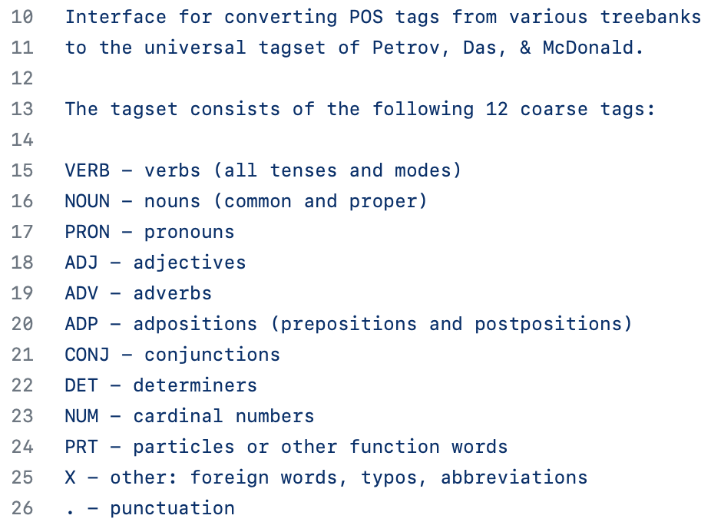
Tagset: Universal
Brown and PTB Mappings:
https://github.com/slavpetrov/universal-pos-tags/blob/fca8727e9424255f0732d1bc437f432f45a0c166/en-brown.map
https://github.com/slavpetrov/universal-pos-tags/blob/c8e49bf1654d337d55553fabd75b4073596feac7/en-ptb.map

Slide 6
Penn Part-of-Speech (POS) Tagset
J&M 3rd ed. draft

Slide 7
Tagset: Penn to Universal mapping
https://www.ling.upenn.edu/courses/Fall_2003/ling001/penn_treebank_pos.html
! . # . $ . '' . ( . ) . , . -LRB- . -RRB- . . . : . ? . LS X `` . | CC CONJ CD NUM CD|RB X DT DET EX DET FW X IN ADP IN|RP ADP JJ ADJ JJR ADJ JJRJR ADJ JJS ADJ JJ|RB ADJ JJ|VBG ADJ | MD VERB NN NOUN NNP NOUN NNPS NOUN NNS NOUN NN|NNS NOUN NN|SYM NOUN NN|VBG NOUN NP NOUN PDT DET POS PRT PRP PRON PRP$ PRON PRP|VBP PRON | VB VERB VBD VERB VBD|VBN VERB VBG VERB VBG|NN VERB VBN VERB VBP VERB VBP|TO VERB VBZ VERB VP VERB | PRT PRT RB ADV RBR ADV RBS ADV RB|RP ADV RB|VBG ADV RN X RP PRT SYM X TO PRT UH X WDT DET WH X WP PRON WP$ PRON WRB ADV

Slide 8
nltk.pos_tag(words)
Example:
>>> import nltk
>>> raw1 = open('ot.txt').read() % Oliver Twist
>>> words1 = nltk.word_tokenize(raw1)
>>> len(words1)
199779
>>> twl = nltk.pos_tag(words1)
>>> twl[-10:]
[('a', 'DT'), ('Church', 'NNP'), (',', ','), ('and', 'CC'), ('she', 'PRP'), ('was', 'VBD'), ('weak', 'JJ'), ('and', 'CC'), ('erring', 'VBG'), ('.', '.')]

Slide 9
nltk.pos_tag(words)
How to extract the adjectives and look at the frequency distribution?
use a conditional list comprehension over the nltk.pos_tag(words1) list.
What is the condition?
Each tuple has form (word, tag).
Tuples can be indexed: e.g. [0] for word or [1] for tag.
Relevant tag is 'JJ'.
Condition is tuple[1] == 'JJ'.
[tuple[0] for tuple in nltk.pos_tag(words1) if tuple[1] == 'JJ']
[word for (word,tag) in nltk.pos_tag(words1) if tag == 'JJ']

Slide 10
nltk.pos_tag(words)
Example:
>>> adjs = [tuple[0] for tuple in nltk.pos_tag(words1) if tuple[1] == 'JJ']
>>> len(adjs)
12439
>>> fd = nltk.FreqDist(adjs)
>>> fd
FreqDist({'’': 514, '“': 457, 'old': 434, '”': 422, 'young': 278, 'little': 262, 'other': 236, 'great': 229, 's': 229, 'good': 189, ...})

Slide 11
nltk.pos_tag(words)
Recall punctuation removal from Homework 7 Review?
>>> def isword(x):
... return any(c.isalpha() for c in x)
...
Get the adjectives (without punctuation):
>>> adjs = [word for (word,tag) in nltk.pos_tag(words1) if tag == 'JJ' and isword(word)]
>>> len(adjs)
11035
fd = nltk.FreqDist(adjs)
>>> fd
FreqDist({'old': 434, 'young': 278, 'little': 262, 'other': 236, 'great': 229, 's': 229, 'good': 189, 'same': 147, 'such': 138, 'll': 136, ...})
>>> fd.most_common(20)
[('old', 434), ('young', 278), ('little', 262), ('other', 236), ('great', 229), ('s', 229), ('good', 189), ('same', 147), ('such', 138), ('ll', 136), ('dear', 135), ('own', 131), ('many', 130), ('much', 127), ('first', 118), ('few', 110), ('last', 90), ('long', 87), ('small', 79), ('poor', 75)]

Slide 12
Worked Example
Let's compare the adjectives used by Charles Dickens in Oliver Twist and Nicholas Nickleby.
>>> raw2 = open('nn.txt').read()
>>> words2 = nltk.word_tokenize(raw2)
>>> adjs2 = [word for (word,tag) in nltk.pos_tag(words2) if tag == 'JJ' and isword(word)]
>>> len(words2)
396970
>>> len(adjs2)
22636
>>> fd2 = nltk.FreqDist(adjs2)
>>> fd2.most_common(20)
[('little', 713), ('old', 541), ('other', 539), ('young', 525), ('great', 521), ('such', 508), ('good', 382), ('dear', 329), ('own', 327), ('same', 320), ('much', 319), ('many', 318), ('last', 312), ('first', 253), ('poor', 218), ('long', 180), ('few', 162), ('short', 155), ('sure', 150), ('new', 141)]

Slide 13
Worked Example
How to plot the histograms?
y-axis: should be relative frequency, not raw counts
# of adjectives: ot: 11035, nn: 22636
x-axis: should be the adjectives
>>> awords2 = [tuple[0] for tuple in fd2.most_common(20)]
>>> awords = [tuple[0] for tuple in fd.most_common(20)]
>>> awords
['old', 'young', 'little', 'other', 'great', 's', 'good', 'same', 'such', 'll', 'dear', 'own', 'many', 'much', 'first', 'few', 'last', 'long', 'small', 'poor']
>>> awords2
['little', 'old', 'other', 'young', 'great', 'such', 'good', 'dear', 'own', 'same', 'much', 'many', 'last', 'first', 'poor', 'long', 'few', 'short', 'sure', 'new']
>>> x = list(set(awords).union(set(awords2)))
['own', 'great', 'll', 'little', 'much', 'dear', 'sure', 'short', 'many', 'first', 'young', 's', 'poor', 'last', 'few', 'small', 'new', 'other', 'same', 'good', 'such', 'long', 'old']

Slide 14
Worked Example
Histograms:
when counts are known, use plt.bar(x-values, heights)
plt.hist(words, bins) counts # occurrences of words for you

Slide 15
Worked Example
Histograms:
>>> import matplotlib.pyplot as plt
>>> plt.bar(range(len(x)),[fd[word]/len(fd) for word in x],fill=False,edgecolor='b',label='Oliver Twist')
>>> plt.bar(range(len(x)),[fd2[word]/len(fd2) for word in x],fill=False,edgecolor='g',label='Nicholas Nickleby')
>>> plt.xticks(range(len(x)),x,rotation=90)
>>> plt.legend()
>>> plt.show()
[fd[word]/len(fd) for word in x]
fd[word] = count for word
len(fd) = total count in FreqDist()
fd[word]/len(fd) = proportion of total count for word

Slide 16
Worked Example
We supply plt.bar() with two arguments:
>>> range(len(x))
range(0, 23) = [0,1,2,3,…]
and
>>> [fd[word]/len(fd) for word in x]
[0.05382087099424815, 0.09408381265406737, 0.05587510271158587, 0.1076417419884963, 0.05217748562037798, 0.055464256368118324, 0.01602300739523418, 0.02875924404272802, 0.05341002465078061, 0.04847986852917009, 0.114215283483977, 0.09408381265406737, 0.030813475760065736, 0.03697617091207888, 0.04519309778142974, 0.03245686113393591, 0.029170090386195564, 0.09695973705834018, 0.06039441248972884, 0.07764995891536565, 0.056696795398520954, 0.03574363188167625, 0.17830731306491374]
0.0941
0.0559
0.0538
0
1
2

Slide 17
Worked Example: top-20 adjectives

Slide 18
Worked Example

Slide 19
Worked Example
plt.bar(x-values, heights)

Slide 20
Worked Example
https://matplotlib.org/stable/gallery/color/named_colors.html#sphx-glr-gallery-color-named-colors-py

Slide 21
Worked Example
plt.bar(x-values, heights)

