Slide 1
LING 388: Computers and Language
Lecture 21

Slide 2
Today's Topics
Homework 8 Review
Let's examine Claude Shannon's 1948 claims about language models!
Bibliomancy
Text generation using a trigram model

Slide 3
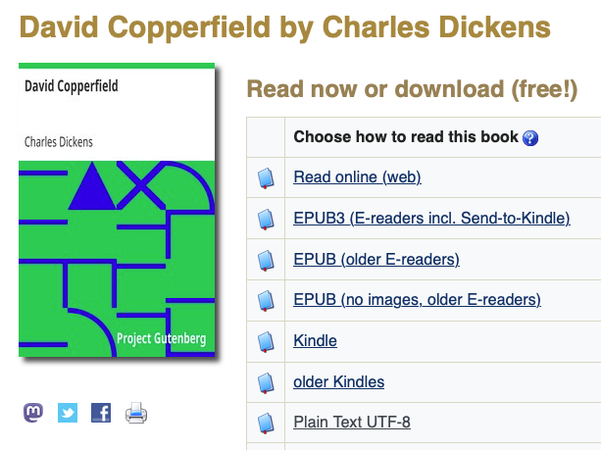
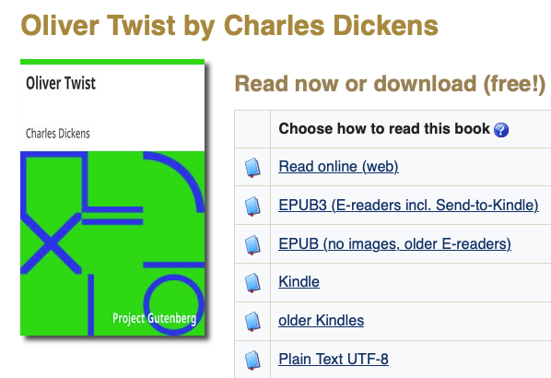
Homework 8 Review
>>> raw1 = open('ot.txt').read()
>>> raw2 = open('nn.txt').read()
>>> raw3 = open('dc.txt').read()
>>> raw = raw1+raw2+raw3
>>> len(raw)
4676272
>>> words = nltk.word_tokenize(raw)
>>> len(words)
1040364
million word Dickens corpus!

Slide 4
Homework 8 Review
>>> cfd = nltk.ConditionalFreqDist(nltk.bigrams(words))
>>> cfd
<ConditionalFreqDist with 28493 conditions>
>>> vocab = set(words)
>>> len(vocab)
28493
>>> sents = nltk.sent_tokenize(raw)
>>> len(sents)
38004
>>> fd = nltk.FreqDist([nltk.word_tokenize(sent)[0] for sent in sents])
>>> fd
FreqDist({'‘': 3383, 'I': 3360, '“': 2329, 'The': 1481, 'He': 1201, "'": 1084, 'It': 1014, 'But': 752, 'She': 558, 'You': 535, ...})

Slide 5
3. THE SERIES OF APPROXIMATIONS TO ENGLISH
Zero-order approximation (symbols independent and equiprobable).
XFOML RXKHRJFFJUJ ZLPWCFWKCYJ FFJEYVKCQSGHYD QPAAMKBZAACIBZL- HJQD.
First-order approximation (symbols independent but with frequencies of English text).
OCRO HLI RGWR NMIELWIS EU LL NBNESEBYA TH EEI ALHENHTTPA OOBTTVA NAH BRL.
Second-order approximation (digram structure as in English).
ON IE ANTSOUTINYS ARE T INCTORE ST BE S DEAMY ACHIN D ILONASIVE TU- COOWE AT TEASONARE FUSO TIZIN ANDY TOBE SEACE CTISBE.
Third-order approximation (trigram structure as in English).
IN NO IST LAT WHEY CRATICT FROURE BIRS GROCID PONDENOME OF DEMONSTURES OF THE REPTAGIN IS REGOACTIONA OF CRE.
First-order word approximation. Rather than continue with tetragram,: : : ,n-gram structure it is easier and better to jump at this point to word units. Here words are chosen independently but with their appropriate frequencies.
REPRESENTING AND SPEEDILY IS AN GOOD APT OR COME CAN DIFFERENT NATURAL HERE HE THE A IN CAME THE TO OF TO EXPERT GRAY COME TO FURNISHES THE LINE MESSAGE HAD BE THESE.
Second-order word approximation, (i.e. bigram). The word transition probabilities are correct but no further structure is included.
THE HEAD AND IN FRONTAL ATTACK ON AN ENGLISH WRITER THAT THE CHARACTER OF THIS POINT IS THEREFORE ANOTHER METHOD FOR THE LETTERS THAT THE TIME OF WHO EVER TOLD THE PROBLEM FOR AN UNEXPECTED.

Slide 6
How did Shannon do this?
To construct (3) for example, one opens a book at random and selects a letter at random on the page. This letter is recorded. The book is then opened to another page and one reads until this letter is encountered. The succeeding letter is then recorded. Turning to another page this second letter is searched for and the succeeding letter recorded, etc.
A similar process was used for (4), (5) and (6).
It would be interesting if further approximations could be constructed, but the labor involved becomes enormous at the next stage.

Slide 7
3. THE SERIES OF APPROXIMATIONS TO ENGLISH
Shannon's claims:
The resemblance to ordinary English text increases quite noticeably at each of the above steps.
Note that these samples have reasonably good structure out to about twice the range that is taken into account in their construction.
In (6) sequences of four or more words can easily be placed in sentences without unusual or strained constructions. The particular sequence of ten words “attack on an English writer that the character of this” is not at all unreasonable.
It appears then that a sufficiently complex stochastic process will give a satisfactory representation of a discrete source.

Slide 8
Homework 8 Review
>>> help(sentence)
Help on function sentence in module __main__:
sentence(w)
generate words until punctuation . ! ?
#1: I
>>> sentence('I')
['I', 'had', 'enough', 'to', 'ruminate', '.']
>>> sentence('I')
['I', 'entreated', 'that', 'it', 'IS', 'DISCUSSED', 'AND', 'Joram', '!']
5
5

Slide 9
Homework 8 Review
#2: The
>>> sentence('The')
['The', 'room', ',', 'she', 'took', 'the', 'wall', '--', 'to', 'win', 'anybody', 'was', 'overpowered', 'by', 'no', 'affinity', 'between', 'him', 'all', 'its', 'shapes', 'and', 'whether', 'my', 'mirror', 'with', 'him', ',', 'surely', 'do', 'you', ',', 'by', 'the', 'fear', ',', 'and', 'asked', 'hurriedly', 'thrust', 'in', 'making', 'a', 'pigeon-house', 'on', 'account', 'of', 'retreating', 'footsteps', '.']
>>> sentence('The')
['The', 'people', 'may', 'be', 'grateful', 'little', 'Em', '’', 's', 'life', ',', 'and', 'kiss', 'from', 'attentions', '.']
9
5

Slide 10
Homework 8 Review
#3: He
>>> sentence('He')
['He', 'had', 'the', 'dusty', 'suburb', 'of', 'me', 'that', 'Oliver', 'felt', 'that', 'I', 'wonder', 'whether', 'he', 'explained', 'to', 'witness', 'their', 'speech', ')', ',', 'that', 'it', 'was', 'spoken', 'of', 'the', 'ground', ',', 'perfectly', 'afford', '.']
>>> sentence('He')
['He', 'is', 'out', '!']
10
3

Slide 11
Homework 8 Review
#4: It
>>> sentence('It')
['It', 'was', 'intoxicated', 'as', 'I', 'think', 'she', 'was', 'yet', 'a', 'feeble', ',', 'and', 'for', 'him', 'away', '.']
>>> sentence('It')
['It', 'was', 'scarcely', 'fair', 'way', 'to', 'have', 'died', 'intestate', ',', 'do', '.']
6
6

Slide 12
Homework 8 Review
#5: But
>>> sentence('But')
['But', 'seeing', 'them', 'their', 'both', 'hands', 'with', 'his', 'face', '.']
>>> sentence('But')
['But', 'wot', 'makes', 'faces', '.']
6
4

Slide 13
Summary
>>> import matplotlib.pyplot as plt
>>> plt.hist(values,range(1,11),align='left')
>>> plt.xticks(range(1,11))
>>> plt.yticks(range(0,5))
>>> plt.xlabel('length of grammatical sequence')
Text(0.5, 0, 'length of grammatical sequence')
>>> plt.ylabel('count')
Text(0, 0.5, 'count')
>>> plt.show()

Slide 14
How did Shannon do this?
It would be interesting if further approximations could be constructed, but the labor involved becomes enormous at the next stage.
We have laptops and nltk, Shannon in 1948 didn't.
We can try trigrams!

Slide 15
An aside …
All you need is a book which is believed to hold truth; popular options include religious tomes such as the Bible or Koran, classics like Homer’s Iliad or Odyssey or perhaps the Complete Works of Shakespeare.
The book is balanced on its spine and allowed to fall open at random;
Some prefer to choose the page through other random means such as the rolling of dice or the use of a random number generator.

Slide 16
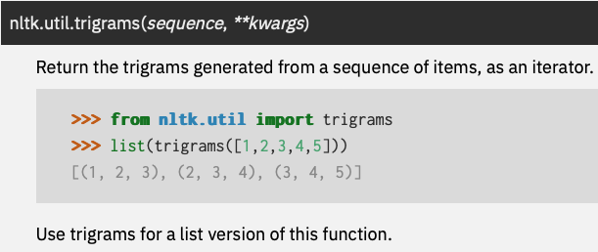
nltk.trigrams(words)
Previously:
nltk.ConditionalFreqDist(nltk.bigrams(words))
takes tuples of exactly length two
nltk.bigrams(words) produces a list of (word1, word2) tuples

Slide 17
nltk.trigrams(words)
>>> cfd = nltk.ConditionalFreqDist([((w1,w2), w3) for (w1,w2,w3) in nltk.trigrams(words)])
Explanation:
((w1,w2), w3) is a 2-item tuple, the condition itself is a tuple (w1, w2)
nltk.trigrams(words) produces the 3-item tuple (w1, w2, w3)
list comprehension builds [((w1,w2), w3) for …loop… ]
we loop over nltk.trigrams(words)
Example:
>>> cfd[('The','people')]
FreqDist({'in': 2, 'who': 1, 'at': 1, 'were': 1, 'of': 1, 'fell': 1, '’': 1, 'was': 1})
>>> cfd3
<ConditionalFreqDist with 257484 conditions>

Slide 18
Code Snippet

Slide 19
nltk.trigrams(words)
Help on function sentence in module __main__:
sentence(w1)
generate words starting with word w1 until punctuation . ! ?
assumes conditional frequency distribtions variables cfd2 and cfd3 for bigrams and trigrams
Recall top 1st words:
FreqDist({'‘': 3383, 'I': 3360, '“': 2329, 'The': 1481, 'He': 1201, "'": 1084, 'It': 1014, 'But': 752, 'She': 558, 'You': 535, ...})

Slide 20
Generate sentences using trigrams
#1: I, #2 The
>>> sentence('I')
['I', 'begged', 'him', 'not', 'to', 'shield', 'my', 'Dora', ',', 'perambulated', 'round', 'and', 'round', 'the', 'neck', ',', 'and', 'with', 'occasional', 'stoppages', ',', 'adapted', 'to', 'my', 'heart', 'and', 'blessing', '!']
>>> sentence('I')
['I', 'was', 'not', 'the', 'custom', 'to', 'do', '.']
>>> sentence('The')
['The', 'memories', 'which', 'peaceful', 'country', 'scenes', 'call', 'up', 'some', 'articles', 'which', 'were', 'lying', 'under-foot', ',', 'and', 'I', 'so', 'arranged', ',', 'and', 'solicitous', ',', 'and', 'was', 'returning', 'to', 'London', ',', 'now', 'made', 'pretty', 'large', ',', 'in', 'the', 'very', 'tiptop', 'and', 'summit', 'of', 'at', 'least', 'four', 'chairs', ',', 'with', 'a', 'mighty', 'creature', ',', "'", 'said', 'Mr.', 'Peggotty', 'too', ',', 'and', 'solitary', '.']
>>> sentence('The')
['The', 'day', 'seems', 'different', 'to', 'me', 'her', 'delicious', 'hand', '.']

Slide 21
Generate sentences using trigrams
#3: He, #4 It
>>> sentence('He')
['He', 'comes', 'to', 'speak', ',', '“', 'and', 'kittens', 'too', ',', 'and', 'Bolter', 'turns', 'King', '’', 's', 'answer', '.']
>>> sentence('He')
['He', '’', 'll', 'ruin', 'him', ',', 'but', 'of', 'two', 'hours', ';', 'she', 'going', 'back', 'those', 'many', 'conflicts', 'of', 'my', 'money', '--', 'on', 'which', 'I', 'noticed', ',', 'by', 'which', 'they', 'were', 'in', 'the', 'coach-yard', '.']
>>> sentence('It')
['It', 'is', 'very', 'comfortable', '.']
>>> sentence('It')
['It', 'is', 'shame', 'to', 'see', 'and', 'hear', 'the', 'bell', 'had', 'rung', 'for', 'him', ',', 'the', 'unsettled', 'habits', 'of', 'the', 'denial', ',', 'for', 'the', 'excitement', 'which', 'had', 'been', ';', 'and', 'my', 'poor', 'poor', 'prayer', '!']

Slide 22
Generate sentences using trigrams
#5: But, #6 She
>>> sentence('But')
['But', 'the', 'girl', '.']
>>> sentence('But')
['But', 'don', '’', 't', 'know', 'when', '.']
>>> sentence('She')
['She', 'thought', 'she', 'never', 'saw', 'a', 'Panorama', 'and', 'some', 'at', 'great', 'length', ';', "'do", "n't", 'call', 'yourself', 'out', 'of', 'book', ',', 'without', 'further', 'discussion', 'of', 'such', 'of', 'the', 'Edwards', '.']
>>> sentence('She')
['She', 'gave', 'me', 'life', ';', 'theft', 'is', 'your', 'opinion', '?']

Slide 23
n-grams
could do quadgrams and 5-grams etc.
I'm not sure what mininum corpus size is required to get meaningful statistics

Slide 24
n-grams
Silva and Cunha (2020)
C = corpus size
D = distinct n-grams
This paper contributes with an empirical study on the n-gram frequency distribution from 1-grams to 6-grams, with large real corpora (English and French) from millions up to a few billion words.

