Slide 1
LING 388: Computers and Language
Lecture 20

Slide 2
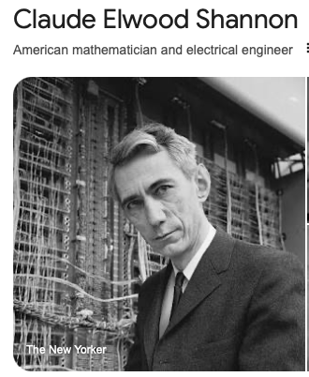
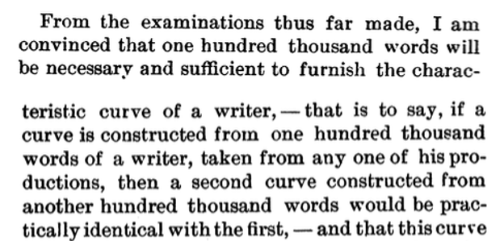
Milestones
Mendenhall's 1887 Science paper
you guys reproduced his experiment (nltk made it easy)
tested his claims about stylometry
Next, on our radar is Claude Shannon!
Fast forward to 1948.
Paper is: The mathematical theory of communication.

Slide 3
Today's Topics
Recap of nltk.ConditionalFreqDist(nltk.bigrams(text))
Homework 8

Slide 4
Last Time
Given any corpus, e.g. words, a list of words:
cfd = nltk.ConditionalFreqDist(nltk.bigrams(words))
nltk.bigrams(words) produces a list of (word1, word2) tuples
cfd[word1] returns a FreqDist for the next word word2.
cfd[word1][word2] = # times bigram word1 word2 occurs
word1 is called the condition
Example
words that follow The/the from the book of Genesis:
>>> cfd['The']
FreqDist({'sons': 5, 'children': 4, 'LORD': 4, 'man': 3, 'days': 2, 'three': 2, 'name': 1, 'woman': 1, 'serpent': 1, 'earth': 1, ...})
>>> cfd['the']
FreqDist({'land': 156, 'LORD': 154, 'earth': 105, 'sons': 69, 'name': 42, 'field': 39, 'men': 36, 'man': 34, 'waters': 30, 'children': 30, ...})

Slide 5
Last Time
Generate text using a bigram probability distribution
https://docs.python.org/3/library/random.html#random.choice
from random import choice
>>> from random import choice
>>> choice(['the','man','the','woman'])
'woman'
>>> choice(['the','man','the','woman'])
'woman'
>>> choice(['the','man','the','woman'])
'the'

Slide 6
random.choice()
Over the long run, experiments should come out right:
python
>>> import nltk
>>> from random import choice
>>> nltk.FreqDist([choice(['the','man','the','woman']) for i in range(1000)])
FreqDist({'the': 491, 'woman': 255, 'man': 254})
500
250
250

Slide 7
Last Time
Course website: randomtext.py

Slide 8
Example
python –i randomtext.py
>>> from nltk.corpus import genesis
>>> words = genesis.words('english-kjv.txt')
>>> cfd = nltk.ConditionalFreqDist(nltk.bigrams(words))
len(words)
44764
cfd
<ConditionalFreqDist with 2789 conditions>
vocab = set(words)
len(vocab)
2789
Our corpus!

Slide 9
Example
>>> nwords(10, 'The')
['The', 'sun', 'went', 'on', 'me', ',', 'the', 'inhabitants', 'of', 'Zilpah']
>>> nwords(10, 'The')
['The', 'dream', ',', 'which', 'was', 'brought', 'him', '.', 'The', 'Kenites']
Notice: punctuation counts as a word
Instead of a fixed number of words, we can generate words until we encounter a sentence-ending punctuation symbol, e.g. ?,!,.
function is called sentence(StartWord)

Slide 10
Example
nn.txt is Nicholas Nickleby
python -i randomtext.py
>>> raw = open('nn.txt').read()
>>> words = nltk.word_tokenize(raw)
>>> cfd = nltk.ConditionalFreqDist(nltk.bigrams(words))
>>> sentence('The')
['The', 'time', 'to', 'be', 'sike', 'scoondrels', 'while', 'he', 'took', 'no', 'more', 'the', 'proposed', ',', 'that', 'after', 'a', 'great', 'Joint', 'Stock', 'Company', '.']
>>> sentence('The')
['The', 'two', 'other', '!']
>>> sentence('The')
['The', 'wretched', ',', 'and', 'disorder', ',', "'don't", 'talk', 'in', 'tears', ',', 'that', 'I', 'am', 'aware', 'of', 'the', 'most', 'convenient', 'toothpicks', '.']

Slide 11
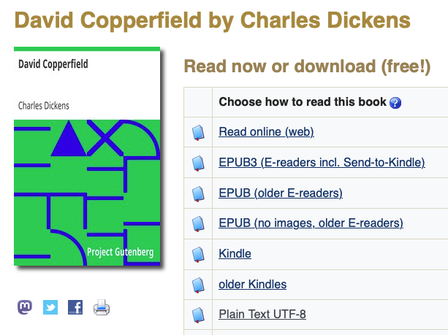
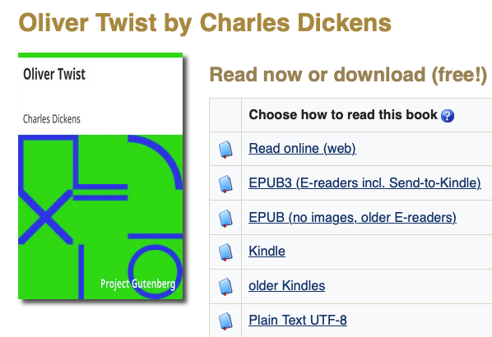
Homework 8
https://www.gutenberg.org
After Homework 7 you have the text of:
words: 396,970
words: 443,615
words: 199,836
About 1 million words!
(after editing out Gutenberg preamble + postscript)

Slide 12
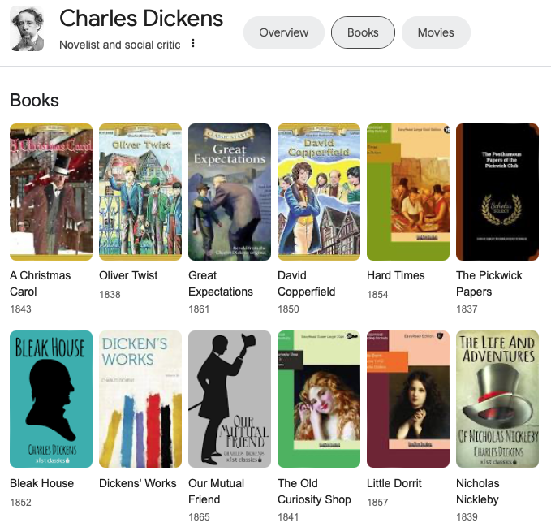
Homework 8
Charles Dickens was a most prolific writer

Slide 13
Homework 8
Step 1: concatenate all three books into a million word corpus.
do it manually or inside python as follows:
raw1 = open('nn.txt').read()
raw2 = …
raw = raw1 + raw2 # + is string concatenation
Step 2: tokenize the raw text
check to see if you have your million words!
Step 3: build the cfd out of the bigrams
Question 1: How many conditions (vocabulary size) do you have?

Slide 14
Homework 8
Step 4: using nltk.sent_tokenize(raw), raw a string (not a list of words!)
Question 2: How many sentences are in this million word Dickens corpus?
Hint: you probably want to save sentences into a list, e.g. sents = nltk.sent_tokenize(raw)
Note: each sentence in the list is still a string (not a list of words).

Slide 15
Homework 8
Step 5: using sents, the list of sentences in step 4, let's compute the Frequency Distribution of the 1st word (of sentences) as follows:
[nltk.word_tokenize(sent)[0] for sent in sents]
Explanation:
nltk.word_tokenize(sent) is the list of words for string sent.
nltk.word_tokenize(sent)[0] is the 1st word in each sentence.
[…] list comprehension collects the first words of all the sentences.
nltk.FreqDist() applied to this corpus of first words will give the distribution of possible first words
Question 3: which is the most frequent 1st word of our sentence corpus?
Hint: you might expect 'The', but you'd be wrong…
Question 4: what are the top 5 1st words (that are not punctuation)?

Slide 16
Homework 8
Step 6: using randomtext.py generate some sample sentences using the top-5 1st words (that are not punctuation) from those you found in step 5.
Question 5: are the bigram-derived sentences grammatical? Explain.
Question 6: what is the longest grammatical (sub)sequence?
Example:
>>> sentence('The')
['The', 'heartiness', ',', 'that', 'really', 'I', 'have', 'being', 'now', ',', 'and', 'Mrs.', 'Corney', '’', 'returned', ',', 'addressing', 'the', 'least', 'it', 'written', 'in', 'search', 'of', 'me', 'in', 'his', 'word', 'with', 'her', ',', 'friendship', '!']

Slide 17
Homework 8 Review
Claude Shannon (1948)
Father of Information Theory

Slide 18
3. THE SERIES OF APPROXIMATIONS TO ENGLISH
Zero-order approximation (symbols independent and equiprobable).
XFOML RXKHRJFFJUJ ZLPWCFWKCYJ FFJEYVKCQSGHYD QPAAMKBZAACIBZL- HJQD.
First-order approximation (symbols independent but with frequencies of English text).
OCRO HLI RGWR NMIELWIS EU LL NBNESEBYA TH EEI ALHENHTTPA OOBTTVA NAH BRL.
Second-order approximation (digram structure as in English).
ON IE ANTSOUTINYS ARE T INCTORE ST BE S DEAMY ACHIN D ILONASIVE TU- COOWE AT TEASONARE FUSO TIZIN ANDY TOBE SEACE CTISBE.
Third-order approximation (trigram structure as in English).
IN NO IST LAT WHEY CRATICT FROURE BIRS GROCID PONDENOME OF DEMONSTURES OF THE REPTAGIN IS REGOACTIONA OF CRE.
First-order word approximation. Rather than continue with tetragram,: : : ,n-gram structure it is easier and better to jump at this point to word units. Here words are chosen independently but with their appropriate frequencies.
REPRESENTING AND SPEEDILY IS AN GOOD APT OR COME CAN DIFFERENT NATURAL HERE HE THE A IN CAME THE TO OF TO EXPERT GRAY COME TO FURNISHES THE LINE MESSAGE HAD BE THESE.
Second-order word approximation, (i.e. bigram). The word transition probabilities are correct but no further structure is included.
THE HEAD AND IN FRONTAL ATTACK ON AN ENGLISH WRITER THAT THE CHARACTER OF THIS POINT IS THEREFORE ANOTHER METHOD FOR THE LETTERS THAT THE TIME OF WHO EVER TOLD THE PROBLEM FOR AN UNEXPECTED.

Slide 19
3. THE SERIES OF APPROXIMATIONS TO ENGLISH
Shannon's claims:
The resemblance to ordinary English text increases quite noticeably at each of the above steps.
Note that these samples have reasonably good structure out to about twice the range that is taken into account in their construction.
In (6) sequences of four or more words can easily be placed in sentences without unusual or strained constructions. The particular sequence of ten words “attack on an English writer that the character of this” is not at all unreasonable.
It appears then that a sufficiently complex stochastic process will give a satisfactory representation of a discrete source.

Slide 20
How did Shannon do this?
To construct (3) for example, one opens a book at random and selects a letter at random on the page. This letter is recorded. The book is then opened to another page and one reads until this letter is encountered. The succeeding letter is then recorded. Turning to another page this second letter is searched for and the succeeding letter recorded, etc.
A similar process was used for (4), (5) and (6).
It would be interesting if further approximations could be constructed, but the labor involved becomes enormous at the next stage.

Slide 21
NLTK Book: Chapter 2
nltk.ConditionalFreqDist() generally works over tuples (condition, value)
i.e. tuples need not be limited to bigrams.
Example:
import nltk
s = "Jim walks to the bank via the river bank and small bridge"
cfd = nltk.ConditionalFreqDist((len(w),w) for w in nltk.word_tokenize(s))
cfd[3]
FreqDist({'the': 2, 'Jim': 1, 'via': 1, 'and': 1})
cfd[4]
FreqDist({'bank': 2})
cfd[5]
FreqDist({'small': 1, 'river': 1, 'walks': 1})
cfd[2]
FreqDist({'to': 1})

Slide 22
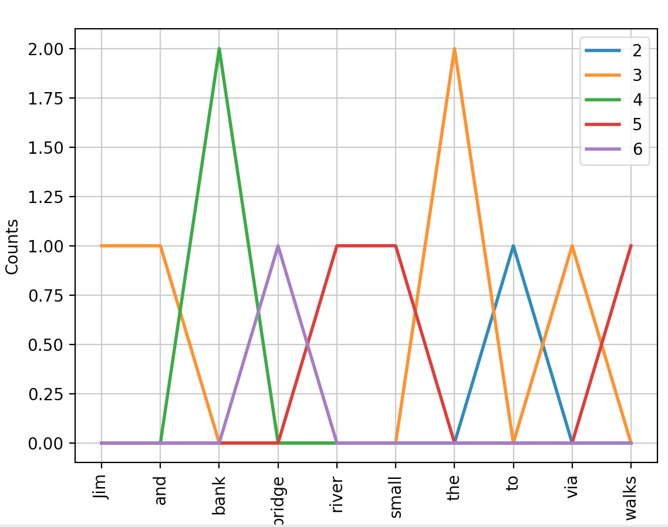
NLTK Book: Chapter 2
ConditionalFreqDist
Example:
cfd.conditions()
[2, 3, 4, 5, 6]
cfd.tabulate()
Jim and bank bridge river small the to via walks
2 0 0 0 0 0 0 0 1 0 0
3 1 1 0 0 0 0 2 0 1 0
4 0 0 2 0 0 0 0 0 0 0
5 0 0 0 0 1 1 0 0 0 1
6 0 0 0 1 0 0 0 0 0 0
cfd.plot()

Slide 23
nltk book: 1.3 Brown Corpus
>>> from nltk.corpus import brown
>>> len(brown.fileids())
500
>>> brown.categories()
['adventure', 'belles_lettres', 'editorial', 'fiction', 'government', 'hobbies', 'humor', 'learned', 'lore', 'mystery', 'news', 'religion', 'reviews', 'romance', 'science_fiction']
>>> news = brown.words(categories='news')
>>> import nltk
>>> fd = nltk.FreqDist(w.lower() for w in news)
>>> modals = ['can', 'could', 'may', 'might', 'must', 'shall', 'should', 'will', 'would']
>>> for m in modals:
... print('{}: {}'.format(m,fd[m]), end=' ')
...
can: 94 could: 87 may: 93 might: 38 must: 53 shall: 5 should: 61 will: 389 would: 246
>>>
frequency distribtution of modals over the category news

Slide 24
nltk book: 2 Conditional Frequency Distributions

Slide 25
nltk book: 2 Conditional Frequency Distributions
>>> modals = ['can', 'could', 'may', 'might', 'must', 'shall', 'should', 'will', 'would']
>>> cfd = nltk.ConditionalFreqDist((cat,word) for cat in brown.categories() for word in brown.words(categories=cat))
>>> cfd.tabulate(conditions=brown.categories(), samples=modals)
can could may might must shall should will would
adventure 46 151 5 58 27 7 15 50 191
belles_lettres 246 213 207 113 170 34 102 236 392
editorial 121 56 74 39 53 19 88 233 180
fiction 37 166 8 44 55 3 35 52 287
government 117 38 153 13 102 98 112 244 120
hobbies 268 58 131 22 83 5 73 264 78
humor 16 30 8 8 9 2 7 13 56
learned 365 159 324 128 202 40 171 340 319
lore 170 141 165 49 96 12 76 175 186
mystery 42 141 13 57 30 1 29 20 186
news 93 86 66 38 50 5 59 389 244
religion 82 59 78 12 54 21 45 71 68
reviews 45 40 45 26 19 1 18 58 47
romance 74 193 11 51 45 3 32 43 244
science_fiction 16 49 4 12 8 3 3 16 79
The NLTK book says, "Observe that the most frequent modal in the news genre is will, while the most frequent modal in the romance genre is could*" *actually, would in this table
Would you have predicted this?

