Slide 1
LING 388: Computers and Language
Lecture 2

Slide 2
Last Time
Homework 1: install Python
Did you manage to do this?
If not, bring your laptop for help
Recommend bringing your laptop to class anyway
follow the examples in the slides
if something doesn't work, you can ask

Slide 3
Today's Lecture
Google N-grams
nothing to install
we'll be using https://books.google.com/ngrams/
follow along using your laptop
Quick Homework 2: due tomorrow night!

Slide 4
Models of Language
We generally seek simple formal models for (rich and complex) human language
reasons: explanatory depth ● plausibly acquired ● plausibly evolved
Examples: Chomsky (1956) 3 models
string concatenation: n-gram
phrases (that expand recursively),
phrase structure grammars
noun phrase (NP): e.g., John, the little house
verb phrase (VP): e.g., ran, walked to the store
transformations (that rearrange structure)
have (perfective) have + -en: has been taking
passive: food was eaten
Minimalist Program (Merge) Chomsky (1995 onwards)
Google n-grams: see later

Slide 5
Simplicity and String Concatenation
Examples: Chomsky (1956) 3 models
string concatenation: n-gram
N-gram:
unigram (1-gram), a single word
bigram (2-gram), i.e. 2 words next to each other
trigram (3-gram), i.e. 3 words in a row
Given any text corpus (or millions of books and articles, e.g. Google)
we can record n-gram counts in a (vast) table
simple and easy to compute given any text corpus
lots of memory is required

Slide 6
Google Books N-gram Viewer
https://books.google.com/ngrams
October 2019: 40 million books "scanned"
copyright issues … lawsuits
Other sources:
Project Gutenberg (since 1971)
public domain literature: 60K books
https://www.gutenberg.org
Google fast scanning machines. Source: Business Insider

Slide 7
Hurricanes, typhoons and cyclones
A hurricane occurs in the Atlantic Ocean and northeastern Pacific Ocean.
A typhoon occurs in the northwestern Pacific Ocean.
A cyclone occurs in the south Pacific or Indian Ocean.
Wikipedia: tropical cyclone [edited].
September 2018: NASA image of hurricane Florence from the ISS (200 km/hr winds; 54 deaths; $24 billion)
Notes:
> $38 billion damage, 130 mph, 6th costliest tropical cyclone on record

Slide 8
Hurricanes, typhoons and cyclones

Slide 9
Hurricanes, typhoons and cyclones
huracan (Carib)
Notes:
Kalina people (Caribs) of South America. It is spoken by around 7,400 people mostly in Venezuela, Trinidad and Tobago,^{[3]} Guyana, Suriname, French Guiana, and Brazil. The language is currently classified as highly endangered

Slide 10
Hurricanes, typhoons and cyclones
spelling
OED:
Notes:
Transition from old to modern English. Invention of the printing press (Gutenberg, 1439)

Slide 11
Hurricanes, typhoons and cyclones
OED:

Slide 12
Hurricanes, typhoons and cyclones
Wikpedia: Orthography standardized by the (metal type) printing press, invented (on the European side) by Gutenberg, c. 1440, imported to England by Caxton, 1476.

Slide 13
Hurricanes, typhoons and cyclones
cyclone is a neoclassical neologism (in 1850) (ancient Greek)

Slide 14
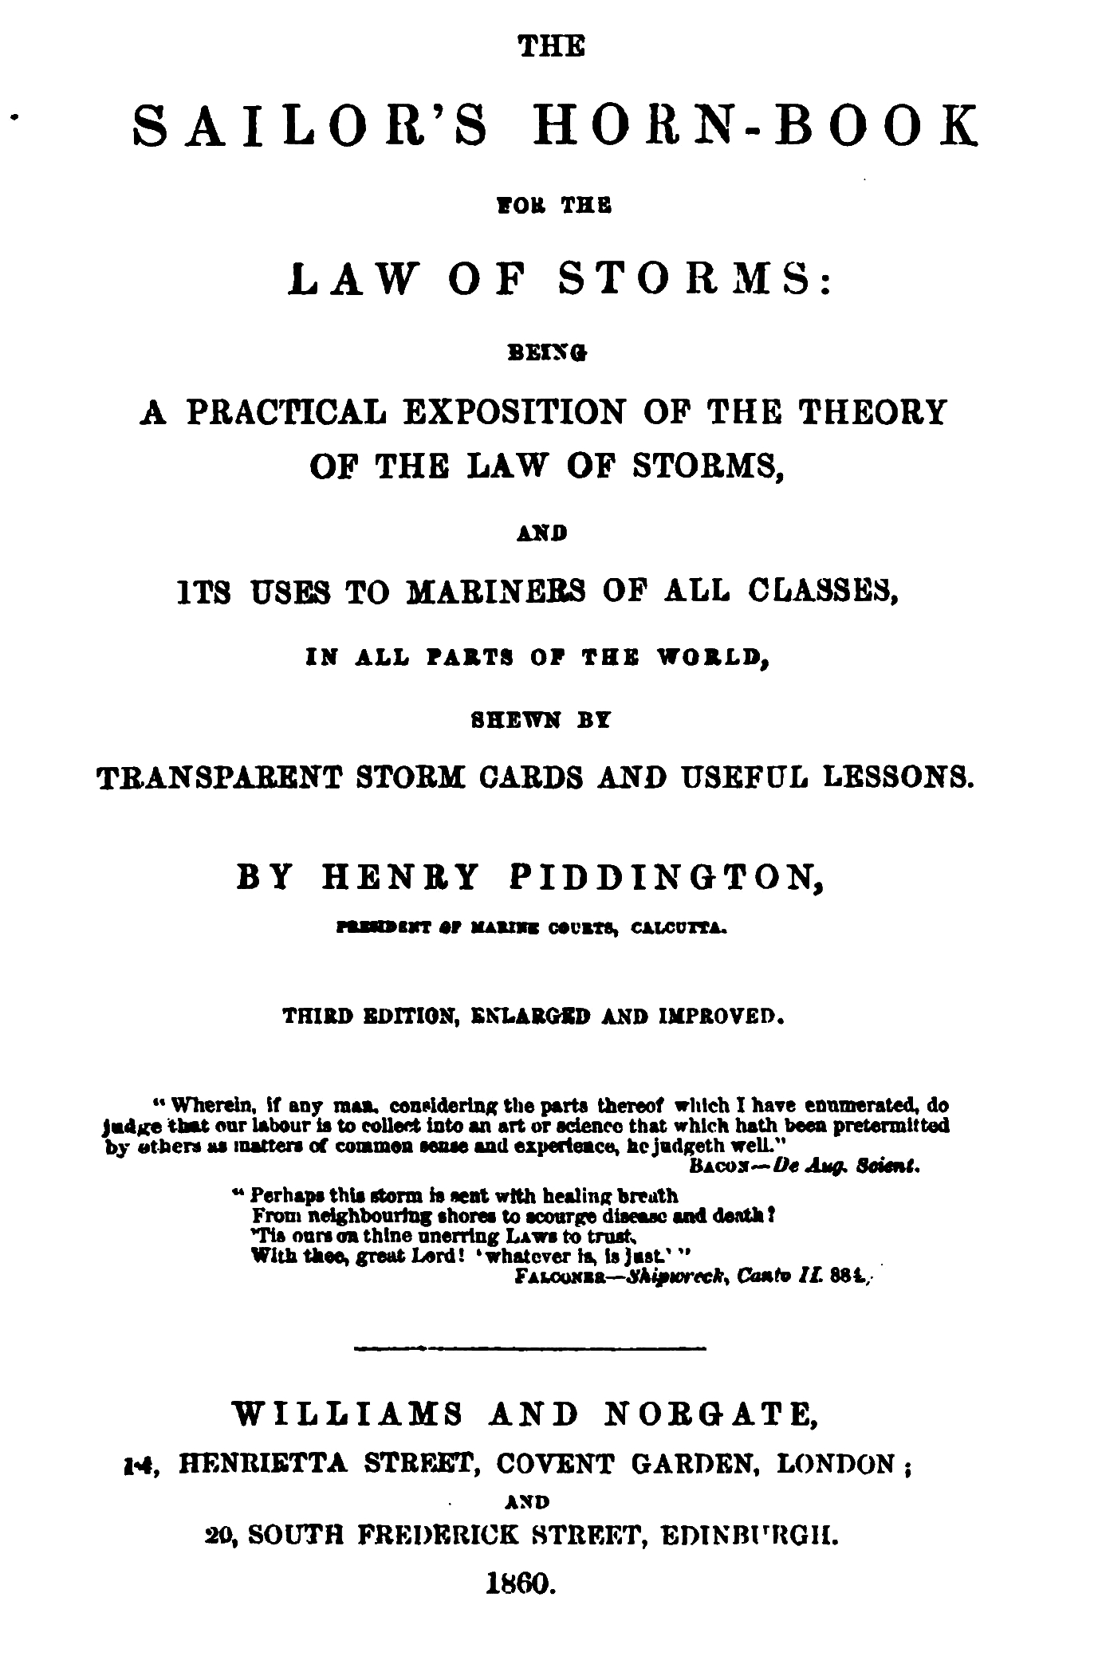
Hurricanes, typhoons and cyclones
Henry Piddington
sailor, captain, curator of museum, president of marine courts in Calcutta (British India).
Notes:
Capital of British India. Kolkata. West Bengal. Bengali.

Slide 15
Hurricanes, typhoons and cyclones

Slide 16
Hurricanes, typhoons and cyclones
Ty∙phoon
大∙風
daai⁶ fung¹ (Cantonese)
dà fēng (Mandarin)
But 颱風 first appeared in the 18th century (Louie & Liu, 2013)
toi⁴ fung² (Cantonese)

Slide 17
Hurricanes, typhoons and cyclones
https://books.google.com/ngrams
大∙風 (OED)
daai⁶ fung¹ (Cantonese)

Slide 18
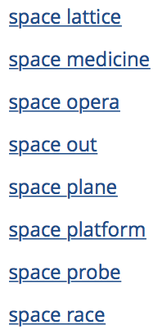
What's an N-gram?
Example (color-coded):
Star Wars is an American epic space opera franchise.
Some bigrams (also trigrams) appear as dictionary headwords:
☜
space opera is an example of a bigram that's a noun-noun compound

Slide 19
What's an N-gram?
How about the trigram epic space opera?
☜can you guess the
meaning?

Slide 20
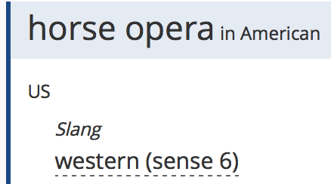
What's an N-gram?

Slide 21
Star Wars and Star Trek
Bigrams
both enormously successful franchises …

Slide 22
Star Wars and Star Trek
Why this blip ???
Zooming in to 1965 onwards…
Next Generation films
Original trilogy
Initial run
canceled: 1969
Syndication
Prequel trilogy

Slide 23
Star Wars and Star Trek
QUESTION:
How can we check
our hypothesis
is right?
Strategic Defense initiative (SDI)

Slide 24
Star Wars and Star Trek

Slide 25
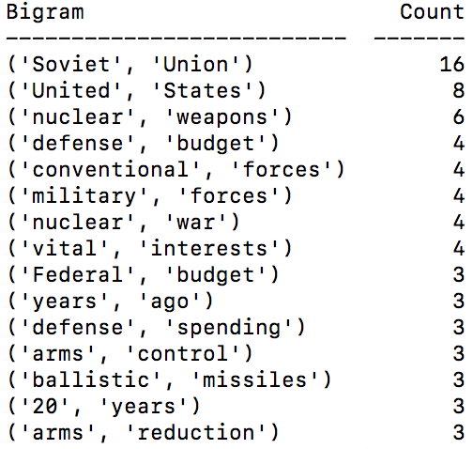
Ronald Reagan "Star Wars" Speech
https://www.youtube.com/watch?v=8phZrqb8QOY
Top bigrams and trigrams:
The bigram
Star Wars
was never actually
mentioned in
the speech …

Slide 26
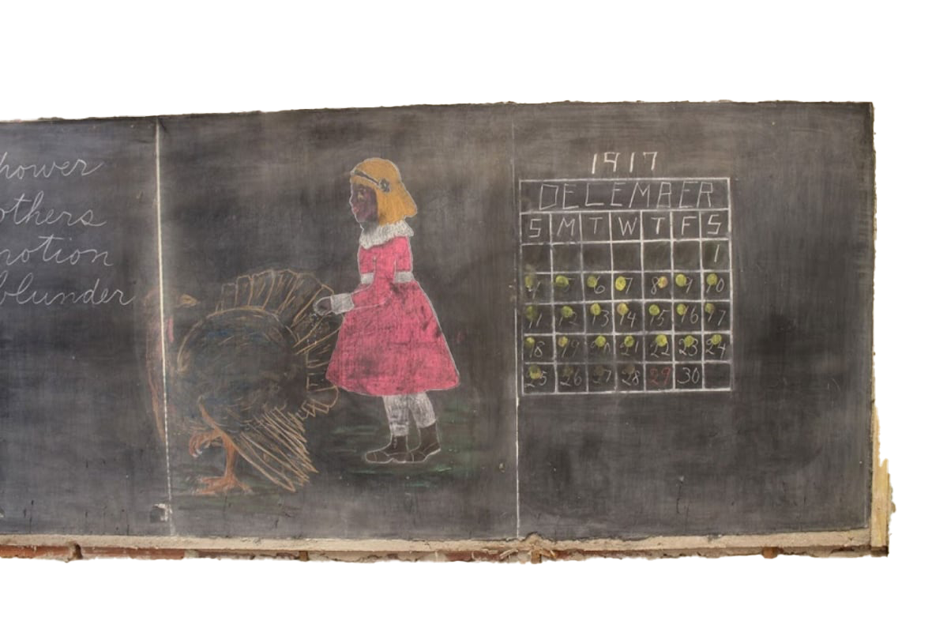
Blackboards, chalkboards and whiteboards
Blackboards:
"The term ‘blackboard’ is attested in English from the mid-eighteenth century."
OED: “with Chalk on a black-Board” (1739)
"first attested use of chalk on blackboard in the United States dates to September 21, 1801, in a lecture course in mathematics given by George Baron."
(Source: Wikipedia)
Okahoma City 1917 classroom preserved (found in 2015)

Slide 27
Blackboards, chalkboards and whiteboards
Staged word compound formation?
"black-Board” (1739) => blackboard
1860

Slide 28
Toothpaste vs tooth paste vs tooth-paste
also tooth-paste, 1832, from tooth + paste (n.).
Earlier substances:
tooth-powder (1540s)
tooth-soap (c. 1600)

Slide 29
Blackboards, chalkboards and whiteboards
whiteboards popular in the computer era
Reasons?
invention of the dry-erase marker (1975)
dust and floppy disk drives
respiratory issues

Slide 30
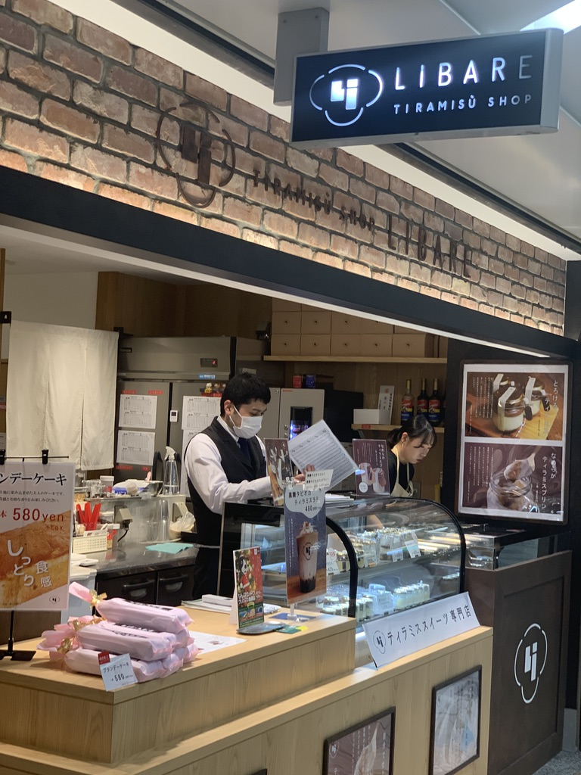
Tiramisu
"Tiramisu is a timeless no-bake Italian dessert combining espresso-dipped ladyfingers and a creamy lightly sweetened mascarpone cream."
https://sallysbakingaddiction.com/tiramisu/

Slide 31
Tiramisu
Most accounts of the origin of tiramisu date its invention to the 1960s in the region of Vento, Italy, at the restaurant Le Beccherie in Trevisio. (Wikipedia)
First mentions:
1980 Sabatini Coletti (Italian dictionary)
1982 Merriam-Webster
Why?

Slide 32
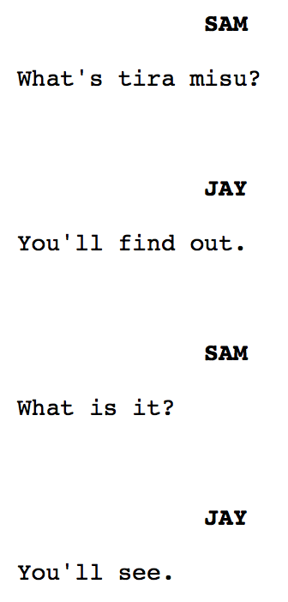
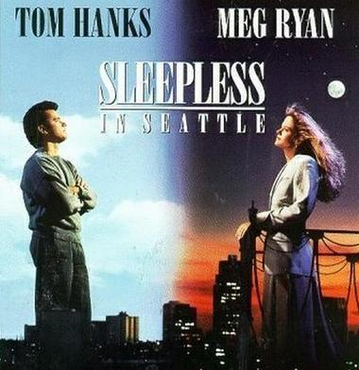
Tiramisu
Dialogue:
The movie "Sleepless in Seattle" came out in 1993!
Notes:
back to previous slide

Slide 33
Tiramisu
Recent sad news …

Slide 34
Quick Homework 2
Using Google N-grams
Question 1: foreign words
Look up pizza, sushi and taco
Which one came into the English language first? Are you surprised?
Question 2: compounding
Look up toothpaste, tooth paste (two words: bigram), tooth-paste (hyphenated)
About how many years did it take toothpaste to overtake the other two forms?

Slide 35
Quick Homework 2
Submit to sandiway@arizona.edu
SUBJECT: 388 Homework 2 YOUR NAME
One PDF file only
include Google N-gram viewer screenshots in your answer
Deadline:
midnight Wednesday
we will review the homework on Thursday

Slide 36
Simplicity and String Concatenation
Examples: Chomsky (1956) 3 models
string concatenation: n-gram
simple and easy to compute
But a poor model of language (§2.4: Chomsky 1956)
"there is no general relation between the frequency of a string (or its component parts) and its grammaticalness"
colorless green ideas sleep furiously (≈0 frequency component bigrams)
furiously sleep ideas green colorless (effectively the same)
(Chomsky, OLLI lecture, Oct 2021):
the bombing_{sg} of the cities_{pl} is_{sg} a/*are crime
Carefully, the man who fixed the car packed his tools
adverb carefully modifies packed, not fixed
needs lots of memory though …

Slide 37
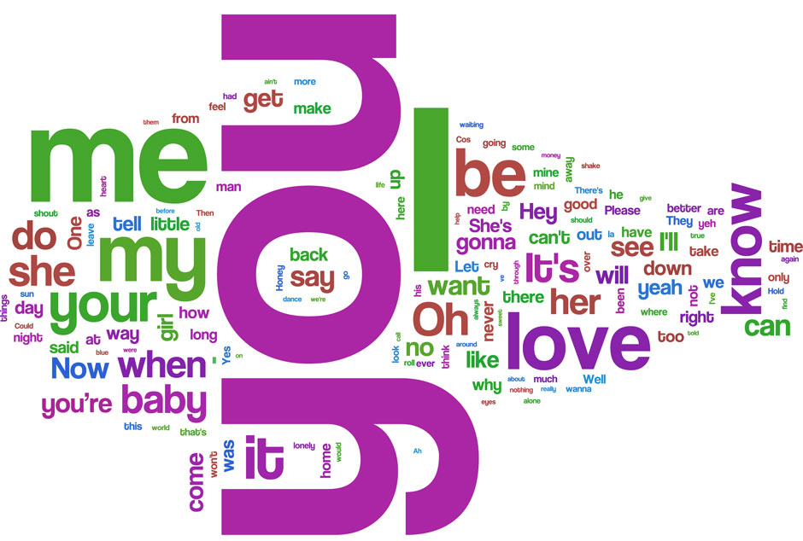
A bigram language model
word cloud
58,500 tokens
3,400 types
https://www.theguardian.com/music/datablog/2010/nov/16/beatles-lyrics-words-music-itunes

Slide 38
Looking ahead: a bigram language model
Example autogenerated lyrics:
I love her all belong . Try to , And
I beg you , baby , We 'll go ,
I write this letter for me down ! A little
I 'm gon na do . That boy would love
Common bigrams:
I 'm
do n't
it 's
I 'll
gon na
you 're
in the
you know
can 't
to me
Needs lots of data
not very grammatical

Slide 39
ChatGPT

