Slide 1
LING 388: Computers and Language
Lecture 19

Slide 2
Today's Topics
Homework 7 Review
New Topic:
nltk.bigrams()
Generating random text using nltk.ConditionalFreqDist()
Brown Corpus
brown.fileids()
brown.categories()
brown.words(categories='news')
using nltk.ConditionalFreqDist() with the Brown corpus

Slide 3
Homework 7 Review

Slide 4
Homework 7 Review

Slide 5
Homework 7 Review
$ python
>>> raw = open('nn.txt').read()
>>> len(raw)
1848364
>>> import nltk
>>> nn = nltk.word_tokenize(raw)
>>> len(nn)
396970
>>> raw2 = open('dc.txt').read()
>>> len(raw2)
1934660
>>> dc = nltk.word_tokenize(raw2)
>>> len(dc)
443615
>>> raw3 = open('oliver_twist.txt').read()
>>> len(raw3)
893534
>>> ot = nltk.word_tokenize(raw3)
>>> len(ot)
199836

Slide 6
Homework 7 Review
Step 4: remove the punctuation
>>> def isword(x):
... return any(c.isalpha() for c in x)
...
>>> nn2 = [word for word in nn if isword(word)]
>>> len(nn2)
328468
>>> dc2 = [word for word in dc if isword(word)]
>>> len(dc2)
361824
>>> ot2 = [word for word in ot if isword(word)]
>>> len(ot2)
160639

Slide 7
Homework 7 Review
Step 6: use a list comprehension to grab the word lengths
>>> def chunk(words, nth, n):
... return [len(word) for word in words[(nth - 1)*n: nth*n]]
...
>>> lnn1 = chunk(nn2, 1, 5000)
>>> len(lnn1)
5000
>>> lnn2 = chunk(nn2, 2, 5000)
>>> len(lnn2)
5000
>>> lnn1[:20]
[3, 4, 3, 10, 2, 8, 8, 10, 1, 8, 7, 2, 3, 8, 11, 9, 12, 3, 8, 6]
>>> lnn2[:20]
[8, 3, 11, 4, 3, 9, 6, 4, 2, 7, 3, 4, 7, 3, 7, 2, 3, 7, 2, 12]
>>> ldc1 = chunk(dc2, 1, 5000)
>>> ldc2 = chunk(dc2, 2, 5000)
>>> len(ldc1)
5000
>>> len(ldc2)
5000
>>> lot1 = chunk(ot2, 1, 5000)
>>> lot2 = chunk(ot2, 2, 5000)
>>> len(lot1)
5000
>>> len(lot2)
5000

Slide 8
Homework 7 Review
Step 7: histogram plot them with overlay
>>> import matplotlib.pyplot as plt
>>> mx = max(max(lnn1),max(lnn2),max(ldc1),max(ldc2),max(lot1),max(lot2))
>>> mx
20
>>> fig , (axs1, axs2, axs3) = plt.subplots(3, sharex=True, sharey=True)
>>> axs1.set_title('Nicholas Nickleby')
Text(0.5, 1.0, 'Nicholas Nickleby')
>>> axs2.set_title('David Copperfield')
Text(0.5, 1.0, 'David Copperfield')
>>> axs3.set_title('Oliver Twist')
Text(0.5, 1.0, 'Oliver Twist')

Slide 9
Homework 7 Review
Step 7: histogram plot them with overlay
>>> axs1.hist(lnn1, range(1,mx+1), histtype='step', label='1st 5000')
(array([2.050e+02, 9.540e+02, 1.082e+03, 7.970e+02, 5.240e+02, 4.070e+02,
3.220e+02, 2.460e+02, 2.060e+02, 1.160e+02, 6.100e+01, 4.700e+01,
1.400e+01, 8.000e+00, 7.000e+00, 3.000e+00, 1.000e+00, 0.000e+00,
0.000e+00]), array([ 1, 2, 3, 4, 5, 6, 7, 8, 9, 10, 11, 12, 13, 14, 15, 16, 17,
18, 19, 20]), [<matplotlib.patches.Polygon object at 0x16d0be760>])
>>> axs1.hist(lnn2, range(1,mx+1), histtype='step', label='2nd 5000')
(array([1.830e+02, 8.120e+02, 1.107e+03, 8.450e+02, 5.660e+02, 4.370e+02,
3.610e+02, 2.750e+02, 1.730e+02, 1.150e+02, 5.200e+01, 4.000e+01,
1.500e+01, 6.000e+00, 5.000e+00, 3.000e+00, 2.000e+00, 1.000e+00,
2.000e+00]), array([ 1, 2, 3, 4, 5, 6, 7, 8, 9, 10, 11, 12, 13, 14, 15, 16, 17,
18, 19, 20]), [<matplotlib.patches.Polygon object at 0x16d0be940>])

Slide 10
Homework 7 Review
Step 7: histogram plot them with overlay
>>> axs2.hist(ldc1, range(1,mx+1), histtype='step', label='1st 5000')
(array([2.92e+02, 9.61e+02, 1.05e+03, 9.67e+02, 4.32e+02, 4.63e+02, 3.15e+02, 1.99e+02, 1.15e+02, 8.70e+01, 6.60e+01, 3.30e+01, 1.20e+01, 2.00e+00, 3.00e+00, 1.00e+00, 2.00e+00, 0.00e+00, 0.00e+00]), array([ 1, 2, 3, 4, 5, 6, 7, 8, 9, 10, 11, 12, 13, 14, 15, 16, 17,18, 19, 20]), [<matplotlib.patches.Polygon object at 0x16d0be7f0>])
>>> axs2.hist(ldc2, range(1,mx+1), histtype='step', label='2nd 5000')
(array([ 388., 1016., 1097., 929., 468., 373., 268., 210., 106., 75., 41., 14., 10., 3., 2., 0., 0., 0., 0.]), array([ 1, 2, 3, 4, 5, 6, 7, 8, 9, 10, 11, 12, 13, 14, 15, 16, 17, 18, 19, 20]), [<matplotlib.patches.Polygon object at 0x16d0beac0>])
>>> axs3.hist(lot1, range(1,mx+1), histtype='step', label='1st 5000')
(array([2.610e+02, 7.790e+02, 1.165e+03, 8.540e+02, 5.500e+02, 4.780e+02, 2.990e+02, 1.810e+02, 1.720e+02, 9.800e+01, 6.800e+01, 4.800e+01, 2.700e+01, 8.000e+00, 8.000e+00, 1.000e+00, 0.000e+00, 0.000e+00,3.000e+00]), array([ 1, 2, 3, 4, 5, 6, 7, 8, 9, 10, 11, 12, 13, 14, 15, 16, 17,18, 19, 20]), [<matplotlib.patches.Polygon object at 0x16d0be910>])
>>> axs3.hist(lot2, range(1,mx+1), histtype='step', label='2nd 5000')
(array([ 221., 806., 1205., 872., 514., 429., 302., 218., 215.,114., 63., 21., 11., 5., 0., 2., 0., 0.,2.]), array([ 1, 2, 3, 4, 5, 6, 7, 8, 9, 10, 11, 12, 13, 14, 15, 16, 17,18, 19, 20]), [<matplotlib.patches.Polygon object at 0x16d2703d0>])

Slide 11
Homework 7 Review
Step 7: histogram plot them with overlay
>>> axs1.set_xticks(range(1,mx+1))
[<matplotlib.axis.XTick object at 0x16d3e3a60>, <matplotlib.axis.XTick object at 0x16d3e3a30>, <matplotlib.axis.XTick object at 0x16d3e3910>, <matplotlib.axis.XTick object at 0x16d270700>, <matplotlib.axis.XTick object at 0x16d2700d0>, <matplotlib.axis.XTick object at 0x16d275310>, <matplotlib.axis.XTick object at 0x16d275a60>, <matplotlib.axis.XTick object at 0x16d27c1f0>, <matplotlib.axis.XTick object at 0x16d27c940>, <matplotlib.axis.XTick object at 0x16d281160>, <matplotlib.axis.XTick object at 0x16d27cbb0>, <matplotlib.axis.XTick object at 0x16d275d30>, <matplotlib.axis.XTick object at 0x16d281850>, <matplotlib.axis.XTick object at 0x16d281e80>, <matplotlib.axis.XTick object at 0x16d287610>, <matplotlib.axis.XTick object at 0x16d287d60>, <matplotlib.axis.XTick object at 0x16d28f4f0>, <matplotlib.axis.XTick object at 0x16d2878b0>, <matplotlib.axis.XTick object at 0x16d270f10>, <matplotlib.axis.XTick object at 0x16d28f250>]
>>> axs1.legend()
<matplotlib.legend.Legend object at 0x16b790d90>
>>> axs2.legend()
<matplotlib.legend.Legend object at 0x16d298520>
>>> axs3.legend()
<matplotlib.legend.Legend object at 0x16d27c1c0>
>>> plt.show()

Slide 12
Homework 7 Review

Slide 13
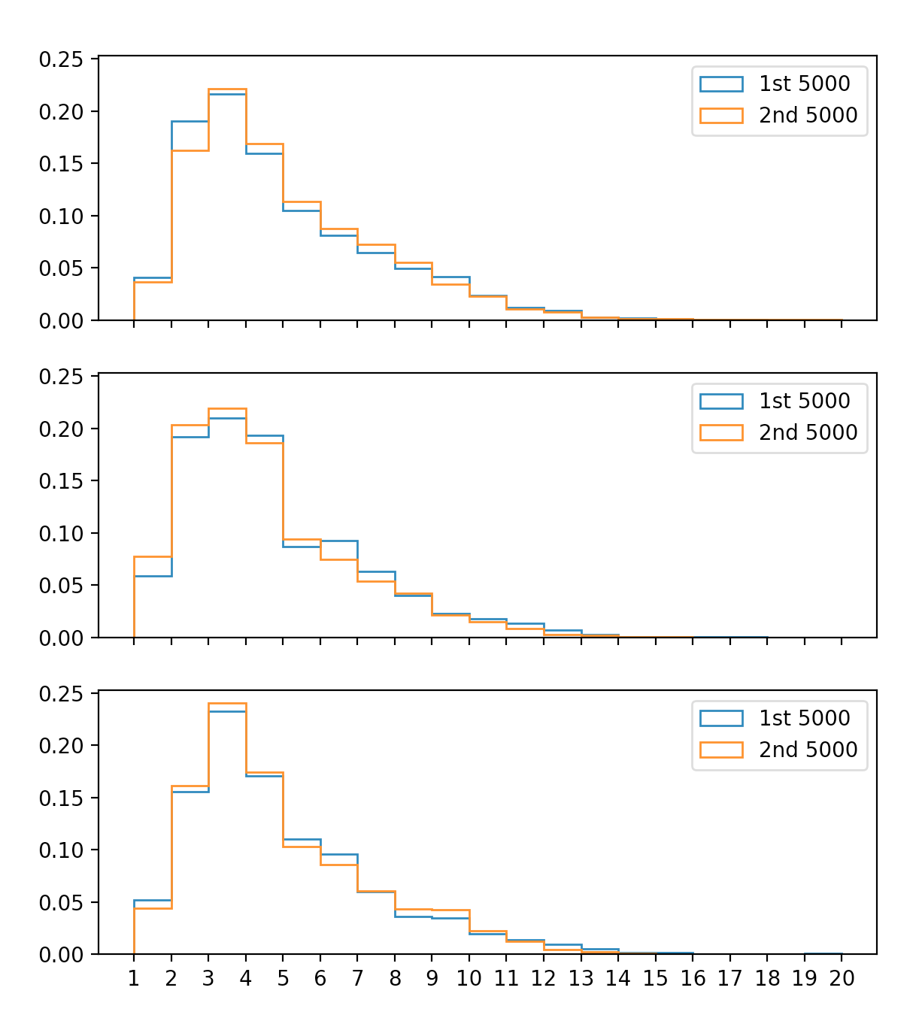
Homework 7 Review
density=True

Slide 14
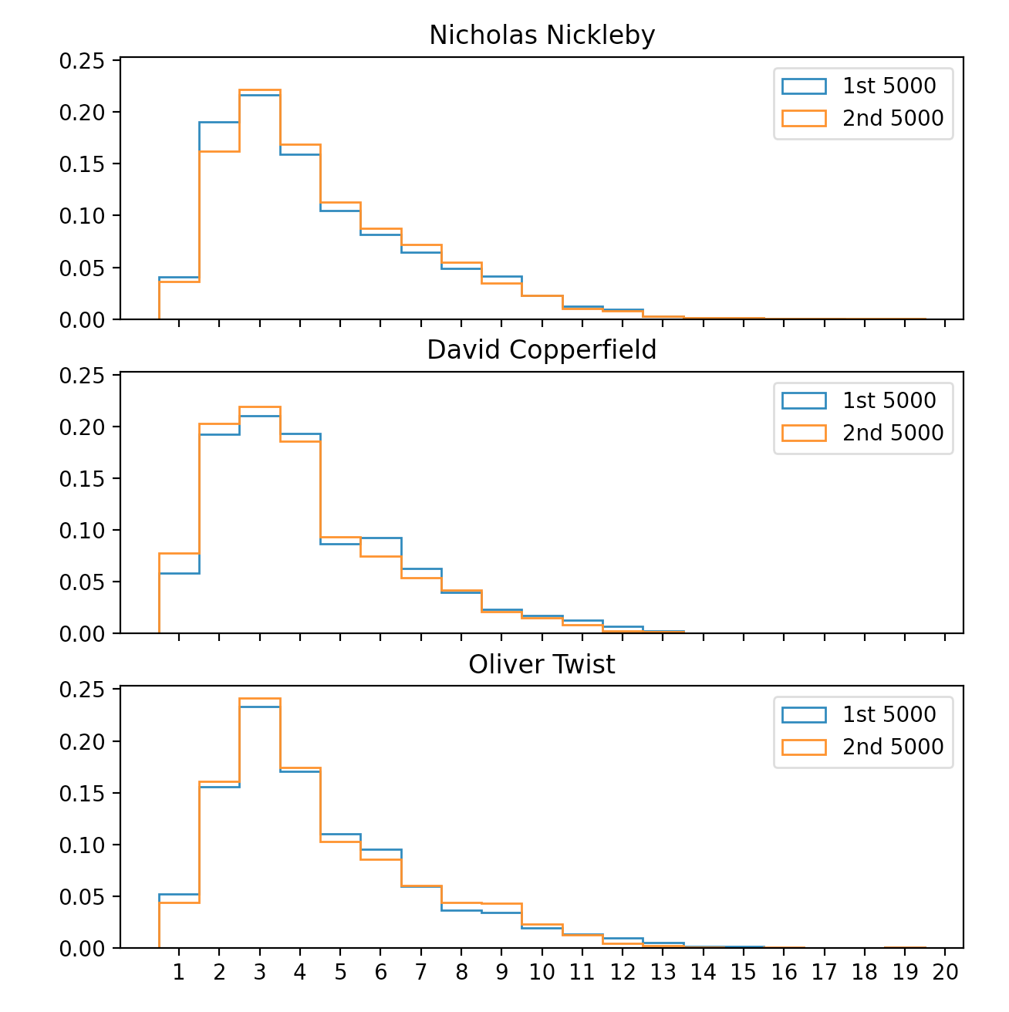
Homework 7 Review
align='left'

Slide 15
Homework 7 Review
https://matplotlib.org/stable/gallery/subplots_axes_and_figures/subplots_demo.html

Slide 16
Homework 7 Review

Slide 17
Homework 7 Review

Slide 18
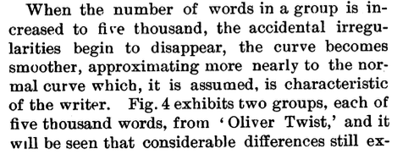
Homework 7
Part 2:
Based on your three-way comparison, what do you think about Mendenhall's claim about six-letter words for Charles Dickens? Is it justified? Explain.

Slide 19
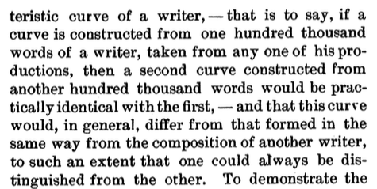
Homework 7
Part 3:
Now take (slice) the first 100,000 words for each of Oliver Twist (1838) with Nicholas Nickleby (1839) and David Copperfield (1850).
Plot them over one another.
Submit your histogram and code.
What do you think of Mendenhall 100,000 word claim?

Slide 20
Homework 7 Review
>>> lot = chunk(ot2, 1, 10000)
>>> len(lot)
10000
>>> lnn = chunk(nn2, 1, 10000)
>>> ldc = chunk(dc2, 1, 10000)
>>> plt.hist(lot, range(1,mx+1), histtype='step', label='Oliver Twist')
(array([ 482., 1585., 2370., 1726., 1064., 907., 601., 399., 387., 212., 131., 69., 38., 13., 8., 3., 0., 0., 5.]), array([ 1, 2, 3, 4, 5, 6, 7, 8, 9, 10, 11, 12, 13, 14, 15, 16, 17, 18, 19, 20]), [<matplotlib.patches.Polygon object at 0x16d2d0550>])
>>> plt.hist(lnn, range(1,mx+1), histtype='step', label='Nicholas Nickleby')
(array([3.880e+02, 1.766e+03, 2.189e+03, 1.642e+03, 1.090e+03, 8.440e+02, 6.830e+02, 5.210e+02, 3.790e+02, 2.310e+02, 1.130e+02, 8.700e+01,2.900e+01, 1.400e+01, 1.200e+01, 6.000e+00, 3.000e+00, 1.000e+00,2.000e+00]), array([ 1, 2, 3, 4, 5, 6, 7, 8, 9, 10, 11, 12, 13, 14, 15, 16, 17,18, 19, 20]), [<matplotlib.patches.Polygon object at 0x16d2d09a0>])
>>> plt.hist(ldc, range(1,mx+1), histtype='step', label='David Copperfield')
(array([6.800e+02, 1.977e+03, 2.147e+03, 1.896e+03, 9.000e+02, 8.360e+02, 5.830e+02, 4.090e+02, 2.210e+02, 1.620e+02, 1.070e+02, 4.700e+01, 2.200e+01, 5.000e+00, 5.000e+00, 1.000e+00, 2.000e+00, 0.000e+00,0.000e+00]), array([ 1, 2, 3, 4, 5, 6, 7, 8, 9, 10, 11, 12, 13, 14, 15, 16, 17,18, 19, 20]), [<matplotlib.patches.Polygon object at 0x16d2d0af0>])

Slide 21
Homework 7 Review
>>> mx = max(max(lot),max(lnn),max(ldc))
>>> mx
20
>>> plt.xticks(range(1,mx+1))
([<matplotlib.axis.XTick object at 0x16d2a3ee0>, <matplotlib.axis.XTick object at 0x16d2a3eb0>, <matplotlib.axis.XTick object at 0x16d2a3d90>, <matplotlib.axis.XTick object at 0x16d2da040>, <matplotlib.axis.XTick object at 0x16d2da640>, <matplotlib.axis.XTick object at 0x16d2dad90>, <matplotlib.axis.XTick object at 0x172dfc520>, <matplotlib.axis.XTick object at 0x16d2dadf0>, <matplotlib.axis.XTick object at 0x16d2d0a30>, <matplotlib.axis.XTick object at 0x172e05040>, <matplotlib.axis.XTick object at 0x172e05640>, <matplotlib.axis.XTick object at 0x172e05d90>, <matplotlib.axis.XTick object at 0x172e0a520>, <matplotlib.axis.XTick object at 0x172e0ac70>, <matplotlib.axis.XTick object at 0x172e0aa00>, <matplotlib.axis.XTick object at 0x172e05700>, <matplotlib.axis.XTick object at 0x172e372e0>, <matplotlib.axis.XTick object at 0x172e37910>, <matplotlib.axis.XTick object at 0x172e350a0>, <matplotlib.axis.XTick object at 0x172e357f0>], [Text(0, 0, ''), Text(0, 0, ''), Text(0, 0, ''), Text(0, 0, ''), Text(0, 0, ''), Text(0, 0, ''), Text(0, 0, ''), Text(0, 0, ''), Text(0, 0, ''), Text(0, 0, ''), Text(0, 0, ''), Text(0, 0, ''), Text(0, 0, ''), Text(0, 0, ''), Text(0, 0, ''), Text(0, 0, ''), Text(0, 0, ''), Text(0, 0, ''), Text(0, 0, ''), Text(0, 0, '')])
>>> plt.legend()
<matplotlib.legend.Legend object at 0x16d2c1400>
>>> plt.show()

Slide 22
Homework 7 Review

Slide 23
Homework 7 Review
>>> lot = chunk(ot2,1, 100000)
>>> lnn = chunk(nn2,1, 100000)
>>> ldc = chunk(dc2,1, 100000)
>>> plt.hist(lot,range(1,mx+1), histtype='step', label='Oliver Twist')
>>> plt.hist(lnn, range(1,mx+1), histtype='step', label='Nicholas Nickleby')
>>> plt.hist(ldc, range(1,mx+1), histtype='step', label='David Copperfield')
18, 19, 20]), [<matplotlib.patches.Polygon object at 0x16eedb9a0>])
>>> plt.xticks(range(1,mx+1))
>>> plt.legend()
>>> plt.show()

Slide 24
Homework 7 Review
density=True

Slide 25
NLTK Book: Chapter 2
2.4 Generating Random Text with Bigrams
>>> import nltk
>>> from nltk.corpus import genesis
>>> genesis
<PlaintextCorpusReader in '.../corpora/genesis' (not loaded yet)>
>>> g = genesis.words('english-kjv.txt')
>>> len(g)
44764
>>> g[:20]
['In', 'the', 'beginning', 'God', 'created', 'the', 'heaven', 'and', 'the', 'earth', '.', 'And', 'the', 'earth', 'was', 'without', 'form', ',', 'and', 'void']

Slide 26
NLTK Book: Chapter 2
2.4 Generating Random Text with Bigrams
>>> bigrams = nltk.bigrams(g)
>>> bigrams
<generator object bigrams at 0x11d540200>
>>> l = list(bigrams)
>>> len(l)
44763
>>> l[:20]
[('In', 'the'), ('the', 'beginning'), ('beginning', 'God'), ('God', 'created'), ('created', 'the'), ('the', 'heaven'), ('heaven', 'and'), ('and', 'the'), ('the', 'earth'), ('earth', '.'), ('.', 'And'), ('And', 'the'), ('the', 'earth'), ('earth', 'was'), ('was', 'without'), ('without', 'form'), ('form', ','), (',', 'and'), ('and', 'void'), ('void', ';')]

Slide 27
NLTK Book: Chapter 2
2.4 Generating Random Text with Bigrams
nltk.ConditionalFreqDist() can take as input a bigram corpus
actually, a list of (word1, word2) tuples such that word1 immediately precedes word2.
>>> cfd = nltk.ConditionalFreqDist(bigrams)
>>> cfd
<ConditionalFreqDist with 0 conditions>
>>> bigrams = nltk.bigrams(g)
>>> cfd = nltk.ConditionalFreqDist(bigrams)
>>> cfd
<ConditionalFreqDist with 2789 conditions>
empty!
(bigrams: generator object)

Slide 28
NLTK Book: Chapter 2
2.4 Generating Random Text with Bigrams
Unigrams (= list of words):
['In', 'the', 'beginning', 'God', 'created', 'the', 'heaven', 'and', 'the', 'earth', '.', 'And', 'the', 'earth', 'was', 'without', 'form', ',', 'and', 'void']
Bigrams (= list of tuples (word1,word2) etc.):
[('In', 'the'), ('the', 'beginning'), ('beginning', 'God'), ('God', 'created'), ('created', 'the'), …]
cfd[word] gives a count dict of which words can follow word:
>>> cfd['In']
FreqDist({'the': 9, 'my': 2, 'thee': 1})

Slide 29
NLTK Book: Chapter 2
2.4 Generating Random Text with Bigrams
cfd[word] gives a count dict of which words can follow word:
>>> cfd['The']
FreqDist({'sons': 5, 'children': 4, 'LORD': 4, 'man': 3, 'days': 2, 'three': 2, 'name': 1, 'woman': 1, 'serpent': 1, 'earth': 1, ...})
>>> cfd['the']
FreqDist({'land': 156, 'LORD': 154, 'earth': 105, 'sons': 69, 'name': 42, 'field': 39, 'men': 36, 'man': 34, 'waters': 30, 'children': 30, ...})
cfd[word].max() tells us what word is most likely to follow word:
>>> cfd['the'].max()
'land'
>>> cfd['The'].max()
'sons'

Slide 30
NLTK Book: Chapter 2
2.4 Generating Random Text with Bigrams
cfd[word] gives a count dict of which words can follow word:
>>> cfd['The']
FreqDist({'sons': 5, 'children': 4, 'LORD': 4, 'man': 3, 'days': 2, 'three': 2, 'name': 1, 'woman': 1, 'serpent': 1, 'earth': 1, ...})
>>> cfd['the']
FreqDist({'land': 156, 'LORD': 154, 'earth': 105, 'sons': 69, 'name': 42, 'field': 39, 'men': 36, 'man': 34, 'waters': 30, 'children': 30, ...})
cfd[word].N() tells us the size (total # words in the corpus) that can follow word:
>>> cfd['the'].N()
2411
>>> cfd['The'].N()
50

Slide 31
NLTK Book: Chapter 2
2.4 Generating Random Text with Bigrams
cfd[word] gives a count dict (aka nltk. FreqDist) of which words can follow word:
>>> cfd['The']
FreqDist({'sons': 5, 'children': 4, 'LORD': 4, 'man': 3, 'days': 2, 'three': 2, 'name': 1, 'woman': 1, 'serpent': 1, 'earth': 1, ...})
cfd[word].keys() gives the keys to the count dict; i.e. all the words that can follow word:
>>> cfd['The'].keys()
dict_keys(['name', 'woman', 'serpent', 'earth', 'end', 'length', 'fountains', 'sons', 'children', 'princes', 'Kenites', 'sun', 'LORD', 'thing', 'field', 'water', 'voice', 'days', 'speckled', 'ringstraked', 'God', 'soul', 'child', 'Hebrew', 'keeper', 'three', 'dream', 'seven', 'man', 'lad', 'land', 'Angel', 'sceptre', 'archers', 'blessings', 'purchase'])
cfd[word][word2] gives the number of times word2 can follow word:
>>> cfd['The']['name']
1
>>> cfd['The']['sons']
5

Slide 32
NLTK Book: Chapter 2
2.4 Generating Random Text with Bigrams
cfd[word] gives a count dict (aka nltk. FreqDist) of which words can follow word:
>>> cfd['The']
FreqDist({'sons': 5, 'children': 4, 'LORD': 4, 'man': 3, 'days': 2, 'three': 2, 'name': 1, 'woman': 1, 'serpent': 1, 'earth': 1, ...})
list comprehension creates a (sub-)corpus for 'The':
>>> [k for k in cfd['The'].keys() for i in range(cfd['The'][k])]
['name', 'woman', 'serpent', 'earth', 'end', 'length', 'fountains', 'sons', 'sons', 'sons', 'sons', 'sons', 'children', 'children', 'children', 'children', 'princes', 'Kenites', 'sun', 'LORD', 'LORD', 'LORD', 'LORD', 'thing', 'field', 'water', 'voice', 'days', 'days', 'speckled', 'ringstraked', 'God', 'soul', 'child', 'Hebrew', 'keeper', 'three', 'three', 'dream', 'seven', 'man', 'man', 'man', 'lad', 'land', 'Angel', 'sceptre', 'archers', 'blessings', 'purchase']
More generally, for word w:
[k for k in cfd[w].keys() for i in range(cfd[w][k])]

Slide 33
NLTK Book: Chapter 2
2.4 Generating Random Text with Bigrams
Algorithm for randomly generating the next word after 'The':
Randomly pick a word from the distribution of possible following words
Repeat with the selected word, i.e. chain word after word
Example
Start with 'The', randomly pick from here:
['name', 'woman', 'serpent', 'earth', 'end', 'length', 'fountains', 'sons', 'sons', 'sons', 'sons', 'sons', 'children', 'children', 'children', 'children', 'princes', 'Kenites', 'sun', 'LORD', 'LORD', 'LORD', 'LORD', 'thing', 'field', 'water', 'voice', 'days', 'days', 'speckled', 'ringstraked', 'God', 'soul', 'child', 'Hebrew', 'keeper', 'three', 'three', 'dream', 'seven', 'man', 'man', 'man', 'lad', 'land', 'Angel', 'sceptre', 'archers', 'blessings', 'purchase']
>>> [k for k in cfd['The'].keys() for i in range(cfd['The'][k])]
Next, use 'children' and randomly pick from here:
>>> [k for k in cfd['children'].keys() for i in range(cfd['children'][k])]
[';', ';', 'to', 'of', 'of', 'of', 'of', 'of', 'of', 'of', 'of', 'of', 'of', 'of', 'of', 'of', 'of', 'of', 'of', 'of', 'of', 'of', 'of', 'of', 'of', 'of', 'of', 'of', 'of', 'of', 'born', ':', 'by', 'by', 'and', '.', '.', 'suck', 'unto', 'unto', 'struggled', ',', ',', ',', ',', ',', ',', ',', ',', ',', 'now', 'are', 'are', 'which', 'which', 'foremost', 'after', 'came', 'be', "'", 'shall', 'also']
Next, use 'of' and so on…

Slide 34
NLTK Book: Chapter 2
from random import choice
def next_word(w):
return choice([k for k in cfd[w].keys() for i in range(cfd[w][k])])
def nwords(n, w):
for i in range(n):
print(w, end=' ')
w = next_word(w)
print()
>>> nwords(10,'The')
The Kenites , and it was not to the children
>>> nwords(10,'The')
The keeper of beasts I wrestled with this night ;
>>> nwords(10,'The')
The water ye rewarded evil beast of your occupation ?

Slide 35
nltk.ConditionalFreqDist()
Summary:
nltk.ConditionalFreqDist() takes as input a bigram corpus (actually a list of (word1,word2) etc. tuples) produced by nltk.bigrams(text)
cfd = nltk.ConditionalFreqDist(nltk.bigrams(text))
cfd[word1] returns a FreqDist for word2.
cfd[word1].max() tells us what word is most likely to follow word1.
cfd[word1].N() tells us the size (total # words in the corpus) that can follow word1.
cfd[word1].keys() gives the keys to the count dict; i.e. list of words that can follow word1.
cfd[word1][word2] gives the number of times word2 can follow word1.

