Slide 1
LING 388: Computers and Language
Lecture 18

Slide 2
Today's Topics
Homework 7
Parts 1, 2 and 3
Last Time:
we did Mendehall (1887) live in class
idea: use word length statistics on Oliver Twist by Charles Dickens

Slide 3
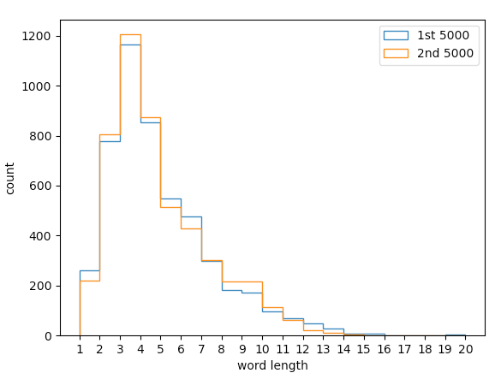
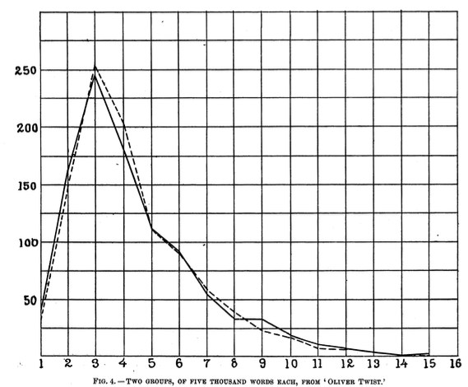
Last Time
We confirmed Mendenhall's 5,000 word plots
two groups of 5,000

Slide 4
Code Recap
$ python
Python 3.9.16
>>> raw = open('oliver_twist.txt').read()
>>> import nltk
>>> words = nltk.word_tokenize(raw)
>>> words2 = [word for word in words if any(c.isalpha() for c in word)]
>>> len1 = [len(word) for word in words2[0:5000]]
>>> len2 = [len(word) for word in words2[5000:10000]]
>>> mx = max(max(len1),max(len2))
>>> mx
20
may need encoding='utf8'

Slide 5
Code Recap
Plotting:
>>> import matplotlib.pyplot as plt
>>> plt.hist(len1, range(1,mx+1), histtype='step', label='1st 5000')
>>> plt.hist(len2, range(1,mx+1), histtype='step', label='2nd 5000')
>>> plt.xticks(range(1,mx+1))
>>> plt.xlabel('word length')
>>> plt.ylabel('count')
>>> plt.legend()
>>> plt.show()

Slide 6
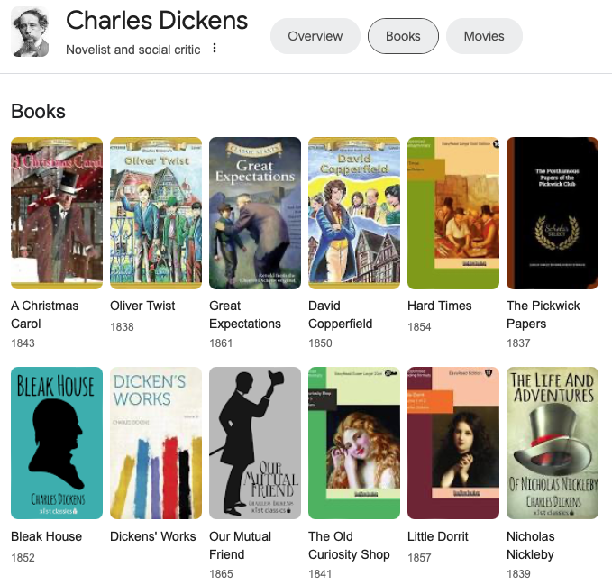
Homework 7
Part 1: Let's compare our two 5,000 word Mendenhall test for Oliver Twist (1838)
with
Nicholas Nickleby (1839) and
David Copperfield (1850)

Slide 7
Homework 7
Part 2:
Mendenhall claims something about six-letter words

Slide 8
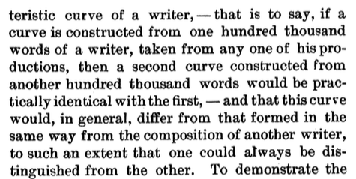
Homework 7
Part 3:
Mendenhall claims something about 100,000 words

Slide 9
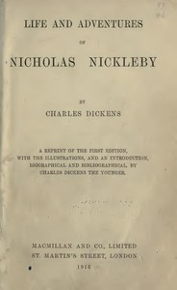
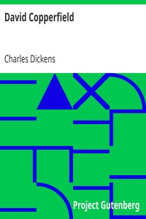
Homework 7
Part 1 details:
Step 1: grab txt files for Nicholas Nickleby (1839) and David Copperfield (1850) from https://www.gutenberg.org
pg967.txt
raw: 1,848,364
words: 396,970
*after editing
pg766.txt
raw: 1,934,660
words: 443,615
* after editing

Slide 10
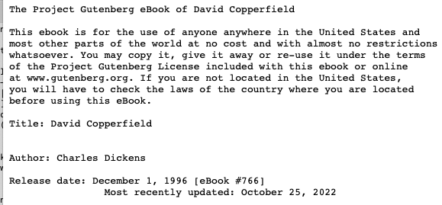
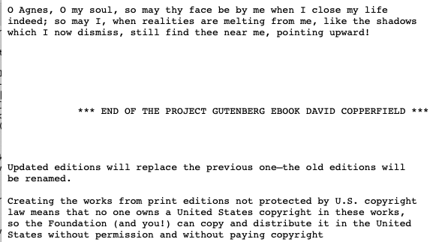
Homework 7
Part 1 details:
Step 2: edit pg967.txt and pg766.txt to remove the Project Gutenberg boilerplate.
You may want to save the edited versions under new names, e.g. nn.txt and dc.txt.

Slide 11
Homework 7
Part 1 details:
Step 3: put them in the right directory, start python. Read in the raw files and nltk.word_tokenize() them.
Step 4: remove the punctuation, see conditional list comprehension in Lecture 17 using condition:
any(c.isalpha() for c in word)
Step 5: slice the corpus into 5,000 word chunks
[0:5000] and [5000:10000]
Step 6: use a list comprehension to grab the word lengths
len = [len(word) for word in chunk]
Step 7: histogram plot them with overlay
plt.hist(len, range(1,mx+1), histtype='step', label='1st 5000')

Slide 12
Homework 7
Part 1:
Let's compare our two 5,000 word Mendenhall test for Oliver Twist (1838) with Nicholas Nickleby (1839) and David Copperfield (1850).
Submit your histograms and python code
What do you think? E.g.
Do you think they are comparable?
Or are there significant differences?
Do you think it's reasonable to think they are written by the same author?

Slide 13
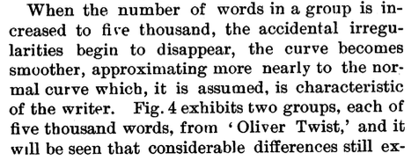
Homework 7
Part 2:
Based on your three-way comparison, what do you think about Mendenhall's claim about six-letter words for Charles Dickens? Is it justified? Explain.

Slide 14
Homework 7
Part 3:
Now take (slice) the first 100,000 words for each of Oliver Twist (1838) with Nicholas Nickleby (1839) and David Copperfield (1850).
Plot them over one another.
Submit your histogram and code.
What do you think of Mendenhall 100,000 word claim?

Slide 15
Homework 7
One PDF file!
Submit to sandiway@arizona.edu
SUBJECT: 388 Homework 7 YOUR NAME
One PDF file only
include Python terminal and histogram screenshots in your answer
Deadline:
midnight Monday
we will review the homework on Tuesday

