Slide 1
LING 388: Computers and Language
Lecture 16

Slide 2
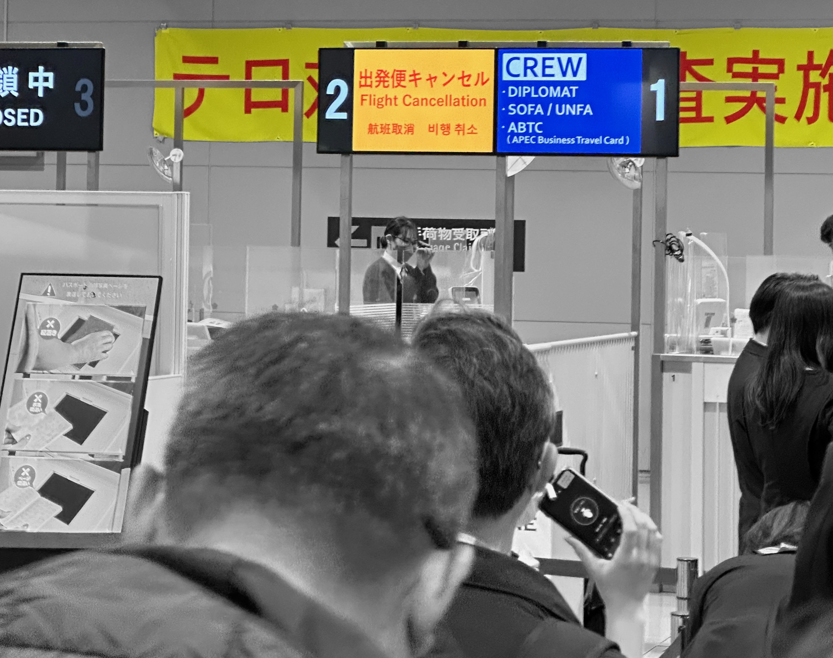
Announcements
There is no lecture 15
Lecture 14 was pre-recorded

Slide 3
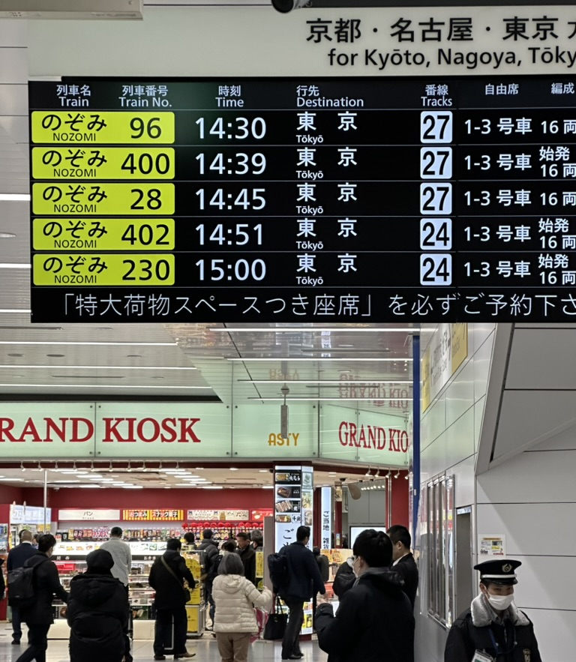

Slide 5
Today's Topics
Regex exercise review
do it live in class
Stylometry
simple statistics to figure out authorship

Slide 6
Today's Topics
Stylometry: Mendenhall 1887 (Science)
Homework: please read this paper for next time (on course website)
word-spectrum (histogram plot) vs. mean word length
chunking the corpus into groups
group or chunk size in thousands of words
the effect of punctuation on the word-spectrum
histogram plotting: using matplotlib

Slide 7
Regex Exercises
Text file on course website: Oliver Twist, Charles Dickens, 1838
imported from Project Gutenberg (https://www.gutenberg.org)
oliver_twist.txt
How to import it:
first, be in the right working directory
raw = open('oliver_twist.txt', encoding='utf-8', errors='ignore').read()
Check it has been imported correctly:
>>> len(raw)
893534

Slide 8
Regex Exercise 1
Look for all 3 letter words ending in ly in raw using a regex.
How many of them are there?
Hints:
\w = word character,
\W = non-word character,
\b = word boundary

Slide 9
Regex Exercise 2
Look in raw for all words ending in ly that are 14 or more letters long.
How many of them are there?
Different solutions are possible:
use re.findall(), collect all answers into a list , filter them by a conditional list comprehension
use re.findall() with a regex with {12,}

Slide 10
Regex Exercise 3
Look in raw for bigrams (here: two words adjacent to each other but could be separated by non-word characters) that both end in ly.
How many of them are there?
Hints:
\W = non-word character,
\b = word boundary

Slide 11
Regex Exercise 4
Look in raw for two words both beginning with a capital letter but separated by a hyphen.
How many of them are there?

Slide 12
Stylometry
What is Stylometry?
Looking at commonalities between works using statistics on stylistic features.
Figure out the author: assuming we have access to other written work.
Adversarial stylometry: hiding authorship by alterations, or perhaps by using ChatGPT?
Good topic for a term project btw …

Slide 13
Stylometry: a modern example
Digital Scholarship in the Humanities, Volume 36, Issue 2, June 2021, Pages 383–391

Slide 14
Stylometry: a modern example
p384:
Stylometry is a statistical technique which indicates likely authorship, forming an ‘impression’ of how a particular author writes by counting the frequency of words across sample texts. While the specific techniques differ across the iterative stages of this study, the analysis is always conducted using the 100 most frequent words² from the chosen samples, with the similarity between styles measured using Support Vector Machine (SVM) classification, Burrows’ Delta and Cosine Delta.
The authors of this article have consistently used no more than 100 most frequent words because they subscribe to the theoretical view that results become less indicative of authorial fingerprint as the number of features is increased. When stylometry is conducted using a small sample of high-frequency words, typically function words, the analysis is conducted using words, which are ‘especially resistant to intentional authorial manipulation’ (Hoover, 2009, p. 35), and thus suited to determining subconscious authorial fingerprints rather than content distinct to the particular narrative.

Slide 15
Stylometry
z-score = (x – mean) / stdev
Delta: a Measure of Stylistic Difference and a Guide to Likely Authorship.
(Burrows 2002)

Slide 16
Stylometry: a modern example

Slide 17
Stylometry
Course website:
Mendenhall1887.pdf
please read
Idea:
average length of words a guide to authorship
easy to compute today with nltk
laborious back in 1887

Slide 18
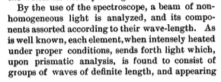
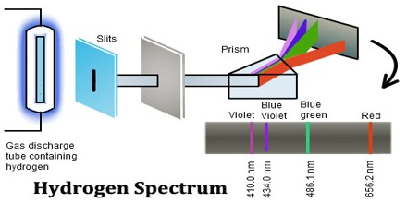
Stylometry
An appeal to physics/science:

Slide 19
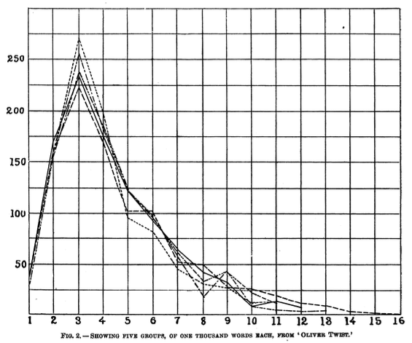
Stylometry

Slide 20
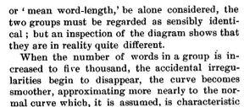
Stylometry
a single mean word length statistic is not enough

Slide 21
Stylometry
bump
discrepancy
"smooth" meaning montonically decreasing

Slide 22
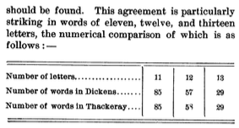
Stylometry

Slide 23
Stylometry

Slide 24
Stylometry

Slide 25
Stylometry
On the course website:
53 chapters, no chapter headings, no titles etc.
oliver_twist.txt
Python:
>>> raw = open('oliver_twist.txt', encoding='utf-8', errors='ignore').read()
>>> len(raw)
882296
>>> import nltk
>>> words = nltk.word_tokenize(raw)
>>> len(words)
197947
>>> vocab = set(words)
>>> len(vocab)
12379

Slide 26
Stylometry
Let's take the (unmodified) text a thousand words at a time:
words1 = words[0:1000]
words2 = words[1000:2000]
etc.
Mendenhall's word-spectrum based on word length:
len1 = [len(word) for word in words[0:1000]]
len2 = [len(word) for word in words[1000:2000]]
Frequency distribution of the word-spectrum:
fd1 = nltk.FreqDist(len1)
fd2 = nltk.FreqDist(len2)

Slide 27
Stylometry
fd1.plot()
fd2.plot()
Why is it difficult to
compare these graphs?

Slide 28
Stylometry
>>> fd1
FreqDist({1: 186, 3: 184, 4: 152, 2: 149, 5: 101, 6: 75, 7: 52, 8: 37, 9: 31, 11: 13, ...})
>>> fd2
FreqDist({3: 215, 1: 150, 2: 132, 4: 126, 5: 102, 6: 87, 7: 54, 8: 43, 9: 28, 10: 17, ...})
>>> max(fd1)
12
>>> max(fd2)
20

