Slide 1
LING 388: Computers and Language
Lecture 12

Slide 2
Today's Topics
List comprehensions: conditional
A class exercise: taking out the punctuation
String methods (more complex patterns? See below):
word.startswith(string) prefix
word.endswith(string) suffix
word.istitle() titlecase
Next time: more complex patterns
regular expressions (regex)

Slide 3
List comprehension
.list.lower(), list.islower(), list.upper(), list.isupper() etc.
https://docs.python.org/3/library/stdtypes.html#string-methods
Note:
not a destructive operation
– recall strings are not mutable
returns a (new) modified copy of the string

Slide 4
List comprehension recap
Just like a for-loop but builds a list __
Example (for-loop):
>>> word = "LING388"
>>> for letter in word:
... print(letter.lower())
...
l
i
n
g
3
8
8
>>> [letter.lower() for letter in word]
['l', 'i', 'n', 'g', '3', '8', '8']
Note:
>>> word.lower()
'ling388'
>>> list(word)
['L', 'I', 'N', 'G', '3', '8', '8']
>>> list(word.lower())
['l', 'i', 'n', 'g', '3', '8', '8']

Slide 5
List comprehension
like last slide but using indexing with a loop variable called i:
>>> word = "LING388"
>>> for i in range(len(word)):
... print(word[i].lower())
...
l
i
n
g
3
8
8
[0, 1, 2, 3, 4, 5, 6]
7
word[0].lower() = 'l'
word[1].lower() = 'i'
2 n
3 g
4 3
5 8
6 8
>>> [word[i].lower() for i in range(len(word))]
['l', 'i', 'n', 'g', '3', '8', '8']

Slide 6
List comprehension (conditional)
Select only some items of the list matching a condition
Example:
>>> [x for x in range(0,100) if x > 90]
[91, 92, 93, 94, 95, 96, 97, 98, 99]
Example:
>>> [x-90 for x in range(0,100) if x > 90]
[1, 2, 3, 4, 5, 6, 7, 8, 9]

Slide 7
List comprehension (conditional)
Select only some items of the list matching a condition
Example:
>>> [letter for letter in '1aB3Ab5d7CD9c' if letter.isupper()]
['B', 'A', 'C', 'D']
>>> [letter for letter in '1aB3Ab5d7CD9c' if letter.islower()]
['a', 'b', 'd', 'c']
>>> [letter for letter in '1aB3Ab5d7CD9c' if letter.isdigit()]
['1', '3', '5', '7', '9']

Slide 8
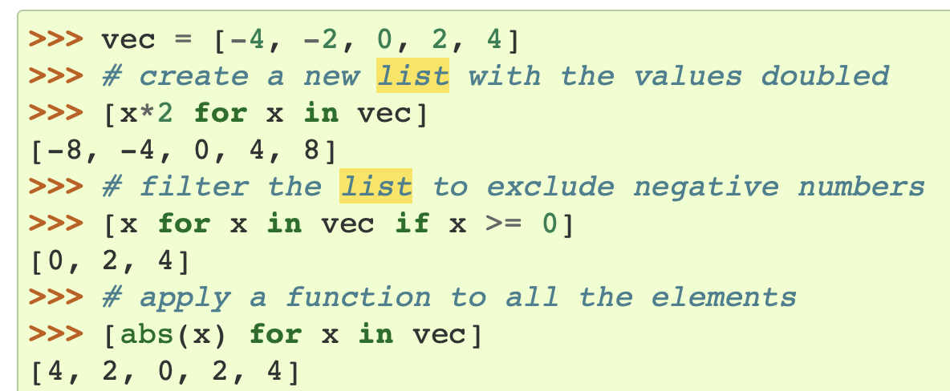
List comprehension (conditional)
https://docs.python.org/3/tutorial/datastructures.html?highlight=list%20comprehension#list-comprehensions

Slide 9
Class Exercise: taking out the punctuation
Recall carroll-alice.txt from nltk.corpus.gutenberg?
Suppose we're interested in statistics across the words of the novel but not the punctuation.
Let's use a conditional list comprehension to extract only words.

Slide 10
Class Exercise: taking out the punctuation
How can we identify punctuation?
strings of length 1?
But how about words like 'A' 'a' or 'I'?
non-alphabetic strings

Slide 11
Class Exercise: taking out the punctuation
Let's test it!
>>> import nltk
>>> words = nltk.corpus.gutenberg.words('carroll-alice.txt')
>>> set([word for word in words if not word.isalnum()])
{"',", ',"', ",'", '"--', '"!\'', '.]', '."', "?'", '--]', "?',", '"', '?)', "!')", '\'"', ']', '\'"--', '"\'', '),', '--"', '--', ".'", "')", ':', '?"\'', '--"\'', '):--', ';', ').', ',"\'', "--'", "';", ')--', '?"', '?--', '*', ".--'", "''", '.', ',)', ".')", "'", '(', ')', '-', '[', '--(', "!'", '!--', ',', '!"', '):', "('", ';--', '!"\'', '!', '_I_', ':--', '.--', ")--'", '?', '!"?\'', '"?\'', ');', '.)', "'--", '."\''}
>>> len(set([word for word in words if not word.isalnum()]))
66
>>> len([word for word in words if not word.isalnum()])
6776

Slide 12
Class Exercise: taking out the punctuation
>>> words2 = [word for word in words if word.isalnum()]
>>> len(words2)
27334
>>> fd = nltk.FreqDist(words2)
FreqDist({'the': 1527, 'and': 802, 'to': 725, 'a': 615, 'I': 543, 'it': 527, 'she': 509, 'of': 500, 'said': 456, 'Alice': 396, ...})
>>> fd.plot(20)

Slide 13
Class Exercise: taking out the punctuation
fd.plot(20)
fd.plot(40)

Slide 14
Documentation

Slide 15
Documentation

Slide 16
Documentation

Slide 17
String methods
>>> "Hello and Welcome To My World!".startswith("Hello")
True
>>> "Hello and Welcome To My World!".startswith("hello")
False
>>> "Hello and Welcome To My World!".startswith(("Hello", "hello"))
True
>>>

Slide 18
String methods
>>> "Hello, And Welcome To My World!".istitle()
True
>>> "Hello and Welcome To My World!".istitle()
False

