Slide 1
LING 388: Computers and Language
Lecture 11

Slide 2
Today's Topics
Homework 5 Review
Some extras
Plotting x-y graphs directly using matplotlib.pyplot
nltk.FreqDist() .freq()
Lists for queues:
deque ("deck")
An obscure way to reverse a list
arange() from numpy

Slide 3
A recent trend: pricey vs. pricy

Slide 4
Homework 5 Review
Step 2: front and back Gutenberg-added text:
>>> fh = open('lookingglass.txt')
>>> raw = fh.read()
>>> len(raw)
183555
>>> raw2 = open('looking-glass.txt').read()
>>> len(raw2)
164233
>>> (183555 - 164233) / 164233
0.11764992419306716
>>>
unedited
edited
12% extra

Slide 5
Homework 5 Review
python
Python 3.9.12 (main, Jun 1 2022, 06:34:44)
>>> import nltk
>>> fh = open("looking_glass.txt")
>>> raw = fh.read()
>>> len(raw)
164233
>>> words = nltk.word_tokenize(raw)
>>> len(words)
39346
>>> wlen = [len(word) for word in words]
>>> len(wlen)
39346
>>> from statistics import mean
>>> mean(wlen)
3.3556905403344683
>>> fd = nltk.FreqDist(wlen)
>>> fd
FreqDist({1: 10905, 3: 7295, 4: 6296, 2: 4969, 5: 3767, 6: 2378, 7: 1714, 8: 809, 9: 494, 10: 343, ...})
>>> fd.plot()
<AxesSubplot:xlabel='Samples', ylabel='Counts'>
>>> vocab = set(words)
>>> len(vocab)
3871
>>> vwlen = [len(word) for word in vocab]
>>> fd2 = nltk.FreqDist(vwlen)
>>> fd2
FreqDist({5: 645, 6: 635, 7: 577, 4: 574, 8: 384, 3: 250, 9: 246, 10: 173, 11: 95, 2: 82, ...})
>>> fd.plot()
<AxesSubplot:xlabel='Samples', ylabel='Counts'>
dir (command line)
ls (PowerShell/macOS)
list comprehension
list comprehension

Slide 6
Homework 5 Review
Basic statistics:
Book | String | Words | Vocabulary | Avg. Word Length | String/Words (rough estimate)
Alice's Adventures | 144395¹ | 34110 | 3016 | 3.4 | 4.23
Through the Looking Glass | 164233 | 39346 | 3871 | 3.4 | 4.17
¹ nltk.corpus.gutenberg.raw('carroll-alice.txt')

Slide 7
Homework 5 Review
Alice:
>>> import nltk
>>> raw = nltk.corpus.gutenberg.raw('carroll-alice.txt')
>>> len(raw)
144395
>>> words = nltk.corpus.gutenberg.words('carroll-alice.txt')
>>> len(words)
34110
>>> wlen = [len(word) for word in words]
>>> len(wlen)
34110
>>> 144395 / 34110
4.233216065669891
>>> from statistics import mean
>>> mean(wlen)
3.401026092055116

Slide 8
Homework 5 Review
>>> fd = nltk.FreqDist(wlen)
>>> fd
FreqDist({1: 10905, 3: 7295, 4: 6296, 2: 4969, 5: 3767, 6: 2378, 7: 1714, 8: 809, 9: 494, 10: 343, ...})
>>> vocab = set(words)
>>> vwlen = [len(word) for word in vocab]
>>> fd2 = nltk.FreqDist(vwlen)
>>> fd2
FreqDist({5: 645, 6: 635, 7: 577, 4: 574, 8: 384, 3: 250, 9: 246, 10: 173, 11: 95, 2: 82, ...})

Slide 9
Homework 5 Review: entire book
looking_glass.txt
carroll-alice.txt
nltk.FreqDist([len(word) for word in nltk.corpus.gutenberg.words('carroll-alice.txt')]).plot()

Slide 10
Homework 5 Review: vocabulary
carroll-alice.txt
looking_glass.txt
nltk.FreqDist([len(word) for word in set(nltk.corpus.gutenberg.words('carroll-alice.txt'))]).plot()

Slide 11
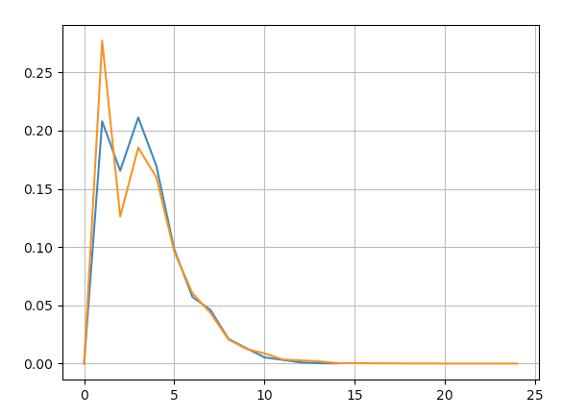
Homework 5 Review
Difficult to compare the shapes due to the x-axis ordering (by frequency of occurrence)
Let's plot them on the same graph
Assume we have
fda: alice word length nltk.FreqDist()
fdg: looking glass word length nltk.FreqDist()
Use
import matplotlib.pyplot as plt
plt.plot(range(15),[fda.freq(i) for i in range(15)])
plt.plot(range(25),[fdg.freq(i) for i in range(25)])
plt.grid()
plt.show()

Slide 12
Homework 5 Review
https://matplotlib.org/stable/api/_as_gen/matplotlib.pyplot.plot.html
plot(x-list, y-list)

Slide 13
Homework 5 Review
https://www.nltk.org/api/nltk.probability.FreqDist.html

Slide 14
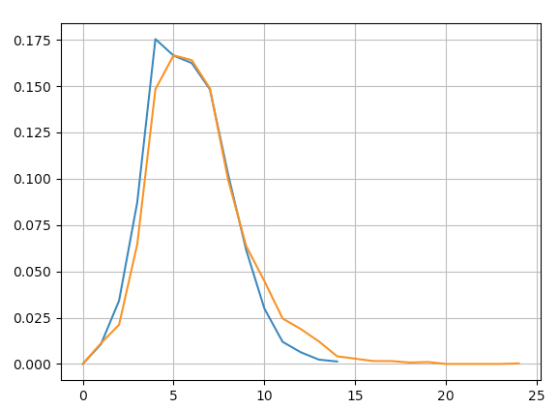
Homework 5 Review
Compare vocabulary
Assume we have
fda: word length nltk.FreqDist() on set(alice)
fdg: word length nltk.FreqDist() on set(looking glass)
Use
import matplotlib.pyplot as plt
plt.plot(range(15),[fda.freq(i) for i in range(15)])
plt.plot(range(25),[fdg.freq(i) for i in range(25)])
plt.grid()
plt.show()

Slide 15
Homework 5 Review
Curious about the long length of the words in looking-glass.txt:
>>> max(vocab, key=len)
#1 'a—_most—provoking_—thing'
>>> vocab.remove('a—_most—provoking_—thing')
>>> max(vocab, key=len)
#2 'Certainly—certainly'
>>> vocab.remove('Certainly—certainly')
>>> max(vocab, key=len)
#3 'proudest—adjectives'
>>> vocab.remove('proudest—adjectives')
>>> max(vocab, key=len)
#4 'Bread-and-Butterfly'

Slide 16
max()
See previous lecture: key= also used for sorted() and .sort()

Slide 17
Python List as a Queue
FYI:
deque is pronounced "deck".
A faster implementation according to section 5.1.2

Slide 18
Obscure way to reverse a list
Another way to reverse is to slice with a negative step:
s[i:j:k]
i,j can be omitted (defaults to beginning and end)
k = -1
>>> l
[1, 3, 5, 7, 9]
>>> l[::-1]
[9, 7, 5, 3, 1]
>>> l
[1, 3, 5, 7, 9]
>>>

Slide 19
arange() from numpy vs. range()
Look up how to install numpy for your platform. Install it if needed!
e.g. (pip or) pip3 install numpy (command line)
https://www.scipy.org/install.html
range() does not work with non-integer steps!
use arange() if you need it

Slide 20
arange() from numpy
>>> from numpy import arange
>>> arange(0,10,0.5)
array([0. , 0.5, 1. , 1.5, 2. , 2.5, 3. , 3.5, 4. , 4.5, 5. , 5.5, 6. ,
6.5, 7. , 7.5, 8. , 8.5, 9. , 9.5])
>>> arange(0,10,0.5).tolist()
[0.0, 0.5, 1.0, 1.5, 2.0, 2.5, 3.0, 3.5, 4.0, 4.5, 5.0, 5.5, 6.0, 6.5, 7.0, 7.5, 8.0, 8.5, 9.0, 9.5]
>>> list(arange(0,10,0.5))
Traceback (most recent call last):
File "<stdin>", line 1, in <module>
TypeError: 'list' object is not callable

Slide 21
arange() from numpy
>>> for i in arange(0,10,0.5): __
... print(i)
...
0.0
0.5
1.0
1.5
2.0
2.5
3.0
3.5
4.0
4.5
5.0
5.5
6.0
6.5
7.0
7.5
8.0
8.5
9.0
9.5

