Slide 1
LING 388: Computers and Language
Lecture 1

Slide 2
Today's Topics
Syllabus
formal link (on course webpage): syllabus.pdf
Homework 1
Introduction
install Python 3 on your own computer
brief sample of stuff we will be able to do

Slide 3
Administrivia
This course has three aims:
Introduce you to natural language processing (problems/tools etc.)
Introduce you to some programming (Python 3)
Prepare you for more fundamental and advanced classes
e.g. LING/C SC/PSYC 438 Computational Linguistics
a possibly pathway to the HLT Master's (Accelerated Program or Regular)
Learning outcomes:
familiarity with tools
know how to write simple programs
be ready to take more classes

Slide 4
Administrivia
There are no pre-requisites
students will have a wide variety of backgrounds
I’m gonna assume you don’t know how to program at all (yet)
everything you need will be supplied – except a laptop (you need this!)
No textbook required
Classroom etiquette
ask questions
follow along with your own laptop (preferred) or use the lab computer!

Slide 5
Administrivia
Slides will be available just before each class:
sandiway.arizona.edu/#courses
may be updated after each class (corrections; clarifications etc.)

Slide 6
Administrivia
Lectures will be recorded using the Panopto system
accessible via the course webpage via a browser
(video, laptop screen, synchronized slides, keyword search)
(successful) recordings of the lectures not guaranteed

Slide 7
Administrivia
Homeworks
approx. 10 homeworks in total (70% of the grade)
homework schedule:
all homeworks will be introduced in class and discussed
all homeworks will be reviewed in class
Example: if handed out on a Thursday, will be reviewed next Tuesday in class. Hence homework will be due by midnight on Monday night prior to class unless otherwise specified
Example: short homeworks may be assigned on a Tuesday and due by midnight Wednesday (reviewed on Thursday)
late policy: none, if you will be away: let's make prior arrangements

Slide 8
Administrivia
Term project (e.g. do an experiment using the tools or build some cool application) – 30% of the grade
don't worry, there'll be lots of opportunities for projects
Office hours: by appointment (send email; try walk-in)
attempt homeworks as early as possible
gives you extra time to ask clarification questions
bring laptop if something is not working
After class (short questions; clarifications):
please ask during class time

Slide 9
Administrivia
Homeworks
Submit by email
sandiway@arizona.edu
Subject line: e.g. 388 Homework # Your Name
ONE PDF file containing everything
no .docx; use cut and paste; screenshots etc.
not one document per homework question
code may be requested (if so submit as a separate attachment to homework email)

Slide 10
Administrivia
Course Policy:
you may discuss homework questions with other students
you may use ChatGPT
however, you must write it up yourself (in your own words, your own code etc.)
cite (web) references, ChatGPT AND your classmates (in the case of discussion)
Student Code of Academic Integrity: plagiarism etc.
http://deanofstudents.arizona.edu/codeofacademicintegrity
Revisions to the syllabus
“the information contained in the course syllabus, other than the grade and absence policies, may be subject to change with reasonable advance notice, as deemed appropriate by the instructor.”

Slide 11
Administrivia
No lectures scheduled on:
Tues Feb 27th: I'm away in Japan
Thurs Feb 29th: ditto.
Tues March 5th: Spring Break
Thurs March 7th: Spring Break
Pre-recorded lecture for Feb 27th
Homework also given out.
Note:
any other cancellation dates will be announced in due course

Slide 12
Tools: we'll use Python
python.org: please install python3 on your laptop (if not already installed)
need help? talk to me
do not install old
Python 2.7

Slide 13
Tools: we'll use Python
You can also try the Anaconda version of Python
Advantage? Python packages (add-ins) are bundled
Don't buy!
https://www.anaconda.com/download
Scroll down until you see =>

Slide 14
Anaconda

Slide 15
Anaconda

Slide 16
Anaconda
If you're done
Test it using Terminal
Congratulations!
Homework 1 is done

Slide 17
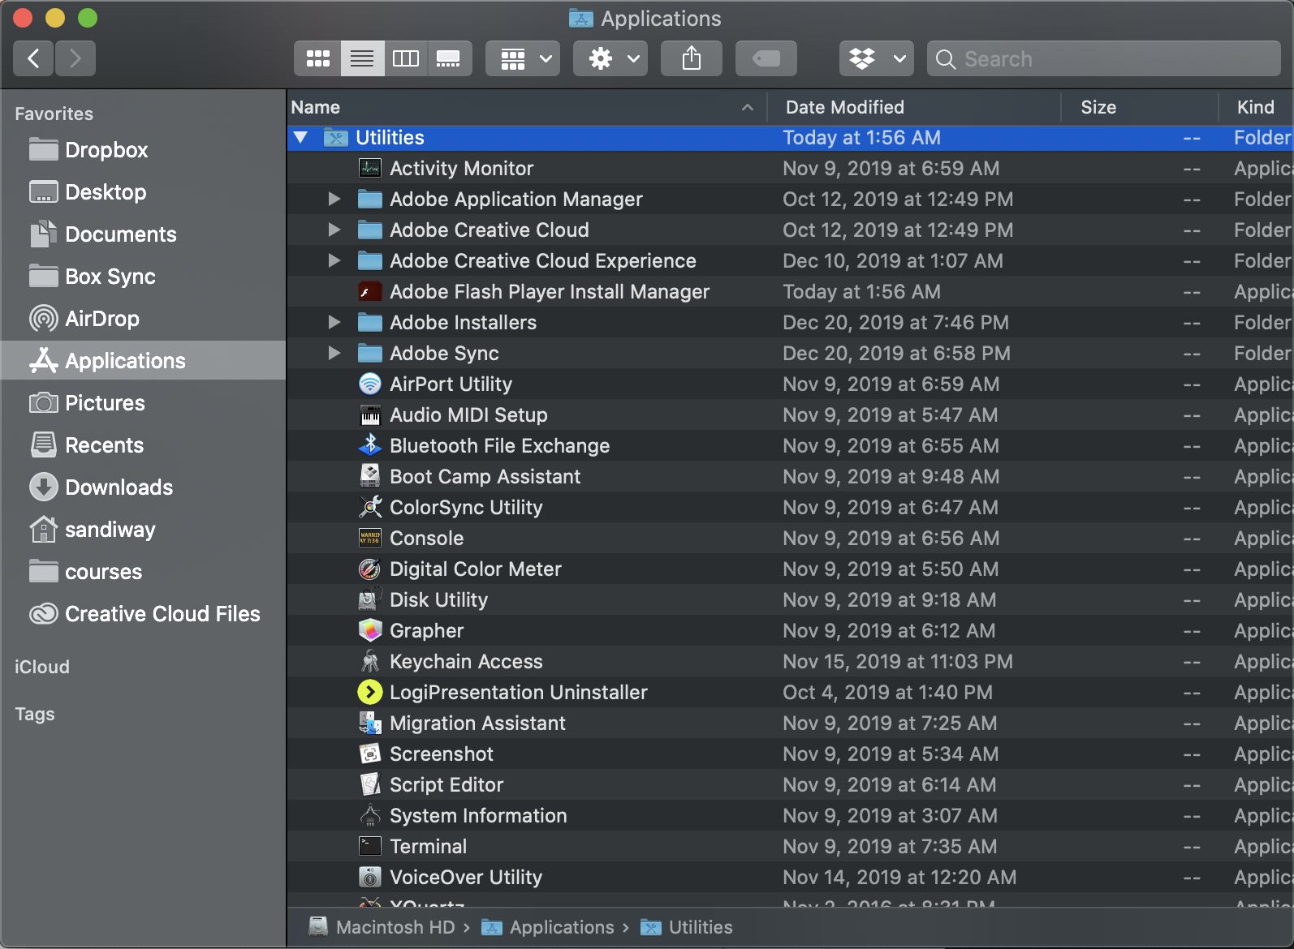
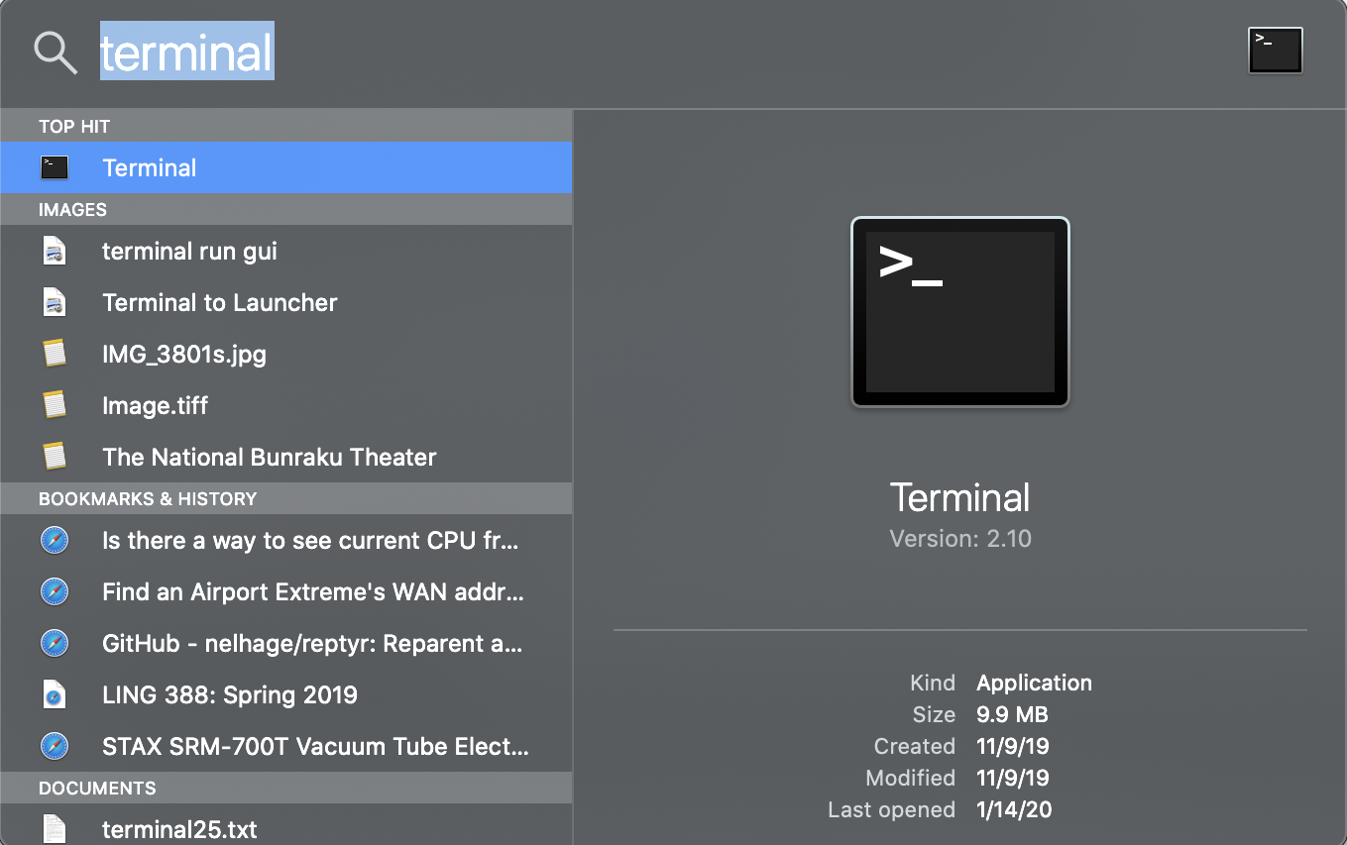
Terminal
Command line interface to the computer.
In MacOS, this program is in the Utilities Folder inside the Applications folder.
Use Spotlight: top right corner spyglass

Slide 18
Terminal
Typing commands in Terminal:
which python
(tells you where python is installed on your PATH)
python
type Control-D to exit

Slide 19
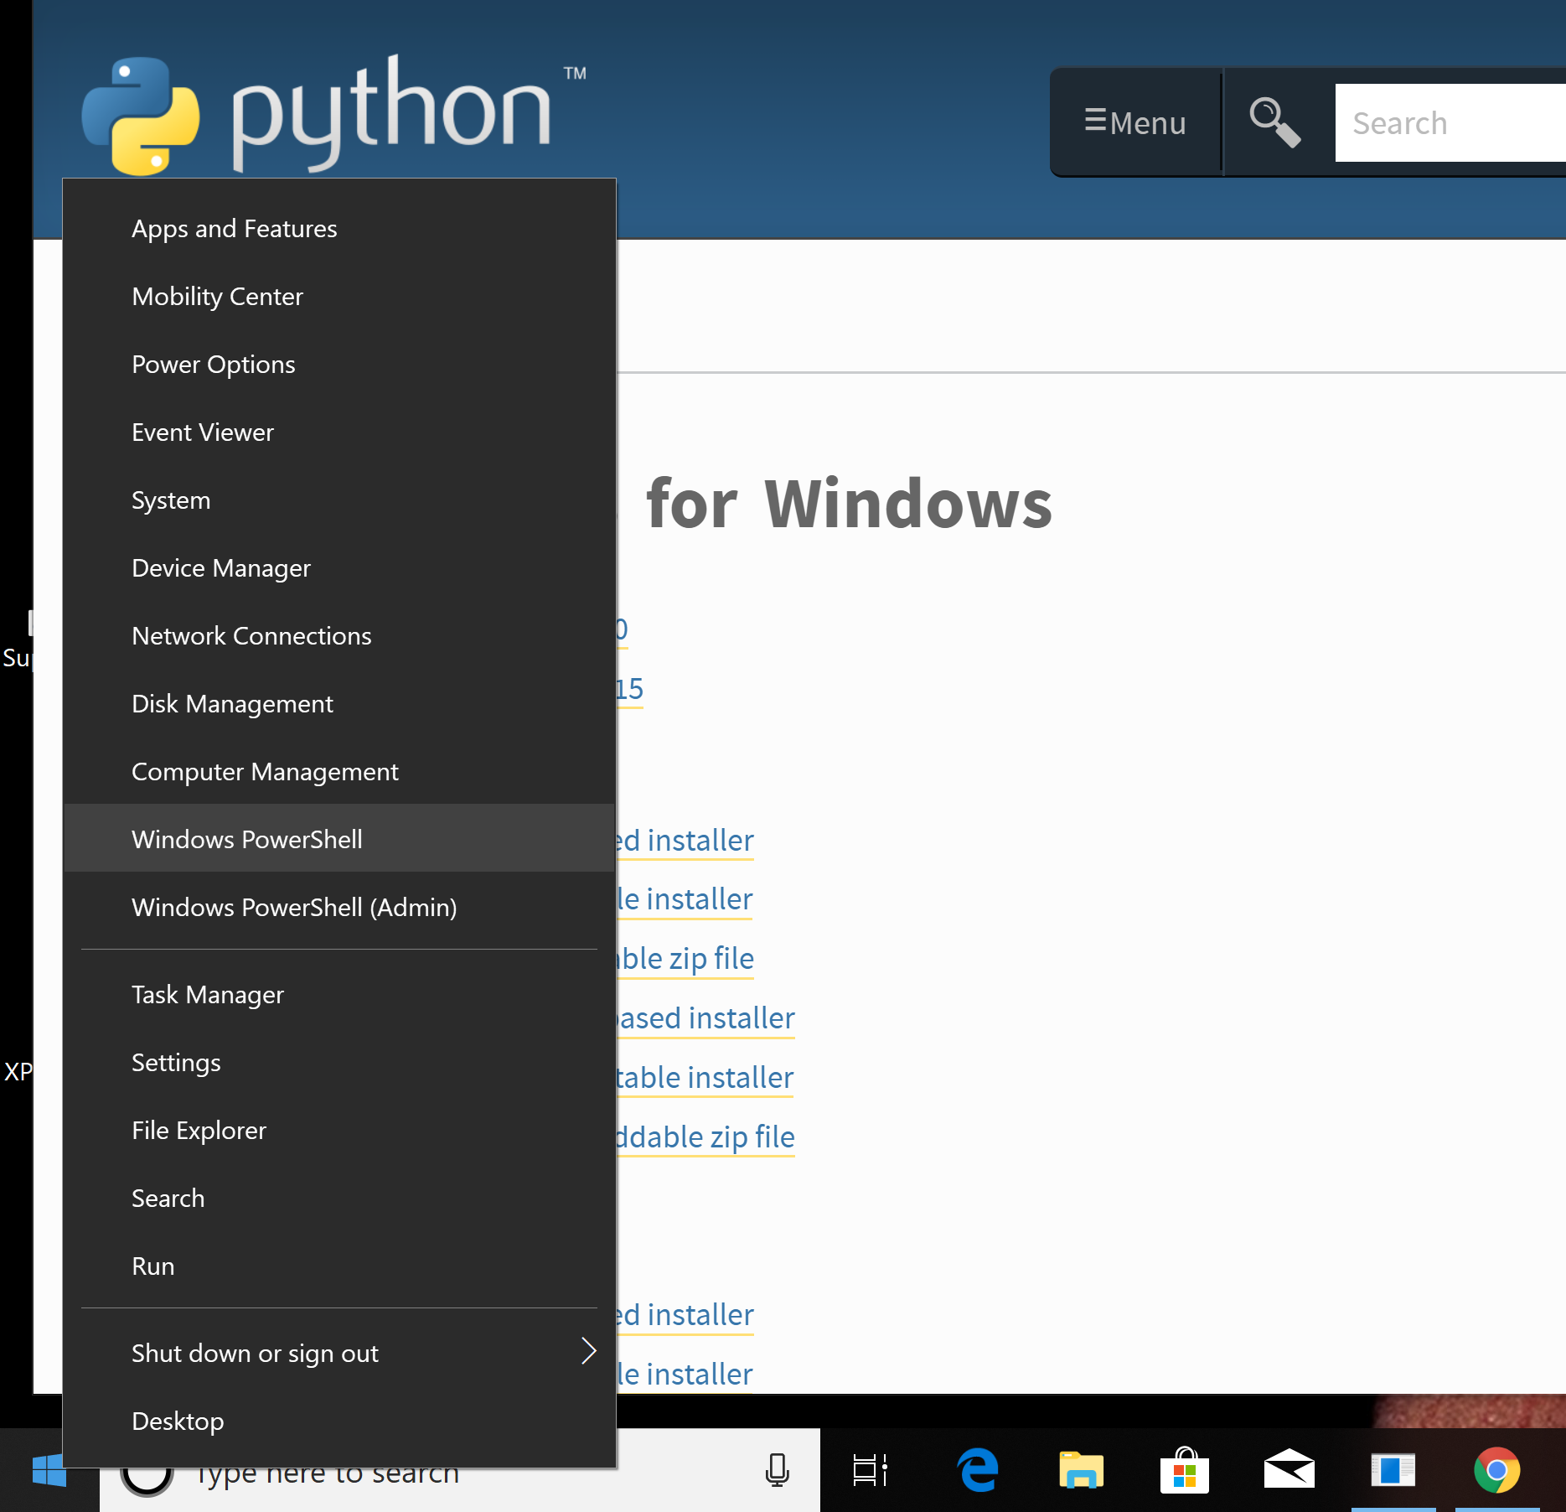
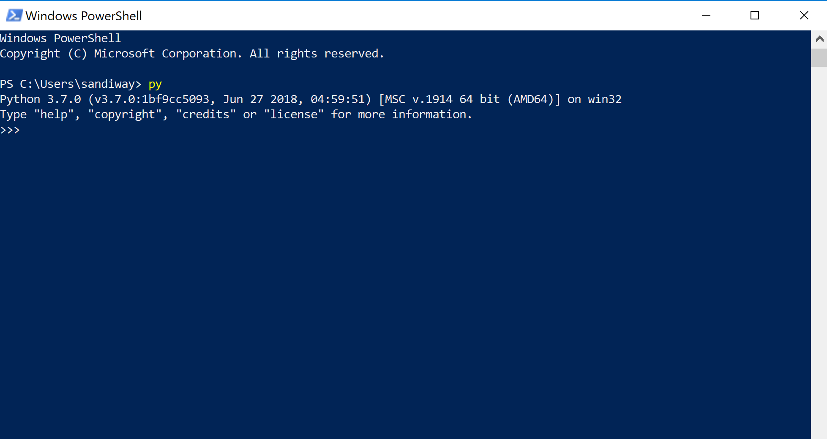
Terminal
On Windows 10/11, you can use PowerShell, type command: py

Slide 20
Running Python
Command line: PowerShell
IDLE (Integrated Development and Learning Environment)

Slide 21
Running the Python 3 installer
should check this box!

Slide 22
Environment Variables
if you need to manually add the directory for the Python executable to your PATH

Slide 23
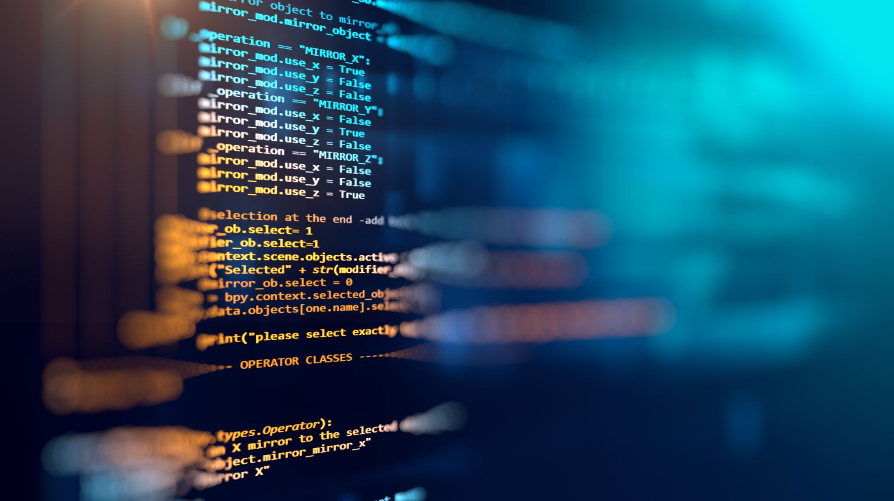
Introduction
Try to install it by next time
If you have trouble, bring your laptop to my office or to class
We won't use Python for Homeworks just yet
We'll talk about Google's N-gram viewer next time …

Slide 24
Google: relative frequency of two spellings
Emma by Jane Austen was published in 1815

Slide 25
Distribution of words in Moby Dick
specifically relevant to Moby Dick;
other reported words are generic
"English plumbing"

Slide 26
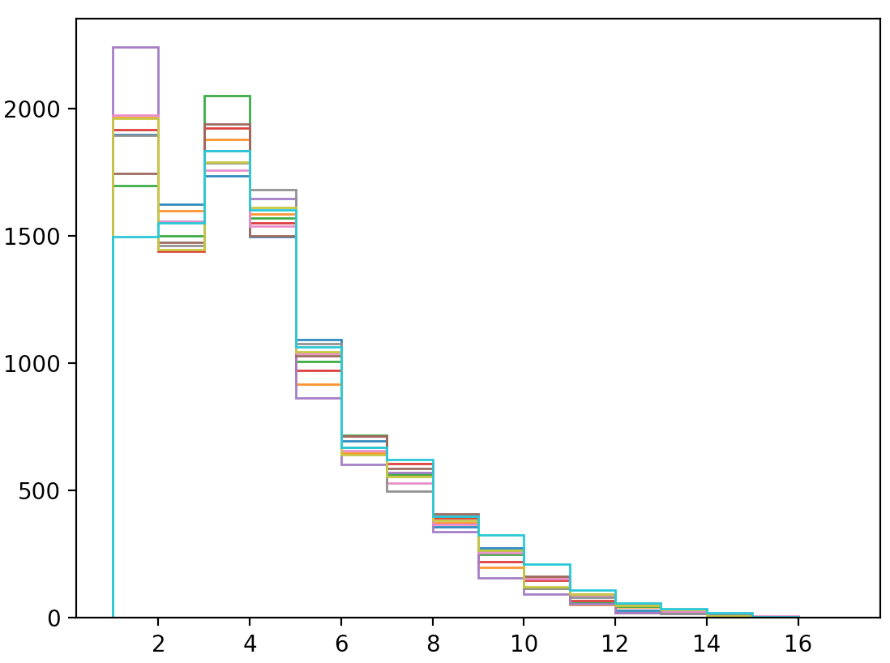
Stylometry: compare word length distribution
len1s = [len1[i*10000:i*10000+10000] for i in range(10)]
for l in len1s:
plt.hist(l, bins=np.arange(min(l),max(l)+1), histtype='step')
plt.show()
Forensic linguistics

Slide 27
Concordance
>>> import nltk
>>> emma = nltk.Text(nltk.corpus.gutenberg.words('austen-emma.txt'))
>>> emma.concordance("surprize")
Displaying 25 of 37 matches:

Slide 28
Counting frequency of occurrences of sequences of vowels in English
iou
eau

Slide 29
Virginia Woolf
Literary Style: Stream of consciousness
we look at using nltk to explore this
'How fresh, how calm, stiller than this of course, the air was in the early morning; like the flap of a wave; the kiss of a wave; chill and sharp and yet (for a girl of eighteen as she then was) solemn, feeling as she did, standing there at the open window, that something awful was about to happen; looking at the flowers, at the trees with the smoke winding off them and the rooks rising, falling; standing and looking until Peter Walsh said, "Musing among the vegetables?"'

Slide 30
Mrs. Dalloway vs. Brown Corpus Fiction Top25

Slide 31
Famous Buffalo sentence
considered grammatical, and
makes sense
but hard to parse even for native speakers
8 consecutive occurrences of the word buffalo
picture borrowed from Analytical Grammar/Grammar Planet on Facebook, who borrowed it from somewhere else...

Slide 32
Context Free Grammar Parsing
buffalo.txt

Slide 33
WordNet relations: types of dogs
dog = wn.synset('dog.n.01')
graph = hyponym_graph(dog)
graph_draw(graph)

Slide 34
WordNet relations: parts of a car
from nltk.corpus import wordnet as wn
c = wn.synset('car.n.01')
g = graph(c, 'part_meronyms')
graph_draw(g)

