Slide 1
Generative AI and Language Understanding: Part 7
Sandiway Fong
University of Arizona

Slide 2
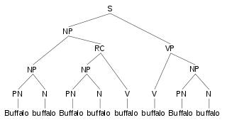
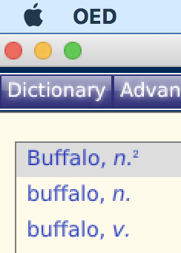
The famous Buffalo sentence
Wikipedia page:
https://en.wikipedia.org/wiki/Buffalo_buffalo_Buffalo_buffalo_buffalo_buffalo_Buffalo_buffalo
Parse:
S = sentence, NP = noun phrase, RC = relative clause VP = verb phrase, PN = proper noun, N = noun, V = verb

Slide 3
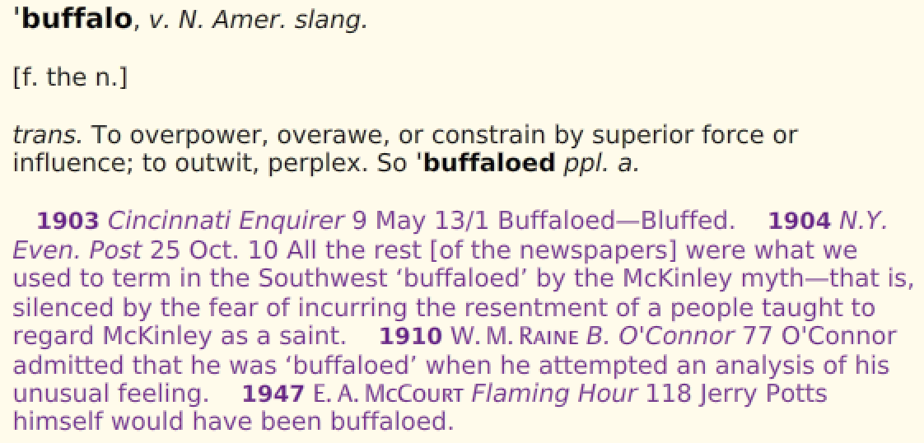
The famous Buffalo sentence
Word Senses for buffalo

Slide 4
The famous Buffalo sentence
See also ChatGPT-4 response in later slides

Slide 5
The famous Buffalo sentence

Slide 6
The famous Buffalo sentence
ChatGPT's answer is incomplete, it doesn't really know how to parse.
Why? See next slide

Slide 7
The famous Buffalo sentence
ChatGPT's answer: the relativized subject reading
But if it knew parsing, it would also know the relativized object reading

Slide 8
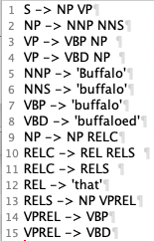
The famous Buffalo sentence
Python nltk code:
Python interpreter:
>>> import nltk
>>> f = open('buffalo.txt','r')
>>> raw = f.read()
>>> raw
"S -> NP VP\nNP -> NNP NNS\nVP -> VBP NP \nVP -> VBD NP \nNNP -> 'Buffalo'\nNNS -> 'buffalo'\nVBP -> 'buffalo'\nVBD -> 'buffaloed'\nNP -> NP RELC\nRELC -> REL RELS \nRELC -> RELS \nREL -> 'that'\nRELS -> NP VPREL\nVPREL -> VBP\nVPREL -> VBD\n"
>>> cfg = nltk.CFG.fromstring(raw)
>>> p = nltk.ChartParser(cfg)
>>> for t in p.parse(['buffalo'] * 8):
... t.draw()
...
buffalo.txt

Slide 9
The famous Buffalo sentence
To verify that ChatGPT has no knowledge of the Buffalo sentence syntax, we can try a longer sentence.

Slide 10
The famous Buffalo sentence
We have added three more buffalo words to the sentence.

Slide 11
The famous Buffalo sentence
Incorrect!
Same response as for the 8 buffalo sentence.

Slide 12
ChatGPT-4

Slide 13
ChatGPT-4

