Slide 1
Generative AI and Language Understanding: Part 6
Sandiway Fong
University of Arizona

Slide 2
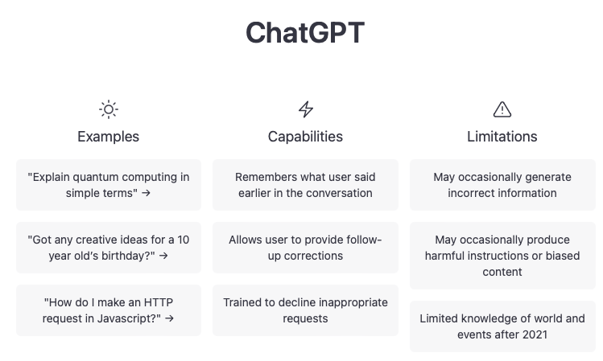
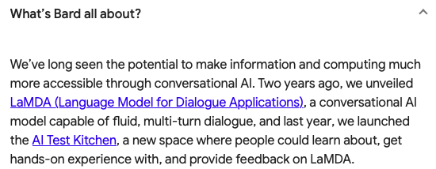
This is the era of Generative AI
https://bard.google.com
https://chat.openai.com/chat

Slide 3
Semantic Opposition
Semantic Opposition (Pustejovsky, 2000):
John mended the torn dress
John mended the red dress
Consider the condition of the dress.
Is it still red?
Is it still torn?
Where does that knowledge come from?

Slide 4
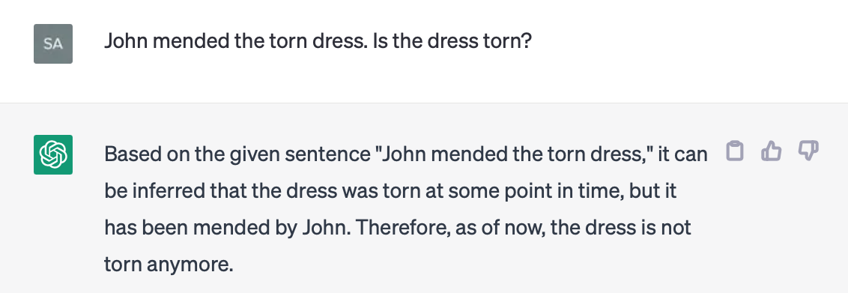
Semantic Opposition

Slide 5
Synset
According to Princeton WordNet, mend is in the same synonym set (synset) as repair and some other verbs.

Slide 6
Semantic Opposition
Presupposition only

Slide 7
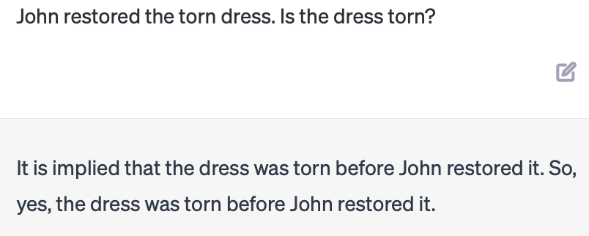
Semantic Opposition
Synset: {repair, fix, restore, mend, … }
Presupposition only

Slide 8
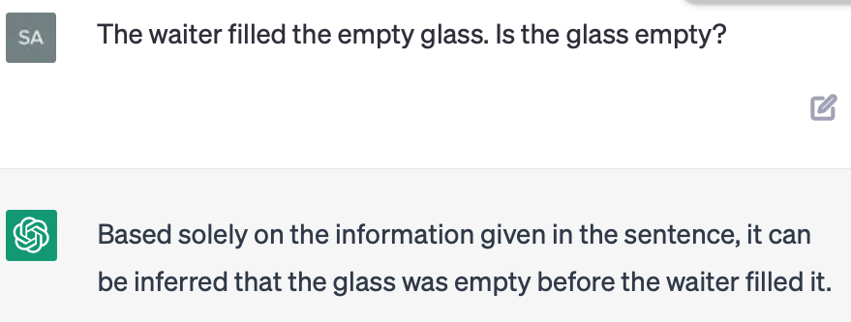
Semantic Opposition
Other accomplishment verbs:
The waiter filled the empty glass
Mary fixed the flat tire
Presupposition only

Slide 9
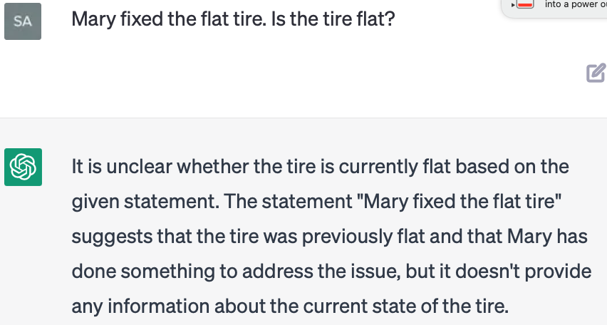
Semantic Opposition
Other accomplishment verbs:
The waiter filled the empty glass
Mary fixed the flat tire

Slide 10
Semantic Opposition
Activity verbs and resultatives:
John painted the red door blue
John swept the dirty floor
John swept the dirty floor clean

Slide 11
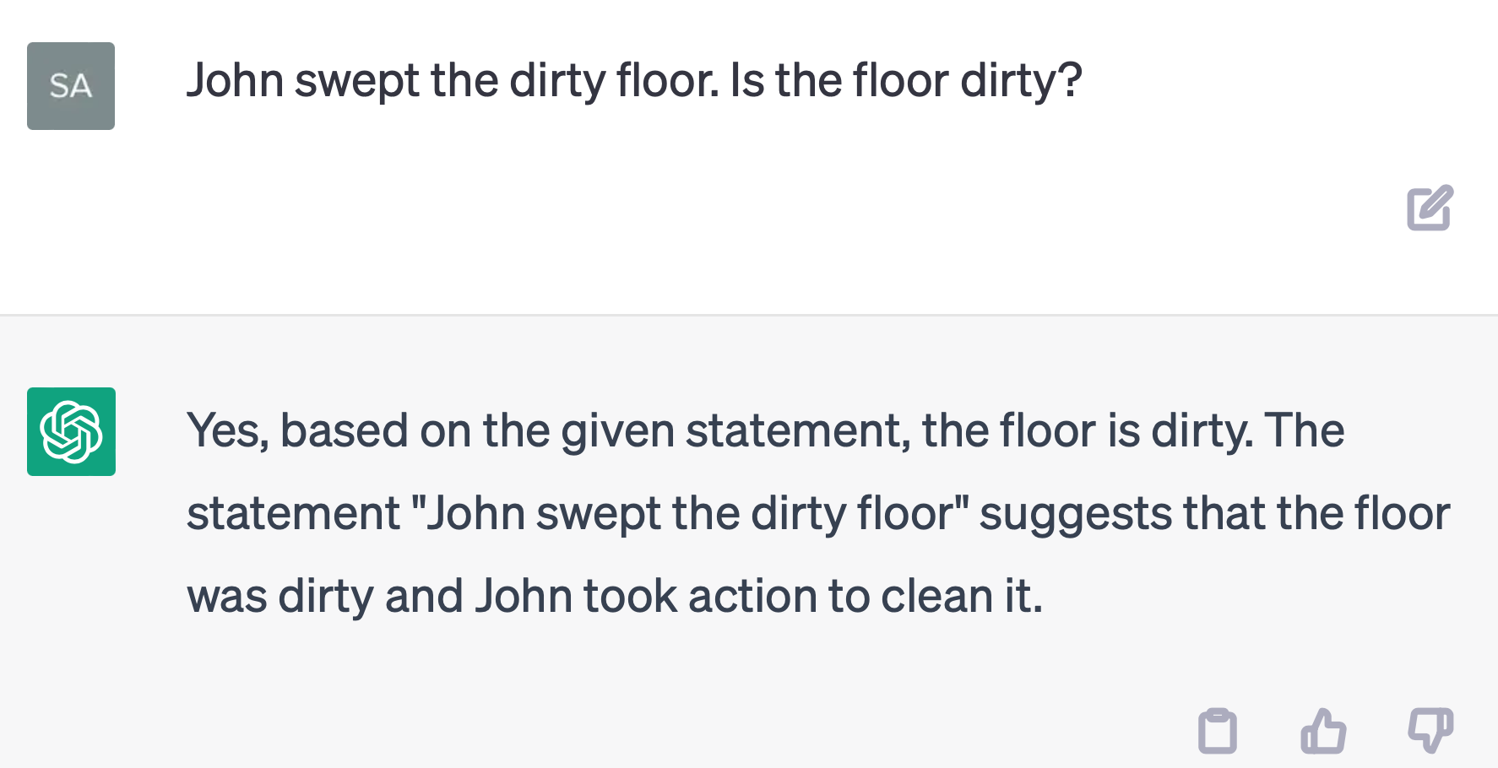
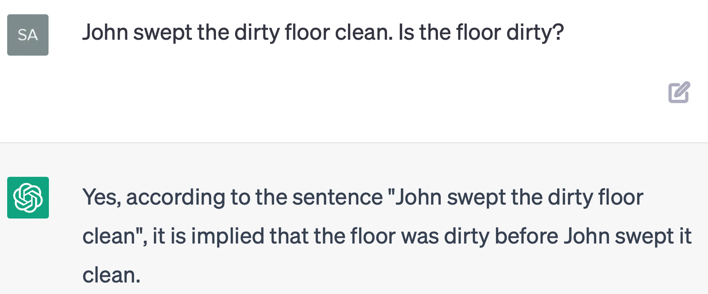
Semantic Opposition
Activity verbs and resultatives:
John swept the dirty floor
John swept the dirty floor clean

