Slide 1
Generative AI and Language Understanding: Part 4
Sandiway Fong
University of Arizona

Slide 2
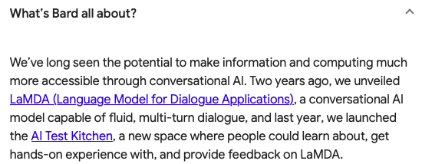
This is the era of Generative AI
https://bard.google.com
https://chat.openai.com/chat

Slide 3
Tough movement
There's a difference between the following two sentences with respect to the interpretation of arguments:
John is easy to please
John is eager to please
Do you see it?
Hint: what are the arguments of the predicate please

Slide 4
Tough movement
Let's test ChatGPT on this. https://chat.openai.com/chat
We'll return to test DNN-based parsers later.

Slide 5
Google Bard
win-win!

Slide 6
Tough movement

Slide 7
Google Bard

Slide 8
Tough movement

Slide 9
Google Bard

Slide 10
Tough movement
A bit suspicious: why cite 1st sentence?

Slide 11
Google Bard

Slide 12
Tough movement
No prior context.

Slide 13
Google Bard

Slide 14
Tough movement
(Roberts 2019) p17:
CP follows the head A (rather than preceding it, as in a head-final language);
English has infinitives, and indeed infinitives of this type;
arbitrary null pronouns can appear in this context with the properties that we observe them to have;
the trace is a wh-trace (in many languages, including all the Romance languages, this construction features an A-dependency),
etc.
easy (different from eager) has no external argument, e.g. It is easy to please John, (*It is eager to please John)

Slide 15
On Wh-movement (Chomsky, 1977)

Slide 16
On Wh-movement (Chomsky, 1977)

Slide 17
On Wh-movement (Chomsky, 1977)

Slide 18
Berkeley Neural Parser
https://parser.kitaev.io

Slide 19
Google Natural Language
Representation has a missing dependency
some dependencies are not explicitly computed, e.g. xcomp
Parse is wrong anyway: see why?
subj_xcomp

