Slide 1
Generative AI and Language Understanding: Part 2
Sandiway Fong
University of Arizona

Slide 2
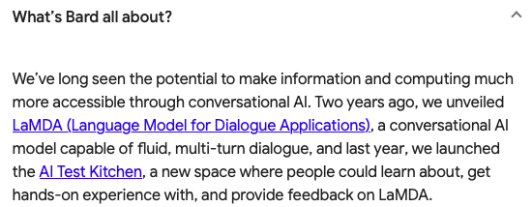
This is the era of Generative AI
https://bard.google.com
https://chat.openai.com/chat

Slide 3
Part 2
ChatGPT and Anaphora Resolution

Slide 4
Some Caveats and Hints
It sometimes gives a different answer when the question is repeated.
A response doesn't necessarily need a question.
Your chat history can affect the response.
If you vary the question a bit, it may choose a different response.
Asking the right question is key … as we'll see.

Slide 5
ChatGPT and Anaphora Resolution
Two examples from (Reuland 2011) ¹
Alice looked at the Queen. She was angry. (pg4)
The white rabbit jumped from behind the bushes. (pg26)
The animal looked around and then he ran away to avoid the angry queen.
¹Reuland, E., Anaphora and Language Design (2011), MIT Press.

Slide 6
ChatGPT and Anaphora Resolution
Alice looked at the Queen. She was angry. (pg4)
Ambiguous, but nearly all students in class picked the Queen also.

Slide 7
Google Bard

Slide 8
ChatGPT and Anaphora Resolution
The white rabbit jumped from behind the bushes. (Reuland 2011: 26)
The animal looked around and then he ran away to avoid the angry queen.

Slide 9
Google Bard

Slide 10
ChatGPT and Anaphora Resolution
The white rabbit jumped from behind the bushes. (Reuland 2011: 26)
The animal looked around and then he ran away to avoid the angry queen.
the expressions the white rabbit, the animal. and he easily receive the same value. For he, for instance, a reading where it gets the same value as the animal/the white rabbit is highly preferred.

Slide 11
Google Bard

Slide 12
ChatGPT and Anaphora Resolution
Let's modify the 2nd example a bit:
The animal was looking around nervously. Suddenly the white rabbit jumped from behind the bushes.
and ask:
Here the rabbit is preferred to have a value different from the animal.

Slide 13
Google Bard

Slide 14
ChatGPT and Anaphora Resolution

Slide 15
Google Bard

Slide 16
ChatGPT and Anaphora Resolution

Slide 17
Google Bard

Slide 18
ChatGPT and Pronominal Binding
Linguists have discussed pronominal binding examples of the following kind, e.g. Reuland (2011) mentions (Jackendoff 1972, Chomsky 1986a, and Williams 1987).
What is the difference between possible antecedents for him?
John told an embarassing/untrue story about him
John heard an embarassing/untrue story about him
Based on the examples given in this lecture, try to devise a statement + question for ChatGPT to reveal whether it knows this difference.
Show your screenshot(s)
You may tweak the example
Homework for students!

Slide 19
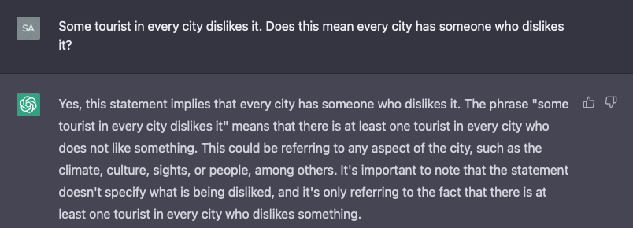
ChatGPT and Pronominal Binding
[Adapted from (Hornstein 1995: 25), from May (1977, 1985) and Reinhart (1983) cited therein.]
Example (inverse linking/VP ellipsis):
Some tourist in every city dislikes it.
Some tourist in every city dislikes it and some resident does too.

Slide 20
Google Bard

Slide 21
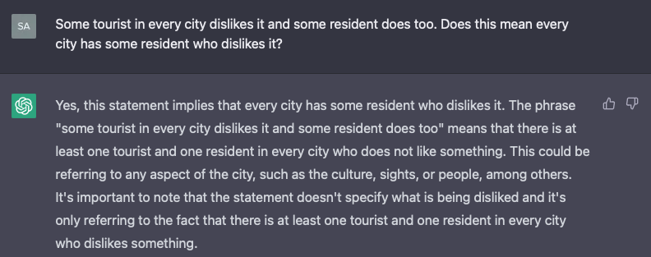
ChatGPT and Pronominal Binding
Example (inverse linking/VP ellipsis):
Some tourist in every city dislikes it.
Some tourist in every city dislikes it and some resident does too.

Slide 22
Google Bard

Slide 23
ChatGPT and Pronominal Binding
Careful questioning is required:

Slide 24
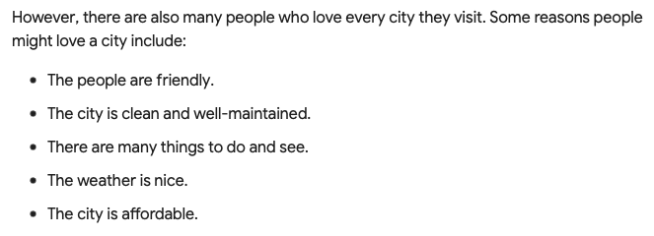
Google Bard

Slide 25
ChatGPT and Pronominal Binding
(Hornstein 1995: 25):
*The man [who disliked every boy_{i}] hit him_{i}
Notes:
clause bound QR, every boy cannot escape the RC

Slide 26
Google Bard

Slide 27
ChatGPT and Pronominal Binding
(Hornstein 1995: 25):
*The man [who disliked every boy_{i}] hit him_{i}
Right answers if you permit the binding (contra Hornstein), but wrong reasoning.
Notes:
clause bound QR, every boy cannot escape the RC

Slide 28
Google Bard

Slide 29
ChatGPT and Pronominal Binding
(Hornstein 1995: 24):
John kissed every child_{i} after Bill introduced him_{i}
Notes:
evidence for Op--var pronominal interpretation after QR

Slide 30
Google Bard

Slide 31
Google Bard

Slide 32
ChatGPT and Anaphora Resolution
Example (Control vs. ECM, adapted from (Reuland 2011:86)):
Finally, John convinced Mary and himself to leave the country.
Finally, John convinced Mary and him to leave the country.
John expected Mary and himself to leave the country.
John expected Mary and him to leave the country.
notice: flipped order
himself and Mary
ERROR here.

Slide 33
Google Bard

Slide 34
Google Bard

Slide 35
ChatGPT and Anaphora Resolution
Example (Control vs. ECM, adapted from (Reuland 2011:86)):
John expected Mary and himself to leave the country.
John expected Mary and him to leave the country.
notice: flipped order
himself and Mary
Fail, right? Actually, just an unclear answer, but wait …

Slide 36
Google Bard

Slide 37
ChatGPT and Anaphora Resolution
Example (Control vs. ECM, adapted from (Reuland 2011:86)):
John expected Mary and himself to leave the country.
John expected Mary and him to leave the country.
Let's add a sentence that will help disambiguate. Bill was undecided.

Slide 38
Google Bard

Slide 39
ChatGPT and Anaphora Resolution
Example (Control vs. ECM, adapted from (Reuland 2011:86)):
John expected Mary and himself to leave the country.
John expected Mary and him to leave the country.
Let's check back with the first example.

Slide 40
Google Bard

Slide 41
ChatGPT and Anaphora Resolution
Reuland (2011:86):

Slide 42
ChatGPT and Anaphora Resolution
(Reuland 2011:92):

Slide 43
ChatGPT and Anaphora Resolution

Slide 44
Google Bard

Slide 45
ChatGPT and Anaphora Resolution
intervener

Slide 46
Google Bard

Slide 47
ChatGPT and Anaphora Resolution
intervener

Slide 48
Google Bard

